Slide 1
Electricity and Magnetism Chapter One Vector Operations
By
Zubayda S Saifaldeen, PhD
Physics Department, College of Science, University of Duhok
Duhok, Kurdistan
Email: zubayda.saifaldeen@uod.ac
Notes:
Electricity and Magnetism are branches of Physics. Electricity concerns the properties and movement of electrically charged particles. Magnetism concerns the properties of magnets and magnetic materials.
Electricity and magnetism are interrelated. Movement of electrical charges creates magnetic fields, while changes in magnetic fields can create electricity.

Slide 2
Outlines
Scalar and vector quantities
Representation of vectors (Cartesian coordinates)
Resolution of vectors into components
Vector Addition
Vector multiplication
Vector product
Scalar product
Notes:
Often a coordinate system is helpful because it can be easier to manipulate the coordinates of a vector rather than manipulating its magnitude and direction directly.

Slide 3
Scalar and Vector Quantities
Scalars: A scalar quantity has only magnitude, for example:
Mass, volume, pressure, temperature, length, speed, power, work, energy, density, …etc.
Vectors: A vector quantity has both magnitude and direction, for example:
Velocity, acceleration, force, momentum, electric field, magnetic field, displacement, …etc.
Notes:
A unit vector is a dimensionless vector having a magnitude of exactly 1. Unit vectors are used to specify a given direction and have no other physical significance.

Slide 4
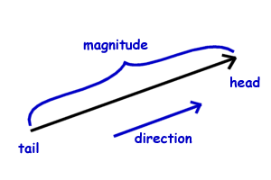
Vector Representation
A vector is represented by an arrow and composed of two parts:
Magnitude (scalar) and direction.
Vector’s symbol ( A or A )
Vector’s magnitude ( A or |A| )
A
Notes:
we describe a method of adding vectors that makes use of the projections of vectors along coordinate axes. These projections are called the components of the vector. Any vector can be completely described by its components.

Slide 5
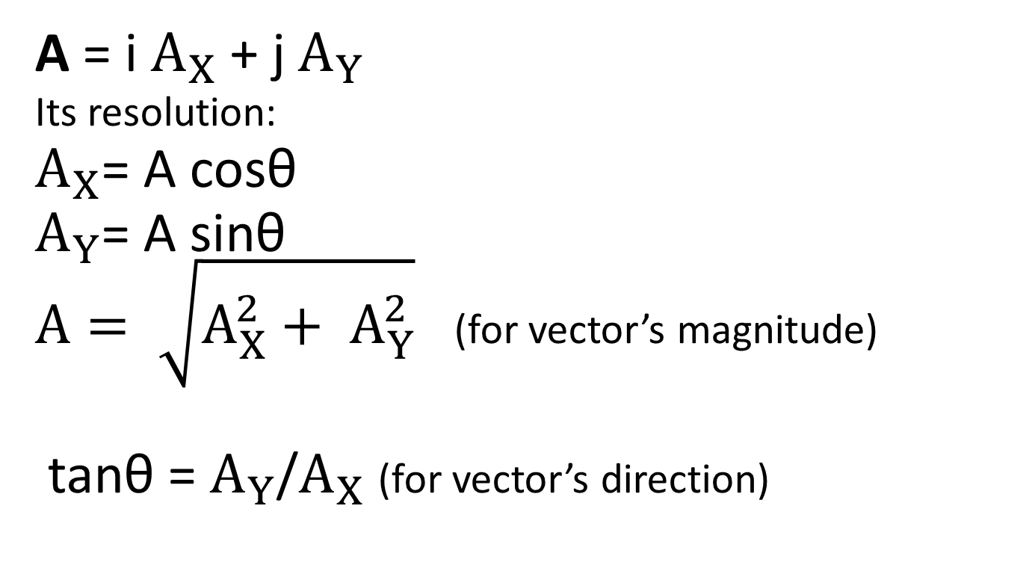




Vector Components (2D)
Y
$$A_{X}$$
A = i${ A}_{X}$ + j${ A}_{Y}$
Its resolution:
$A_{X}$= A cosθ
$A_{Y}$= A sinθ
$A= \sqrt{A_{X}^{2}+ A_{Y}^{2}}$ (for vector’s magnitude)
tanθ = $A_{Y}$/$A_{X}$ (for vector’s direction)
A
$$A_{Y}$$
$$A_{Y}$$
θ
X
$$A_{X}$$
Notes:
Often a coordinate system is helpful because it can be easier to manipulate the coordinates of a vector rather than manipulating its magnitude and direction directly. When we express a vector in a coordinate system, we identify a vector with a list of numbers, called coordinates or components, that specify the geometry of the vector in terms of the coordinate system. Here we will discuss the standard Cartesian coordinate systems in the plane and in three-dimensional space.

Slide 6

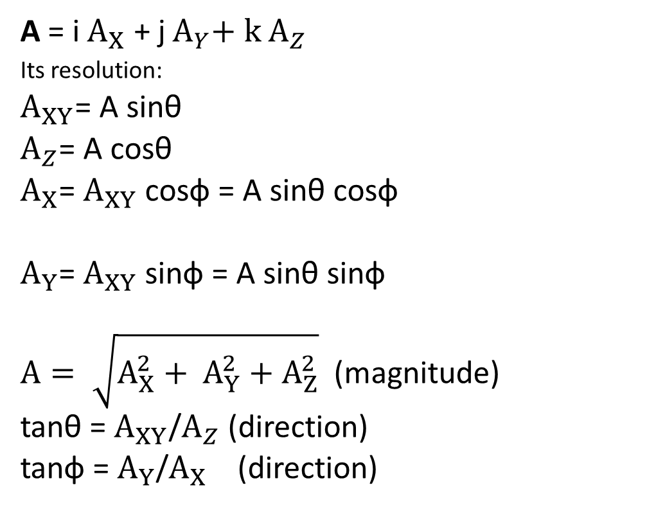







Vector Components (3D)
Z
$$A_{XY}$$
A = i${ A}_{X}$ + j${ A}_{Y}+{ k A}_{Z}$
Its resolution:
$A_{XY}$= A sinθ
$A_{Z}$= A cosθ
$A_{X}$= $A_{XY}$ cosф = A sinθ cosф
$A_{Y}$= $A_{XY}$ sinф = A sinθ sinф
$A= \sqrt{A_{X}^{2}+ A_{Y}^{2}+A_{Z}^{2}}$ (magnitude)
tanθ = $A_{XY}$/$A_{Z}$ (direction)
tanф = $A_{Y}$/$A_{X}$ (direction)
$$A_{Z}$$
A
θ
$$A_{Z}$$
$$A_{X}$$
X
$$A_{Y}$$
ф
$$A_{XY}$$
$$A_{Y}$$
Y
$$A_{X}$$
Notes:
Vector quantities often are expressed in terms of unit vectors. A unit vector is a dimensionless vector having a magnitude of exactly 1. Unit vectors are used to specify a given direction and have no other physical significance. They are used solely as a convenience in describing a direction in space. We shall use the symbols

Slide 7

Vector Addition
B
A
A = i${ A}_{X}$ + j${ A}_{Y}+{ k A}_{Z}$
B = i${ B}_{X}$ + j${ B}_{Y}+{ k B}_{Z}$
C = A + B = i (${ A}_{X}$ + ${ B}_{X}$) + j (${ A}_{Y}$ + ${ B}_{Y}$ ) + k (${ A}_{Z}$ + $B_{Z}$ )
Vectors subtraction
C = A – B = A + (- B )
C
B
C
A

Slide 8
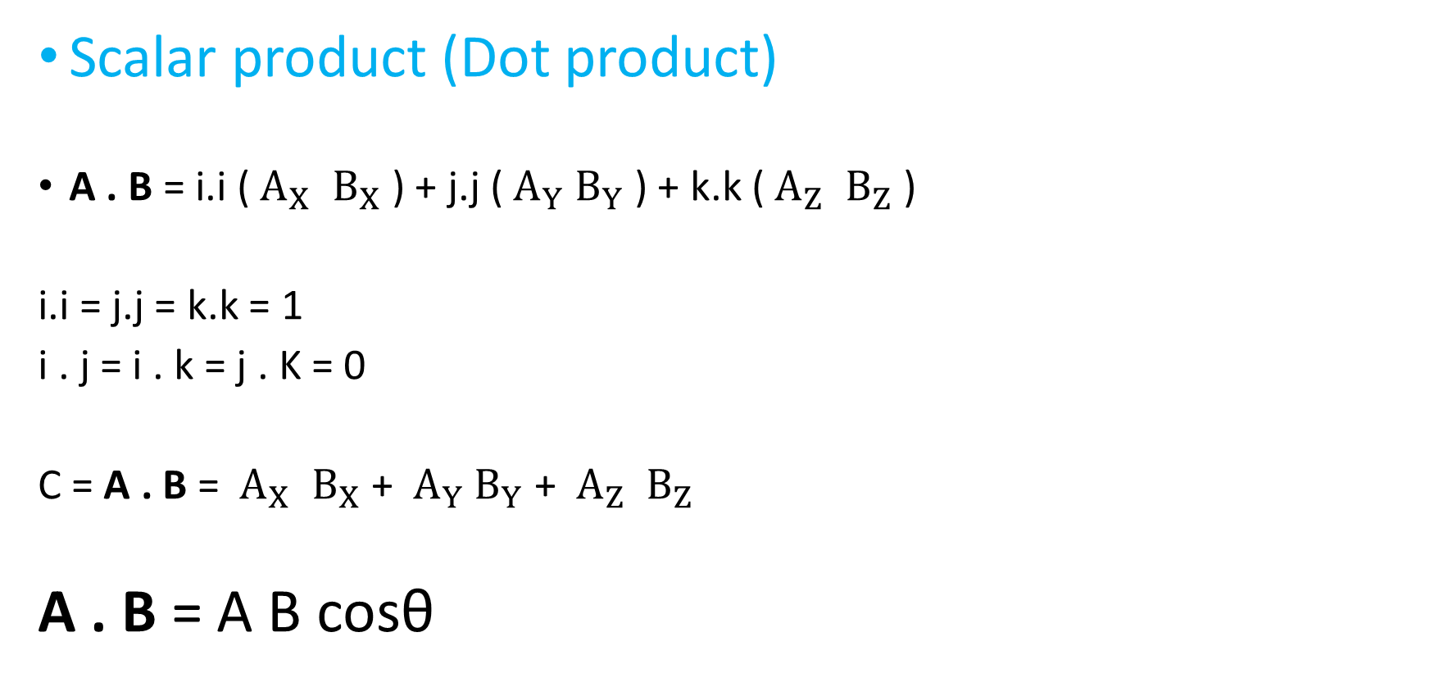
Vector Multiplication
Scalar product (Dot product)
A . B = i.i (${ A}_{X}$ ${ B}_{X}$ ) + j.j (${ A}_{Y}$ $B_{Y}$ ) + k.k (${ A}_{Z}$ ${ B}_{Z}$ )
i.i = j.j = k.k = 1
i . j = i . k = j . K = 0
C = A . B = ${ A}_{X}$ ${ B}_{X}$ + ${ A}_{Y}$ $B_{Y}$ + ${ A}_{Z}$ ${ B}_{Z}$
A . B = A B cosθ
B
θ
A

Slide 9
Scalar Product Rules
Commutative
A . B = B . A
Distributive
A . (B + C) = A . B + A . C
Bilinear
A . (tB + C) = t (A . B) + (A . C)
Scalar multiplication
(t A) . B = t (A . B)
Orthogonal
A . B = 0 (A and B are non zero vectors)

Slide 10
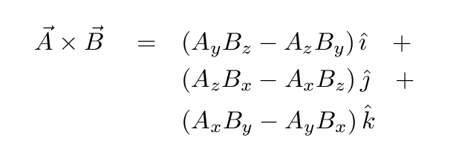
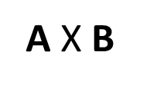
Vector product (Cross product)
i x i = j x j = k x k = 0
i x j = k, j x k = i, k x i = j
i x k = -j, k x j = -i, j x i = -k
C = |A X B| = A B sinθ
C = A X B
B
θ
A

Slide 11
Vector product rules
Anti-commutative
A X B = - B X A
Distributive
A X (B + C) = A X B + A X C
Scalar multiplication
(t A) X B = t (A X B)
Triple product expansion
A X (B X C) = B (A . C) – C (A . B)
Cross and dot product
A . (B X C) = det (A B C)

Slide 12
1) Given r1 = 3i - 2j + k, r2 = 2i - 4j - 3k, r3 = - i + 2j + 2k,
find the magnitudes of
(a) r3 , (b) r1 + r2 + r3 , (c) 2r1- 3r2 - 5r3 .
2) Find the sum of two vectors A and B lying in the xy plane and given by
A = (2.0i + 2.0j) m and B= (2.0i - 4.0j) m

Slide 13
3) Consider two vectors A = 3i 2j and B = -i - 4j.
Calculate (a) A + B, (b) A - B, (c)|A+B| (d) |A-B|
(e) the directions of )|A+B| and )|A-B|
1) Is it ok to add velocity vector with displacement vector?
2) Is it possible to add a vector quantity to a scalar quantity?
Explain.

Slide 14
Example 1
Calculate the cross product between a=(3,−3,1)a=(3,−3,1) and b=(4,9,2)
b=(4,9,2).
Solution: The cross product is
−15i−2j+39k
Example 2
Calculate the dot product of a= (1,2,3), b= (4,-5,6)

