Slide 1
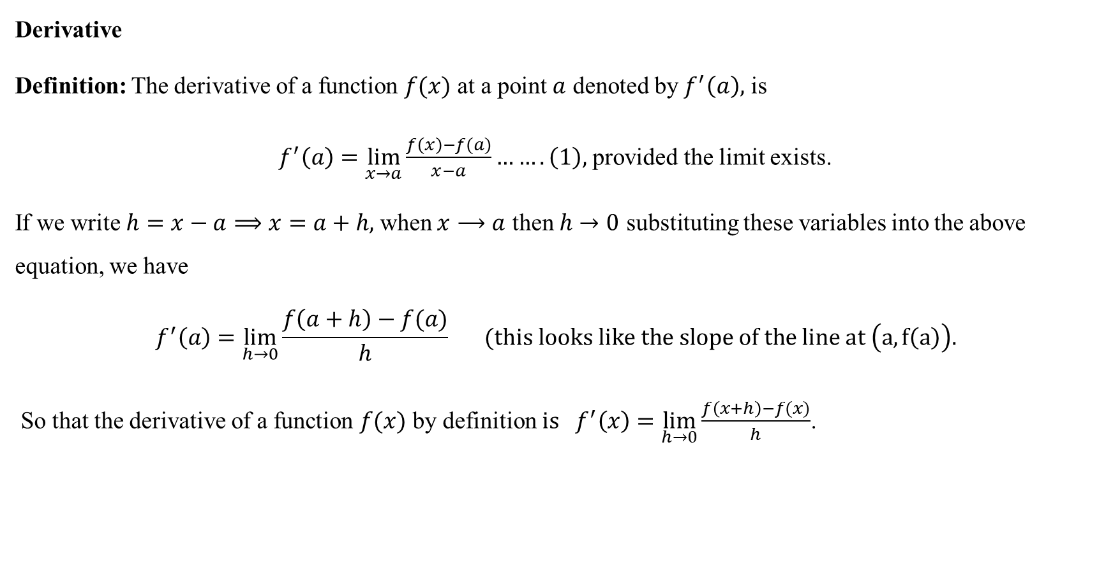
Differentiation
Derivative
Definition: The derivative of a function $f(x)$ at a point $a$ denoted by $f^{′}\left(a\right),$ is
$f^{′}\left(a\right)=\lim_{x→a}{\frac{f\left(x\right)−f(a)}{x−a}…….\left(1\right),}$ provided the limit exists.
If we write$h=x−a⟹x=a+h,$when $x⟶a$ then $h→0$ substituting these variables into the above equation, we have
$$f^{′}\left(a\right)=\lim_{h→0}{\frac{f\left(a+h\right)−f(a)}{h}} (this looks like the slope of the line at \left(a,f\left(a\right)\right).$$
So that the derivative of a function $f(x)$ by definition${ is f}^{′}\left(x\right)=\lim_{h→0}{\frac{f\left(x+h\right)−f(x)}{h}}$.

Slide 2
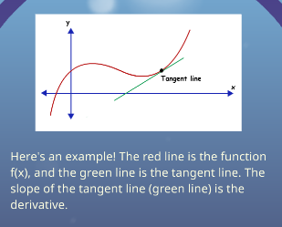
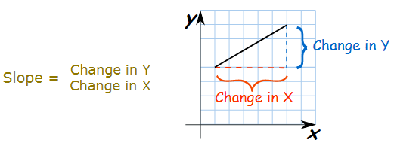

Geometric interpretation of the derivative:-
The tangent line to the curve $y=f(x)$ at $(a,f\left(a\right))$ is the line passes through $p$ with slope.
$$m=\lim_{x→a}{\frac{f\left(x\right)−f(a)}{x−a},} (this is exactly the derivative of f at a)$$
Mathematicians use different notations for the derivative:
$${f^{′}, f}^{′}\left(x\right),y^{′},\frac{dy}{dx},D_{x}f,\frac{d}{dx}f\left(x\right), …$$

Slide 3
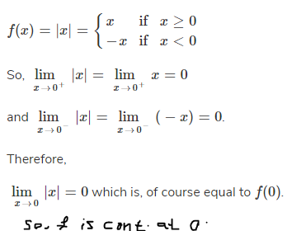
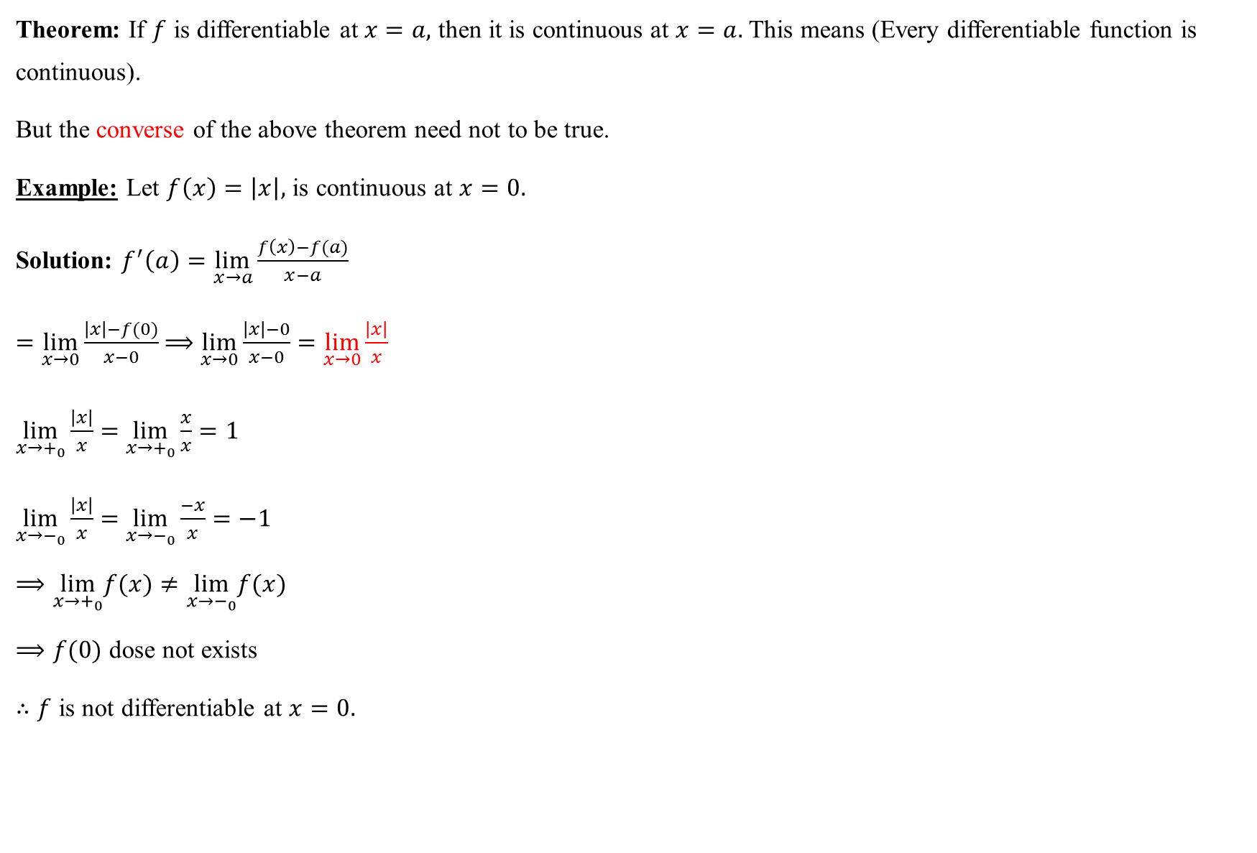
Theorem: If $f$ is differentiable at $x=a,$ then it is continuous at $x=a.$ This means (Every differentiable function is continuous).
But the converse of the above theorem need not to be true.
Example: Let $f\left(x\right)=\left|x\right|,$ is continuous at $x=0.$
Solution: $f^{′}\left(a\right)=\lim_{x→a}{\frac{f\left(x\right)−f(a)}{x−a}}$
$=\lim_{x→0}{\frac{\left|x\right|−f(0)}{x−0}}$ $⟹$ $\lim_{x→0}{\frac{\left|x\right|−0}{x−0}}=\lim_{x→0}{\frac{\left|x\right|}{x}}$
$\lim_{x→+_{0}}{\frac{\left|x\right|}{x}}=$ $\lim_{x→+_{0}}{\frac{x}{x}=1}$
$\lim_{x→−_{0}}{\frac{\left|x\right|}{x}}=$ $\lim_{x→−_{0}}{\frac{−x}{x}=−1}$
$$⟹\lim_{x→+_{0}}f(x)≠\lim_{x→−_{0}}f(x)$$
$⟹f(0)$ dose not exists
$∴f$ is not differentiable at $x=0.$

Slide 4

The derivative of a function $f(x)$ by definition${ is f}^{′}\left(x\right)=\lim_{h→0}{\frac{f\left(x+h\right)−f(x)}{h}}$.
Example: Find the derivative of ${ f\left(x\right)=x}^{2}$ by using definition:
$$f^{′}\left(x\right)=\frac{dy}{dx}=\lim_{h→0}{\frac{f\left(x+h\right)−f(x)}{h}}$$
$$=\lim_{h→0}{\frac{{\left(x+h\right)}^{2}−x^{2}}{h}}$$
$$=\lim_{h→0}{\frac{x^{2}+2xh+h^{2}−x^{2}}{h}}$$
$$=\lim_{h→0}{\frac{h[2x+h] }{h}}$$
$$=\lim_{h→0}{[2x+h]}$$
$$=2x$$
$$∴f^{′}\left(x\right)=2x$$

Slide 5
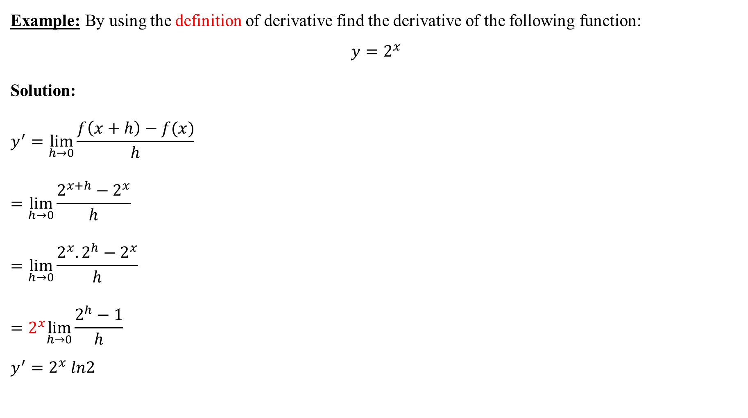
Example: By using the definition of derivative find the derivative of the following function:
$$y=2^{x}$$
Solution:
$$y^{′}=\lim_{h→0}{\frac{f\left(x+h\right)−f(x)}{h}}$$
$$=\lim_{h→0}\frac{2^{x+h}−2^{x}}{h}$$
$$=\lim_{h→0}\frac{2^{x}.2^{h}−2^{x}}{h}$$
$$=2^{x}\lim_{h→0}\frac{2^{h}−1}{h}$$
$$y^{′}=2^{x} ln2$$

Slide 6

Example: Find the Derivative of $y=e^{2x}$ by using limit definition:
Solution:
$$y^{′}=\lim_{h→0}{\frac{f\left(x+h\right)−f(x)}{h}}$$
$$=\lim_{h→0}{\frac{e^{2(x+h)}−e^{2x}}{h}}$$
$$=\lim_{h→0}{\frac{e^{2x}e^{2h}−e^{2x}}{h}}$$
$⟹$ $y^{′}=$ 2$e^{2x}$ $\lim_{h→0}{\frac{e^{2h}−1}{2h}}$
${∴y}^{′}=$2 $e^{2x}$
H.W: Find the Derivative of $f(x)$=$e^{x}$ by using limit definition.

Slide 7

Example: By using the definition of derivative find the derivative of $y=lnx$:
Solution: $y^{′}=\lim_{h→0}{\frac{f\left(x+h\right)−f(x)}{h}}$
$$=\lim_{h→0}{\frac{ln\left(x+h\right)−lnx}{h}}$$
$$=\lim_{h→0}{\frac{ln⁡(\frac{x+h}{x})}{h}}$$
$$=\lim_{h→0}{\frac{ln⁡(1+\frac{h}{x})}{x \frac{h}{x}}}$$
= $\frac{1}{x}$ ($1$) = $\frac{1}{x}$,

Slide 8

1. Differentiation Rules: Let $f$ and $g$ be two differentiable functions of $c∈R,$then
1. $\frac{d}{dx}\left(c\right)=0, \frac{d}{ dx}=\left(x\right)=1$ 7.$f\left(x\right)=\sqrt{x}⟹f^{′}\left(x\right)=\frac{1}{2\sqrt{x}}$
2. $\frac{d}{dx}\left(x^{n}\right)=nx^{n−1},n≥0.$
$\frac{d}{dx}\left({(f(x))}^{n}\right)=n{f(x)}^{n−1}$ $f^{′}$ $8. f \left(x\right)=\sqrt{g(x)}⟹f^{′}\left(x\right)=\frac{1}{2\sqrt{g\left(x\right)}}∙g^{′}(x)$
3. $\frac{d}{dx}\left(c∙f\left(x\right)\right)=c∙\frac{df}{dx}$
4. $\frac{d}{dx}\left(f∓g\right)=\frac{d}{dx}\left(f\right)∓\frac{d}{dx}\left(g\right), f=f\left(x\right), g=g(x)$
5. $\frac{d}{dx}\left(f\left(x\right)∙g\left(x\right)\right)=f\left(x\right) \frac{d}{dx}\left(g\left(x\right)\right)+$ $g\left(x\right) \frac{d}{dx}\left(f\left(x\right)\right)$
$=f∙g^{′}+g∙f^{′}$
6. $\frac{d}{dx}\left(\frac{f(x)}{g(x)}\right)=\frac{g\left(x\right)∙\frac{d}{dx}\left(f\left(x\right)\right)−f(x)∙\frac{d}{dx}(g\left(x\right))}{{(g\left(x\right))}^{2}}$
$$=\frac{g∙f^{′}−f∙g^{′}}{g^{2}}, g(x)≠0$$

Slide 9

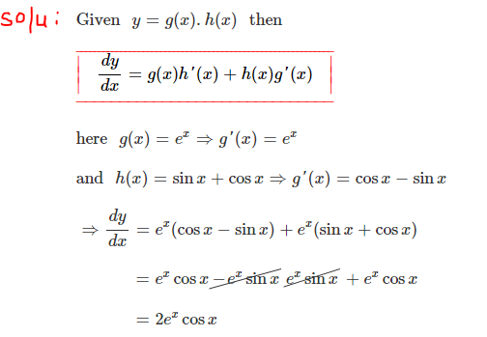

Example: Let $f\left(x\right)=\sqrt{x^{2}+1},$ find $f^{′}\left(x\right)$?
Solution: $f^{′}\left(x\right)=\frac{1}{2\sqrt{x^{2}+1}}∙2x=\frac{x}{\sqrt{x^{2}+1}}$
Example: find the derivative of

Slide 10
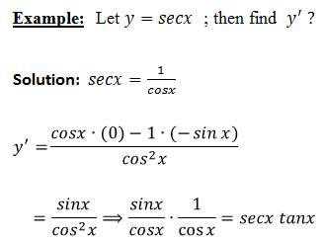
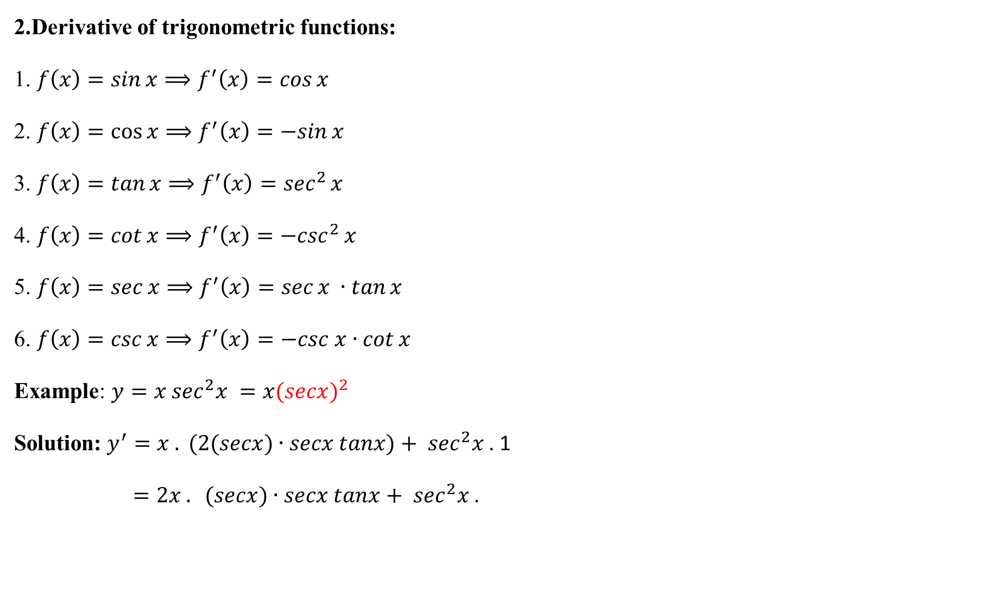
2.Derivative of trigonometric functions:
1. $f\left(x\right)=\sin{x}⟹f^{′}\left(x\right)=\cos{x}$
2. $f\left(x\right)=\cos{x}⟹f^{′}\left(x\right)=−sin{x}$
3. $f\left(x\right)=\tan{x}⟹f^{′}\left(x\right)=\sec^{2}{x}$
4. $f\left(x\right)=\cot{x}⟹f^{′}\left(x\right)=−\csc^{2}{x}$
5. $f\left(x\right)=\sec{x}⟹f^{′}\left(x\right)=\sec{x ∙\tan{x}}$
6. $f\left(x\right)=\csc{x}⟹f^{′}\left(x\right)=−csc x∙cot{x}$
Example: $y=x \sec^{2}x =x{(secx)}^{2}$
$\text{Solution}\text{:} y^{′}=x . (2(secx)∙secx tanx)+ \sec^{2}x$. 1
$=2x . (secx)∙secx tanx+ \sec^{2}x$.

Slide 11
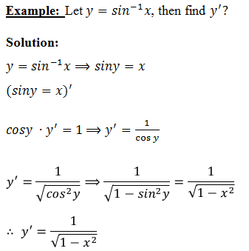
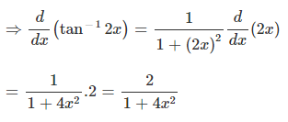

3. Derivative of inverse trigonometric functions:
1. ${f\left(x\right)=sin}^{−1}x⟹f^{′}\left(x\right)=\frac{1}{\sqrt{1−x^{2}}}$
2. ${f\left(x\right)=cos}^{−1}x⟹f^{′}\left(x\right)=\frac{−1}{\sqrt{1−x^{2}}}$
3. ${f\left(x\right)=tan}^{−1}x⟹f^{′}\left(x\right)=\frac{1}{1+x^{2}}$
4. ${f\left(x\right)=cot}^{−1}x⟹f^{′}\left(x\right)=\frac{−1}{1+x^{2}}$
5. ${f\left(x\right)=sec}^{−1}x⟹f^{′}\left(x\right)=\frac{1}{x\sqrt{x^{2}−1}}$ example:${f\left(x\right)=tan}^{−1}2x$ find $f^{′}?$
6. ${f\left(x\right)=csc}^{−1}x⟹f^{′}\left(x\right)=\frac{−1}{x\sqrt{x^{2}−1}}$

Slide 12
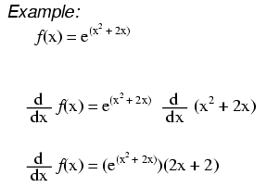
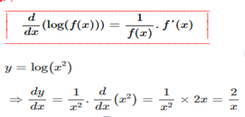

4.Derivative of exponential functions:
1. $f\left(x\right)=e^{x}$ $⟹f^{′}\left(x\right)=e^{x}$
$f\left(x\right)=e^{g(x)}$ $⟹f^{′}\left(x\right)=g^{′}(x)∙e^{g(x)}$
2. $f\left(x\right)=a^{x}$ $⟹f^{′}\left(x\right)=a^{x}\ln{a}$
$f\left(x\right)=a^{g(x)}$ $⟹f^{′}\left(x\right)=a^{g(x)}\ln{a}$ $g^{′}(x)$
3. $f\left(x\right)=\ln{x}$ $⟹$ $f^{′}\left(x\right)=\frac{1}{x}$
$f\left(x\right)=\ln{g(x)}$ $⟹$ $f^{′}\left(x\right)=\frac{1}{g(x)}$ $g^{′}(x)$
Example: if $f\left(x\right)= 3^{−2x}$ then $f^{′}(x)$ $= 3^{−2x}\ln{3}(−2)$
5. Derivative of logarithmic functions
$f\left(x\right)=\log_{a}^{x}$ $⟹f^{′}\left(x\right)=\frac{1}{x ln a}$ $, f\left(x\right)=\log_{a}{(g\left(x\right))}⟹f^{′}\left(x\right)=\frac{g^{′}(x)}{g(x) ln a}$

Slide 13
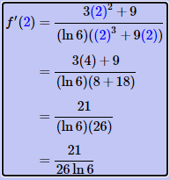

Example: Suppose $f\left(x\right)=\ln\left(8x−3\right),$Find $f′(x)$:
Solution: $f^{′}\left(x\right)=\frac{1}{8x−3}\frac{d}{dx}\left(8x−3\right)$
$=\frac{1}{8x−3}⋅8=\frac{8}{8x−3}$
Example: Find and simplify $\frac{\text{d}}{\text{dx}}$ ($ln(sinx)$):
Solution:
$$f′(x)=\frac{1}{sinx}⋅cosx=\frac{cosx}{sinx}=cotx$$
Example: Suppose $f\left(x\right)=\log_{6}{(x^{3}+9x}).$Find $f′(2)$. Solution:
$$f^{′}\left(x\right)=\frac{1}{\left(ln6\right){(x}^{3}+9x)}⋅\frac{d}{dx}\left(x^{3}+9x\right)$$
$$=\frac{1}{\left(ln6\right){(x}^{3}+9x)}⋅\left(3x^{2}+9\right) = \frac{3x^{2}+9}{(ln6)(x^{3}+9x) }$$

Slide 14
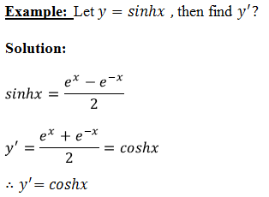

6. Derivatives of hyperbolic functions:
1. $f\left(x\right)=sinhx$ $⟹$ $f^{′}\left(x\right)=coshx$
2. $f\left(x\right)=coshx$ $⟹$ $f^{′}\left(x\right)=sinhx$
3. $f\left(x\right)=tanhx$ $⟹$ $f^{′}\left(x\right)=sech^{2}x$
4. $f\left(x\right)=cothx$ $⟹$ $f^{′}\left(x\right)=−csch^{2}x$
5. $f\left(x\right)=sechx$ $⟹$ $f^{′}\left(x\right)=−sechx tanhx$
6. $f\left(x\right)=cschx$ $⟹$ $f^{′}\left(x\right)=−cschx cothx$

Slide 15
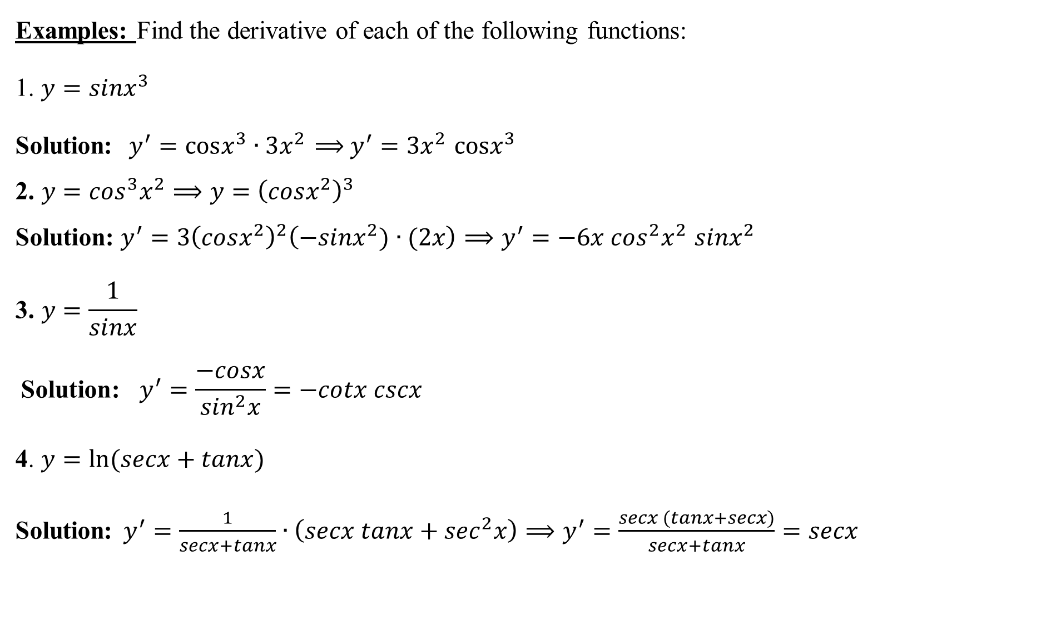
Examples: Find the derivative of each of the following functions:
1. $y=sinx^{3}$
Solution:$y^{′}=cosx^{3}∙3x^{2}$ $⟹$ $y^{′}=3x^{2}$ $cosx^{3}$
$$\text{2}\text{. }y=\cos^{3}x^{2}⟹y={\left(cosx^{2}\right)}^{3}$$
$$\text{Solution}\text{:} y^{′}=3{\left(cosx^{2}\right)}^{2}\left(−sinx^{2})∙(2x\right)⟹y^{′}=−6x \cos^{2}x^{2} sinx^{2}$$
$$\text{3}\text{. }y=\frac{1}{sinx}$$
$$\text{Solution}\text{: } y^{′}=\frac{−cosx}{\sin^{2}x}=−cotx cscx$$
4. $y=ln⁡(secx+tanx)$
Solution:$y^{′}=\frac{1}{secx+tanx}∙\left(secx tanx+\sec^{2}x\right)⟹y^{′}=\frac{secx (tanx+secx)}{secx+tanx}=secx$

