Slide 1




Chain Rule: If $y=f(x)$ and $u=y(x)$ are differentiable, then $\frac{dy}{dx}=\frac{dy}{du}∙\frac{du}{dx}$
Examples:
1. Differentiate $f(x){=(6x^{2}+7x)}^{4}$
Solution:
2. Differentiate $y=\sqrt[3]{1−8z} .$
Solution: $y{=(1−8z)}^{\frac{1}{3}}$
$\frac{dy}{dz}= \frac{1}{3}$ ${ \left(1−8z\right)}^{\frac{−2}{ 3}} . \left(−8\right) =\frac{−8}{ 3}$ ${ \left(1−8z\right)}^{\frac{−2}{ 3}}$.
3. Differentiate solution:

Slide 2
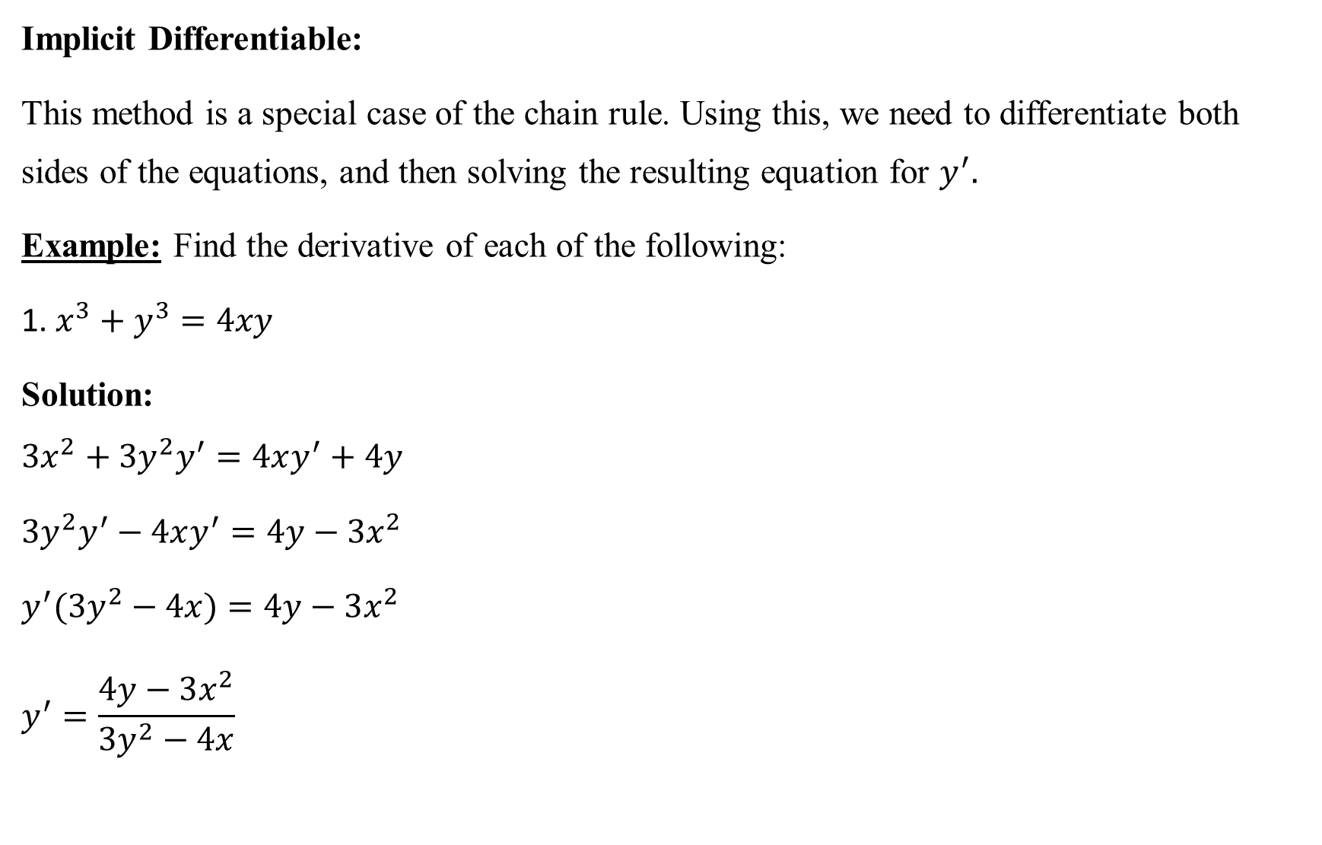
Implicit Differentiable:
This method is a special case of the chain rule. Using this, we need to differentiate both sides of the equations, and then solving the resulting equation for $y^{′}.$
Example: Find the derivative of each of the following:
1. $x^{3}+y^{3}=4xy$
Solution:
$$3x^{2}+3y^{2}y^{′}=4xy^{′}+4y$$
$3y^{2}y^{′}−$ $4xy^{′}=4y−3x^{2}$
$y^{′}(3y^{2}−$ $4x)=4y−3x^{2}$
$$y^{′}=\frac{4y−3x^{2}}{3y^{2}−4x}$$

Slide 3

2. $y=x^{x} ⟹lny=lnx^{x}$ $⟹lny=xlnx$
Solution: $lny=xlnx$
$$\frac{y^{′}}{y}=x∙\frac{1}{x}+lnx⟹y^{′}=y(1+lnx)$$
$$y^{′}=x^{x}(1+lnx).$$
3. $y={(sinx)}^{cosx}$
$⟹lny=ln{(sinx)}^{cosx}$ $⟹lny=cosx ln(sinx)$
Solution:
$$\frac{y^{′}}{y}=cosx∙\frac{cosx}{sinx}−sinx ln⁡(sinx)$$
$y^{′}=$ $y\left(\frac{\cos^{2}x}{sinx}−sinx\ln\left(sinx\right)\right)$
$y^{′}=$ ${\left(sinx\right)}^{cosx}(cotx cosx−sinx\ln{sinx)}$.

Slide 4
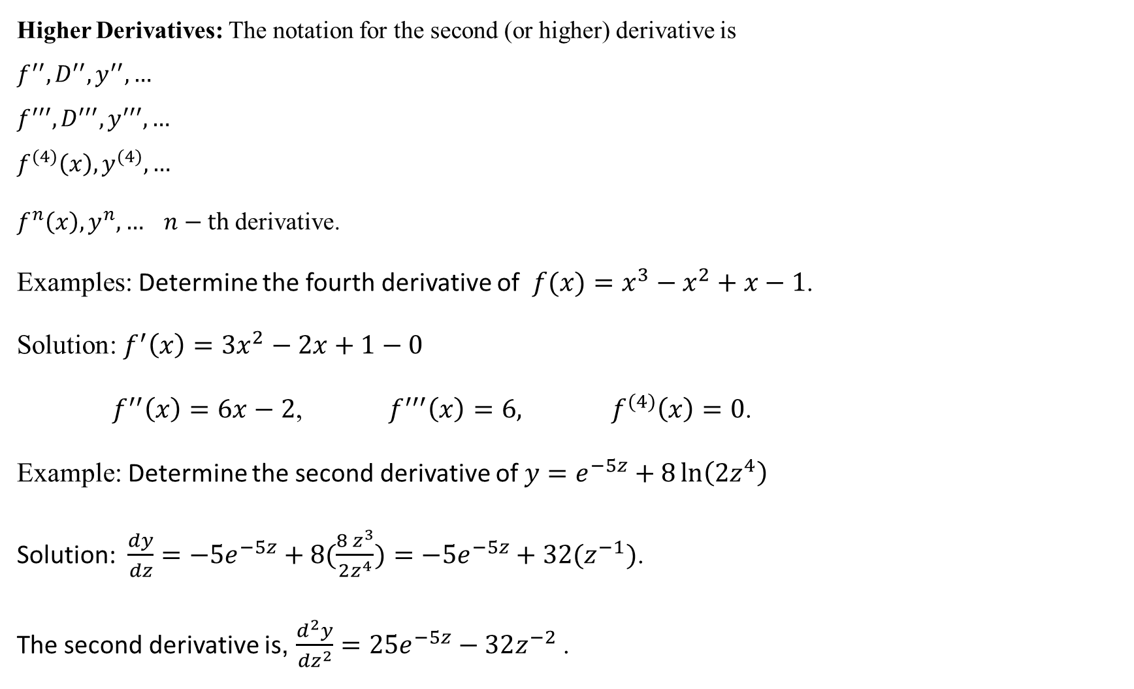
Higher Derivatives: The notation for the second (or higher) derivative is
$$f^{′′},D^{′′},y^{′′},…$$
$$f^{′′′},D^{′′′},y^{′′′},…$$
$$f^{(4)}\left(x\right),y^{(4)},…$$
$f^{n}\left(x\right),y^{n},… n−th$derivative.
Examples: Determine the fourth derivative of $f(x)=x^{3}−x^{2}+x−1$.
Solution: $f^{′}\left(x\right)={3x}^{2}−2x+1−0$
$f^{′′}\left(x\right)=6x−2$, $f^{′′′}\left(x\right)=6,$ ${ f}^{(4)}\left(x\right)=0$.
Example: Determine the second derivative of $y=e^{−5z}+8\ln\left(2z^{4}\right)$
Solution: $\frac{dy}{dz}=−5e^{−5z}+8(\frac{8 z^{3}}{2z^{4}})=−5e^{−5z}+32(z^{−1})$.
The second derivative is, $\frac{d^{2}y}{{dz}^{2}}=25e^{−5z}−32z^{−2 }$.

Slide 5
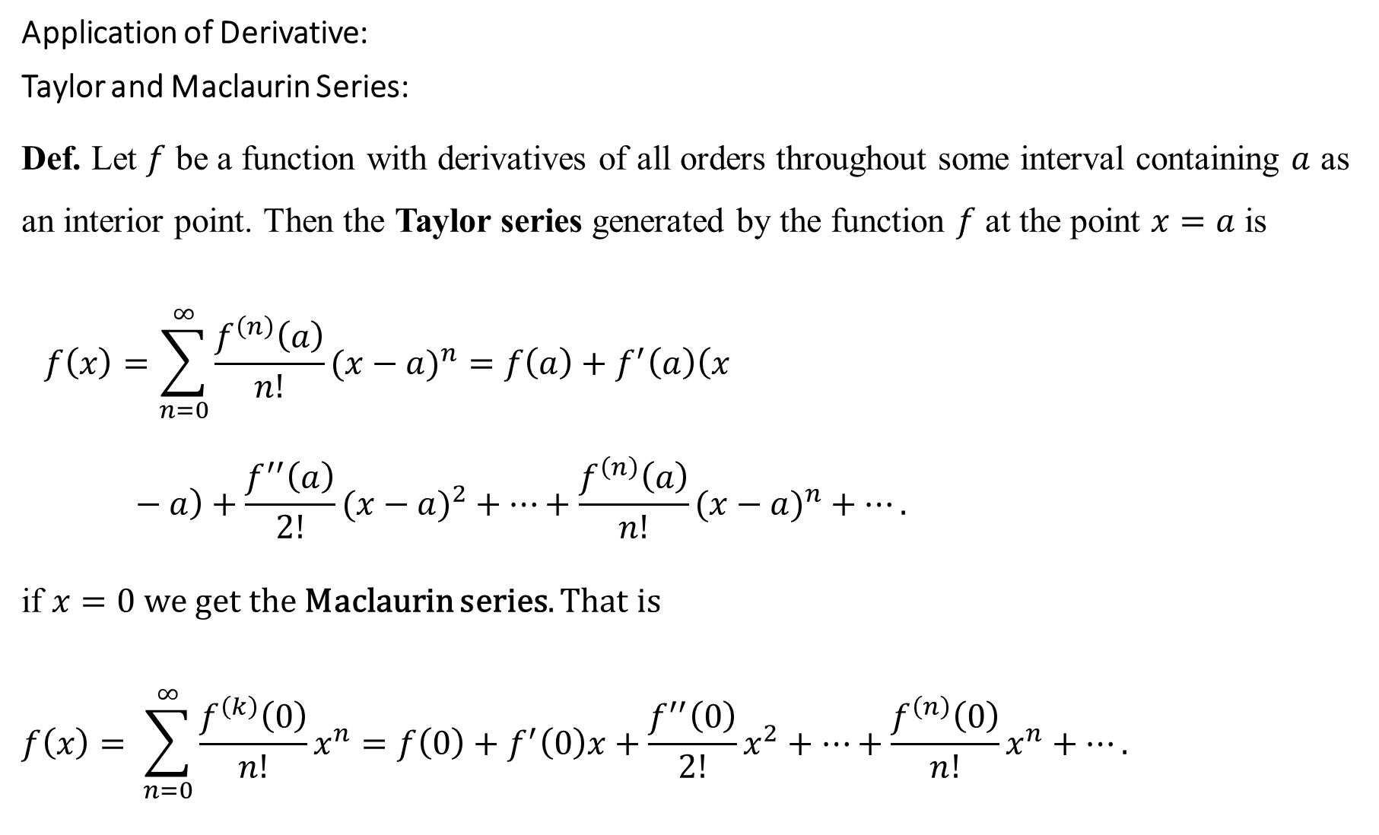
Application of Derivative:
Taylor and Maclaurin Series:
Def. Let $f$ be a function with derivatives of all orders throughout some interval containing $a$ as an interior point. Then the Taylor series generated by the function $f$ at the point $x=a$ is
$$f\left(x\right)=\sum_{n=0}^{∞}{\frac{f^{\left(n\right)}\left(a\right)}{n!}(x−a)^{n}=f\left(a\right)+f^{′}\left(a\right)\left(x−a\right)+\frac{f^{′′}\left(a\right)}{2!}(x−a)^{2}+…+\frac{f^{\left(n\right)}\left(a\right)}{n!}(x−a)^{n}+…}.$$
if $x=0$ we get the Maclaurin series. That is
$$f\left(x\right)= \sum_{n=0}^{∞}{\frac{f^{\left(k\right)}\left(0\right)}{n!}x^{n}=f\left(0\right)+f^{′}\left(0\right)x+\frac{f^{′′}\left(0\right)}{2!}x^{2}+…+\frac{f^{\left(n\right)}\left(0\right)}{n!}x^{n}+…}.$$

Slide 6

Example: Find the Taylor series for the function $f\left(x\right)=e^{x}$at $a=1.$
Solution:
$f\left(x\right)=e^{x}$ $f\left(1\right)=e^{1}=e$
$$f^{′}\left(x\right)=e^{x}{ f}^{′}\left(1\right)=e^{1}=e$$
$$f^{′′}\left(x\right)=e^{x}{ f}^{′′}\left(1\right)=e^{1}=e$$
$$f^{′′′}\left(x\right)=e^{x}{ f}^{′′′}\left(1\right)=e^{1}=e$$
$$⋮$$
$$f^{(n)}\left(x\right)=e^{x}{ f}^{(n)}\left(1\right)=e^{1}=e$$
$$f\left(x\right)=\sum_{n=0}^{∞}{\frac{f^{\left(n\right)}(a)}{n!}(x−a)^{n}=f\left(1\right)+f^{′}\left(1\right)\left(x−1\right)+\frac{f^{′′}\left(1\right)}{2!}(x−1)^{2}+…+\frac{f^{\left(n\right)}\left(1\right)}{n!}(x−1)^{n}+…}$$
$$e^{x}=e+e\left(x−1\right)+\frac{e(x−1)^{2}}{2!}+\frac{e(x−1)^{3}}{3!}+…$$

Slide 7

Example: Find the Taylor series for the function $f\left(x\right)=x lnx$ at $a=e.$
Solution:
$$f\left(x\right)=xlnx f\left(e\right)=elne=e∙1=e$$
$$f^{′}\left(x\right)=1+lnx{ f}^{′}\left(e\right)=1+lne=2$$
$$f^{′′}\left(x\right)=\frac{1}{x}{ f}^{′′}\left(e\right)=\frac{1}{e}$$
$$f^{′′′}\left(x\right)=\frac{−1}{{ x}^{2}}{ f}^{′′′}\left(e\right)=\frac{−1}{e^{2}}$$
$$xlnx=e+2\left(x−e\right)+\frac{1}{e}\frac{(x−e)^{2}}{2!}−\frac{1}{e^{2}}\frac{(x−e)^{3}}{3!}+…$$
$$=e+2\left(x−e\right)+\frac{1}{e}\frac{(x−e)^{2}}{2}−\frac{1}{e^{2}}\frac{(x−e)^{3}}{3∙2}+…$$

Slide 8

Example: Find the Maclaurin series for the following functions:
1. $f\left(x\right)=sinx$ 2. $f\left(x\right)=sin3x$ 3. $f\left(x\right)=cos3x$ 4. $f\left(x\right)=\cos^{2}x$.
Solution:
1. $f\left(x\right)=sinx f\left(0\right)=sin0=0$
$$f^{′}\left(x\right)=cosx f^{′}\left(0\right)=cos0=1$$
$f^{′′}\left(x\right)=−sinx f^{′′}\left(0\right)=−sin0=0$
$$f^{′′′}\left(x\right)=−cosx f^{′′′}\left(0\right)=−cos0=−1$$
$f^{(4)}\left(x\right)=sinx f^{(4)}\left(0\right)=sin0=0$, $f^{(5)}\left(x\right)=cosx f^{(5)}\left(0\right)=cos0=1$
$$⋮$$
$$f^{(2n)}\left(x\right)=0$$
$f^{(2n+1)}\left(x\right)={(−1)}^{n}$
$f\left(x\right)=\sum_{n=0}^{∞}{\frac{f^{\left(n\right)}(0)x^{n}}{n!}}$ = $f\left(0\right)+f^{′}\left(0\right)x+\frac{f^{′′}\left(0\right)}{2!}x^{2}+…+\frac{f^{\left(n\right)}\left(0\right)}{n!}x^{n}$
$=x−\frac{x^{3}}{3!}+\frac{x^{5}}{5!} −\frac{x^{7}}{7!}+…$

Slide 9

2. Replace each $x$ by $3x$ we get
$$sin3x=3x−\frac{{\left(3x\right)}^{3}}{3!}+\frac{{\left(3x\right)}^{5}}{5!}+…$$
3. $cosx=1−\frac{x^{2}}{2!}$ $+\frac{x^{4}}{4!}−…$
${4. cos}^{2}x=$ $\frac{{2x}^{2}}{2!} +\frac{{2^{3}x}^{4}}{4!}−…$

