Slide 1
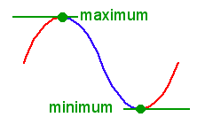
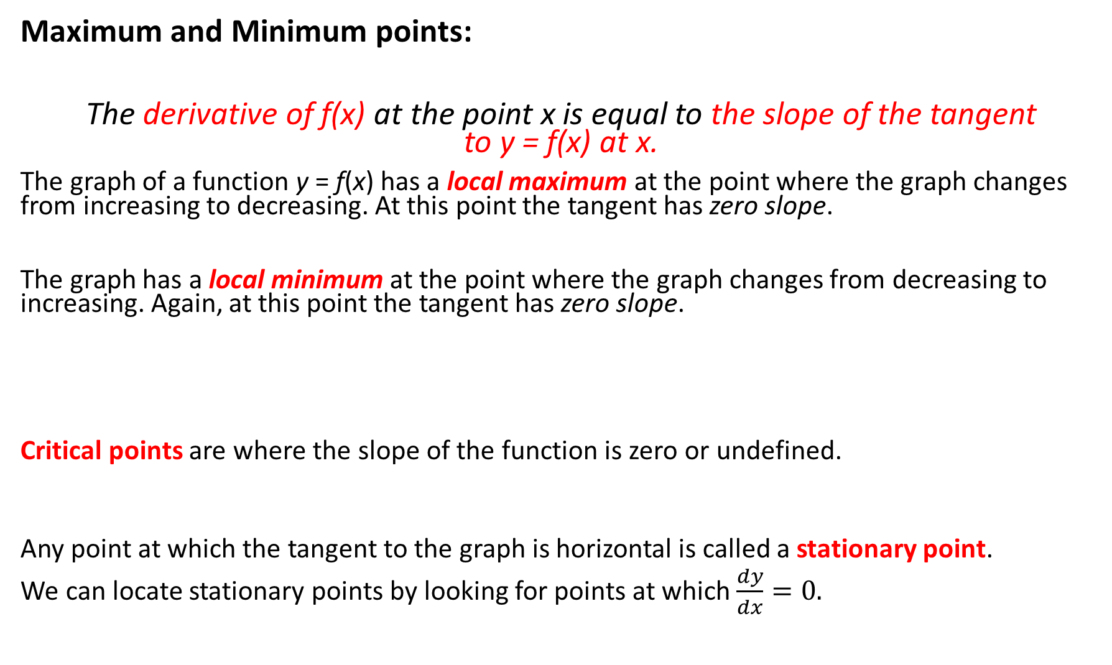
Maximum and Minimum points:
The derivative of f(x) at the point x is equal to the slope of the tangent to y = f(x) at x.
The graph of a function y = f(x) has a local maximum at the point where the graph changes from increasing to decreasing. At this point the tangent has zero slope.
The graph has a local minimum at the point where the graph changes from decreasing to increasing. Again, at this point the tangent has zero slope.
Critical points are where the slope of the function is zero or undefined.
Any point at which the tangent to the graph is horizontal is called a stationary point.
We can locate stationary points by looking for points at which $\frac{dy}{dx}=0.$

Slide 2
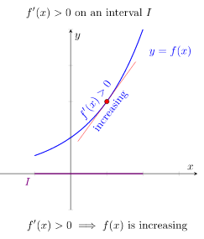
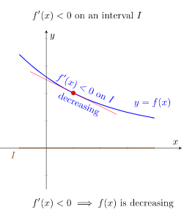

Theorem: ‘Increasing and Decreasing’
Suppose $f(x)$ is a differentiable function on an open interval $I$.
If $f′(x)>$0 on $I$, then $f(x)$ is increasing on $I$ and similarly,
If $f′(x)<0$ on $I$, then $f(x)$ is decreasing on $I$.

Slide 3
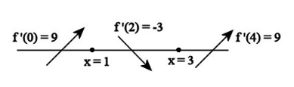
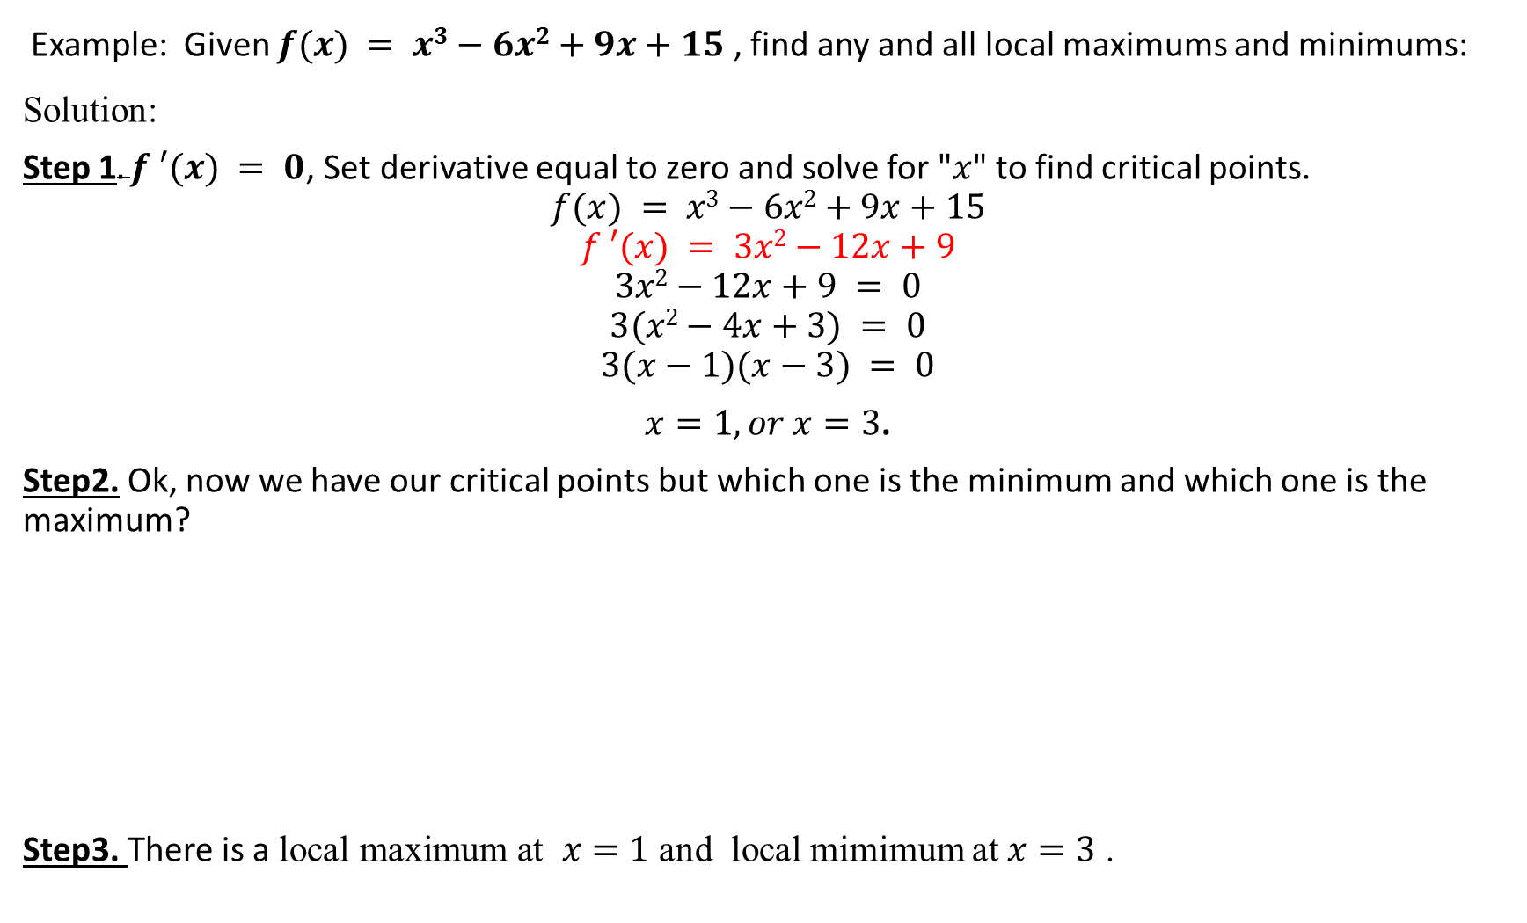
Example: Given $f(x) = x3−6x2+9x+15$ , find any and all local maximums and minimums:
Solution:
Step 1$.f ′(x) = 0$, Set derivative equal to zero and solve for "$x$" to find critical points.
$$f(x) = x3−6x2+9x+15$$
$$f ′(x) = 3x2−12x+9$$
$$3x2−12x+9 = 0$$
$$3(x2−4x+3) = 0$$
$$3(x−1)(x−3) = 0$$
$x=1, or x=3$.
Step2. Ok, now we have our critical points but which one is the minimum and which one is the maximum?
Step3. There is a $\text{local} \text{maximum} \text{at} x=1$ and local mimimum at $x=3$ .

Slide 4
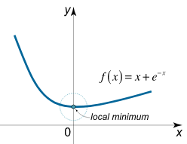
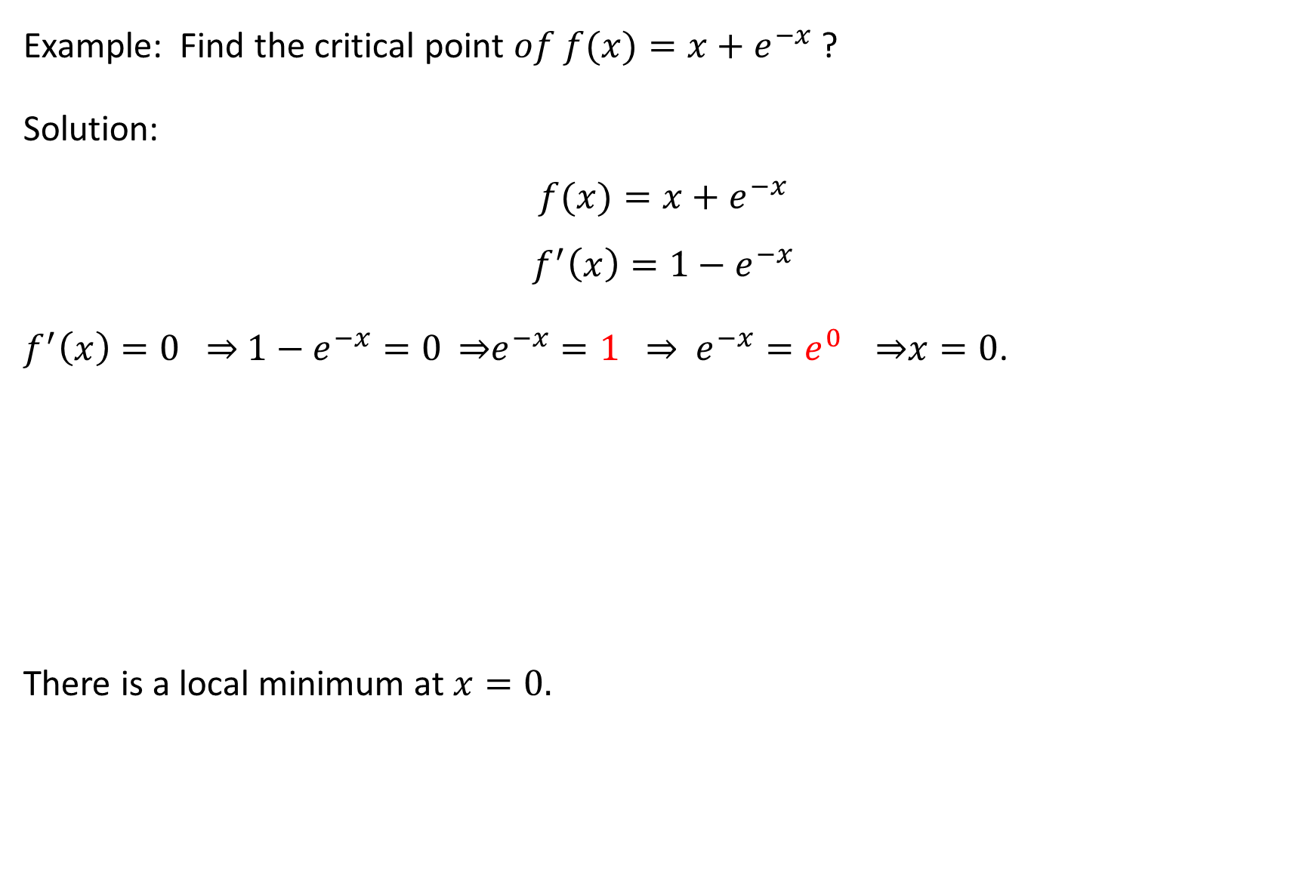
Example: Find the $\text{critical} \text{point} of f(x)=x+e^{−x}$ ?
Solution:
$$f(x)=x+e^{−x}$$
$$f^{′}\left(x\right)=1−e^{−x}$$
$f^{′}\left(x\right)=0$ ⇒ $1−e^{−x}=0$ ⇒$e^{−x}=1$ ⇒ $e^{−x}=e^{0}$⇒$x=0$.
There is a local minimum at $x=0.$

Slide 5
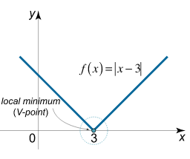

Example: The function $f(x)=|x−3|$ has a critical point (local minimum) at $c=3$. The derivative does not exist at this point.

Slide 6
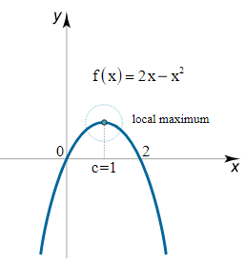

Example: The function $f(x)=2x−x^{2}$ has a critical point (local maximum) at
$x=1$. The derivative is zero at this point.
$$f(x)=2x−x^{2}$$
$$f′(x)=2−2x$$
$f′(x)=0,⇒2−2x=0,⇒x=1$.

Slide 7
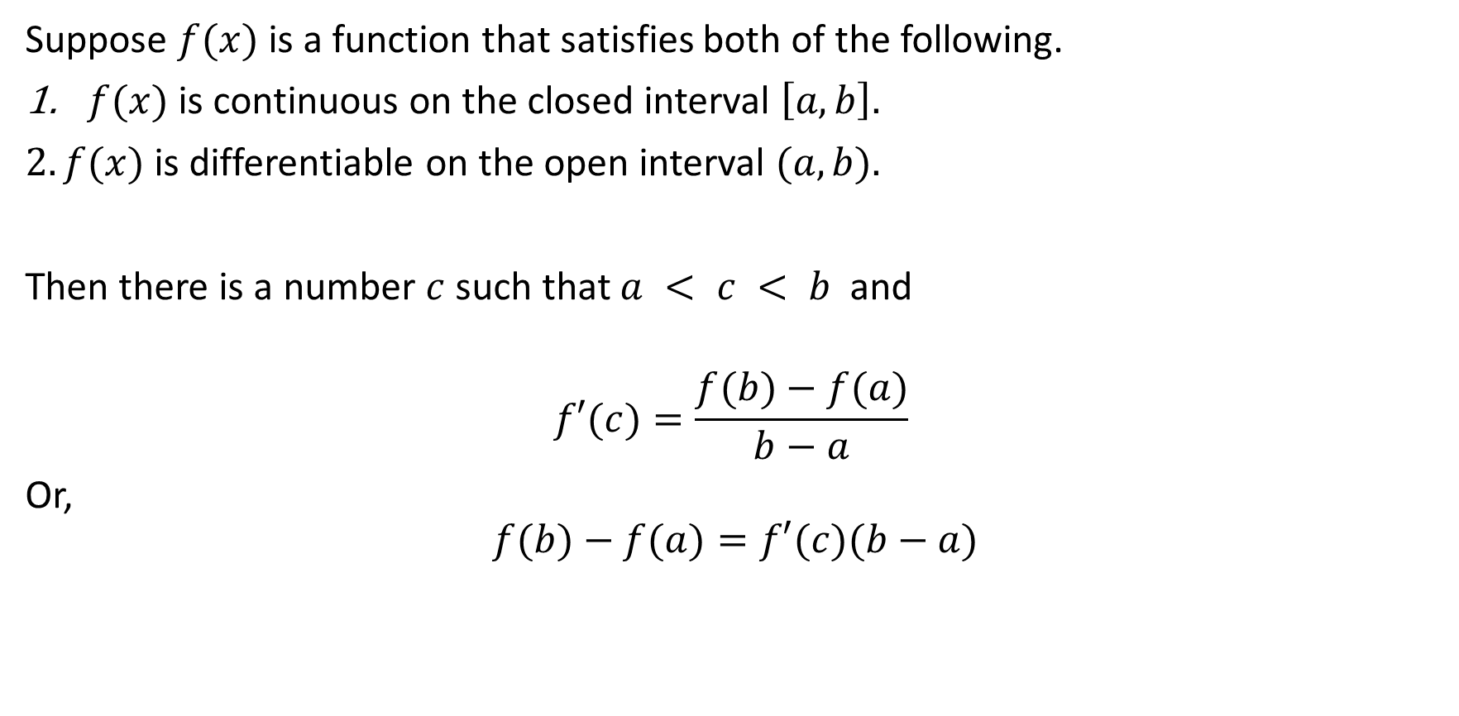
The main value theorem
Suppose $f(x)$is a function that satisfies both of the following.
$f(x)$ is continuous on the closed interval $\left[a,b\right].$
$2.f(x)$ is differentiable on the open interval $(a,b).$
Then there is a number $c$ such that $a < c < b$ and
$$f′(c)=\frac{f(b)−f(a)}{b−a}$$
Or,
$$f(b)−f(a)=f′(c)(b−a)$$

Slide 8
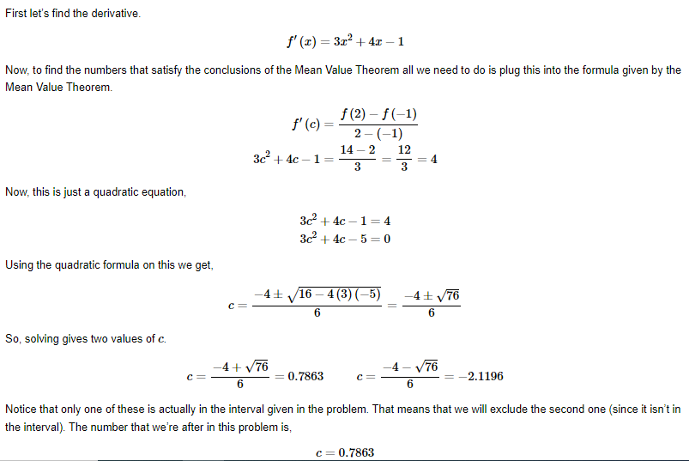

$Example$ : Determine all the numbers c which satisfy the conclusions of the Mean Value Theorem for the following function. $f\left(x\right)=x^{3}+2x^{2}−x$on$[−1,2]$

Slide 9
