Slide 1
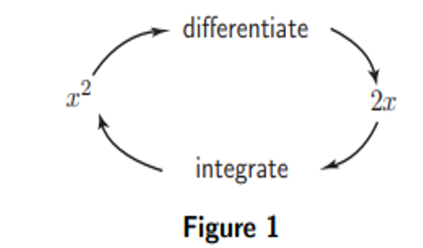
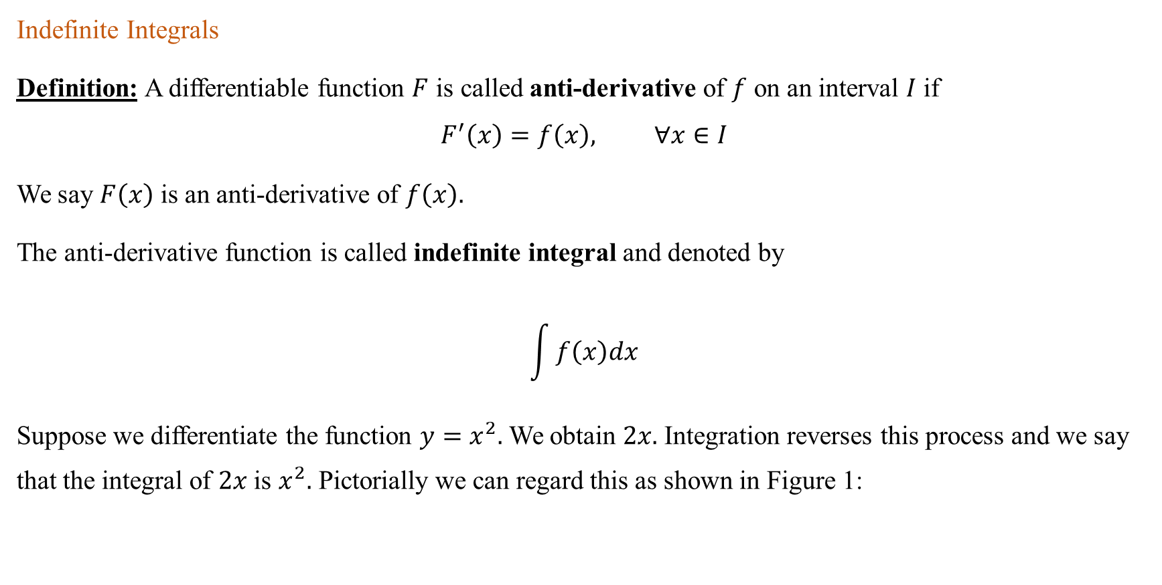
Integration(Integrals)
Indefinite Integrals
Definition: A differentiable function $F$ is called anti-derivative of $f$ on an interval $I$ if
$$F^{′}\left(x\right)=f\left(x\right), ∀x∈I$$
We say $F\left(x\right)$ is an anti-derivative of $f\left(x\right).$
The anti-derivative function is called indefinite integral and denoted by
$$\int{f\left(x\right)dx}$$
Suppose we differentiate the function $y=x^{2}.$ We obtain $2x.$ Integration reverses this process and we say that the integral of $2x$ is $x^{2}.$ Pictorially we can regard this as shown in Figure 1:

Slide 2

Example: Find the anti-derivative of $f\left(x\right)=2x⟹F\left(x\right){=x}^{2},$ but
$\left.\begin{aligned} F\left(x\right)=x^{2}+1 \\ F\left(x\right)=x^{2}+108 \\ F\left(x\right)=x^{2}−6\end{aligned}\right\}$are also antiderivatives of $f.$
Therefore, we need to have a general form of anti-derivative of the given function.
If $F$ is anti-derivative of $f$ on $I,$ then the most general form of anti-derivative of $f$ is
$F\left(x\right)+c,$ where $c$ is constant. That is
$$\int{f\left(x\right)dx=F\left(x\right)+c}$$

Slide 3
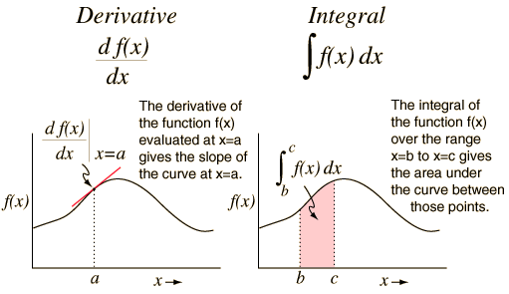
Relation of Integration with Derivatives:

Slide 4

Some useful identities:
1.$\cos^{2}x+\sin^{2}x=1$ dividing this identity in turn by $\cos^{2}x$ and $\sin^{2}x$ is gives
$$\frac{\cos^{2}x}{\cos^{2}x}+\frac{\sin^{2}x}{\cos^{2}x}=\frac{1}{\cos^{2}x} from this we get (2)$$
2.$1+\tan^{2}x=\sec^{2}x$
3.$1+\cot^{2}x=\csc^{2}x$
4. $\sin\left(x±y\right)=sinx.cosy±cosx.siny$
5. $\cos\left(x±y\right)=cosx.cosy∓sinx.siny$
6. $\sin{2x=2sin⁡x}cos⁡$x

Slide 5

7.$\cos{2θ=}\cos^{2}{θ}−\sin^{2}⁡θ$
${=2cos}^{2}{θ}−1$
$$=1−2\sin^{2}⁡θ$$
8. $\sin^{2}θ=\frac{1−cos2x}{2}$
9. $\cos^{2}θ=\frac{1+cos2x}{2}$
10. $sinA−sinB=2sin\left(\frac{A−B}{2}\right)cos\left(\frac{A+B}{2}\right)$
11. $sinxcosy=\frac{1}{2}[\sin\left(x+y\right)+\sin\left(x−y\right)]$
12. $cosxcosy=\frac{1}{2}[\cos\left(x+y\right)+\cos\left(x−y\right)]$
13. $tan2x=\frac{2tanx}{1−\tan^{2}x}$

Slide 6
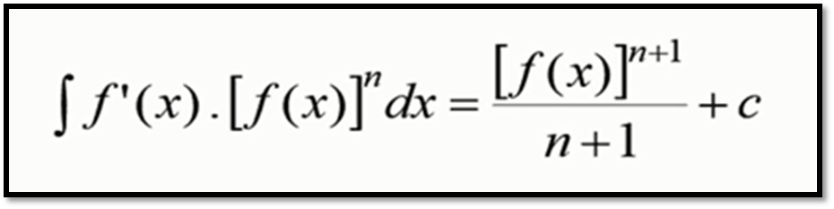
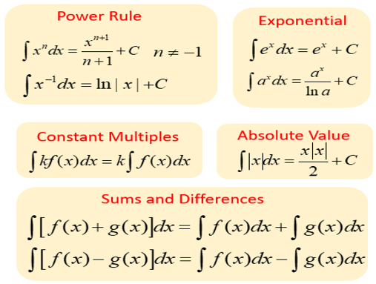
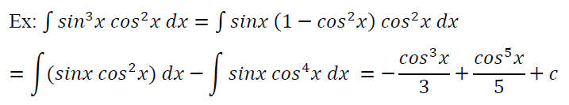

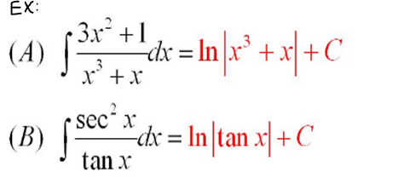
Integration Basic Rules: Rules for Indefinite Integrals:

Slide 7
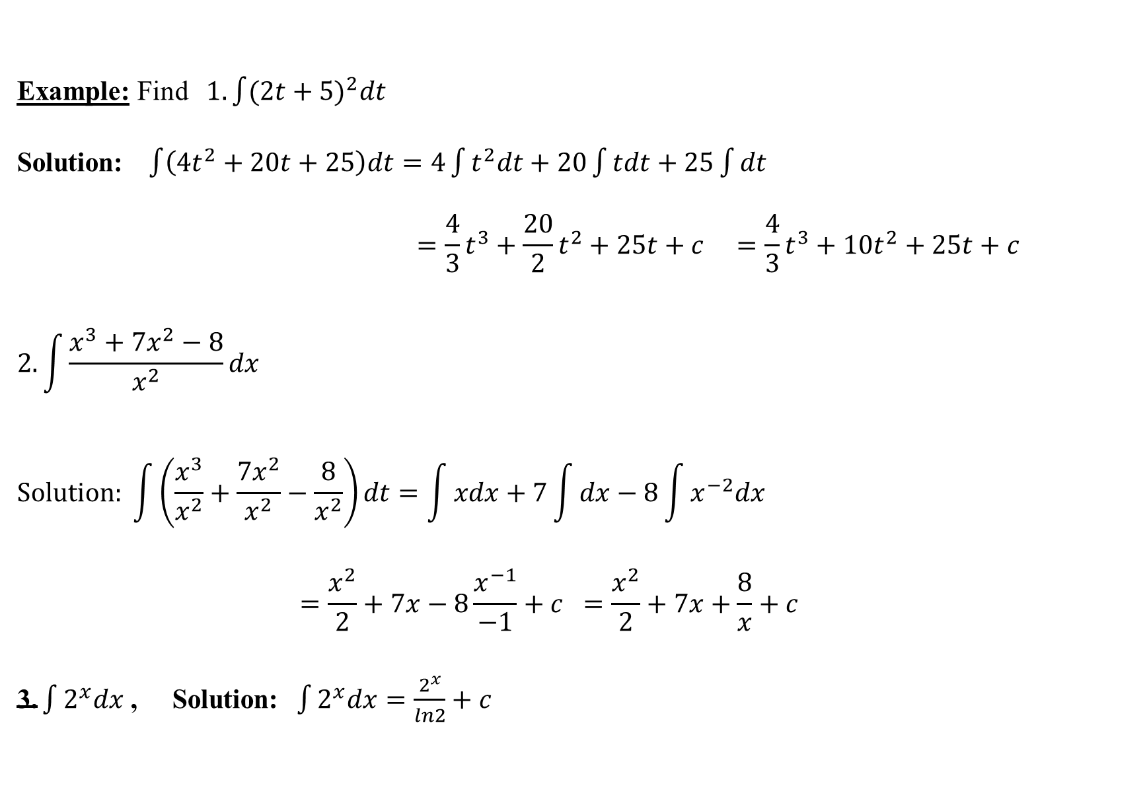
Example: Find $1. \int{(2t+5)^{2}dt}$
Solution: $\int{\left(4t^{2}+20t+25\right)dt=4\int{t^{2}dt+20\int{tdt+25\int{dt}}}}$
$$=\frac{4}{3}t^{3}+\frac{20}{2}t^{2}+25t+c =\frac{4}{3}t^{3}+10t^{2}+25t+c$$
$$2. \int{\frac{x^{3}+7x^{2}−8}{x^{2}}dx}$$
$$Solution: \int{\left(\frac{x^{3}}{x^{2}}+\frac{7x^{2}}{x^{2}}−\frac{8}{x^{2}}\right)dt=\int{xdx+7\int{dx}−8\int{x^{−2}dx}}}$$
$$=\frac{x^{2}}{2}+7x−8\frac{x^{−1}}{−1}+c =\frac{x^{2}}{2}+7x+\frac{8}{x}+c$$
$\text{3.}\int{2^{x}dx}$ , Solution:$\int{2^{x}dx}=\frac{2^{x}}{ln2}+c$

Slide 8
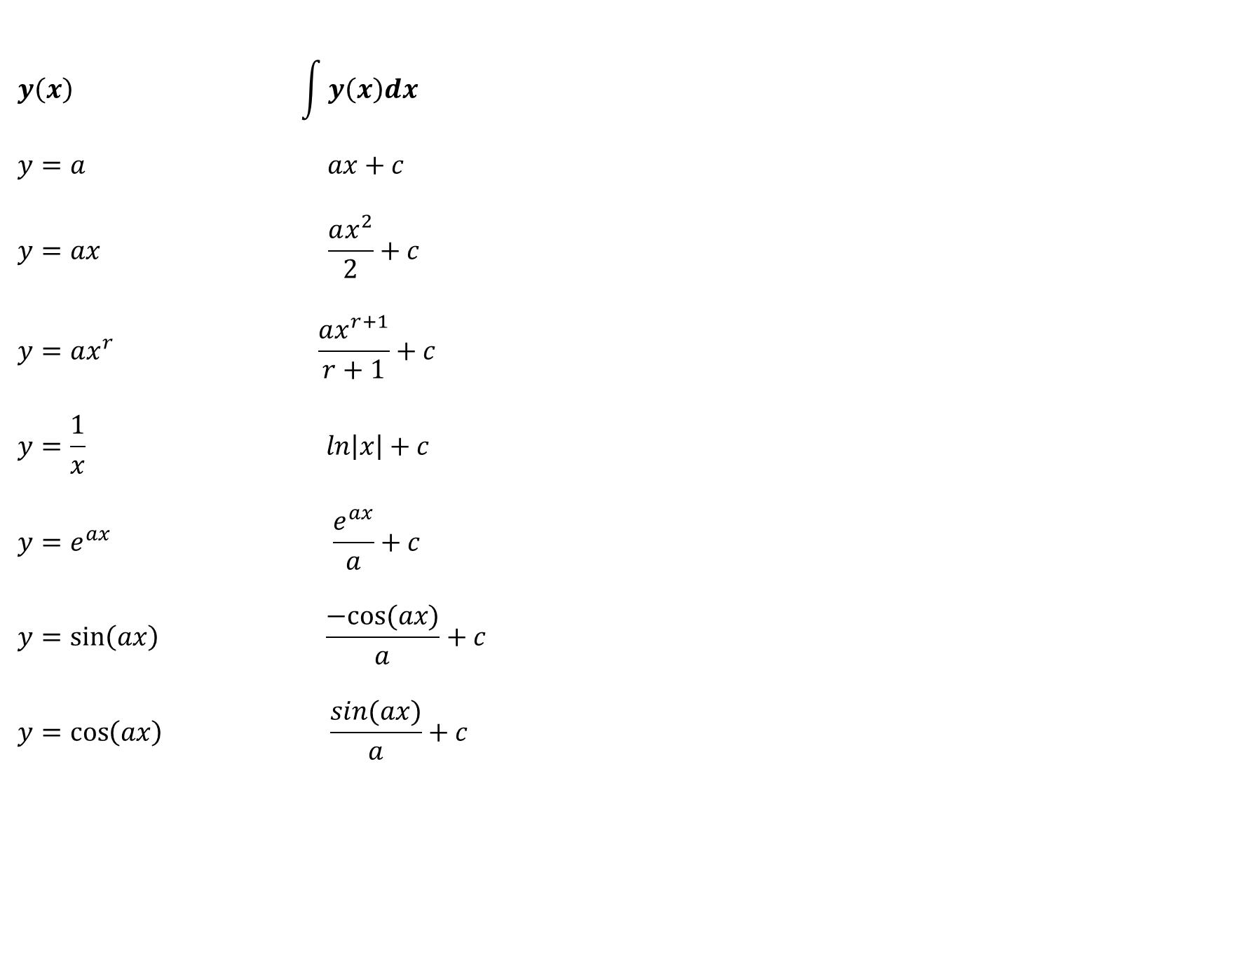
$$y\left(x\right) \int{y\left(x\right)dx}$$
$$y=a ax+c$$
$$y=ax \frac{ax^{2}}{2}+c$$
$$y=ax^{r} \frac{ax^{r+1}}{r+1}+c$$
$$y=\frac{1}{x} ln\left|x\right|+c$$
$$y=e^{ax} \frac{e^{ax}}{a}+c$$
$$y=\sin\left(ax\right) \frac{−cos⁡(ax)}{a}+c$$
$$y=\cos\left(ax\right) \frac{sin⁡(ax)}{a}+c$$
Notes:
s

Slide 9
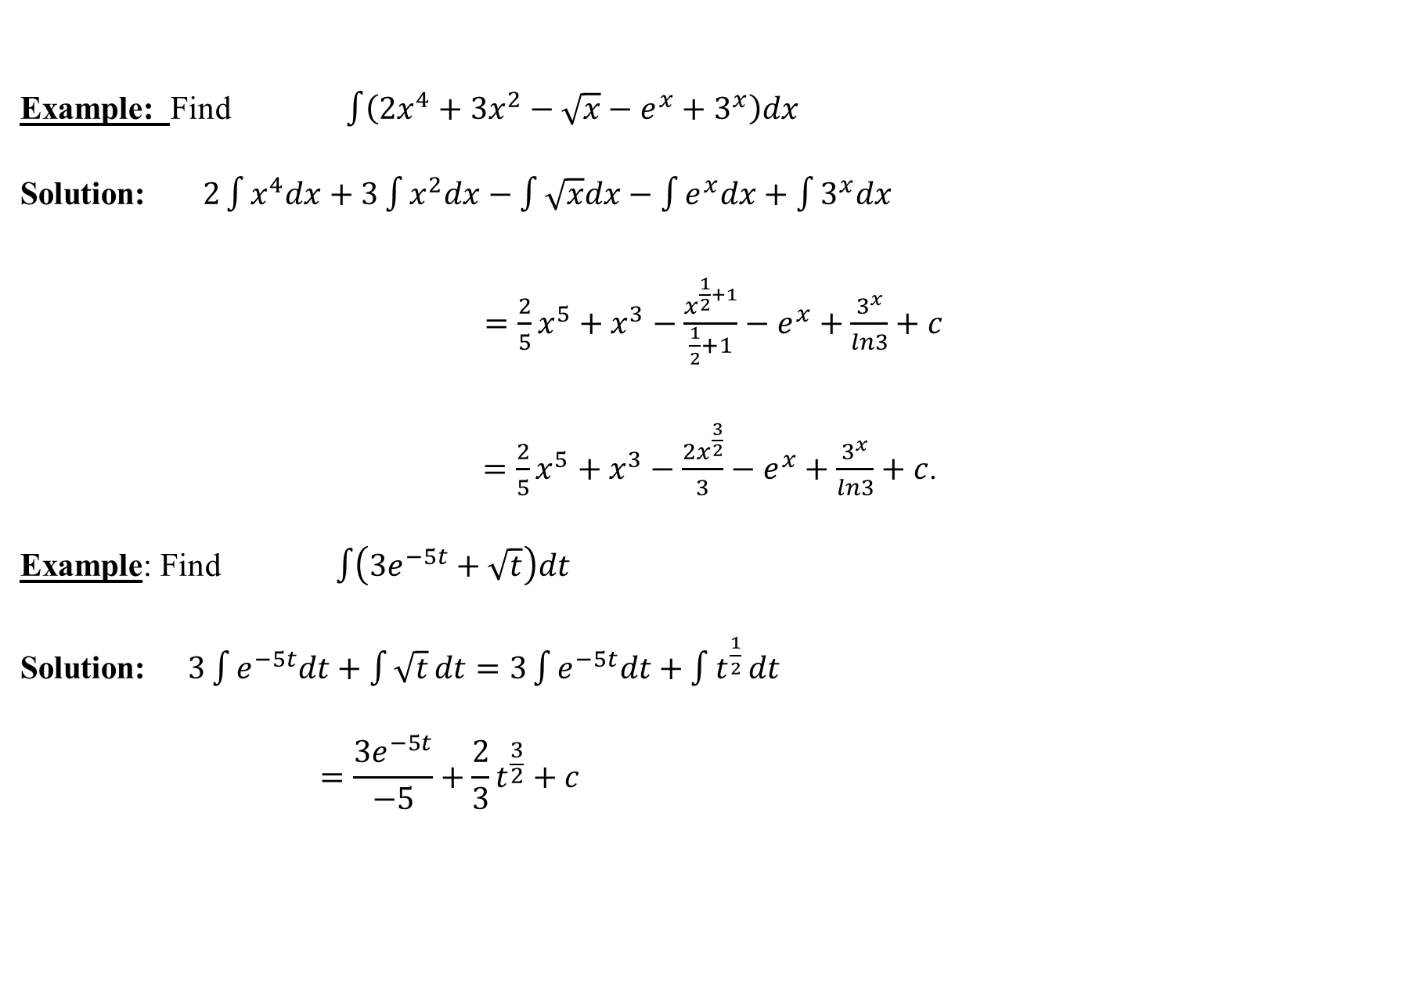
Example: Find$\int{\left(2x^{4}+3x^{2}−\sqrt{x}−e^{x}+3^{x}\right)dx}$
Solution:$2\int{x^{4}dx+3\int{x^{2}dx−\int{\sqrt{x}dx}−\int{e^{x}dx}+\int{3^{x}dx}}}$
$=\frac{2}{5}x^{5}+x^{3}−\frac{x^{\frac{1}{2}+1}}{\frac{1}{2}+1}−e^{x}+\frac{3^{x}}{ln3}+c$
$=\frac{2}{5}x^{5}+x^{3}−\frac{{2x}^{\frac{3}{2}}}{3}−e^{x}+\frac{3^{x}}{ln3}+c$.
Example: Find $\int{\left(3e^{−5t}+\sqrt{t}\right)dt}$
Solution:$3\int{e^{−5t}dt+\int{\sqrt{t}}dt=3\int{e^{−5t}dt+\int{t^{\frac{1}{2}}}dt}}$
$$=\frac{3e^{−5t}}{−5}+\frac{2}{3}t^{\frac{3}{2}}+c$$

Slide 10
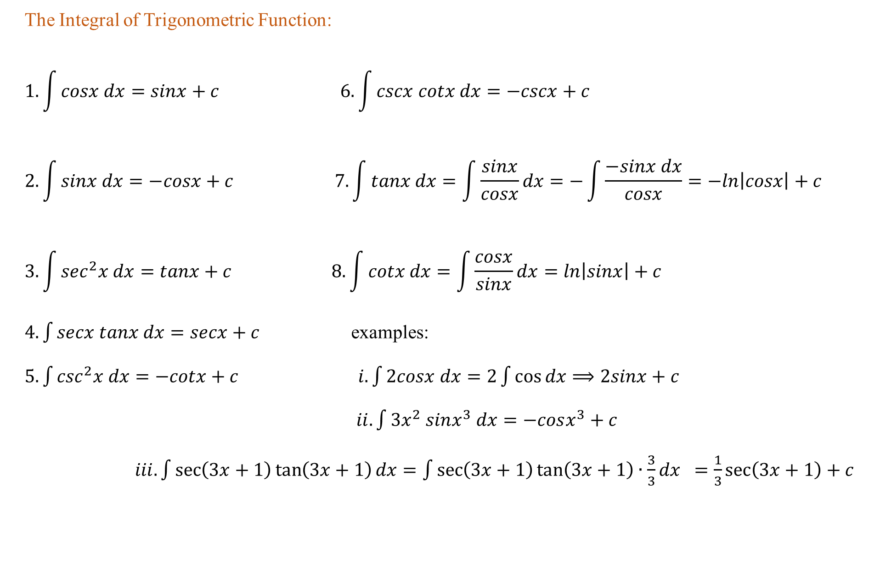
The Integral of Trigonometric Function:
$$1. \int{cosx dx=sinx+c} 6. \int{cscx cotx dx=−cscx+c}$$
$$2. \int{sinx dx=−cosx+c 7. \int{tanx dx=\int{\frac{sinx}{cosx}}dx=−\int{\frac{−sinx dx}{cosx}=−ln\left|cosx\right|+c}}}$$
$$3. \int{\sec^{2}x dx=tanx+c} 8. \int{cotx dx=\int{\frac{cosx}{sinx}}dx=ln\left|sinx\right|+c}$$
$4. \int{secx tanx dx=secx+c}$ examples:
$5. \int{\csc^{2}x dx=−cotx+c}$ $i.\int{2cosx dx=2\int{\cos{dx}}⟹2sinx+c}$
$ii.\int{3x^{2} sinx^{3} dx}=−cosx^{3}+c$
$iii.\int{\sec\left(3x+1\right)\tan\left(3x+1\right)dx}=\int{\sec\left(3x+1\right)\tan\left(3x+1\right)∙\frac{3}{3}dx} =\frac{1}{3}\sec\left(3x+1\right)+c$

Slide 11
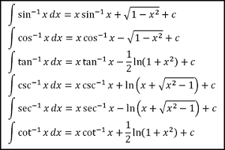
Integration of Inverse Trigonometric functions:

Slide 12
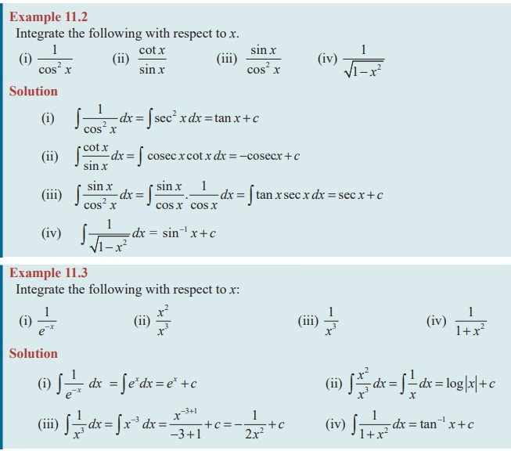


Slide 13
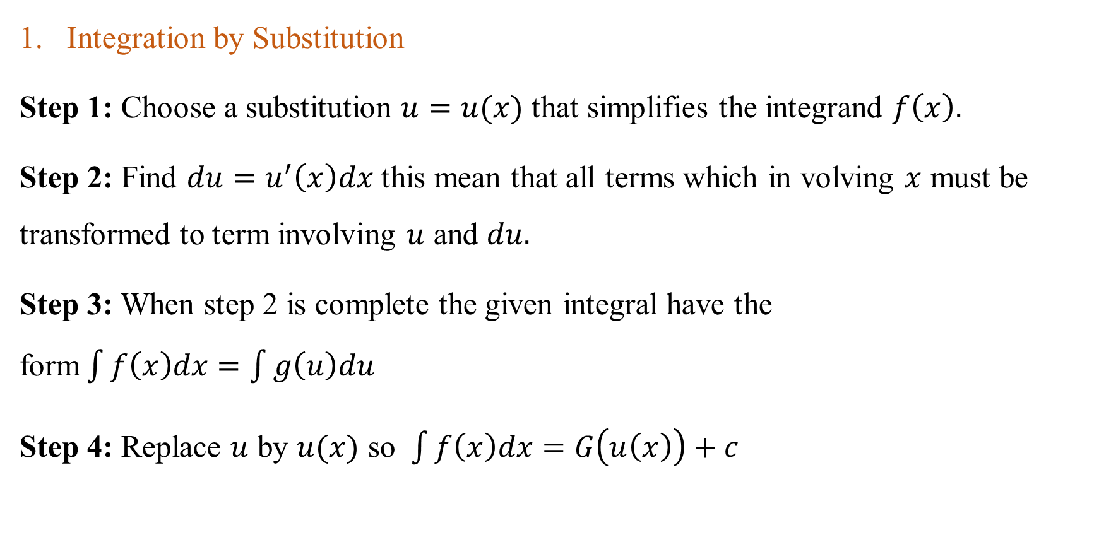
Techniques of Integration
Integration by Substitution
Step 1: Choose a substitution $u=u(x)$ that simplifies the integrand $f\left(x\right).$
Step 2: Find $du=u^{′}\left(x\right)dx$ this mean that all terms which in volving $x$ must be transformed to term involving $u$ and $du.$
Step 3: When step 2 is complete the given integral have the form$\int{f\left(x\right)dx=\int{g\left(u\right)du}}$
Step 4: Replace $u$ by $u(x)$ so $\int{f\left(x\right)dx=G\left(u\left(x\right)\right)+c}$

Slide 14
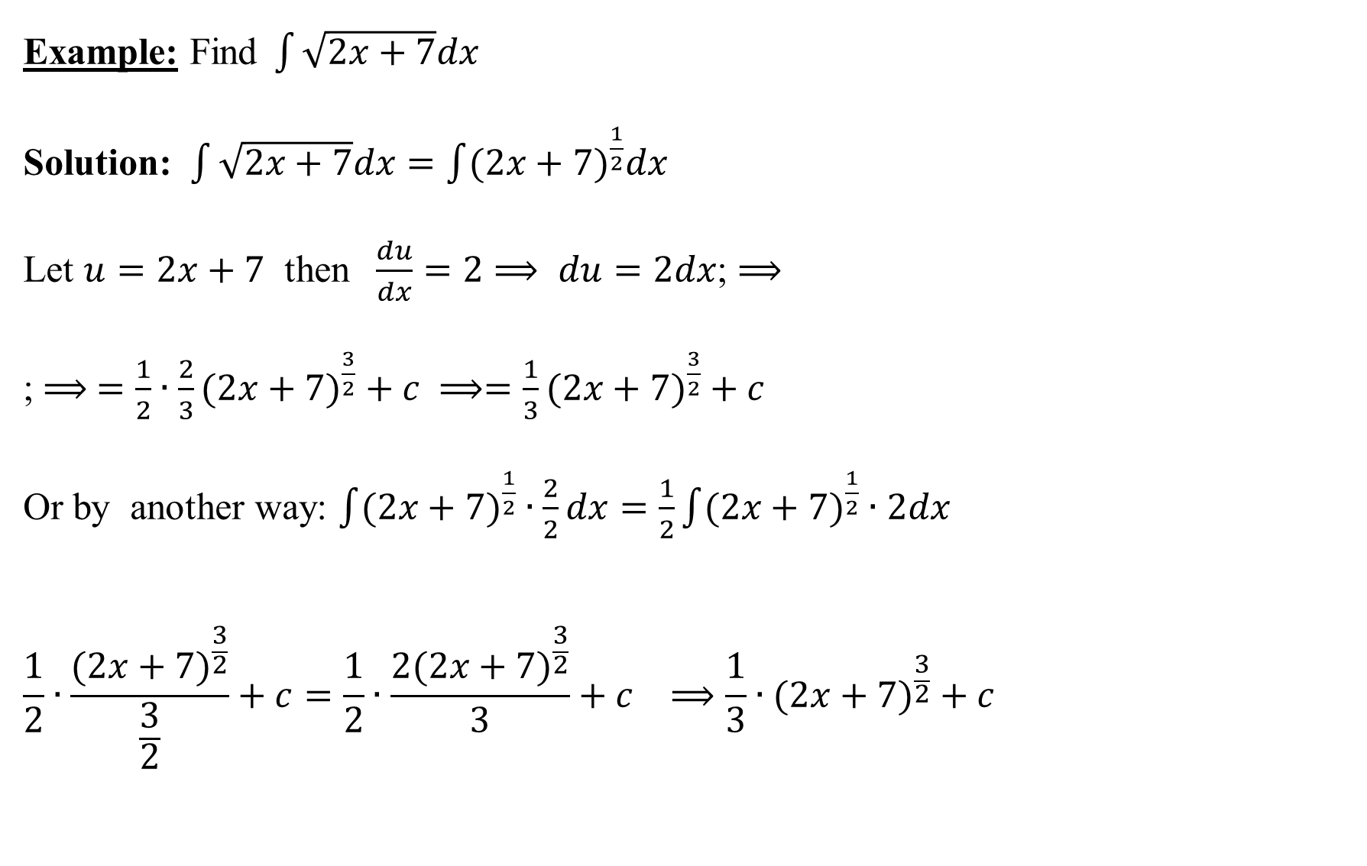
Example: Find$\int{\sqrt{2x+7}dx}$
Solution: $\int{\sqrt{2x+7}dx}=\int{(2x+7)^{\frac{1}{2}}dx}$
Let $u=2x+7$ then $\frac{du}{dx}=2⟹ du=2dx$; $⟹$
; $⟹ =\frac{1}{2}∙\frac{2}{3}(2x+7)^{\frac{3}{2}}+c ⟹=\frac{1}{3}(2x+7)^{\frac{3}{2}}+c$
Or by another way: $\int{(2x+7)^{\frac{1}{2}}}∙\frac{2}{2}dx=\frac{1}{2}\int{(2x+7)^{\frac{1}{2}}∙2dx}$
$$\frac{1}{2}∙\frac{(2x+7)^{\frac{3}{2}}}{\frac{3}{2}}+c=\frac{1}{2}∙\frac{2(2x+7)^{\frac{3}{2}}}{3}+c ⟹\frac{1}{3}∙(2x+7)^{\frac{3}{2}}+c$$

Slide 15
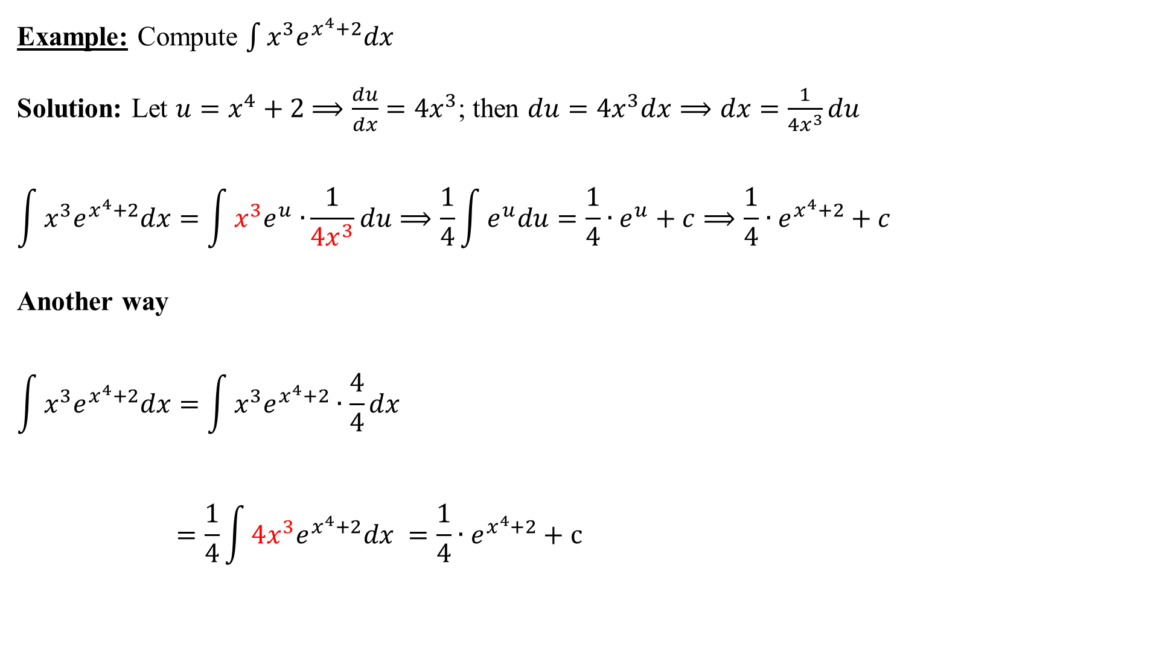
Example: Compute $\int{x^{3}e^{x^{4}+2}dx}$
Solution: Let $u=x^{4}+2$ $⟹\frac{du}{dx}=4x^{3}$; then $du=4x^{3}dx⟹dx=\frac{1}{{4x}^{3}}du$
$$\int{x^{3}e^{x^{4}+2}dx}=\int{x^{3}e^{u}∙}\frac{1}{{4x}^{3}}du⟹\frac{1}{4}\int{e^{u}du}=\frac{1}{4}∙e^{u}+c⟹\frac{1}{4}∙e^{x^{4}+2}+c$$
Another way
$$\int{x^{3}e^{x^{4}+2}dx}=\int{x^{3}e^{x^{4}+2}∙\frac{4}{4}dx}$$
$$=\frac{1}{4}\int{{4x^{3}e}^{x^{4}+2}dx} =\frac{1}{4}∙e^{x^{4}+2}+c$$

Slide 16
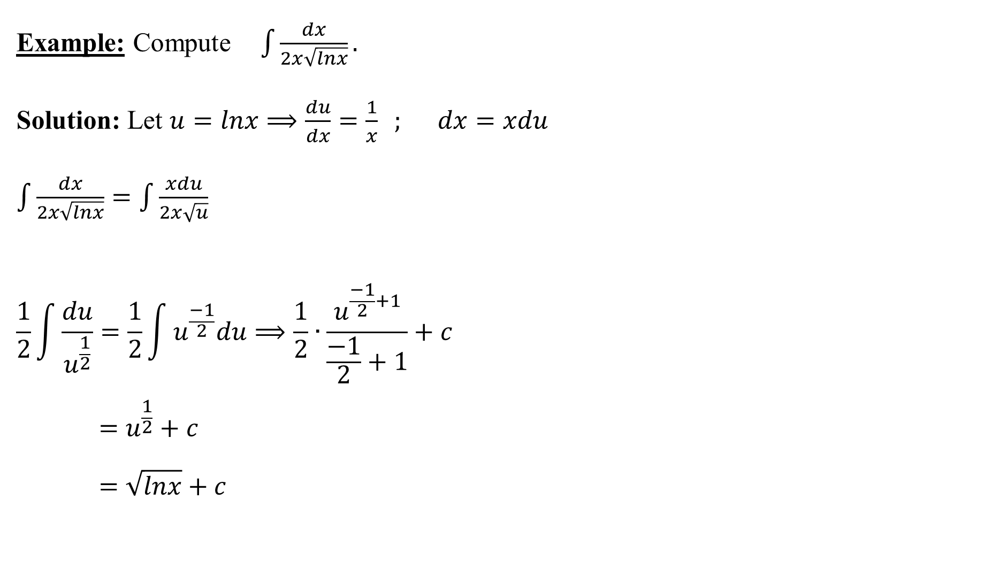
Example: Compute$\int{\frac{dx}{2x\sqrt{lnx}}}.$
Solution: Let $u=lnx⟹\frac{du}{dx}=\frac{1}{x} ;$ $dx=xdu$
$\int{\frac{dx}{2x\sqrt{lnx}}}=\int{\frac{xdu}{2x\sqrt{u}}}$
$$\frac{1}{2}\int{\frac{du}{u^{\frac{1}{2}}}=\frac{1}{2}\int{u^{\frac{−1}{2}}du}}⟹\frac{1}{2}∙\frac{u^{\frac{−1}{2}+1}}{\frac{−1}{2}+1}+c$$
$$=u^{\frac{1}{2}}+c$$
$$=\sqrt{lnx}+c$$

