Slide 1
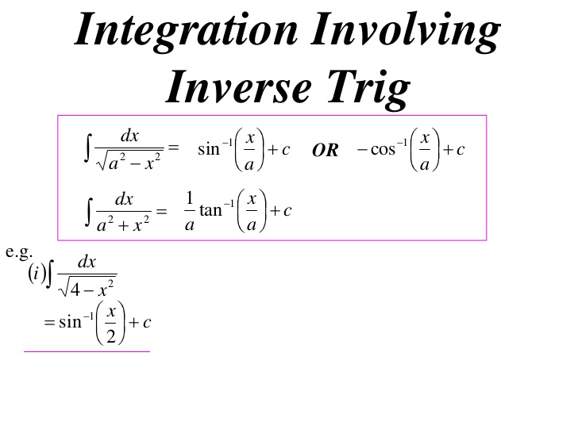
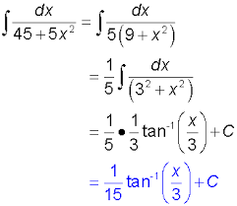
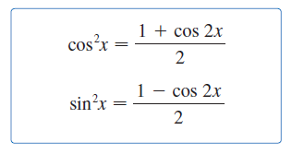

Slide 2
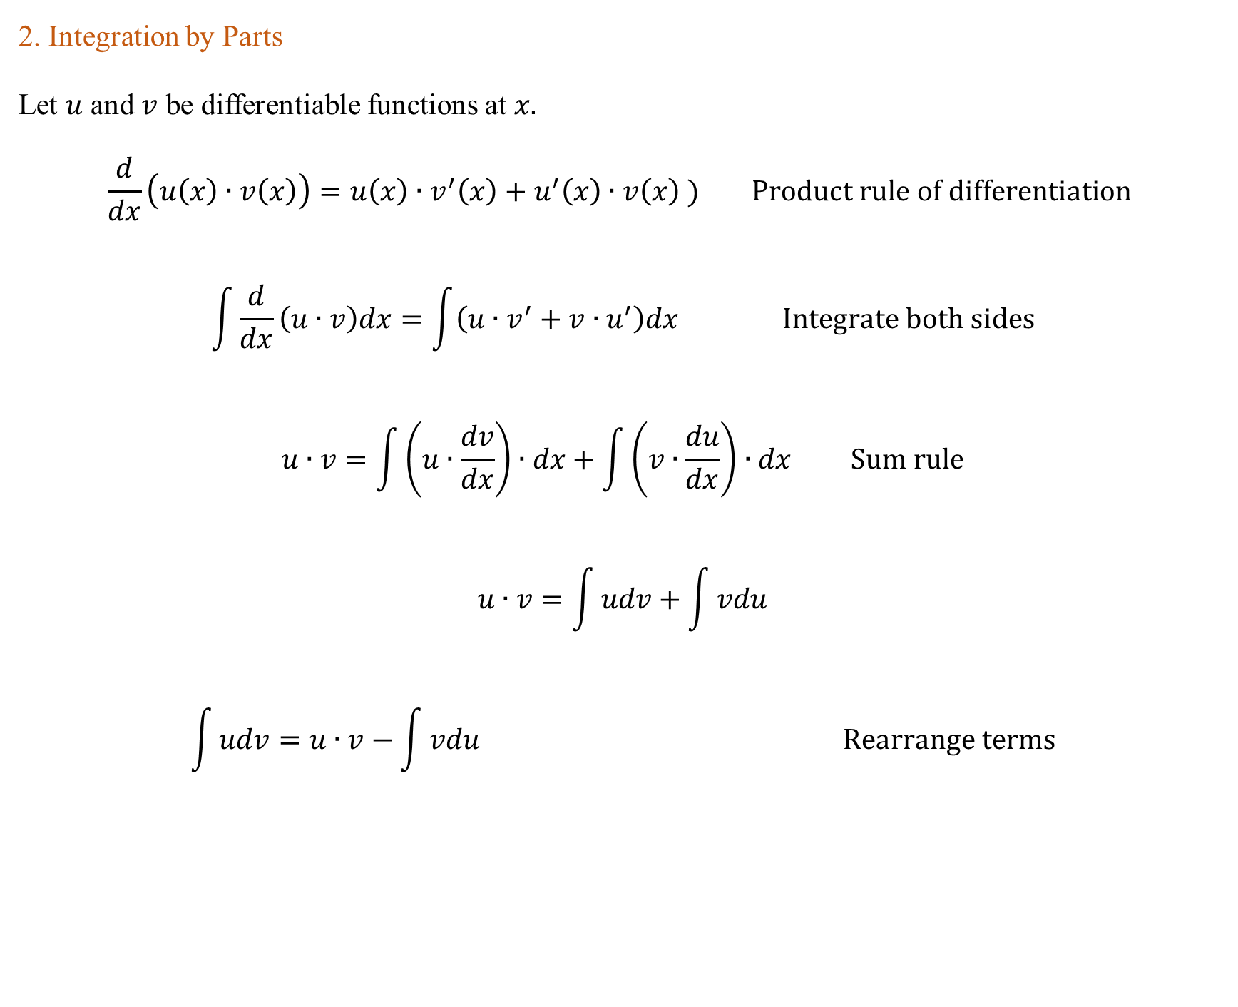
2. Integration by Parts
Let $u$ and $v$ be differentiable functions at $x.$
$$\frac{d}{dx}\left(u\left(x\right)∙v\left(x\right)\right)=u\left(x\right)∙v^{′}\left(x\right)+u^{′}\left(x\right)∙v\left(x\right) ) Product rule of differentiation$$
$$\int{\frac{d}{dx}\left(u∙v\right)dx}=\int{\left(u∙v^{′}+v{∙u}^{′}\right)dx} Integrate both sides$$
$$u∙v=\int{\left(u∙\frac{dv}{dx}\right)∙dx+\int{\left(v∙\frac{du}{dx}\right)∙dx Sum rule}}$$
$$u∙v=\int{udv+\int{vdu}}$$
$$\int{udv=u∙v−\int{vdu}} Rearrange terms$$

Slide 3
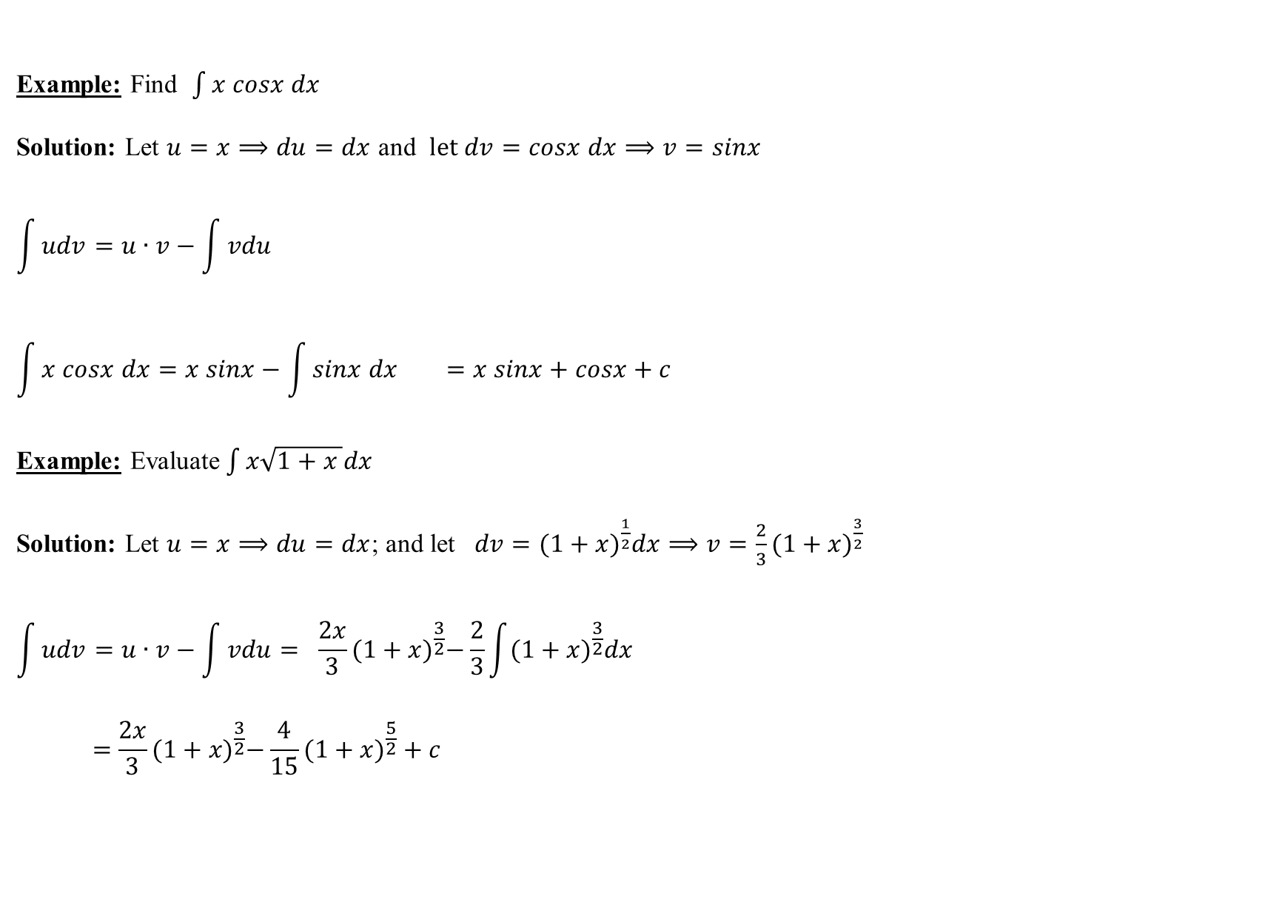
Example: Find $\int{x cosx dx}$
Solution: Let $u=x⟹du=dx$ and $let dv=cosx dx⟹v=sinx$
$$\int{udv=u∙v−\int{vdu}}$$
$$\int{x cosx dx}=x sinx−\int{sinx dx} =x sinx+cosx+c$$
Example: Evaluate$\int{x\sqrt{1+x }dx}$
Solution: Let $u=x⟹du=dx$; and let $dv={(1+x)}^{\frac{1}{2}}dx⟹v=\frac{2}{3}(1+x)^{\frac{3}{2}}$
$$\int{udv=u∙v−\int{vdu}= \frac{2x}{3}}{(1+x)}^{\frac{3}{2}}−\frac{2}{3}\int{(1+x)^{\frac{3}{2}}dx}$$
$$=\frac{2x}{3}{(1+x)}^{\frac{3}{2}}−\frac{4}{15}(1+x)^{\frac{5}{2}}+c$$

Slide 4
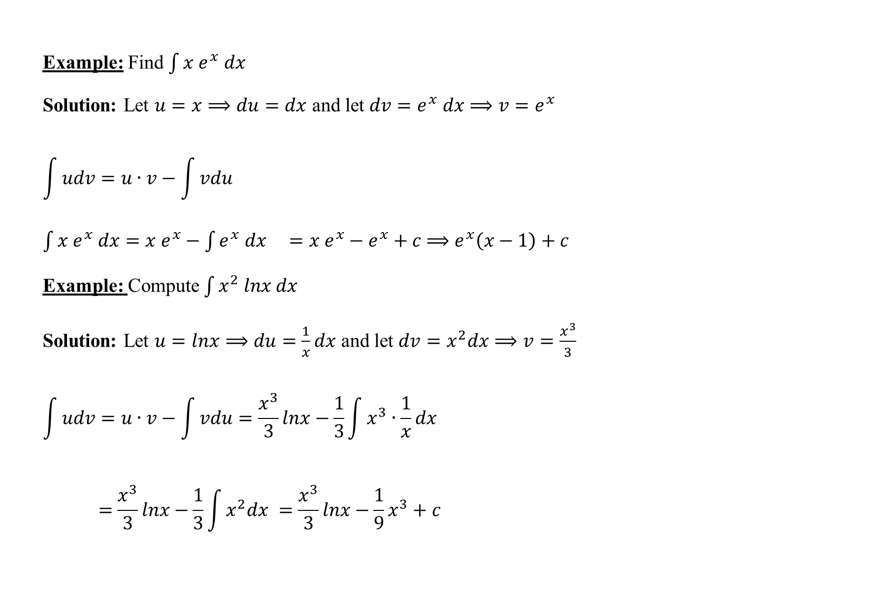
Example: Find $\int{x e^{x} dx}$
Solution: Let $u=x⟹du=dx$ and let $dv=e^{x} dx⟹v=e^{x}$
$$\int{udv=u∙v−\int{vdu}}$$
$\int{x e^{x} dx}=x e^{x}−\int{e^{x} dx} =x e^{x}−e^{x}+c$ $⟹e^{x}\left(x−1\right)+c$
Example: Compute$\int{x^{2} lnx dx}$
Solution: Let $u=lnx⟹du=\frac{1}{x}dx$ and let $dv=x^{2}dx⟹v=\frac{x^{3}}{3}$
$$\int{udv=u∙v−\int{vdu}}=\frac{x^{3}}{3}lnx−\frac{1}{3}\int{x^{3}∙\frac{1}{x}dx}$$
$$=\frac{x^{3}}{3}lnx−\frac{1}{3}\int{x^{2}dx} =\frac{x^{3}}{3}lnx−\frac{1}{9}x^{3}+c$$

Slide 5
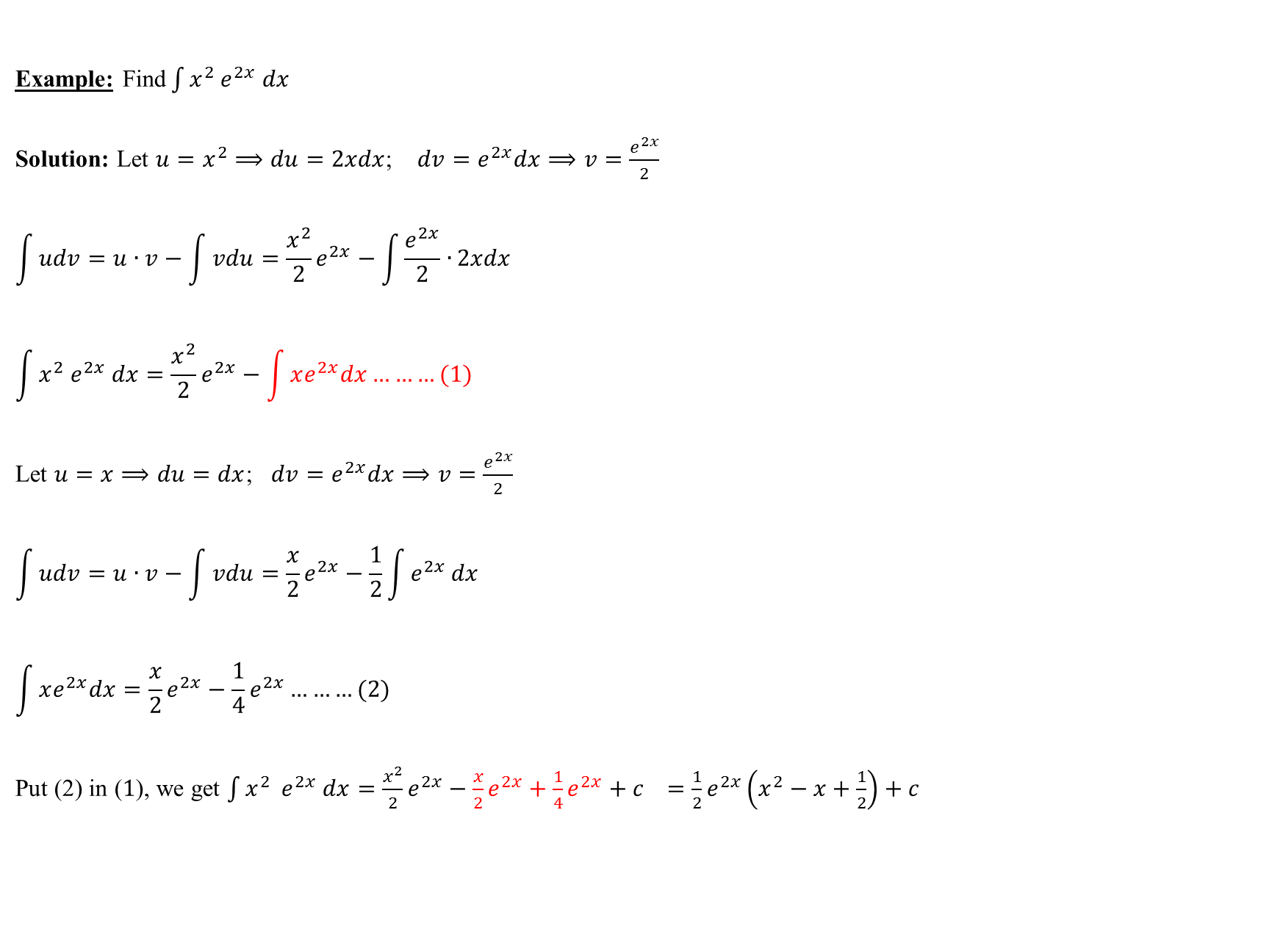
Example: Find$\int{x^{2} e^{2x} dx}$
Solution: Let $u=x^{2}⟹du=2xdx$; $dv=e^{2x}dx⟹v=\frac{e^{2x}}{2}$
$$\int{udv=u∙v−\int{vdu}}=\frac{x^{2}}{2}e^{2x}−\int{\frac{e^{2x}}{2}∙}2xdx$$
$$\int{x^{2} e^{2x} dx}=\frac{x^{2}}{2}e^{2x}−\int{xe^{2x}dx………(1)}$$
Let $u=x⟹du=dx$; $dv=e^{2x}dx⟹v=\frac{e^{2x}}{2}$
$$\int{udv=u∙v−\int{vdu}}=\frac{x}{2}e^{2x}−\frac{1}{2}\int{e^{2x}}dx$$
$$\int{xe^{2x}dx}=\frac{x}{2}e^{2x}−\frac{1}{4}e^{2x}………(2)$$
Put (2) in ($1$), we get $\int{x^{2} { e}^{2x} dx}=\frac{x^{2}}{2}e^{2x}−\frac{x}{2}e^{2x}+\frac{1}{4}e^{2x}+c$ $=\frac{1}{2}e^{2x}\left(x^{2}−x+\frac{1}{2}\right)+c$

Slide 6
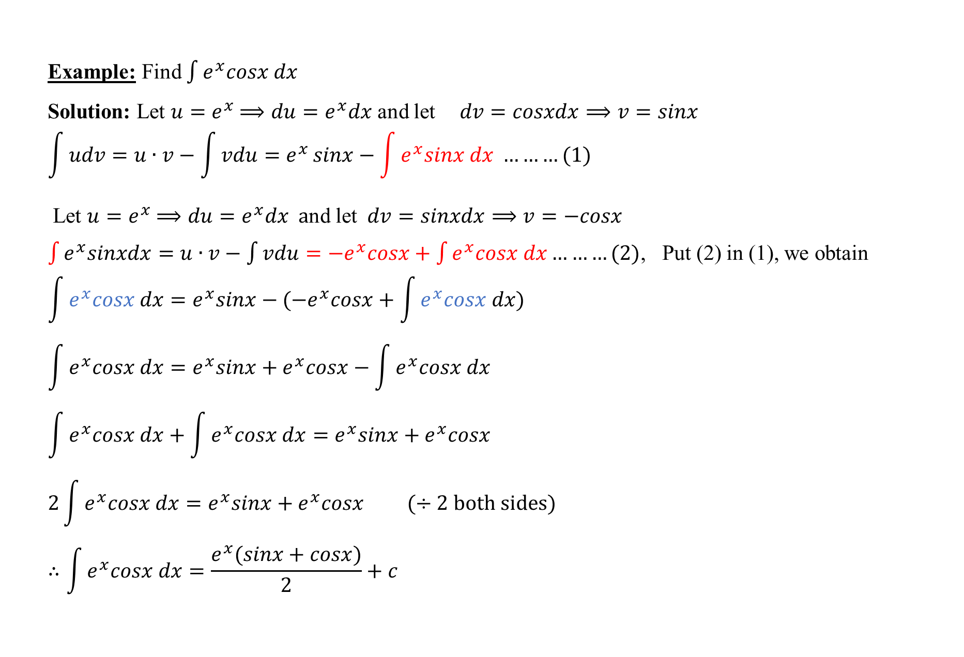
Example: Find $\int{e^{x}cosx dx}$
Solution: Let $u=e^{x}$ $⟹du=e^{x}dx$ and let $dv=cosxdx⟹v=sinx$
$$\int{udv=u∙v−\int{vdu}=e^{x}}sinx−\int{e^{x}sinx dx} ………(1)$$
Let $u=e^{x}$ $⟹du=e^{x}dx a$nd let $dv=sinxdx⟹v=−cosx$
$\int{e^{x}sinxdx=u∙v−\int{vdu}={−e}^{x}cosx+\int{e^{x}cosx dx}}………(2)$, Put (2) in (1), we obtain
$$\int{e^{x}cosx dx=e^{x}sinx−(−e^{x}cosx+\int{e^{x}cosx dx)}}$$
$$\int{e^{x}cosx dx}=e^{x}sinx+e^{x}cosx−\int{e^{x}cosx dx}$$
$$\int{e^{x}cosx dx}+\int{e^{x}cosx dx}=e^{x}sinx+e^{x}cosx$$
$${2\int{e^{x}cosx dx}=e}^{x}sinx+e^{x}cosx (÷2 both sides)$$
$$∴\int{e^{x}cosx dx}=\frac{e^{x}(sinx+cosx)}{2}+c$$

Slide 7
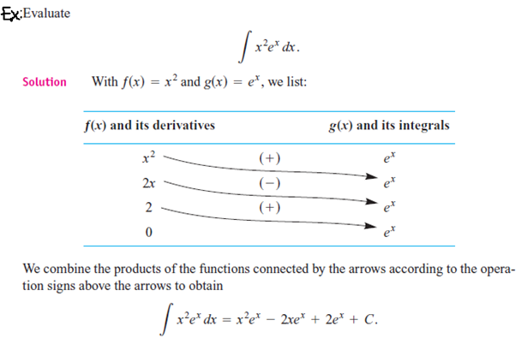

Slide 8
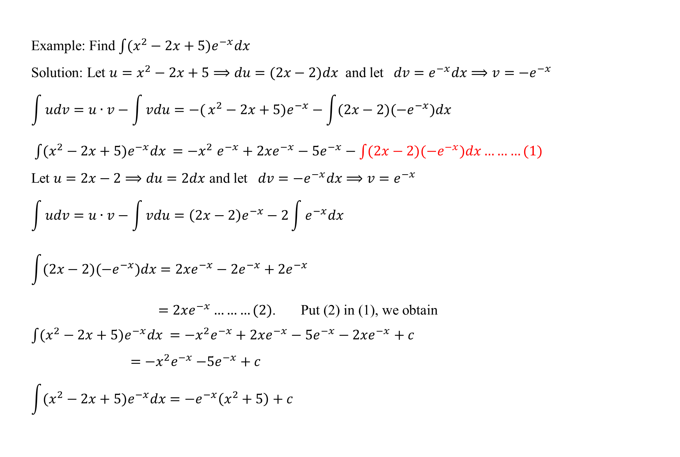
Example: Find$\int{(x^{2}−2x+5)e^{−x}dx}$
Solution: Let $u=x^{2}−2x+5⟹du=(2x−2)dx$ and let $dv=e^{−x}dx⟹v=−e^{−x}$
$$\int{udv=u∙v−\int{vdu}=−(}x^{2}−2x+5)e^{−x}−\int{(2x−2){(−e}^{−x})dx}$$
$\int{(x^{2}−2x+5)e^{−x}dx}$ ${=−x}^{2}e^{−x}+2xe^{−x}−5e^{−x}−\int{(2x−2){(−e}^{−x})dx………(1)}$
Let $u=2x−2⟹du=2dx$ and let $dv={−e}^{−x}dx⟹v=e^{−x}$
$$\int{udv=u∙v−\int{vdu}=\left(2x−2\right)e^{−x}−2\int{e^{−x}dx}}$$
$$\int{(2x−2){(−e}^{−x})dx}=2xe^{−x}−2e^{−x}+2e^{−x}$$
$=2xe^{−x}………(2)$. Put (2) in (1), we obtain
${\int{(x^{2}−2x+5)e^{−x}dx} =−x}^{2}e^{−x}+2xe^{−x}−5e^{−x}−2xe^{−x}+c$
${ =−x}^{2}e^{−x}$ $−5e^{−x}+c$
$$\int{(x^{2}−2x+5)e^{−x}dx}=−e^{−x}\left(x^{2}+5\right)+c$$

Slide 9
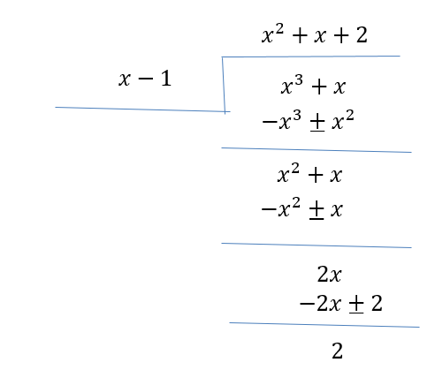
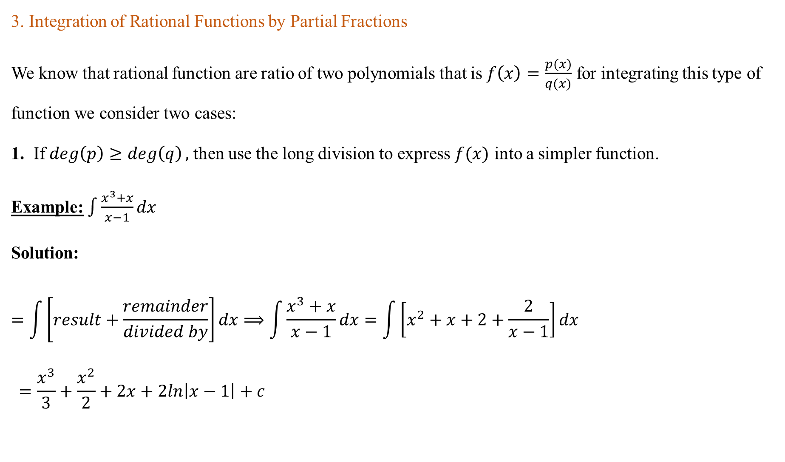
3. Integration of Rational Functions by Partial Fractions
We know that rational function are ratio of two polynomials that is $f\left(x\right)=\frac{p(x)}{q(x)}$ for integrating this type of function we consider two cases:
1. If $\deg\left(p\right)≥\deg\left(q\right),$ then use the long division to express $f(x)$ into a simpler function.
Example:$\int{\frac{x^{3}+x}{x−1}dx}$
Solution:
$$=\int{\left[result+\frac{remainder}{divided by}\right]dx⟹\int{\frac{x^{3}+x}{x−1}dx}=\int{\left[x^{2}+x+2+\frac{2}{x−1}\right]dx}}$$
$$=\frac{x^{3}}{3}+\frac{x^{2}}{2}+2x+2ln\left|x−1\right|+c$$

Slide 10
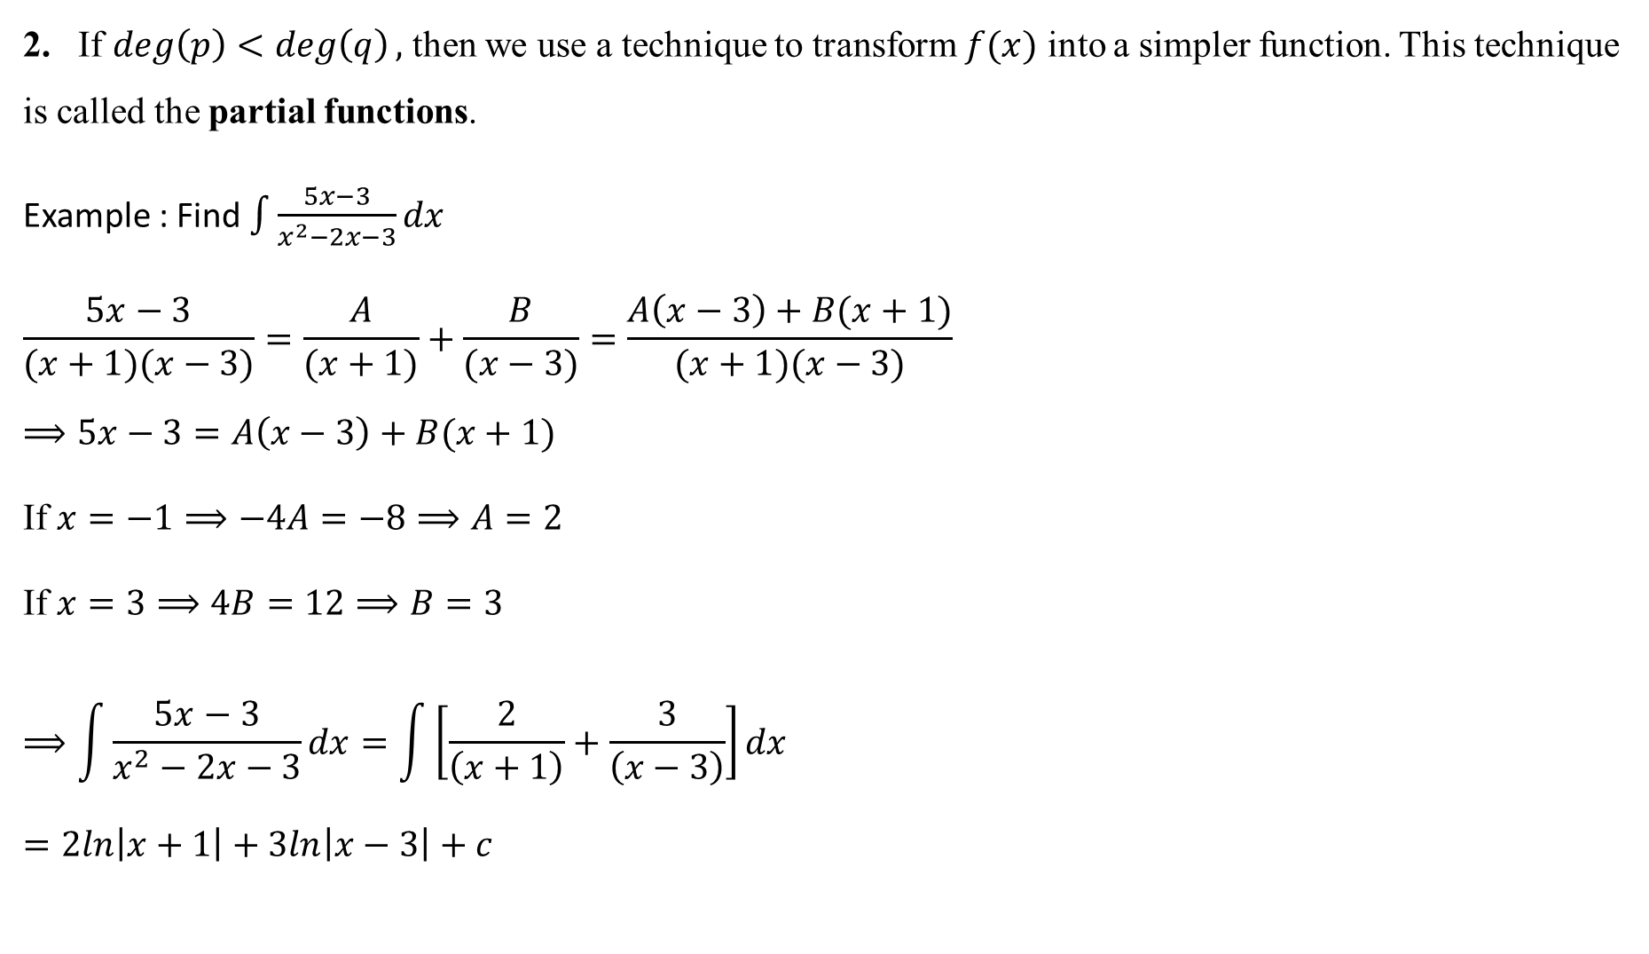
2. If $\deg\left(p\right)<\deg\left(q\right),$ then we use a technique to transform $f(x)$ into a simpler function. This technique is called the partial functions.
Example : Find $\int{\frac{5x−3}{x^{2}−2x−3}dx}$
$$\frac{5x−3}{(x+1)(x−3)}=\frac{A}{(x+1)}+\frac{B}{(x−3)}=\frac{A\left(x−3\right)+B(x+1)}{(x+1)(x−3)}$$
$$⟹5x−3=A\left(x−3\right)+B(x+1)$$
If $x=−1⟹−4A=−8⟹A=2$
If $x=3⟹4B=12⟹B=3$
$$⟹\int{\frac{5x−3}{x^{2}−2x−3}dx=\int{\left[\frac{2}{\left(x+1\right)}+\frac{3}{\left(x−3\right)}\right]dx}}$$
$$=2ln\left|x+1\right|+3ln\left|x−3\right|+c$$

Slide 11
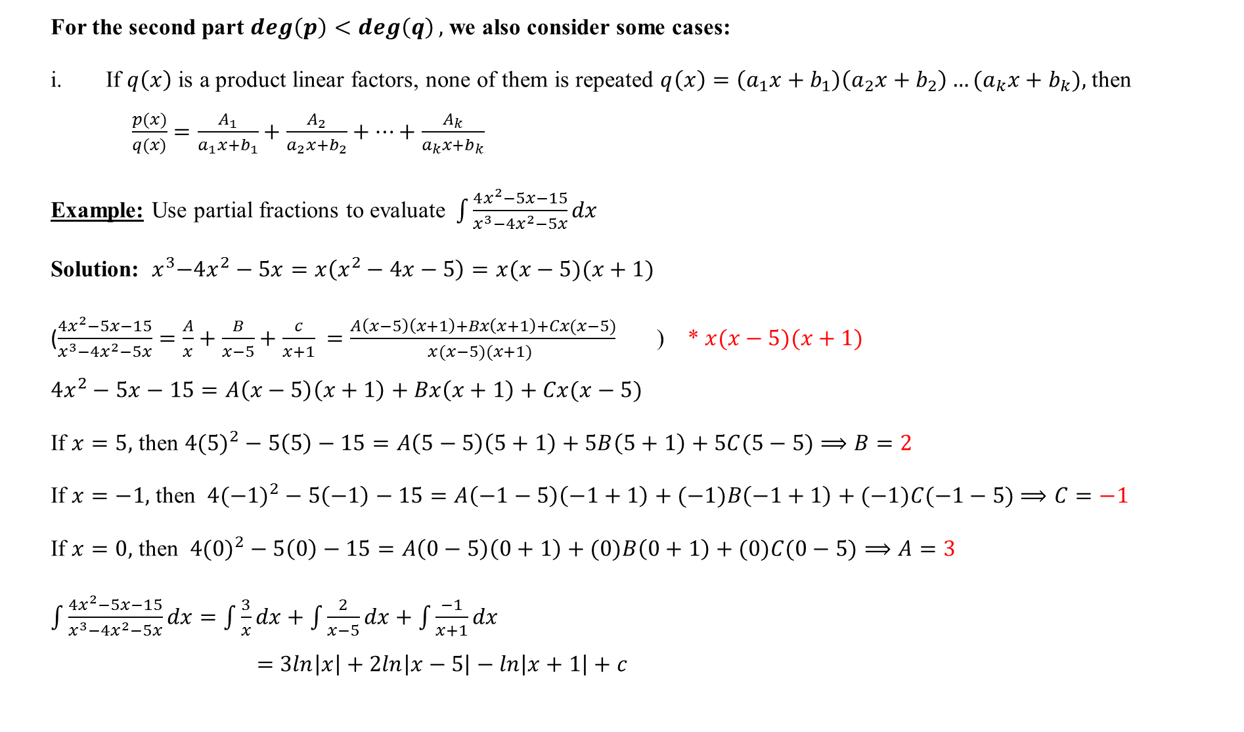
For the second part $\deg\left(p\right)<\deg\left(q\right),$ we also consider some cases:
If $q\left(x\right)$ is a product linear factors, none of them is repeated $q\left(x\right)=\left(a_{1}x+b_{1}\right)\left(a_{2}x+b_{2}\right)…{(a}_{k}x+b_{k}),$ then $\frac{p(x)}{q(x)}=\frac{A_{1}}{a_{1}x+b_{1}}+\frac{A_{2}}{a_{2}x+b_{2}}+…+\frac{A_{k}}{a_{k}x+b_{k}}$
Example: Use partial fractions to evaluate$\int{\frac{4x^{2}−5x−15}{x^{3}−4x^{2}−5x}dx}$
Solution: ${ x}^{3}−4x^{2}−5x=x\left(x^{2}−4x−5\right)=x(x−5)(x+1)$
($\frac{4x^{2}−5x−15}{x^{3}−4x^{2}−5x}=\frac{A}{x}+\frac{B}{x−5}+\frac{c}{x+1} =\frac{A\left(x−5\right)\left(x+1\right)+Bx\left(x+1\right)+Cx(x−5)}{x(x−5)(x+1) }$ ) * $x(x−5)(x+1)$
$$4x^{2}−5x−15=A\left(x−5\right)\left(x+1\right)+Bx\left(x+1\right)+Cx(x−5)$$
If $x=5,$ then $4(5)^{2}−5\left(5\right)−15=A\left(5−5\right)\left(5+1\right)+5B\left(5+1\right)+5C(5−5)$ $⟹B=2$
If $x=−1,$ then $4(−1)^{2}−5\left(−1\right)−15=A\left(−1−5\right)\left(−1+1\right)+(−1)B\left(−1+1\right)+(−1)C(−1−5)$ $⟹C=−1$
If $x=0,$ then $4(0)^{2}−5\left(0\right)−15=A\left(0−5\right)\left(0+1\right)+(0)B\left(0+1\right)+(0)C(0−5)⟹A=3$
$\int{\frac{4x^{2}−5x−15}{x^{3}−4x^{2}−5x}dx=\int{\frac{3}{x}dx+\int{\frac{2}{x−5}dx+\int{\frac{−1}{x+1}dx}}}}$
$$=3ln\left|x\right|+2ln\left|x−5\right|−ln\left|x+1\right|+c$$

Slide 12
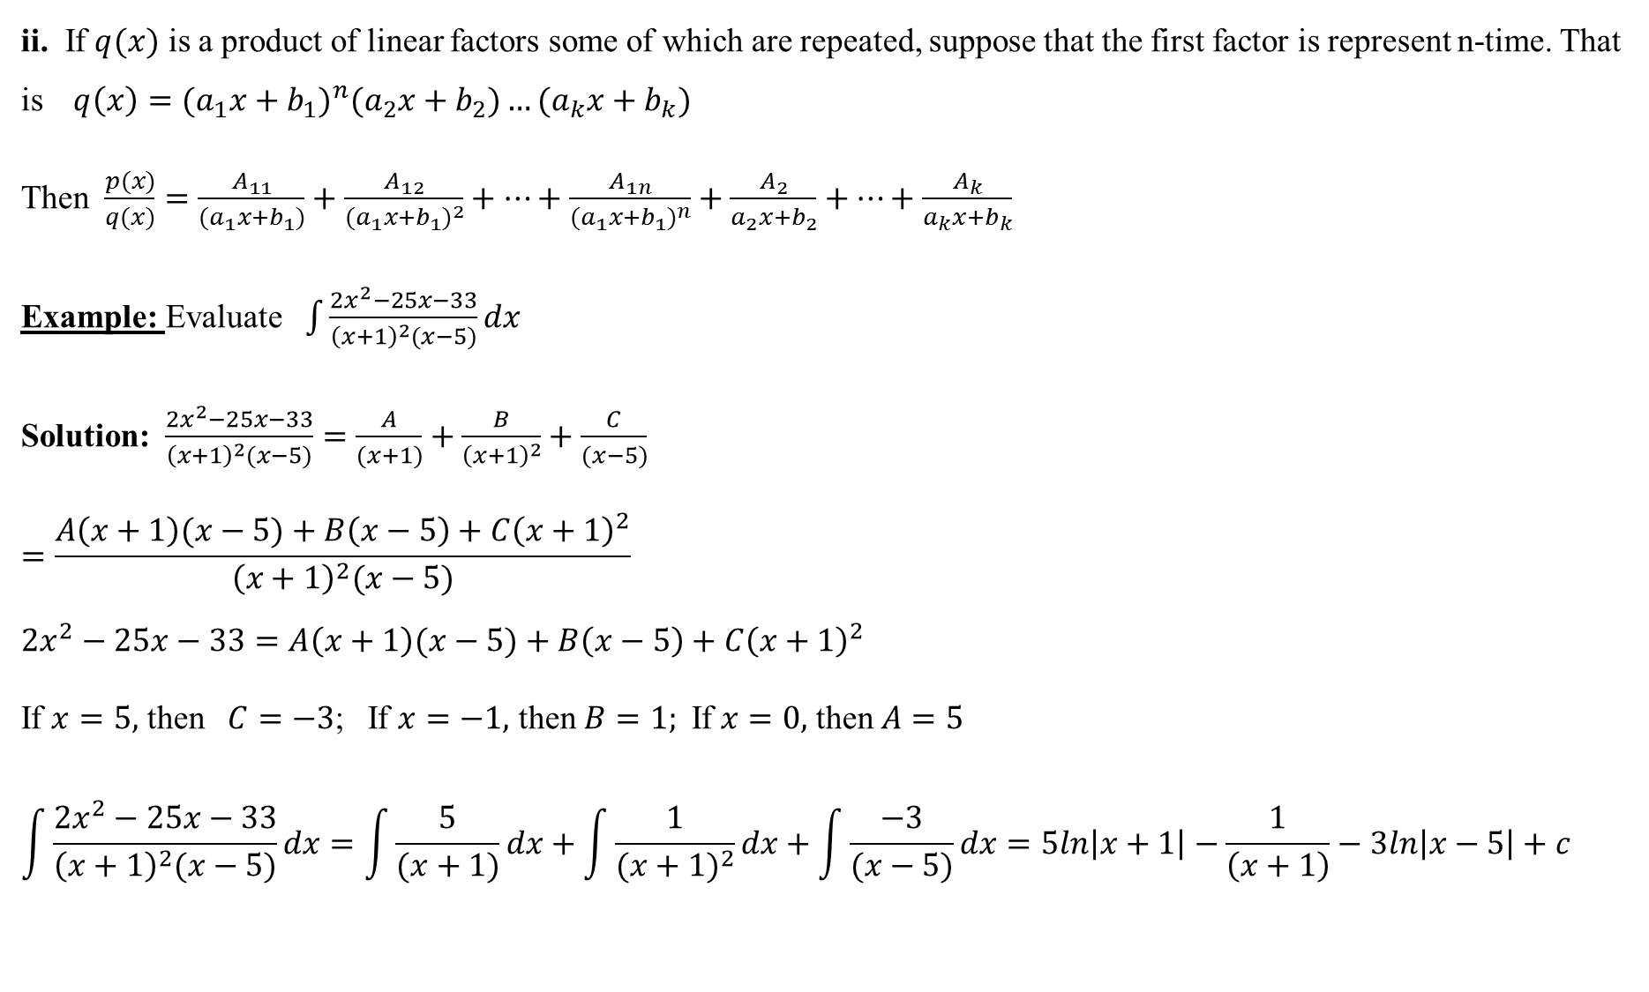
ii. If $q(x)$ is a product of linear factors some of which are repeated, suppose that the first factor is represent n-time. That is $q\left(x\right)={{(a}_{1}x+b_{1})}^{n}{(a}_{2}x+b_{2})…{(a}_{k}x+b_{k})$
Then $\frac{p(x)}{q(x)}=\frac{A_{11}}{{(a}_{1}x+b_{1})}+\frac{A_{12}}{{(a_{1}x+b_{1})}^{2}}+…+\frac{A_{1n}}{{(a_{1}x+b_{1})}^{n}}+\frac{A_{2}}{a_{2}x+b_{2}}+…+\frac{A_{k}}{a_{k}x+b_{k}}$
Example: Evaluate$\int{\frac{2x^{2}−25x−33}{{\left(x+1\right)}^{2}(x−5)}dx}$
Solution:$\frac{2x^{2}−25x−33}{{\left(x+1\right)}^{2}(x−5)}=\frac{A}{(x+1)}+\frac{B}{{\left(x+1\right)}^{2}}+\frac{C}{(x−5)}$
$$=\frac{A\left(x+1\right)(x−5)+B\left(x−5\right)+C{\left(x+1\right)}^{2}}{{\left(x+1\right)}^{2}(x−5)}$$
$$2x^{2}−25x−33=A\left(x+1\right)(x−5)+B\left(x−5\right)+C{\left(x+1\right)}^{2}$$
If $x=5,$ then$C=−3$; If $x=−1,$ then$B=1;$If $x=0,$ then $A=5$
$$\int{\frac{2x^{2}−25x−33}{{\left(x+1\right)}^{2}(x−5)}dx}=\int{\frac{5}{(x+1)}dx+\int{\frac{1}{{(x+1)}^{2}}dx+\int{\frac{−3}{(x−5)}dx}}}=5ln\left|x+1\right|−\frac{1}{\left(x+1\right)}−3ln\left|x−5\right|+c$$

Slide 13
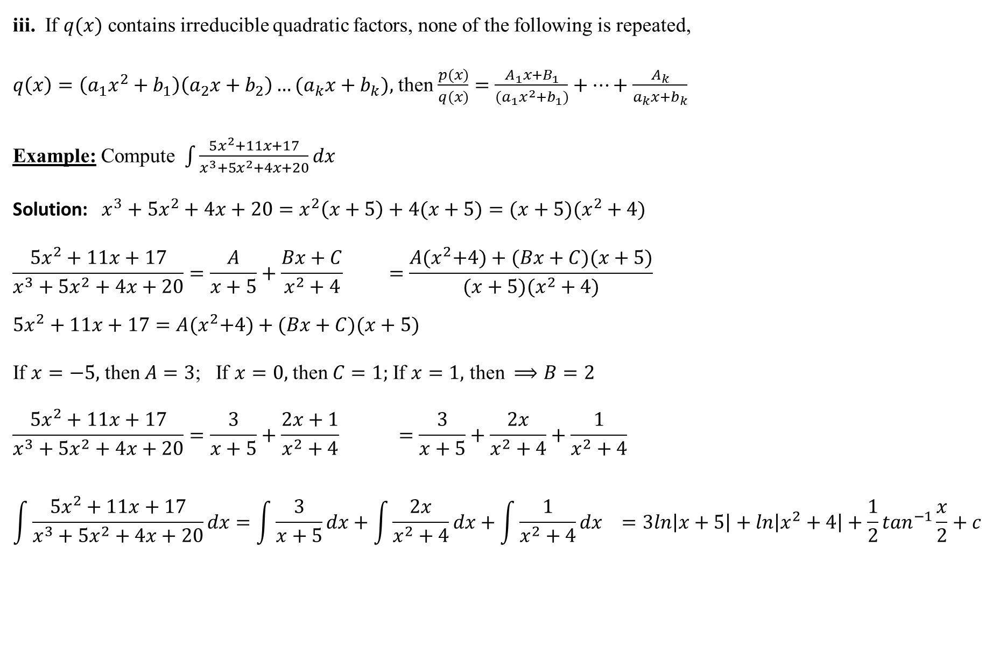
iii. If $q(x)$ contains irreducible quadratic factors, none of the following is repeated,
$q\left(x\right)=\left(a_{1}x^{2}+b_{1}\right)\left(a_{2}x+b_{2}\right)…{(a}_{k}x+b_{k}),$ then$\frac{p(x)}{q(x)}=\frac{A_{1}x+B_{1}}{{(a}_{1}x^{2}+b_{1})}+…+\frac{A_{k}}{a_{k}x+b_{k}}$
Example: Compute$\int{\frac{5x^{2}+11x+17}{x^{3}+5x^{2}+4x+20}dx}$
Solution: $x^{3}+5x^{2}+4x+20=x^{2}\left(x+5\right)+4(x+5)=(x+5)(x^{2}+4)$
$$\frac{5x^{2}+11x+17}{x^{3}+5x^{2}+4x+20}=\frac{A}{x+5}+\frac{Bx+C}{x^{2}+4} =\frac{A{(x}^{2}+4)+(Bx+C)(x+5)}{(x+5)(x^{2}+4)}$$
$$5x^{2}+11x+17=A{(x}^{2}+4)+(Bx+C)(x+5)$$
If $x=−5,$ then $A=3$; If $x=0,$ then $C=1;$If $x=1,$ then $⟹B=2$
$$\frac{5x^{2}+11x+17}{x^{3}+5x^{2}+4x+20}=\frac{3}{x+5}+\frac{2x+1}{x^{2}+4} =\frac{3}{x+5}+\frac{2x}{x^{2}+4}+\frac{1}{x^{2}+4}$$
$$\int{\frac{5x^{2}+11x+17}{x^{3}+5x^{2}+4x+20}dx}=\int{\frac{3}{x+5}dx+\int{\frac{2x}{x^{2}+4}dx+\int{\frac{1}{x^{2}+4}dx}}} =3ln\left|x+5\right|+ln\left|x^{2}+4\right|+\frac{1}{2}\tan^{−1}\frac{x}{2}+c$$

Slide 14
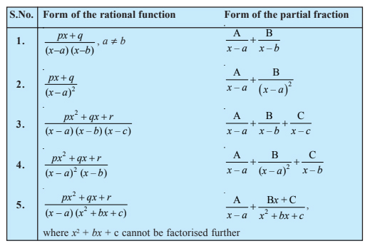
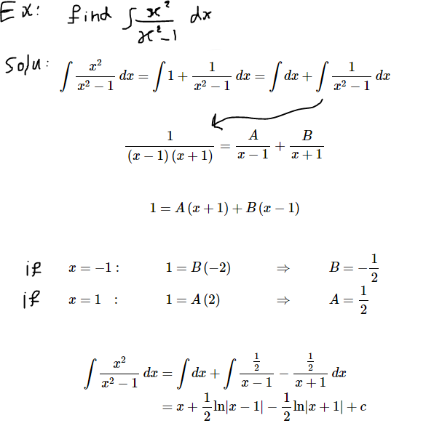

Slide 15
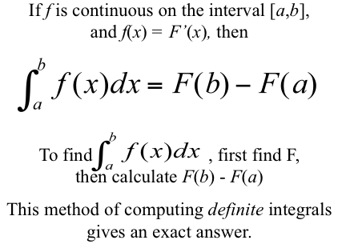
Finding Area by integration:

Slide 16
