Slide 1
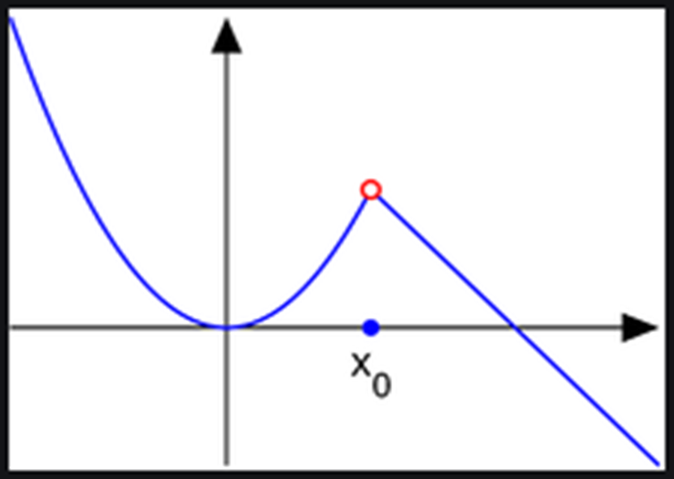
Continuity of function

Slide 2
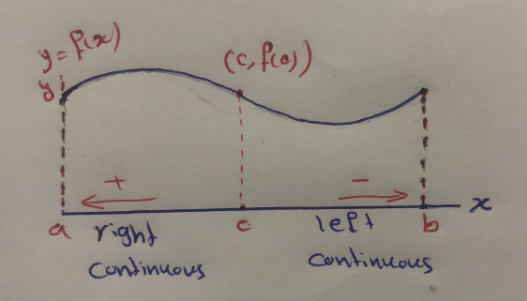

Def. A function $f$ is continuous at a point $c$ of its domain if $\lim_{x→c}{f\left(x\right)=f(c)},$ this mean that
1. $f(c)$ is defined $\left(c∈D_{f}\right).$
2. $\lim_{x→c}{f\left(x\right)}$ exists ($\lim_{x→c+}{f\left(x\right)}$= $\lim_{x→c−}{f\left(x\right)}$).
3. $\lim_{x→c}{f\left(x\right)=f(c)}$.
Otherwise, we say $f$ is not continuous (discontinuous) at $c$ either
1. $\lim_{x→c}{f\left(x\right)}$ dose not exist.
2. $\lim_{x→c}{f\left(x\right)≠f(c)}$.

Slide 3
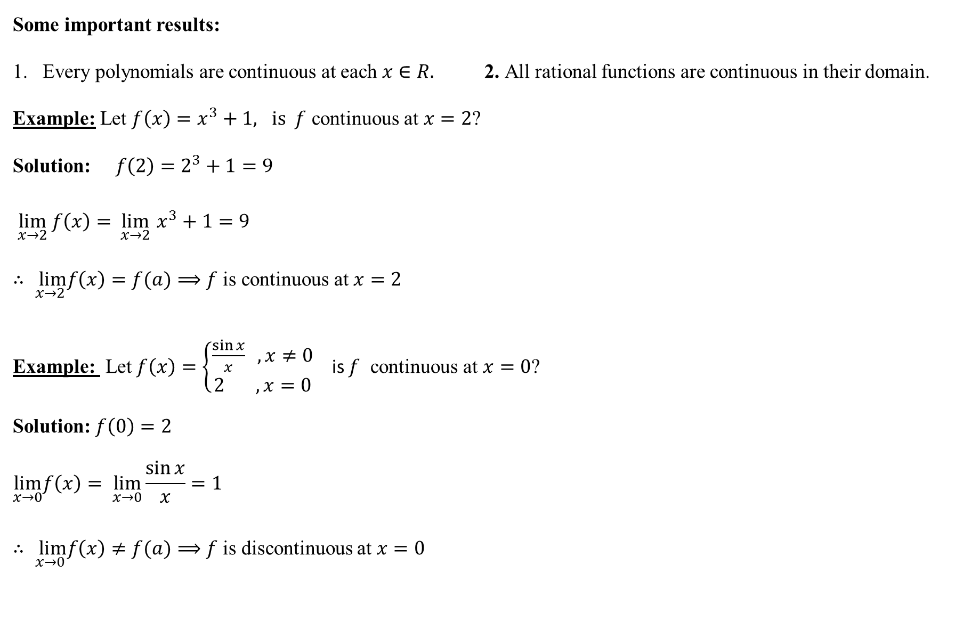
Some important results:
Every polynomials are continuous at each $x∈R.$ 2. All rational functions are continuous in their domain.
Example: Let $f\left(x\right)=x^{3}+1, is f$ continuous at $x=2$?
Solution: $f\left(2\right)=2^{3}+1=9$
$\lim_{x→2} f\left(x\right)=\lim_{x→2}{x^{3}+1=9}$
$∴ \lim_{x→2}f\left(x\right)=f(a)⟹f$ is continuous at $x=2$
Example: Let $f\left(x\right)=\left\{\begin{aligned}\frac{\sin{x}}{x} ,x≠0 \\ 2 ,x=0\end{aligned}\right.$ is $f$ continuous at $x=0$?
Solution: $f\left(0\right)=2$
$$\lim_{x→0}f\left(x\right)= \lim_{x→0}{\frac{\sin{x}}{x}=1}$$
$∴ \lim_{x→0}f\left(x\right)≠f(a)⟹f$ is discontinuous at $x=0$

Slide 4
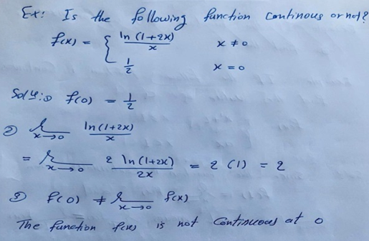


$Example:\text{I}\text{s} f\left(x\right)=\left\{\begin{aligned}\frac{x^{2}−1}{x−1} , x≠1 \\ 2 , x=1\end{aligned}\right.$ continuous at $x=1$?
Solution: $f\left(1\right)=2⟹f$ is defined at $x=1.$
$$\lim_{x→1}f\left(x\right)=\lim_{x→1}{\frac{x^{2}−1}{x−1}=\lim_{x→1}{\frac{(x−1)(x+1)}{x−1}}}$$
$$=\lim_{x→1}{(x+1)=2}$$
So that, $f$ is continuous at $x=1$ because $f\left(1\right)=\lim_{x→1}{f(x)}$

Slide 5
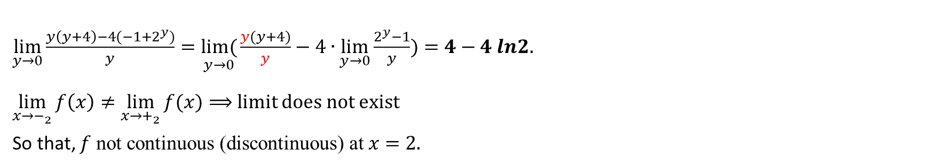

Example: Let$f\left(x\right)=\left\{\begin{aligned}\frac{x^{2}−2^{x}}{x−2} , x>2 \\ 4lnx , x≤2\end{aligned}\right.$ is $f$ continuous at $x=2 ?$
Solution: $f(c)=f\left(2\right)=4ln2$
$$\lim_{x→−_{2}} f\left(x\right)=\lim_{x→2}{ 4lnx=4ln2}$$
$$\underset{x→+_{2 }}{lim f(x)} = \lim_{x→2}{\frac{x^{2}−2^{x}}{x−2}=\frac{0}{0}}$$
Let $y=x−2, x=y+$2 when $x→2,$ then y$→0$
$$\lim_{y→0}{\frac{{(y+2)}^{2}−2^{(y+2)}}{y}}=\lim_{y→0}{\frac{y^{2}+4y+4−2^{y}∙2^{2}}{y}}$$
$\lim_{y→0}{\frac{y\left(y+4\right)−4(−1+2^{y})}{y}}=\underset{y→0}{lim(}{\frac{y(y+4)}{y}−4∙\lim_{y→0}{\frac{2^{y}−1}{y}}})=4−4 ln2.$
$\lim_{x→−_{2}}{f\left(x\right)≠\lim_{x→+_{2}}{f(x)}}⟹$limit does not exist
So that, $f \text{not} \text{continuous} \text{(}\text{discontinuous}\text{) }\text{at} x=2.$

Slide 6

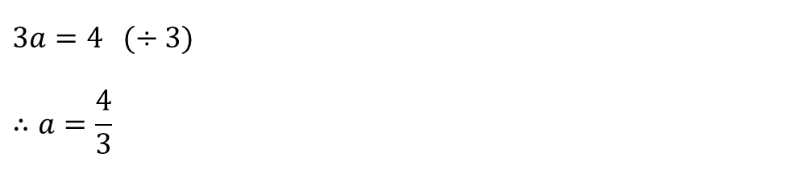

Example: Find the value of the constants $a$ such that the function $f\left(x\right)=\left\{\begin{aligned}ax^{2} , x≤2 \\ 2x+a , x>2\end{aligned}\right.$
is continuous at $x=2?$
Solution: $f\left(2\right)=a({2)}^{2}=4a$
$$\lim_{x→+_{2}}f\left(x\right)=\lim_{x→2}{2x+a=4+a}$$
$$\lim_{x→−_{2}}f(x){=\lim_{x→2} a({x)}^{2}=4a }$$
Since $f$ is continuous at $x=2,$ we have ($\lim_{x→c+}{f\left(x\right)}$ = $\lim_{ x→c−}{f\left(x\right)}$)
$$4a=4+a⟹4a−a=4$$
$$3a=4 (÷3)$$
$$∴a=\frac{4}{3}$$

Slide 7
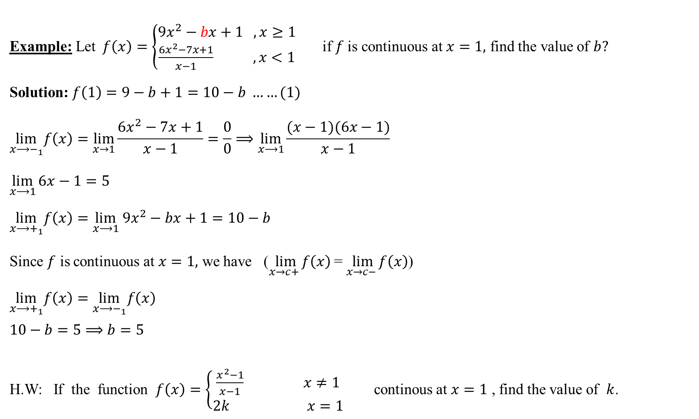
Example: Let$f\left(x\right)=\left\{\begin{aligned}9x^{2}−bx+1 , x≥1 \\ \frac{6x^{2}−7x+1}{x−1} , x<1\end{aligned}\right.$ if $f$is continuous at $x=1,$ find the value of $b?$
Solution: $f\left(1\right)=9−b+1=10−b ……(1)$
$$\lim_{x⟶−_{1}}f\left(x\right)=\lim_{x→1}{\frac{6x^{2}−7x+1}{x−1}=\frac{0}{0}⟹\lim_{x⟶1}{\frac{(x−1)(6x−1)}{x−1}}}$$
$$\lim_{x⟶1}{6x−1=5}$$
$$\lim_{x⟶+_{1}}f\left(x\right)=\lim_{x⟶1} 9x^{2}−bx+1=10−b$$
Since $f$ is continuous at $x=1,$ we have ($\lim_{x→c+}{f\left(x\right)}$ = $\lim_{x→c−}{f\left(x\right)}$)
$$\lim_{x⟶+_{1}}f\left(x\right)=\lim_{x⟶−_{1}}f\left(x\right)$$
$$10−b=5⟹b=5$$
H.W: If the function $f\left(x\right)=\left\{\begin{matrix}\frac{x^{2}−1}{x−1} x≠1 \\ 2k x=1\end{matrix}\right.$ continous at $x=1$ , find the value of $k$.

Slide 8

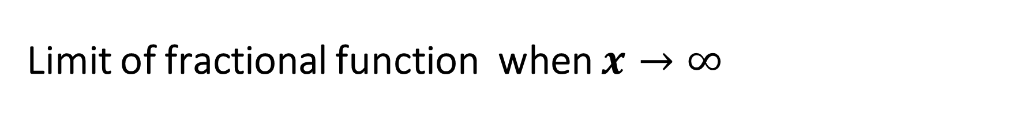
Limit of fractional function when $x→∞$
$$\lim_{x→∞}{\frac{3x^{2}+2x+1}{5x^{2}+3}=\frac{3}{5}}$$
$$\lim_{x→∞}{\frac{x+1}{5x^{2}+3}=0}$$
$$\lim_{x→∞}{\frac{x^{3}+1}{x+2}=∞}$$

Slide 9

Types of Discontinuity:
1. Removable discontinuity: $f(x)$ has a removable discontinuity at $x=a$ iff
i. $\lim_{x→a}{f(x)}$ exist ii. $f(a)$ exist iii. They are not equal
2. Jump discontinuity: limit exist from both sides left and right, but not equal.
3. Infinite discontinuity: limits for both sides left and right are $∞.$
4. Oscillation discontinuity: neither left nor right limit exist.

