Slide 1
Cache Memory
Mapping Function

Slide 2
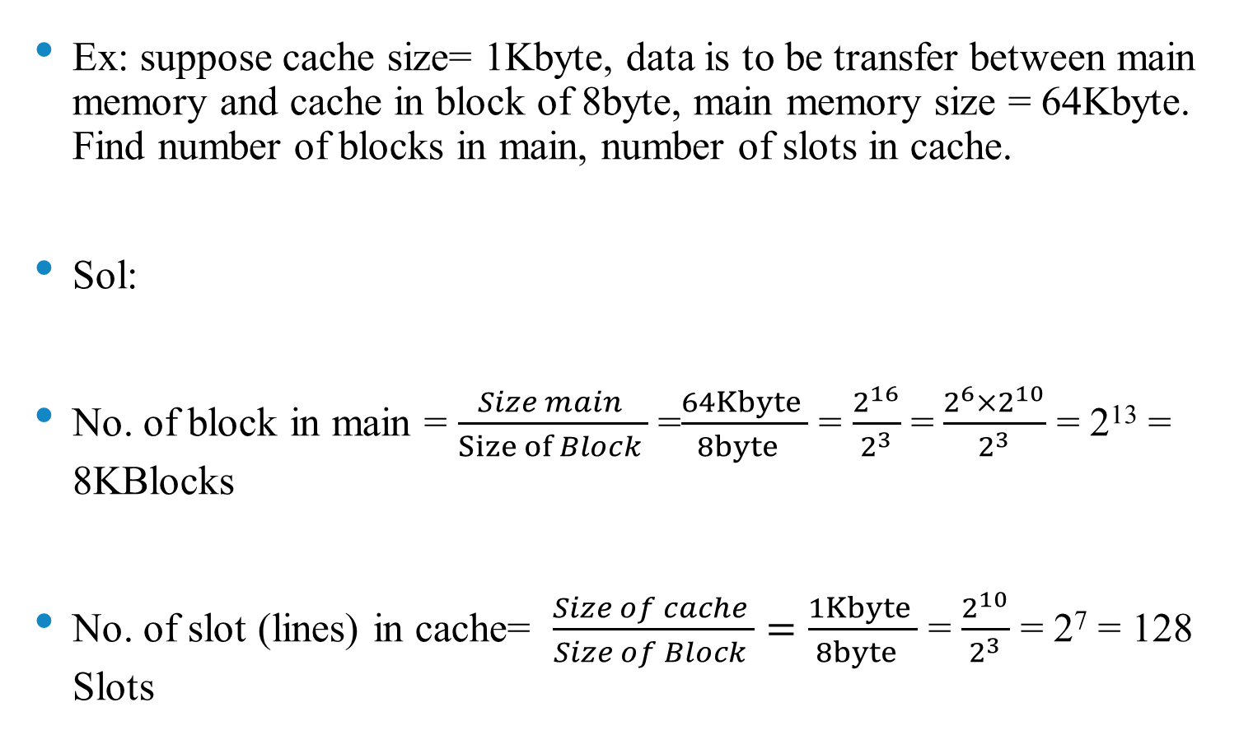
Mapping Function
Ex: suppose cache size= 1Kbyte, data is to be transfer between main memory and cache in block of 8byte, main memory size = 64Kbyte. Find number of blocks in main, number of slots in cache.
Sol:
No. of block in main = $\frac{Size main }{Size of Block }$ =$\frac{64Kbyte }{8byte }$ = $\frac{2^{16}}{2^{3}}$ =$\frac{2^{6}×2^{10}}{2^{3}}$ = 2¹³ = 8KBlocks
No. of slot (lines) in cache= $\frac{Size of cache }{Size of Block }=\frac{1Kbyte }{8byte }$ = $\frac{2^{10}}{2^{3}}$ = 2⁷ = 128 Slots

Slide 3
Associative
The fastest and most flexible cache organization uses it.
The associative memory stores both the address and content (data) of the memory word.
Permits to store at any location in cache any word from main memory.
A main memory block can be load (mapped) in any slot in the cache. Such as block0 can be mapped in slot 0, or slote1, or any other slot in the cache.

Slide 4
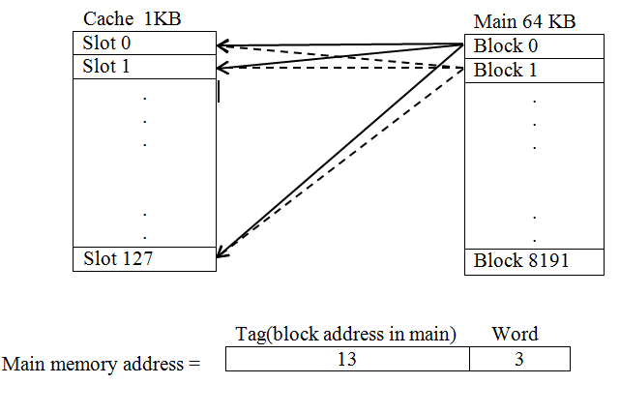

Slide 5
Associative
Tag: identifies which particular block is currently being stored.
The tag is usually a portion of the main memory address
The main memory address in this method will be in two parts
main memory address consist of 16 bits(64 kB), and the block (8 byte )can represent it by 3 bits, therefore the tag will be represent by 13 bits.
The CPU sends an address for word to the cache
If there is a match, then the word part will be picked up from the words part in block
If there is no match, then by the tag part the CPU will fetch the specified block from the main memory

Slide 6
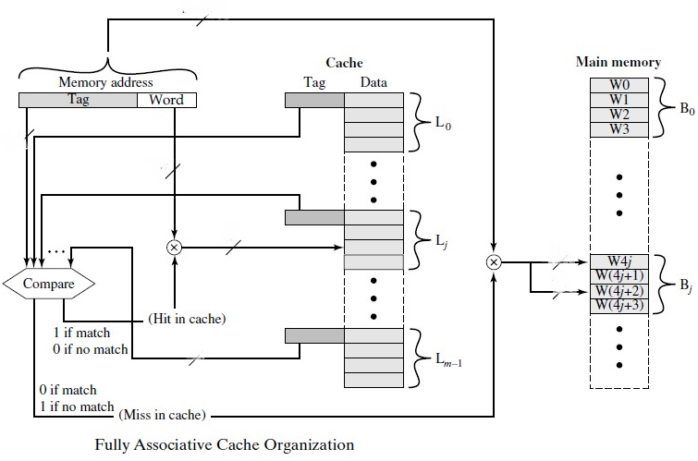

Slide 7
Direct Mapping
Maps each block of main memory into only one possible cache line
The mapping is expressed as S = A modulo C
Where
S= cache line (slot) number
A= main memory block number
C= number of lines (slots) in the cache
According to example:
Block0 S= 0modulo 128 S=0
Block1 S= 1modulo 128 S=1
:
Block127 S= 127modulo 128 S=127
Block128 S= 128 modulo 128 S=0
Block129 S= 129modulo 128 S=1

Slide 8
Direct Mapping
Therefore
Block 0,128,256,384………….. Mapping on slot 0
Block 1,129,257,385………….. Mapping on slot 1
:
Block 127, 255… 8191………. Mapping on slot 127

Slide 9
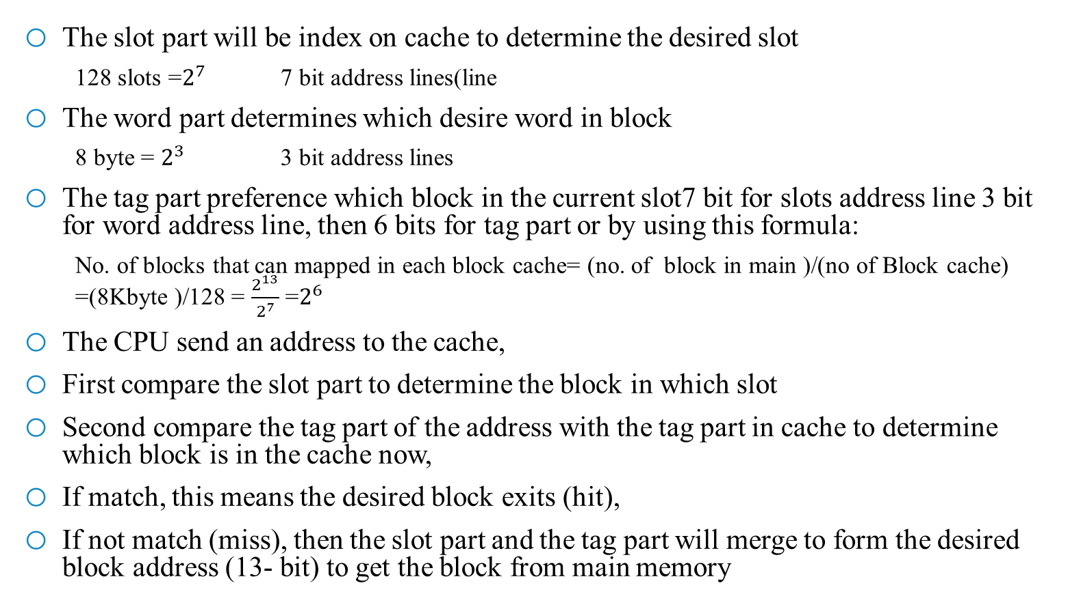
Direct Mapping
The slot part will be index on cache to determine the desired slot
128 slots =$2^{7}$ 7 bit address lines(line
The word part determines which desire word in block
8 byte = $2^{3}$ 3 bit address lines
The tag part preference which block in the current slot7 bit for slots address line 3 bit for word address line, then 6 bits for tag part or by using this formula:
No. of blocks that can mapped in each block cache= (no. of block in main )/(no of Block cache) =(8Kbyte )/128 = $\frac{2^{13}}{2^{7}}$ =$2^{6}$
The CPU send an address to the cache,
First compare the slot part to determine the block in which slot
Second compare the tag part of the address with the tag part in cache to determine which block is in the cache now,
If match, this means the desired block exits (hit),
If not match (miss), then the slot part and the tag part will merge to form the desired block address (13- bit) to get the block from main memory

Slide 10
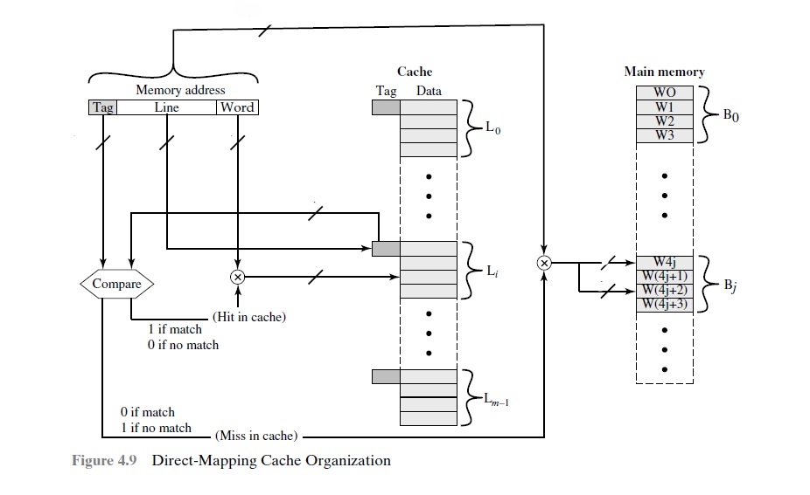
Direct Mapping

