Slide 1
Computer Organization and Architecture

Slide 2
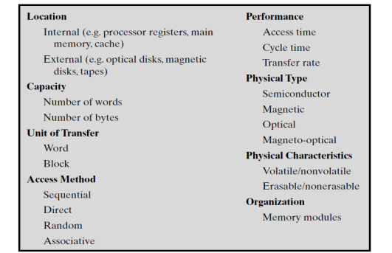
Characteristics of Memory Systems.
Classify memory systems according to their key characteristics is made memory more manageable.

Slide 3
Characteristics of Memory Systems.
Location: refers to whether memory is internal and external to the computer.
Internal memory: main memory, Registers and cache.
External memory consists of peripheral storage devices, such as disk and tape that are accessible to the processor via I/O controllers.
Capacity:
Internal memory is typically expressed in terms of bytes (1 byte = 8 bits) or words.
Common word lengths are 8, 16, and 32 bits.
External memory capacity is typically expressed in terms of bytes

Slide 4
Characteristics of Memory Systems.
Unit of transfer:
Internal memory the unit of transfer is equal to the number of electrical lines into and out of the memory module. This may be equal to the word length or larger, such as 64, 128, or 256 bits.
Three related concepts for internal memory are there.
Word: The unit of organization of memory.
The size of the word is typically equal to the number of bits used to represent an integer and to the instruction length.
The Intel x86 architecture has a wide variety of instruction lengths, expressed as multiples of bytes, and a word size of 32 bits.

Slide 5
Characteristics of Memory Systems.
Addressable units: In some systems,
The addressable unit is the word.
Many systems allow addressing at the byte level.
The relationship between the length in bits A of an address and the number N of addressable units is 2^{A}=N.
Unit of transfer: For main memory
This is the number of bits read out or written into memory at a time.
The unit of transfer need not equal a word or an addressable unit.
For external memory, data are often transferred in much larger units than a word, and these are referred to as blocks.

Slide 6
Characteristics of Memory Systems.
Method of accessing units of data: These include the following:
Sequential access:
Memory is organized into units of data called records.
Access must be made in a specific linear sequence.
Store addressing information is used to separate records and assist in the retrieval process.
A shared read– write mechanism is used and this must be moved from its current location to the desired location, passing and rejecting each intermediate record.
The time to access an arbitrary record is highly variable. Like tape units

Slide 7
Characteristics of Memory Systems.
Direct access:
As with sequential access, direct access involves a shared read–write mechanism.
Individual blocks or records have a unique address based on physical location.
Access is accomplished by direct access to reach general vicinity plus sequential searching, counting, or waiting to reach the final location.
Access time is variable. Like disk unit

Slide 8
Characteristics of Memory Systems.
Random access:
Each addressable location in memory has a unique, physically wired-in addressing mechanism.
The time to access a given location is independent of the sequence of prior accesses and is constant.
Any location can be selected at random and directly addressed and accessed.
Main memory and some cache systems are random access.

Slide 9
Characteristics of Memory Systems.
Associative:
This a random access type of memory that enables one to make a comparison of desired bit locations within a word for a specified match, and to do this for all words simultaneously.
A word is retrieved based on a portion of its contents rather than its address.
As with ordinary random-access memory each location has its own addressing mechanism,
Retrieval time is constant independent of location or prior access patterns.
Cache memories may employ associative access.

Slide 10
Characteristics of Memory Systems.
Performance: The parameters that are used
Access time (latency):
For random-access memory, represent time it takes to perform a read or write operation
For non-random-access memory, access time is the time it takes to position the read–write mechanism at the desired location.
Memory cycle time: This concept applied to random-access memory and consists of the access time plus any additional time required before a second access can commence. Note that memory cycle time is concerned with the system bus, not the processor.

Slide 11
Characteristics of Memory Systems.
Transfer rate: Rate at which data can be transferred into or out of a memory unit.
For random-access memory, it is equal to 1/ (cycle time).
For non-random-access memory, the following relationship holds:
T_{N}=T_{A}+N/R where
T_{N} = Average time to read or write N bits
T_{A} = Average access time
N = Number of bits
R = Transfer rate, in bits per second (bps)

Slide 12
Characteristics of Memory Systems.
Physical types of memory:
The most common today used are semiconductor memory, magnetic surface memory, used for disk and tape, and optical and magneto-optical.
Physical characteristics: for data storage are important.
In a volatile memory, information is lost when electrical power is switched off.
In a nonvolatile memory, information once recorded remains without any change until changed by user.
Magnetic-surface memories are nonvolatile.
Semiconductor memory may be either volatile or nonvolatile.

Slide 13
Address line (Address Bus)
Address line represent the line that entrance to memory.
It specify the number of locations that can be stored data inside it .
Let the number of line enter to memory is n then
No. of location =2^{n}
No. of line (n) No of location (2^{n})
10 1024=1K
11 2048=2K
20 2²⁰=2¹⁰*2¹⁰=1K*1K=1M

Slide 14
Data line (Data Bus)
The ROM and RAM have same group of output or input data
Or input/output data (that called bidirectional) on the same pin in chip.
The size of store data in each location in memory depend on the data line, some chips have 16-bit, 8-bit, 4-bit, or 1-bit.
The size capacity of chip measure by the number of location multiply by size capacity store in each location.
Let chip have number of locations equal to 1K and each location store 8-bit it will represent the capacity of chip and write in 1K*8 bit .

Slide 15
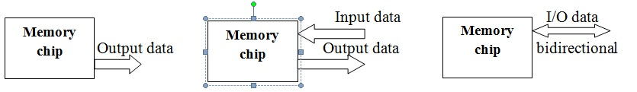
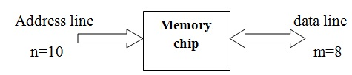

Slide 16
RAM and ROM Chips:
RAM chip is better suited for communication with the CPU.
RAM has one or more control inputs that select the chip only when needed.
RAM has a common feature that is a bidirectional data bus.
A bidirectional data bus allows transferring the data either from memory to CPU during a read operation or from CPU to memory during a write operation.
A bidirectional bus constructed with three-state buffers output :
a signal equivalent to logic 1.
a signal equivalent to logic 0.
or a high-impedance state.

Slide 17
RAM and ROM Chips:
EX: A Ram chip (128 × 8) is used to implement memory
The capacity of the memory is 128 words of 8 bits per word.
It requires a 7-bit address and an 8-bit bidirectional data bus.
The read and write inputs specify the memory operation
The two chips select (CS) control inputs are for enabling the chip only when it is selected by the microprocessor. That facilitates the decoding of the address lines to select the chip when multiple chips are used in the microcomputer.
The read and write inputs are sometimes combined into one line labeled R/W.
When the chip is selected, the two binary states in this line specify the two operations of read or write.

Slide 18
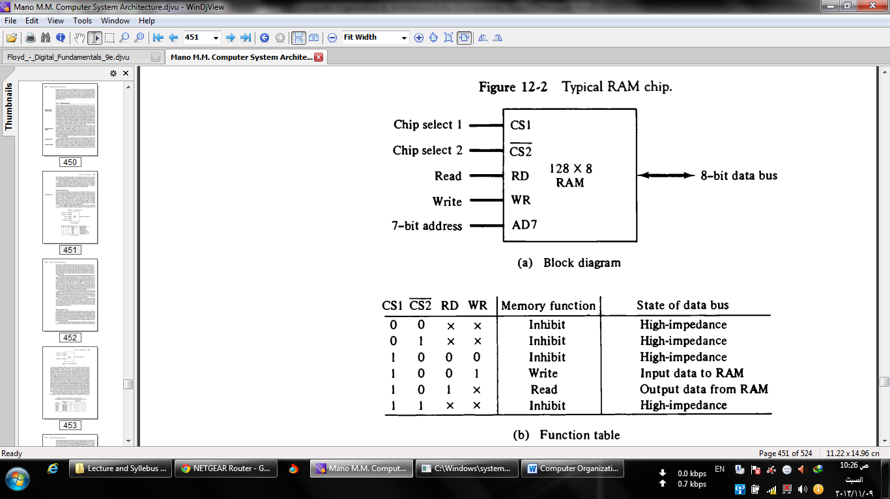
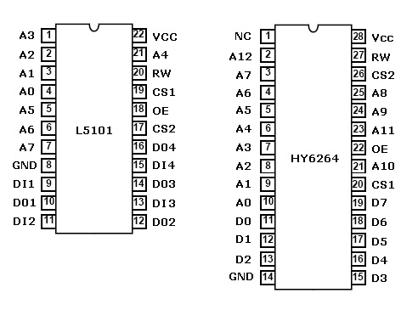

Slide 19
RAM and ROM Chips:
The unit is in operation only when CS1 = 1 and CS2 = 0.
If they are enabled but the read or write inputs are not enabled, the memory is inhibited and its data bus is in a high-impedance state.
Or the memory can be placed in a write or read mode.
If the chip select inputs are not enabled, the memory is inhibited
ROM can only read, the data bus can only be in an output mode.
For the same-size chip, it is possible to have more bits of ROM than of RAM, because the internal binary cells in ROM occupy less space than in RAM.

Slide 20
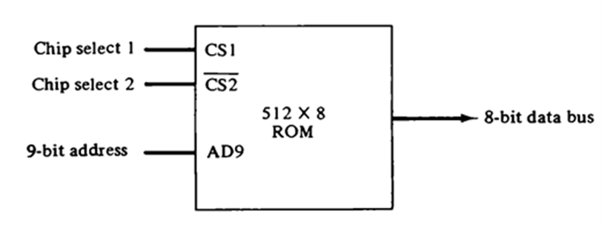
RAM and ROM Chips:
The nine address lines in the ROM chip specify any one of the 512 bytes stored in it.
The two chip select inputs must be CS1 = 1 and CS2 = 0 for the unit to operate.
There is no need for a read or write control because the unit can only read.
When the chip is enabled by the two select inputs, the byte selected by the address lines appears on the data bus.

Slide 21
Memory Address Map
The designer of a computer system must calculate the amount of memory required for the particular application and assign it to either RAM or ROM.
The addressing of memory can be established by means of a table that specifies the memory address assigned to each chip.
The table, called a memory address map, is a pictorial representation of assigned address space for each chip in the system.
Let have this a particular example, assume that a computer system needs 512 bytes of RAM and 512 bytes of ROM. The RAM and ROM chips to be used are specified before.
The memory address map for this configuration is shown in Table down

Slide 22
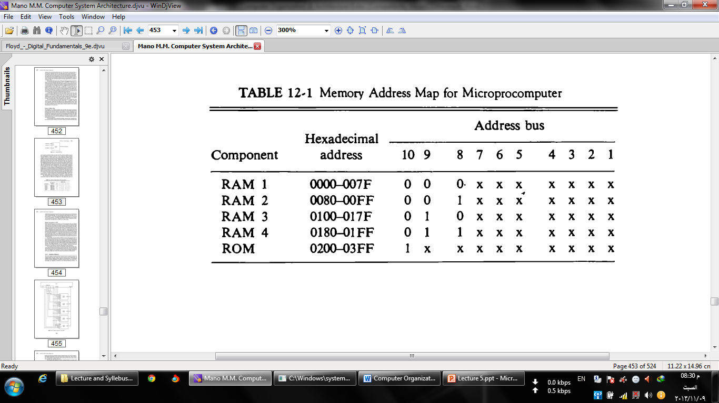

Slide 23
Memory Connection to CPU
RAM and ROM chips are connected to a CPU through the data and address buses.
The low-order lines in the address bus select the byte within the chips and other lines in the address bus select a particular chip through its chip select inputs.
This configuration gives a memory capacity of 512 bytes of RAM and 512 bytes of ROM.

Slide 24
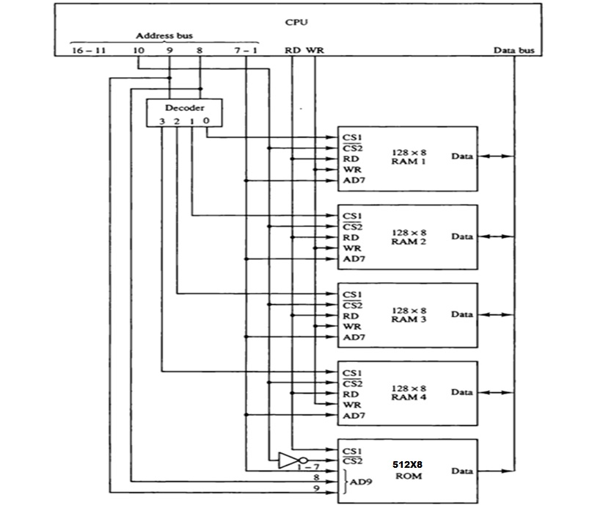

Slide 25
Memory Connection to CPU
Connection :
Each RAM receives the seven low-order bits of the address bus to select one of 128 possible bytes.
The particular RAM chip selected is determined from lines 8 and 9 in the address bus and that done through a 2 x 4 decoder whose outputs go to the CS1 inputs in each RAM chip
The RD and WR outputs from the microprocessor are applied to the inputs of each RAM chip.

Slide 26
Memory Connection to CPU
Connection :
The selection between RAM and ROM is achieved through bus line 10.The RAMs are selected when the bit in this line is 0 and the ROM when the bit is 1.
The other chip select input in the ROM is connected to the RD control line for the ROM chip to be enabled only during a read operation.
Address bus lines 1 to 9 are applied to the input address of ROM without going through the decoder.

Slide 27
Memory Connection to CPU
This assigns addresses 0 to 511 to RAM and 512 to 1023 to ROM.
The data bus of the ROM has only an output capability, whereas the data bus connected to the RAMs can transfer information in both directions.
If more chips are connected, then more external decoders are required for selection among the chips.
The designer must establish a memory map that assigns addresses to the various chips from which the required connections are determined.

