Slide 1
Write a C++ program that displays the numbers 1 through 10 and their squares using for Loop.
Number Number Squared
---------------------------------------------------
1 1
2 4
3 9
4 16
5 25
6 36
7 49
8 64
9 81
10 100

Slide 2
Write a C++ program to displays the numbers 1 through N and their squares using for Loop .
(N = maximum value determine by the User).
Enter N = 5
Number Number Squared
---------------------------------------------------
1 1
2 4
3 9
4 16
5 25

Slide 3
Write a C++ program that displays all of the odd numbers, from 1 through 49 (use for loop).

Slide 4
Write a C++ program that takes daily sales over a period of time and calculates their total.
For how many days do you have sales ? 5 [Enter]
Enter the sales for day 1: 489.32 [Enter]
Enter the sales for day 2: 421.65 [Enter]
Enter the sales for day 3: 497.89 [Enter]
Enter the sales for day 4: 532.37 [Enter]
Enter the sales for day 5: 506.92 [Enter]
The total sales are $2448.15

Slide 5
Write a C++ program that asks the user for a positive integer value. The program should use a loop to get the sum of all the integers from 1 up to the number entered.
For example, if the user enters 50, the loop will find the sum of 1, 2, 3, 4, ... 50.
Input Validation: Do not accept a negative starting number.

Slide 6
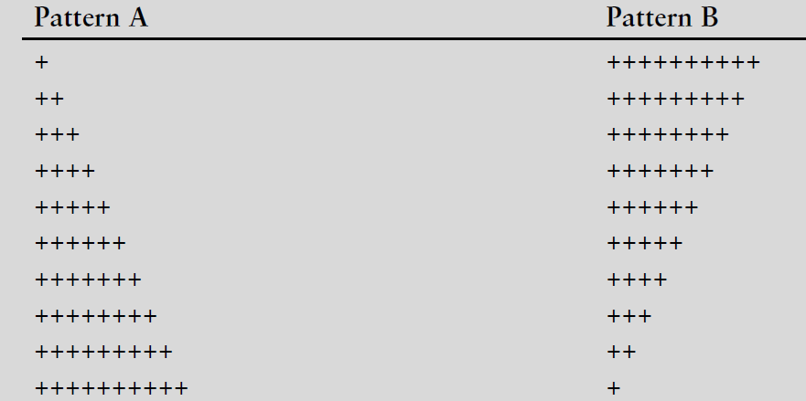
Write a program that uses a loop to display Pattern A below, followed by another loop that displays Pattern B.

