Slide 1
Write a C++ program to displays the numbers 1 through N and their squares using while Loop .
(N = maximum value determine by the User).
Enter N = 5
Number Number Squared
---------------------------------------------------
1 1
2 4
3 9
4 16
5 25

Slide 2
Write a program with a while loop that prints the numerals from 10 to 20 (inclusive), with a blank line between each number.
Number
--------------
10
11
12
13
.
.
20

Slide 3
Write a weather-calculator program that asks for a list of the previous 5 days’ temperatures, computes the average, and prints the results.

Slide 4
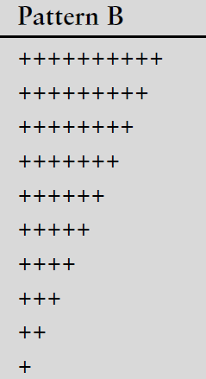
Write a program that uses a while loop to display Pattern B below.

Slide 5
Write a program with a while loop that calculate (Passed - Failed) if user input (1) increase (passed) by 1 if user input (2) increase (failed) by (1) then print them both as showing below.
Enter result (1=pass,2=fail): 1
Enter result (1=pass,2=fail): 2
Enter result (1=pass,2=fail): 2
Enter result (1=pass,2=fail): 1
Enter result (1=pass,2=fail): 1
Passed 3
Failed 2

Slide 6
How many players do you wish per team?
(Enter a value in the range 9-15): 4 [Enter]
You should have at least 9 but no more than 15 per team.
How many players do you wish per team? 12 [Enter]
How many players are available? –142 [Enter]
Please enter a positive number: 142 [Enter]
There will be 11 teams with 10 players left over.

