Slide 1

Computer Skills Department of Computer Science First Year
University of Duhok
College of Science
Computer Skills Department of Mathematic First Year
Shimal Shukri Taher
2022
IT Lecture 5 - Networks

Slide 2
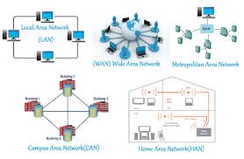
What is Network?
A computer network is a group of computers linked to each other that enables the computer to communicate with another computer and share their resources, data, and applications.

Slide 3
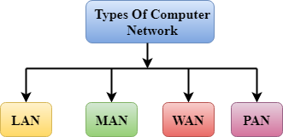
Network Types
A computer network can be categorized by their size. A computer network is mainly of four types:
LAN(Local Area Network)
PAN(Personal Area Network)
MAN(Metropolitan Area Network)
WAN(Wide Area Network)

Slide 4
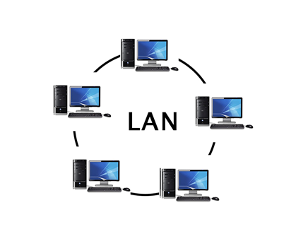
LAN(Local Area Network)
Local Area Network is a group of computers connected to each other in a small area such as building, office.
LAN is used for connecting two or more personal computers through a communication medium such as twisted pair, coaxial cable, etc.
It is less costly as it is built with inexpensive hardware such as hubs, network adapters, and Ethernet cables.
The data is transferred at an extremely faster rate in Local Area Network.
Local Area Network provides higher security.

Slide 5
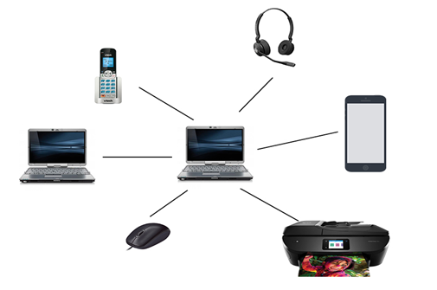
PAN(Personal Area Network)
Personal Area Network is a network arranged within an individual person, typically within a range of 10 meters.
Personal Area Network is used for connecting the computer devices of personal use is known as Personal Area Network.
Thomas Zimmerman was the first research scientist to bring the idea of the Personal Area Network.
Personal Area Network covers an area of 30 feet.
Personal computer devices that are used to develop the personal area network are the laptop, mobile phones, media player and play stations.

Slide 6
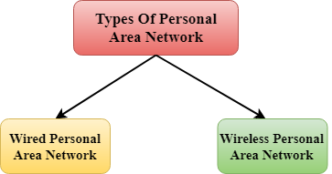
Types of PAN
Wired Personal Area Network
Wireless Personal Area Network

Slide 7
Cont.
Wireless Personal Area Network: Wireless Personal Area Network is developed by simply using wireless technologies such as WiFi, Bluetooth. It is a low range network.
Wired Personal Area Network: Wired Personal Area Network is created by using the USB.

Slide 8
Examples of PAN
Body Area Network
Offline Network
Small Home Office

Slide 9
MAN(Metropolitan Area Network)
A metropolitan area network is a network that covers a larger geographic area by interconnecting a different LAN to form a larger network.
Government agencies use MAN to connect to the citizens and private industries.
In MAN, various LANs are connected to each other through a telephone exchange line.
The most widely used protocols in MAN are RS-232, Frame Relay, ATM, ISDN, OC-3, ADSL, etc.
It has a higher range than Local Area Network(LAN).

Slide 10
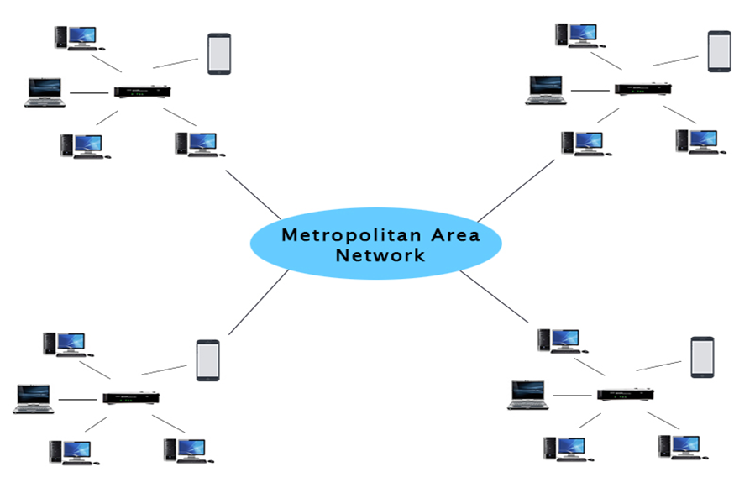
Cont.

Slide 11
Uses Of Metropolitan Area Network:
MAN is used in communication between the banks in a city.
It can be used in an Airline Reservation.
It can be used in a college within a city.
It can also be used for communication in the military.

Slide 12
WAN(Wide Area Network)
A Wide Area Network is a network that extends over a large geographical area such as states or countries.
A Wide Area Network is quite bigger network than the LAN.
A Wide Area Network is not limited to a single location, but it spans over a large geographical area through a telephone line, fibre optic cable or satellite links.
The internet is one of the biggest WAN in the world.
A Wide Area Network is widely used in the field of Business, government, and education.

Slide 13
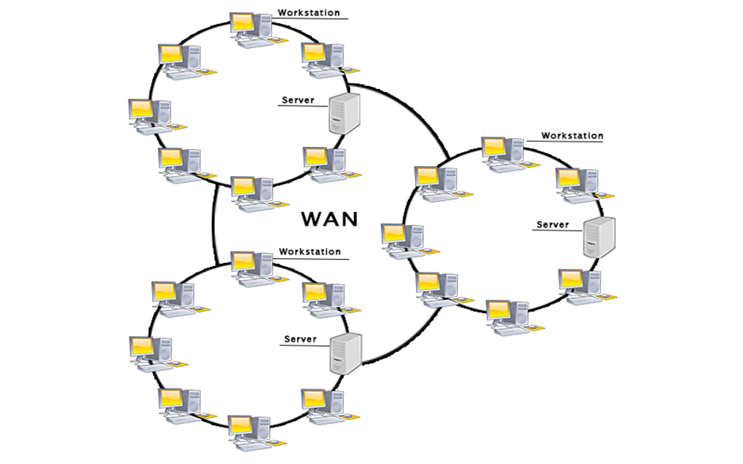
Cont.

Slide 14
Examples Of Wide Area Network:
Mobile Broadband
Last mile
Private network

Slide 15

Any question
Thank you
…………

