Slide 1
Finite Mathematics I
First stage
First semester

Slide 2
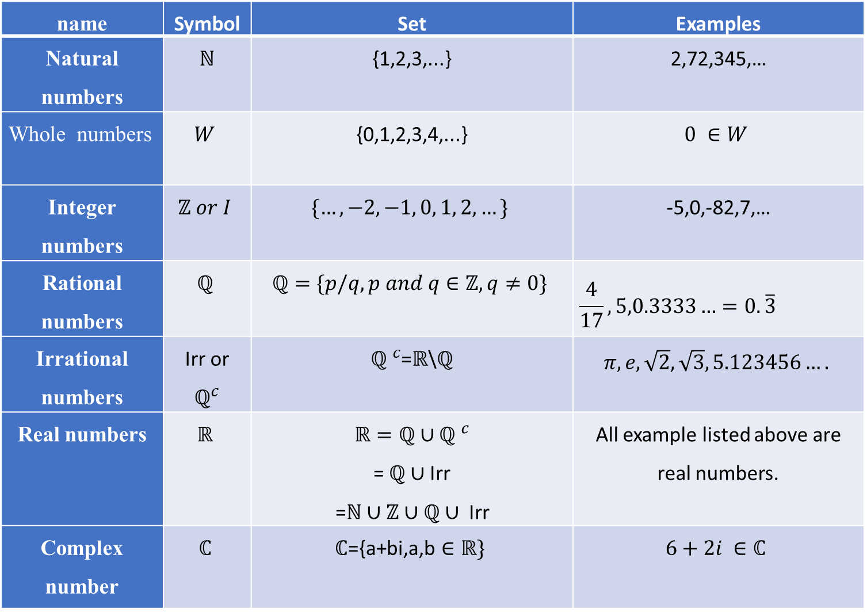
Sets of numbers
name | Symbol | Set | Examples
Natural numbers | $ℕ$ | {1,2,3,...} | 2,72,345,…
Whole numbers | $$W$$ | {0,1,2,3,4,...} | $$0 ∈W$$
Integer numbers | $$ℤ or I$$ | $$\{…,−2,−1, 0, 1, 2,…\}$$ | -5,0,-82,7,…
Rational numbers | $$ℚ$$ | $$ℚ=\{p/q, p and q∈ℤ, q≠0\}$$ | $$\frac{4}{17},5,0.3333…=0.\overline{3}$$
Irrational numbers | Irr or $ℚ^{c}$ | ${ℚ }^{c}$=$ℝ$\$ℚ$ | $$π,e,\sqrt{2},\sqrt{3},5.123456….$$
Real numbers | $$ℝ$$ | $$ℝ=ℚ∪{ℚ }^{c}$$ = $ℚ∪$Irr =$ℕ$ $∪ℤ∪ℚ∪ \text{Irr}$ | All example listed above are real numbers.
Complex number | $$ℂ$$ | $$ℂ\text{=\{}\text{a}\text{+}\text{bi}\text{,}\text{a}\text{,}\text{b}∈ℝ\}$$ | $6+2i ∈ℂ$

Slide 3
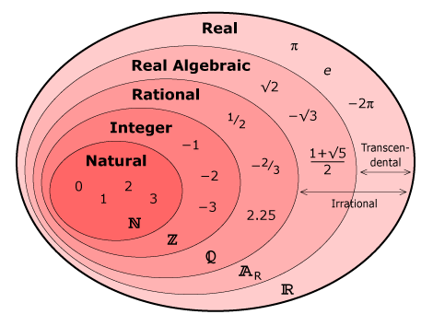

Slide 4
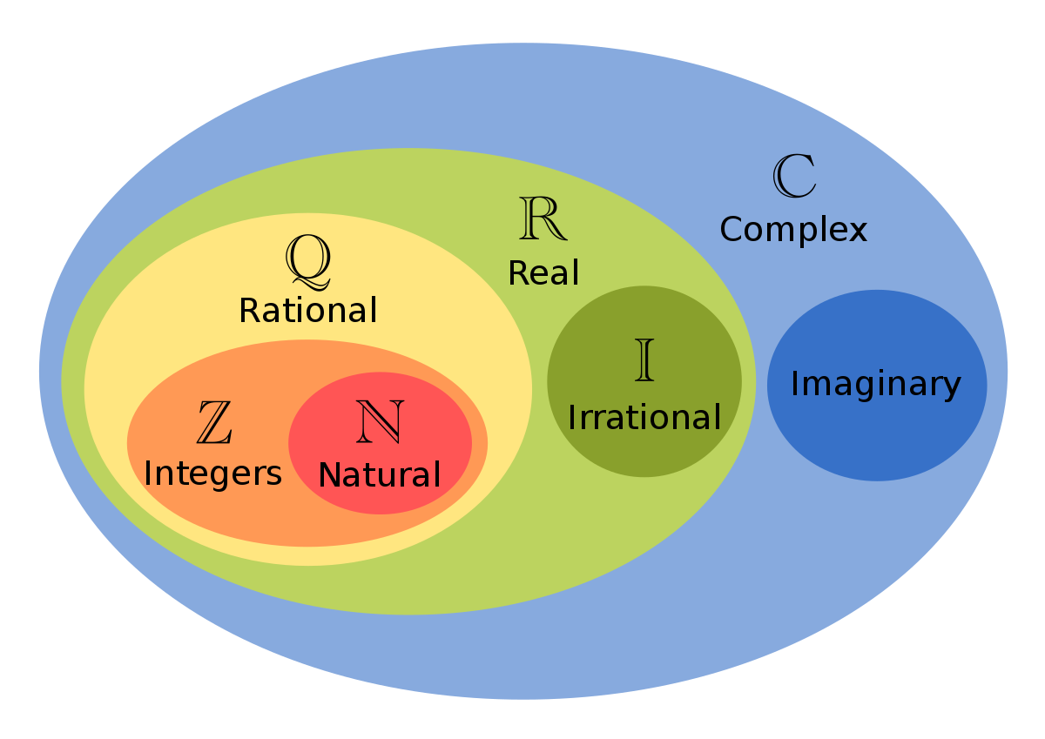

Slide 5
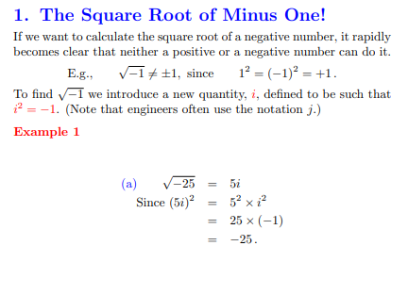
Complex Number

Slide 6
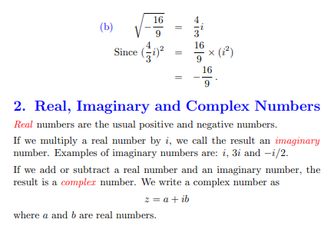

Slide 7
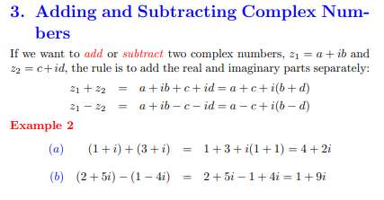

Slide 8
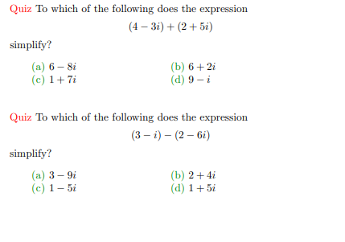

Slide 9
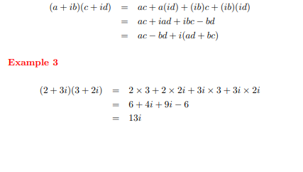

4. Multiplying Complex Numbers
We multiply two complex numbers just as we would multiply expressions of the form $(x+y)$ together

