Slide 1
Finite Mathematics I

Slide 2
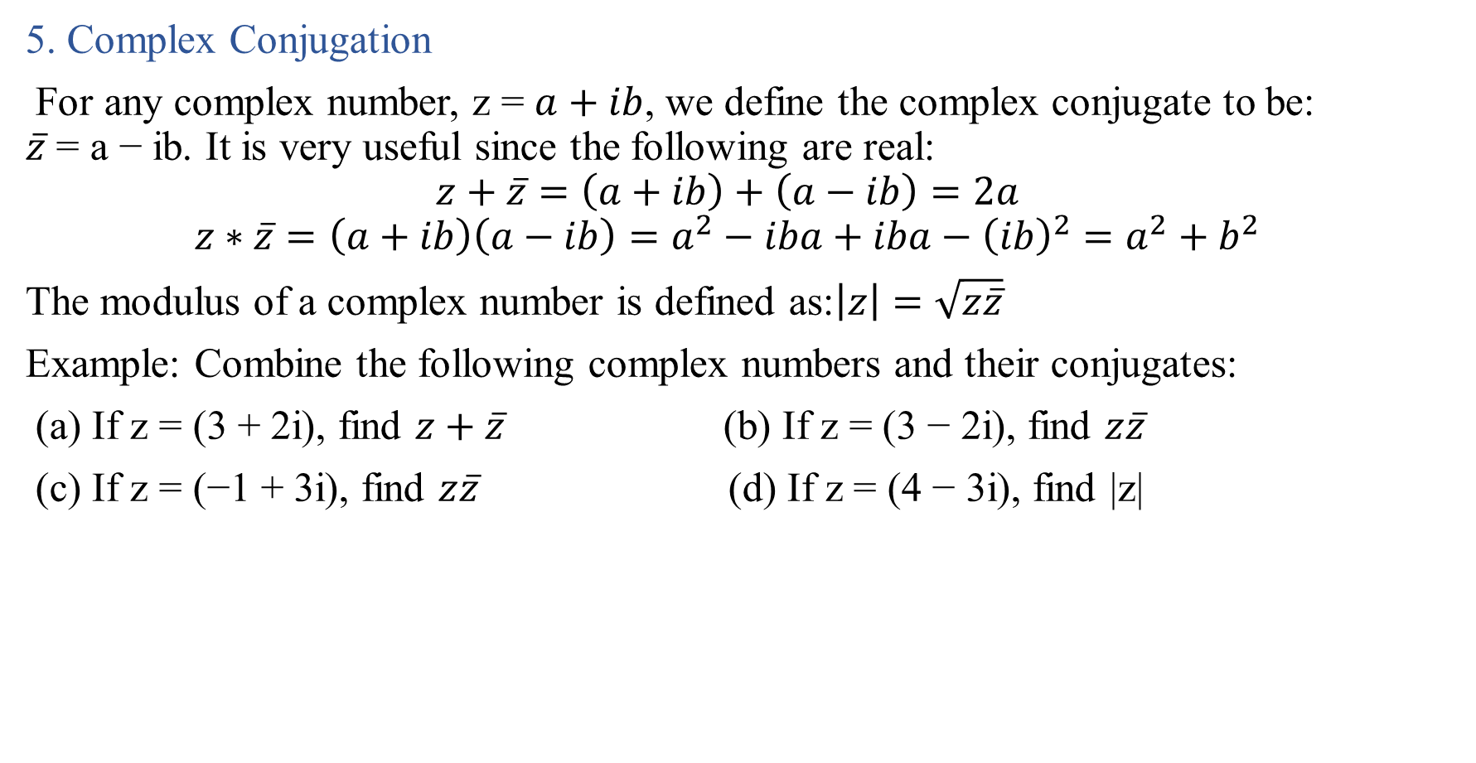
5. Complex Conjugation
For any complex number, z = $a+ib$, we define the complex conjugate to be: $\overline{z}$ = a − ib. It is very useful since the following are real:
$$z+\overline{z}=\left(a+ib\right)+\left(a−ib\right)=2a$$
$$z∗\overline{z}=\left(a+ib\right)\left(a−ib\right)=a^{2}−iba+iba−{\left(ib\right)}^{2}=a^{2}+b^{2}$$
The modulus of a complex number is defined as:$\left|z\right|=\sqrt{z\overline{z}}$
Example: Combine the following complex numbers and their conjugates:
(a) If z = (3 + 2i), find $z+\overline{z}$ (b) If z = (3 − 2i), find $z\overline{z}$
(c) If z = (−1 + 3i), find $z\overline{z}$ (d) If z = (4 − 3i), find |z|

Slide 3

Let $z=a+ib and w=c+id$ ; some basic properties of the conjugate are :
$z\overline{z}=a^{2}+b^{2}$
$\overline{\overline{z}}=z$
$\overline{z+w}=\overline{z}+\overline{w}$
$\overline{zw}=\overline{z}\overline{w}$
$\overline{(\frac{z}{w})}=\frac{\overline{z}}{\overline{w}}$
$\frac{z+\overline{z}}{2}=a=R(z)$
$\frac{z−\overline{z}}{2}=b=Im(z)$

Slide 4
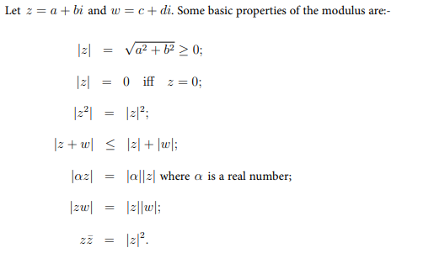

Slide 5
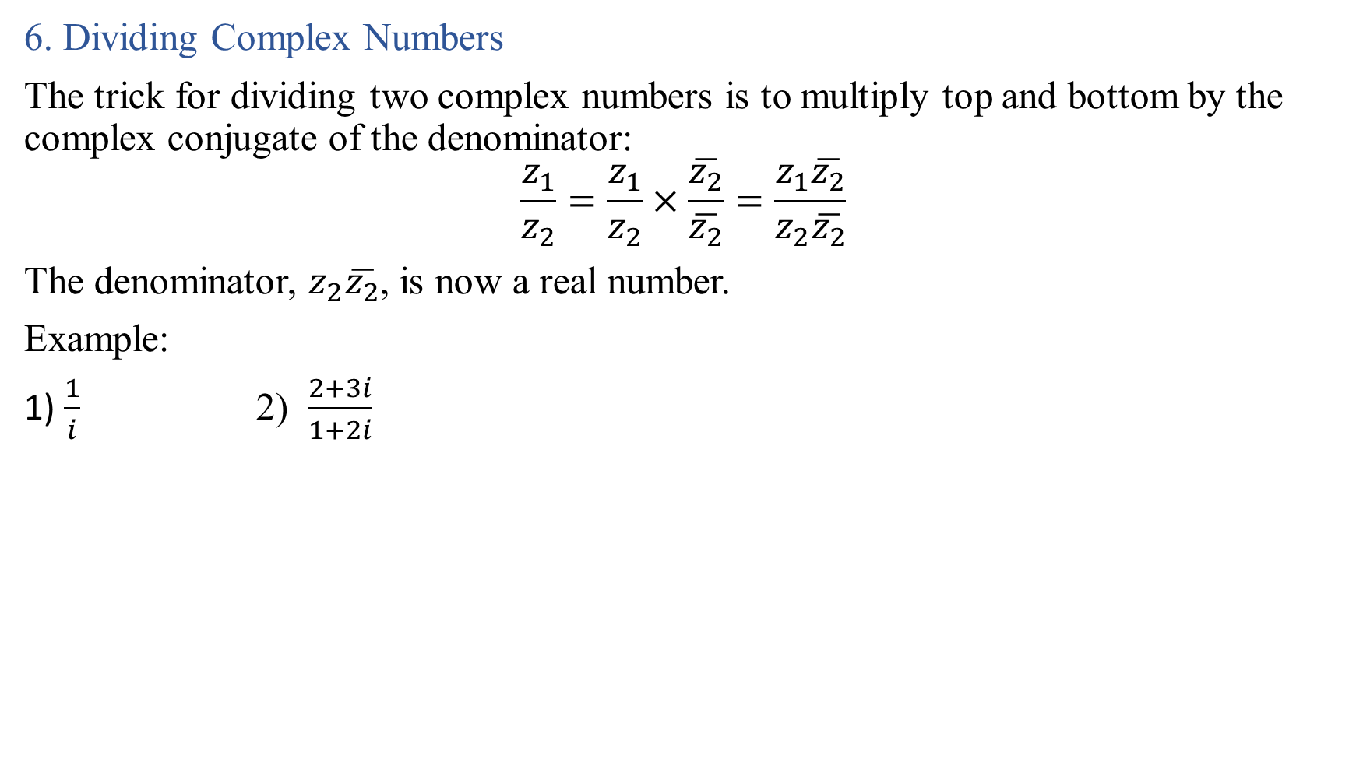
6. Dividing Complex Numbers
The trick for dividing two complex numbers is to multiply top and bottom by the complex conjugate of the denominator:
$$\frac{z_{1}}{z_{2}}=\frac{z_{1}}{z_{2}}×\frac{\overline{z_{2}}}{\overline{z_{2}}}=\frac{z_{1}\overline{z_{2}}}{z_{2}\overline{z_{2}}}$$
The denominator, $z_{2}\overline{z_{2}}$, is now a real number.
Example:
1) $\frac{1}{i}$ 2) $\frac{2+3i}{1+2i}$

Slide 6

Example: solve each of the following equations for the complex number z
$4+5i=z−(1−i)$
$\left(1+2i\right)z=2+5i$
Solution:

Slide 7
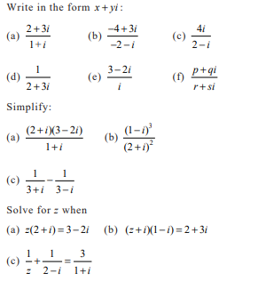
Example:
1.
2.
3.

Slide 8

Polar triangular form
Instead of the cartesian $x+yi$ form, sometimes it is convenient to express complex number in the other equivalent forms.
Using trigonometry in the complex plane we see that we can express any non-zero complex number z in the form
$$z=r(\cos{θ+i\sin{θ}})$$
Where r is the distance to the origin and $θ$ is the angle

Slide 9
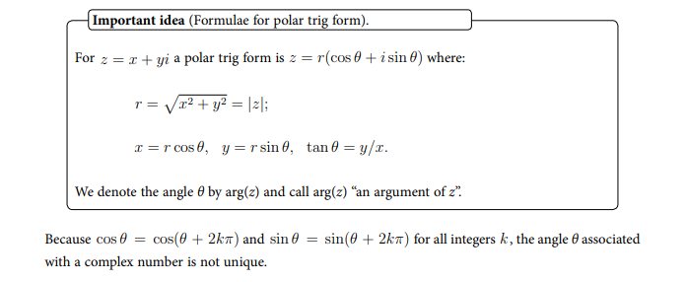

Slide 10
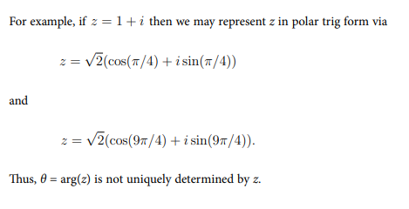

Slide 11

Example :

Slide 12
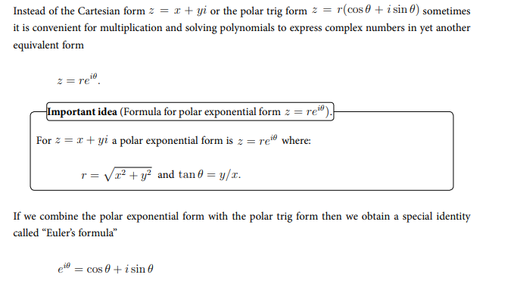

Slide 13
