Slide 1
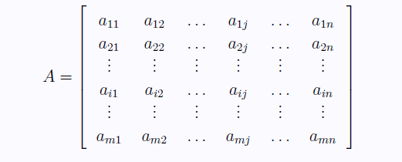

Matrices
Definition: A $m×n$ matrix $A$ is a rectangular array of $m . n$real numbers arranged in $m$horizontal rows and $n$vertical columns. That is,

Slide 2
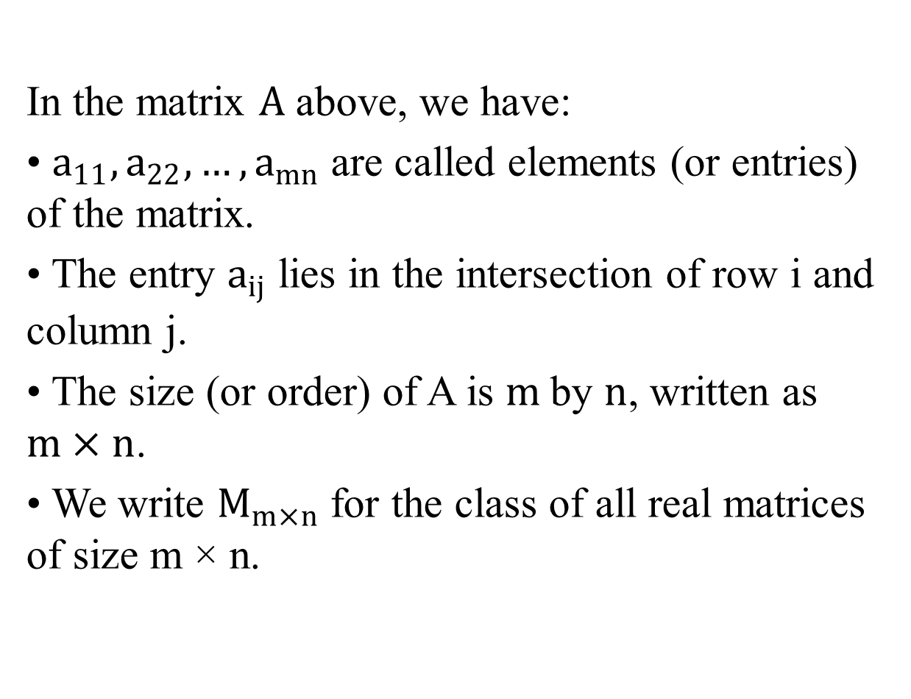
In the matrix $A$ above, we have:
• $a_{11},a_{22}, …, a_{mn}$ are called elements (or entries) of the matrix.
• The entry $a_{ij}$ lies in the intersection of row i and column j.
• The size (or order) of A is $m$by $n$, written as $m×n$.
• We write $M_{m×n}$ for the class of all real matrices of size m × n.

Slide 3

A matrix $A∈M_{3×3}$ and another matrix$B∈M_{2×3}$.
$B={\left[\begin{matrix}5 & 2 & 8 \\ −1 & 0 & 7\end{matrix}\right]}_{2×3} A={\left[\begin{matrix}1 & −2 & 9 \\ 0 & 5 & 3 \\ 8 & −1 & 7\end{matrix}\right]}_{3×3}$
$$a_{11}=1 , a_{31}=8 , a_{23}=3$$
$$b_{22}=0 , b_{12}=2$$

Slide 4
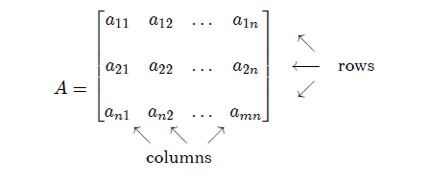
Some Special Type of Matrices:
m =Number of rows
n =Number of columns

Slide 5
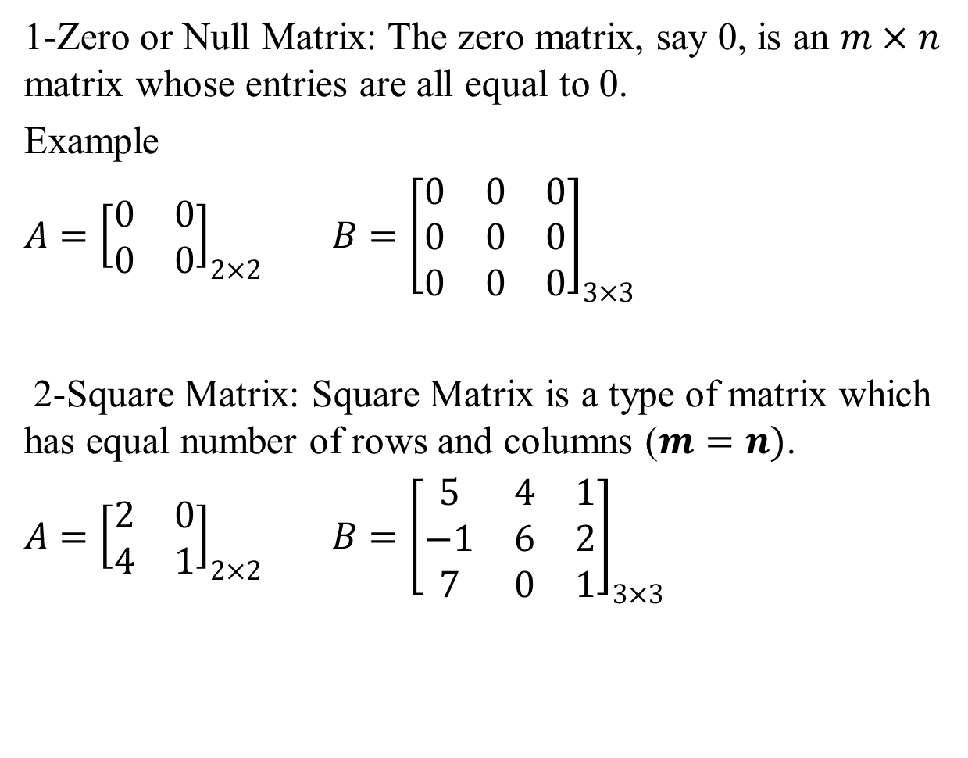
1-Zero or Null Matrix: The zero matrix, say 0, is an $m×n$ matrix whose entries are all equal to 0.
Example
$A={\left[\begin{matrix}0 & 0 \\ 0 & 0\end{matrix}\right]}_{2×2}$ ${B=\left[\begin{matrix}0 & 0 & 0 \\ 0 & 0 & 0 \\ 0 & 0 & 0\end{matrix}\right]}_{3×3}$
2-Square Matrix: Square Matrix is a type of matrix which has equal number of rows and columns ($m=n)$.
$A={\left[\begin{matrix}2 & 0 \\ 4 & 1\end{matrix}\right]}_{2×2}$ ${B=\left[\begin{matrix}5 & 4 & 1 \\ −1 & 6 & 2 \\ 7 & 0 & 1\end{matrix}\right]}_{3×3}$

Slide 6
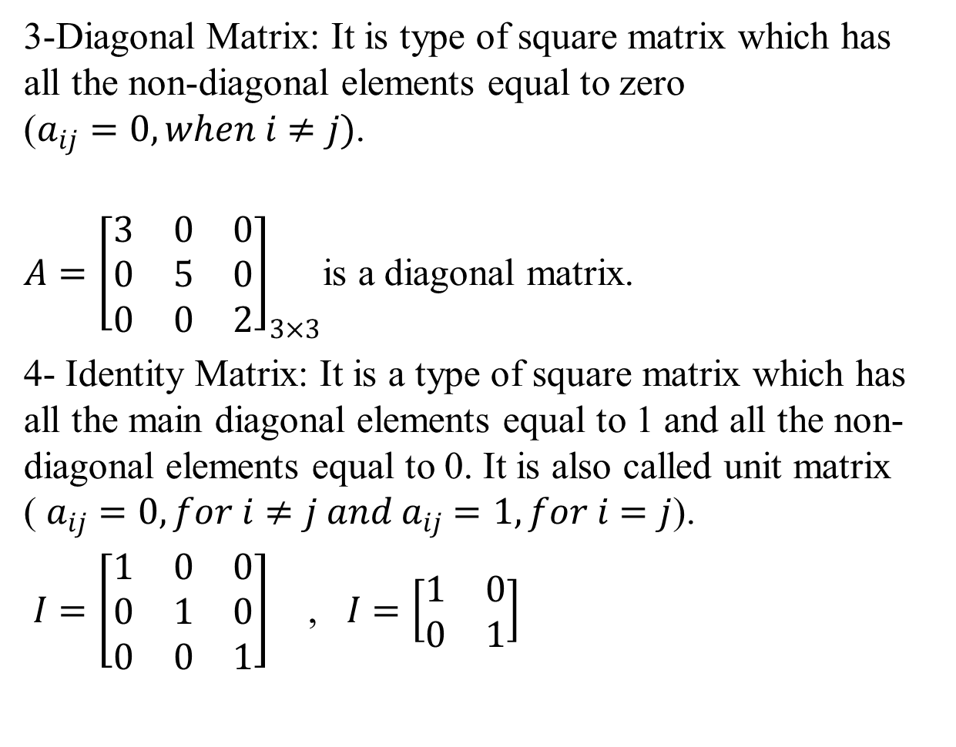
3-Diagonal Matrix: It is type of square matrix which has all the non-diagonal elements equal to zero ($a_{ij}=0, when i≠j)$.
$A={\left[\begin{matrix}3 & 0 & 0 \\ 0 & 5 & 0 \\ 0 & 0 & 2\end{matrix}\right]}_{3×3}$is a diagonal matrix.
4- Identity Matrix: It is a type of square matrix which has all the main diagonal elements equal to 1 and all the non-diagonal elements equal to 0. It is also called unit matrix ( $a_{ij}=0, for i≠j and a_{ij}=1, for i=j$).
$I=\left[\begin{matrix}1 & 0 & 0 \\ 0 & 1 & 0 \\ 0 & 0 & 1\end{matrix}\right]$ , $I=\left[\begin{matrix}1 & 0 \\ 0 & 1\end{matrix}\right]$

Slide 7
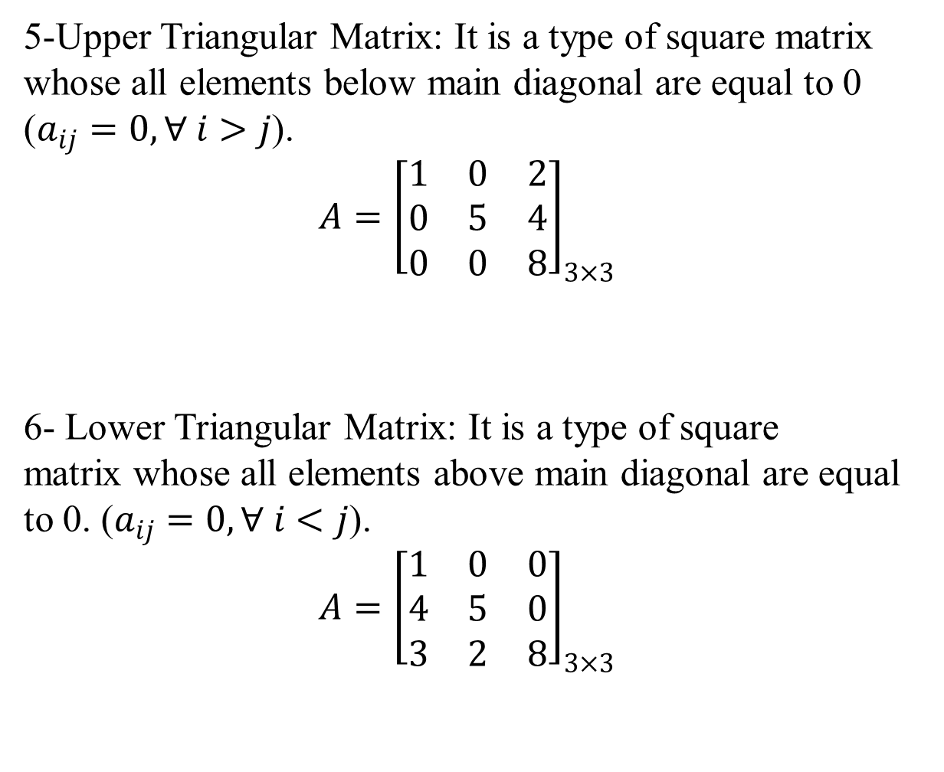
5-Upper Triangular Matrix: It is a type of square matrix whose all elements below main diagonal are equal to 0 ($a_{ij}=0, ∀ i>j$).
$${A=\left[\begin{matrix}1 & 0 & 2 \\ 0 & 5 & 4 \\ 0 & 0 & 8\end{matrix}\right]}_{3×3}$$
6- Lower Triangular Matrix: It is a type of square matrix whose all elements above main diagonal are equal to 0. ($a_{ij}=0, ∀ i<j$).
$${A=\left[\begin{matrix}1 & 0 & 0 \\ 4 & 5 & 0 \\ 3 & 2 & 8\end{matrix}\right]}_{3×3}$$

Slide 8

7-The column matrix: is $m×1$ matrix.
$${A=\left[\begin{matrix}3 \\ −1 \\ \begin{matrix}0 \\ 5\end{matrix}\end{matrix}\right]}_{4×1}$$
8-The row matrix: is $1×n$ matrix.
$$A={\left[2 1 9\right]}_{1×3}$$

Slide 9
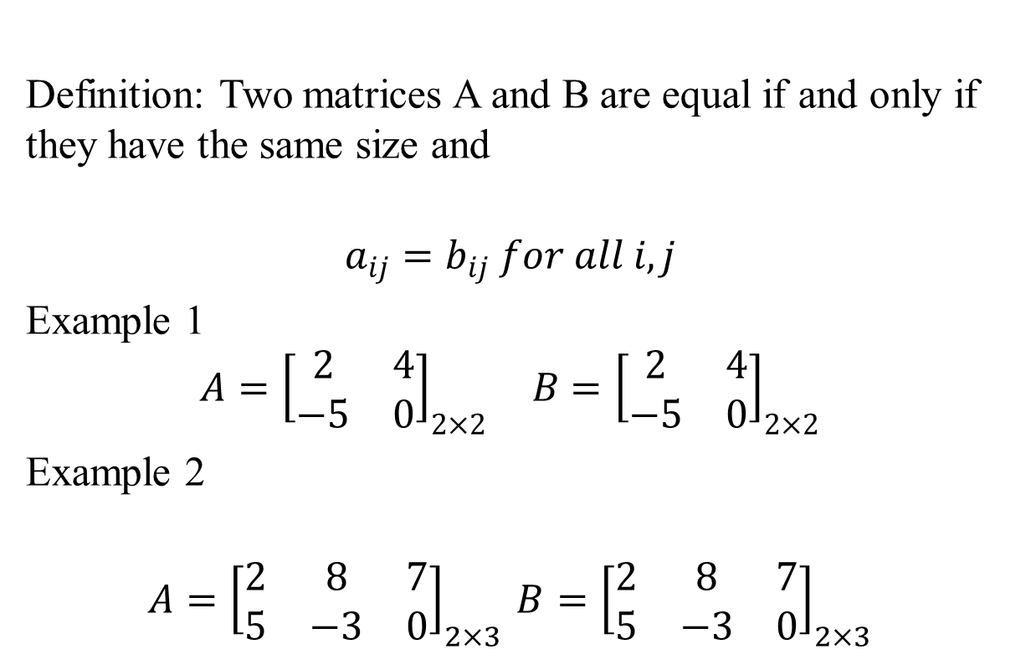
Equality, Addition, Multiplication
Definition: Two matrices A and B are equal if and only if they have the same size and
$$a_{ij}=b_{ij} for all i,j$$
Example 1
$${A=\left[\begin{matrix}2 & 4 \\ −5 & 0\end{matrix}\right]}_{2×2} B={\left[\begin{matrix}2 & 4 \\ −5 & 0\end{matrix}\right]}_{2×2}$$
Example 2
$${A=\left[\begin{matrix}2 & 8 & 7 \\ 5 & −3 & 0\end{matrix}\right]}_{2×3 }{B=\left[\begin{matrix}2 & 8 & 7 \\ 5 & −3 & 0\end{matrix}\right]}_{2×3}$$

Slide 10
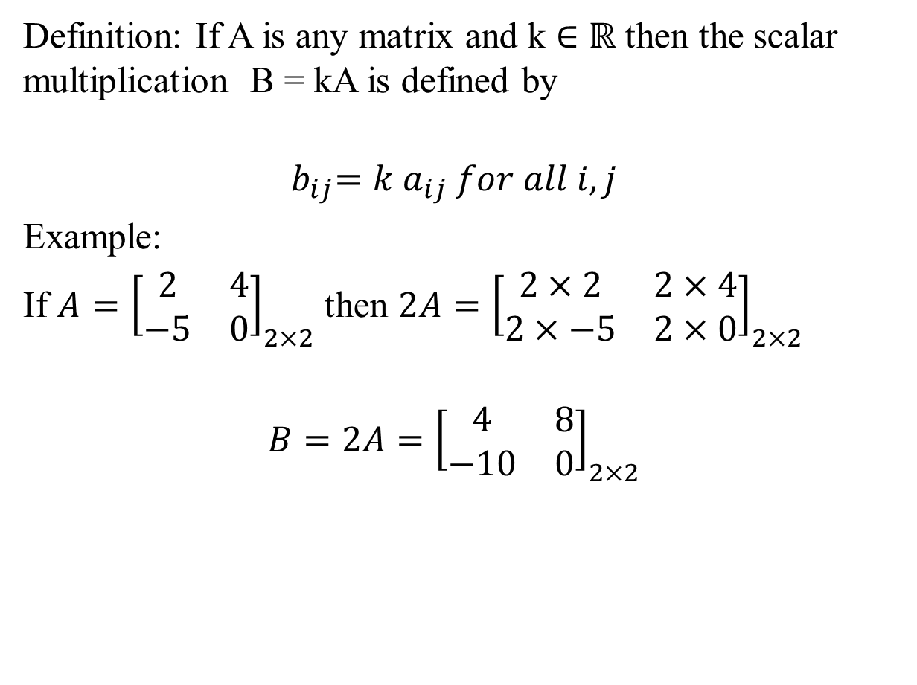
Definition: If A is any matrix and k ∈ $ℝ$ then the scalar multiplication B = kA is defined by
$${ b}_{ij}=k{ a}_{ij} for all i,j$$
Example:
If ${A=\left[\begin{matrix}2 & 4 \\ −5 & 0\end{matrix}\right]}_{2×2}$ then ${2A=\left[\begin{matrix}2×2 & 2×4 \\ 2×−5 & 2×0\end{matrix}\right]}_{2×2}$
$$B=2A={\left[\begin{matrix}4 & 8 \\ −10 & 0\end{matrix}\right]}_{2×2}$$

Slide 11
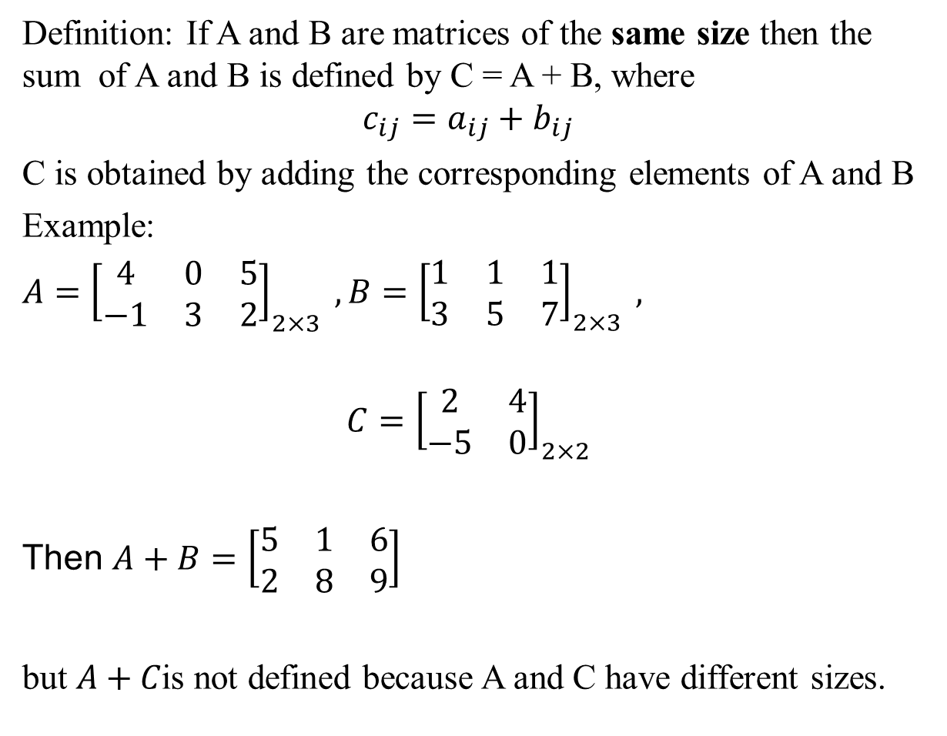
Definition: If A and B are matrices of the same size then the sum of A and B is defined by C = A + B, where
$$c_{ij}=a_{ij}+b_{ij}$$
C is obtained by adding the corresponding elements of A and B
Example:
$A={\left[\begin{matrix}4 & 0 & 5 \\ −1 & 3 & 2\end{matrix}\right]}_{2×3} ,B={\left[\begin{matrix}1 & 1 & 1 \\ 3 & 5 & 7\end{matrix}\right]}_{2×3} ,$
$${C=\left[\begin{matrix}2 & 4 \\ −5 & 0\end{matrix}\right]}_{2×2}$$
Then $A+B=\left[\begin{matrix}5 & 1 & 6 \\ 2 & 8 & 9\end{matrix}\right]$
but $A+C$is not defined because A and C have different sizes.

Slide 12
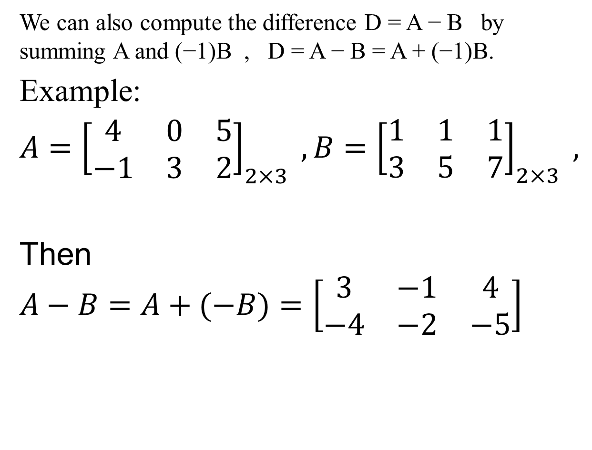
We can also compute the difference D = A − B by summing A and (−1)B , D = A − B = A + (−1)B.
Example:
$A={\left[\begin{matrix}4 & 0 & 5 \\ −1 & 3 & 2\end{matrix}\right]}_{2×3} ,B={\left[\begin{matrix}1 & 1 & 1 \\ 3 & 5 & 7\end{matrix}\right]}_{2×3} ,$
Then $A−B=A+(−B)=\left[\begin{matrix}3 & −1 & 4 \\ −4 & −2 & −5\end{matrix}\right]$

Slide 13
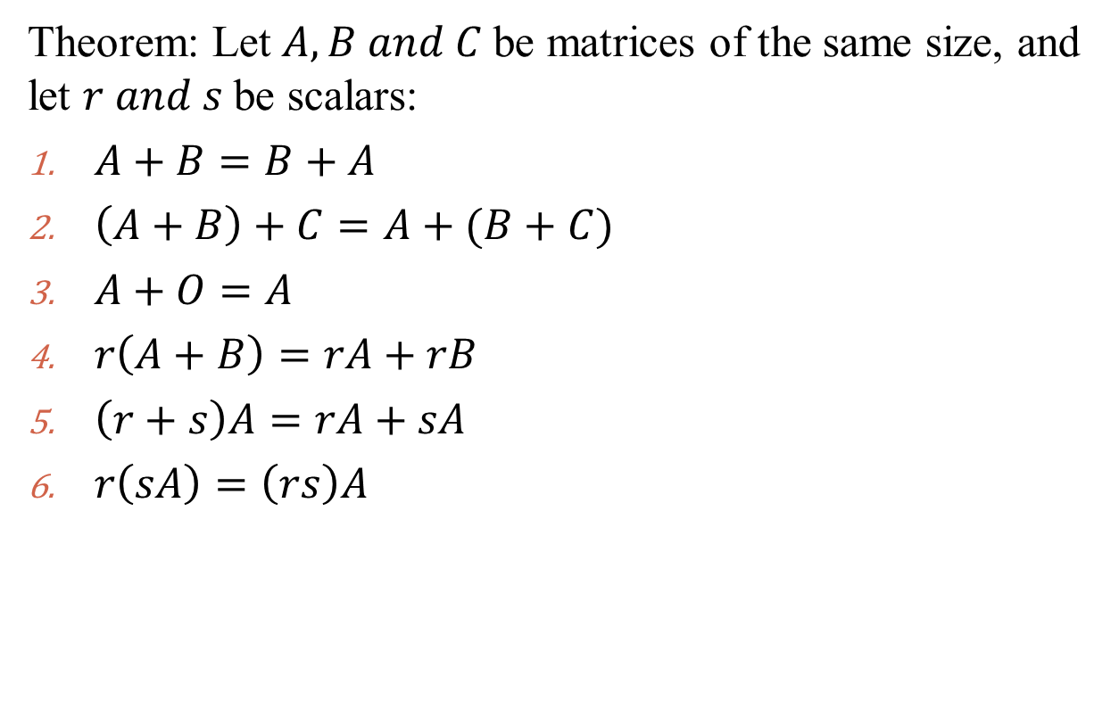
Properties of matrix addition
Theorem: Let $A, B and C$be matrices of the same size, and let $r and s$be scalars:
$A+B=B+A$
$\left(A+B\right)+C=A+(B+C)$
$A+O=A$
$r\left(A+B\right)=rA+rB$
$\left(r+s\right)A=rA+sA$
$r\left(sA\right)=\left(rs\right)A$

