Slide 1
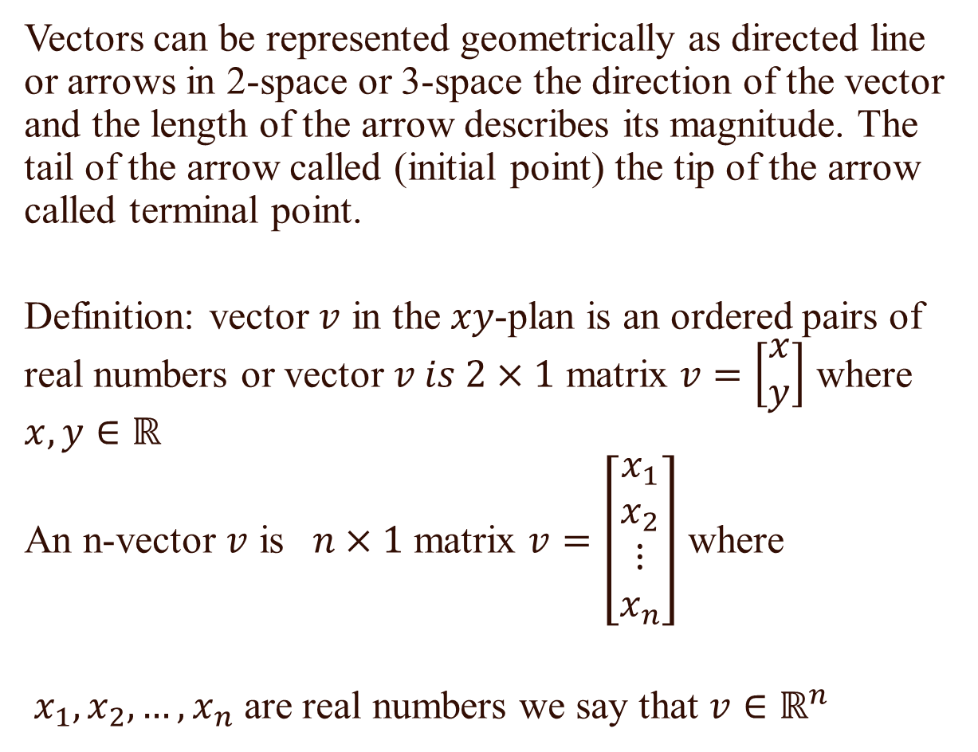
vector
Vectors can be represented geometrically as directed line or arrows in 2-space or 3-space the direction of the vector and the length of the arrow describes its magnitude. The tail of the arrow called (initial point) the tip of the arrow called terminal point.
Definition: vector $v$ in the $xy$-plan is an ordered pairs of real numbers or vector $v is 2×1$ matrix $v=\left[\begin{matrix}x \\ y\end{matrix}\right]$ where $x,y∈ℝ$
An n-vector $v$ is $n×1$ matrix $v=\left[\begin{matrix}x_{1} \\ x_{2} \\ \begin{matrix}⋮ \\ x_{n}\end{matrix}\end{matrix}\right]$ where
$x_{1},x_{2},…,x_{n}$ are real numbers we say that $v∈ℝ^{n}$

Slide 2
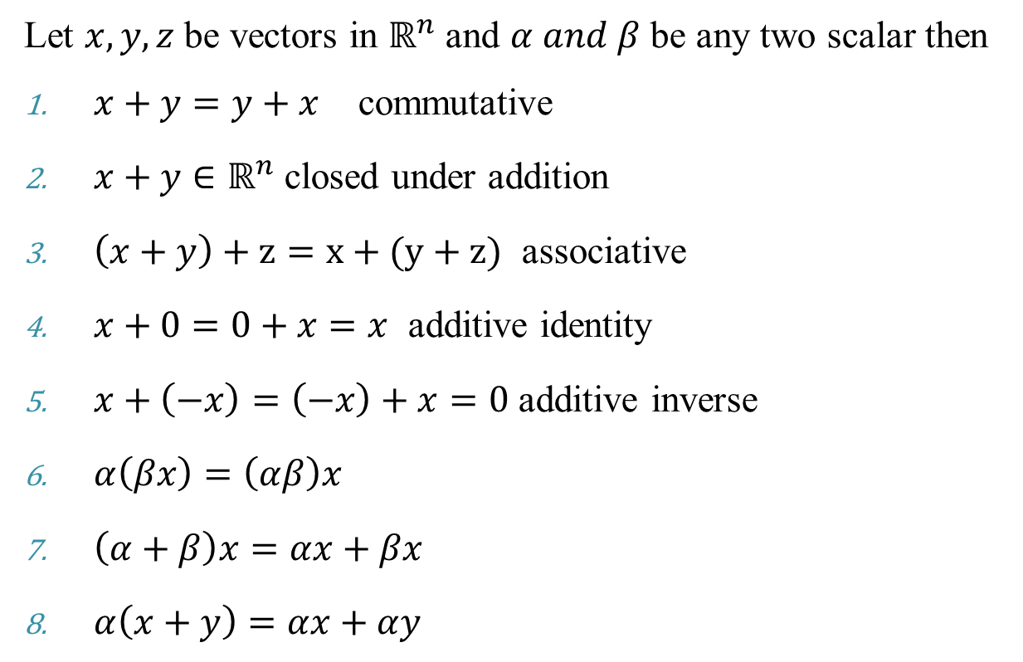
Some properties of vectors
Let $x,y,z$ be vectors in $ℝ^{n}$ and $α and β$ be any two scalar then
$x+y=y+x$ commutative
$x+y∈ℝ^{n}$ closed under addition
$\left(x+y\right)+z=x+(y+z)$ associative
$x+0=0+x=x$ additive identity
$x+\left(−x\right)=\left(−x\right)+x=0$ additive inverse
$α\left(βx\right)=\left(αβ\right)x$
$\left(α+β\right)x=αx+βx$
$α\left(x+y\right)=αx+αy$

Slide 3

Let $u=\left(2,4,−5\right)$ and $v=(1,−6,9)$
$$u+v=\left(2+1,4+\left(−6\right),−5+9\right)$$
$$u+v=(3,−2,4)$$
$$5u=(5∗2, 5∗4, 5∗\left(−5\right))$$
$$5u=(10,20,−25)$$
$$3u−5v=\left(6,12,−15\right)+\left(−5,30,−45\right)$$
$$3u−5v=(1,42,−60)$$

Slide 4
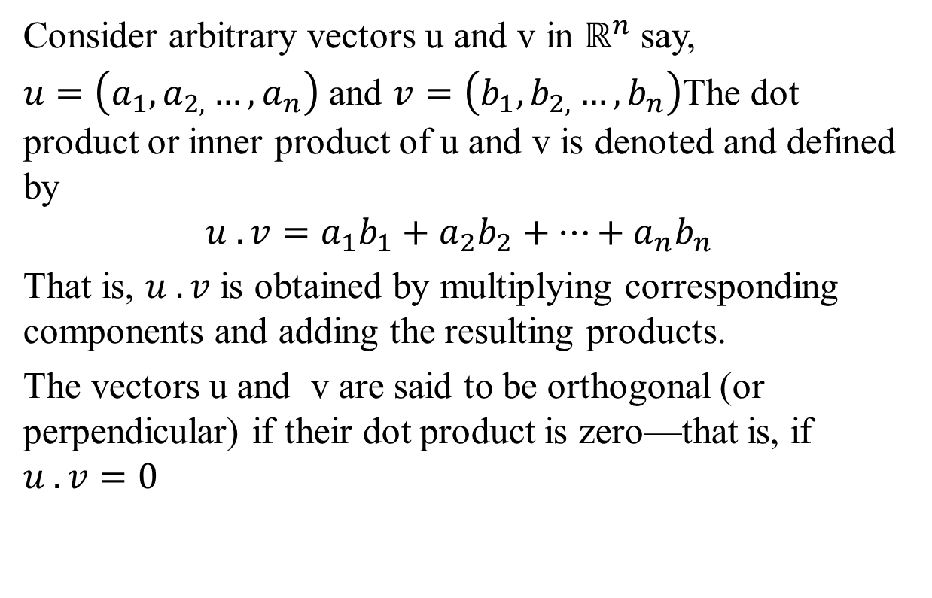
Dot (Inner) Product
Consider arbitrary vectors u and v in $ℝ^{n}$say,
$u=\left(a_{1},a_{2,}…,a_{n}\right)$ and $v=\left(b_{1},b_{2,}…,b_{n}\right)$The dot product or inner product of u and v is denoted and defined by
$$u . v=a_{1}b_{1}+a_{2}b_{2}+…+a_{n}b_{n}$$
That is, $u . v$is obtained by multiplying corresponding components and adding the resulting products.
The vectors u and v are said to be orthogonal (or perpendicular) if their dot product is zero—that is, if
$$u . v=0$$

Slide 5
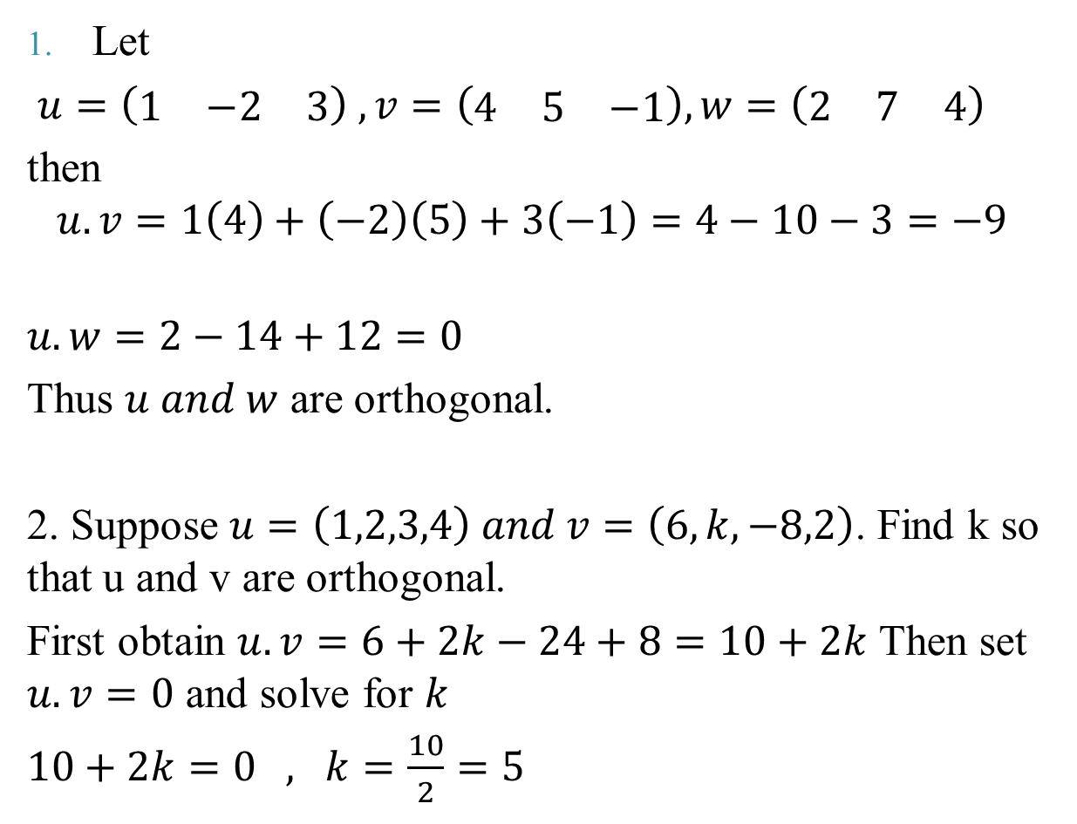
Let
$u=\left(\begin{matrix}1 & −2 & 3\end{matrix}\right) ,v=\left(\begin{matrix}4 & 5 & −1\end{matrix}\right), w=\left(\begin{matrix}2 & 7 & 4\end{matrix}\right)$
then
$$u.v=1\left(4\right)+\left(−2\right)\left(5\right)+3\left(−1\right)=4−10−3=−9$$
$$u.w=2−14+12=0$$
Thus $u and w$ are orthogonal.
2. Suppose $u=\left(1,2,3,4\right) and v=\left(6,k,−8,2\right)$. Find k so that u and v are orthogonal.
First obtain $u.v=6+2k−24+8=10+2k$ Then set $u.v=0$ and solve for $k$
$10+2k=0 , k=\frac{10}{2}=5$

Slide 6
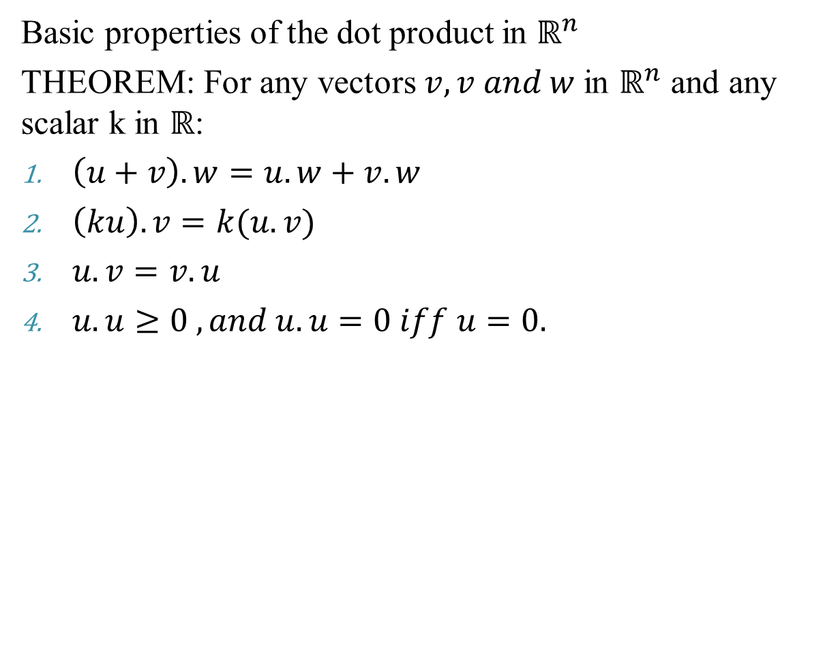
Basic properties of the dot product in $ℝ^{n}$
THEOREM: For any vectors $v,v and w$in $ℝ^{n}$ and any scalar k in $ℝ$:
$\left(u+v\right).w=u.w+v.w$
$\left(ku\right).v=k(u.v)$
$u.v=v.u$
$u.u≥0 , and u.u=0 iff u=0.$

Slide 7
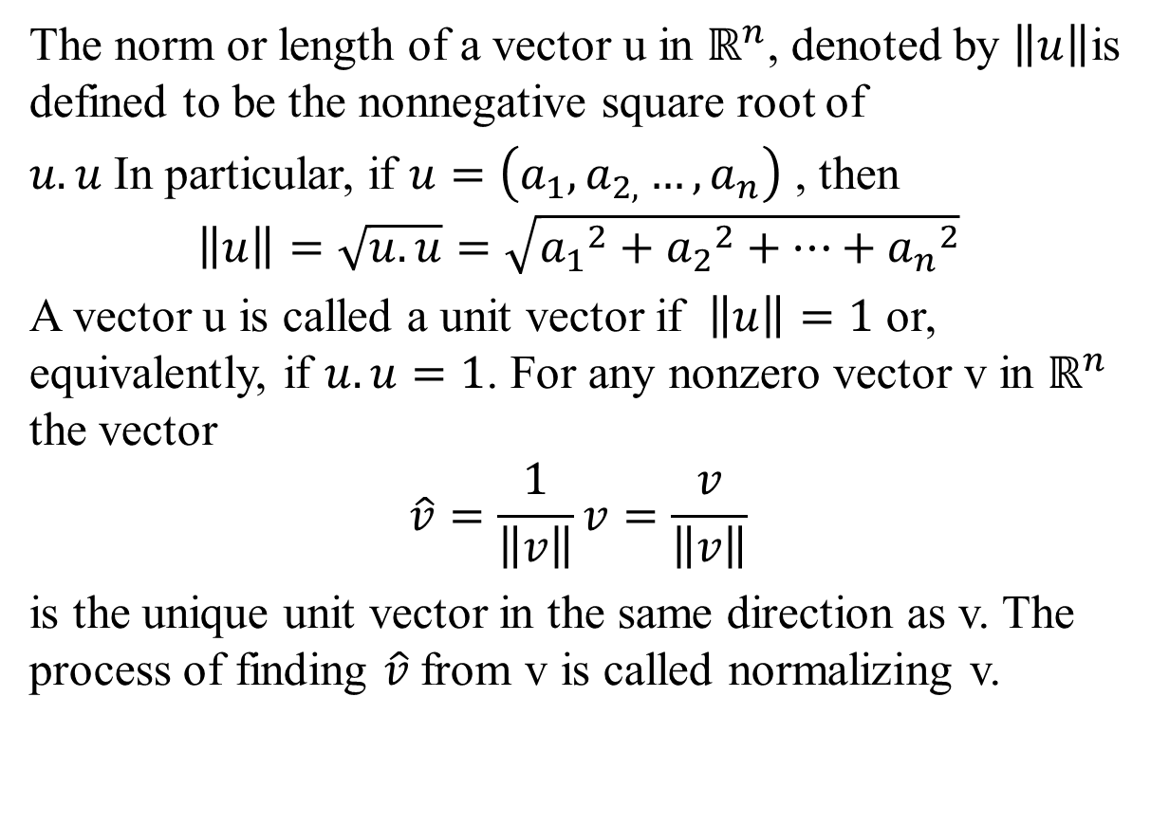
Norm (Length) of a Vector
The norm or length of a vector u in $ℝ^{n}$, denoted by $\left\|u\right\|$is defined to be the nonnegative square root of
$u.u$In particular, if $u=\left(a_{1},a_{2,}…,a_{n}\right)$ , then
$$\left\|u\right\|=\sqrt{u.u}=\sqrt{{a_{1}}^{2}+{a_{2}}^{2}+…+{a_{n}}^{2}}$$
A vector u is called a unit vector if $\left\|u\right\|=1$ or, equivalently, if $u.u=1$. For any nonzero vector v in $ℝ^{n}$ the vector
$$\hat{v}=\frac{1}{\left\|v\right\|}v=\frac{v}{\left\|v\right\|}$$
is the unique unit vector in the same direction as v. The process of finding $\hat{v}$from v is called normalizing v.

Slide 8
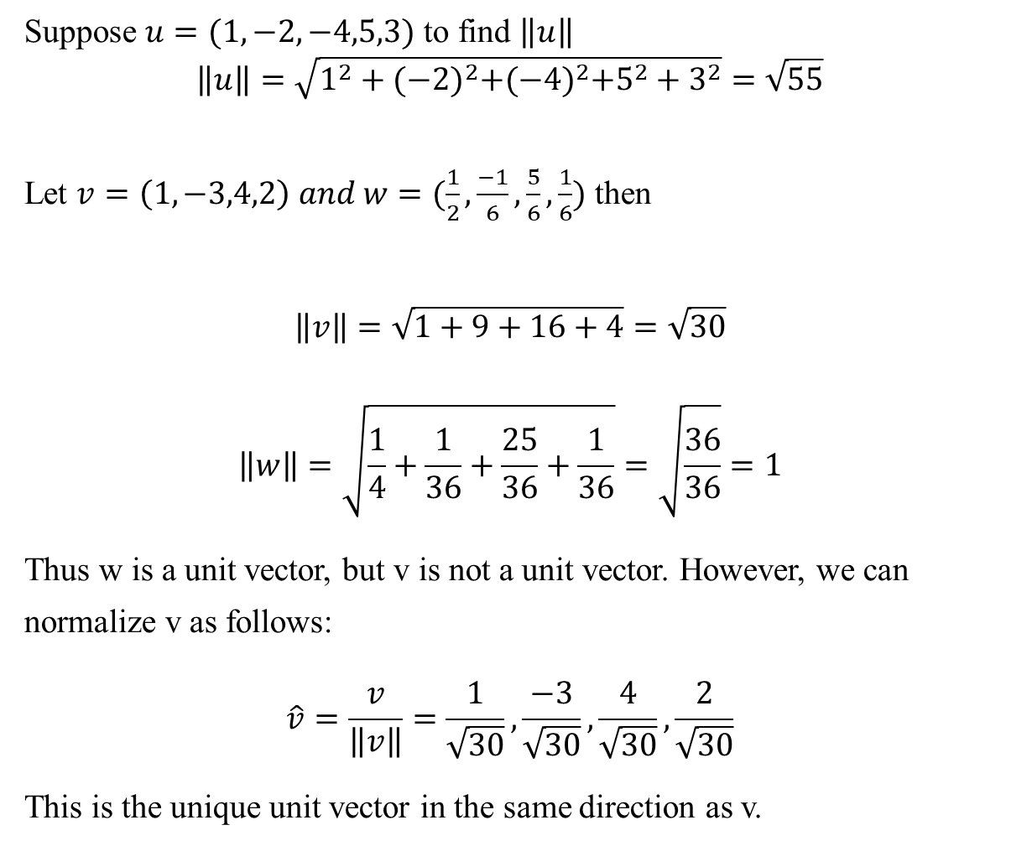
Suppose $u=(1,−2,−4,5,3)$ to find $\left\|u\right\|$
$$\left\|u\right\|=\sqrt{1^{2}+{(−2)}^{2}+{(−4)}^{2}+5^{2}+3^{2}}=\sqrt{55}$$
Let $v=\left(1,−3,4,2\right) and w=(\frac{1}{2},\frac{−1}{6},\frac{5}{6},\frac{1}{6})$ then
$$\left\|v\right\|=\sqrt{1+9+16+4}=\sqrt{30}$$
$$\left\|w\right\|=\sqrt{\frac{1}{4}+\frac{1}{36}+\frac{25}{36}+\frac{1}{36}}=\sqrt{\frac{36}{36}}=1$$
Thus w is a unit vector, but v is not a unit vector. However, we can normalize v as follows:
$$\hat{v}=\frac{v}{\left\|v\right\|}=\frac{1}{\sqrt{30}},\frac{−3}{\sqrt{30}},\frac{4}{\sqrt{30}},\frac{2}{\sqrt{30}}$$
This is the unique unit vector in the same direction as v.

Slide 9
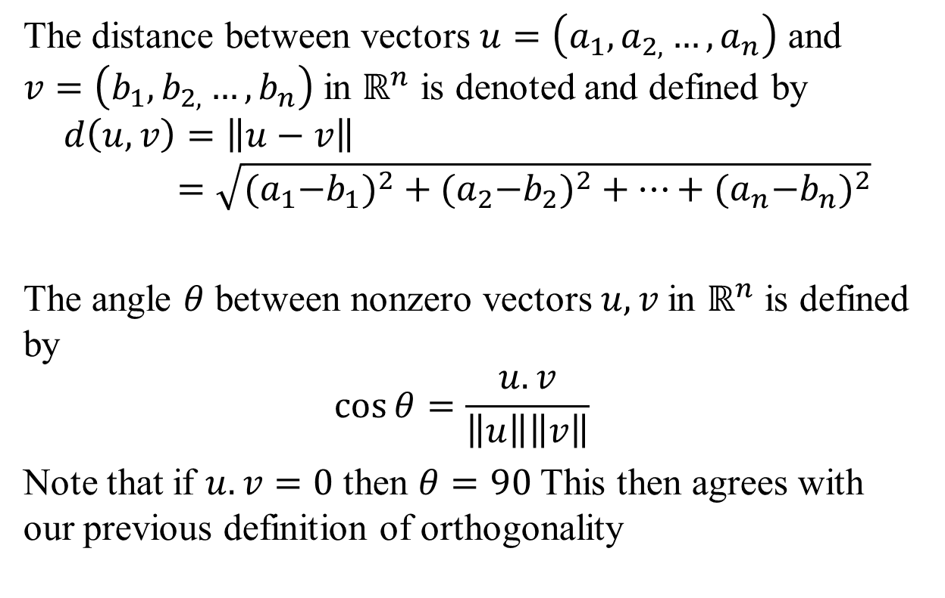
Distance, Angles
The distance between vectors $u=\left(a_{1},a_{2,}…,a_{n}\right)$ and $v=\left(b_{1},b_{2,}…,b_{n}\right)$in $ℝ^{n}$ is denoted and defined by
$$d\left(u,v\right)=\left\|u−v\right\|=\sqrt{{{(a}_{1}−b_{1})}^{2}+{{(a}_{2}−b_{2})}^{2}+…+{{(a}_{n}−b_{n})}^{2}}$$
The angle $θ$ between nonzero vectors $u, v$in $ℝ^{n}$ is defined by
$$\cos{θ=\frac{u.v}{\left\|u\right\|\left\|v\right\|}}$$
Note that if $u.v=0$ then $θ=90$This then agrees with our previous definition of orthogonality

Slide 10
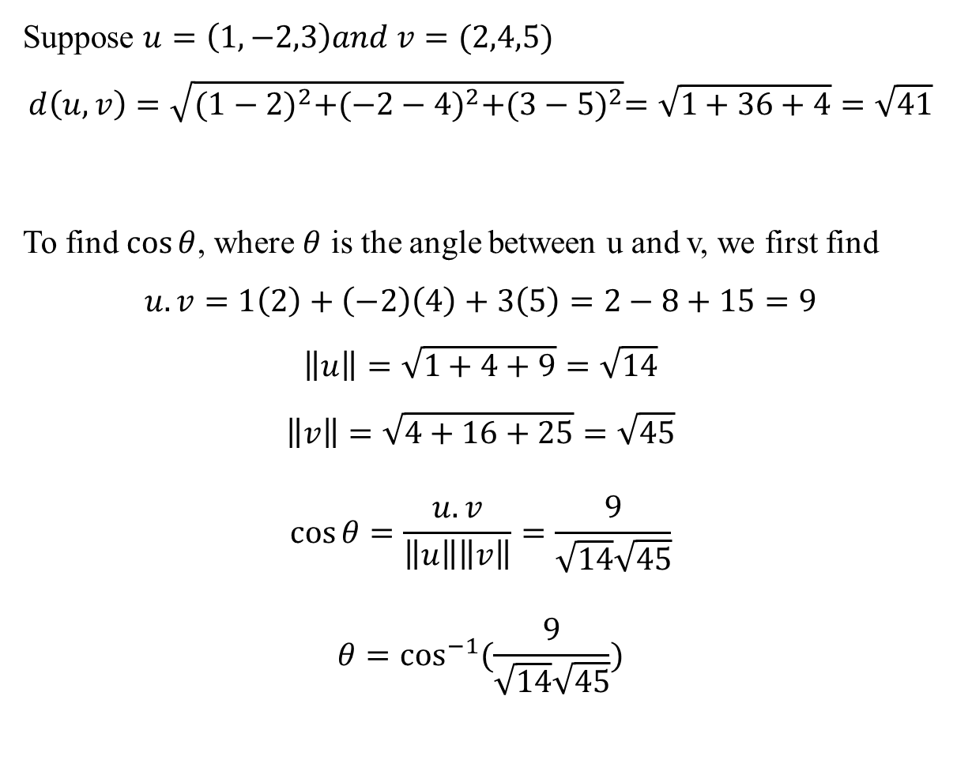
Suppose $u=\left(1,−2,3\right)and v=(2,4,5)$
$$d\left(u,v\right)=\sqrt{{(1−2)}^{2}+{(−2−4)}^{2}+{(3−5)}^{2}}=\sqrt{1+36+4}=\sqrt{41}$$
To find $\cos{θ}$, where $θ$ is the angle between u and v, we first find
$$u.v=1\left(2\right)+\left(−2\right)\left(4\right)+3\left(5\right)=2−8+15=9$$
$$\left\|u\right\|=\sqrt{1+4+9}=\sqrt{14}$$
$$\left\|v\right\|=\sqrt{4+16+25}=\sqrt{45}$$
$$\cos{θ=\frac{u.v}{\left\|u\right\|\left\|v\right\|}=\frac{9}{\sqrt{14}\sqrt{45}}}$$
$$θ=\cos^{−1}{(\frac{9}{\sqrt{14}\sqrt{45}})}$$

