Slide 1
Boundedness and Cardinality
Upper bound
Lower bound
Supremum
Infimum
Cardinality of infinite sets

Slide 2
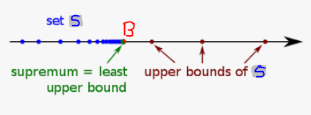
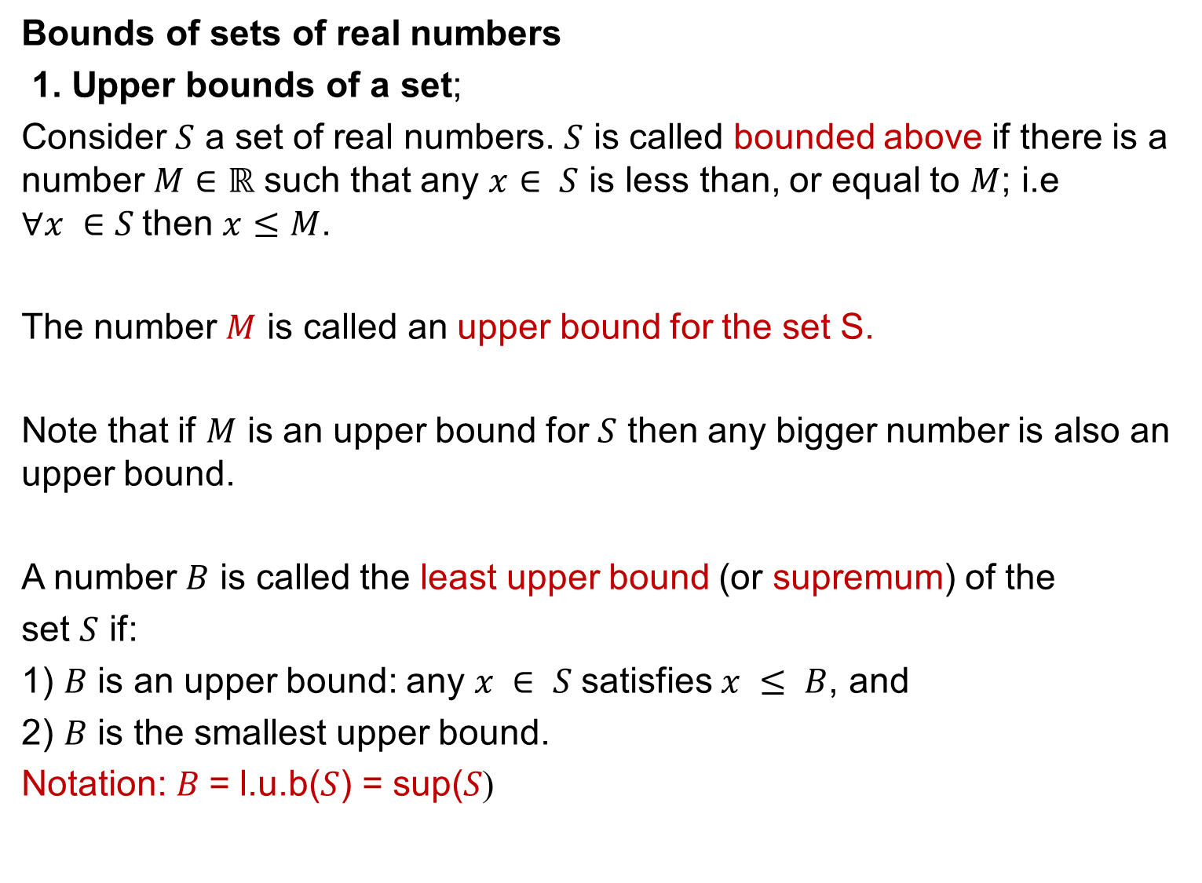
Bounds of sets of real numbers
1. Upper bounds of a set;
Consider $S$ a set of real numbers. $S$ is called bounded above if there is a number $M∈ℝ$ such that any $x$ $∈ S$ is less than, or equal to $M$; i.e $∀x ∈S$then $x≤M$.
The number $M$ is called an upper bound for the set S.
Note that if $M$ is an upper bound for $S$ then any bigger number is also an upper bound.
A number $B$ is called the least upper bound (or supremum) of the
set $S$ if:
1) $B$ is an upper bound: any $x ∈ S$satisfies $x ≤ B$, and
2) $B$ is the smallest upper bound.
(Notation: $B$= l.u.b($S$) = sup($S$

Slide 3
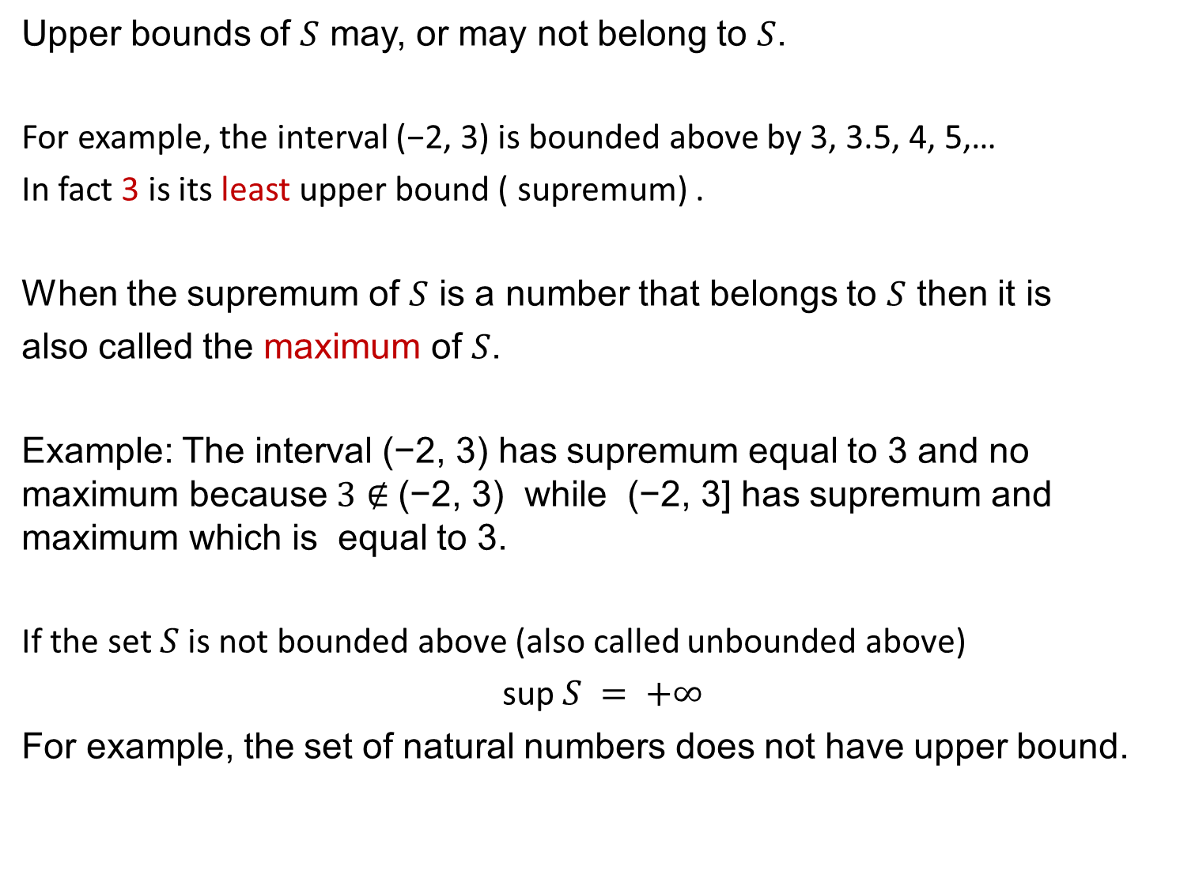
Upper bounds of $S$ may, or may not belong to $S$.
For example, the interval (−2, 3) is bounded above by 3, 3.5, 4, 5,…
In fact 3 is its least upper bound ( supremum) .
When the supremum of $S$ is a number that belongs to $S$ then it is
also called the maximum of $S$.
Example: The interval (−2, 3) has supremum equal to 3 and no maximum because $3∉$(−2, 3) while (−2, 3] has supremum and maximum which is equal to 3.
If the set $S$ is not bounded above (also called unbounded above)
sup $S = +∞$
For example, the set of natural numbers does not have upper bound.

Slide 4
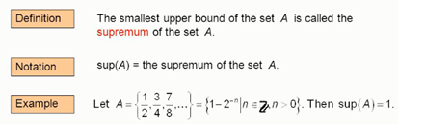

Slide 5
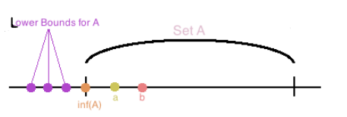
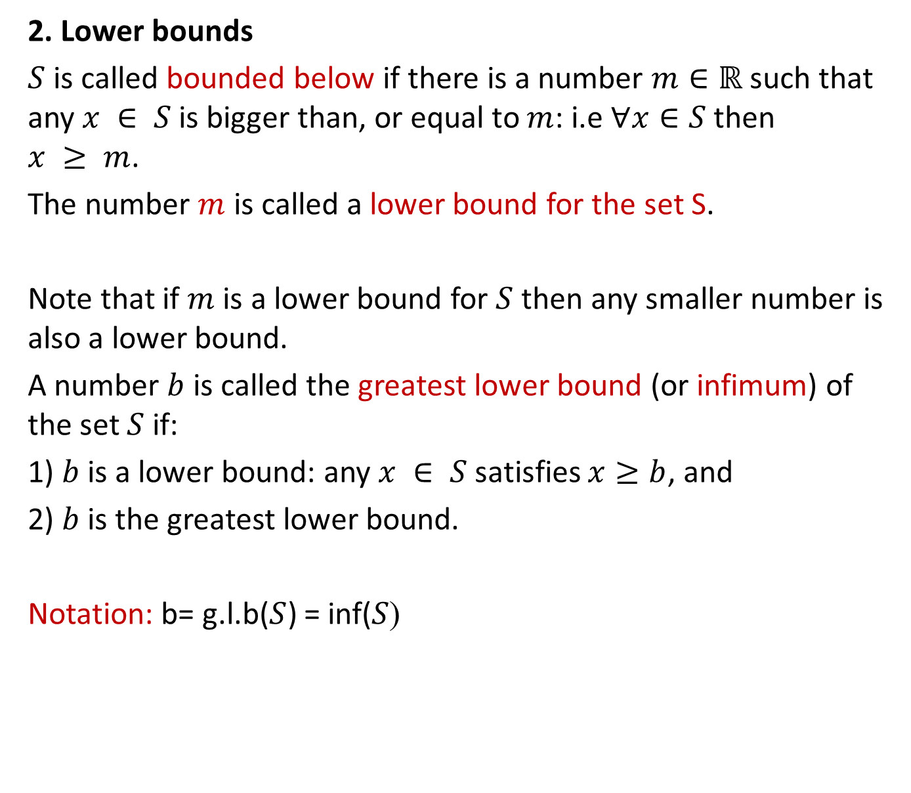
2. Lower bounds
$S$ is called bounded below if there is a number $m∈ℝ$ such that any $x ∈ S$is bigger than, or equal to $m$: i.e $∀x∈S$then $x ≥ m$.
The number $m$ is called a lower bound for the set S.
Note that if $m$ is a lower bound for $S$ then any smaller number is also a lower bound.
A number $b$ is called the greatest lower bound (or infimum) of the set $S$ if:
1) $b$ is a lower bound: any $x ∈ S$satisfies $x≥b$, and
2) $b$ is the greatest lower bound.
(Notation: b= g.l.b($S$) = inf($S$

Slide 6
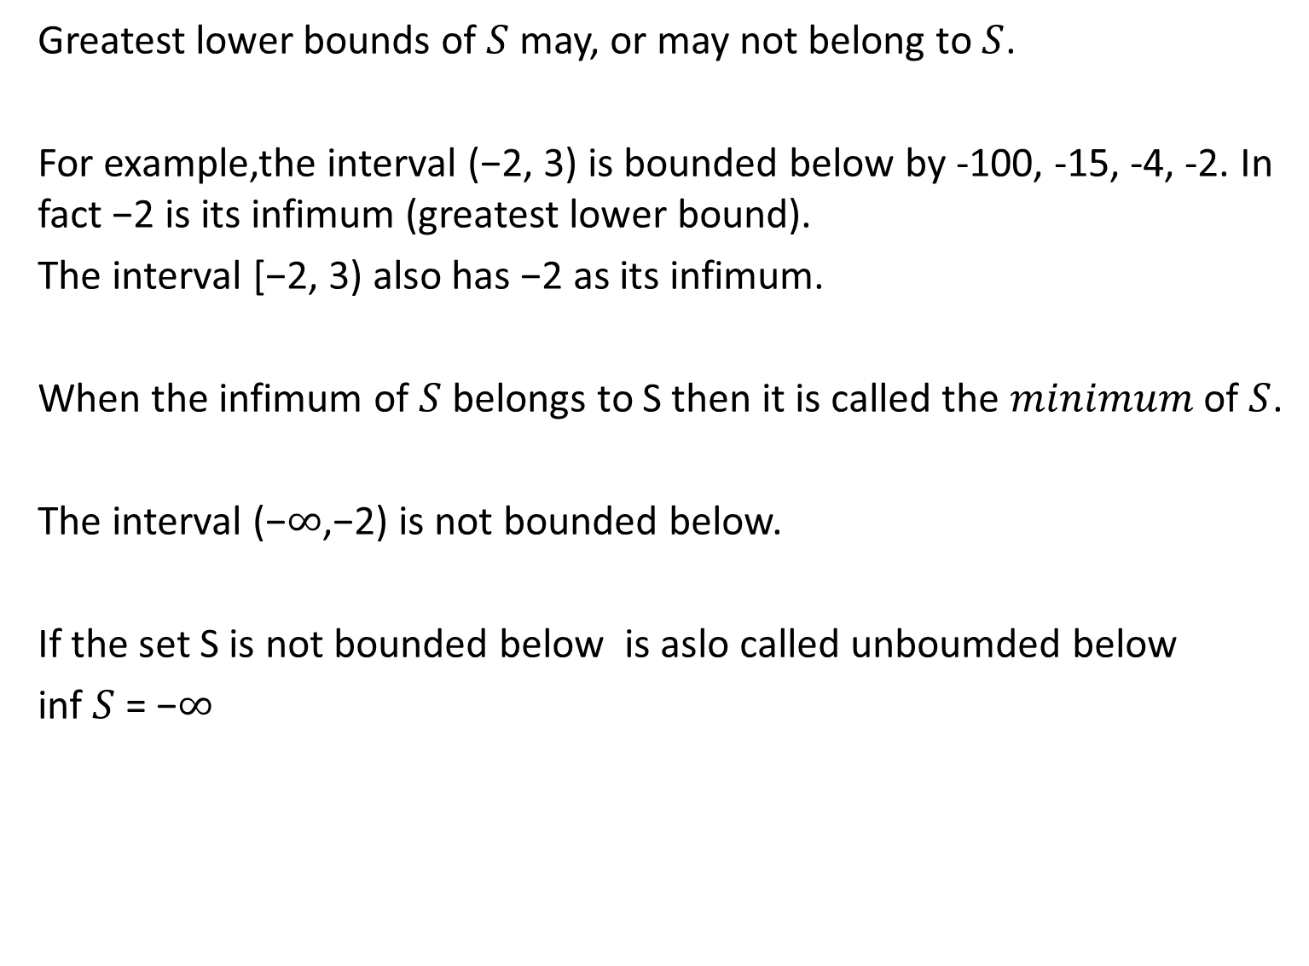
Greatest lower bounds of $S$ may, or may not belong to $S$.
For example,the interval (−2, 3) is bounded below by -100, -15, -4, -2. In fact −2 is its infimum (greatest lower bound).
The interval [−2, 3) also has −2 as its infimum.
When the infimum of $S$ belongs to S then it is called the $minimum$ of $S$.
The interval (−$∞$,−2) is not bounded below.
If the set S is not bounded below is aslo called unboumded below
inf $S$ = −$∞$

Slide 7
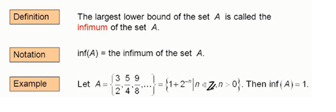
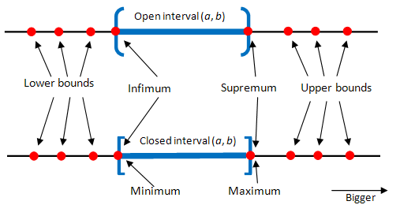

Slide 8
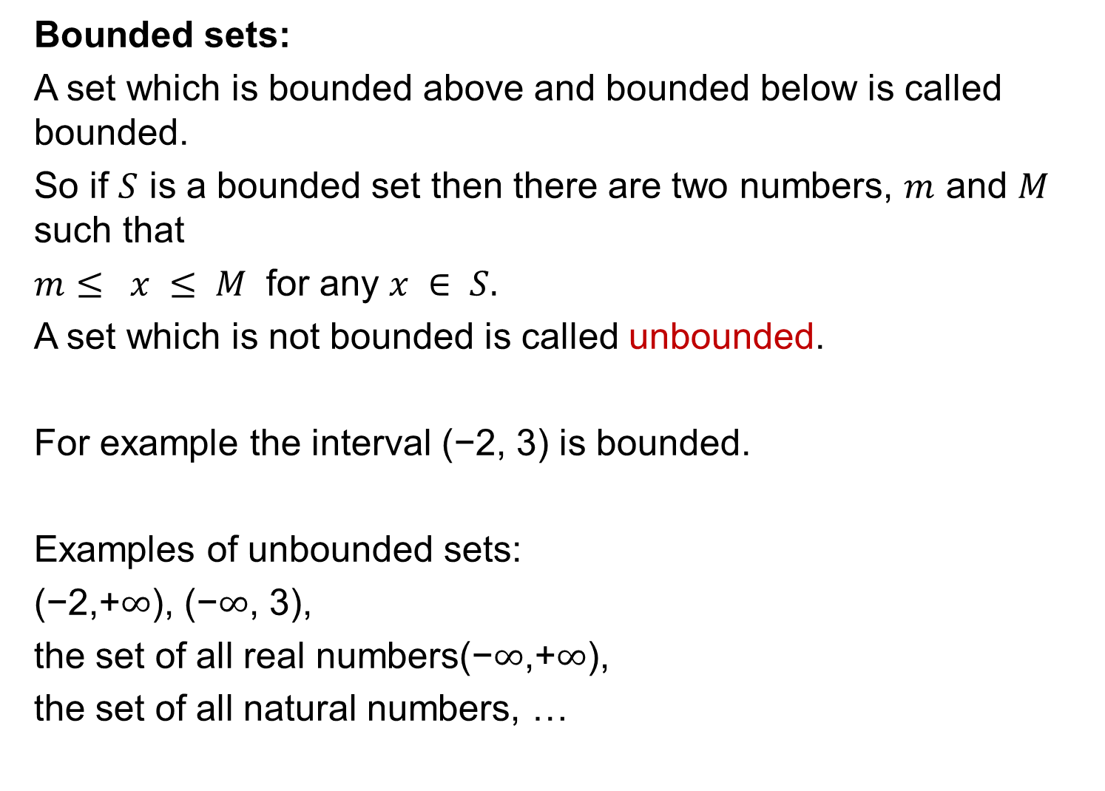
Bounded sets:
A set which is bounded above and bounded below is called bounded.
So if $S$ is a bounded set then there are two numbers, $m$ and $M$ such that
$m≤ x ≤ M$ for any $x ∈ S.$
A set which is not bounded is called unbounded.
For example the interval (−2, 3) is bounded.
Examples of unbounded sets:
(−2,+$∞$), (−$∞$, 3),
the set of all real numbers(−$∞$,+$∞$),
the set of all natural numbers, …

Slide 9
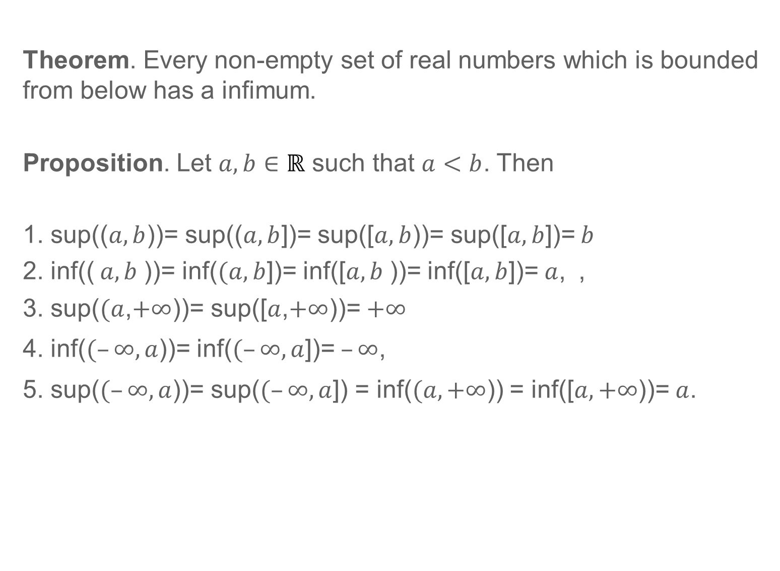
Theorem. Every non-empty set of real numbers which is bounded from below has a infimum.
Proposition. Let $a,b∈ℝ$ such that $a<b$. Then
1. sup(($a,b$))= sup(($a,b$])= sup([$a,b$))= sup([$a,b$])= $b$
2. inf(( $a,b$))= inf($(a,b$])= inf([$a,b$))= inf([$a,b$])=$a$, ,
3. sup($(a$,$+∞$))= sup([$a$,$+∞$))=$+∞$
4. inf($(–∞,a$))= inf($(–∞,a$])=$–∞$,
5. sup($(–∞,a$))= sup($(–∞,a$]) = inf($(a,+∞$)) = inf([$a,+∞$))=$a$.

Slide 10
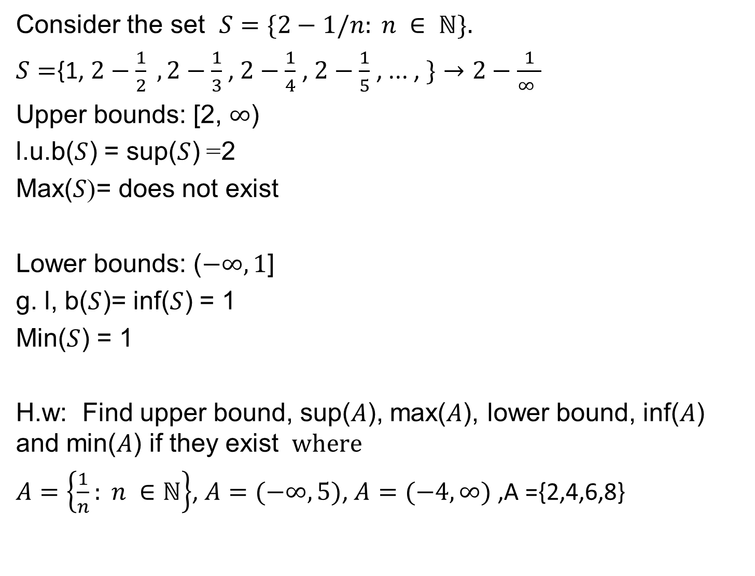
Consider the set $S=\{2−1/n: n ∈ ℕ\}.$
$S=${1, $2−\frac{1}{2} , 2−\frac{1}{3}$ , $2−\frac{1}{4}$ , $2−\frac{1}{5}$ , ... , $\}→2−\frac{1}{∞ }$
Upper bounds: [2, $∞$)
2= l.u.b($S$) = sup($S$)
= does not exist (Max($S$
Lower bounds: ($−∞,1$]
g. l, b($S$)= inf($S$) = 1
Min($S$) = 1
H.w: Find upper bound, sup($A$), max($A$), lower bound, inf($A$) and min($A$) if they exist $where$
$A=\left\{\frac{1}{n}: n ∈ℕ\right\}$, $A=(−∞,5)$, $A=(−4,∞)$ ,A ={2,4,6,8}

Slide 11
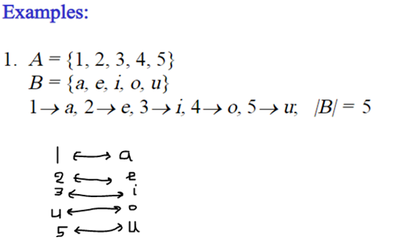

1-1Correspondence
Definition: A one-to-one correspondence; the elements in two sets $can be matched$ together in such a way that each element is paired with exactly one unique element from the other set.

Slide 12
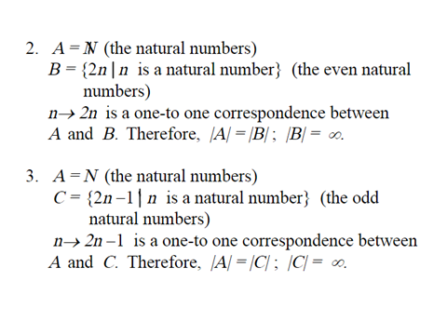

Slide 13
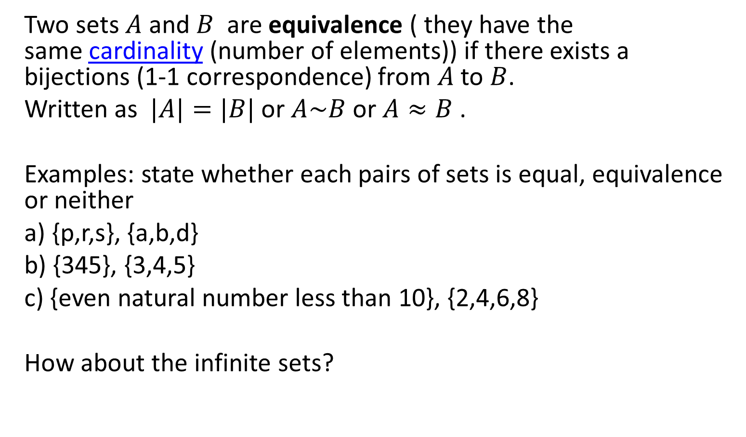
: Equivalence(equinumerous)
Two sets $A$ and $B$ are equivalence ( they have the same cardinality (number of elements)) if there exists a bijections (1-1 correspondence) from $A$ to $B$.
Written as $|A|=|B|$or $A\sim B$ or $A≈B$ .
Examples: state whether each pairs of sets is equal, equivalence or neither
a) {p,r,s}, {a,b,d}
b) {345}, {3,4,5}
c) {even natural number less than 10}, {2,4,6,8}
How about the infinite sets?

Slide 14
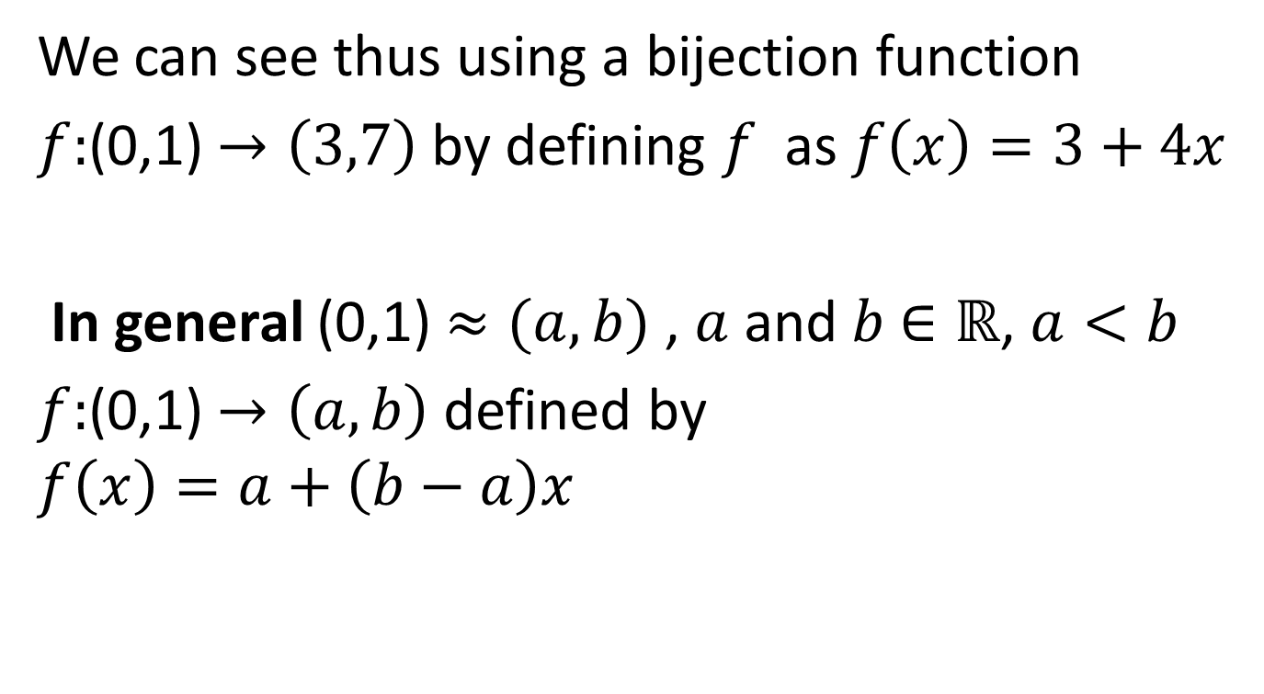

Example: (0,1) $≈(3,7)$
We can see thus using a bijection function
$f:$(0,1) $→\left(3,7\right)$ by defining $f$ as $f\left(x\right)=3+4x$
In general (0,1) $≈(a,b)$ , $a$ and $b$ $∈ℝ$, $a<b$
$f:$(0,1) $→\left(a,b\right)$ defined by
$$f\left(x\right)=a+\left(b−a\right)x$$

Slide 15
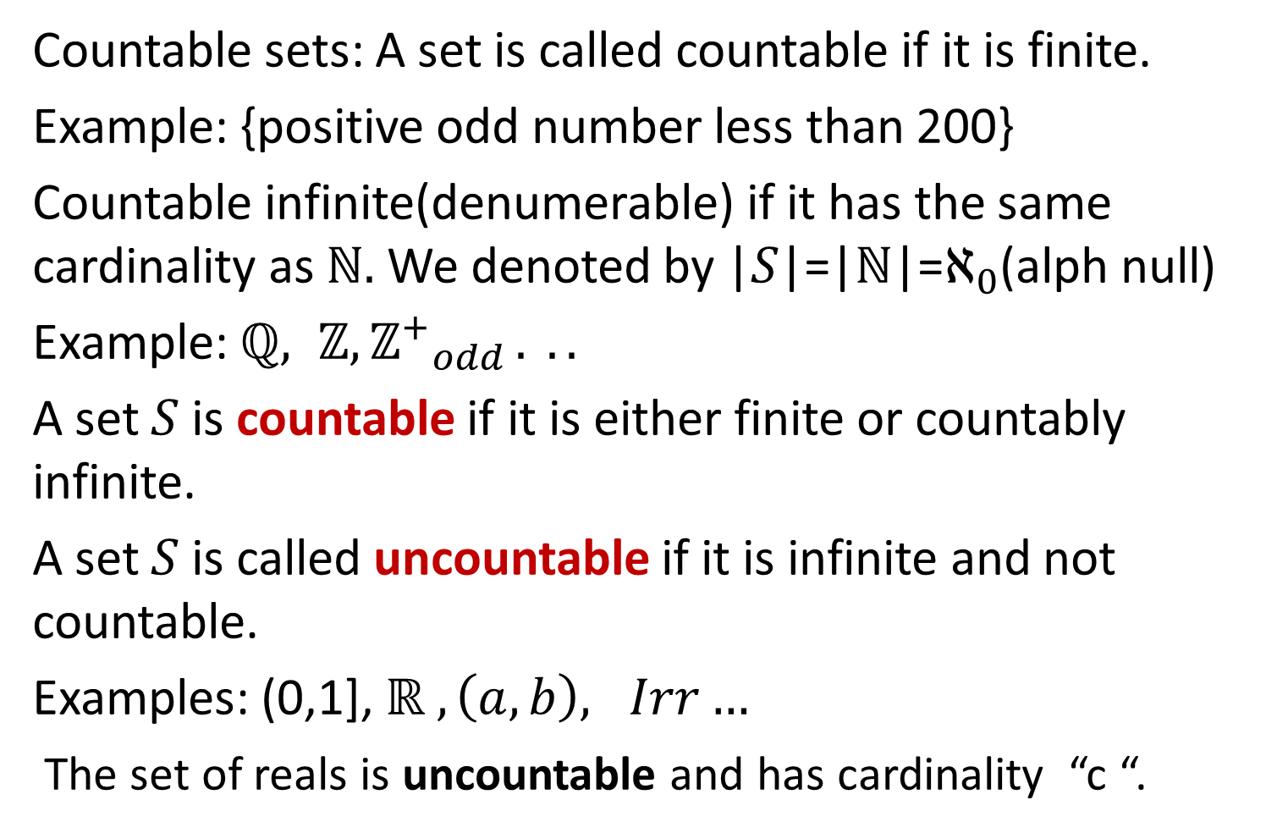
Countable and Uncountable sets
Countable sets: A set is called countable if it is finite.
Example: {positive odd number less than 200}
Countable infinite(denumerable) if it has the same cardinality as $ℕ.$We denoted by |$S$|=|$ℕ$|=$ℵ_{0}$(alph null)
Example: $ℚ, ℤ, {ℤ^{+}}_{odd }. ..$
A set $S$ is countable if it is either finite or countably infinite.
A set $S$ is called uncountable if it is infinite and not countable.
Examples: (0,1], $ℝ , \left(a,b\right), Irr…$
The set of reals is uncountable and has cardinality “c “.

Slide 16
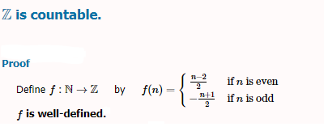
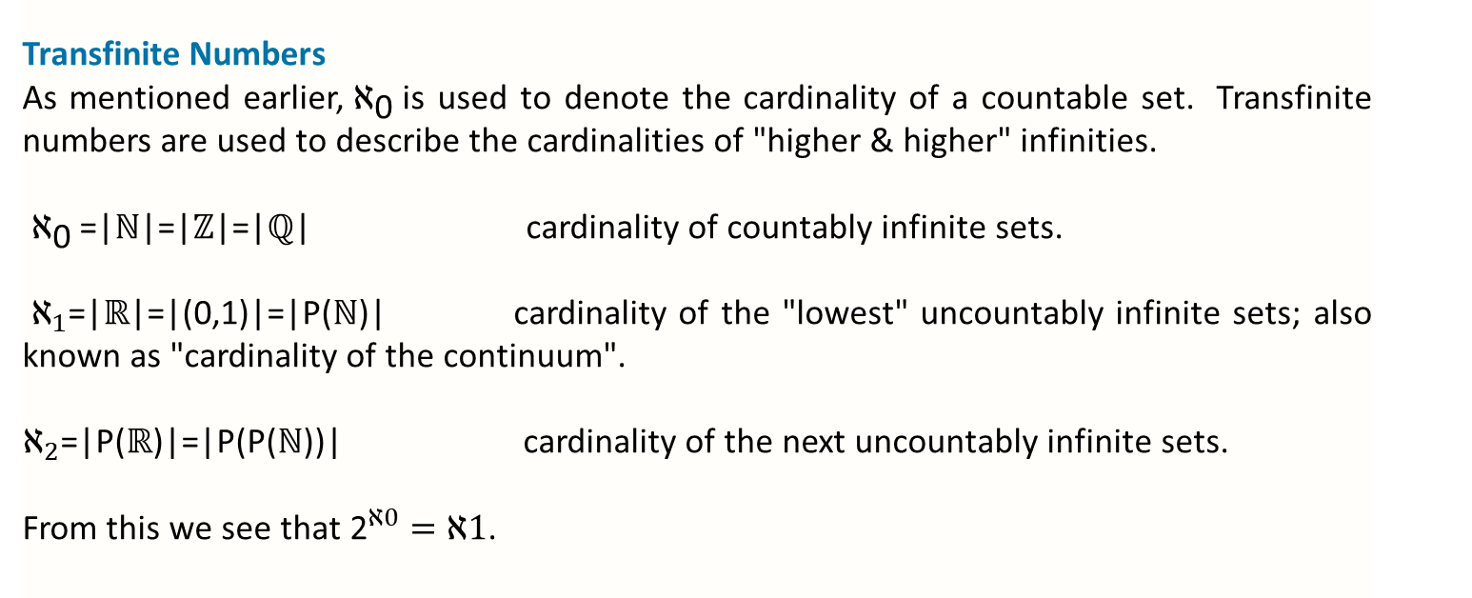
Transfinite Numbers
As mentioned earlier, ${\text{ℵ}}_{\text{0}}$ is used to denote the cardinality of a countable set. Transfinite numbers are used to describe the cardinalities of "higher & higher" infinities.
${\text{ℵ}}_{\text{0}}$=|$ℕ$|=|$ℤ$|=|$ℚ$| cardinality of countably infinite sets.
$ℵ_{1}$=|$ℝ$|=|(0,1)|=|P($ℕ$)| cardinality of the "lowest" uncountably infinite sets; also known as "cardinality of the continuum".
$ℵ_{2}$=|P($ℝ$)|=|P(P($ℕ$))| cardinality of the next uncountably infinite sets.
From this we see that ${\text{2}}^{ℵ0}=ℵ1$.

Slide 17
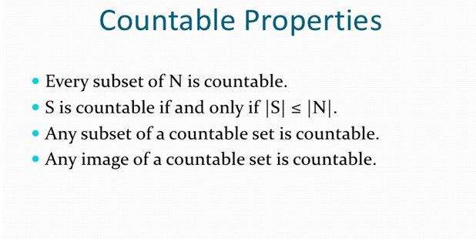

Slide 18
