Slide 1
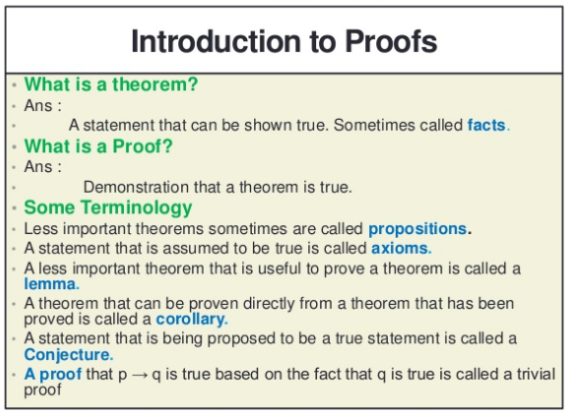

Slide 2
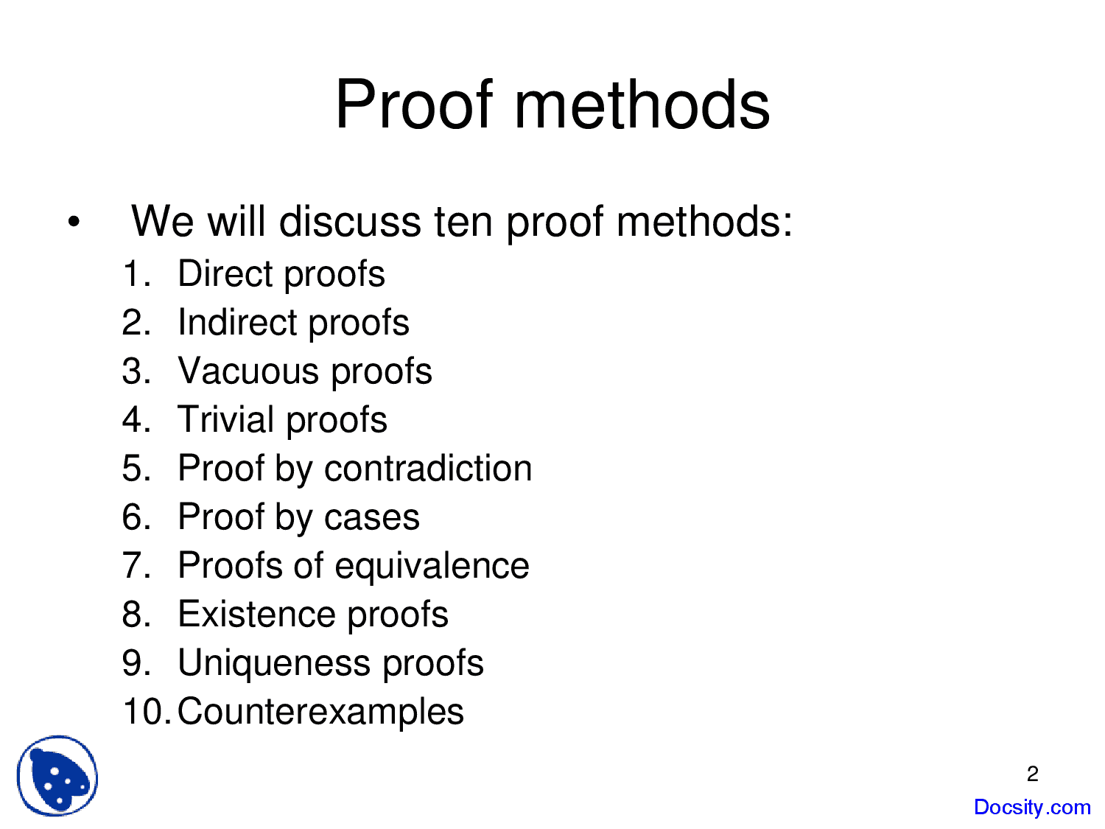

Slide 3
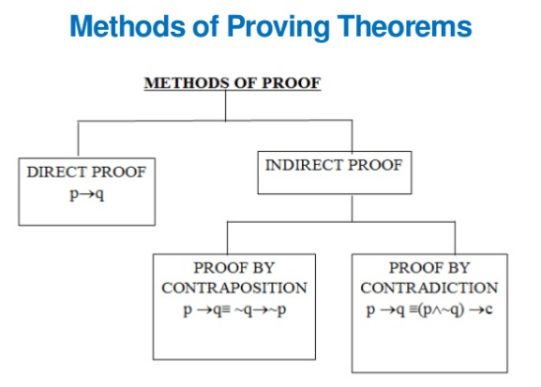

Slide 4

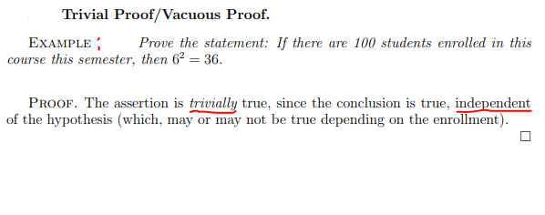


Slide 5
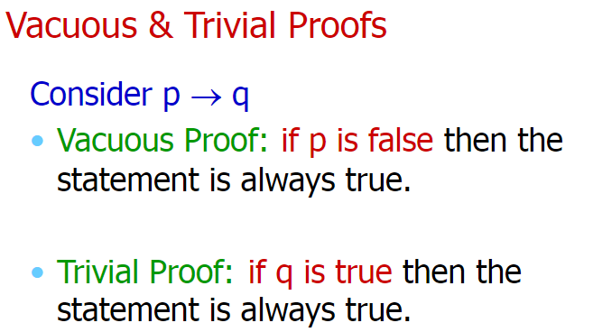
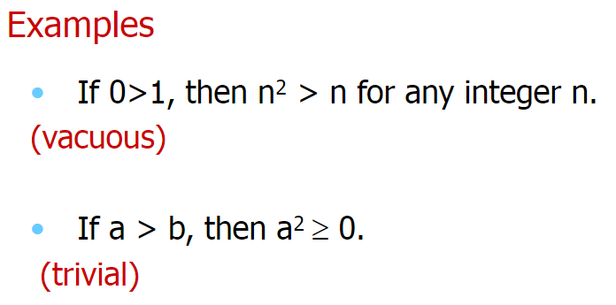

Slide 6
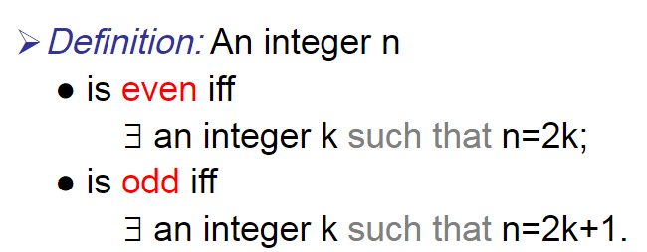
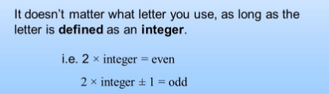

Slide 7
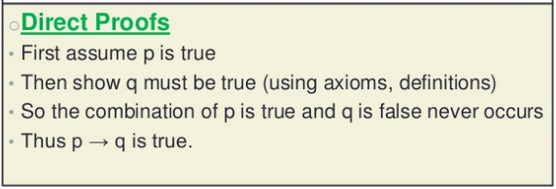
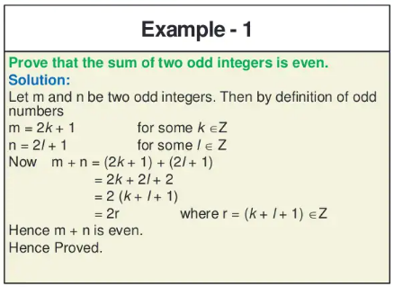

Slide 8
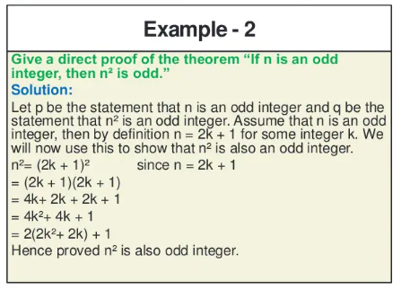

Slide 9
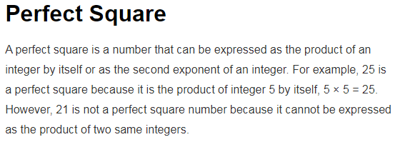
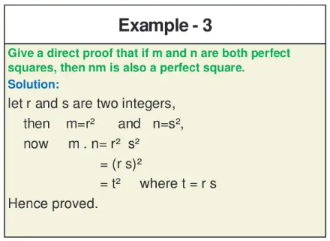

Slide 10
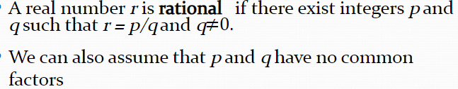
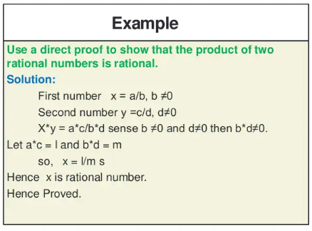

Slide 11
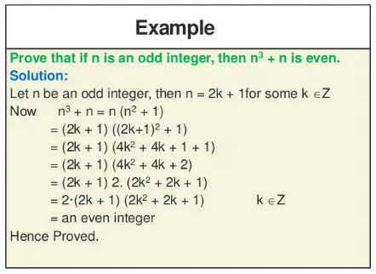


Slide 12
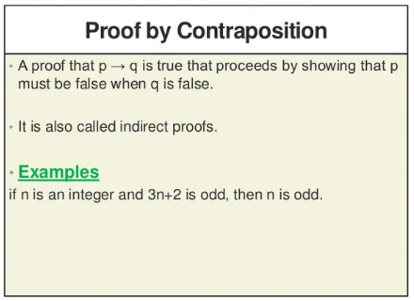

Slide 13
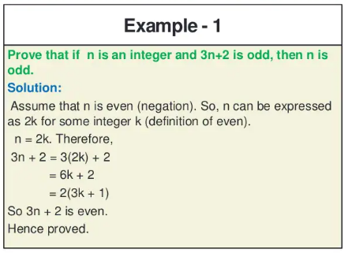

Slide 14
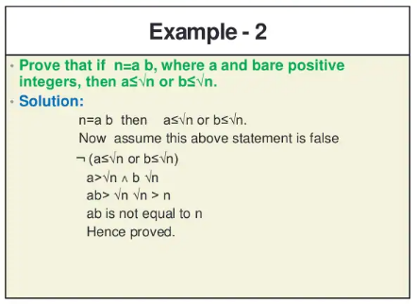


Slide 15
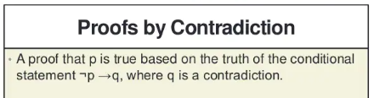

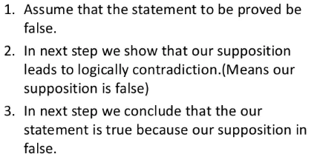

Slide 16
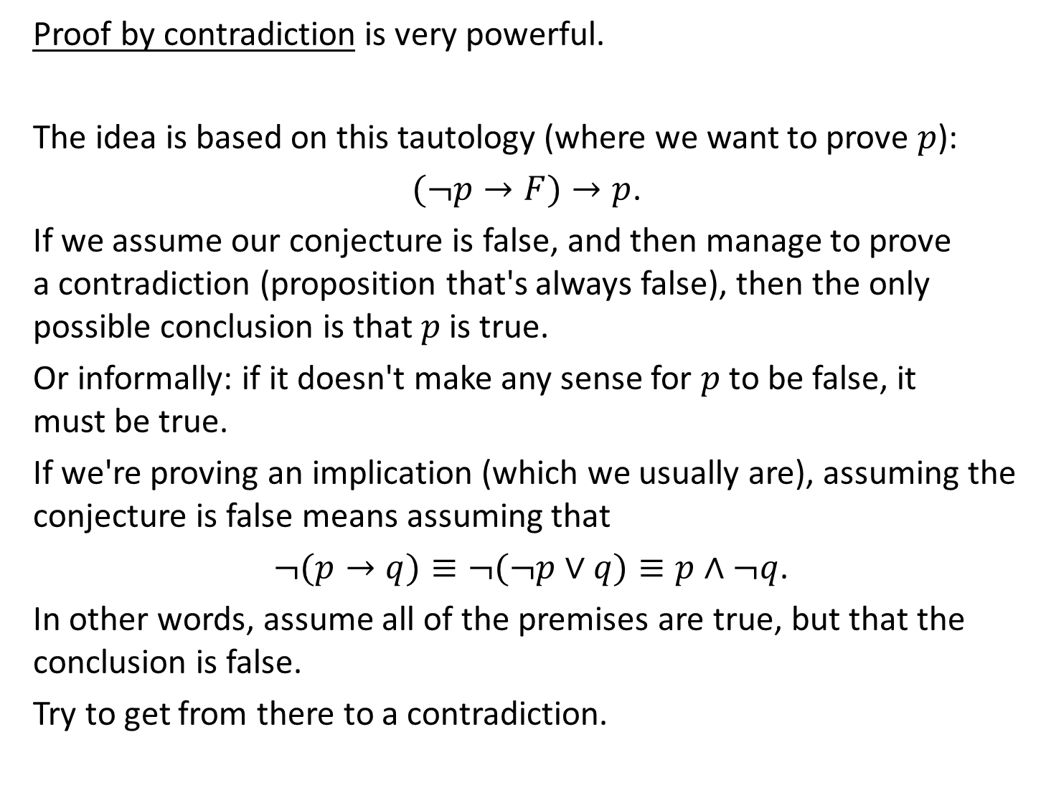
Proof by contradiction is very powerful.
The idea is based on this tautology (where we want to prove $p$):
$(¬p→F)→p$.
If we assume our conjecture is false, and then manage to prove a contradiction (proposition that's always false), then the only possible conclusion is that $p$ is true.
Or informally: if it doesn't make any sense for $p$ to be false, it must be true.
If we're proving an implication (which we usually are), assuming the conjecture is false means assuming that
$¬(p→q)≡¬(¬p∨q)≡p∧¬q$.
In other words, assume all of the premises are true, but that the conclusion is false.
Try to get from there to a contradiction.

Slide 17
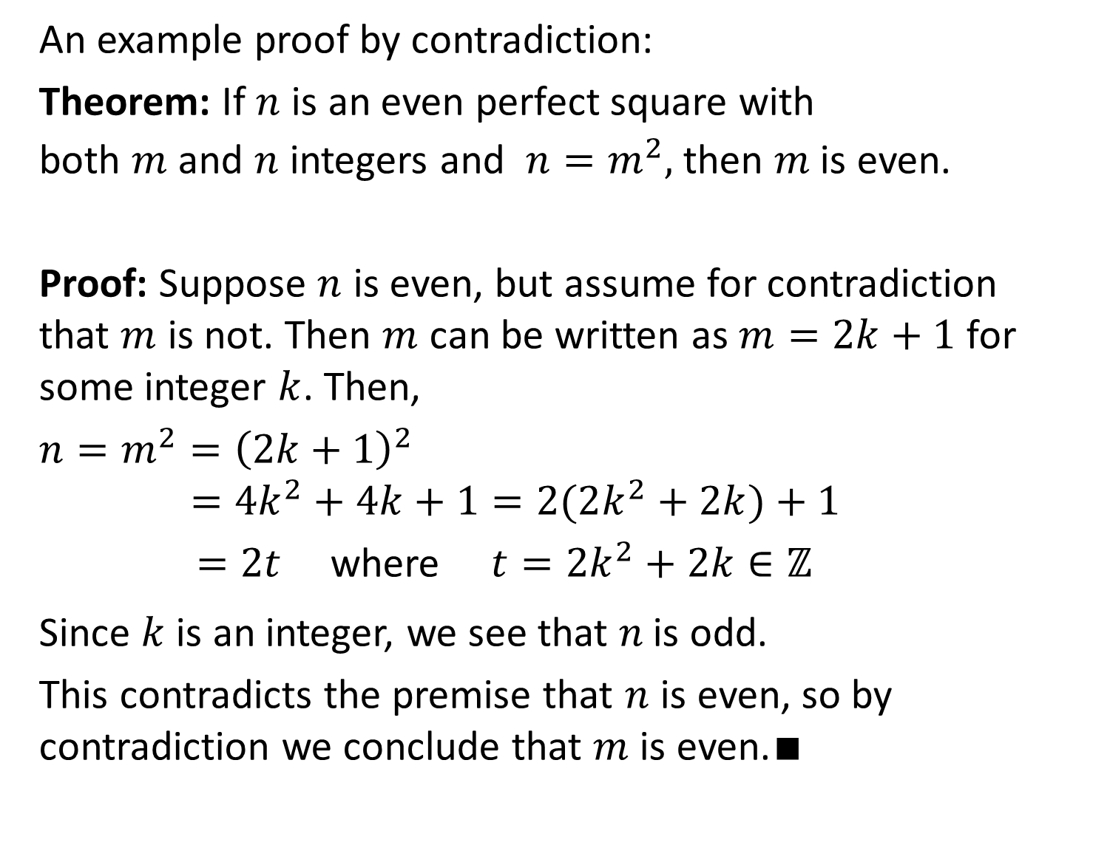
An example proof by contradiction:
Theorem: If $n$ is an even perfect square with both $m$ and $n$ integers and $n=m^{2},$ then $m$is even.
Proof: Suppose $n$ is even, but assume for contradiction that $m$ is not. Then $m$ can be written as $m=2k+1$ for some integer $k$. Then,
$n=m^{2}={\left(2k+1\right)}^{2}$ $=4k^{2}+4k+1=2(2k^{2}+2k)+1$
$=2t$ where $t=2k^{2}+2k∈ℤ$
Since $k$ is an integer, we see that $n$is odd.
This contradicts the premise that $n$ is even, so by contradiction we conclude that $m$ is even.∎

Slide 18
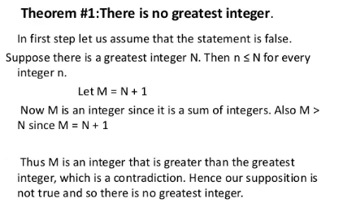


Slide 19
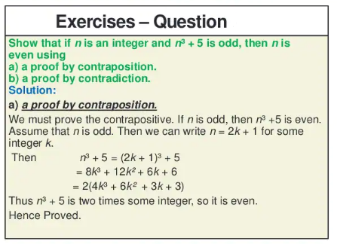

Slide 20
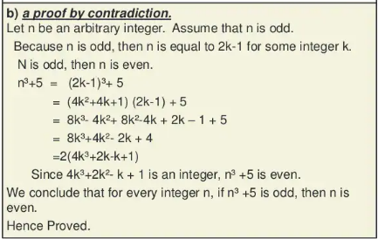

Slide 21
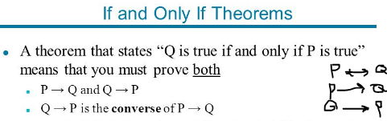
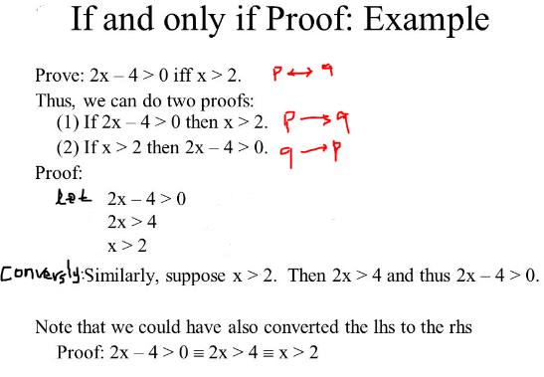

Slide 22
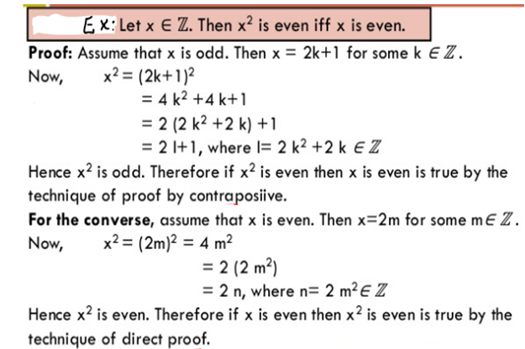

Slide 23
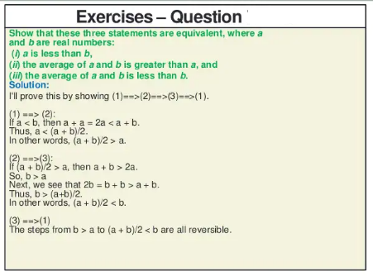

Slide 24
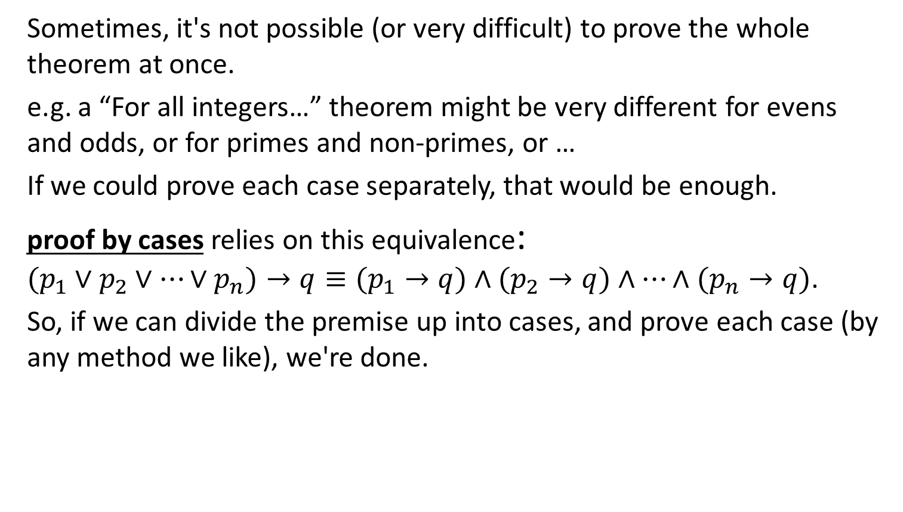
Proof by Cases
Sometimes, it's not possible (or very difficult) to prove the whole theorem at once.
e.g. a “For all integers…” theorem might be very different for evens and odds, or for primes and non-primes, or …
If we could prove each case separately, that would be enough.
proof by cases relies on this equivalence: $(p_{1}∨p_{2}∨⋯∨p_{n})→q≡(p_{1}→q)∧(p_{2}→q)∧⋯∧(p_{n}→q)$.
So, if we can divide the premise up into cases, and prove each case (by any method we like), we're done.

Slide 25
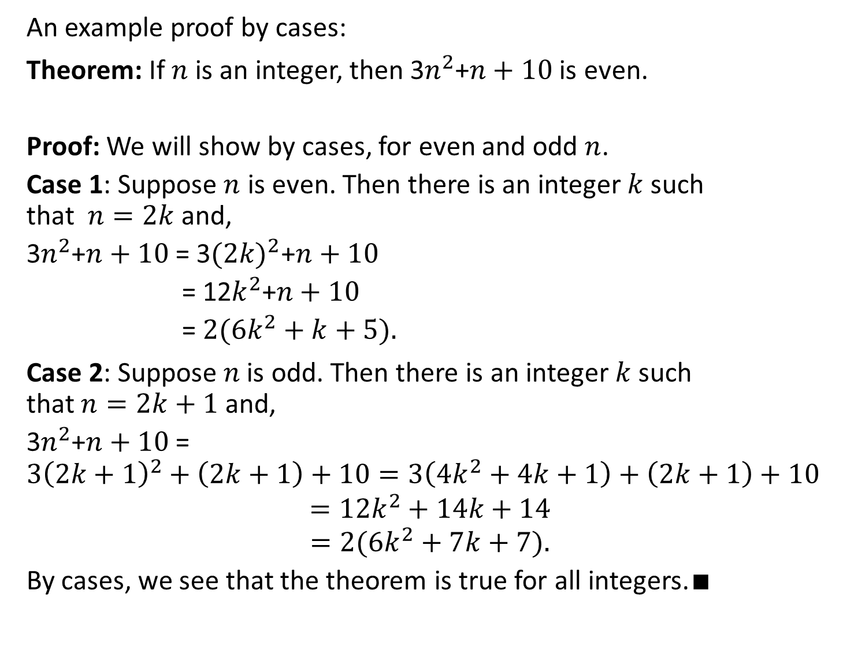
An example proof by cases:
Theorem: If $n$ is an integer, then 3$n^{2}$+$n+10$is even.
Proof: We will show by cases, for even and odd $n$.
Case 1: Suppose $n$ is even. Then there is an integer $k$ such that $n=2k$ and,
3$n^{2}$+$n+10$= 3${(2k)}^{2}$+$n+10$
= 12$k^{2}$+$n+10$
=$2(6k^{2}+k+5).$
Case 2: Suppose $n$is odd. Then there is an integer $k$ such that $n=2k+1$ and,
3$n^{2}$+$n+10$=$3{\left(2k+1\right)}^{2}+\left(2k+1\right)+10=3\left(4k^{2}+4k+1\right)+\left(2k+1\right)+10$
$$=12k^{2}+14k+14$$
$$=2(6k^{2}+7k+7).$$
By cases, we see that the theorem is true for all integers.∎

Slide 26
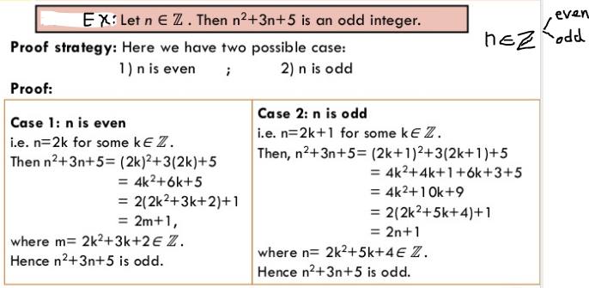

Slide 27
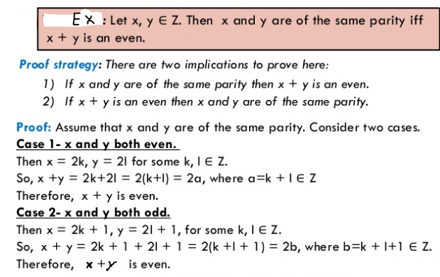
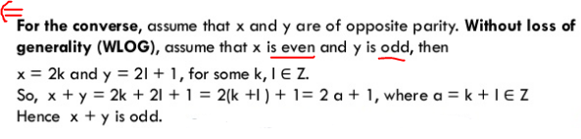

Slide 28
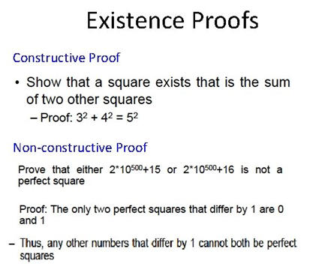

Slide 29
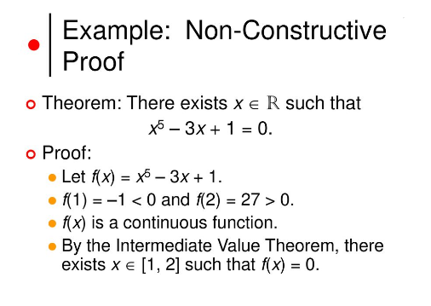

Slide 30
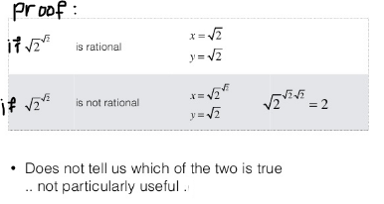


Slide 31
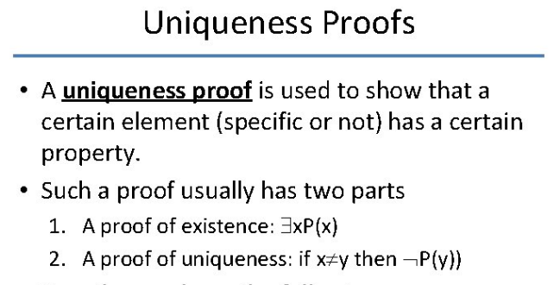
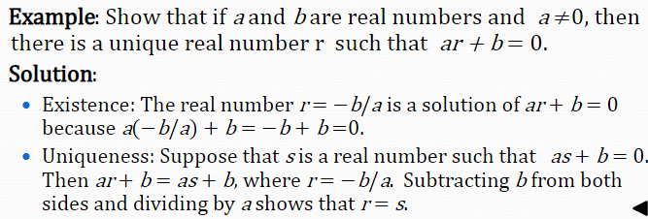

Slide 32
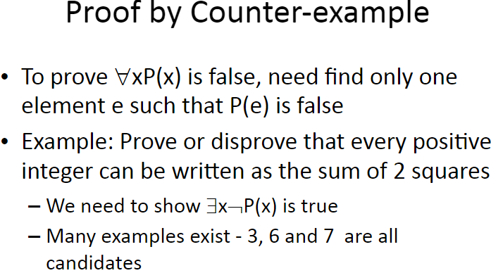

Slide 33
