Slide 1
Finite Mathematics II
Linear programing

Slide 2
Sketching the Region Represented by a Linear Inequality in Two Variables
Sketch the straight line obtained by replacing the given inequality with an equality.
Choose a test point that is not on the line; (0,0) is a good choice if the line does not pass through the origin.
If the test point satisfies the inequality, then the set of solutions is the line plus the entire region on the same side of the line as the test point. Otherwise, it is the line plus the region on the other side of the line. In either case, shade (block out) the side that does not contain the solutions, leaving the solution set unshaded.

Slide 3
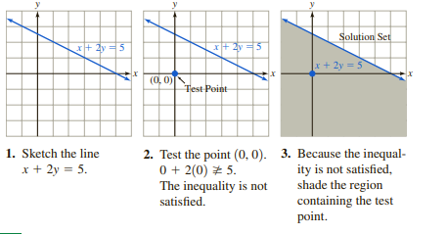

Here are the three steps used to graph the inequality $x+2y≥5$

Slide 4
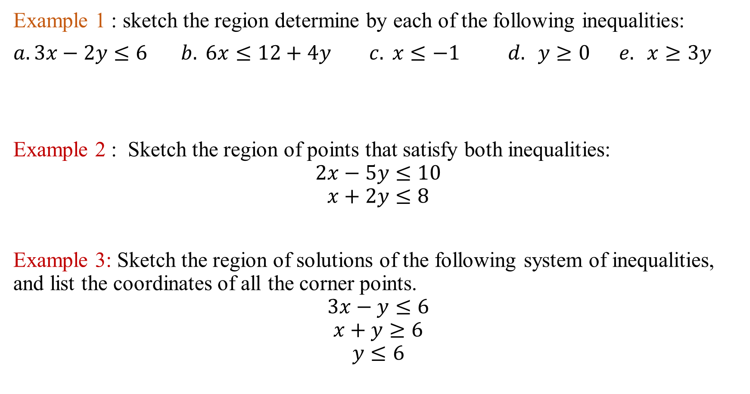
Example 1 : sketch the region determine by each of the following inequalities:
$a.3x−2y≤6 b. 6x≤12+4y c. x≤−1 d. y≥0 e. x≥3y$
Example 2 : Sketch the region of points that satisfy both inequalities:
$$2x−5y≤10$$
$$x+2y≤8$$
Example 3: Sketch the region of solutions of the following system of inequalities, and list the coordinates of all the corner points.
$$3x−y≤6$$
$$x+y≥6$$
$$y≤6$$

Slide 5
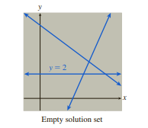
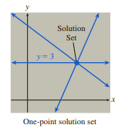

Note : the solution set of the system is empty.
$$3x−y≤6$$
$$x+y≥6$$
$$y≤2$$
the solution set of the system is one point .
$$3x−y≤6$$
$$x+y≥6$$
$$y≤2$$

Slide 6
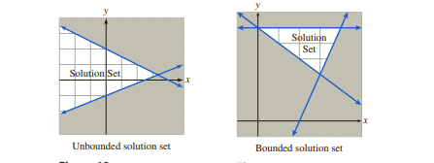
Notice that the solution set in Figure A extends infinitely far to the left, whereas the one in Figure B is completely enclosed by a boundary. Sets that are completely enclosed are called bounded, and sets that extend infinitely in one or more directions are unbounded.
Figure A
Figure B

Slide 7
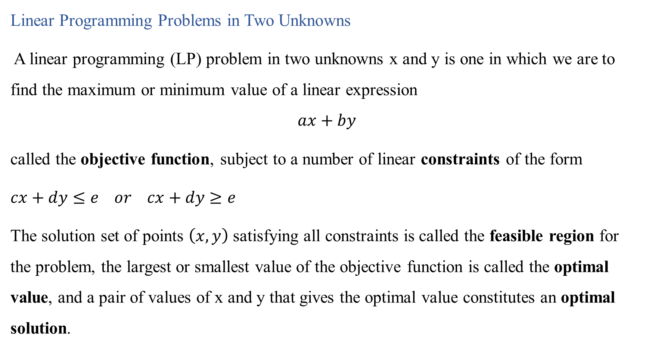
Linear Programming Problems in Two Unknowns
A linear programming (LP) problem in two unknowns x and y is one in which we are to find the maximum or minimum value of a linear expression
$$ax+by$$
called the objective function, subject to a number of linear constraints of the form
$cx+dy≤e or cx+dy≥e$
The solution set of points $\left(x,y\right)$ satisfying all constraints is called the feasible region for the problem, the largest or smallest value of the objective function is called the optimal value, and a pair of values of x and y that gives the optimal value constitutes an optimal solution.

Slide 8
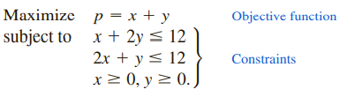
Fundamental Theorem of Linear Programming
(a) Linear programming problems with bounded, nonempty feasible regions always have optimal solutions.
(b) If an LP problem has optimal solutions, then at least one of these solutions occurs at a corner point of the feasible region

Slide 9
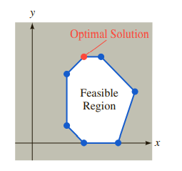
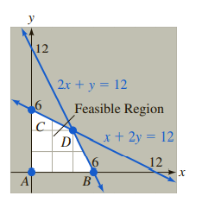

Example: solving a Linear Programming Problem
Maximize $p=x+y$
Subjected to $x+2y≤12$
$2x+y≤12$
$x≥0 ,y≥0.$

Slide 10
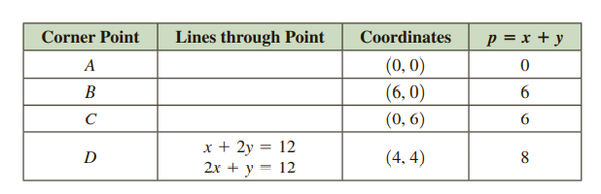
Now we simply pick the one that gives the largest value for p, which is D. Therefore, the optimal value of p is 8, and an optimal solution is (4,4).

