Slide 1
Finite mathematicsII
Linear System

Slide 2
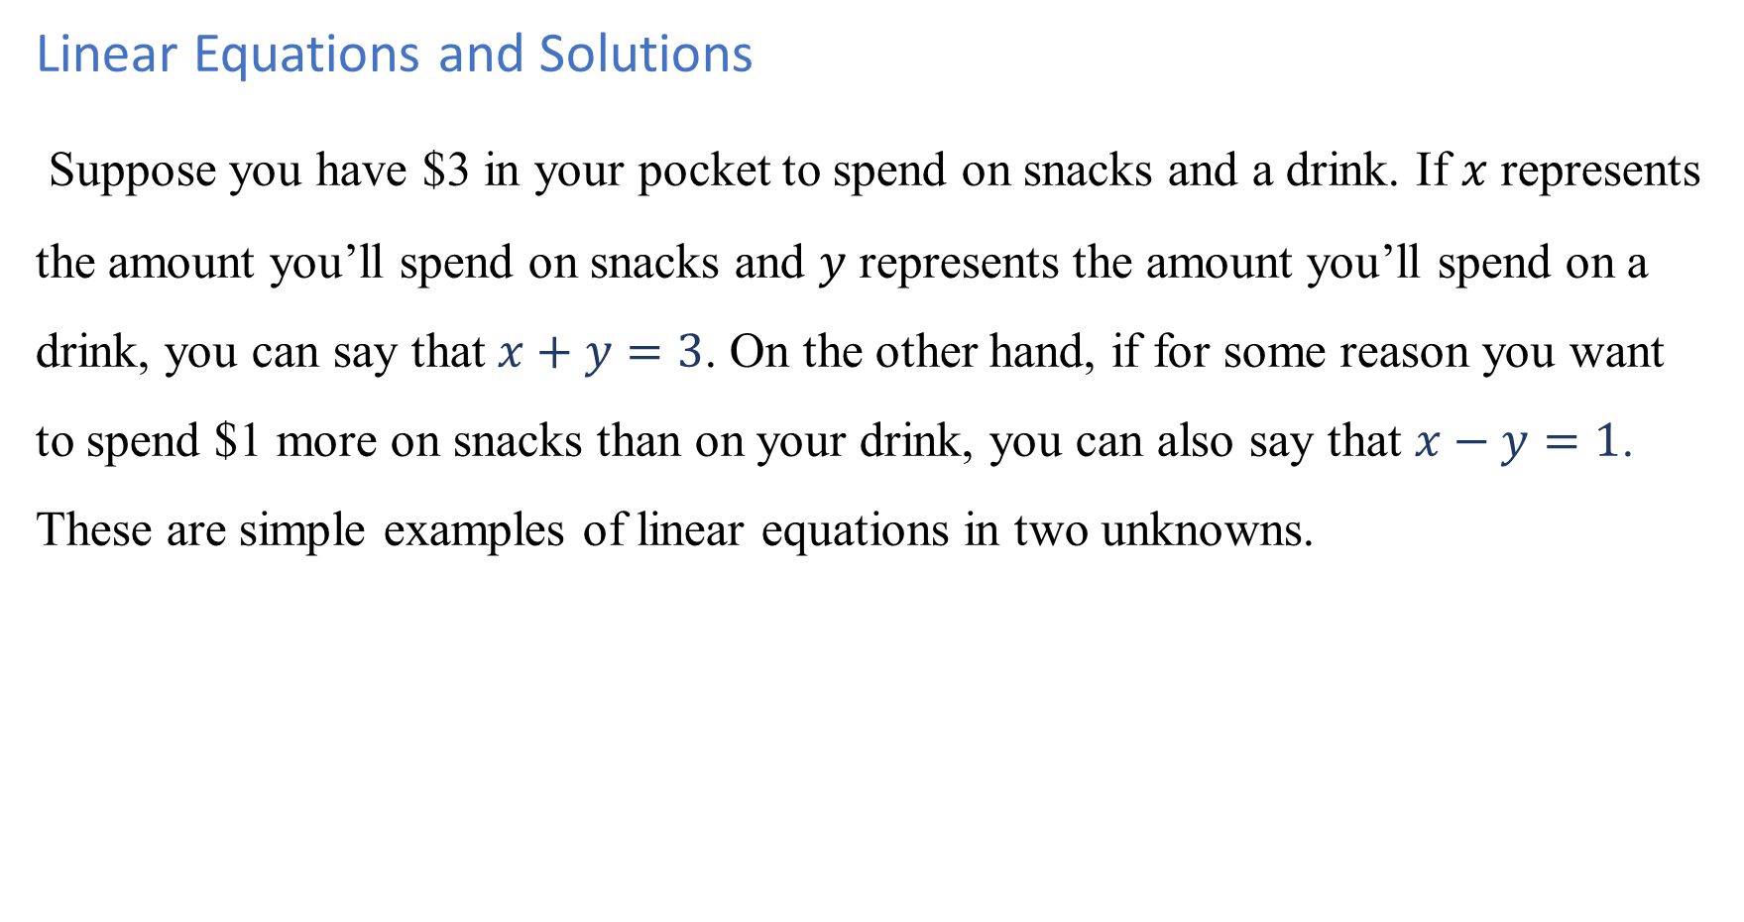
Linear Equations and Solutions
Suppose you have $3 in your pocket to spend on snacks and a drink. If $x$ represents the amount you’ll spend on snacks and $y$ represents the amount you’ll spend on a drink, you can say that $x+y=3$. On the other hand, if for some reason you want to spend $1 more on snacks than on your drink, you can also say that $x−y=1$. These are simple examples of linear equations in two unknowns.

Slide 3
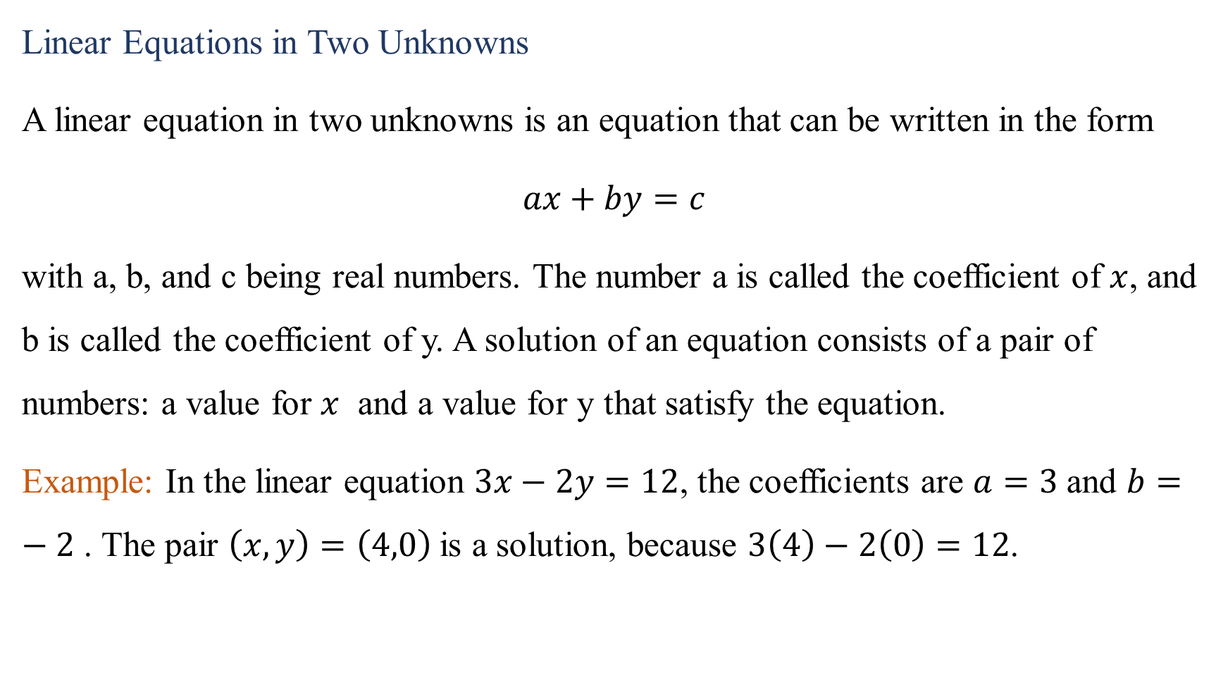
Linear Equations in Two Unknowns
A linear equation in two unknowns is an equation that can be written in the form
$ax+by=c$
with a, b, and c being real numbers. The number a is called the coefficient of $x$, and b is called the coefficient of y. A solution of an equation consists of a pair of numbers: a value for $x$ and a value for y that satisfy the equation.
Example: In the linear equation $3x−2y=12$, the coefficients are $a=3$and $b=−2$ . The pair $\left(x,y\right)=\left(4,0\right)$is a solution, because $3\left(4\right)−2\left(0\right)=12$.

Slide 4
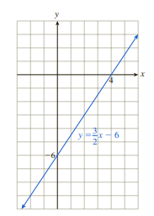

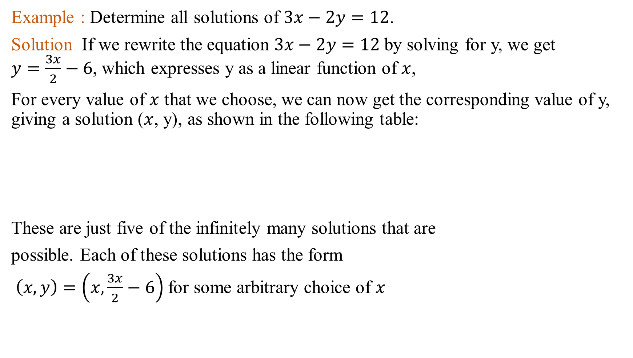
Example : Determine all solutions of $3x−2y=12$.
Solution If we rewrite the equation $3x−2y=12$by solving for y, we get $y=\frac{3x}{2}−6$, which expresses y as a linear function of $x$,
For every value of $x$ that we choose, we can now get the corresponding value of y, giving a solution ($x$, y), as shown in the following table:
These are just five of the infinitely many solutions that are
possible. Each of these solutions has the form
$\left(x,y\right)=\left(x,\frac{3x}{2}−6\right)$for some arbitrary choice of $x$

Slide 5
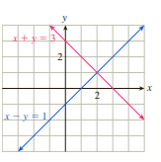
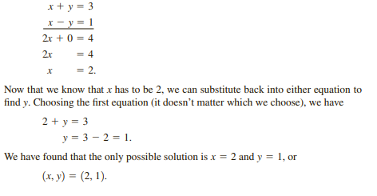

Example : Find all solutions $(x,y)$ of the following system of two equations:
$$x+y=3$$
$$x−y=1$$
Solution :

Slide 6
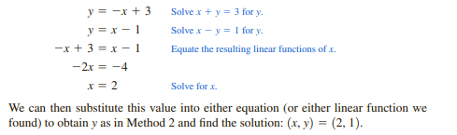
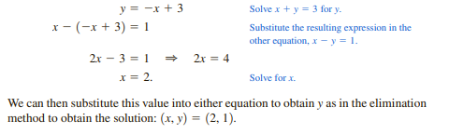
Another way
Another way

Slide 7

Example 2 :
$$\frac{x}{5}+\frac{y}{3}=0$$
$$0.2x+0.7y=0.1$$
Example 3 :
$$x−3y=5$$
$$−2x+6y=8$$
Example 4 :
$$x+y=2$$
$$2x+2y=4$$

Slide 8
Example : Acme Baby Foods mixes two strengths of apple juice. One quart of Beginner’s juice is made from 30 fluid ounces of water and 2 fluid ounces of apple juice concentrate. One quart of Advanced juice is made from 20 fluid ounces of water and 12 fluid ounces of concentrate. Every day Acme has available 30,000 fluid ounces of water and 3,600 fluid ounces of concentrate. If the company wants to use all the water and concentrate, how many quarts of each type of juice should it mix?

