Slide 1
Probability

Slide 2
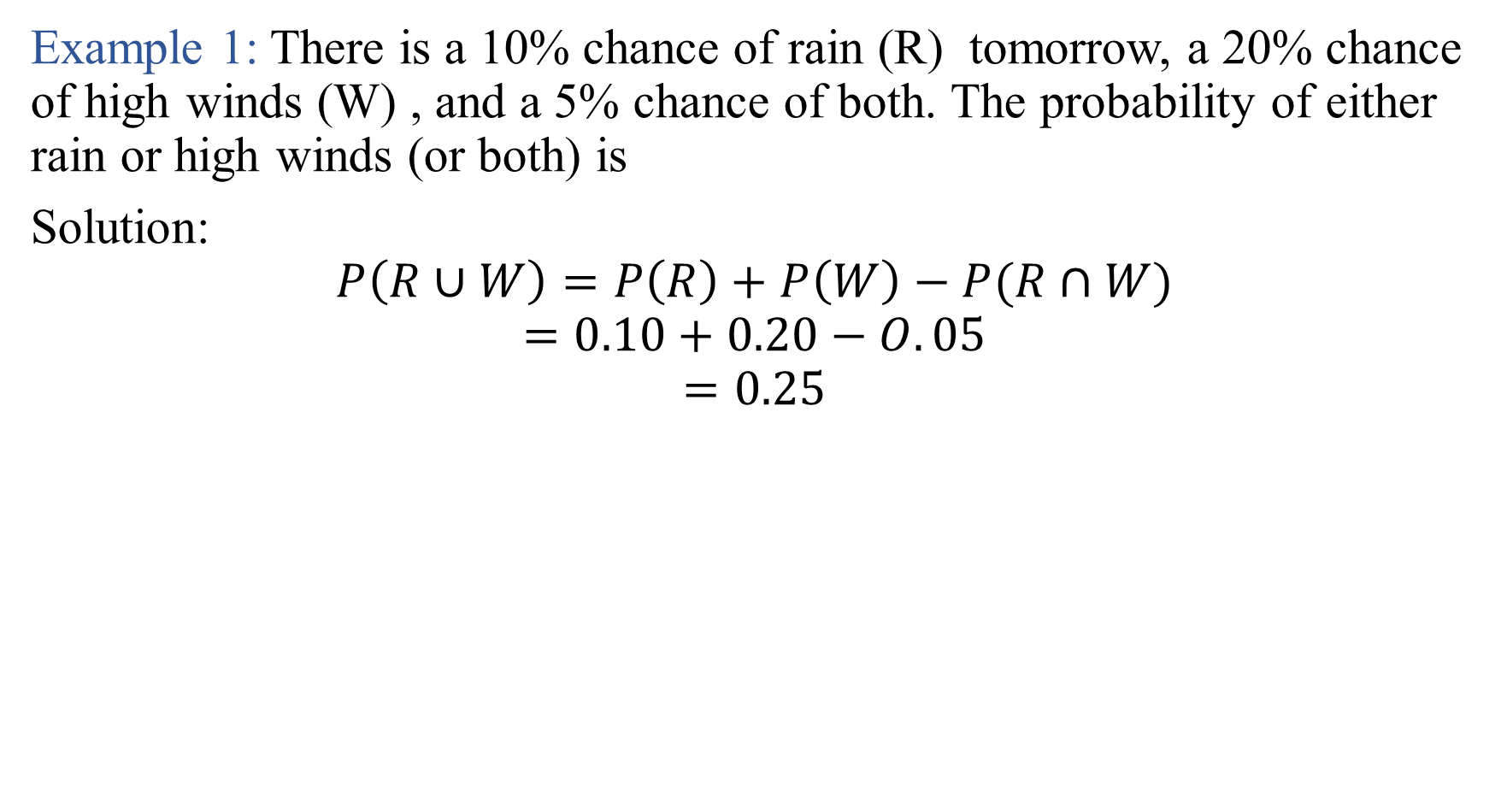
Example 1: There is a 10% chance of rain (R) tomorrow, a 20% chance of high winds (W) , and a 5% chance of both. The probability of either rain or high winds (or both) is
Solution:
$$P\left(R∪W\right)=P\left(R\right)+P\left(W\right)−P(R∩W)$$
$$=0.10+0.20−O.05$$
$$=0.25$$

Slide 3
EXAMPE 2: the probability that you will be in Cairo at 6:00 am tomorrow (C) is 0.3, while the probability that you will be in Alexandria at 6:00 am tomorrow (A) is 0 .2. Thus, the probability that you will be in either Cairo or Alexandria at 6:00 am tomorrow is
Example 3: A survey conducted by the Bureau of Labor Statistics found that 68% of the high school graduating class of 2010 went on to college the following year, while 42% of the class was working. Furthermore, 92% were either in college or working (or both). What percentage went on to college and work at the same time?

Slide 4
Example 4: there is a 10% chance of rain (R) tomorrow. Therefore, the probability that it will not rain is
Example 5: If there is a 50% chance of rain (R) and a 20% chance of lightning (L) if it rains, then the probability of both rain and lightning is

