Slide 1
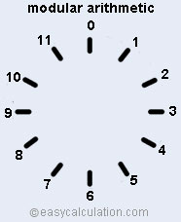
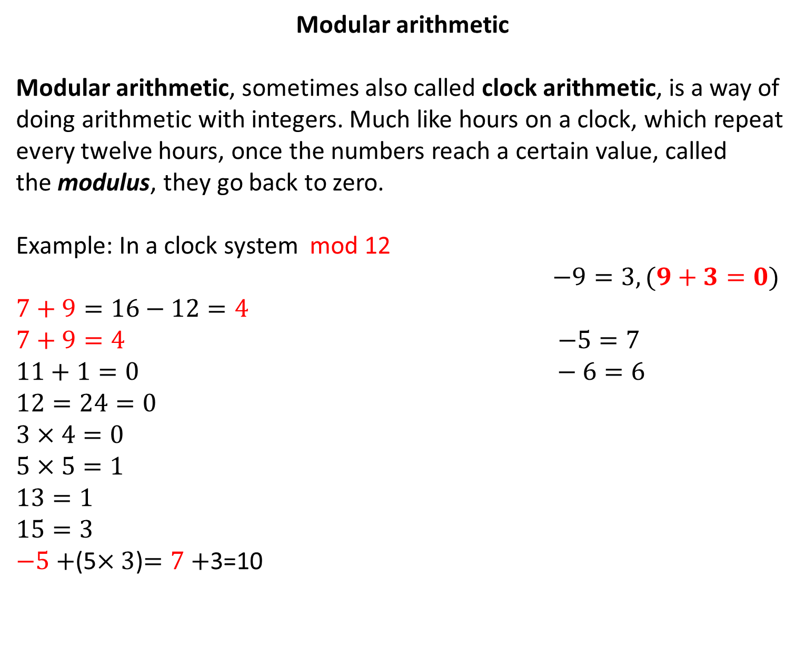
Modular arithmetic
Modular arithmetic, sometimes also called clock arithmetic, is a way of doing arithmetic with integers. Much like hours on a clock, which repeat every twelve hours, once the numbers reach a certain value, called the modulus, they go back to zero.
Example: In a clock system mod 12
$−9=3, (9+3=0)$
$$7+9=16−12=4$$
$7+9=4$ $−5=7$
$11+1=0$ $− 6=6$
$$12=24=0$$
$3×4=0$
$$5×5=1$$
$13=1$
$15=3$
$−5+$(5$×3$)$=7+$3=10

Slide 2
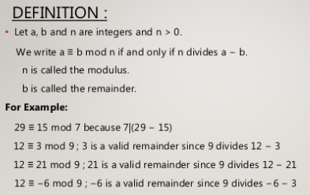
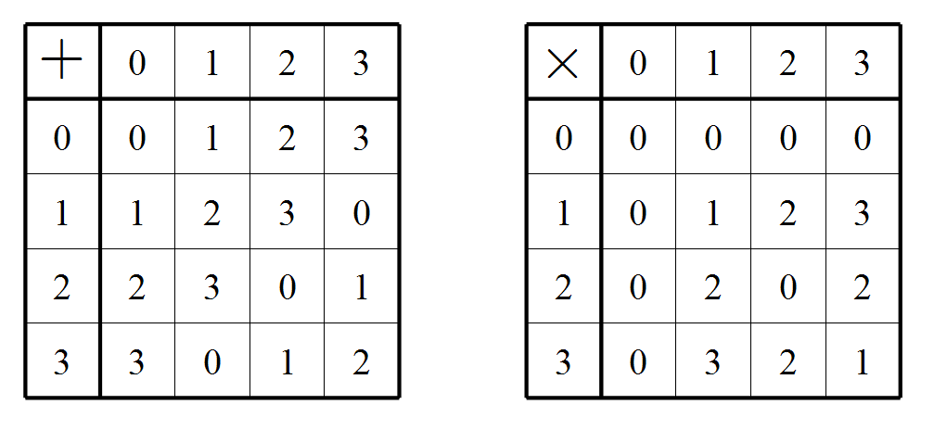
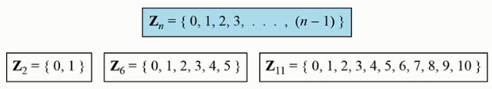
Example:construct addition and multiplication table for arithmetic mod 4:

Slide 3
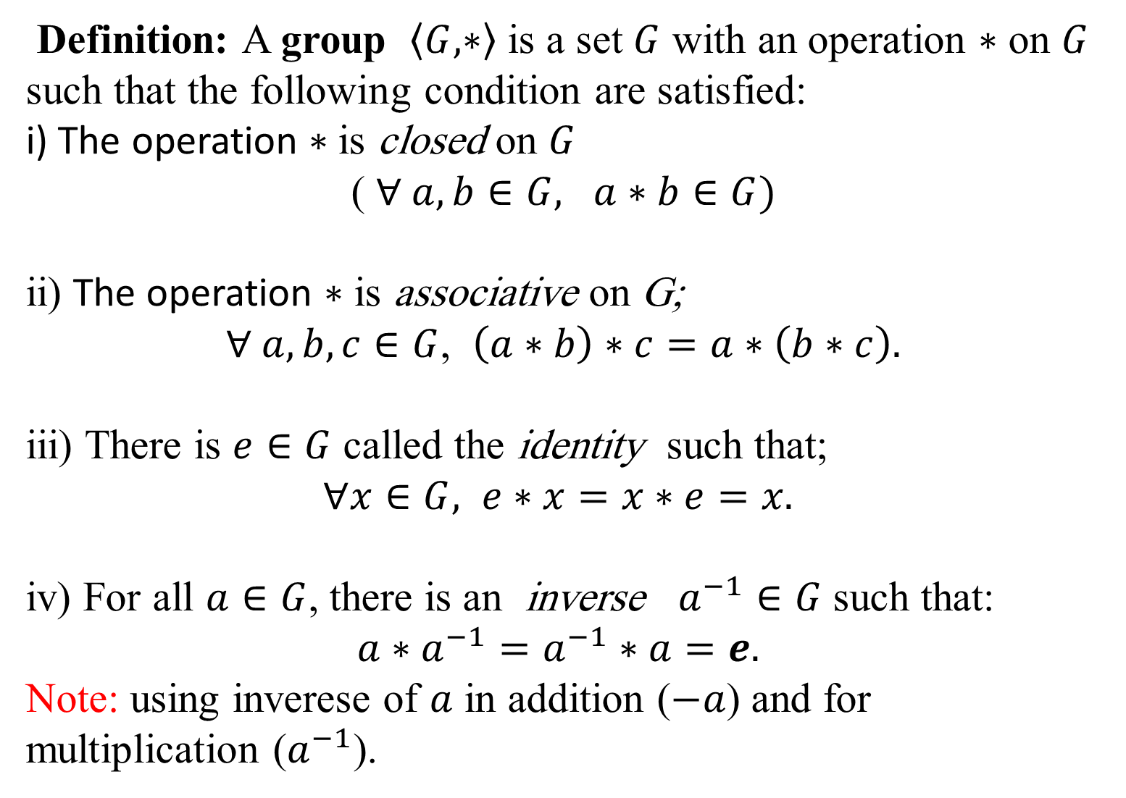
Definition: A group $\left\langle G,∗\right\rangle$ is a set $G$ with an operation $∗$ on $G$ such that the following condition are satisfied:
i) The operation $∗$ is closed on $G$
( $∀ a,b∈G, a∗b∈G)$
ii) The operation $∗$ is associative on G;
$∀ a, b, c∈G$, $\left(a∗b\right)∗c=a∗\left(b∗c\right).$
iii) There is $e∈G$ called the identity such that;
$∀x∈G,$ $e∗x=x∗e=x.$
iv) For all $a∈G$, there is an inverse $a^{−1}∈G$ such that:
$a∗a^{−1}=a^{−1}∗a=e.$
Note: using inverese of $a$ in addition ($−a$) and for multiplication ($a^{−1}$).

Slide 4
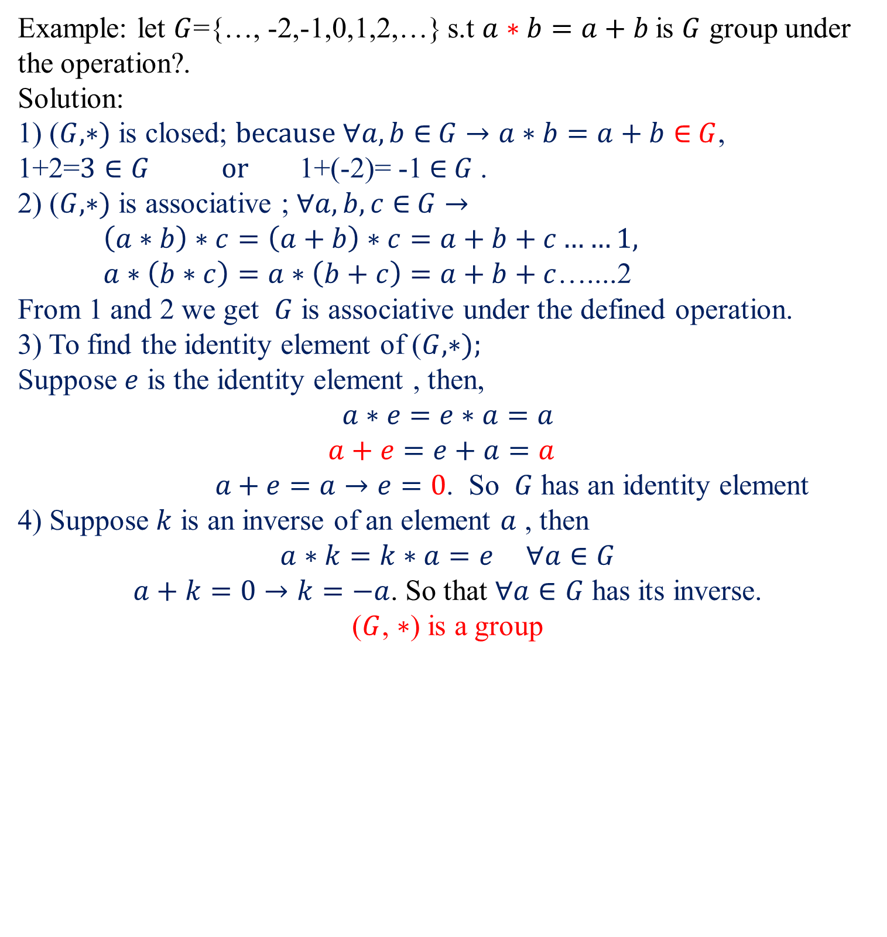
Example: let $G$={…, -2,-1,0,1,2,…} s.t $a∗b=a+b$is $G$ group under the operation?.
Solution:
1) ($G,∗)$ is closed; $because ∀a,b∈$ $G$ $→a∗b=a+b∈$ $G$, 1+2=$3∈G or$1+(-2)= -1 $∈$ $G$.
2) ($G,∗)$ is associative ; $∀a,b,c∈$ $G$ $→$
$\left(a∗b\right)∗c=\left(a+b\right)∗c=a+b+c……1,$
$a∗\left(b∗c\right)=a∗\left(b+c\right)=a+b+c$…....2
From 1 and 2 we get $G$ is associative under the defined operation.
3) To find the identity element of ($G,∗);$
Suppose $e$ is the identity element , then,
$$a∗e=e∗a=a$$
$$a+e=e+a=a$$
$a+e=a→e=0$. So $G$ has an identity element
4) Suppose $k$ is an inverse of an element $a$ , then
$$a∗k=k∗a=e ∀a∈G$$
$a+k=0→k=−a$. So that $∀a∈G$ has its inverse.
($G$, $∗$) is a group

Slide 5
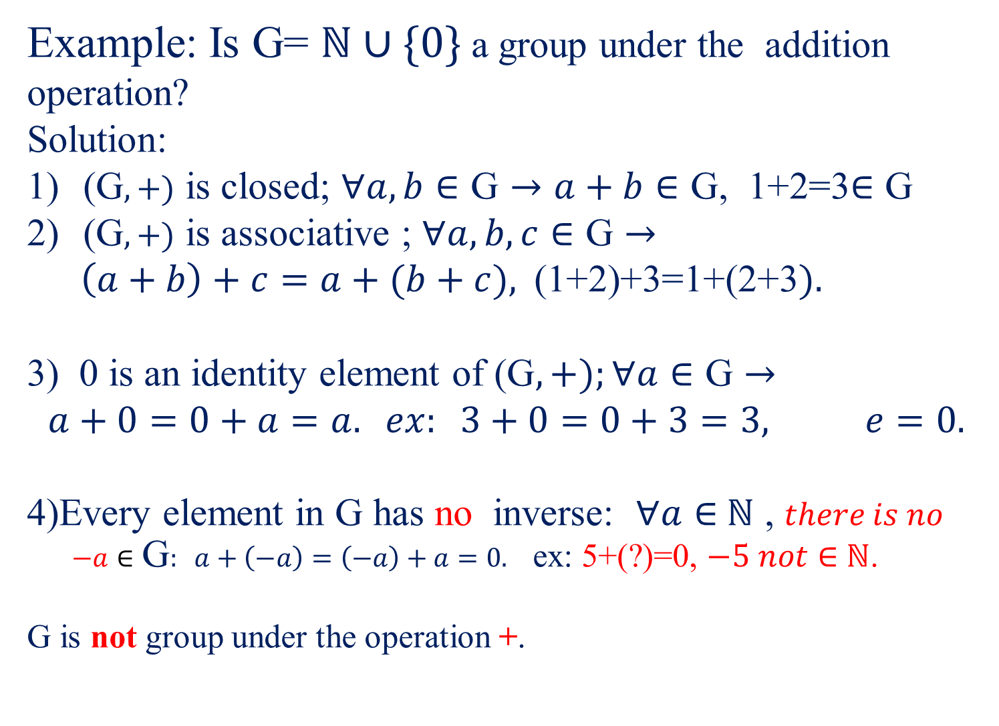
Example: Is G= $ℕ∪\{0\}$ a group under the addition operation?
Solution:
($\text{G},+)$ is closed; $∀a,b∈\text{G}→a+b∈\text{G}$, 1+2=3$∈\text{G}$
($\text{G},+)$ is associative ; $∀a,b,c∈\text{G}→$
$\left(a+b\right)+c=a+(b+c),$(1+2)+3=1+(2+3$).$
3) 0 is an identity element of ($\text{G},+);∀a∈\text{G}→$
$$a+0=0+a=a. ex: 3+0=0+3=3, e=0.$$
4)Every element in $\text{G}$ has no inverse: $∀a∈$ $ℕ$ , $there is no$
$−a∈\text{G}: a+\left(−a\right)=\left(−a\right)+a=0.$ ex: 5+(?)=0, $−5 not∈$ $ℕ$.
G is not group under the operation +.

Slide 6
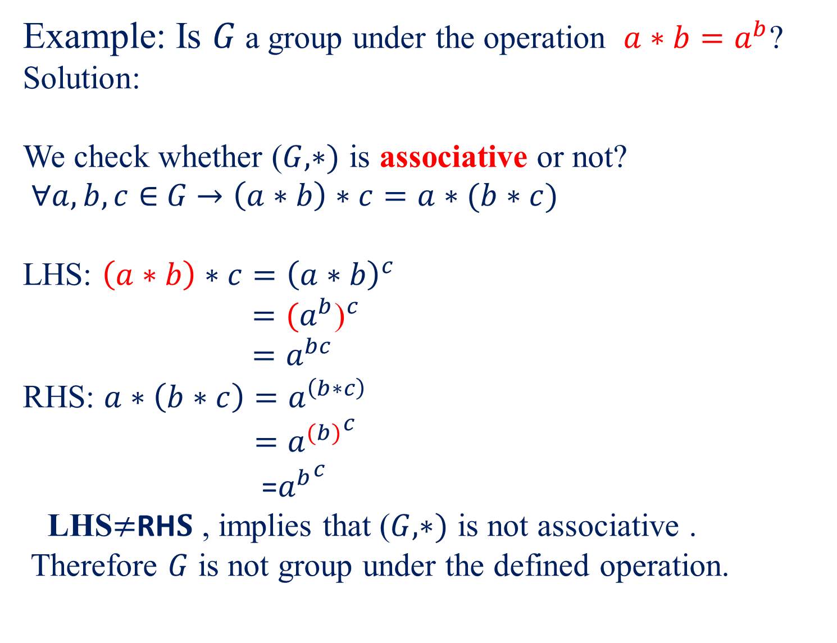
Example: Is $G$a group under the operation $a∗b=a^{b}$?
Solution:
We check whether ($G,∗)$ is associative or not?
$∀a,b,c∈$ $G$ $→\left(a∗b\right)∗c=a∗(b∗c)$
LHS: $\left(a∗b\right)∗c={\left(a∗b\right)}^{c}$
$={{(a}^{b}\text{)}}^{c}$
${=a}^{bc}$
RHS: $a∗\left(b∗c\right)=a^{\left(b∗c\right)}$
$={a^{(b)}}^{c}$
=${a^{b}}^{c}$
LHS$≠$RH$S$ , implies that ($G,∗)$ is not associative .
Therefore $G$ is not group under the defined operation.

Slide 7

HW: Are the following operations associative or not?
$a∗b=b−a$
$a∗b=ab+1$
$a∗b=\frac{ab}{2}$
$a∗b=a+b+ab$

Slide 8

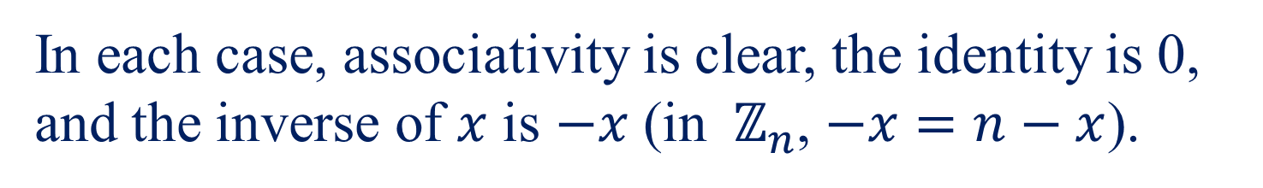

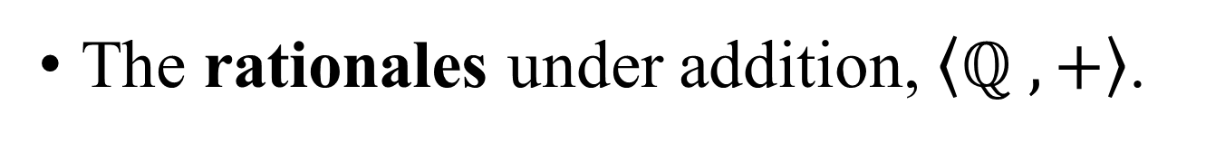
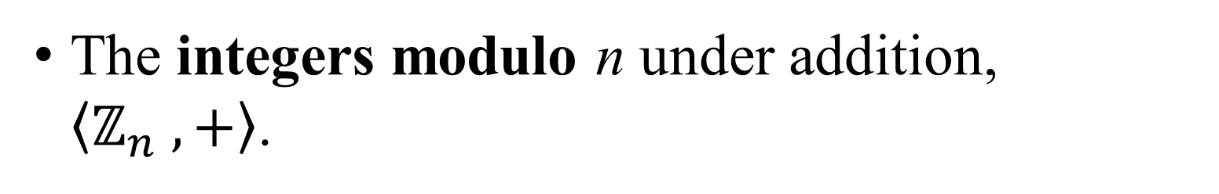
Familiar Groups, Examples 1
The integers under addition, $\left\langle ℤ,+\right\rangle$.
The rationales under addition, $\left\langle ℚ ,+\right\rangle$.
The real numbers under addition, $\left\langle ℝ ,+\right\rangle$.
The complex numbers under addition, $\left\langle ℂ ,+\right\rangle$.
The integers modulo n under addition, $\left\langle ℤ_{n} ,+\right\rangle$.
In each case, associativity is clear, the identity is 0, and the inverse of $x$ is $−x$ (in$ℤ_{n}$, $−x=n−x$).

Slide 9
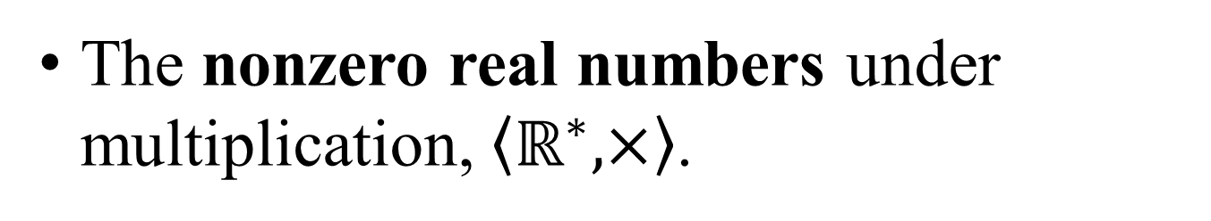

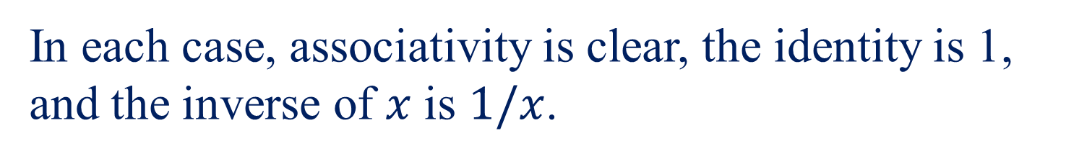
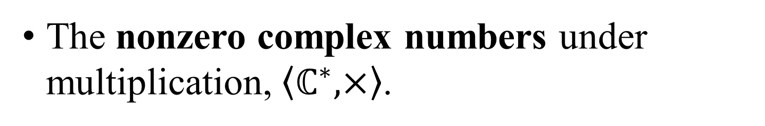
Familiar Groups, Examples 2
The nonzero rational under multiplication, $\left\langle ℚ^{∗} ,×\right\rangle$.
The nonzero real numbers under multiplication, $\left\langle ℝ^{∗},×\right\rangle$.
The nonzero complex numbers under multiplication, $\left\langle ℂ^{∗},×\right\rangle$.
In each case, associativity is clear, the identity is 1, and the inverse of $x$ is $1/x$.

Slide 10
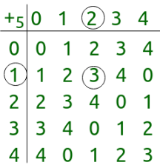
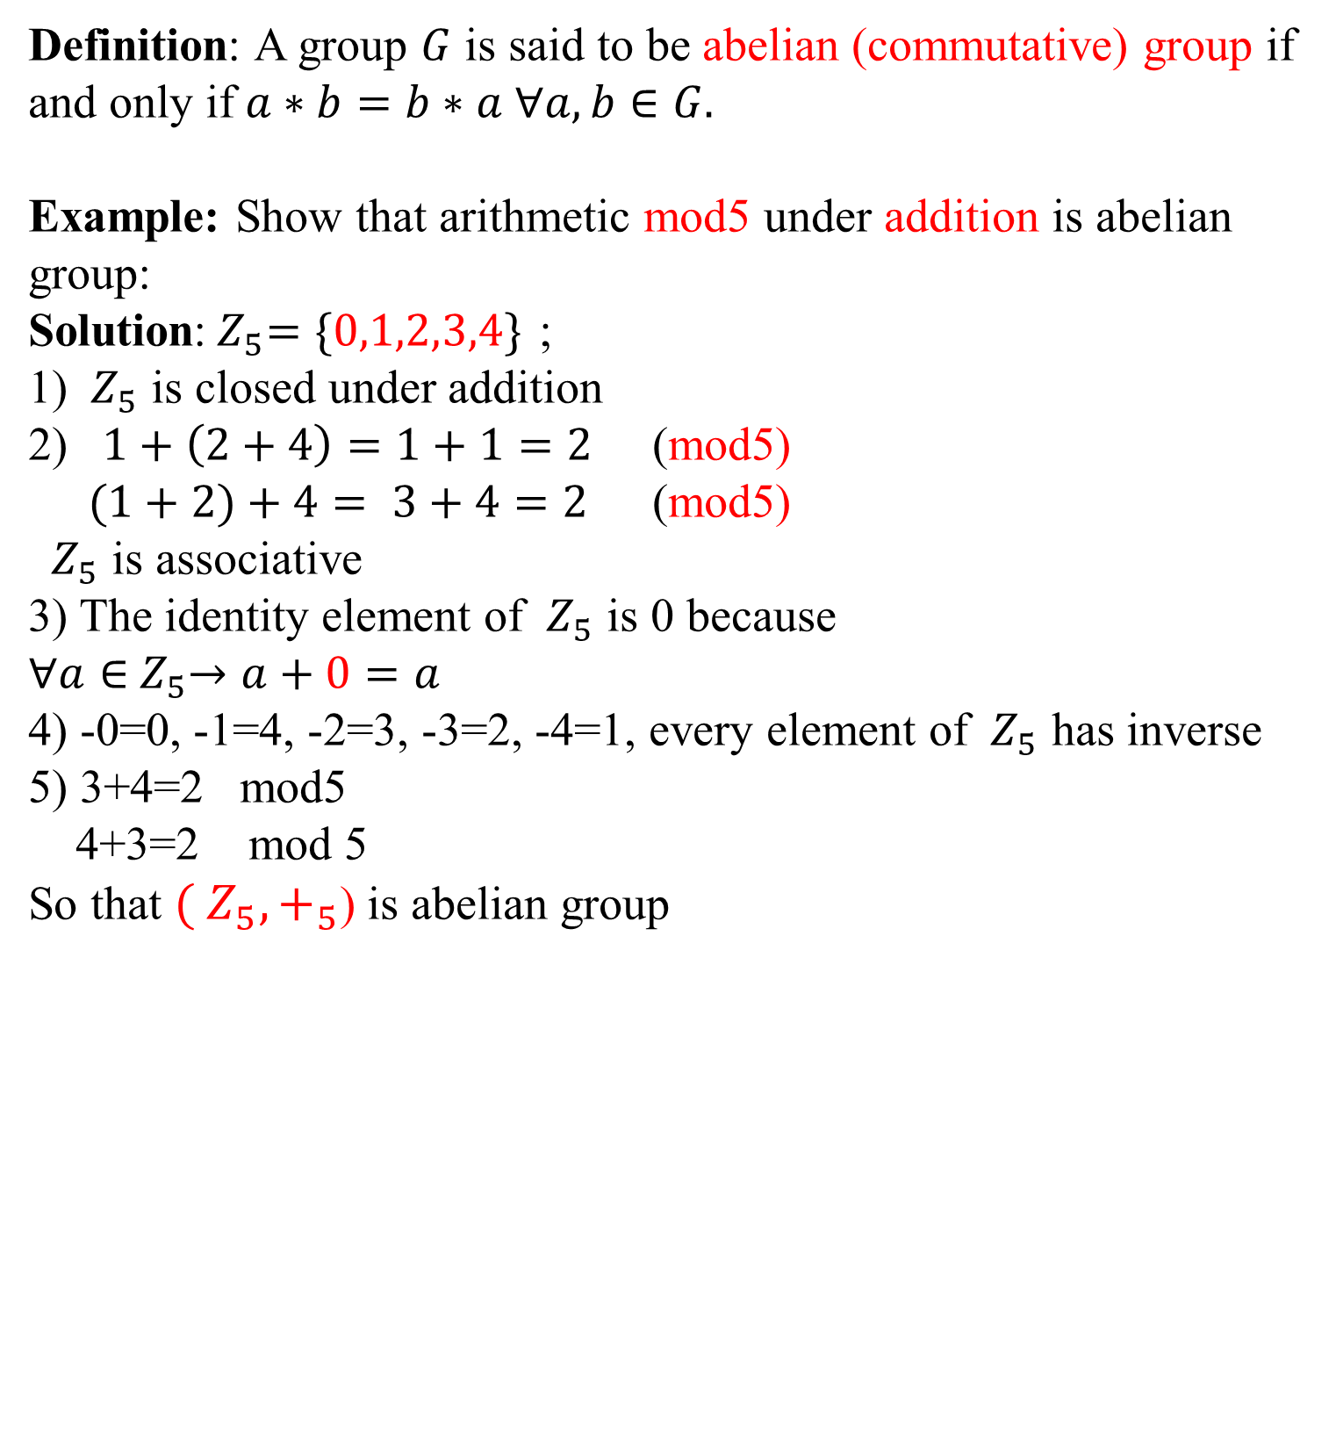
Definition: A group $G$ is said to be abelian (commutative) group if and only if$a∗b=b∗a$ $∀a,b∈G.$
Example: Show that arithmetic mod5 under addition is abelian group:
Solution:${ Z}_{5}=\{0,1,2,3,4\}$ ;
1) ${ Z}_{5}$ is closed under addition
2) $1+\left(2+4\right)=1+1=2$ (mod5)
$(1+2)+4= 3+4=2$(mod5)
${ Z}_{5}$ is associative
3) The identity element of ${ Z}_{5}$ is 0 because
$∀a∈{ Z}_{5}→a+0=a$
4) -0=0, -1=4, -2=3, -3=2, -4=1, every element of ${ Z}_{5}$ has inverse
5) 3+4=2 mod5
4+3=2 mod 5
So that ${( Z}_{5},+_{5}$) is abelian group

Slide 11

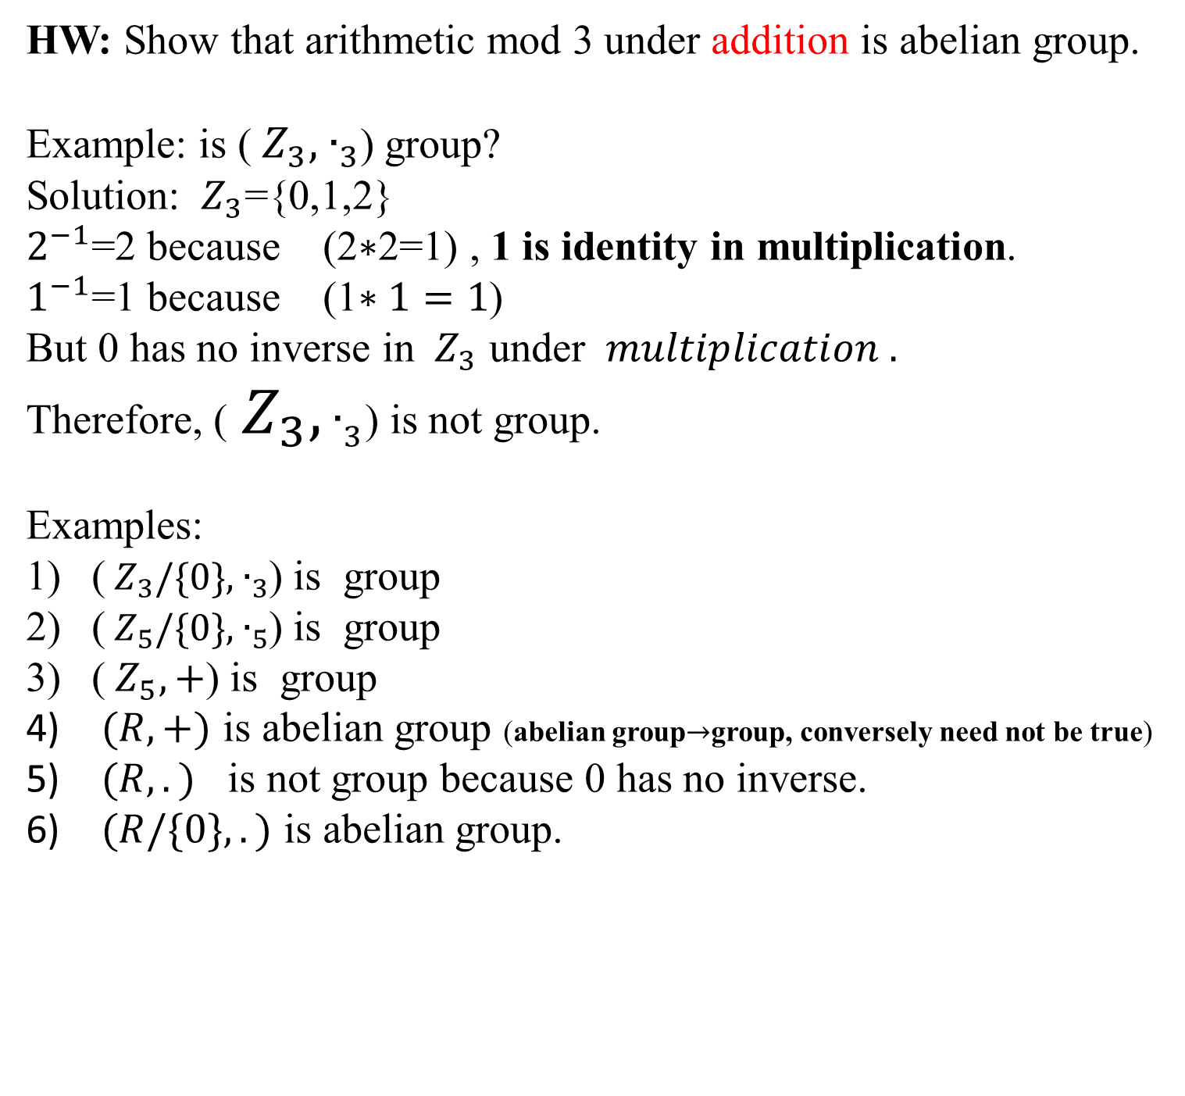
HW: Show that arithmetic mod 3 under addition is abelian group.
Example: is (${ Z}_{3},{ ∙}_{3}$) group?
Solution: ${ Z}_{3}$={0,1,2}
$2^{−1}$=2 because (2$∗$2=1) , 1 is identity in multiplication.
$1^{−1}$=1 because (1$∗1=1$)
But 0 has no inverse in ${ Z}_{3}$ under $multiplication .$
Therefore, (${ Z}_{3},{ ∙}_{3}$) is not group.
Examples:
(${ Z}_{3}/\{0\},{ ∙}_{3}$) is group
(${ Z}_{5}/\{0\},{ ∙}_{5}$) is group
(${ Z}_{5}, +$) is group
$(R,+)$ is abelian group (abelian group$→$group, conversely need not be true)
$(R,.)$ is not group because 0 has no inverse.
$(R/\{0\},.)$ is abelian group.

Slide 12
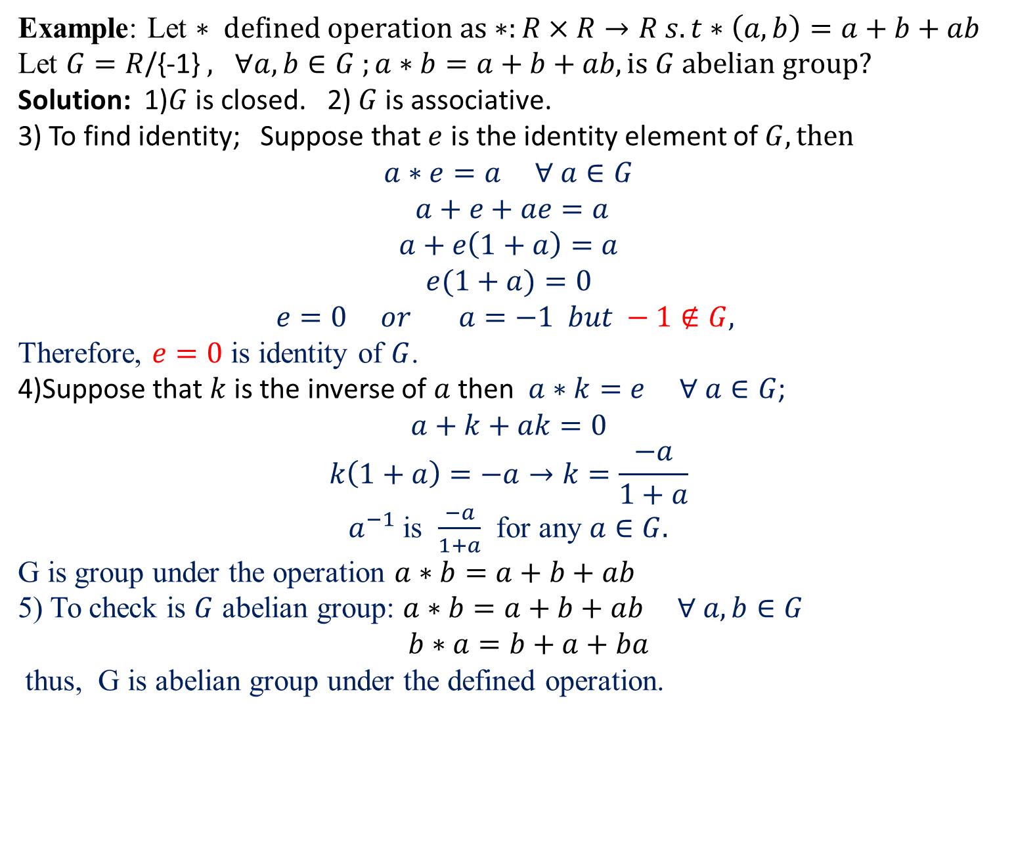
Example: Let $∗ defined operation as∗:R×R→R s.t∗\left(a,b\right)=a+b+ab$
Let $G=R$/{-1} $, ∀a,b∈G ;a∗b=a+b+ab, is G abelian group?$
Solution: 1)$G$ is closed. 2) $G$ is associative.
3) To find identity; Suppose that $e$ is the identity element of $G, then$
$$a∗e=a ∀ a∈G$$
$a+e+ae=a$
$$a+e\left(1+a\right)=a$$
$$e(1+a)=0$$
$$e=0 or a=−1 but −1∉G,$$
Therefore, $e=0$ is identity of $G$.
4)Suppose that $k$ is the inverse of $a$then $a∗k=e ∀ a∈G$;
$$a+k+ak=0$$
$$k\left(1+a\right)=−a→k=\frac{−a}{1+a}$$
$a^{−1}$ is $\frac{−a}{1+a}$ for any $a∈G.$
G is group under the operation $a∗b=a+b+ab$
5) To check is $G$ abelian group: $a∗b=a+b+ab ∀ a,b∈G$
$b∗a=b+a+ba$
thus, G is abelian group under the defined operation.

Slide 13
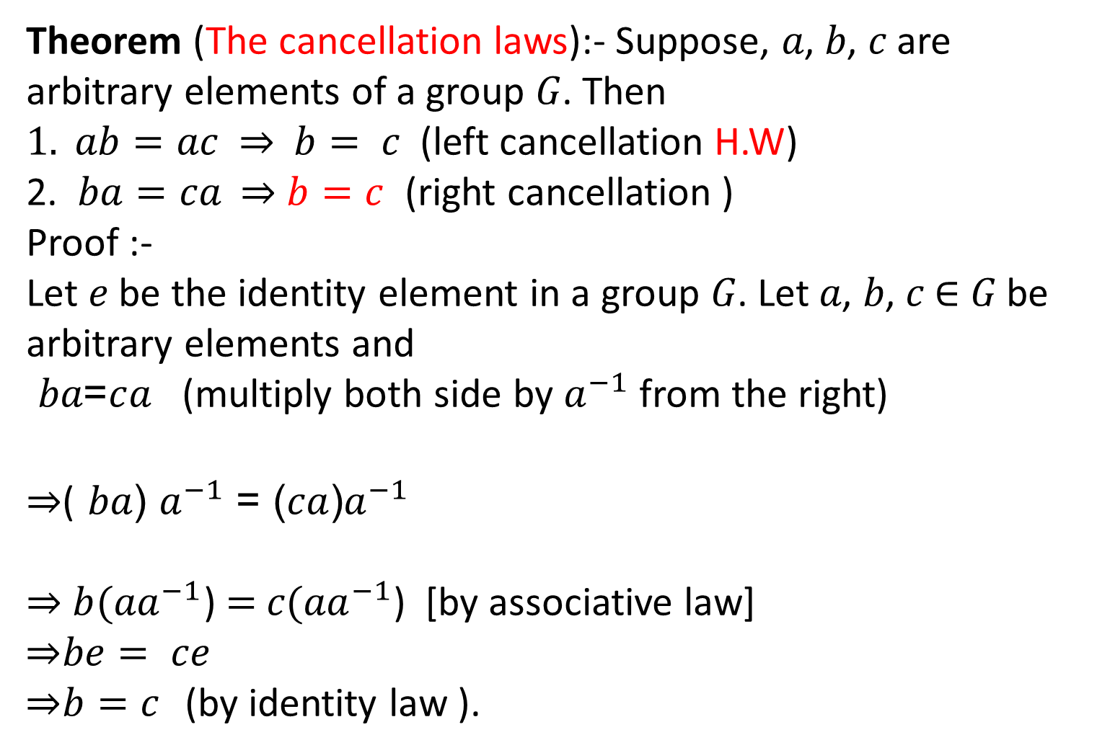
Theorem (The cancellation laws):- Suppose, 𝑎, 𝑏, 𝑐 are arbitrary elements of a group 𝐺. Then
$1. ab=ac \text{⇒} b= c$(left cancellation H.W)
2. $ba=ca$⇒$b=c$ (right cancellation )
Proof :-
Let 𝑒 be the identity element in a group 𝐺. Let 𝑎, 𝑏, 𝑐 ∈ 𝐺 be arbitrary elements and
=𝑎𝑏 $c$𝑎 (multiply both side by $a^{−1}$ from the right)
⇒( (𝑎𝑏 $a^{−1}$= ${\text{ (}\text{ac}\text{)}a}^{−1}$
⇒ ${\text{b}(\text{a}a}^{−1}$) $=$ 𝑐${(\text{a}a}^{−1}$) [by associative law]
⇒$be= ce$
⇒$b=c$ (by identity law ).

Slide 14
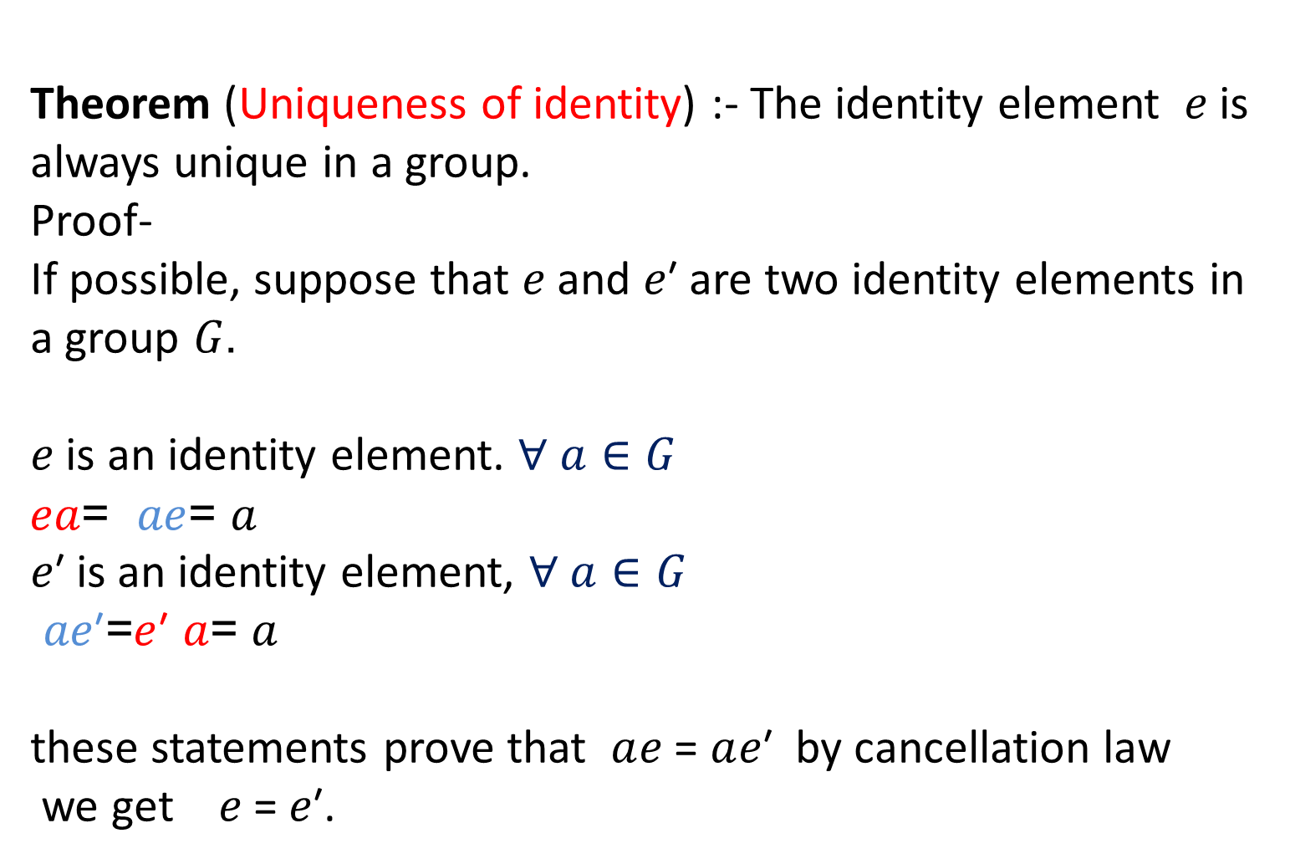
Theorem (Uniqueness of identity) :- The identity element 𝑒 is always unique in a group.
Proof-
If possible, suppose that 𝑒 and 𝑒′ are two identity elements in a group.𝐺
𝑒 is an identity element. $∀ a∈G$
𝑎𝑒= 𝑒𝑎 = 𝑎
𝑒′ is an identity element, $∀ a∈G$
′𝑒𝑎 =𝑒′𝑎 = 𝑎
these statements prove that $a$𝑒 = $a$𝑒′ by cancellation law
we get 𝑒 = 𝑒′.

Slide 15
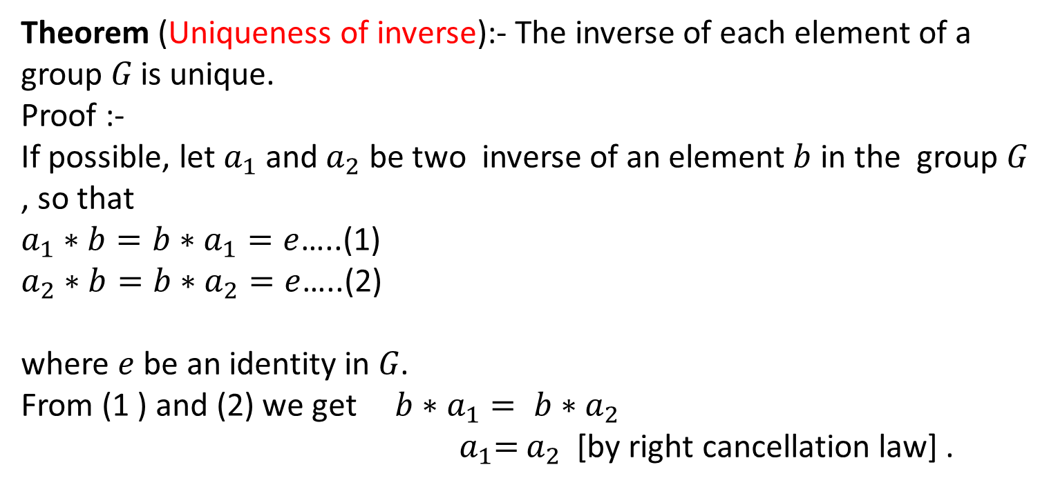
Theorem (Uniqueness of inverse):- The inverse of each element of a group 𝐺 is unique.
Proof :-
If possible, let ${\text{a}}_{1}$ and${ \text{a}}_{2}$ be two inverse of an element $b$ in the group 𝐺, so that
${\text{a}}_{1}∗b=b∗{\text{a}}_{1}=e$…..(1)
${\text{a}}_{2}∗b=b∗{\text{a}}_{2}=e$…..(2)
where $e$ be an identity in 𝐺.
From (1 ) and (2) we get $b∗{\text{a}}_{1}= b∗{\text{a}}_{2}$
${ \text{a}}_{1}=$ ${\text{a}}_{2}$[by right cancellation law] .

Slide 16
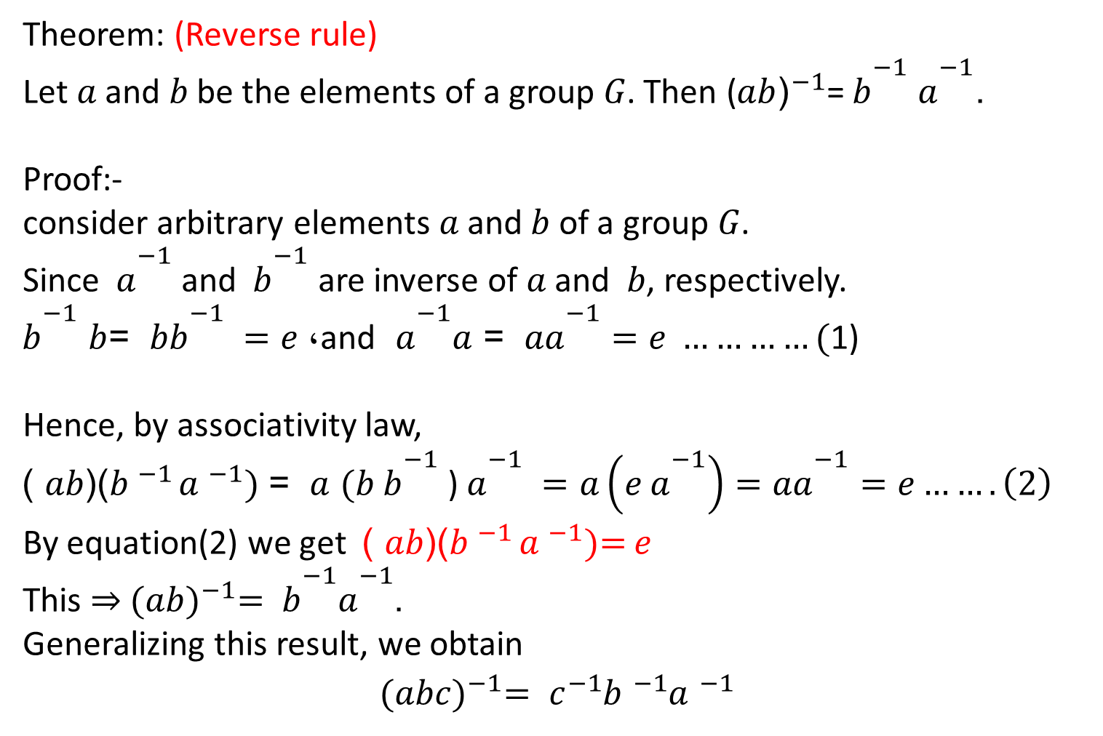
Theorem: (Reverse rule)
Let 𝑎 and 𝑏 be the elements of a group 𝐺. Then ${\text{(}\text{ba}\text{)}}^{−1}$= ${\text{b}}^{−1}$ ${\text{a}}^{−1}$.
Proof:-
consider arbitrary elements 𝑎 and 𝑏 of a group 𝐺.
Since ${\text{a}}^{−1}$ and ${\text{b}}^{−1}$ are inverse of 𝑎 and 𝑏, respectively.
${\text{b}}^{−1}$𝑏 =𝑏 ${\text{b}}^{−1} =$, 𝑒 and ${\text{a}}^{−1}$ 𝑎= 𝑎 ${\text{a}}^{−1}=e …………($1)
Hence, by associativity law,
)(𝑏𝑎 )${\text{b} }^{−1 }{\text{a} }^{−1}\text{)}$ 𝑎 = $(b$ ${\text{b}}^{−1}$ ) ${\text{a}}^{−1} =a\left(e {\text{a}}^{−1}\right)=a{\text{a}}^{−1}=e…….\left(2\right)$
By equation(2) we get )(𝑏𝑎 )${\text{b} }^{−1 }{\text{a} }^{−1}\text{)}\text{=}$ $e$
This ⇒ ${(ab)}^{−1}= {\text{b}}^{−1}{\text{a}}^{−1}$.
Generalizing this result, we obtain
$${(abc)}^{−1}= c^{−1}{\text{b} }^{−1}{\text{a} }^{−1}$$

Slide 17
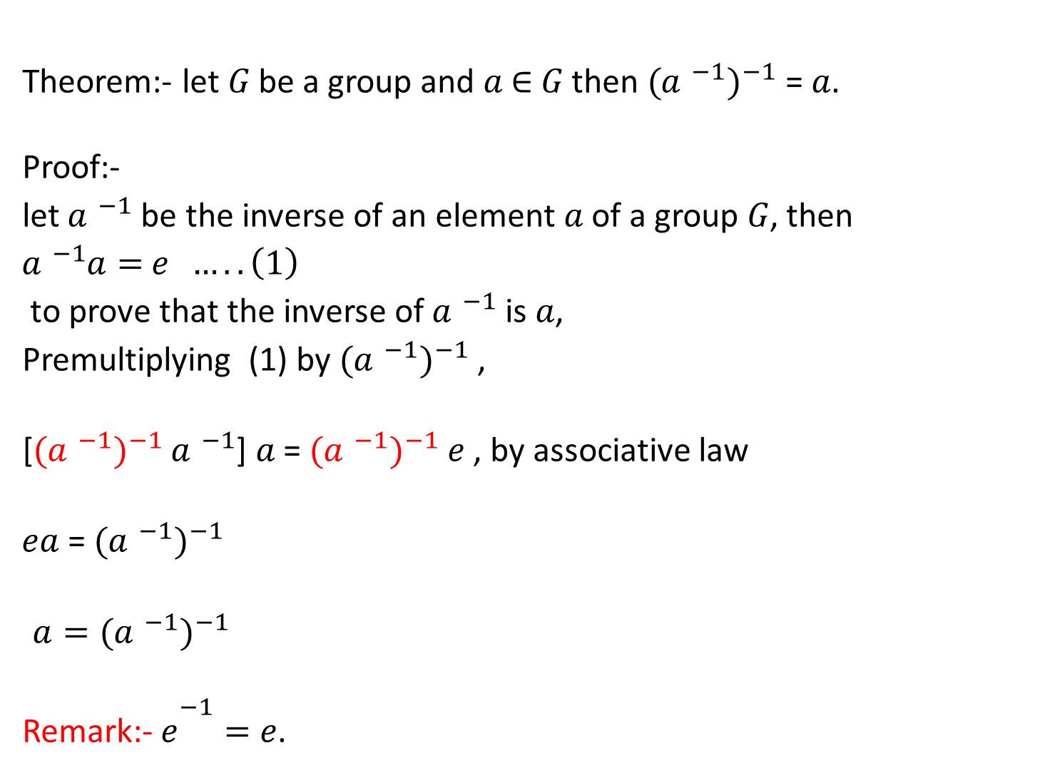
Theorem:- let 𝐺 be a group and 𝑎 ∈ 𝐺 then ${({\text{a} }^{−1})}^{−1}$= 𝑎.
Proof:-
let ${\text{a} }^{−1}$ be the inverse of an element 𝑎 of a group 𝐺, then
${\text{a} }^{−1}\text{a}=$ $e …..\left(1\right)$
to prove that the inverse of ${\text{a} }^{−1}$ is 𝑎,
Premultiplying (1) by ${({\text{a} }^{−1})}^{−1}$,
[${({\text{a} }^{−1})}^{−1} {\text{a} }^{−1}$] 𝑎 = ${({\text{a} }^{−1})}^{−1}$𝑒 , by associative law
𝑎𝑒 = ${({\text{a} }^{−1})}^{−1}$
${a=({\text{a} }^{−1})}^{−1}$
Remark:- ${\text{e}}^{−1}=\text{e}$ .

Slide 18
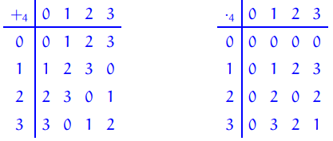
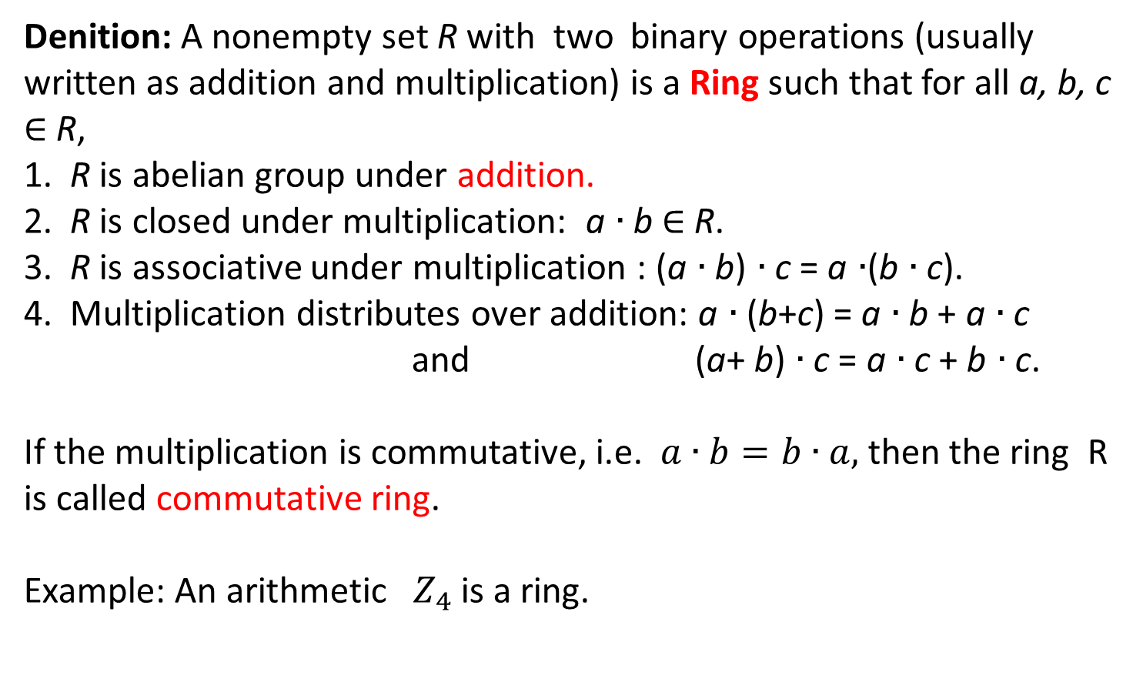
Denition: A nonempty set R with two binary operations (usually
written as addition and multiplication) is a Ring such that for all a, b, c $∈$ R,
1. R is abelian group under addition.
2. R is closed under multiplication: a $∙$b $∈$ R.
3. R is associative under multiplication : (a $∙$b) $∙$c = a $∙$(b $∙$c).
4. Multiplication distributes over addition: a $∙$(b+c) = a $∙$b + a $∙$c
and (a+ b) $∙$c = a $∙$c + b $∙$c.
If the multiplication is commutative, i.e. $a∙b=b∙a,$then the ring R is called commutative ring.
Example: An arithmetic ${ Z}_{4}$ is a ring.

Slide 19
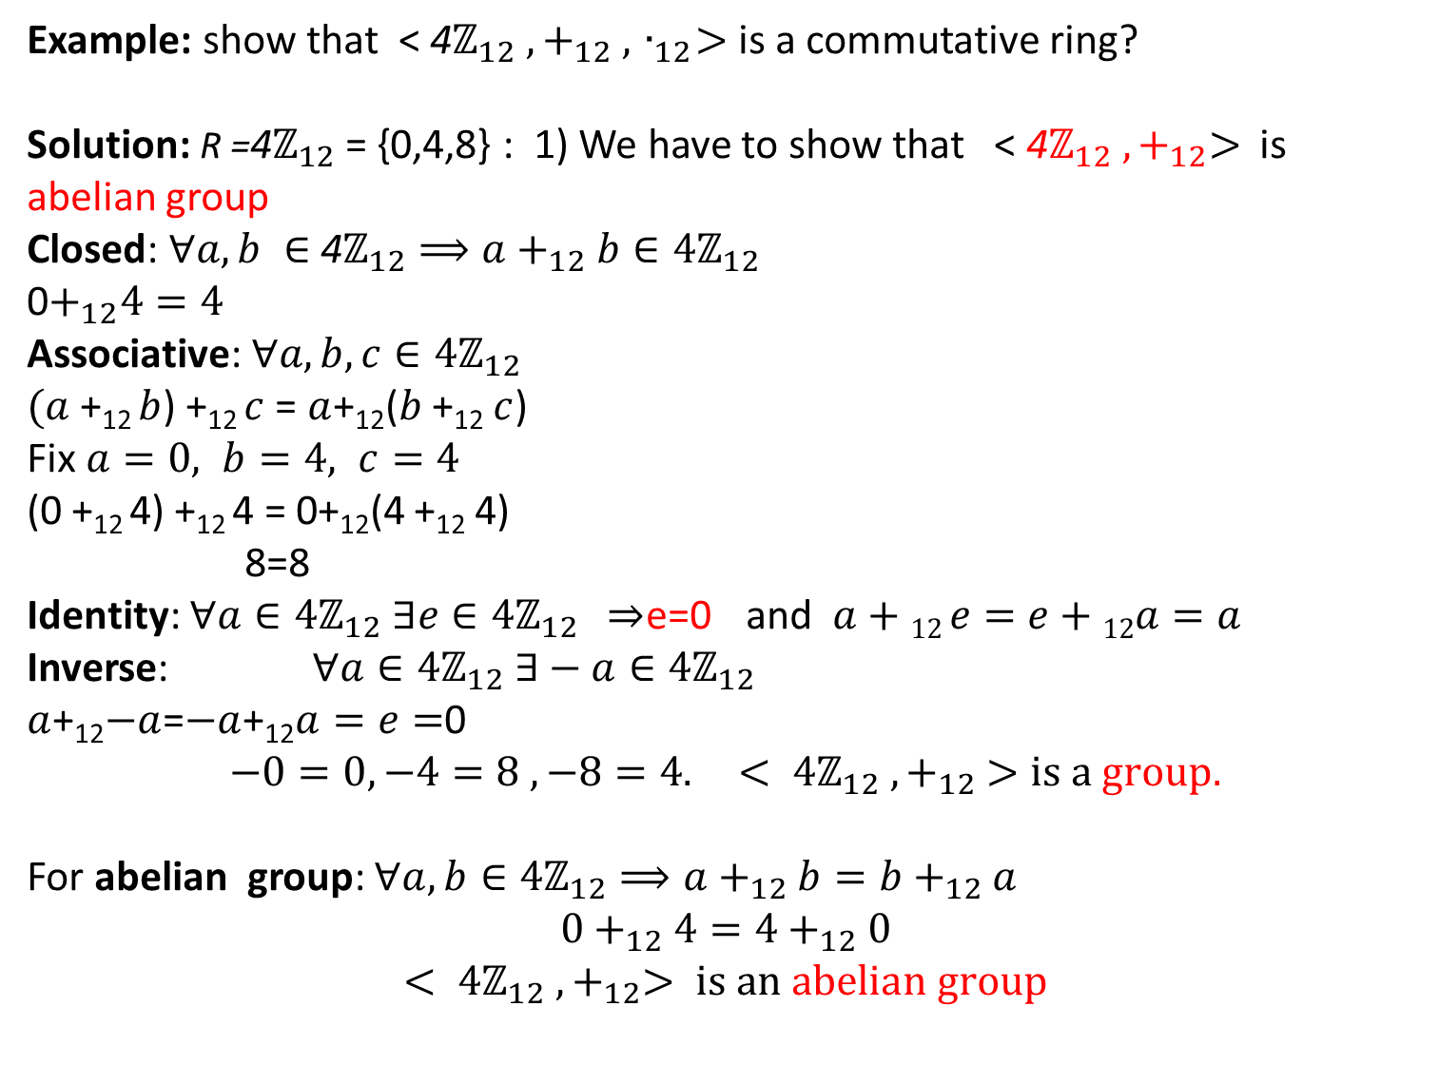
Example: show that < 4$ℤ_{12} ,+_{12} ,{ ∙}_{12}>$ is a commutative ring?
Solution: R =4$ℤ_{12}$ = {0,4,8} : 1) We have to show that < 4$ℤ_{12} ,+_{12}>$is abelian group
Closed: $∀a,b ∈$4$ℤ_{12}⟹a+_{12}b∈4ℤ_{12}$
0$+_{12}4=4$
Associative: $∀a,b,c∈4ℤ_{12}$
$(a$ +₁₂ $b$) +₁₂ $c$ = $a$+₁₂($b$ +₁₂ $c$)
Fix $a=0, b=4, c=4$
(0 +₁₂ 4) +₁₂ 4 = 0+₁₂(4 +₁₂ 4)
8=8
Identity: $∀a∈4ℤ_{12} ∃e∈4ℤ_{12}$ ⇒e=0 and $a+12 e=e+12a=a$
Inverse: $∀a∈4ℤ_{12} ∃−a∈4ℤ_{12}$
$a$+₁₂$−a$=$−a$+₁₂$a=e=$0
$$−0=0,−4=8 ,−8=4. < 4ℤ_{12} ,+_{12} >is a group.$$
For abelian group: $∀a,b∈4ℤ_{12}⟹a+_{12}b=b+_{12}a$
$$0+_{12}4=4+_{12}0$$
$$< 4ℤ_{12} ,+_{12}> is an abelian group$$
continues

Slide 20
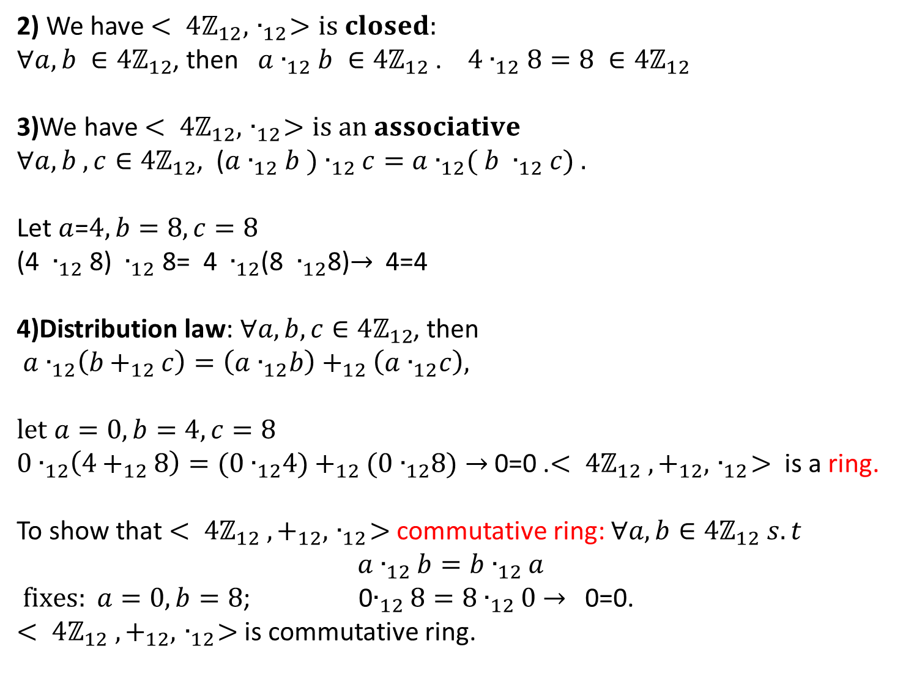
2) We have $< 4ℤ_{12},{ ∙}_{12}>is closed:$
$∀a,b ∈4ℤ_{12}$, then $a{ ∙}_{12}$ $b ∈4ℤ_{12}$ . $4{ ∙}_{12}$ $8=8 ∈4ℤ_{12}$
3)We have $< 4ℤ_{12},{ ∙}_{12}>is an associative$
$∀a,b ,c∈4ℤ_{12}$, ($a{ ∙}_{12}$ $b ){ ∙}_{12}$ $c=a{ ∙}_{12}\text{(} b$ ${ ∙}_{12}$ $c) .$
Let $a$=$4,b=8,c=8$
(4 ${ ∙}_{12}$ 8) ${ ∙}_{12}$ 8= 4 ${ ∙}_{12}$(8 ${ ∙}_{12}$8)$→$ 4=4
4)Distribution law:$∀a,b, c∈4ℤ_{12}$, then $a{ ∙}_{12}\left(b+_{12}c\right)=\left(a{ ∙}_{12}b\right)+_{12}\left(a{ ∙}_{12}c\right),$
$$let a=0,b=4,c=8$$
$0{ ∙}_{12}\left(4+_{12}8\right)=(0{ ∙}_{12}4)+_{12}(0{ ∙}_{12}8)→$ 0=0 .$< 4ℤ_{12} ,+_{12},{ ∙}_{12}>$is a ring.
To show that $< 4ℤ_{12} ,+_{12},{ ∙}_{12}>$commutative ring: $∀a,b∈4ℤ_{12} s.t$
$$a∙_{12}b=b∙_{12}a$$
$fixes: a=0, b=8$; 0$∙_{12}8=8∙_{12}0$ $→$ 0=0.
$< 4ℤ_{12} ,+_{12},{ ∙}_{12}>$is commutative ring.

Slide 21
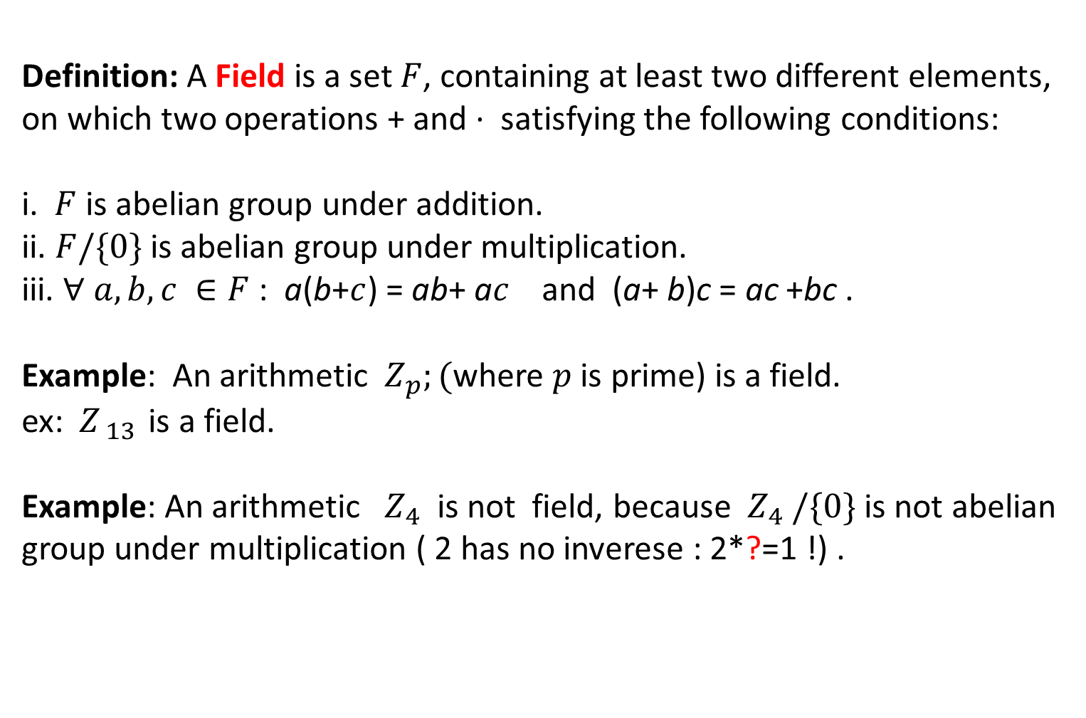
Definition: A Field is a set $F$, containing at least two different elements, on which two operations + and · satisfying the following conditions:
i. $F$ is abelian group under addition.
ii. $F/\{0\}$ is abelian group under multiplication.
iii. $∀ a,b,c ∈F$ : a(b+$c$) = ab+ a$c$ and (a+ b)c = ac +bc .
Example: An arithmetic ${ Z}_{p};($where $p$ is prime) is a field.
ex: ${ Z}_{ 13 }$is a field.
Example: An arithmetic ${ Z}_{4}$ is not field, because ${ Z}_{4}$ $/\{0\}$ is not abelian group under multiplication ( 2 has no inverese : 2*?=1 !) .

