Slide 1

Elementary Number Theory
Divisibility
Fundamental theorem of arithmetics
Division algorithm

Slide 2
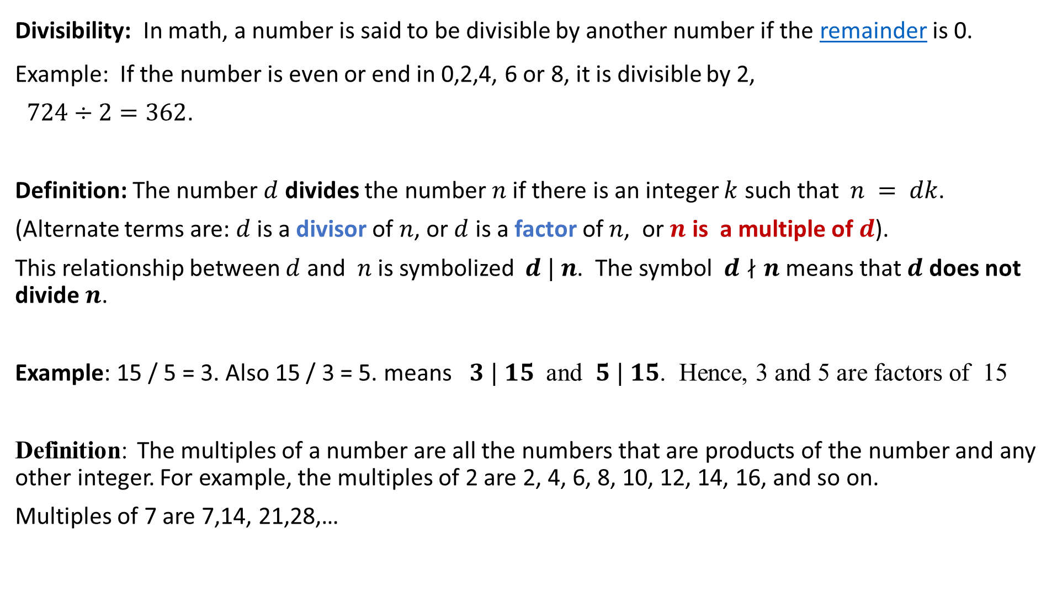
Divisibility: In math, a number is said to be divisible by another number if the remainder is 0.
Example: If the number is even or end in 0,2,4, 6 or 8, it is divisible by 2,
$724÷2=362$.
Definition: The number $d$ divides the number $n$ if there is an integer $k$ such that$n = dk$.
(Alternate terms are: $d$ is a divisor of $n$, or $d$ is a factor of $n$, or $n$ is a multiple of $d$).
This relationship between $d$ and $n$ is symbolized $d | n$. The symbol $d∤n$means that $d$ does not divide $n$.
Example: 15 / 5 = 3. Also 15 / 3 = 5. means $3 | 15$ and $5 | 15$. Hence, 3 and 5 are factors of 15
Definition: The multiples of a number are all the numbers that are products of the number and any other integer. For example, the multiples of 2 are 2, 4, 6, 8, 10, 12, 14, 16, and so on.
Multiples of 7 are 7,14, 21,28,…

Slide 3
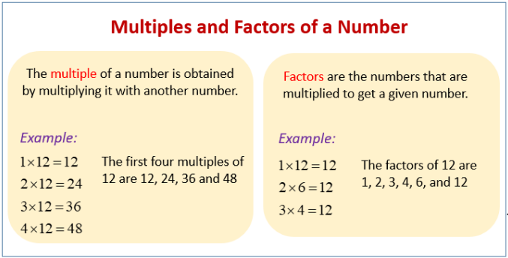
Example: This example showing the multiples of 3, Multiply 3 by 1, then by 2, then by 3, and so on.
3 x 1 = 3, 3 x 2 = 6, 3 x 3 = 9, 3 x 4 = 12, 3 x 5 = 15, 3 x 6 = 18…
The first six multiples of 3 are 3 , 6 , 9, 12 , 15 , and 18.

Slide 4
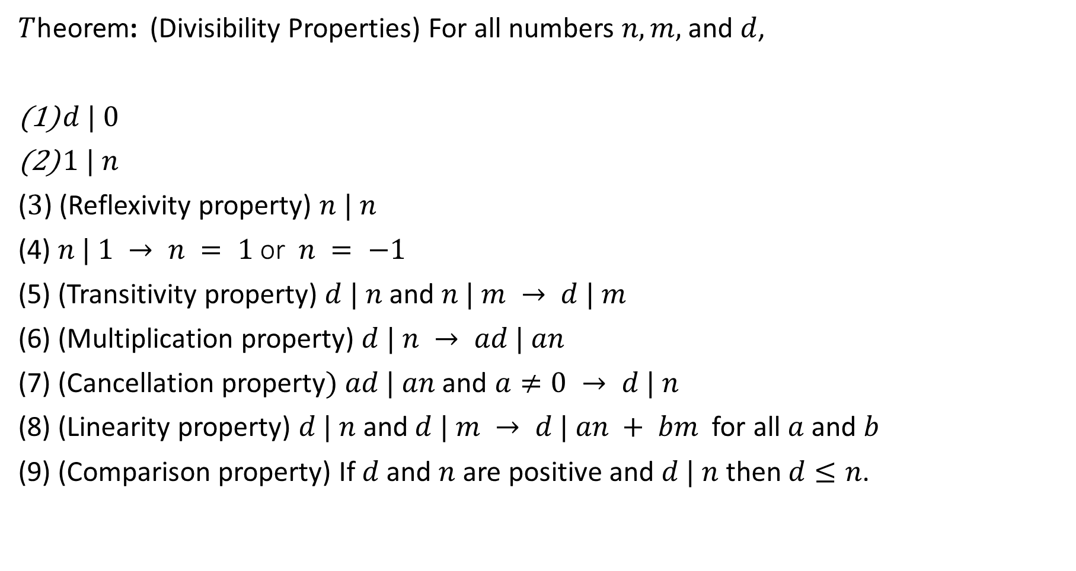
$T$heorem: (Divisibility Properties) For all numbers $n, m,$ and $d$,
$d | 0$
$1 | n$
($3$) (Reflexivity property) $n | n$
(4) $n | 1 → n = 1$or$n = −1$
(5) (Transitivity property) $d | n$and $n | m → d | m$
(6) (Multiplication property) $d | n → ad | an$
(7) (Cancellation property$) ad | an$and $a≠0 → d | n$
(8) (Linearity property) $d | n$and $d | m → d | an + bm$for all $a$ and $b$
(9) (Comparison property) If $d$ and $n$ are positive and $d | n$then $d≤n$.

Slide 5
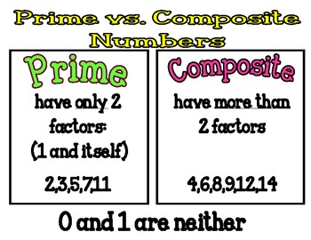

Definition: An integer $p≥2$ is prime if it has no positive divisors other
than 1 and itself. Ex: 2,3,5,7,…
An integer greater than or equal to 2 that is not prime is composite.
Ex: 4,6,8,9,…

Slide 6
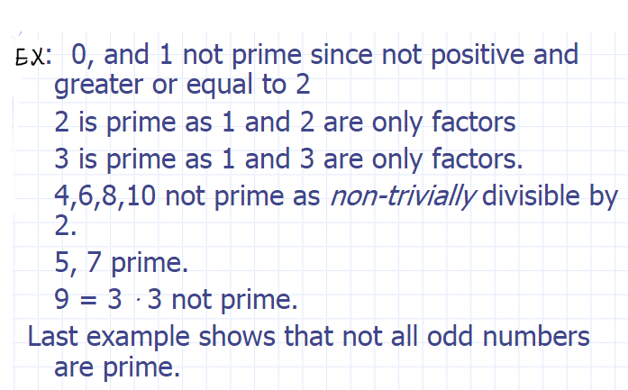

Slide 7
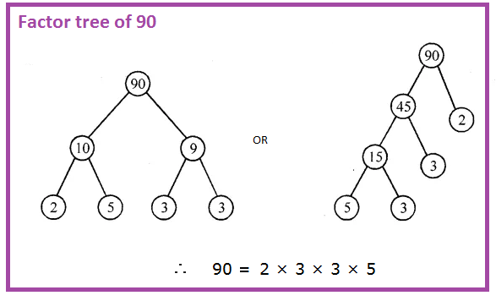
Recall: Factors are numbers that can be multiplied together to get another number. For instance, take 3 * 2 = 6. Here 3 and 2 are factors of 6.
Prime Factorization:
Any number can be written in the form of multiplication of their prime factors. This is known as Prime Factorization.
For example, take 90. It would be 2 * 45. Now take 45 that would be 5 * 9. Again 9 would be 3 * 3. Hence 90 is 2 * 3 * 3 * 5.

Slide 8


The other method to find the prime factors of a number apart from the factor tree is the short division method.
Let us find the prime factors of 60 using this method.
$60=2∙2∙3∙5$.

Slide 9
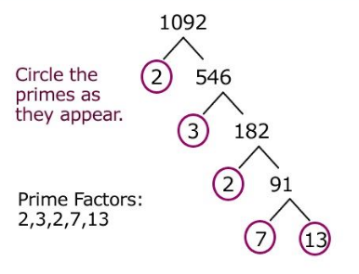
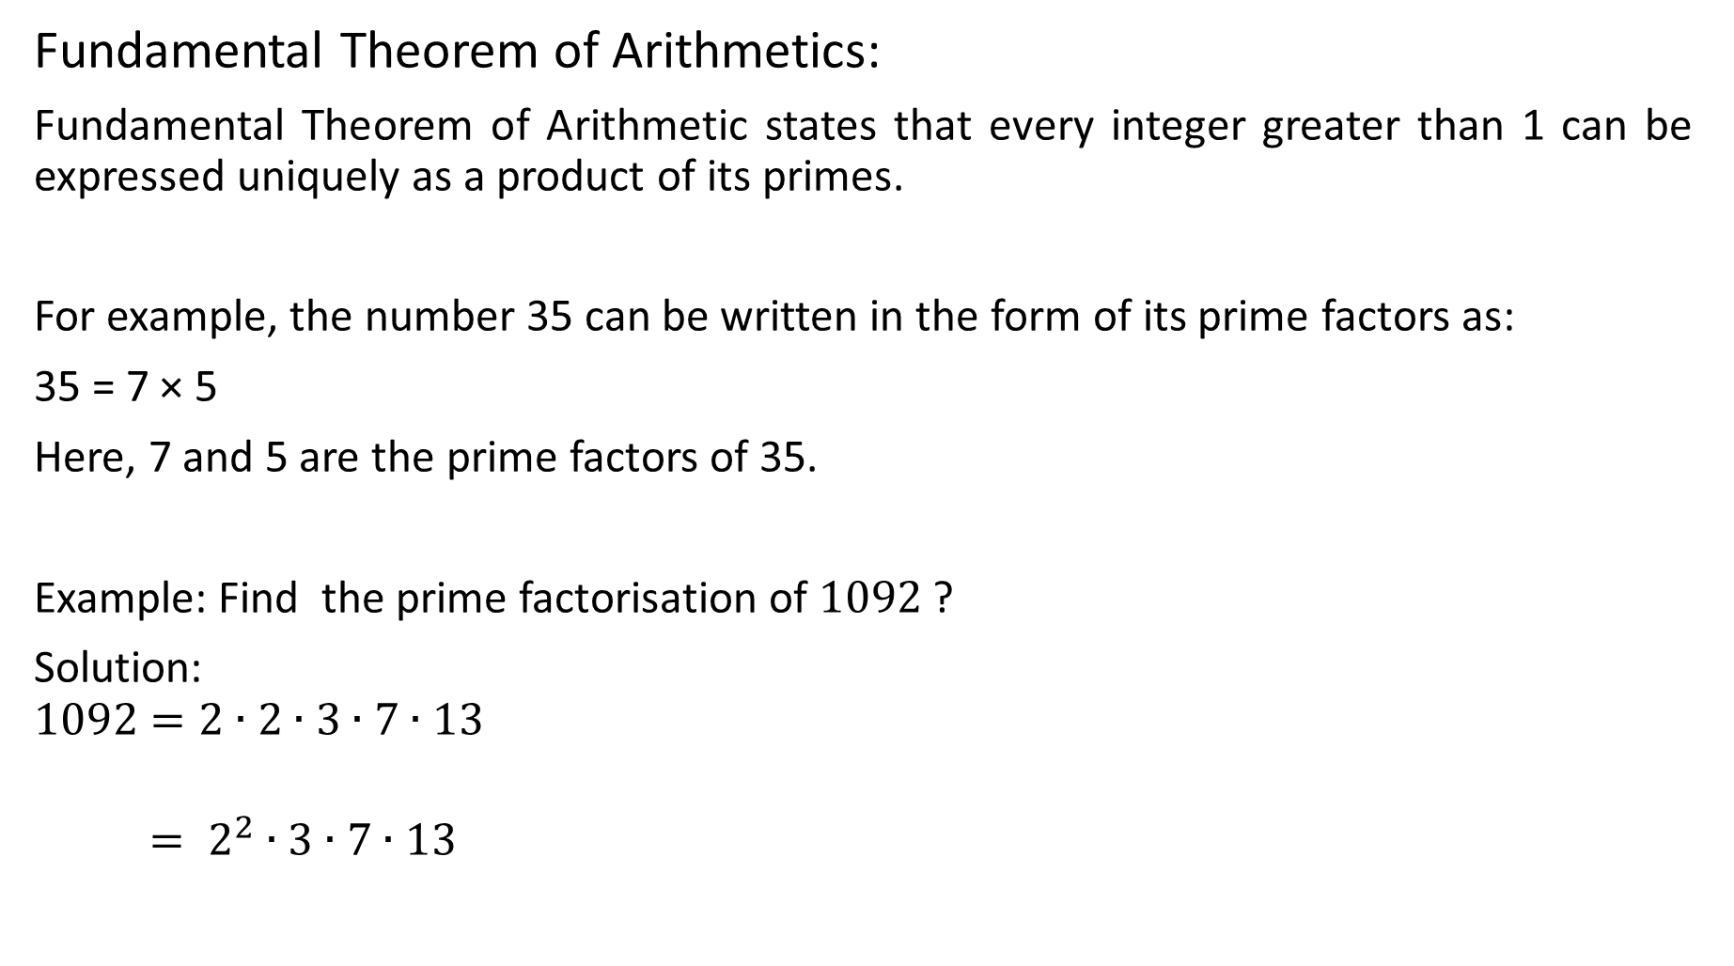
Fundamental Theorem of Arithmetics:
Fundamental Theorem of Arithmetic states that every integer greater than 1 can be expressed uniquely as a product of its primes.
For example, the number 35 can be written in the form of its prime factors as:
35 = 7 × 5
Here, 7 and 5 are the prime factors of 35.
Example: Find the prime factorisation of $1092$ ?
Solution:
$$1092=2∙2∙3∙7∙13$$
$= 2^{2}∙3∙7∙13$

Slide 10
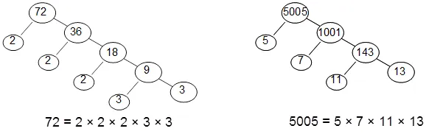
Example: What is the prime factorasation of 72 and 5005?
Solution:

Slide 11
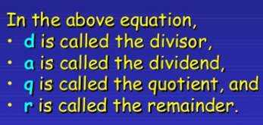
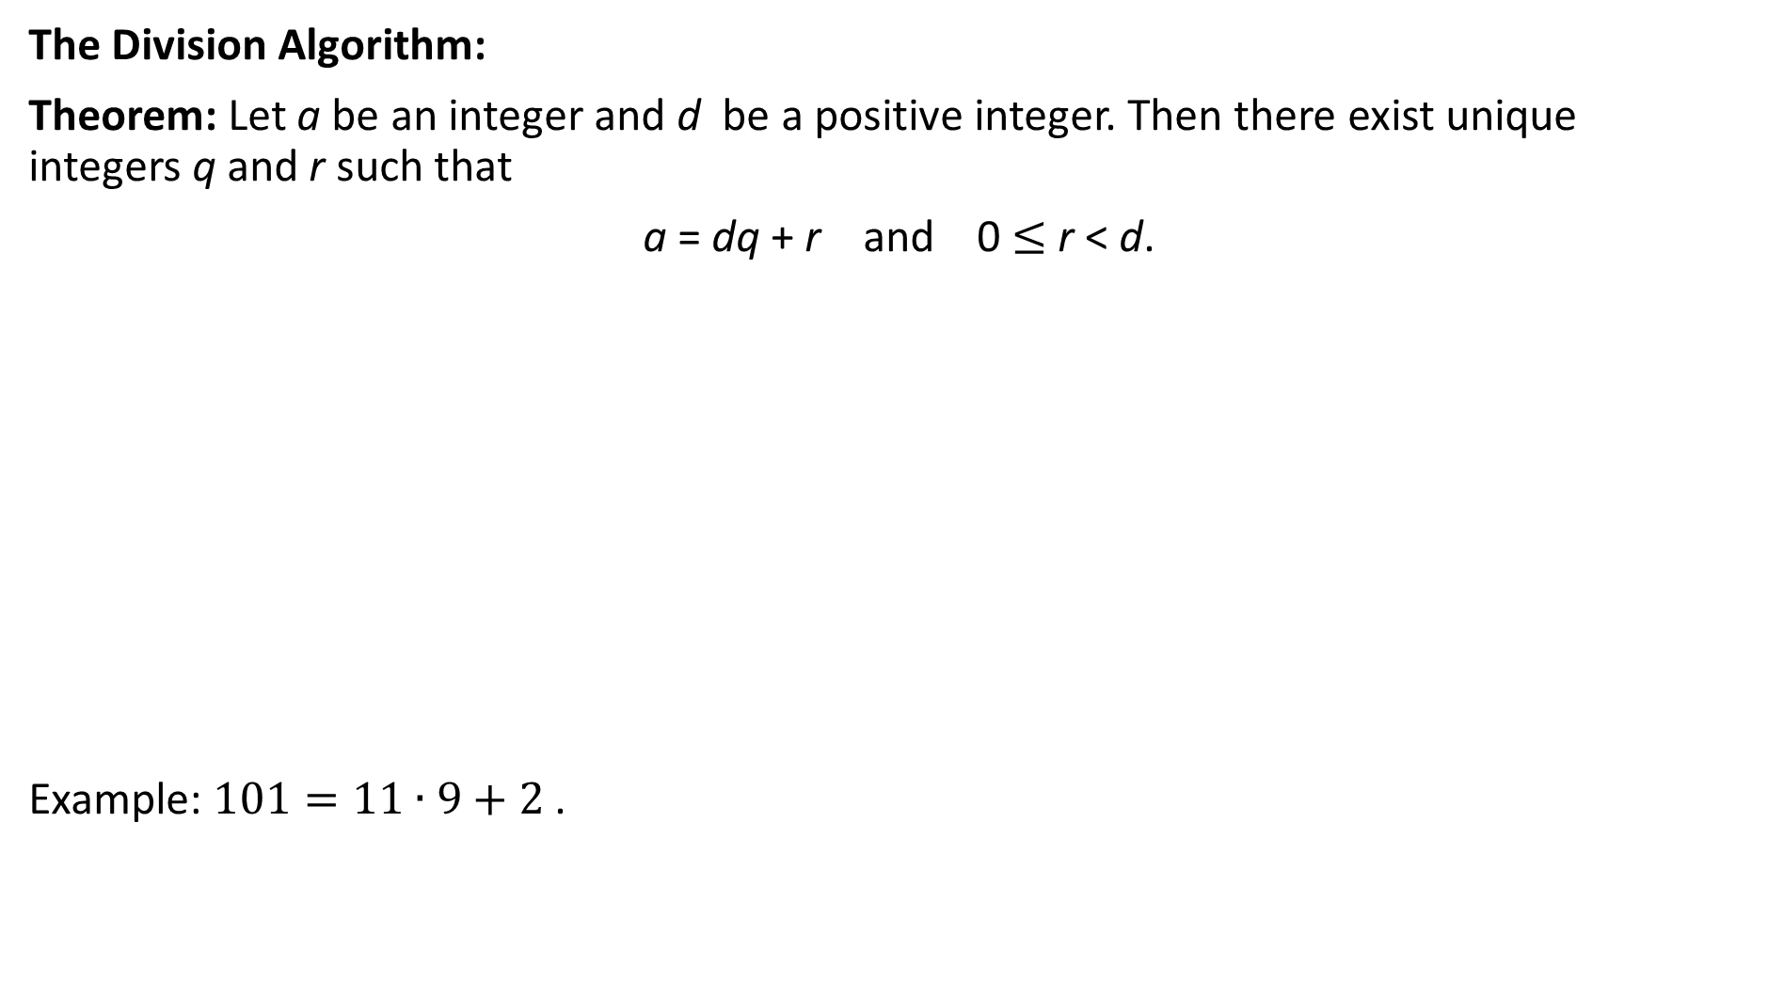
The Division Algorithm:
Theorem: Let a be an integer and d be a positive integer. Then there exist unique integers q and r such that
a = dq + r and 0 $≤$ r < d.
Example: $101=11∙9+2$ .

