Slide 1
Introduction to Number Theory
Greatest Common Divisor(GCD) or Highest common factor(HCF).
Least Common Multiple(LCM) or Lowest common multiple (LCM).
Euclidean Algorithm

Slide 2
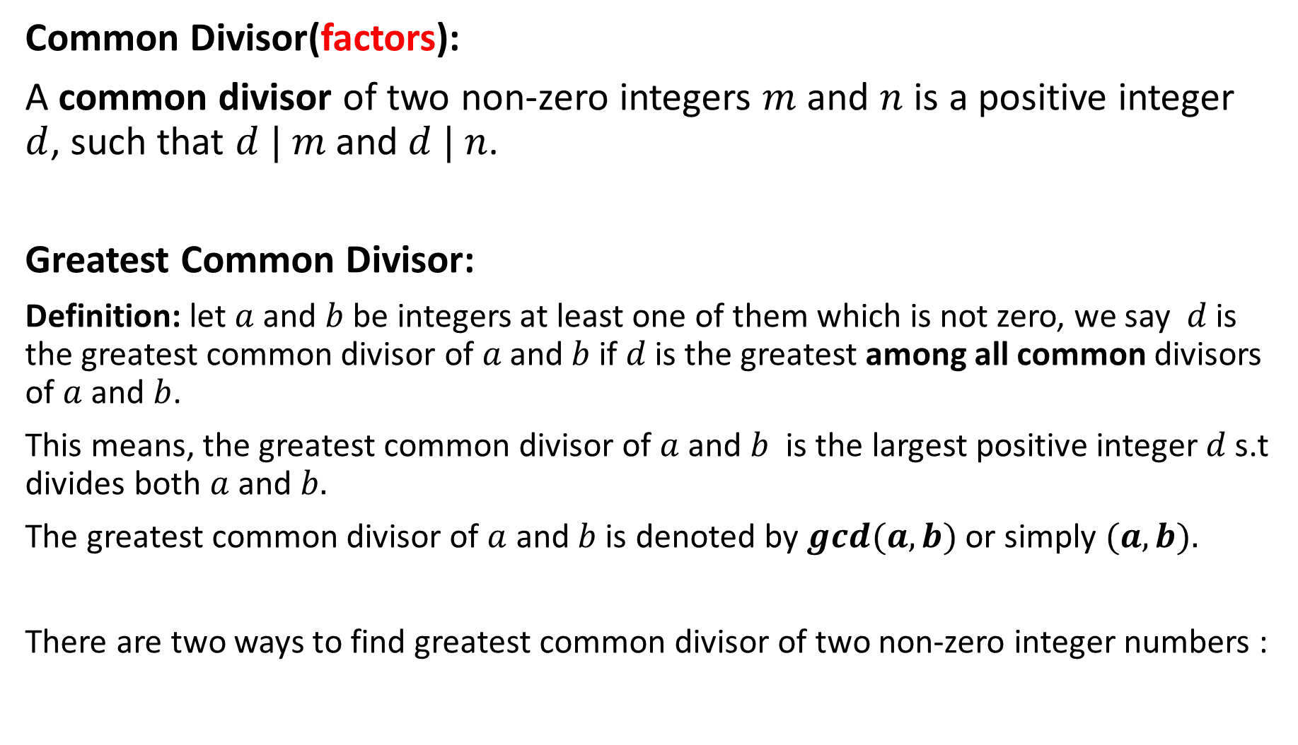
Common Divisor(factors):
A common divisor of two non-zero integers $m$ and $n$ is a positive integer $d$, such that $d | m$and $d | n$.
Greatest Common Divisor:
Definition: let $a$ and $b$ be integers at least one of them which is not zero, we say $d$is the greatest common divisor of $a \text{and} b$ if $d$ is the greatest among all common divisors of $a$ and $b$.
This means, the greatest common divisor of $a$ and $b$ is the largest positive integer $d$ s.t divides both $a$ and $b.$
The greatest common divisor of $a$ and $b$ is denoted by $gcd⁡(a, b)$or simply $(a, b).$
There are two ways to find greatest common divisor of two non-zero integer numbers :

Slide 3
First way: By listing their factors
List the divisors of both numbers
List common divisor of both numbers
Pick the largest common divisor of both which is gcd.
Ex: what is the greatest common divisor of 12 and 15?
Solution:
Divisor of 12 are : 1, 2, 3, 4, 6, 12.
Divisor of 15 are : 1, 3, 5, 15.
Common divisors are: 1 , 3.
Greatest common divisor is 3. so that, gcd(12,15)=3

Slide 4
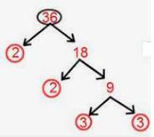
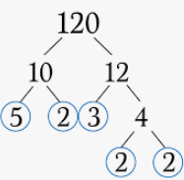
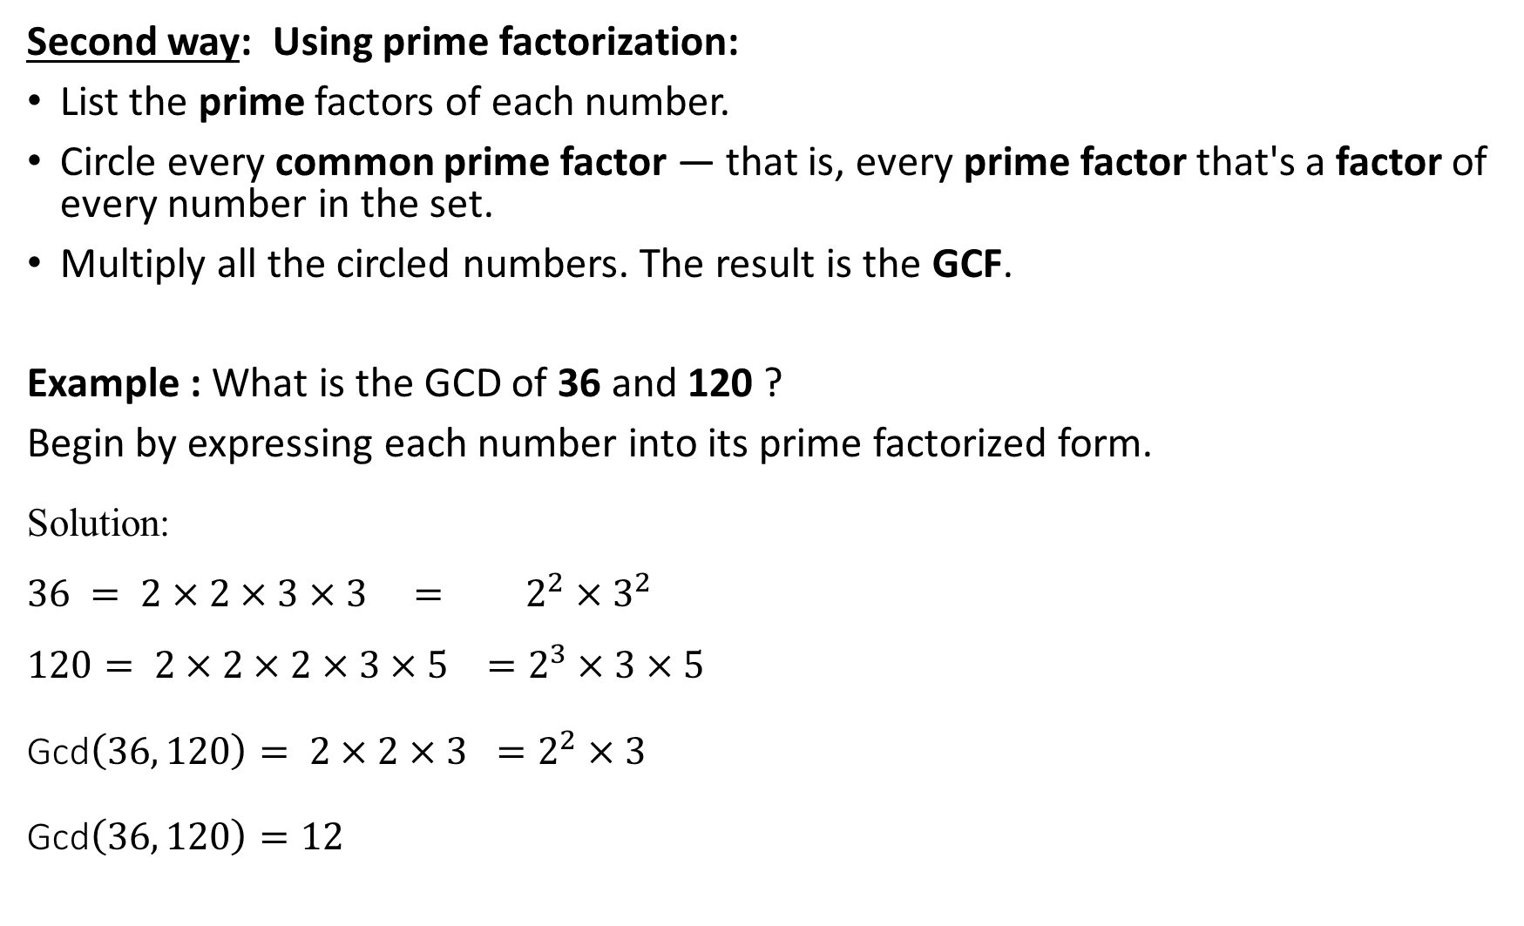
Second way: Using prime factorization:
List the prime factors of each number.
Circle every common prime factor — that is, every prime factor that's a factor of every number in the set.
Multiply all the circled numbers. The result is the GCF.
Example : What is the GCD of 36 and 120 ?
Begin by expressing each number into its prime factorized form.
Solution:
$$36 = 2×2×3×3 = 2^{2}×3^{2}$$
$$120= 2×2×2×3×5 =2^{3}×3×5$$
Gcd$\left(36, 120\right)= 2×2×3 =2^{2}×3$
Gcd$\left(36, 120\right)=12$

Slide 5
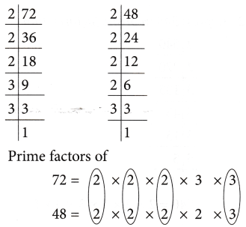
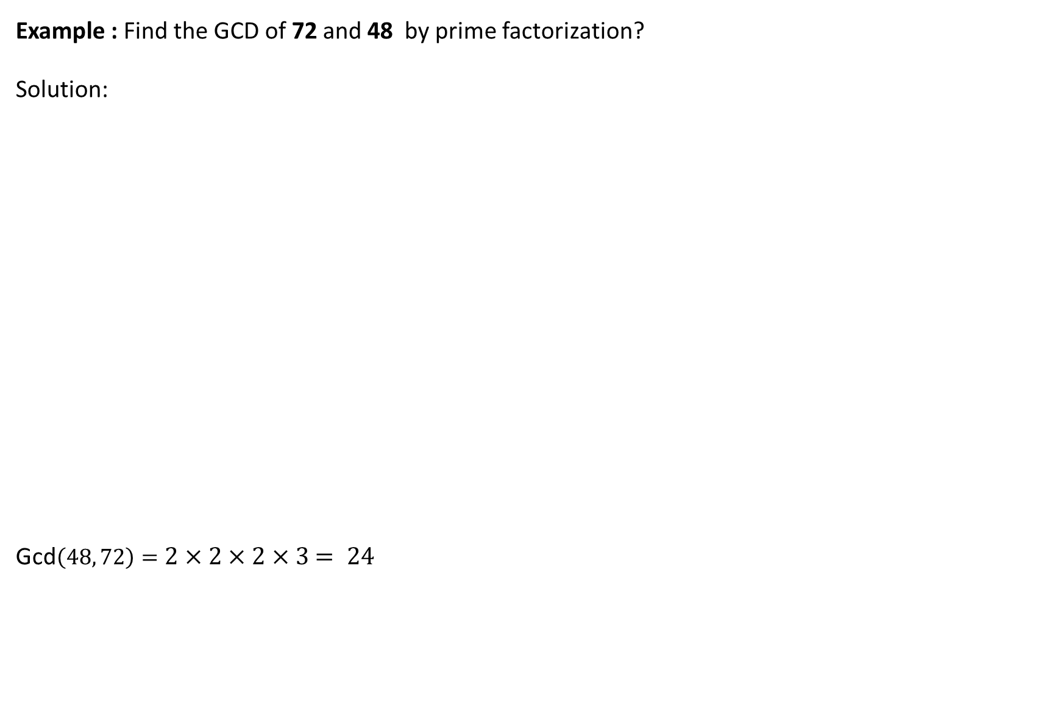
Example : Find the GCD of 72 and 48 by prime factorization?
Solution:
Gcd$\left(48, 72\right)=2×2×2×3$ $= 24$

Slide 6
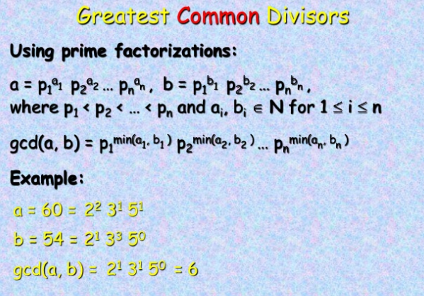

Slide 7
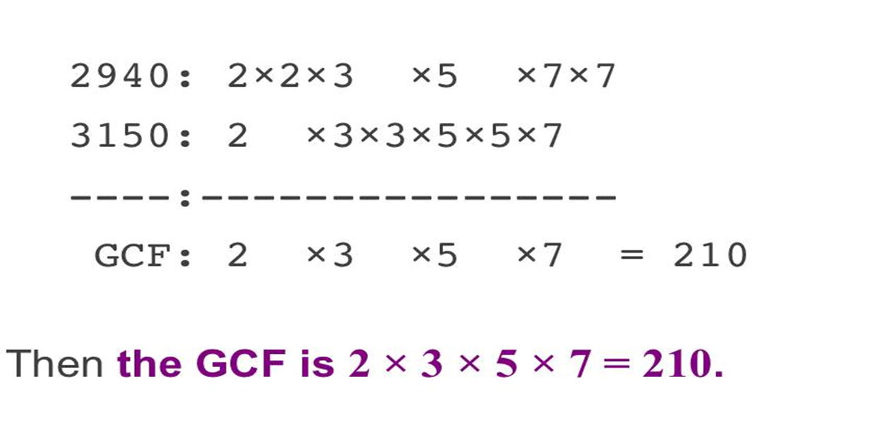
Example : Find the GCD of 2940 and 3150 by using prime factorization ?
Solution:

Slide 8
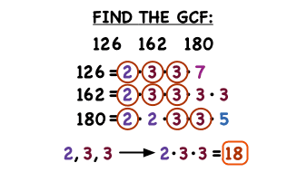
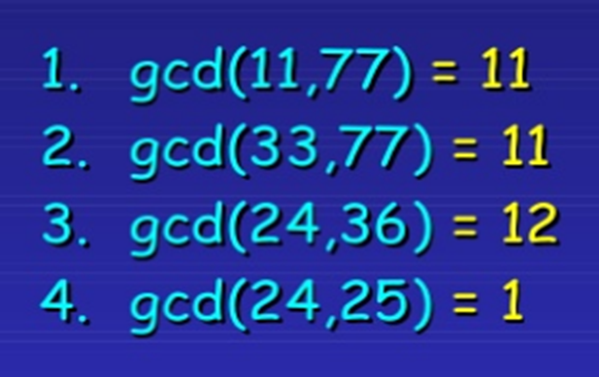

Slide 9
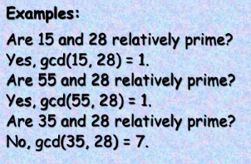

Relatively prime:
Definition: Two integers $a$ and $b$ are relatively prime(coprime) if $gcd⁡(a,b)=1.$

Slide 10
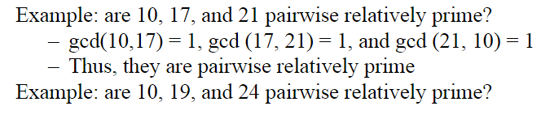
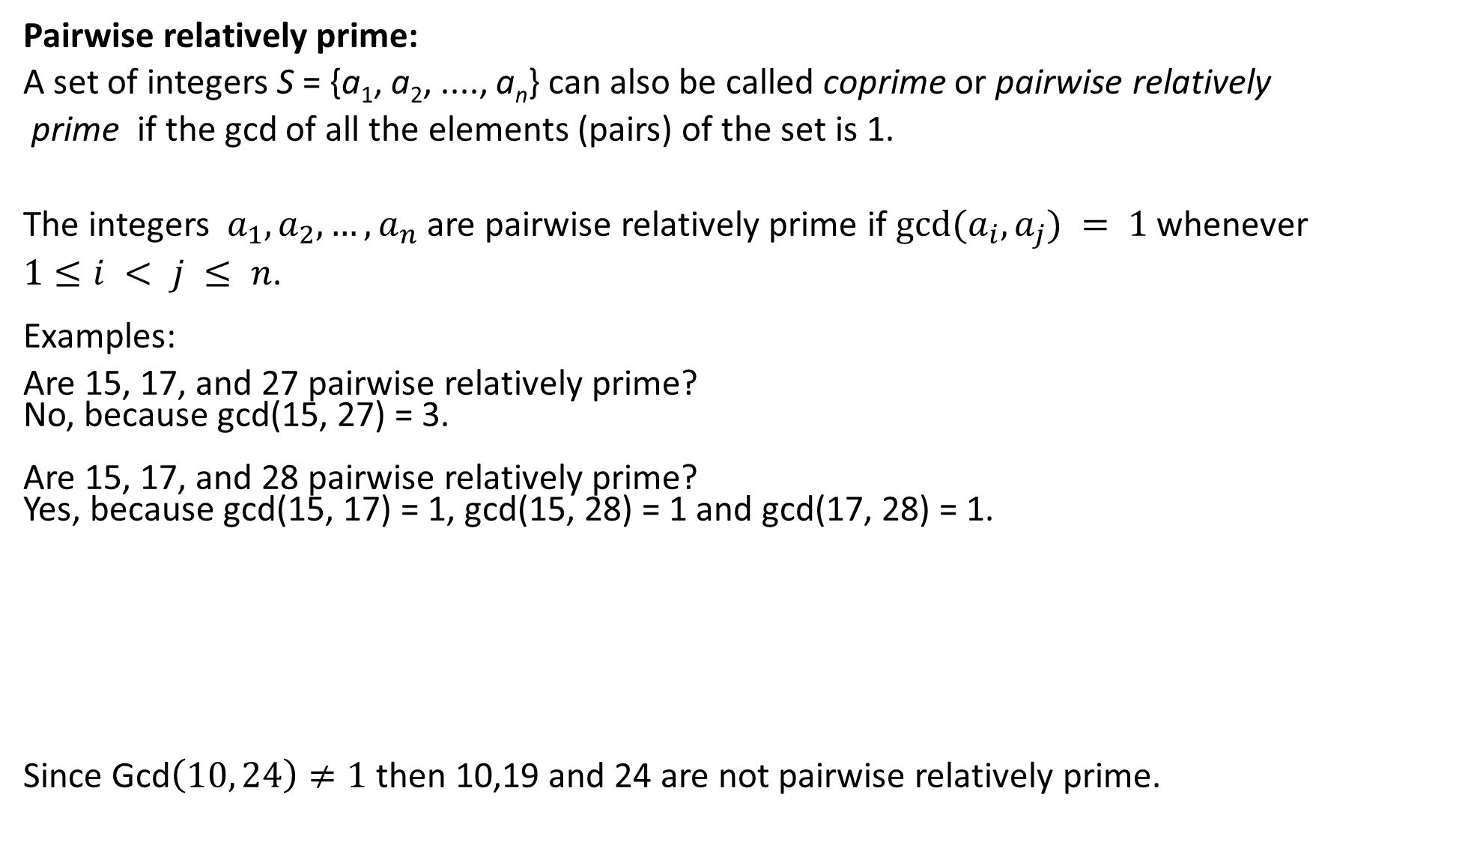
Pairwise relatively prime:
A set of integers S = {a₁, a₂, ...., a_{n}} can also be called coprime or pairwise relatively
prime if the gcd of all the elements (pairs) of the set is 1.
The integers${ a}_{1},a_{2}, …,a_{n}$ are pairwise relatively prime if $gcd⁡(a_{i},a_{j}) = 1$whenever
$1≤i < j ≤ n$. Examples:
Are 15, 17, and 27 pairwise relatively prime? No, because gcd(15, 27) = 3. Are 15, 17, and 28 pairwise relatively prime? Yes, because gcd(15, 17) = 1, gcd(15, 28) = 1 and gcd(17, 28) = 1.
Since Gcd$\left(10, 24\right)≠1$ then 10,19 and 24 are not pairwise relatively prime.

Slide 11
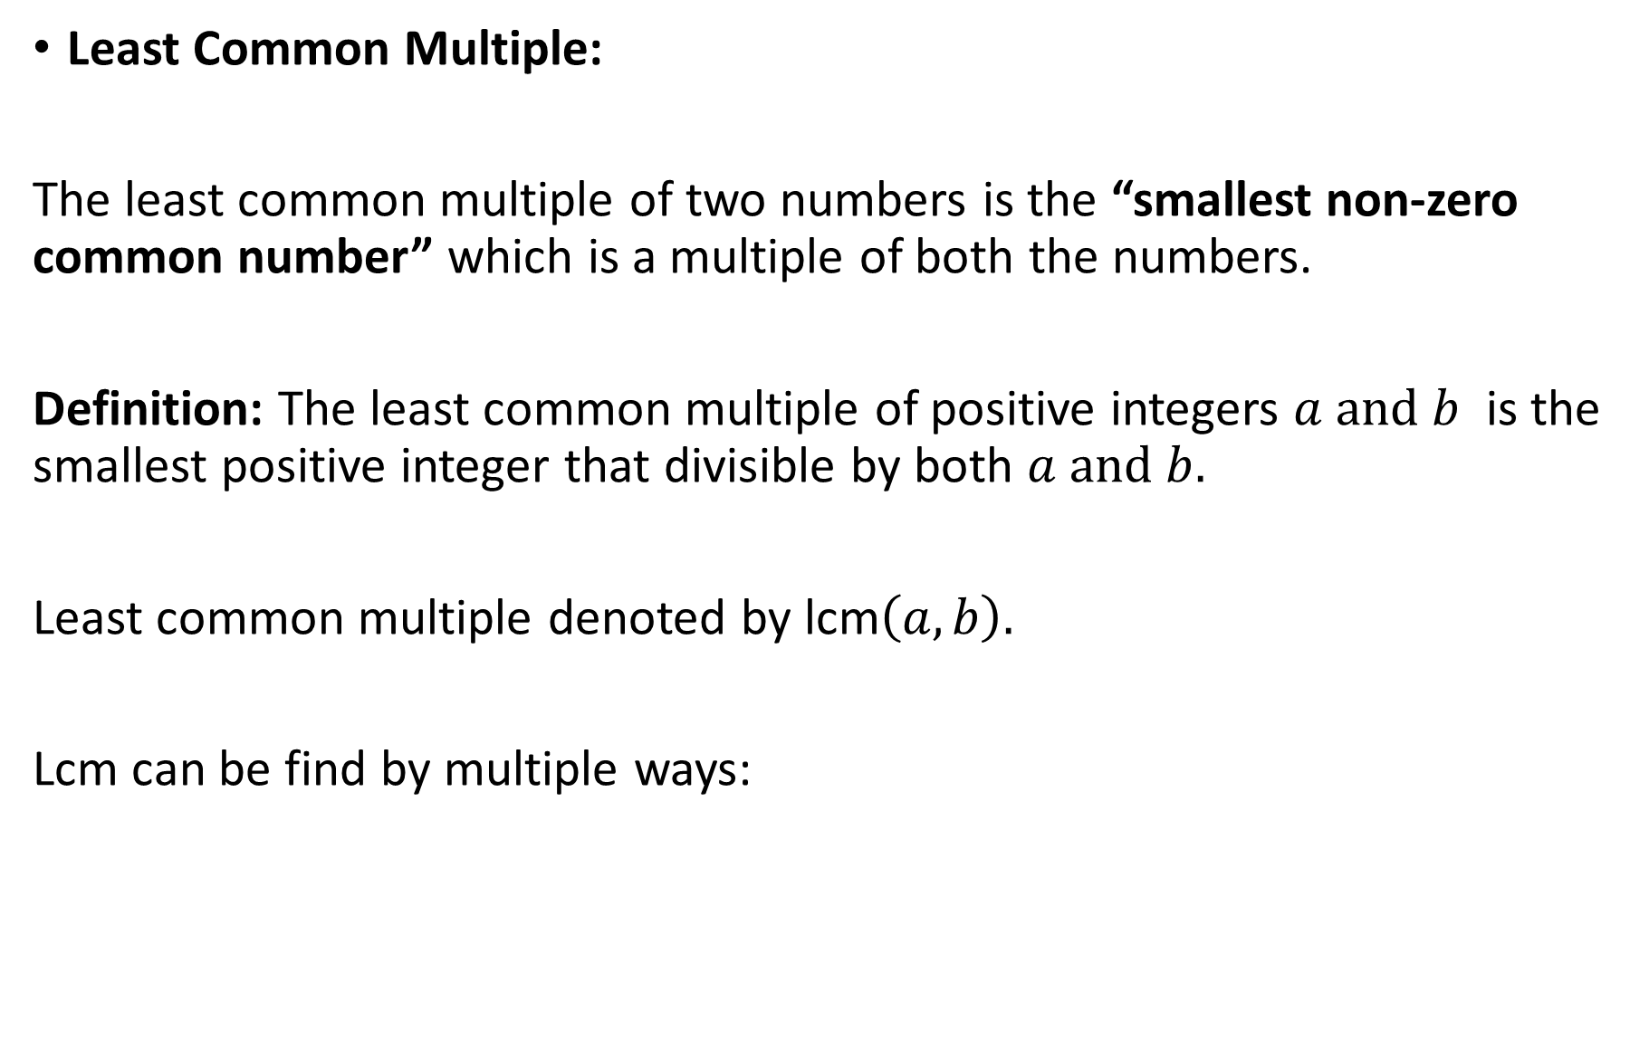
Least Common Multiple:
The least common multiple of two numbers is the “smallest non-zero common number” which is a multiple of both the numbers.
Definition: The least common multiple of positive integers $a and b$ is the smallest positive integer that divisible by both $a and b.$
Least common multiple denoted by lcm$\left(a,b\right).$
Lcm can be find by multiple ways:

Slide 12
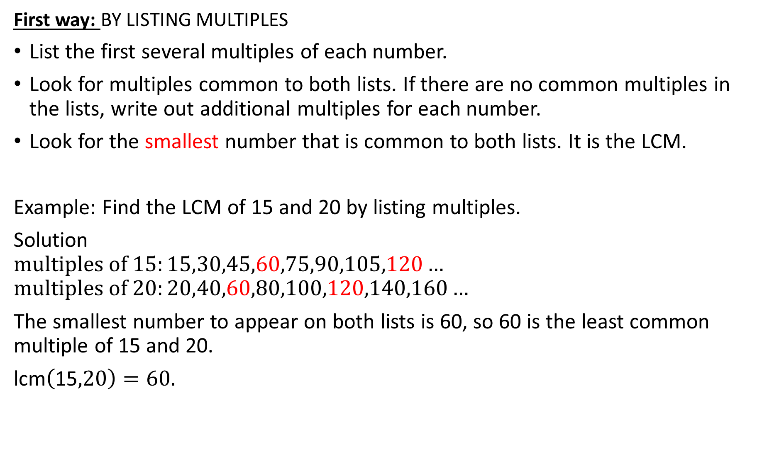
First way: BY LISTING MULTIPLES
List the first several multiples of each number.
Look for multiples common to both lists. If there are no common multiples in the lists, write out additional multiples for each number.
Look for the smallest number that is common to both lists. It is the LCM.
Example: Find the LCM of 15 and 20 by listing multiples.
Solution
$$multiples of 15:15,30,45,60,75,90,105,120…$$
$$multiples of 20:20,40,60,80,100,120,140,160…$$
The smallest number to appear on both lists is 60, so 60 is the least common multiple of 15 and 20.
lcm$\left(\text{15},20\right)=60.$

Slide 13
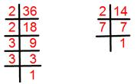
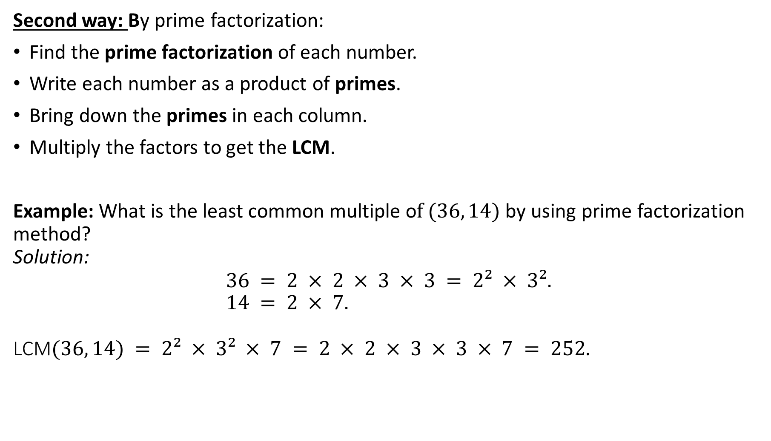
Second way: By prime factorization:
Find the prime factorization of each number.
Write each number as a product of primes.
Bring down the primes in each column.
Multiply the factors to get the LCM.
Example: What is the least common multiple o$f (36, 14)$by using prime factorization method? Solution: $$36 = 2 × 2 × 3 × 3 = 2² × 3². \\ 14 = 2 × 7.$$ LCM$(36, 14) = 2² × 3² × 7 = 2 × 2 × 3 × 3 × 7 = 252$.

Slide 14
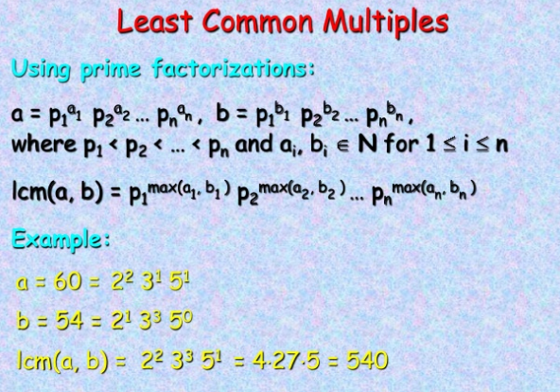

Slide 15
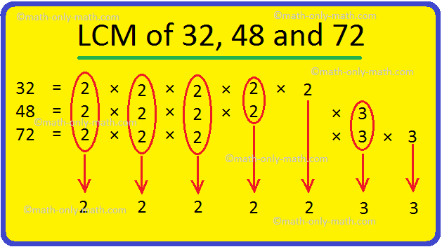

Example: What is the least common multiple, LCM$(32, 48, 72)$by using prime factorization method?
$$32=2^{5}×3^{0}$$
$$48=2^{4}×3^{1}$$
$$72=2^{3}×3^{2}$$
LCM$\left(32, 48, 72\right)=2^{5}×3^{2}$
$=2 × 2 ×2 ×2 × 2 × 3 × 3$
$=288$.

