Slide 1
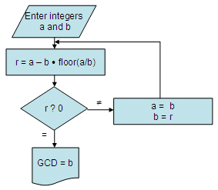
Introduction to Number Theory
Greatest Common Divisor(GCD) or Highest common factor(HCF).
Least Common Multiple(LCM) or Lowest common multiple (LCM).
Euclidean Algorithm

Slide 2
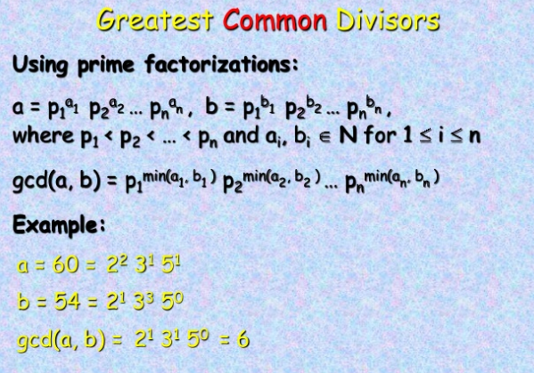

Slide 3
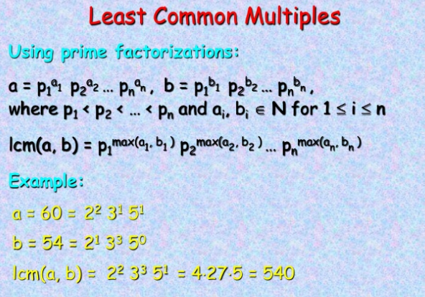

Slide 4
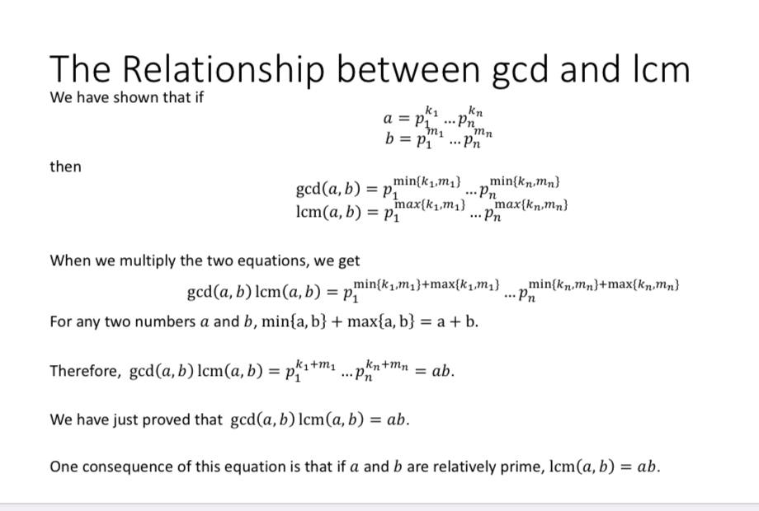

Slide 5
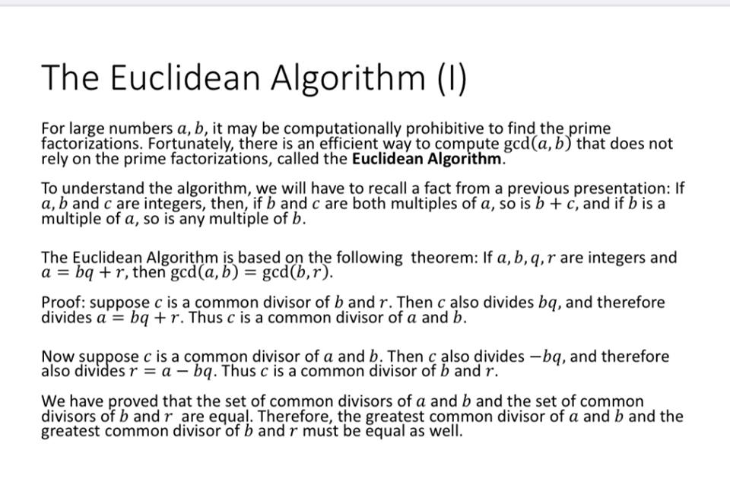

Slide 6
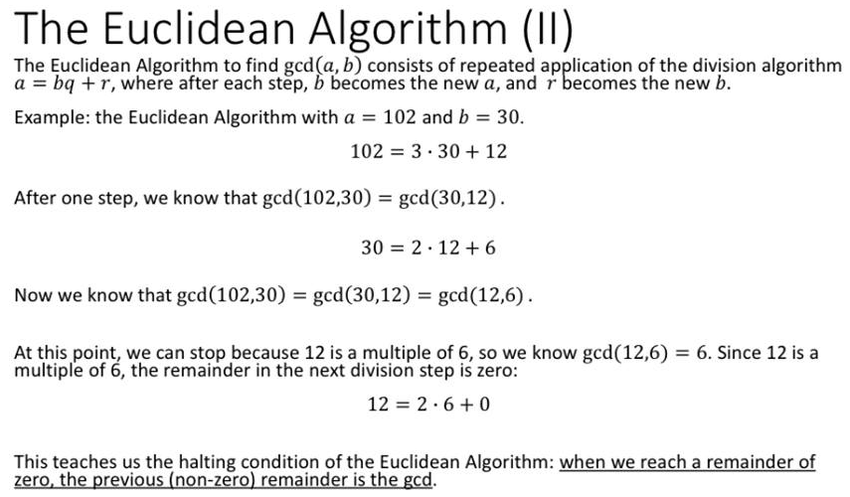

Slide 7
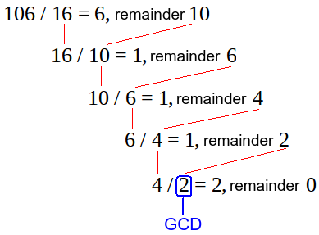


Example: Find the greatest common divisor of ($106, 16$) by Euclidean algorithm:
Solution:
$GCD(106, 16)$=2

Slide 8
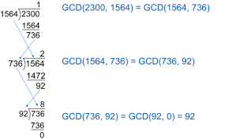


Example: Find the gcd($2300, 1564$) by Euclidean algorithm:
Solution:
gcd($2300, 1564$) =92

Slide 9
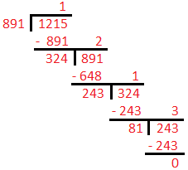
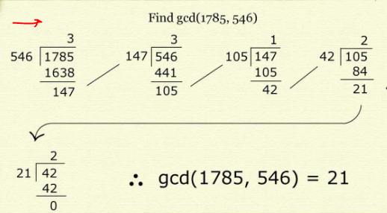
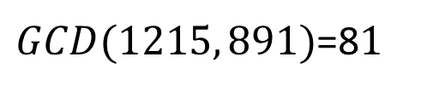
Examples: Find the greatest common divisor of ($1215, 891$) by Euclidean algorithm
$GCD(1215, 891)$=8$1$

Slide 10
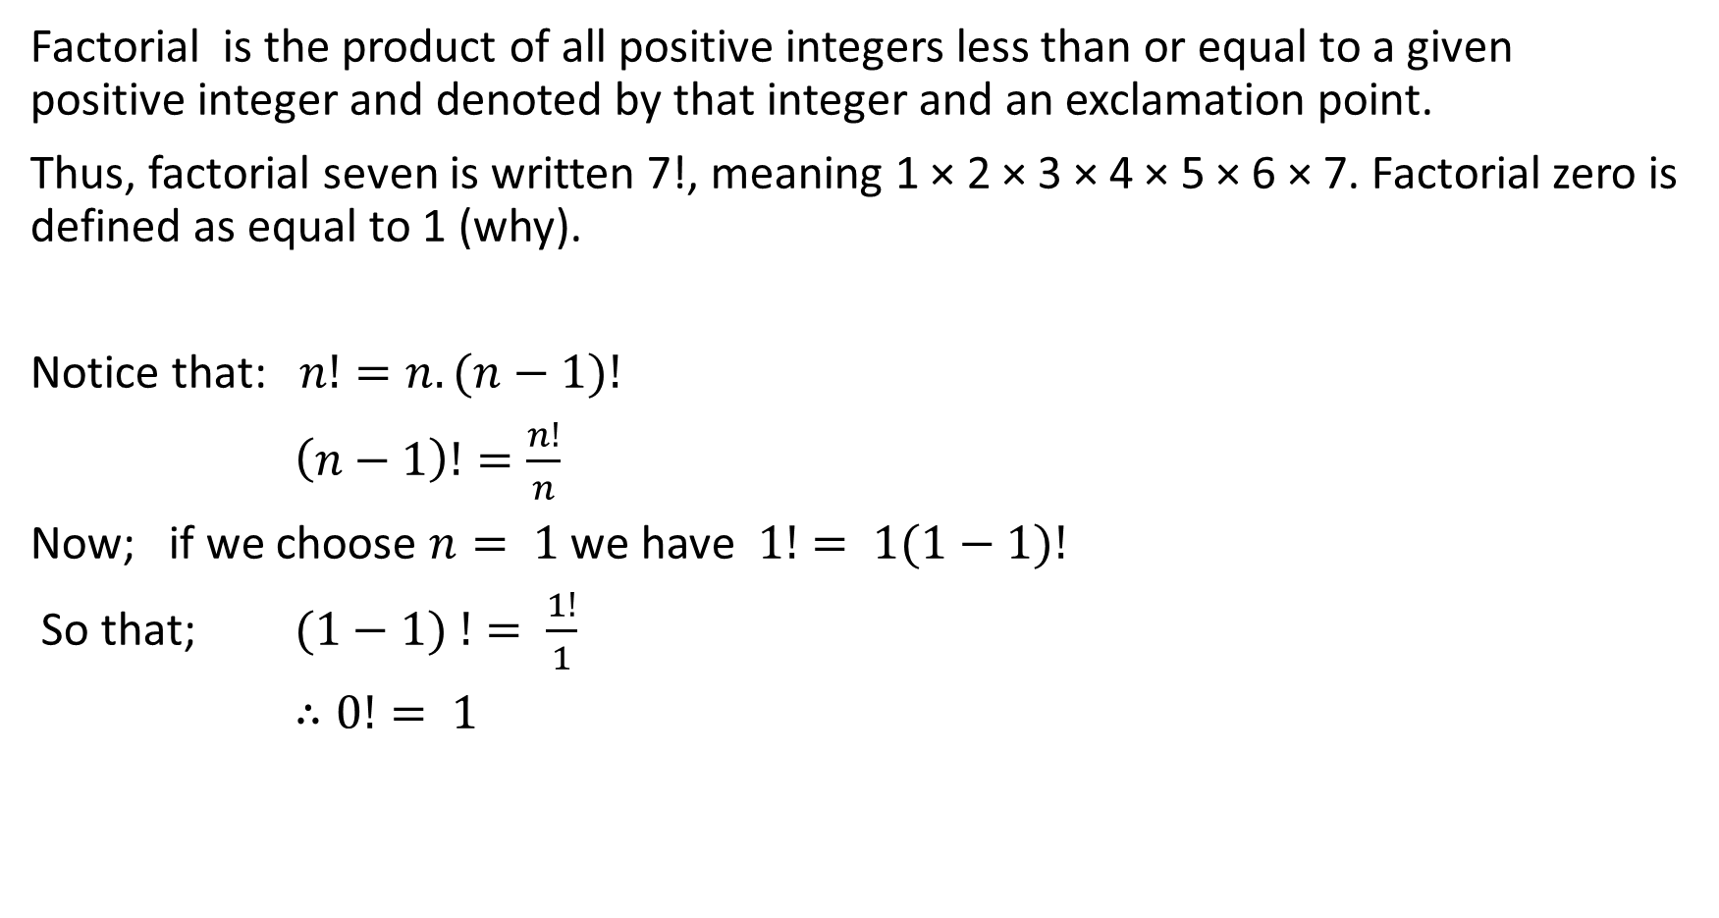
Factorial:
Factorial is the product of all positive integers less than or equal to a given positive integer and denoted by that integer and an exclamation point.
Thus, factorial seven is written 7!, meaning 1 × 2 × 3 × 4 × 5 × 6 × 7. Factorial zero is defined as equal to 1 (why).
Notice that: $n!=n.(n−1)!$
$\left(n−1\right)!=\frac{n!}{n}$
Now; if we choose $n= 1$we have $1!= 1(1−1)!$
So that; $(1−1) != \frac{1!}{1}$
$∴0!= 1$

Slide 11
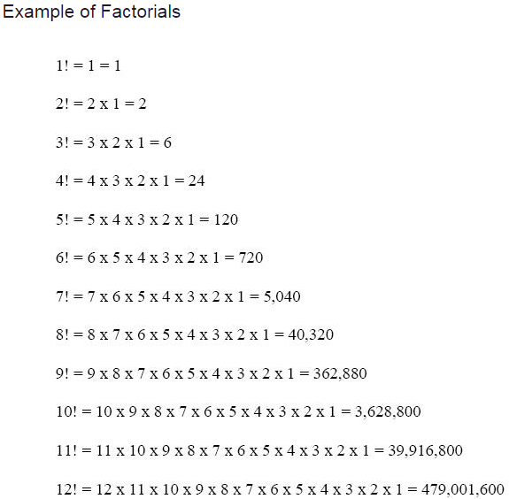

Slide 12

Why $a^{0}=1?$
since $a^{0}=a^{1−1}$
$=\frac{a^{1}}{a^{1}}$
$=1$

