Slide 1
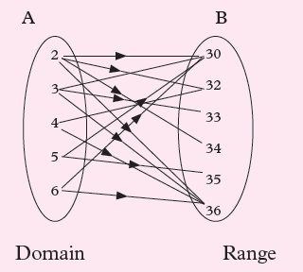
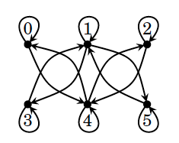
Relations and Their Properties

Slide 2
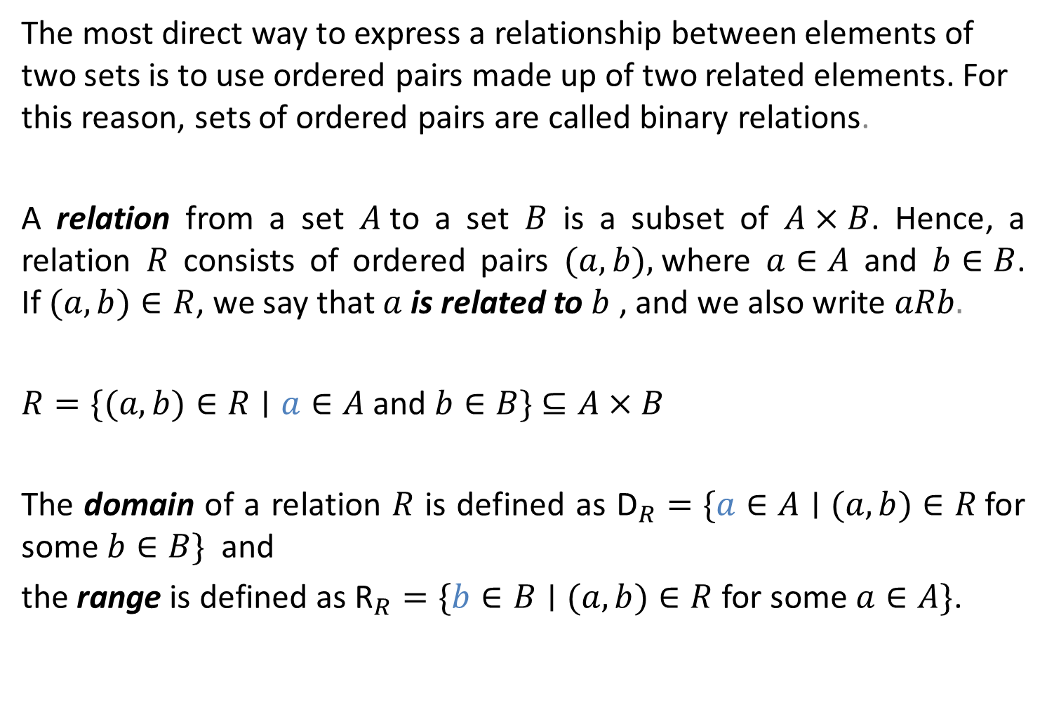
Relations and Their Properties
The most direct way to express a relationship between elements of two sets is to use ordered pairs made up of two related elements. For this reason, sets of ordered pairs are called binary relations.
A relation from a set $A$to a set $B$ is a subset of $A×B$. Hence, a relation $R$ consists of ordered pairs $(a,b),$where $a∈A$ and $b∈B$. If $(a,b)∈R$, we say that $a$ is related to $b$ , and we also write $aRb.$
$R=\{(a,b)∈R∣a∈A$and $b∈B\}$ $⊆A×B$
The domain of a relation $R$ is defined as ${\text{D}}_{R}=\{a∈A∣(a,b)∈R$for some $b∈B\}$and
the range is defined as ${\text{R}}_{R}=\{b∈B∣(a,b)∈R$ for some $a∈A\}$.

Slide 3
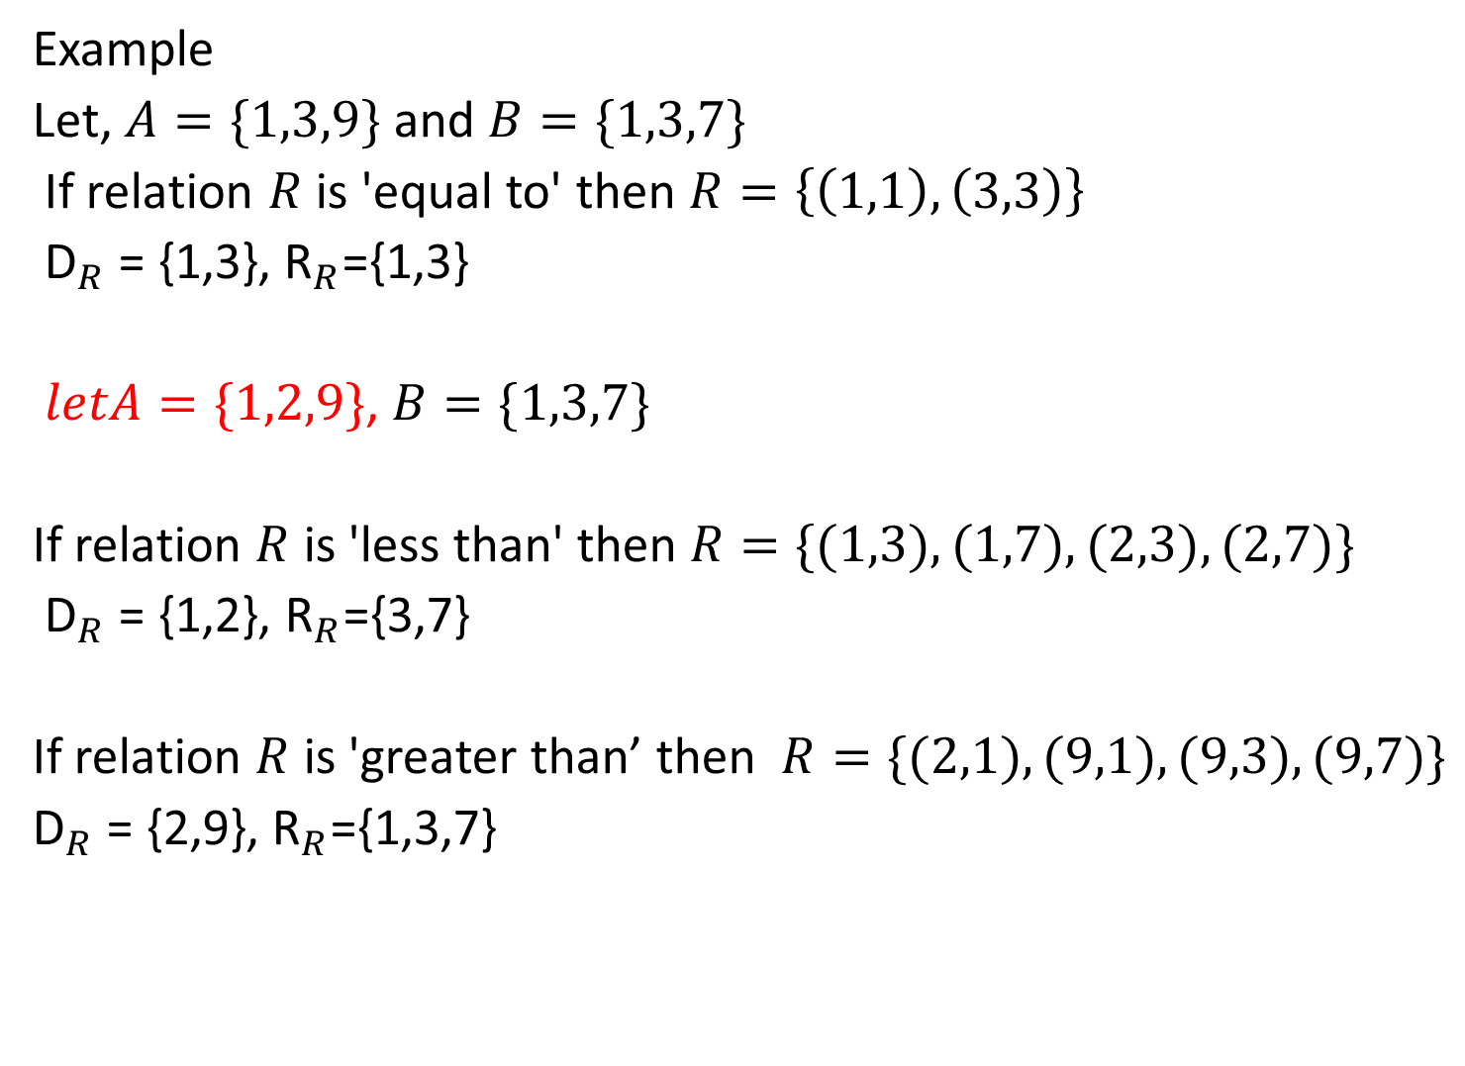
Example
Let, $A=\{1,3,9\}$ and $B=\{1,3,7\}$
If relation $R$ is 'equal to' then $R=\left\{\left(1,1\right),\left(3,3\right)\right\}$
${\text{D}}_{R}$ = {1,3}, ${\text{R}}_{R}$={1,3}
$letA=\{1,2,9\}$, $B=\{1,3,7\}$
If relation $R$ is 'less than' then $R=\{(1,3),(1,7),(2,3),(2,7)\}$
${\text{D}}_{R}$ = {1,2}, ${\text{R}}_{R}$={3,7}
If relation $R$ is 'greater than’ then $R=\{(2,1),(9,1),(9,3),(9,7)\}$
${\text{D}}_{R}$ = {2,9}, ${\text{R}}_{R}$={1,3,7}

Slide 4
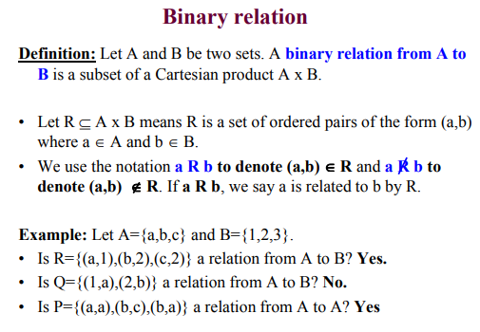

Slide 5
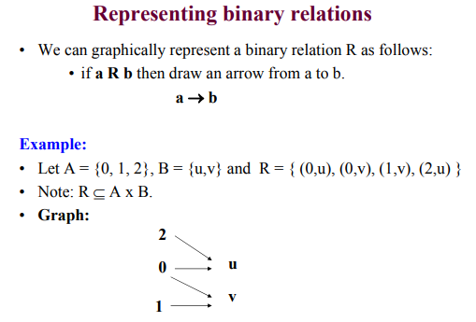
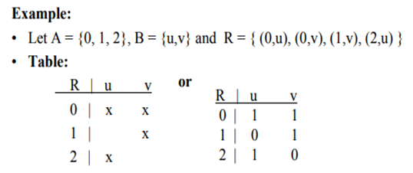

Slide 6
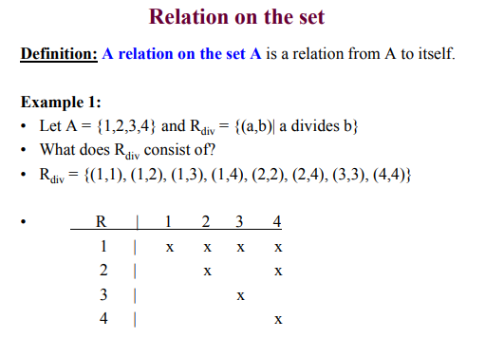
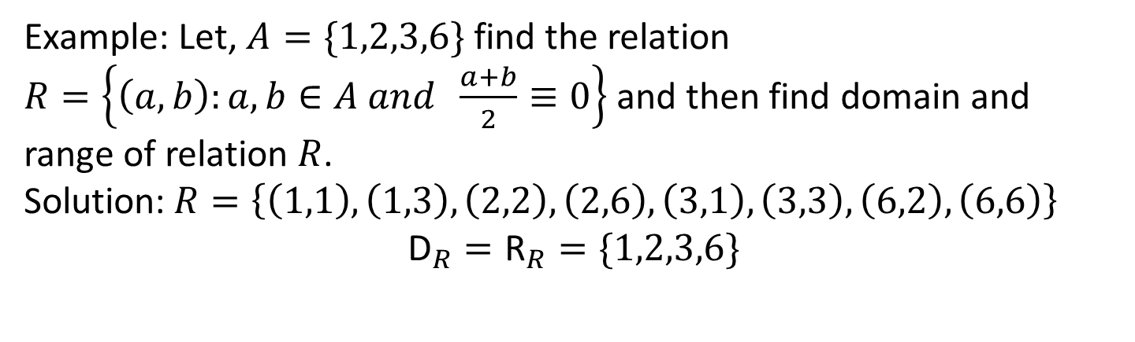
Example: Let, $A=\{1,2,3,6\}$ find the relation $R=\left\{\left(a,b\right):a,b∈A and \frac{a+b}{2}≡0\right\}$ and then find domain and range of relation $R$.
Solution:$R=\left\{\left(1,1\right),\left(1,3\right),\left(2,2\right),\left(2,6\right),\left(3,1\right),\left(3,3\right),\left(6,2\right),\left(6,6\right)\right\}$
$${\text{D}}_{R}={\text{R}}_{R}=\{1,2,3,6\}$$

Slide 7
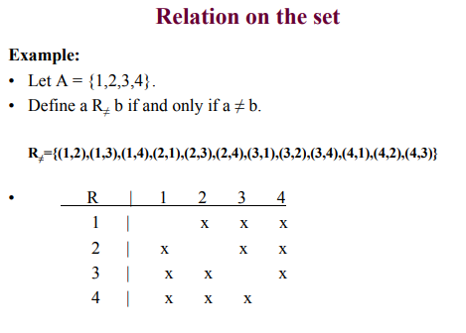

Slide 8
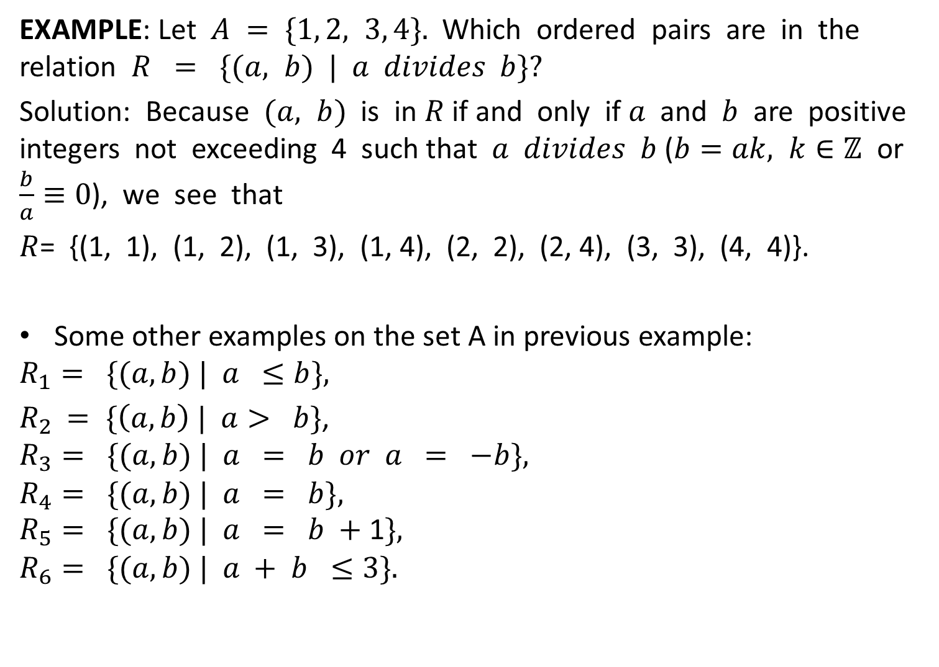
EXAMPLE: Let $A = \{1, 2, 3, 4\}.$ Which ordered pairs are in the relation $R = \{(a, b) | a divides b\}?$
Solution: Because $(a, b)$is in $R$ if and only if $a$ and $b$ are positive integers not exceeding 4 such that $a divides b$ ($b=ak, k∈ℤ$ or $\frac{b}{a}≡0$), we see that
$R$= {(1, 1), (1, 2), (1, 3), (1, 4), (2, 2), (2, 4), (3, 3), (4, 4)}.
Some other examples on the set A in previous example:
$$R_{1}= \{(a, b) | a ≤b\},$$
$R_{2}$ $= \{\left(a, b\right) | a> b\}$,
$$R_{3}= \{(a, b) | a = b or a = −b\},$$
$$R_{4}= \{(a, b) | a = b\},$$
$$R_{5}= \{(a, b) | a = b +\text{1}\},$$
$$R_{6}= \{(a,b) | a + b ≤3\}.$$

Slide 9
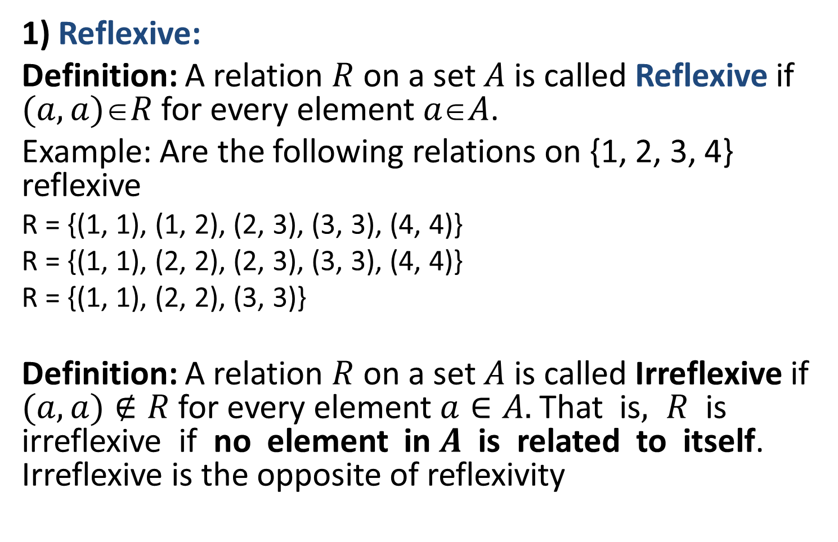
Properties of Relations
1) Reflexive:
Definition: A relation $R$ on a set $A$ is called Reflexive if $(a, a)R$for every element $aA$.
Example: Are the following relations on {1, 2, 3, 4} reflexive
R = {(1, 1), (1, 2), (2, 3), (3, 3), (4, 4)}
R = {(1, 1), (2, 2), (2, 3), (3, 3), (4, 4)}
R = {(1, 1), (2, 2), (3, 3)}
Definition: A relation $R$ on a set $A$ is called Irreflexive if $(a, a)∉R$for every element $a∈A.$ That is$, R$ is irreflexive if no element in $A$ is related to itself. Irreflexive is the opposite of reflexivity
No.
Yes.
No.

Slide 10
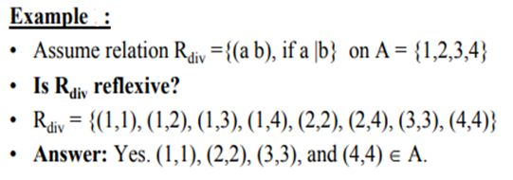
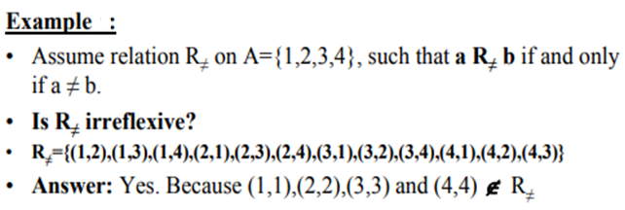
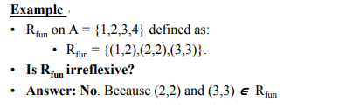

Slide 11
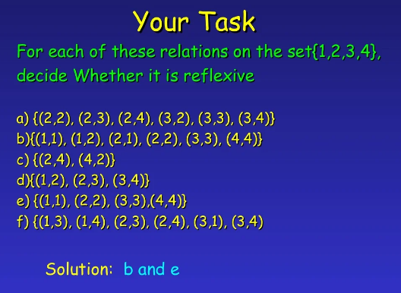


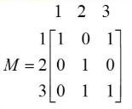

Slide 12
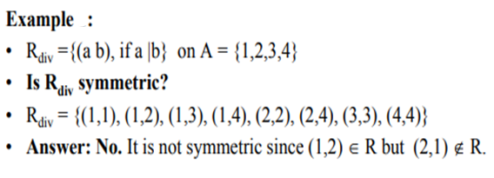
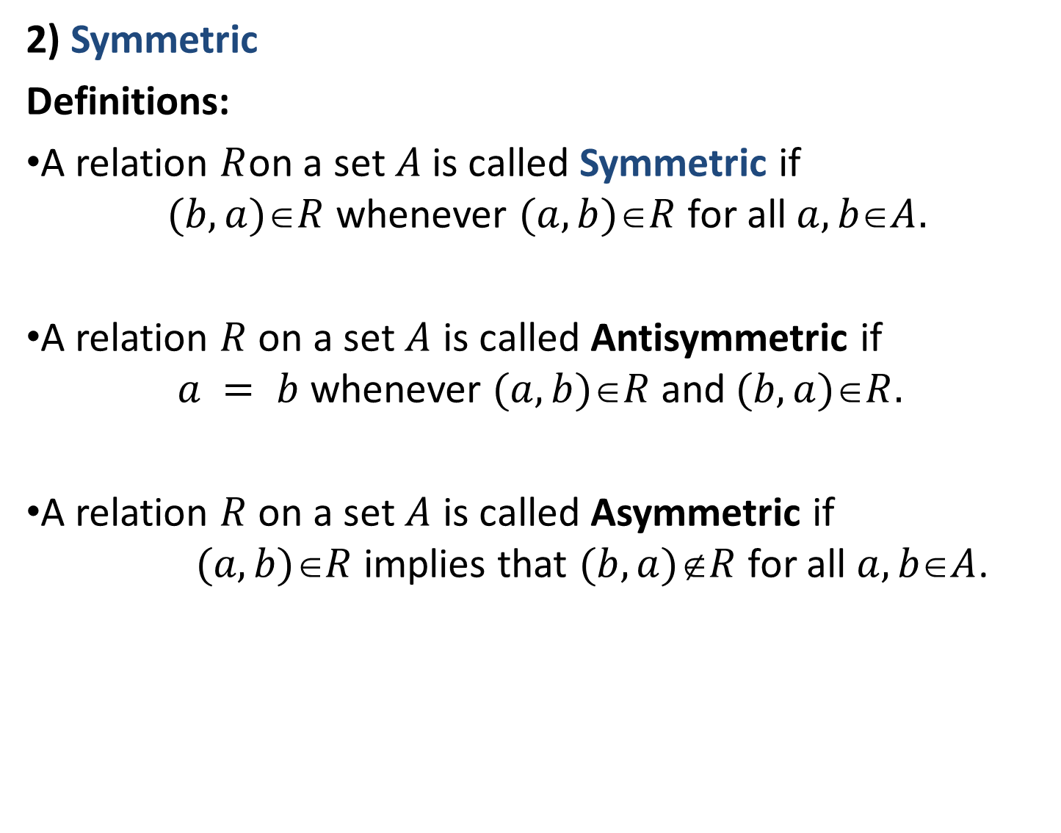
2) Symmetric
Definitions:
A relation $R$on a set$A$is called Symmetric if $(b, a)R$whenever $(a, b)R$for all $a, bA.$
A relation $R$ on a set $A$ is called Antisymmetric if $a = b$whenever $(a, b)R$and$(b, a)R.$
A relation $R$ on a set $A$ is called Asymmetric if $(a, b)R$implies that $(b, a)R$for all $a, bA$.

Slide 13
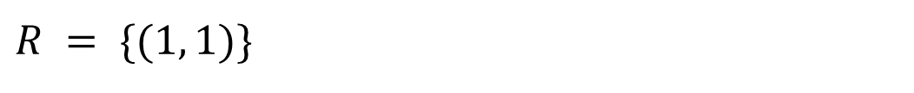
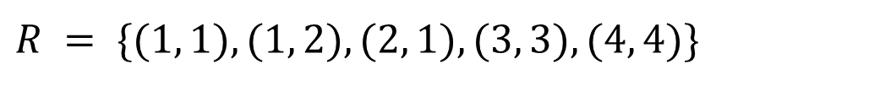
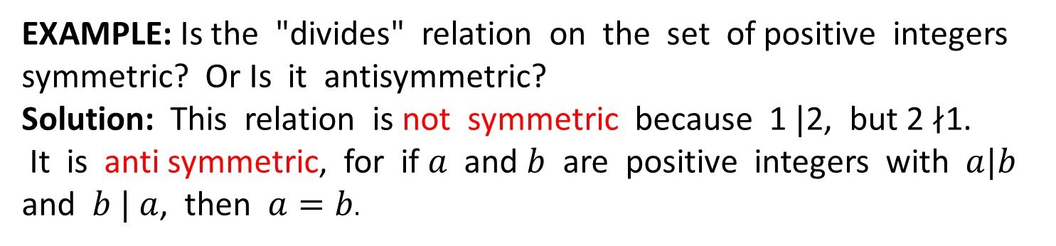
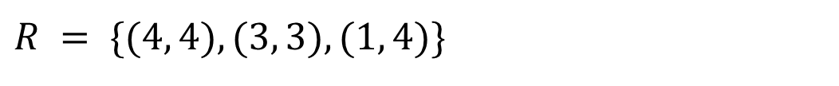
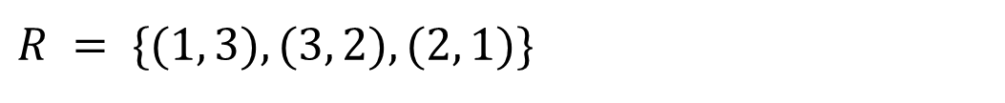
Example: Are the following relations on {1, 2, 3, 4} symmetric, anti-symmetric, or asymmetric?
Solution:
$$R = \{(1, 1), (1, 2), (2, 1), (3, 3), (4, 4)\}$$
symmetric
$$R = \{(1, 1)\}$$
sym. and anti.s.
$$R = \{(4, 4), (3, 3), (1, 4)\}$$
anti.s.
$$R = \{(1, 3), (3, 2), (2, 1)\}$$
asym. anti. s.
EXAMPLE: Is the "divides" relation on the set of positive integers symmetric? Or Is it antisymmetric?
Solution: This relation is not symmetric because 1 $|$2, but 2 $∤$1.
It is anti symmetric, for if $a$ and $b$ are positive integers with $a|b$ and $b$ $|$ $a$, then $a=b.$

Slide 14
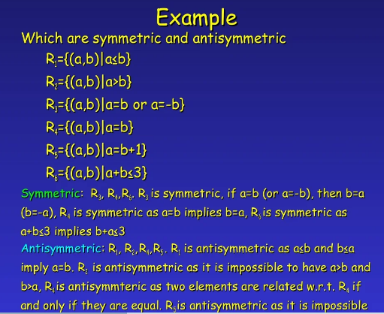

Slide 15
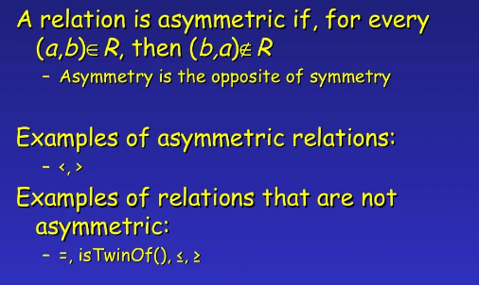

Slide 16
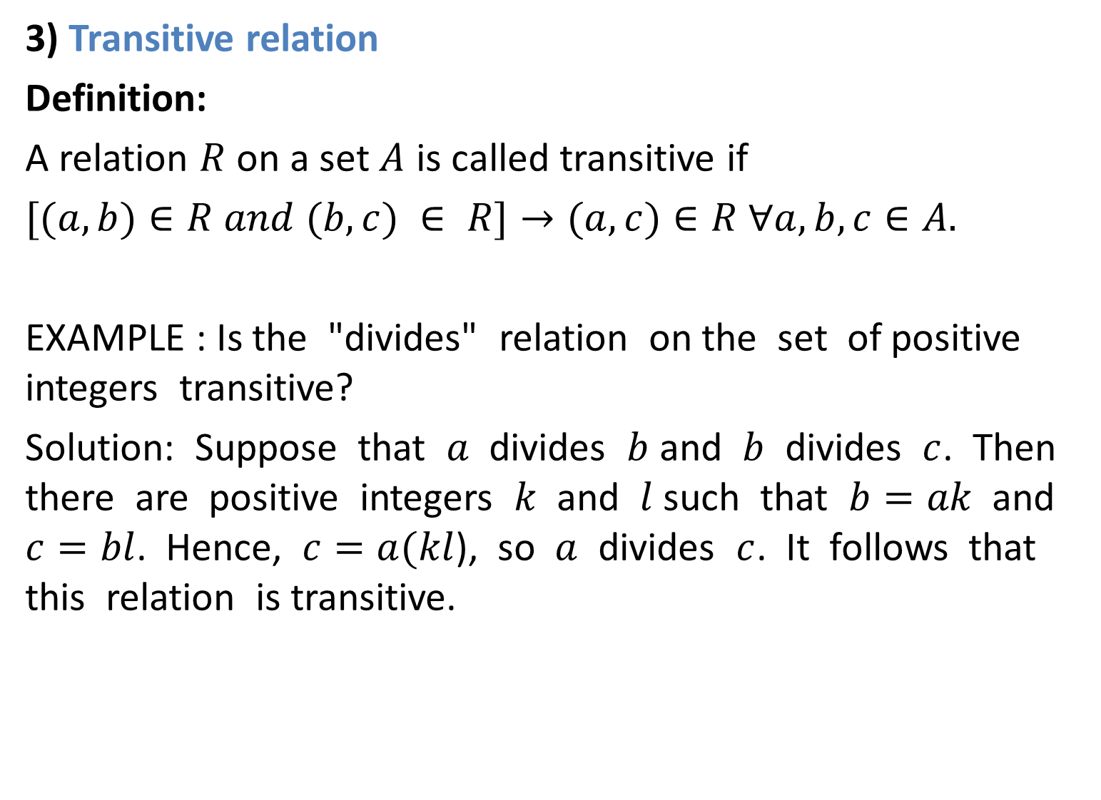
3) Transitive relation
Definition:
A relation $R$ on a set $A$ is called transitive if
$[(a,b)∈R and (b,c) ∈ R]→(a,c)∈R ∀a, b, c∈A.$
EXAMPLE : Is the "divides" relation on the set of positive integers transitive?
Solution: Suppose that $a$ divides $b$ and $b$ divides $c$. Then there are positive integers $k$ and $l$ such that $b=ak$and $c=bl$. Hence, $c=a(kl$), so $a$ divides $c$. It follows that this relation is transitive.

Slide 17
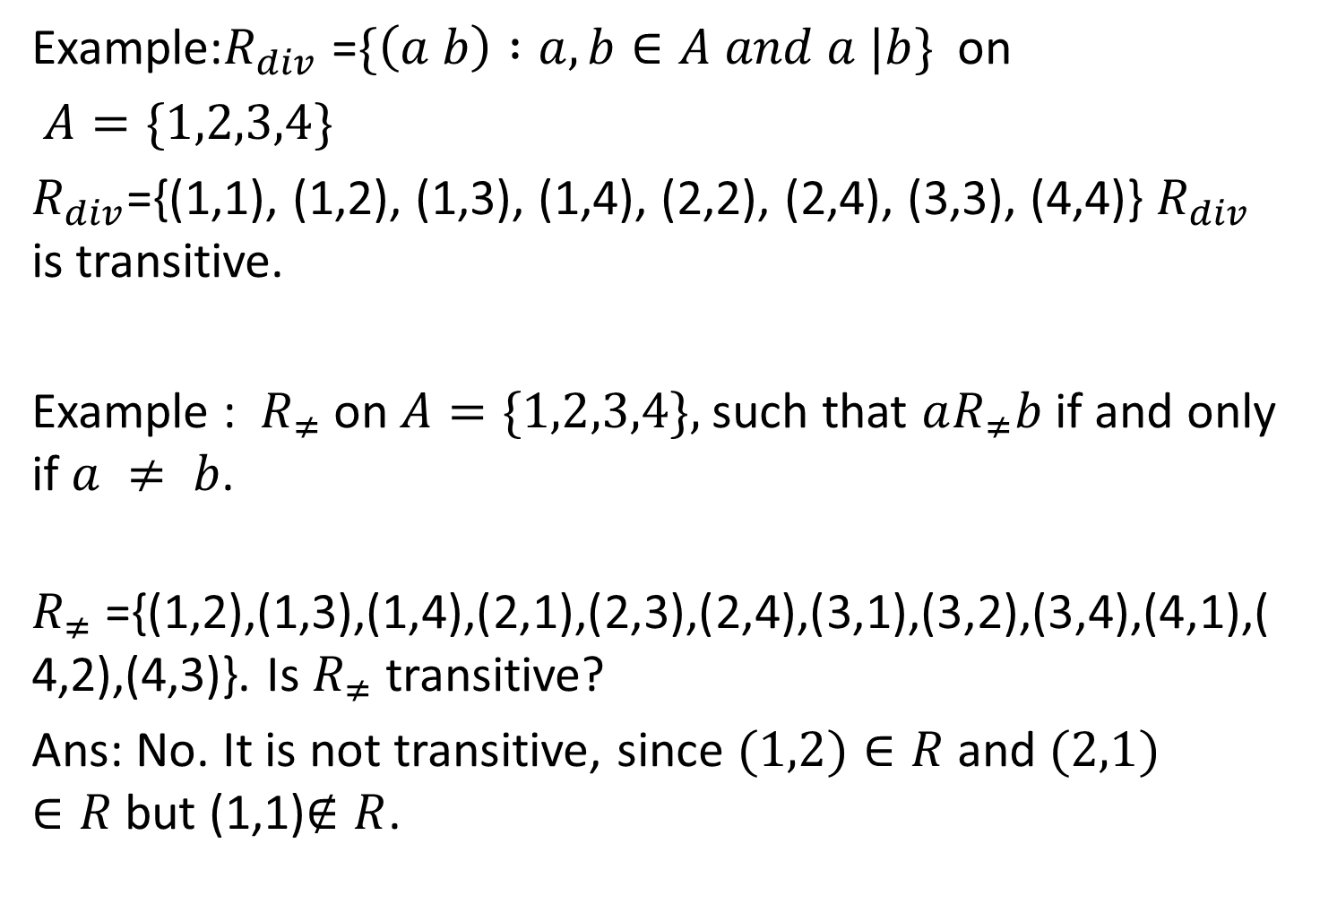
Example:$R_{div}$ =$\{\left(a b\right) :a,b∈A and a |b\}$on
$A=\{1,2,3,4\}$
$R_{div}$={(1,1), (1,2), (1,3), (1,4), (2,2), (2,4), (3,3), (4,4)} $R_{div}$ is transitive.
Example : $R_{≠}$on$A=\{1,2,3,4\},$such that $aR_{≠}b$if and only if $a ≠ b$.
$R_{≠}$={(1,2),(1,3),(1,4),(2,1),(2,3),(2,4),(3,1),(3,2),(3,4),(4,1),(4,2),(4,3)}. Is $R_{≠}$transitive?
Ans: No. It is not transitive, since $(1,2)∈R$and $(2,1)∈R$but (1,1)$∉R$.

Slide 18
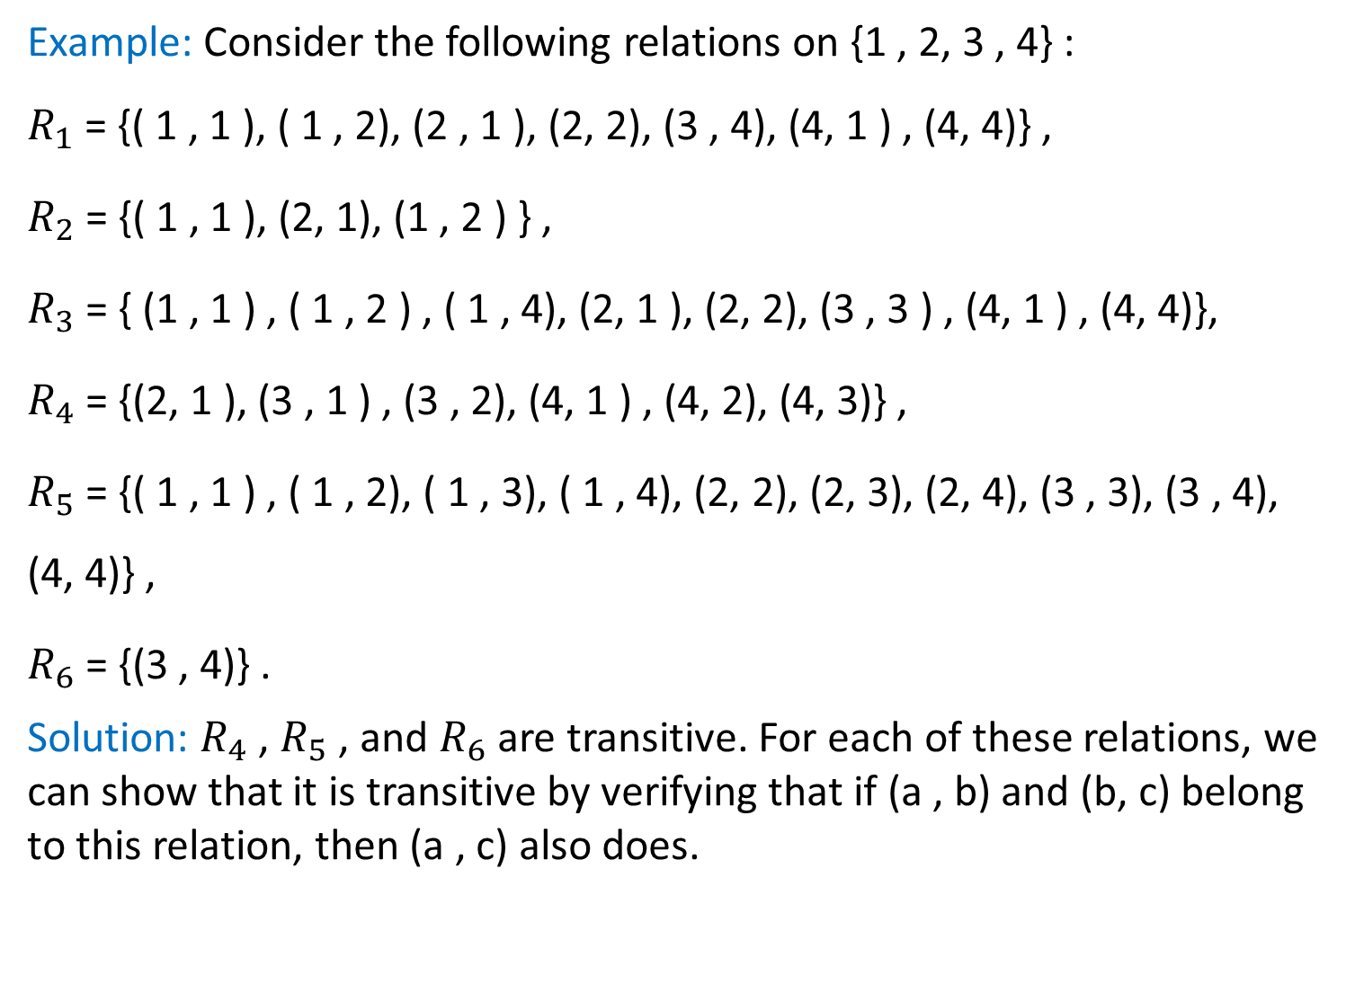
Example: Consider the following relations on {1 , 2, 3 , 4} :
$R_{1}$= {( 1 , 1 ), ( 1 , 2), (2 , 1 ), (2, 2), (3 , 4), (4, 1 ) , (4, 4)} ,
$R_{2}$ = {( 1 , 1 ), (2, 1), (1 , 2 ) } ,
$R_{3}$ = { (1 , 1 ) , ( 1 , 2 ) , ( 1 , 4), (2, 1 ), (2, 2), (3 , 3 ) , (4, 1 ) , (4, 4)},
$R_{4}$ = {(2, 1 ), (3 , 1 ) , (3 , 2), (4, 1 ) , (4, 2), (4, 3)} ,
$R_{5}$ = {( 1 , 1 ) , ( 1 , 2), ( 1 , 3), ( 1 , 4), (2, 2), (2, 3), (2, 4), (3 , 3), (3 , 4), (4, 4)} ,
$R_{6}$= {(3 , 4)} .
Solution: $R_{4}$ , $R_{5}$ , and $R_{6}$ are transitive. For each of these relations, we can show that it is transitive by verifying that if (a , b) and (b, c) belong to this relation, then (a , c) also does.

Slide 19
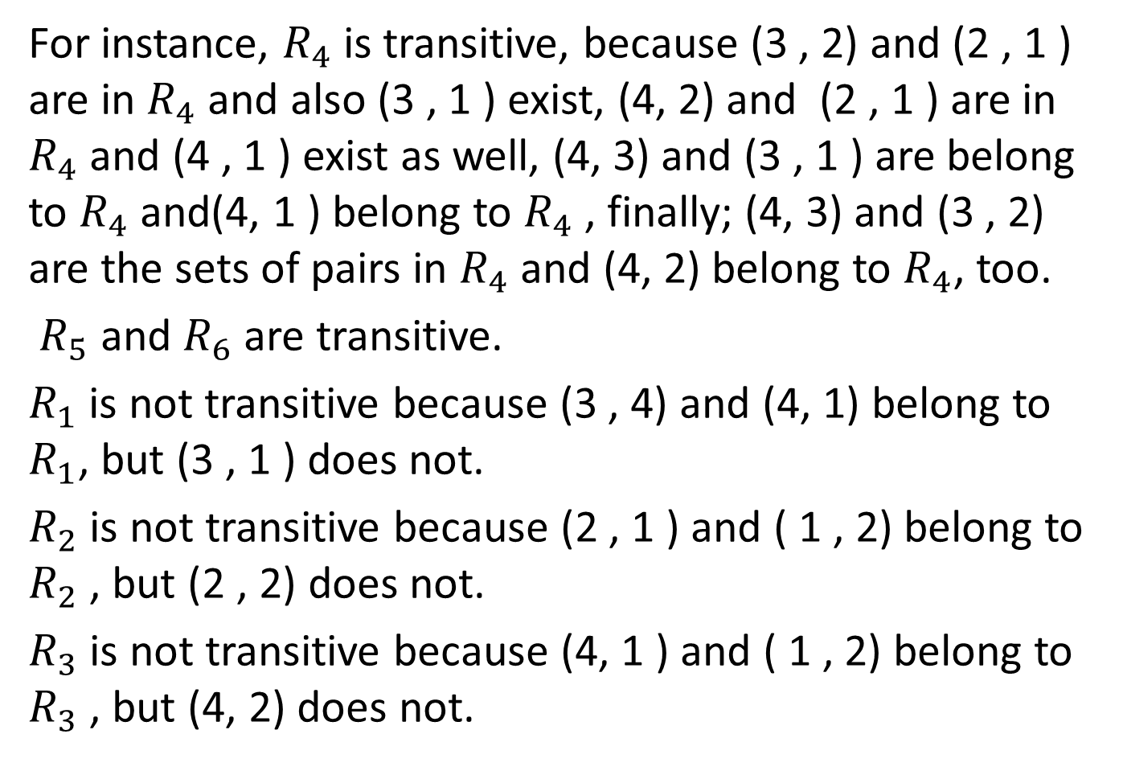
For instance, $R_{4}$ is transitive, because (3 , 2) and (2 , 1 ) are in $R_{4}$ and also (3 , 1 ) exist, (4, 2) and (2 , 1 ) are in $R_{4}$ and (4 , 1 ) exist as well, (4, 3) and (3 , 1 ) are belong to $R_{4}$ and(4, 1 ) belong to $R_{4}$ , finally; (4, 3) and (3 , 2) are the sets of pairs in $R_{4}$ and (4, 2) belong to $R_{4}$, too.
$R_{5}$ and $R_{6}$ are transitive.
$R_{1}$ is not transitive because (3 , 4) and (4, 1) belong to $R_{1}$, but (3 , 1 ) does not.
$R_{2}$ is not transitive because (2 , 1 ) and ( 1 , 2) belong to $R_{2}$ , but (2 , 2) does not.
$R_{3}$ is not transitive because (4, 1 ) and ( 1 , 2) belong to $R_{3}$ , but (4, 2) does not.

Slide 20
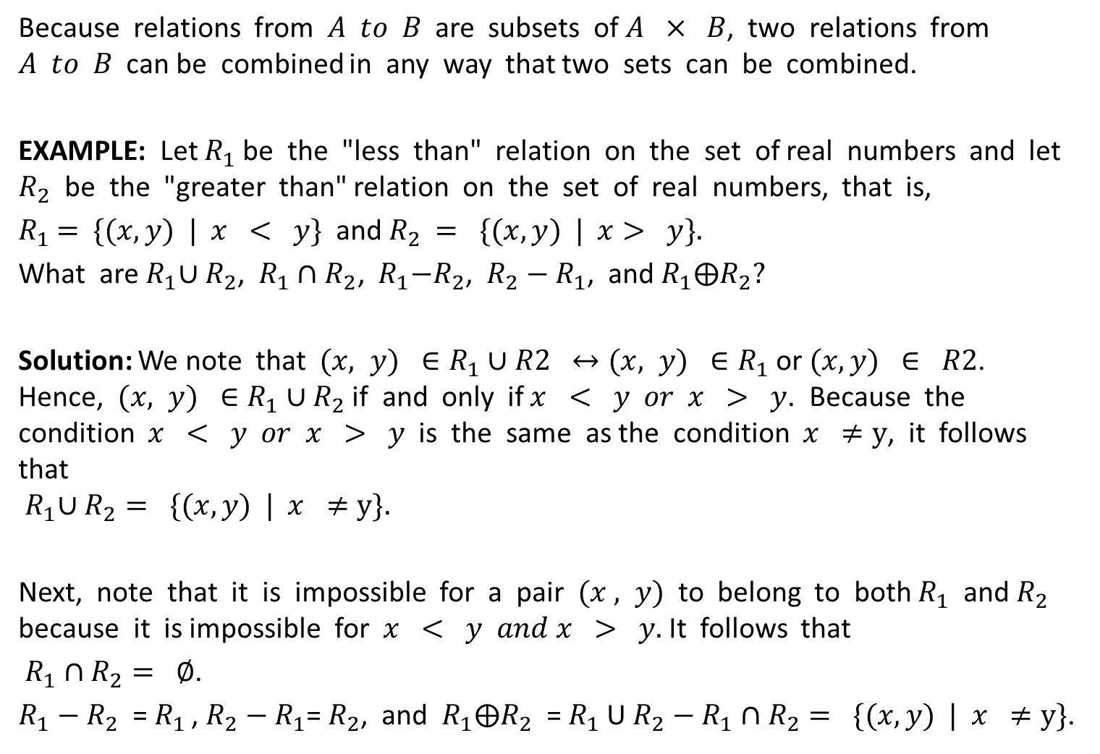
Combining Relations
Because relations from $A to B$are subsets of $A × B$, two relations from $A to B$can be combined in any way that two sets can be combined.
EXAMPLE: Let $R_{1}$be the "less than" relation on the set of real numbers and let $R_{2}$ be the "greater than" relation on the set of real numbers, that is,
$R_{1}$ $=$ $\{(x,y) | x < y\}$and $R_{2}$ $= \{(x,y) | x> y\}.$
What are${ R}_{1}∪R_{2}$, $R_{1}∩R_{2}$,${ R}_{1}−R_{2}$, $R_{2}−R_{1}$, and $R_{1}⨁R_{2}?$
Solution: We note that $(x, y) ∈R_{1}∪R2 ↔(x, y) ∈R_{1}$ or $(x, y) ∈ R2$. Hence, $(x, y) ∈R_{1}∪R_{2}$ if and only if $x < y or x > y$. Because the condition $x < y or x > y$ is the same as the condition $x ≠y$, it follows that
$${ R}_{1}∪R_{2}= \{(x, y) | x ≠y\}.$$
Next, note that it is impossible for a pair $(x , y)$to belong to both $R_{1}$ and $R_{2}$ because it is impossible for $x < y and x > y.$It follows that
${ R}_{1} ∩R_{2}= ∅$.
$R_{1}−R_{2}$ = $R_{1 }$, $R_{2}−R_{1}$= $R_{2}$, and $R_{1}⨁R_{2}$ = $R_{1}$U $R_{2}−R_{1}∩R_{2}= \{(x, y) | x ≠y\}$.

Slide 21
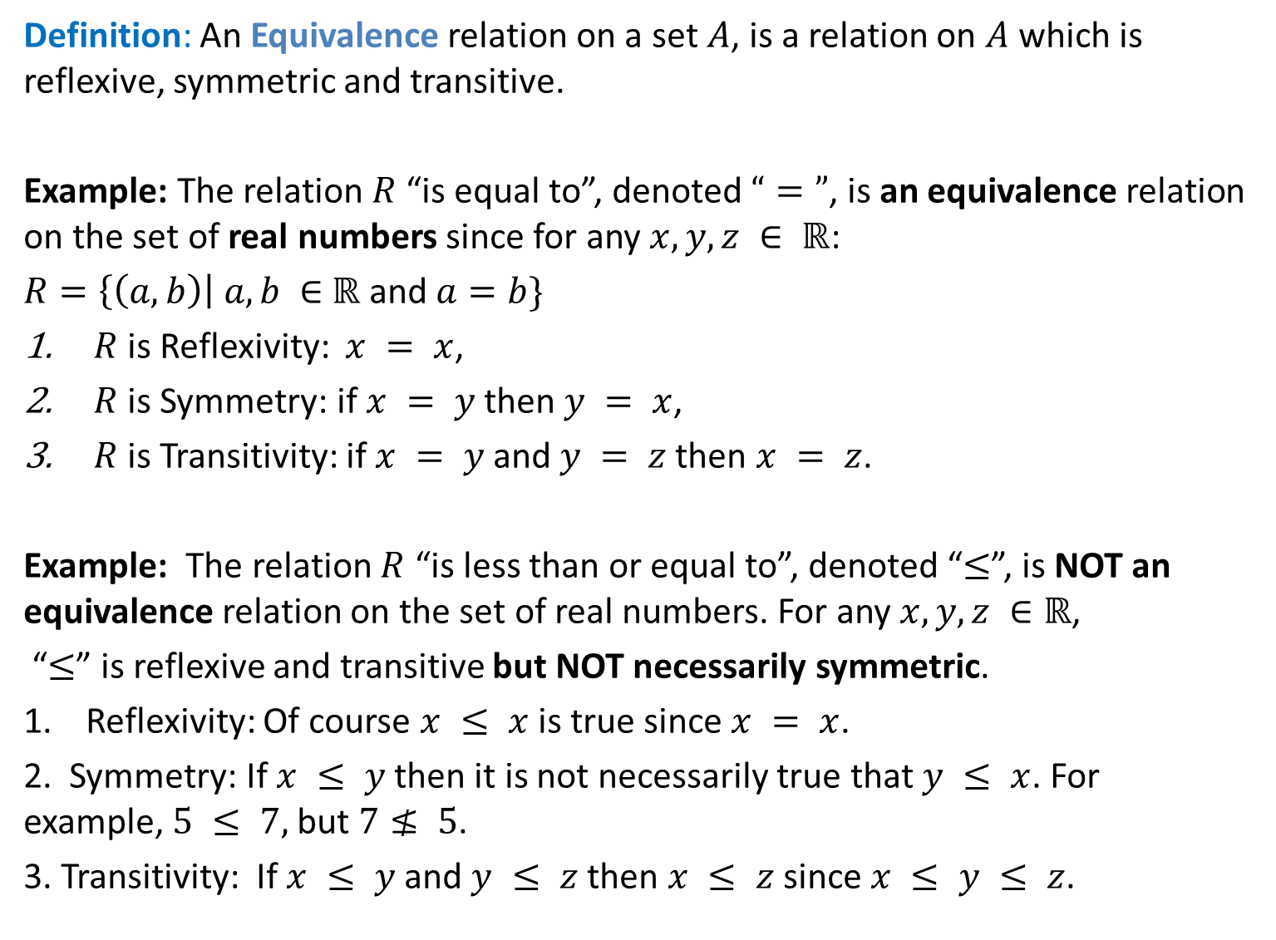
Definition: An Equivalence relation on a set $A$, is a relation on $A$which is reflexive, symmetric and transitive.
Example: The relation $R$ “is equal to”, denoted $“=”$, is an equivalence relation on the set of real numbers since for any $x, y, z ∈ ℝ$:
$R=\left\{\left(a,b\right)\right| a,b ∈$ $ℝ$ and $a=b\}$
$R$is Reflexivity: $x = x$,
$R$ is Symmetry: if $x = y$then $y = x$,
$R$is Transitivity: if $x = y$and $y = z$then $x = z$.
Example: The relation $R$ “is less than or equal to”, denoted “$≤$”, is NOT an equivalence relation on the set of real numbers. For any $x, y, z ∈ℝ$,
“$≤$” is reflexive and transitive but NOT necessarily symmetric.
Reflexivity: Of course $x ≤ x$is true since $x = x$.
2. Symmetry: If $x ≤ y$then it is not necessarily true that $y ≤ x$. For example, $5 ≤ 7,$but $7≰ 5$.
3. Transitivity: If $x ≤ y$and $y ≤ z$then $x ≤ z$since $x ≤ y ≤ z$.

Slide 22
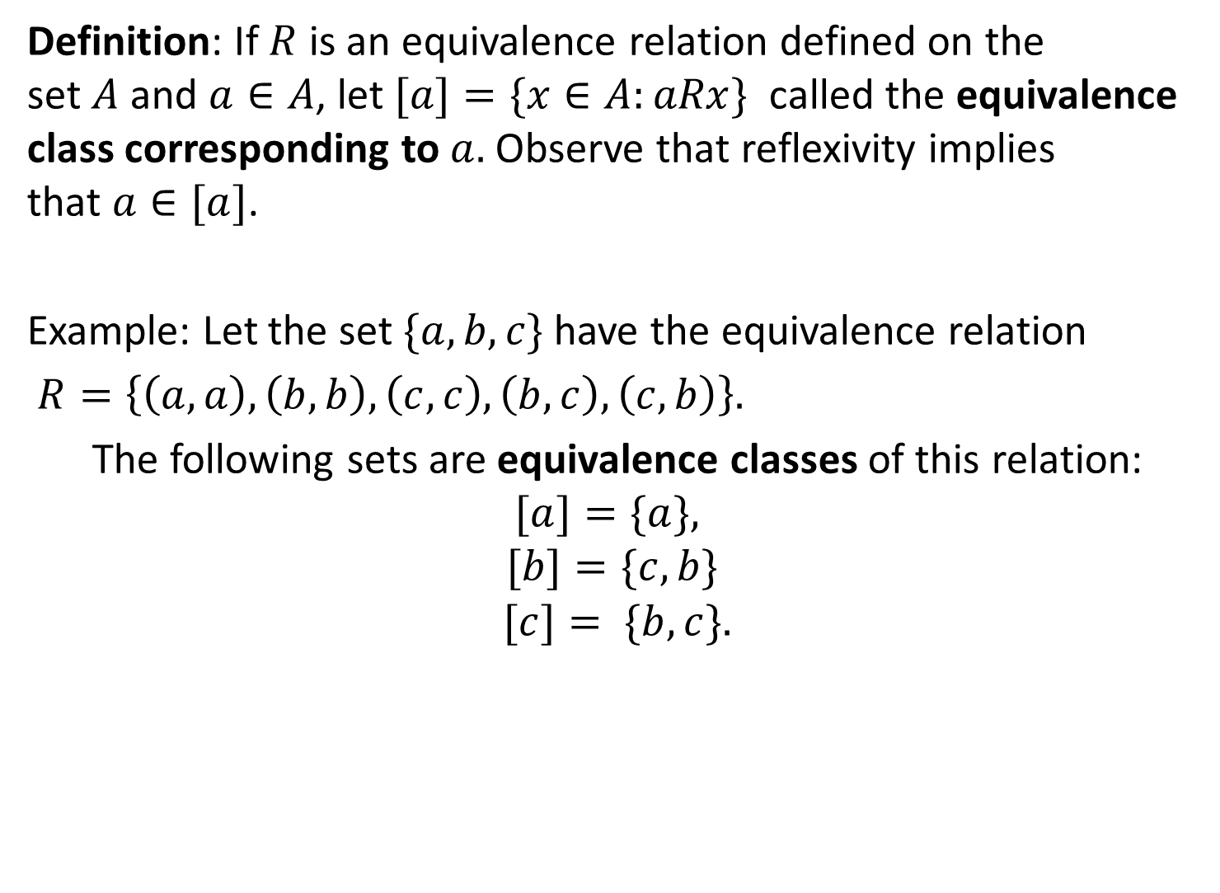
Definition: If $R$ is an equivalence relation defined on the set $A$and $a∈A$, let $[a]=\{x∈A:aRx\}$ called the equivalence class corresponding to $a.$Observe that reflexivity implies that $a∈[a]$.
Example: Let the set $\{a,b,c\}$ have the equivalence relation
$R=\left\{\left(a,a\right),\left(b,b\right),\left(c,c\right),\left(b,c\right),\left(c,b\right)\right\}.$
The following sets are equivalence classes of this relation: $[a]=\{a\},$
$$[b]=\{c,b\}$$
$$[c]= \{b,c\}.$$

Slide 23
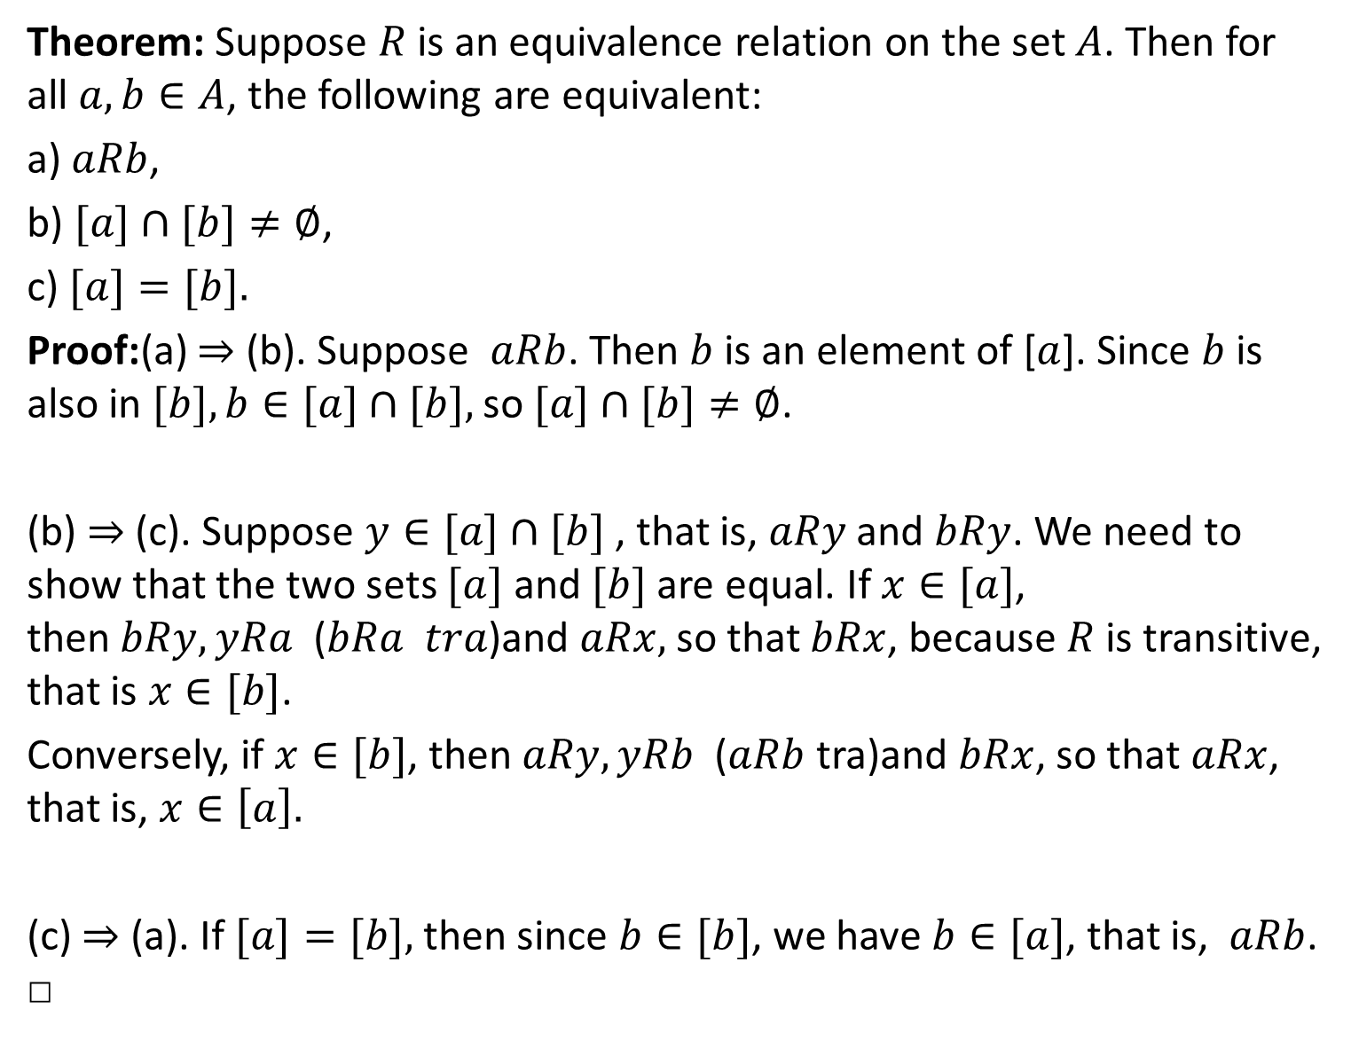
Theorem: Suppose $R$ is an equivalence relation on the set $A$. Then for all $a,b∈A$, the following are equivalent:
a)$aRb$,
b) $[a]∩[b]≠∅$,
c) $[a]=[b].$
Proof:(a) ⇒ (b). Suppose $aRb$. Then $b$ is an element of [$a$]. Since $b$ is also in $[b], b∈[a]∩[b],$so $[a]∩[b]≠∅$.
(b) ⇒ (c). Suppose $y∈[a]∩[b]$ , that is, $aRy$ and $bRy$. We need to show that the two sets $[a]$ and $[b]$ are equal. If $x∈[a]$, then $bRy, yRa$ ($bRa tra$)and $aRx,$ so that $bRx$, because $R$ is transitive, that is $x∈[b]$.
Conversely, if $x∈[b]$, then $aRy, yRb$ ($aRb$ tra)and $bRx$, so that $aRx$, that is, $x∈\left[a\right].$
(c) ⇒ (a). If $[a]=[b],$then since $b∈[b]$, we have $b∈[a]$, that is, $aRb$. □

Slide 24
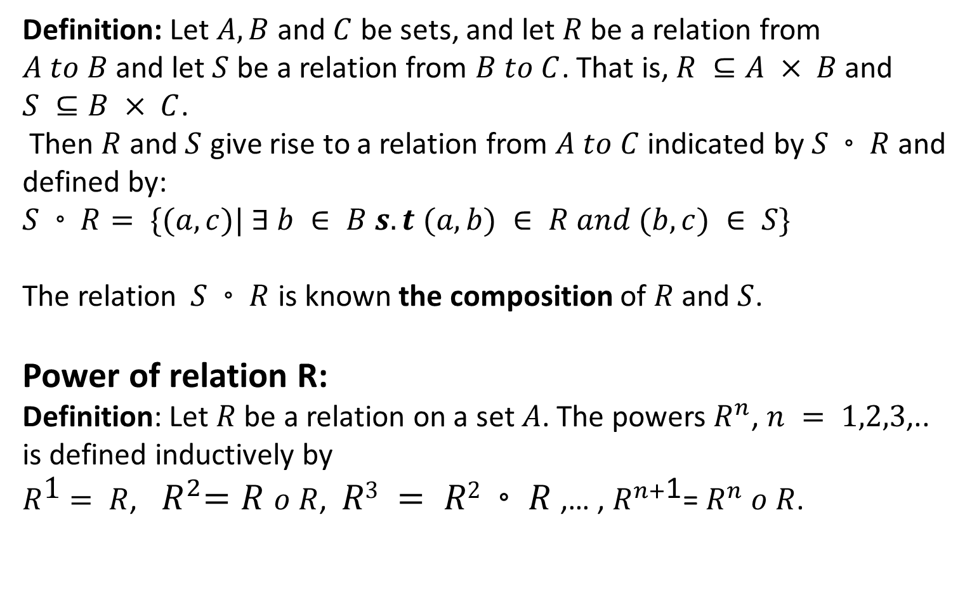
Composition of Relations
Definition: Let $A, B$and $C$ be sets, and let $R$ be a relation from $A to B$and let $S$ be a relation from $B to C$. That is, $R ⊆A × B$and $S ⊆B × C$.
Then $R$ and $S$ give rise to a relation from $A to C$indicated by$S◦R$ and defined by:
$S◦R= \{(a, c)| ∃ b ∈ B s.t (a, b) ∈ R and (b, c) ∈ S\}$
The relation$S◦R$ is known the composition of $R$and $S$.
Power of relation R:
Definition: Let $R$ be a relation on a set $A$. The powers $R^{n}$, $n = 1,2,3$,.. is defined inductively by
$R^{\text{1}}$ $= R$, ${ R}^{2}=R o R$, $R3 = R2◦R$,… , $R^{n+\text{1}}$= $R^{n}$ $o R$.

Slide 25
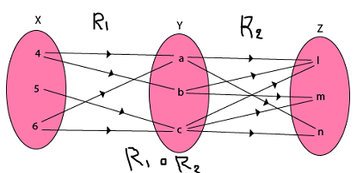
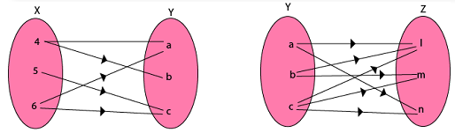
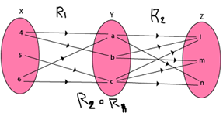

Example1: Let $X = \{4, 5, 6\}, Y = \{a, b, c\}$and$Z = \{l, m, n\}$. Consider the relation $R1$ from $X to Y$and $R2$from$Y to Z.$
$$R1 = \left\{\left(4, a\right), \left(4, b\right), \left(5, c\right), \left(6, a\right), \left(6, c\right)\right\}$$
$$R2 = \{(a, l), (a, n), (b, l), (b, m), (c, l), (c, m), (c, n)\}$$
Find the composition of relation $R2o R1$.
Solution:
$$R2o R1=\{(4, l), (4, n), (4, m), (5, l), (5, m), (5, n), (6, l), (6, m), (6, n)\}$$

Slide 26


EXAMPLE: What is the composite of the relations $R and S$, where $R = \{(1, 1), (1, 4), (2, 3), (3, 1), (3, 4)\}$and
$S = \{(1, 0), (2, 0), (3, 1), (3, 2), (4, 1)\}?$
Solution: $So R$ $=\left\{\left(1, 0\right), \left(1, 1\right), \left(2, 1\right), \left(2, 2\right), \left(3, 0\right), \left(3, 1\right)\right\}.$
EXAMPLE :
Let $R = \{(1, 1), (2, 1), (3, 2), (4, 3)\}.$Find the powers $R^{n}$, $n = 2, 3,4, ….$
$Solution:$Because$R^{2}= RoR$, we find that
$${ R}^{2} = \left\{\left(1, 1\right), \left(2, 1\right), \left(3, 1\right), \left(4, 2\right)\right\}.$$
Furthermore, $becauseR^{3}=R^{2}o R$,
${ R}^{3}= \{(1, 1), (2, 1), (3, 1), (4,1)\}.$
Additional computation shows that $R^{4}$ is the same as $R^{3}$, so ${ R}^{4}= \left\{\left(1, 1\right), \left(2, 1\right), \left(3, 1\right), \left(4, 1\right)\right\}=R^{3}$.
It also follows that $R^{n}=R^{3} for n=5, 6, 7….$

Slide 27
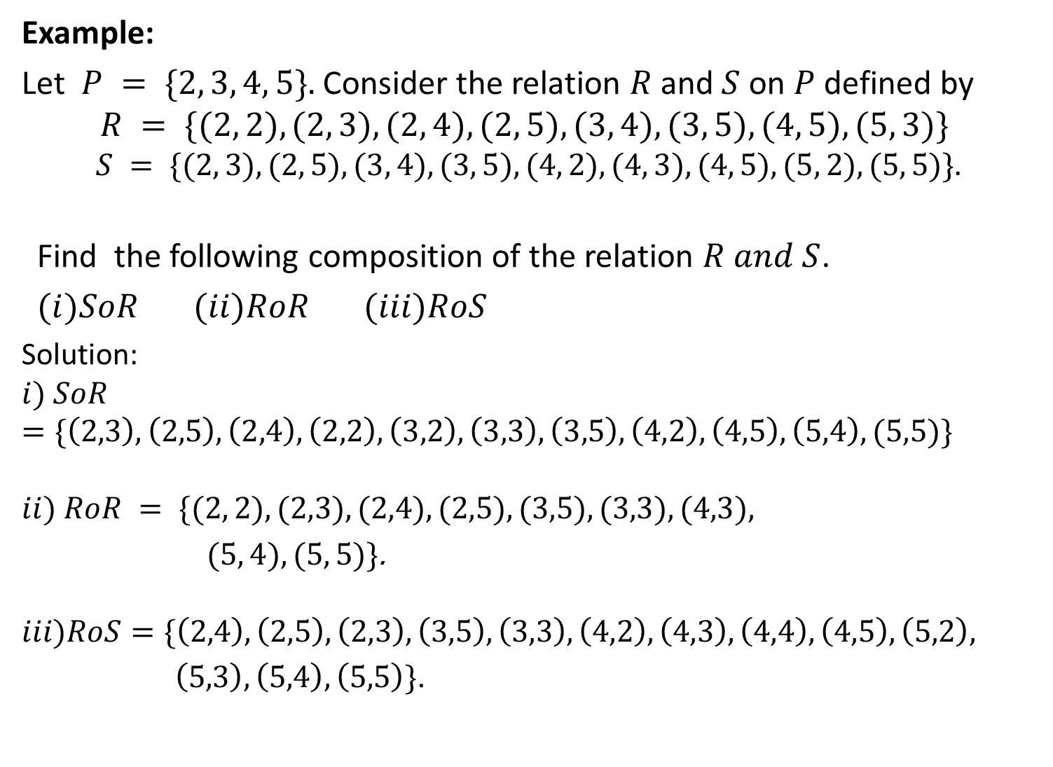
Example:
Let $P = \{2, 3, 4, 5\}.$ Consider the relation $R$ and$S$ on $P$defined by
$$R = \{(2, 2), (2, 3), (2, 4), (2, 5), (3, 4), (3, 5), (4, 5), (5, 3)\}$$
$$S = \{(2, 3), (2, 5), (3, 4), (3, 5), (4, 2), (4, 3), (4, 5), (5, 2), (5, 5)\}.$$
Find the following composition of the relation $R and S$.
$(i)SoR (ii)RoR (iii)RoS$
Solution:
$$i) SoR=\{\left(2,3\right),\left(2,5\right),\left(2,4\right),\left(2,2\right),\left(3,2\right),\left(3,3\right),\left(3,5\right),\left(4,2\right),\left(4,5\right),\left(5,4\right),(5,5)\}$$
$$ii) RoR = \{(2, 2), (2,3), (2,4), (2,5), (3,5), (3,3), (4,3),$$
$(5, 4), (5, 5)\}$.
$$iii)RoS=\{\left(2,4\right),\left(2,5\right),\left(2,3\right),\left(3,5\right),\left(3,3\right),\left(4,2\right),\left(4,3\right),\left(4,4\right),\left(4,5\right),\left(5,2\right),$$
$\left(5,3\right),\left(5,4\right),\left(5,5\right)\}$.

Slide 28
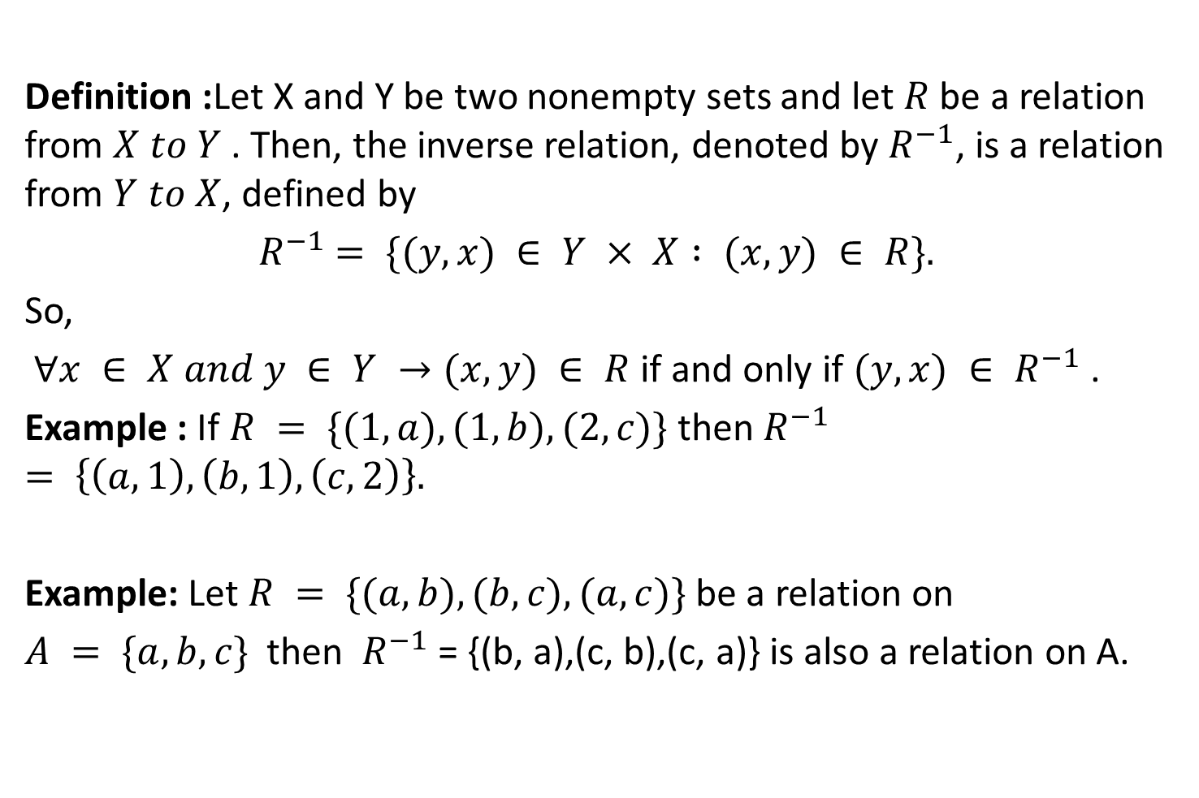
Inverse of relation
Definition :Let X and Y be two nonempty sets and let $R$ be a relation from $X to Y$. Then, the inverse relation, denoted by $R^{−1}$, is a relation from $Y to X$, defined by
$R^{−1}$ $= \{(y, x) ∈ Y × X : (x, y) ∈ R\}.$
So,
$∀x ∈ X and y ∈ Y →(x, y) ∈ R$if and only if $(y, x) ∈ R^{−1}$ .
Example : If $R = \{(1, a),(1, b),(2, c)\}$then $R^{−1}$ $= \left\{\left(a, 1\right),\left(b, 1\right),\left(c, 2\right)\right\}.$
Example: Let $R = \{(a, b),(b, c),(a, c)\}$be a relation on
$A = \{a, b, c\}$ then $R^{−1}$ = {(b, a),(c, b),(c, a)} is also a relation on A.

Slide 29
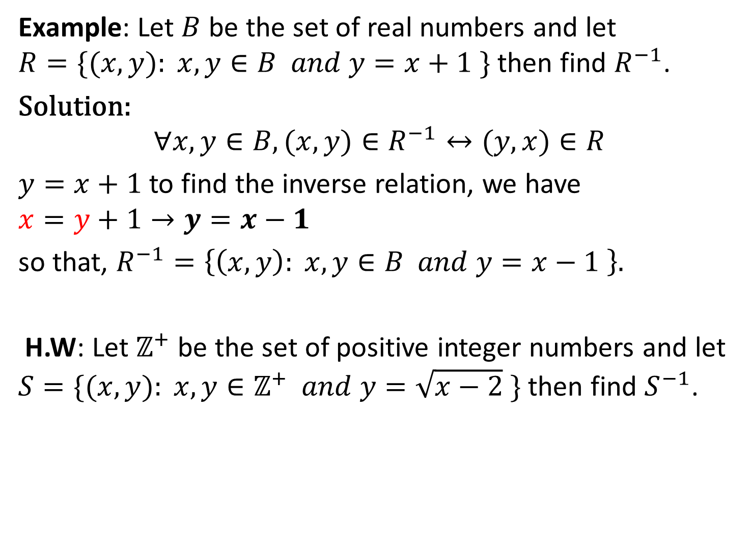
Example: Let $B$ be the set of real numbers and let $R=\{(x,y): x,y∈B and y=x+1 \}$ then find $R^{−1}$.
Solution:
$$∀x,y∈B,(x,y)∈R^{−1}↔(y,x)∈R$$
$y=x+1$to find the inverse relation, we have
$$x=y+1→y=x−1$$
so that, $R^{−1}=\left\{\left(x,y\right): x,y∈B and y=x−1 \right\}.$
H.W: Let $ℤ^{+}$ be the set of positive integer numbers and let $S=\{(x,y): x,y∈ℤ^{+} and y=\sqrt{x−2} \}$ then find $S^{−1}$.

Slide 30
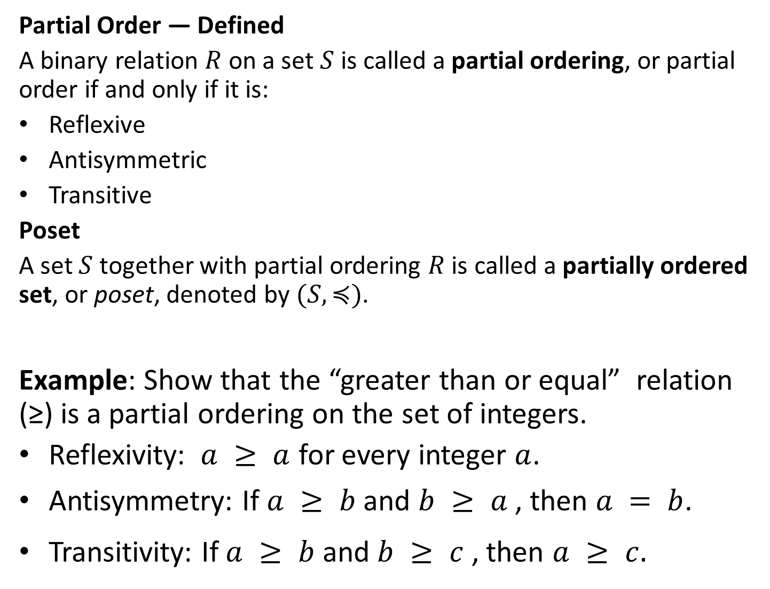
Partial Order — Defined
A binary relation $R$ on a set $S$ is called a partial ordering, or partial order if and only if it is:
Reflexive
Antisymmetric
Transitive
Poset
A set $S$ together with partial ordering $R$ is called a partially ordered set, or poset, denoted by $(S,≼)$.
Example: Show that the “greater than or equal” relation (≥) is a partial ordering on the set of integers.
Reflexivity: $a ≥ a$ for every integer $a$.
Antisymmetry: If $a ≥ b$ and $b ≥ a$ , then $a = b$.
Transitivity: If $a ≥ b$ and $b ≥ c$ , then $a ≥ c.$

Slide 31
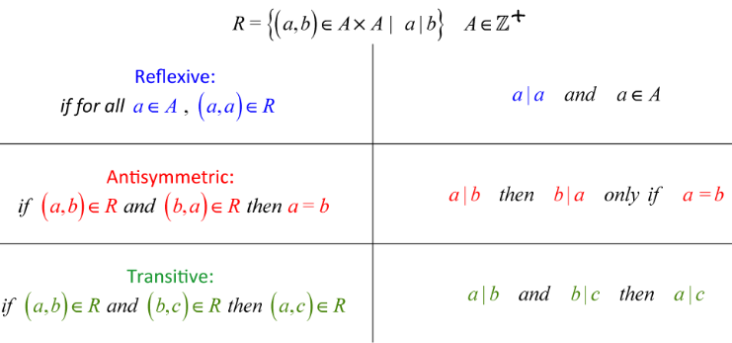
Partial Order Relations
Now, the three fundamental partial order relations are:
Less Than Or Equal To 2. Subset 3. Divisibility
For example, let’s show that “divisibility” is a partial order relation on A.
R is a partial order on a ser A and (A,R) is poset

Slide 32


Example: Show that the inclusion relation (⊆) is a partial
ordring on the power set of a set $S$.
Reflexivity: $A ⊆ A$ whenever $A$ is a subset of $S$.
Antisymmetry: If $A$ and $B$ are positive integers with
$A⊆B$ and $B⊆A$, then $A=B$.
Transitivity: If $A⊆B$and $B ⊆C$, then $A⊆C$.
Comparability: Let ≼ denote any reflexive, antisymmetric, transitive relation, then the elements $a$ and $b$ of a poset ($S$,≼ ) are comparable if either $a ≼ b$ or $b ≼ a$.
When $a$ and $b$ are elements of $S$ so that neither $a≼b$ nor
$b≼ a$, then $a$ and $b$ are called incomparable.

Slide 33
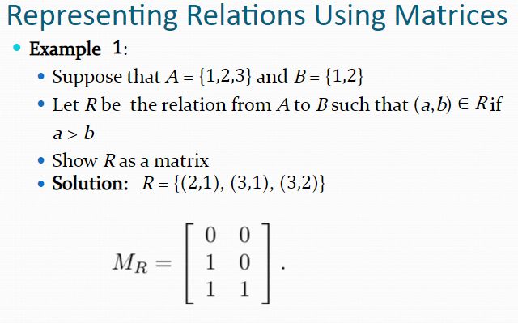
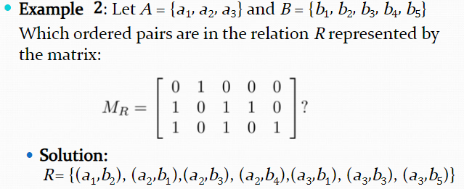

Slide 34


Slide 35


Slide 36


Slide 37

Relations as Directed graphs:
A directed graph consists of nodes or vertices connected by directed edges or arcs. Let $R$ is relation from set $A$ to set $B$ defined as $(a,b)$Є$R$, then in directed graph-it is represented as edge(an arrow from $a$ to $b$) between ($a,b$).
Properties:
A relation $R$ is reflexive if there is loop at every node of directed graph.
A relation $R$ is symmetric if for every edge between distinct nodes, an edge is always present in opposite direction.
A relation $R$ is transitive if there is an edge from $a to b$and $b to c$, then there is always an edge from $a to c$.

Slide 38


Example:
The directed graph of relation $R =${(a,a),(a,b),(b,b),(b,c),(c,c),(c,b),(c,a)} is represented as :
Since, there is loop at every node,it is reflexive but it is neither symmetric nor antisymmetric as there is an edge from a to b but no opposite edge from b to a and also directed edge from b to c in both directions.
R is not transitive as there is an edge from a to b and b to c but no edge from a to c.

Slide 39

Ex: Determine whether the following relations that represented by directed graphs are reflexive, symmetric anti-symmetric or transitive.

