Slide 1
Computer Organization and Architecture
Introduction

Slide 2
Introduction
Computer Architecture :Represent the attributes of system visible to a programmer like
The instruction set.
The number of bit used to represent various data type.
I/O mechanisms.
Computer Organization: Represent the operational units and there interconnections that realize the architecture specification like :
Those hardware details transparent to the programmer such as control signals, interface between the computer and peripherals and memory technology used.

Slide 3
Example
Let have a multiply instruction that is an architecture issue.
The organizational for this instruction will be implement by a special multiply unite or by a mechanism that makes repeated use of add unite of system . The organizational decision based on
Anticipated frequency of use of the multiply instruction .
The relative speed of approaches .
the cost and physical size of special multiply unite.
Mul Bx
Action dx:ax Ax*Bx
AX Bx
Mul Unit
Result

Slide 4
Structure and Function
A computer is a complex system that can be reorganized by its hierarchical nature
It is essential for their design and description.
At each level of hierarchy, the system consist a set of components &their interrelation ship.
The behavior at each level depends only on simplified, abstract characterization of the system at the next lower level.
At each level most concerned with structure and function.
In these lectures computer system will describe from top to down and we begin with the major components of computer.

Slide 5
Function
The operation of each individual component as part of structure.
The basic functions that computer perform are :
Data processing: computer must be able to process data.it represent the collection and manipulation of items of data to produce meaningful information.
Data storage: every computer must contain apart to store data.
There are two type of it
Short –term data storage function and
long-term data storage function.
Data movement: the computer must able to move the data between itself and outside world.
When data are received from or delivered to device that is directly connected to the computer is known as input-output (I/O), and that device is referred as peripheral.

Slide 6
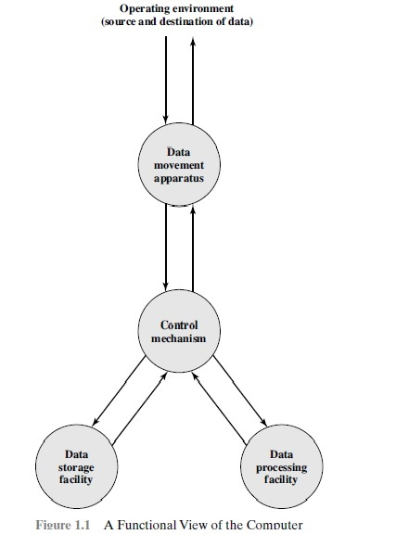

Slide 7
Function
Control: It handle all the these function.
The control is exercised by the individual who provides the computer with instruction.
The possible operations that can be performed is four type operations fig(2)
The computer can function as data movement device like (transferring data from one peripheral or communication line to another fig (2-a)
It also function as a data storage device .like transferred from external environment to computer storage as a (read) or (write) fig (2-b)
It function as a data processing on data in storage fig (2-c).
Route between storage and external environment fig (2-d)

Slide 8
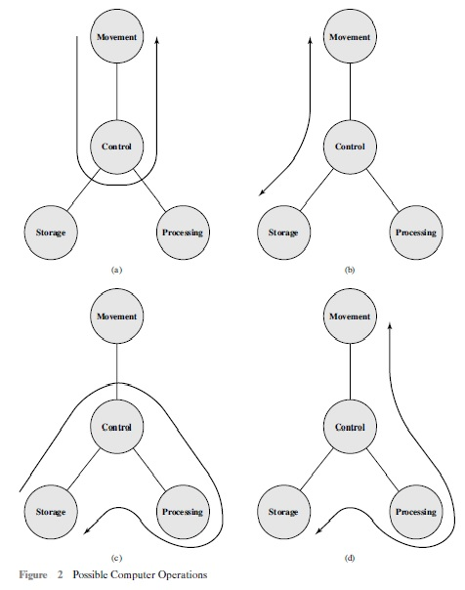

Slide 9
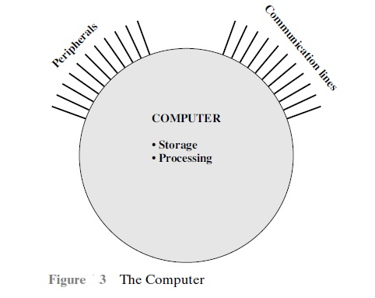
Structure
The way in which the component are interrelated.
The simplest possible depiction of computer in fig 3:

Slide 10
Structure
There are four main structure component fig (4)
Central processing unit(CPU):control the operation of computer and performs its data processing function. Major structural components of CPU are:
Control unit: control the operation of the CPU and hence the computer.
Arithmetic &logic unit (ALU):perform the computers data processing function.
Register : provide internal storage to the CPU.
CPU interconnection: mechanism that provides for communication among control unite, ALU and Register.
Main Memory: storage data.
Input- Output (I/O): move data between the computer and its external environment .
System interconnection: mechanism that provides for communication among CPU main memory and I/O

Slide 11
