Slide 1
Generation Of Computer

Slide 2
The First Generation
ENIAC: Electronic Numerical integrated and computer.
Constructed on university of Pennsylvania by Milky John.
In the first generation purpose electronic digital computer using vacuum tube.
Its huge, weight 3o tons, occupying 1500 square feet space, containing more than 1800 vacuum tubes, need power 140 kilowatts, capable to make 5000 additions per second .
It was decimal rather than a binary machine.
Numbers were represented in decimal form and arithmetic was performed in decimal system
Memory consisted of 20 accumulators capable to handle a 10 digit decimal number
The draw back of its it had to be programed manually by setting switch and plugging and unplugging cables

Slide 3
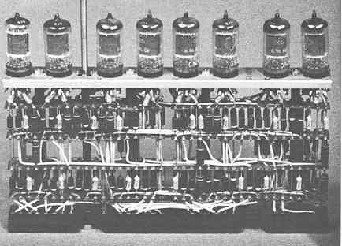
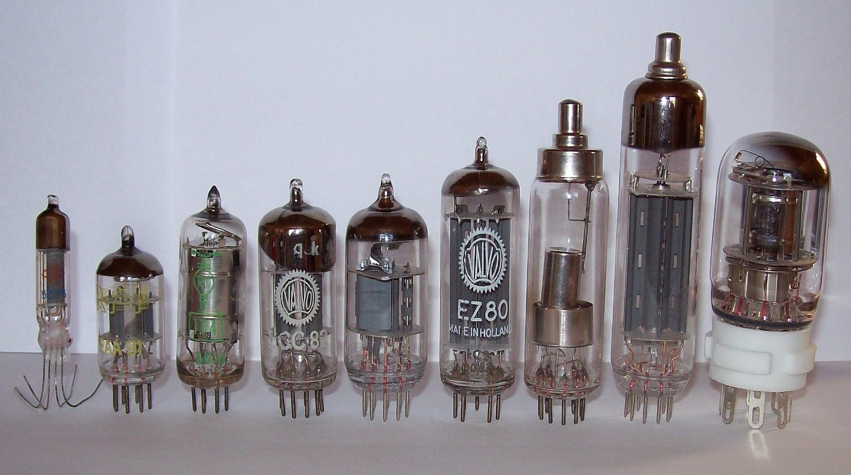

Slide 4
The Von Neumann Machine
The program could be represent in a form suitable for storing in memory alongside the data. Then a computer could get its instructions by reading them from memory and a program could be set the values of a portion of memory , this known stored –program concept.
Von Neumann proposed new computer (EDVAC) (Electronic discrete variable computer) in 1945.
IAS computer prototype present in 1952 by Von Neumann.
The (IAS) general structure consist from:
Main Memory: to store data &instructions .
Arithmetic & Logic Unit (ALU) capable of operating on binary data.
Control Unite interprets the instruction in memory and cause them to be executed
Input-Output (I/O): equipment operated by the control unit

Slide 5
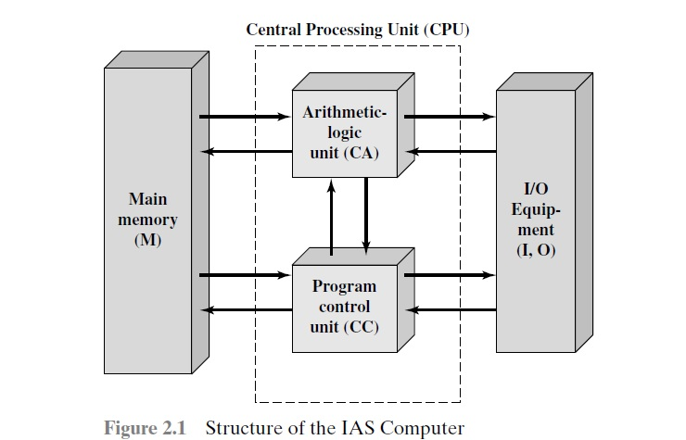

Slide 6
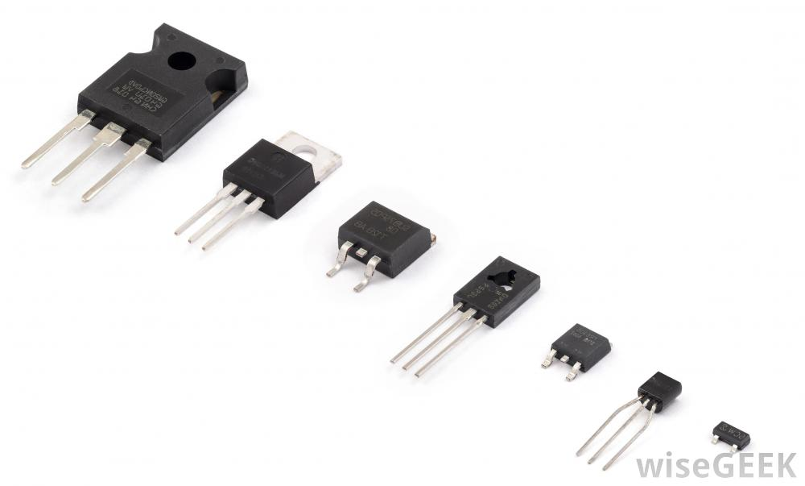
Second Generation
Using transistor instead vacuum tube.
Transistor is solid-state device made from silicon, its smaller, cheaper and dissipates less heat than vacuum tube also the vacuum tube need wire, mental plates, glass capsulate and vacuum
In this generation introduce more complex Arithmetic & Logic Units also Control Unites, using high level programing language and provision of system software for computer

Slide 7
Computer Generation Table
Typical speed operations per sec | technology | Approximate dates | Generation
40 000 | Vacuum tube | 1946-1957 | 1
200 000 | Transistor | 1958-1964 | 2
1 000 000 | Small& medium scale integration | 1965-1971 | 3
10 000 000 | Large Scale integration | 1972-1977 | 4
100 000 000 | Very large Scale integration | 1978-1991 | 5
1 000 000 000 | Ultra Large Scale integration | 1991 ــــــ | 6

Slide 8
The IBM 7094
Transistor technology used in the CPU
Memory size 32KB, compared to 2-4 KB in IBM 701
50 times faster than IBM 701 model
185 Opcode compared to only 24in IBM 701
Has many I/O peripherals

Slide 9
Different between IBM7094and IAS
Use of data channel :
Data channel is an independent I/O module with its own processor and its own instruction set
In computer with data channels the CPU will not execute a detail I/O instruction such instruction are stored in main memory
It will be executed by a special –purpose processor in the data channel itself .
The CPU initials an I/O transfer by sending a control signal to data channel, instructing it to execute a sequence of instructions in memory
The data channel performs its task independently of the CPU and Signal will back to CPU when operation is complete
The other feature is
Existing of a multiplexer which schedules access to the memory from the CPU and data channel, allowing these devices to act independently

Slide 10
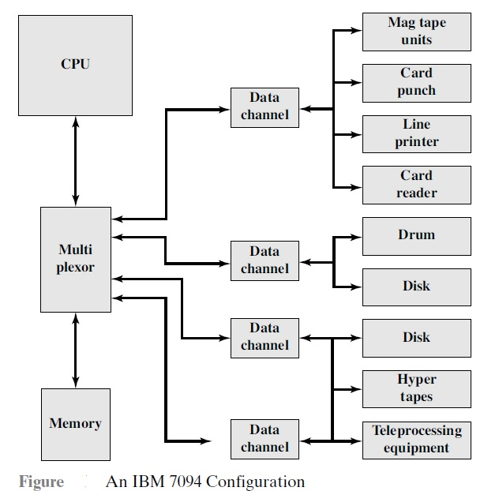

Slide 11
Third Generation (integrated circuits)
Discrete component were manufactured separately packaged in their own containers and soldered or wired together on circuit board and installed in computer is very expensive.
In 1958, the integrated circuits was invented – it represent third generation of computer
The basic element of a digital computer must perform storage, movement, processing and central function only two fundamental type of components are required gates and memory cells

Slide 12
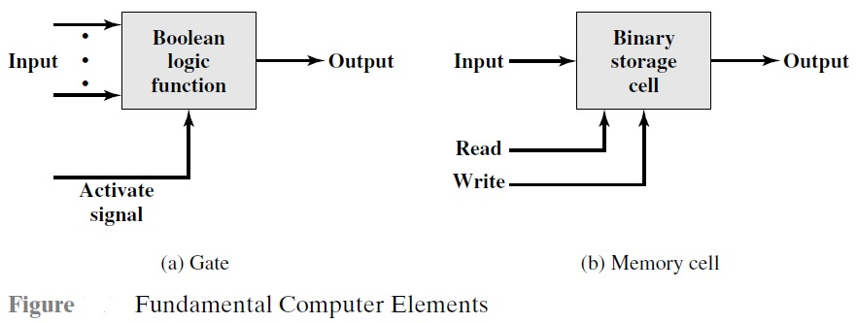
Cont’d..
Gates is device that implement a simple Boolean or logical function, such as IF(A) AND (B) are true then (C) is true (AND gate ).
It called gates because they control data flow in much the same way that canal gate do (work).
Memory cell is devise that can store one bit of data. that is, the device can be in one of two stable states at any time.

Slide 13
Cont’d..
By inter connecting large number of these fundamental device can construct a computer. relate this to our four basic function as follow.
Data storage: provided by memory cells
Data processing : provided by gate.
Data movement : the paths among components are used to move data from memory to memory and from memory through gates to memory
Control : the path between components can carry control signal
EX: a gate will have one or two data input plus a control signal input activites the gate .

Slide 14
Later generations:
Beyond the third generation there is less general agreement on defining generations of computer
It suggest that there have been number of later generations depend on the advances in integrated circuit technology, like
large scale integration (LSI) more than 1000 component can place in integrated circuit chip
very-large –scale integration (VLSI) more than 10000 component per chip
ultra –large scale integration (ULSI) chips contain million components.

Slide 15
Memory (core)
In 1950’s and 1960’s most computer was constructed from tiny ring of Ferro magmatic material .
Each of this sixteenth of an inch in diameter.
Magnetized one way.
This ring called core represented a one-magnetized the other stood for zero.
Magnetic- core memory was rather fast, it took as a little as a millionth of second to read a bit stored in memory.

Slide 16
Semiconductor memory
It released in 1970.
A chip which is the size of a single core
Hold 256 bits of memory
Non destructive read, much faster then core
Since 1970 11 generations: 1K, 4K, 16K, 64K, 1M, 4M, 16M, 64M, 128M &1 G bit for single chip.

