Slide 1
Classification Of computer architecture

Slide 2
Von Neumann machines
Von Neumann machines: It meet the following criteria
It have three basic hardware systems
CPU
main memory
I/O system
It is a stored-program computer
It carries out instruction sequentially. The CPU executes or at least appears to execute one program at time .
It has, or at least appear to have a single path between the main memory system and control unite of the CPU and this as Von Neumann bottleneck
Conventional Von Neumann machines provide one path way for address & a second pathways for data & instruction

Slide 3
Non Von Neumann Machines
Fly in 1966 define the taxonomy of computer
It based on the notion of stream of information (instruction & Data)
Instruction stream: is a sequence of instruction performed by the processing unit
Data stream: is define as data traffic exchange between the memory and the processing unit
According to Flynn’s classification , either of instruction or data stream can be single or multiple as follows

Slide 4
Single Instruction ,Single Data (SISD)
Von Neumann machine belongs to this category
SISD computer have one CPU that execute one instruction at time and fetch or store one item of data at time
CU: Control Unite IS: Instruction Stream
PU: Process Unit DS: Data Stream
M:Memory
CU
IS
PU
DS
M
I/O

Slide 5
Single Instruction Multiple Data stream (SIMD)
There are many process element under same control unit
All process element receive same instruction from control unit
Each process element execute the same instruction on different data item
PU1
DS1
M
CU
IS
PU2
DS2
I/O
.
.
.
PUn
DSn

Slide 6
Multiple Instruction Single Data stream (MISD)
In this type there are n processor or unit each of them have different instruction and process same data input for all processor unit
The output result from the processor unit became input for next process unit
There is no practical work for this type

Slide 7
Multiple Instruction Multiple Data stream (MIMD)
Its also called multiprocessor
There are more than one independent processor and each processor can execute a different program on its own data

Slide 8
Memory Organization & Management.

Slide 9
The Memory Hierarchy:
The memory unit is an essential component in any digital computer needed for storing programs and data.
The memory unit that communicates directly with the CPU is called the main memory.
Devices that provide backup storage are called auxiliary memory. Such as magnetic disks and tapes.
Only programs and data currently needed by the processor reside in main memory.

Slide 10
Cont’d..
Constraints on design memory can be summed in three think: How much? How fast? How expensive?
How much :If the capacity is there, applications will likely be developed to use it.
How fast: The memory must be able to keep up with the processor. Ex: as the processor is executing instructions, we would not want to pause the execute and waiting for instructions or operands.
How expensive: The cost of memory must be reasonable in relationship to other components.

Slide 11
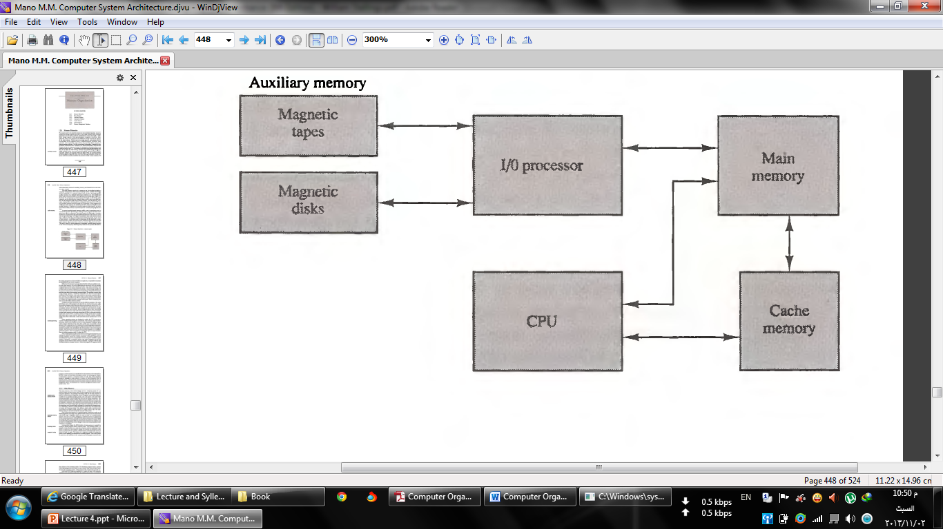
Memory Hierarchy in a computer system

Slide 12
The Memory Hierarchy

Slide 13
Cont’d..
A typical hierarchy is illustrated in Fig above as one goes down the hierarchy, the following occur:
Decreasing cost per bit
Increasing capacity
Increasing access time
Decreasing frequency of access of the memory by the processor

Slide 14
Main Memory:
The main memory is the central storage unit in a computer system. It is a relatively large and fast used to store programs and data during the computer operation.
Memory cell is the basic element of a semiconductor memory.
All memory cells share certain properties, Although a variety of electronic technologies used:
They exhibit two stable (or semi-stable) states, which can be used to represent binary 1 and 0.
They are capable of being written into (at least once), to set the state.
They are capable of being read to sense the state.

Slide 15
Cont’d..
The cell has three functional terminals capable of carrying an electrical signal
The select terminal make a memory cell work as a read or write operation.
The control terminal indicates read or write. For writing, the other terminal provides an electrical signal that sets the state of the cell to 1 or 0. For reading, that terminal is used for output of the cell’s state

Slide 16
Cont’d..
There are two type of integrated circuit of memory, Random-Access Memory (RAM), Read-Only Memory (ROM)
Random-Access Memory (RAM)
Integrated circuit RAM chips are available in two possible operating modes, static and dynamic.
The stored information remains valid as long as power is applied to the unit.
RAM used for a reading or writing ,it is random access
RAM is volatile. the contents are destroyed when power is turned off.

Slide 17
Cont’d..
RAM is used for storing the bulk of the programs and data that are subject to change.
The static RAM consists essentially of internal flip-flops that store the binary information.
The static RAM is easier to use and has shorter read and write cycles.
Static RAMs are generally faster than dynamic RAMs.
Static RAM used for cache memory.
The dynamic RAM stores the binary information in the form of electric charges that are applied to capacitors.

Slide 18
Cont’d..
The capacitors are provided inside the chip by MOS transistors. Capacitors have a natural tendency to discharge.
dynamic RAMs require periodic charge refreshing to maintain data storage
The term dynamic refers to this tendency of the stored charge to leak away, even with power continuously applied.
The dynamic RAM offers reduced power consumption and larger storage capacity in a single memory chip.
The dynamic RAM is used for main memory.

