Slide 1
Capstone Project – 1
EDA on Airbnb Booking Analysis
By – Abdul Rehman Ansari

Slide 2

What is Airbnb?
Airbnb is an American San Francisco-based company operating an online marketplace for short-term homestays and experience.
The company acts as a broker and charges a commission from each booking.
Travelers can rent a space for multiple people to share, a shared space with private rooms, or the entire property for themselves.
It has in excess of six million listings, covering more than 100,000 cities and towns and 220-plus countries worldwide.

Slide 3
What is EDA?
Exploratory data analysis (EDA) is used by data scientists to analyze and investigate data sets and summarize their main characteristics, often employing data visualization methods.
It helps determine how best to manipulate data sources to get the answers you need, making it easier for data scientists to discover patterns, spot anomalies, test a hypothesis, or check assumptions.
The following steps are involved in the process of EDA :
Acquire and load the Data
Finding all Variables and Understanding Them
Cleaning the Dataset
Exploring and Visualizing Data
Analyzing Relationship between variables

Slide 4
Summary :-
In this EDA we are provided with a Data set Containing 49000 column and 16 rows.
As the first step, we have to perform data wrangling over the raw data.
In it we dropped the unnecessary columns and columns with maximum null values.
Then we saw that price column has some irregularity as the minimum price of the apartment is ‘zero’ i.e. Free stay, which doesn’t make sense so we replaced all the zeros with ‘Median Price’.
Further, we divided the complete Project into four parts i.e.
Different hosts and areas analysis
Analysis of location, price, reviews
Busiest host’s analysis
Analysis on noticeable difference of traffic.

Slide 5
Following are a few questions that we aim to answer through our analysis:
• What can we learn about different hosts and areas?
Host having highest number of properties listed.
Most properties are located in ?
• What can we learn from predictions? (ex: locations, prices, reviews, etc)
Who has highest no of review
what price people prefer most?
what room type people prefer?
Which is the most expensive neighbourhood
• Which host are busiest and why?
Check top 10 busiest host
What room type this busiest host prefer the most?
• Is there any noticeable difference of traffic among different areas and what could be the reason for it?

Slide 6
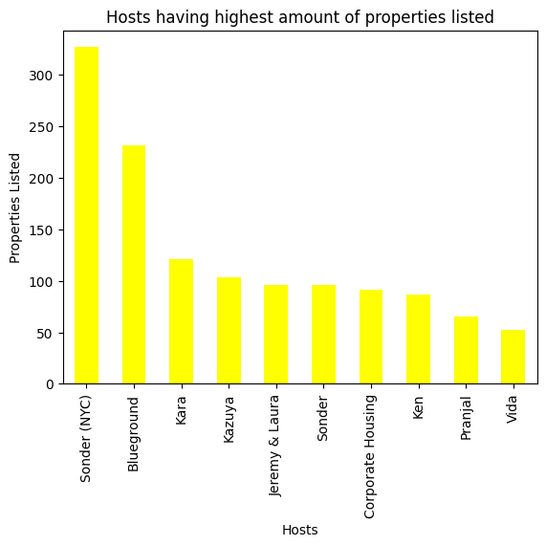
What can we learn about different hosts and areas?
Top Host of property listed
We can that “Sonder(NYC)” has 327 no of properties listed which is the highest.
“Blueground” has 232 the second highest.
“Kara” with 121 no of listings the third highest and so on.

Slide 7
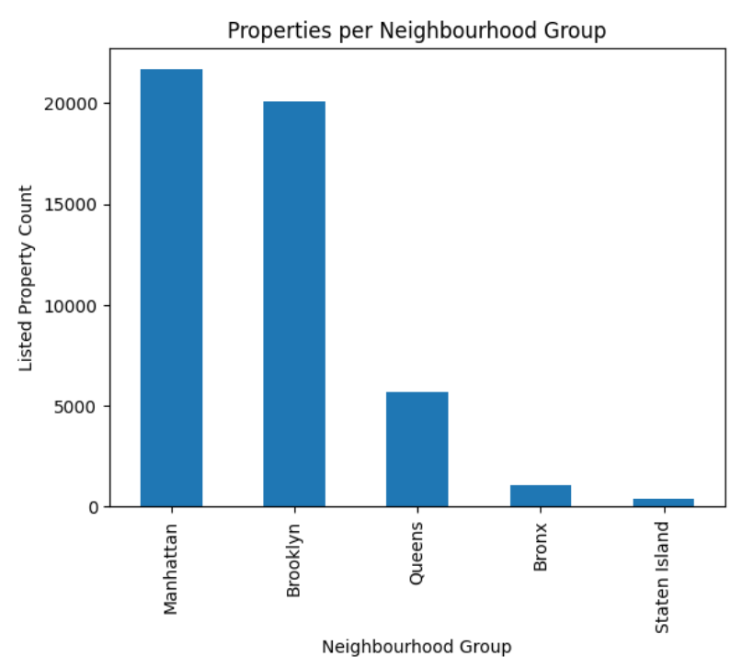
Neighbourhood Group
We can see Most properties are located in Manhattan and Brooklyn.
This clearly shows that Manhattan and Brooklyn are the most popular destinations at Airbnb in New York City.
Accommodation in the Bronx and Staten Island are rather marginal.

Slide 8
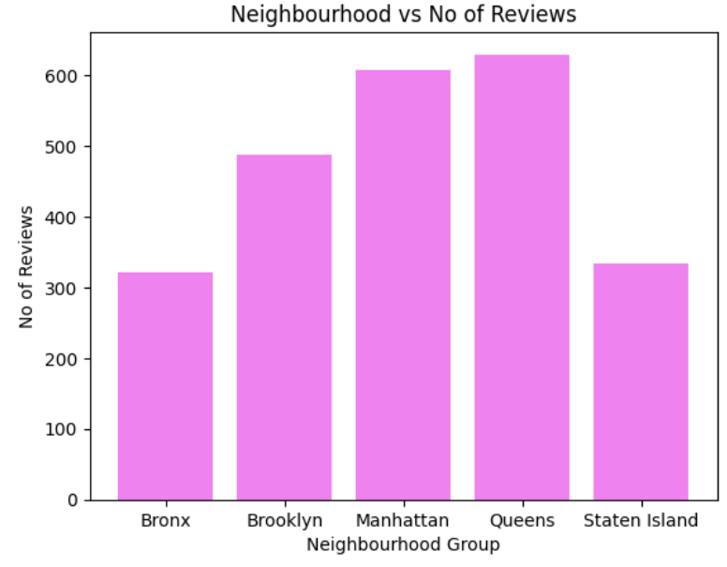
What can we learn from predictions?(ex: locations, prices, reviews, etc.)
1. Neighbourhood vs Number of Reviews
We can see that Queens has highest No of Reviews.
We know from previous analysis that Manhattan has most no of listed properties.
This means that the number of properties listed on the Airbnb does not mean that the number of customers you will have will be more.

Slide 9
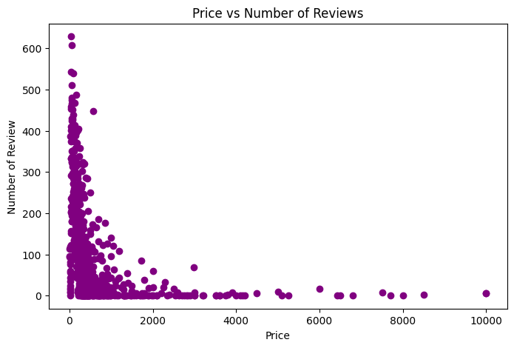
2.Price vs Number of Reviews
By analyzing the price we can say that Most of the properties price are between 0 - 2000.
we can say that most people prefer to stay in place where price is less.

Slide 10
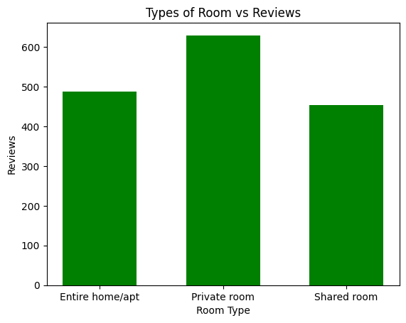
3.Analyzing Room Type
We can see from graph that people usually like to stay in private room. thus it has highest no of Reviews.

Slide 11
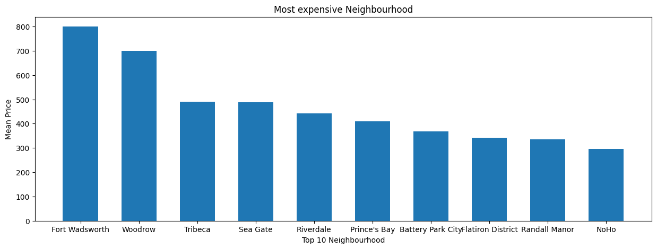
4.Most Expensive Neighborhoods
By comparing Neighborhoods with Average price we can see the Top 10 Most expensive Neighborhood.
Fort “Wadsworth” is most expensive Neighborhood with an average price of $800 followed by “Woodrow” price $700, “Tribeca” price $490.60 and so on.

Slide 12
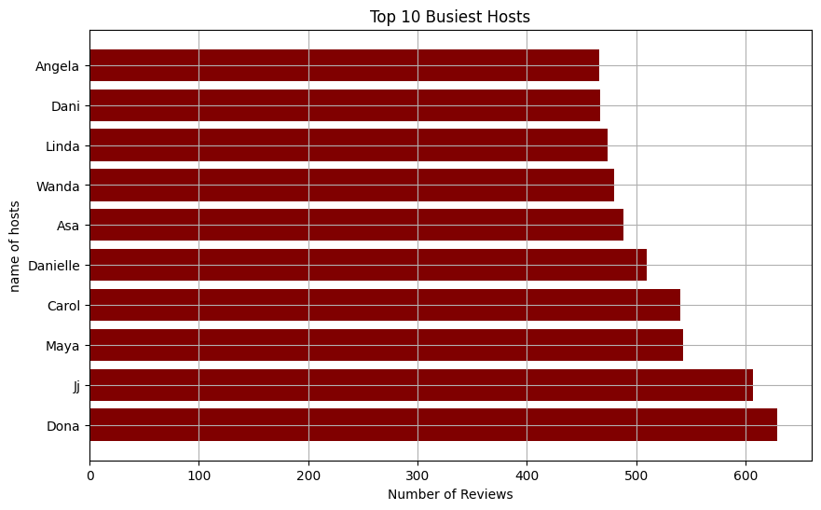
Now lets see which hosts are the busiest and why?
We can see from below Graph that “Dona” is the busiest host having 629 no of reviews followed by “Jj” having 607 no of reviews, then “Maya” – 543 and so on

Slide 13
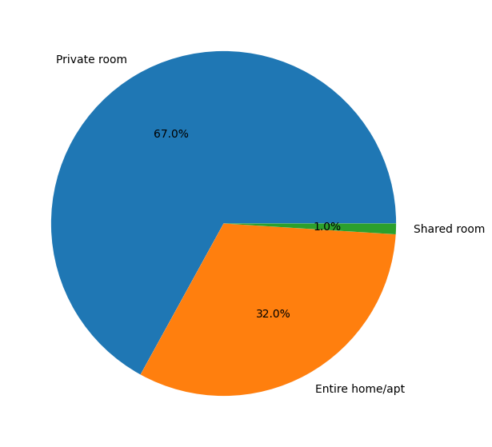
What room type busiest host prefer the most?
Taking a sample of first 100 busiest host to find their choices regarding room type we can say that most number of hosts are opting for 'Private room' than the rest.
almost 2/3rd of the hosts leaning towards 'private rooms' in the sample size of busiest host. This might be influential factor for most busiest hosts.
They are repetitive in terms of choosing private rooms.

Slide 14
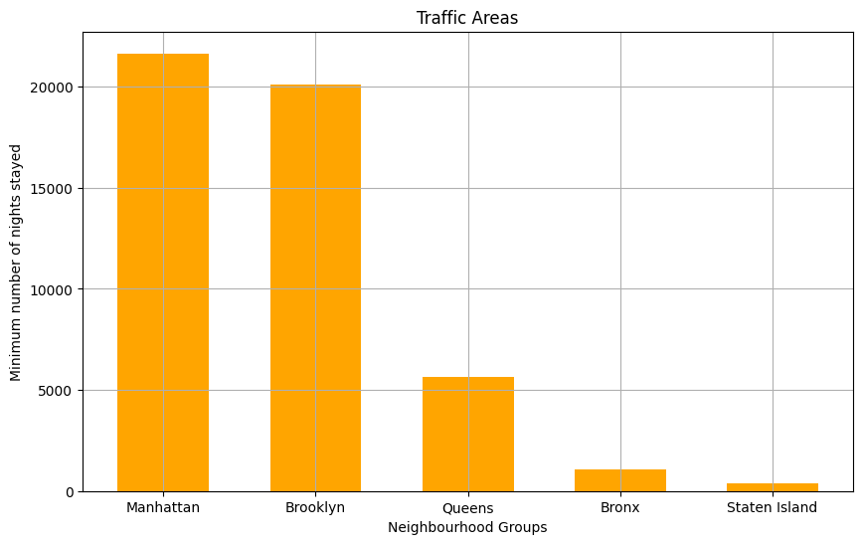
Is there any noticeable difference of traffic among different areas and what could be the reason for it?
From the Bar plot we can see that Manhattan and Brooklyn has the highest traffic share followed by Queens, Bronx and Staten Island.
From the previous analysis we know that most of property are listed in Manhattan and Brooklyn that’s why it has most Traffic.
We know that Manhattan and Brooklyn have many places of Tourist attraction like “Statue of Liberty and Ellis Island” in Manhattan, “Prospect Park, Cony Island” in Brooklyn.

Slide 15
Conclusion:-
So far we have done some basic exploring of the dataset and have gain few insights from it such as
-From the analysis we came to know most properties are located in Manhattan and Brooklyn neighbourhood group .
-We know the Top 10 hosts with most No of properties listed. Sonder(NYC) is a Top Host, with 327 no of properties listed.
-We know which Neighbourhood group has most No of reviews as compared to No of properties listed. i.e Queens has highest No of Reviews but Manhattan has the highest no of properties listed.
-By analyzing Price and No of Reviews, We know most people prefer to stay where the Price is less.
-By analyzing Room Type with No of Reviews, We know that Most people prefer to stay in Private Room.
-We know Fort Wadsworth is the most expensive Neighbourhood, by comparing Average price and Neighbourhood.
-We came to know the top 10 Busiest Host and their preference regarding Room Type.
Manhattan and Brooklyn has the highest traffic share followed by Queens, Bronx and Staten Island. Because Manhattan and Brooklyn have many places of Tourist attraction like ‘’Statue of Liberty and Ellis Island’’.

Slide 16
Thank you….

