Slide 1
MACHINE LEARNING SEMESTER PROJECT
Diabetes Prediction using
Machine Learning
A Comparative Study of Logistic Regression, Decision Tree, Random Forest, SVM, and KNN
on the Pima Indians Diabetes Dataset
Ghani
Registration No: FA22-BSE-099
COMSATS University Islamabad, Abbottabad Campus
Final Lab Presentation — 9 July 2026

Slide 2
Problem Statement
Given a patient's clinical measurements, predict whether they are likely to be diabetic — a binary classification task.
Objectives
1
Explore the dataset (EDA)
•
Diabetes is a leading chronic disease; early detection enables timely intervention.
2
Preprocess: handle missing values, scale features
•
Traditional diagnosis relies on clinical lab tests — costly and slow.
3
Train & compare 5 ML classification models
•
ML can flag high-risk patients using routinely collected measurements alone.
4
Evaluate with accuracy, precision, recall, F1, confusion matrix
5
Build a dashboard for real-time prediction
2 / 10

Slide 3
Dataset
Pima Indians Diabetes Dataset
Feature | Meaning
Glucose | Plasma glucose concentration
BloodPressure | Diastolic blood pressure (mm Hg)
SkinThickness | Triceps skin fold thickness (mm)
Insulin | 2-hr serum insulin (mu U/ml)
BMI | Body mass index
DiabetesPedigreeFunction | Family history likelihood
Age | Age in years
Outcome | Target: 1 = Diabetic, 0 = Non-Diabetic
Source: National Institute of Diabetes and Digestive and Kidney Diseases
(via Machine Learning Mastery GitHub Datasets repository)
768
7
1
Patient Records
Clinical Features
Target Variable
Note: The original dataset's Pregnancies feature was excluded to keep the model
focused on non-reproductive clinical measurements.
3 / 10

Slide 4
Preprocessing: Missing Values, Encoding, Scaling & Split
1
Missing Value Handling
Biologically invalid zero values in Glucose, BloodPressure, SkinThickness, Insulin, and BMI were treated as missing and imputed with the column median.
2
Feature Scaling
All features standardized (StandardScaler: zero mean, unit variance) — essential for distance-based models like SVM and KNN.
3
Train/Test Split
80% training / 20% testing, using stratified sampling to preserve class balance. Random seed fixed at 42 for reproducibility.
4 / 10

Slide 5
Models Used: 5 ML Algorithms
1
2
3
Logistic Regression
Decision Tree
Random Forest
Simple, interpretable linear baseline
Captures non-linear feature interactions (max depth 5)
Ensemble of 200 trees, robust to overfitting
4
5
SVM
K-Nearest Neighbors
RBF kernel, margin-based separation
Instance-based learner (k = 9)
All models trained on the same preprocessed data and evaluated on the same held-out test set for a fair comparison.
5 / 10

Slide 6
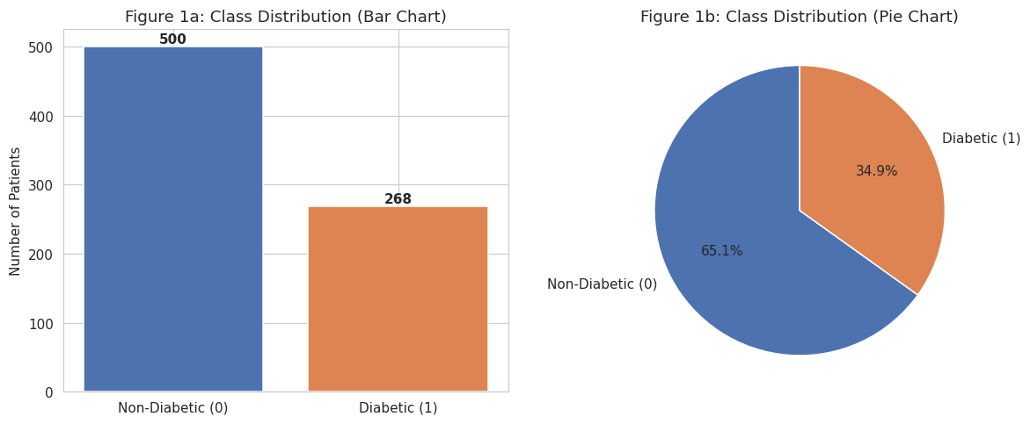
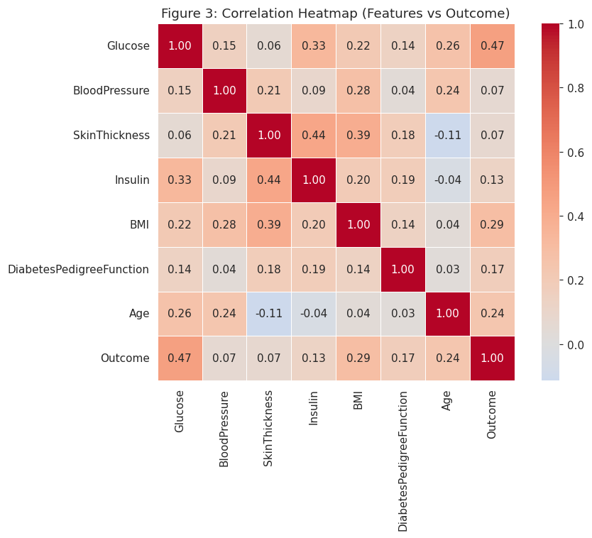
Graphs: Dataset Visuals & Feature Understanding
Figure 1: Target/Class Distribution — moderate imbalance (~65% Non-Diabetic vs ~35% Diabetic).
Feature distributions (Figure 2) show Glucose and BMI roughly normal around clinical norms; Insulin & SkinThickness needed zero-value imputation.
Figure 3: Correlation Heatmap — Glucose shows the strongest positive correlation with Outcome, followed by BMI and Age.
6 / 10

Slide 7
Results: Accuracy, Precision, Recall, F1-score
Model | Accuracy | Precision | Recall | F1-score
Decision Tree | 77.27% | 65.57% | 74.07% | 69.57%
KNN | 76.62% | 69.57% | 59.26% | 64.00%
Random Forest | 75.32% | 67.39% | 57.41% | 62.00%
SVM | 73.38% | 65.85% | 50.00% | 56.84%
Logistic Regression | 72.08% | 62.22% | 51.85% | 56.57%
Best Model: Decision Tree
Highest accuracy (77.27%), highest recall (74.07%) and highest F1-score (69.57%) — most balanced performer overall.
7 / 10

Slide 8
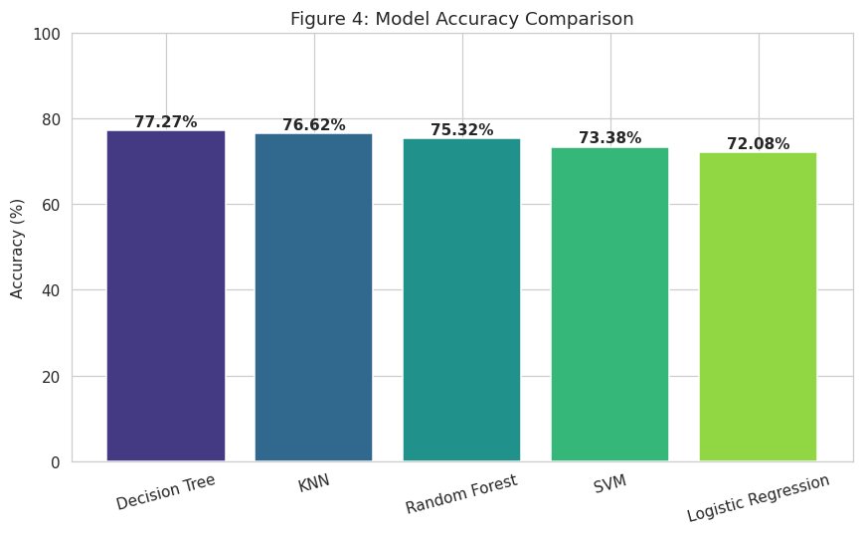
Model Comparison & Best Model
Why Decision Tree Wins
Highest accuracy (77.27%) and F1-score (69.57%) among all 5 models.
Highest recall (74.07%) — clinically important, since missed diagnoses (false negatives) are the costliest error type.
Outperforms the Random Forest ensemble here — likely because the dataset is small (768 rows), where a well-tuned shallow tree generalizes competitively.
Figure 4: Accuracy Comparison across all 5 models.
Fastest to train (0.004s) alongside KNN — ideal for a responsive live dashboard.
8 / 10

Slide 9
UI / Dashboard: Demo Flow
Planned dashboard workflow — live prediction demo shown in the final lab.
1. Input
2. Prediction
3. Key Metrics
4. Visual Graph
Patient enters clinical values: Glucose, BMI, Age, Blood Pressure, Insulin, Skin Thickness, Pedigree Function
Trained Decision Tree model returns Diabetic / Non-Diabetic prediction with confidence
Dashboard displays model accuracy, precision, recall, and F1-score
Feature importance / risk chart shown alongside the prediction
➜
➜
➜
The trained model (best_model.pkl) and scaler are already exported from the notebook, ready to power the live dashboard.
9 / 10

Slide 10
Conclusion, Limitations & Future Work
Key Achievement
Future Work
Built and compared 5 ML classifiers for diabetes prediction. Decision Tree achieved the best result: 77.27% accuracy, 69.57% F1-score.
• Class balancing (SMOTE) to improve recall further
• Hyperparameter tuning (GridSearchCV)
• K-fold cross-validation for robust estimates
Limitations
Small dataset (768 records), single demographic (Pima Indian women), moderate class imbalance (~65/35).
• Deploy as a full clinical decision-support web app
Thank you — Questions Welcome
Ghani | FA22-BSE-099 | COMSATS University Islamabad
10 / 10

