Slide 1

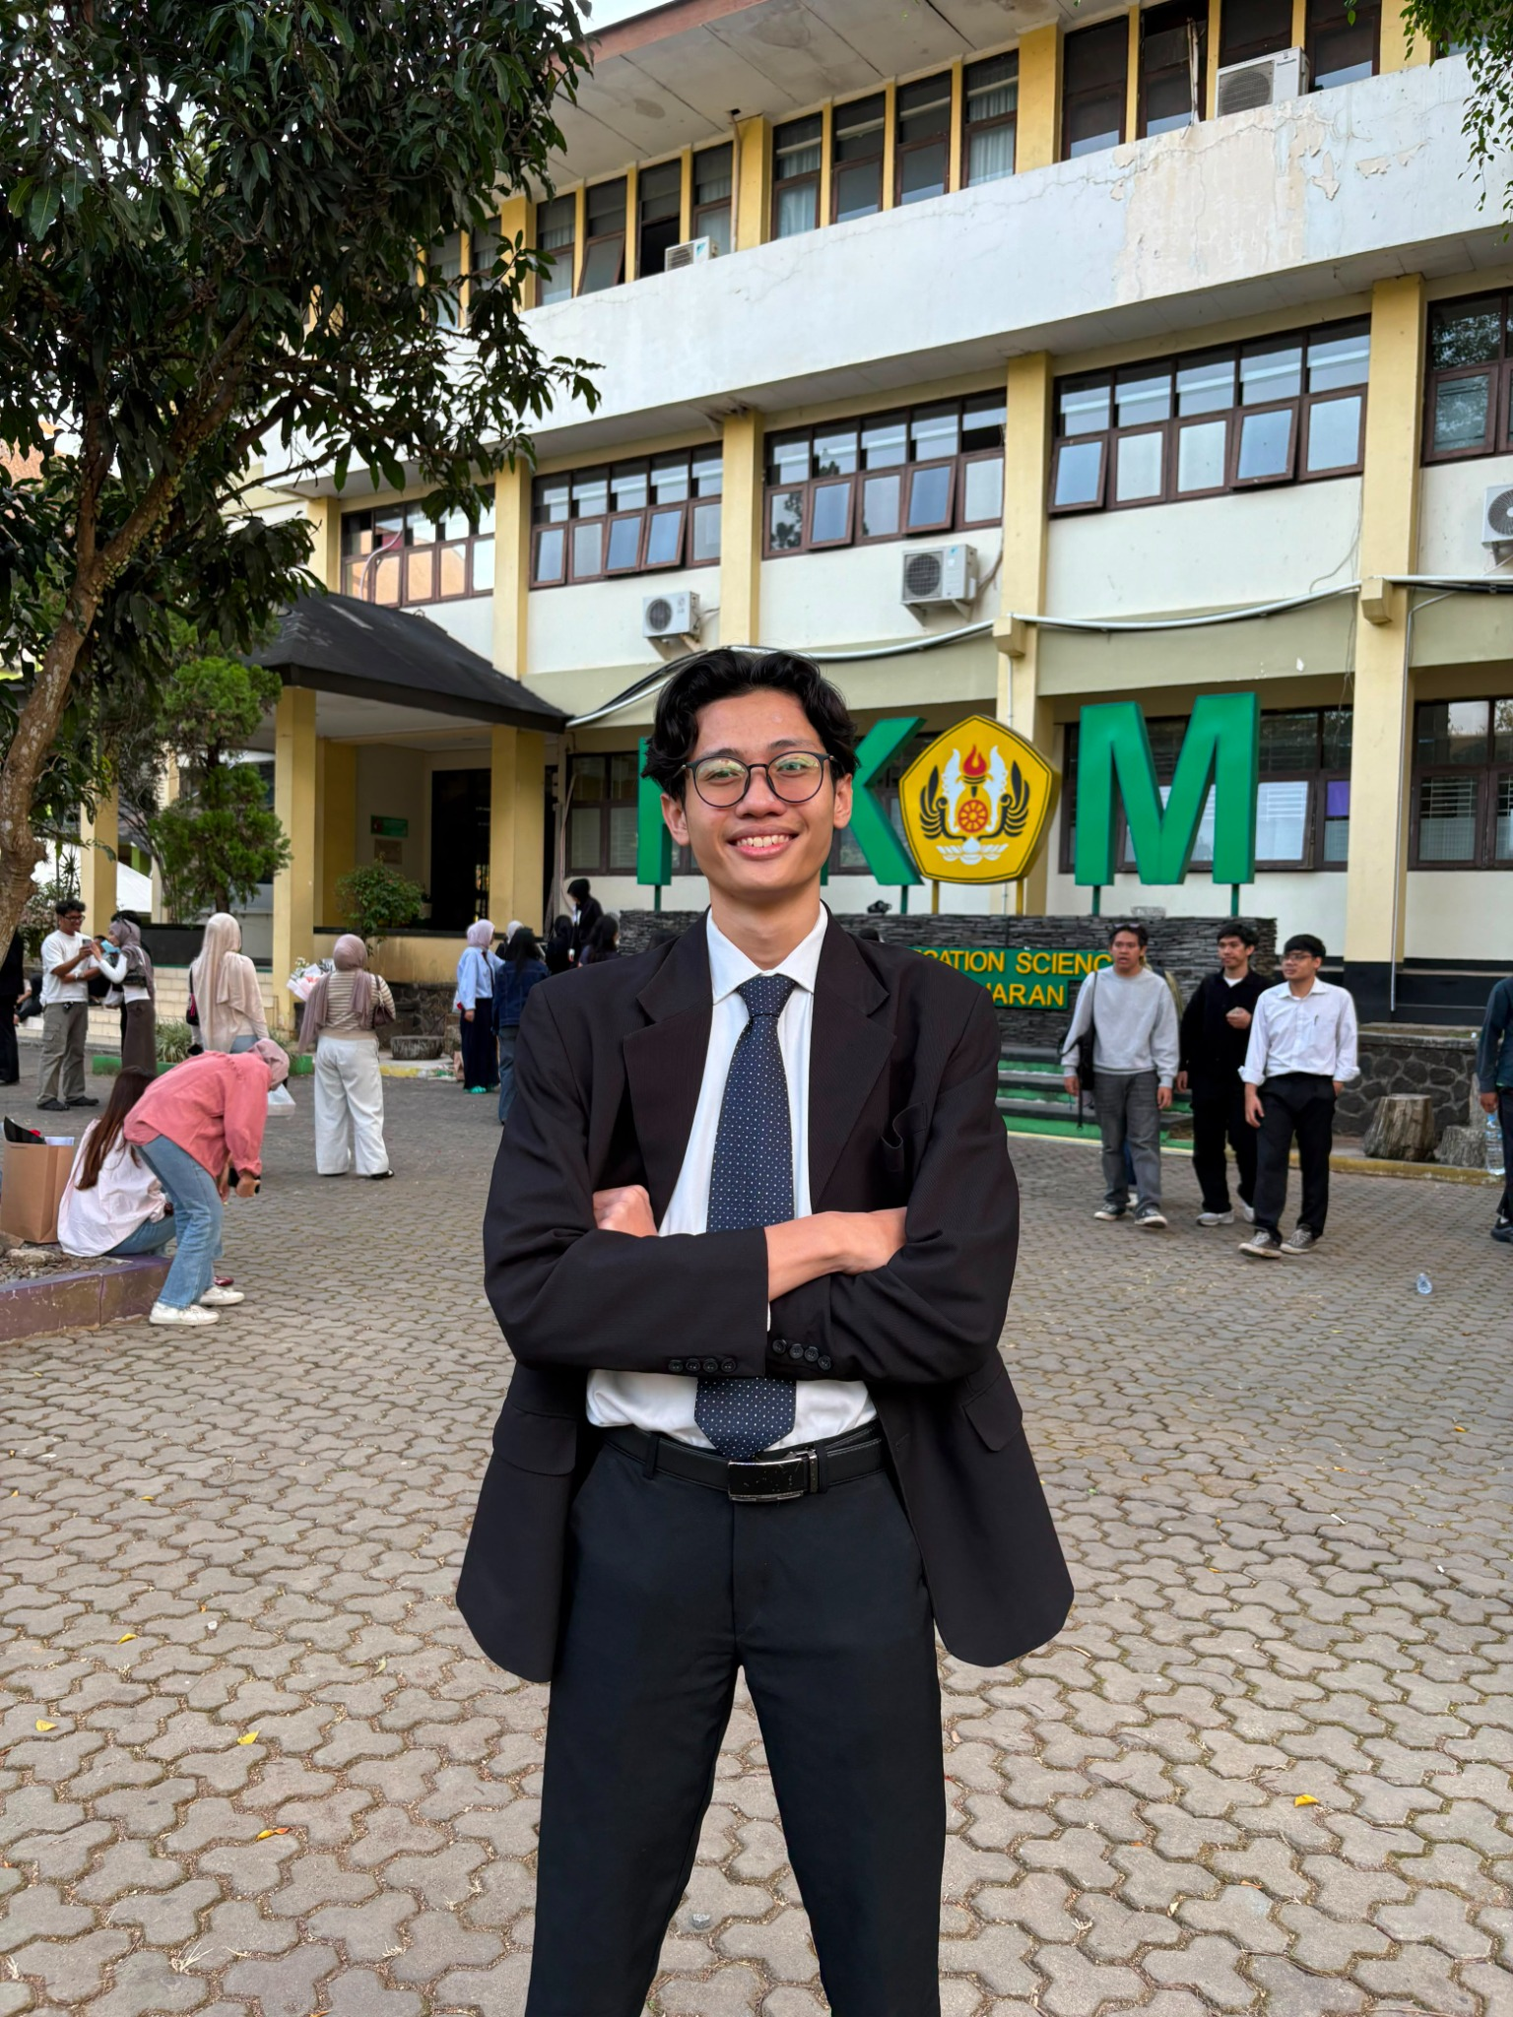
raihan.
About me
Portfolio 2026
Bekasi, Indonesia / Padjadjaran University
Explore selected work
Muhammad
Raihan
Ramadhan
I develop content strategies and brand communications, then use
audience responses to improve execution.
Faculty of Communication
Sciences, Padjadjaran University
Marketing Communication / Social Media / Public Relations
Selected work
Next
01 / 22

Slide 2
raihan.
About me
Portfolio 2026
Hello, I’m Raihan.
I am interested in how brands build relationships with audiences
through relevant messages and creative content.
Bachelor’s degree in
Communication
Management
My experience spans F&B brand marketing, technology content,
and campus media communications. I develop ideas, execute
content, and use audience responses to shape the next
iteration.
Padjadjaran University
Since August 2023
Beyond content, I have experience coordinating teams and
building partnerships. I am interested in pursuing a career in
digital marketing and public relations.
3.70
GPA / 4.00
Based in Bekasi
Selected work
Previous
Next
02 / 22

Slide 3
raihan.
Portfolio navigation
Portfolio 2026
Choose a project to explore
Divia Unpad TV
Campus media, employer branding & B2B
04-08
TIRIZ
Content strategy, KOLs & campaign evaluation
09-13
Cakradata
Technology content for students
14
Organizations & events
Partnerships, team coordination & programs
15-19
Skills & tools
Communication, Google, Microsoft & Canva
20-21
Selected work
Previous
Next
03 / 22

Slide 4

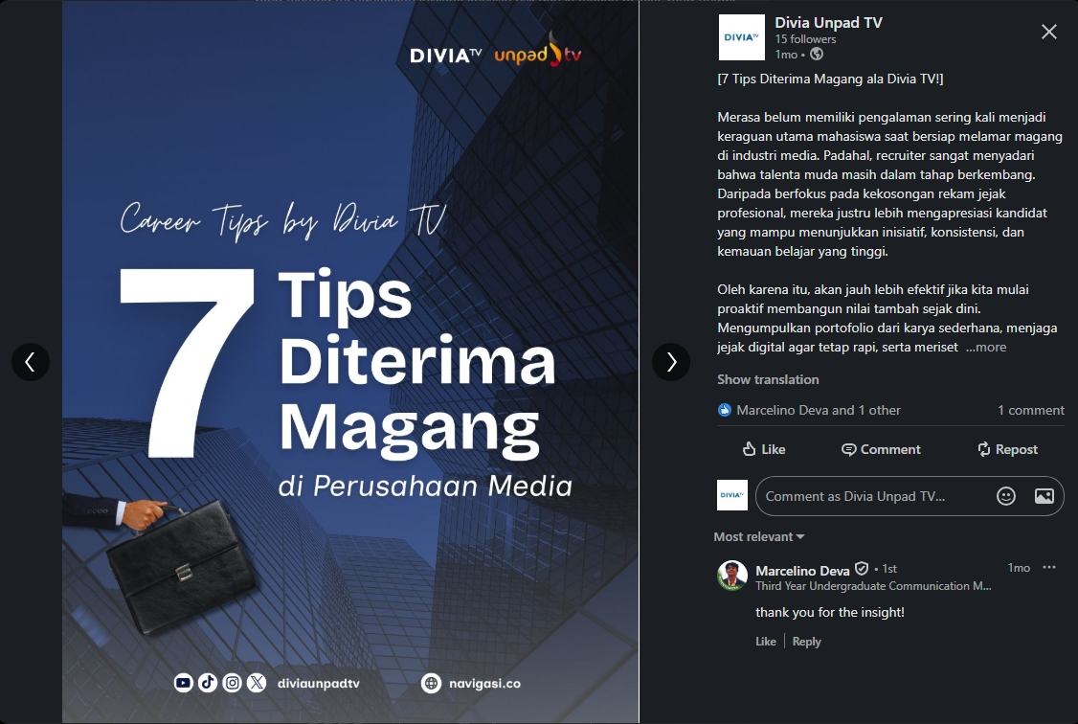
raihan.
Divia Unpad TV / June - August 2026
Career content that
resonates with students
Marketing Communication Intern
Divia Unpad TV is the official community television station of
Padjadjaran University, operating under the Faculty of
Communication Sciences. Holding an official Broadcasting
Operating Permit (IPP), it serves the West Java 1 region with
24-hour digital broadcasts and professional editorial standards
comparable to commercial media institutions.
I built Divia’s LinkedIn presence from the ground up, used
the AIDA framework for copy, and developed an editorial
calendar for employer branding.
61.6%
CTR on the top-performing post
Original Divia Unpad TV LinkedIn post
Content calendar & working documents
Selected work
Previous
Next
04 / 22

Slide 5
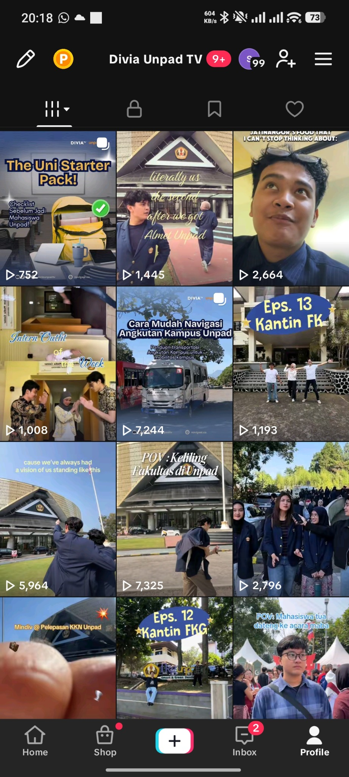
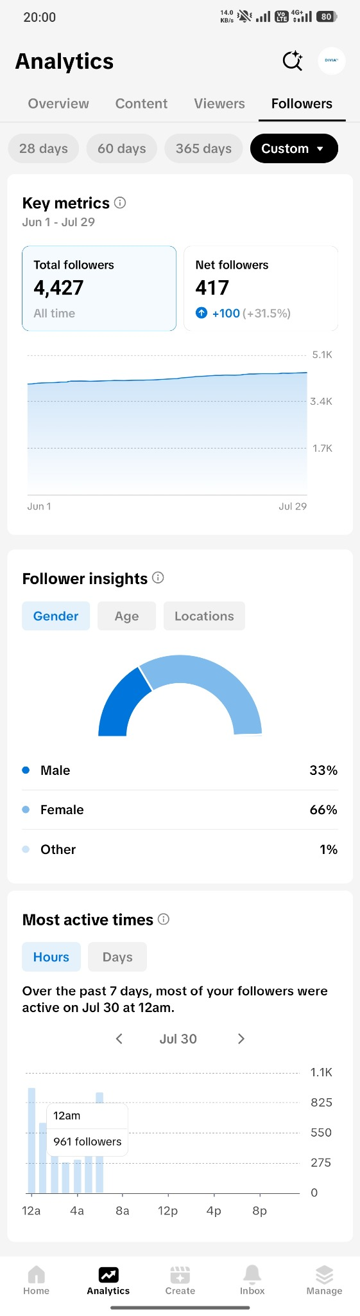
raihan.
Divia / TikTok, June 1 - July 29, 2026
Portfolio 2026
TikTok follower growth
417
Net TikTok followers during the reporting period
+31.5%
Change in net followers versus the
comparison period.
Analytics shows 4,427 total followers. The
+31.5% figure compares net followers with the
previous period.
Divia Unpad TV TikTok feed
Divia TikTok Analytics
This is not the percentage growth in total followers.
Selected work
Previous
Next
05 / 22

Slide 6
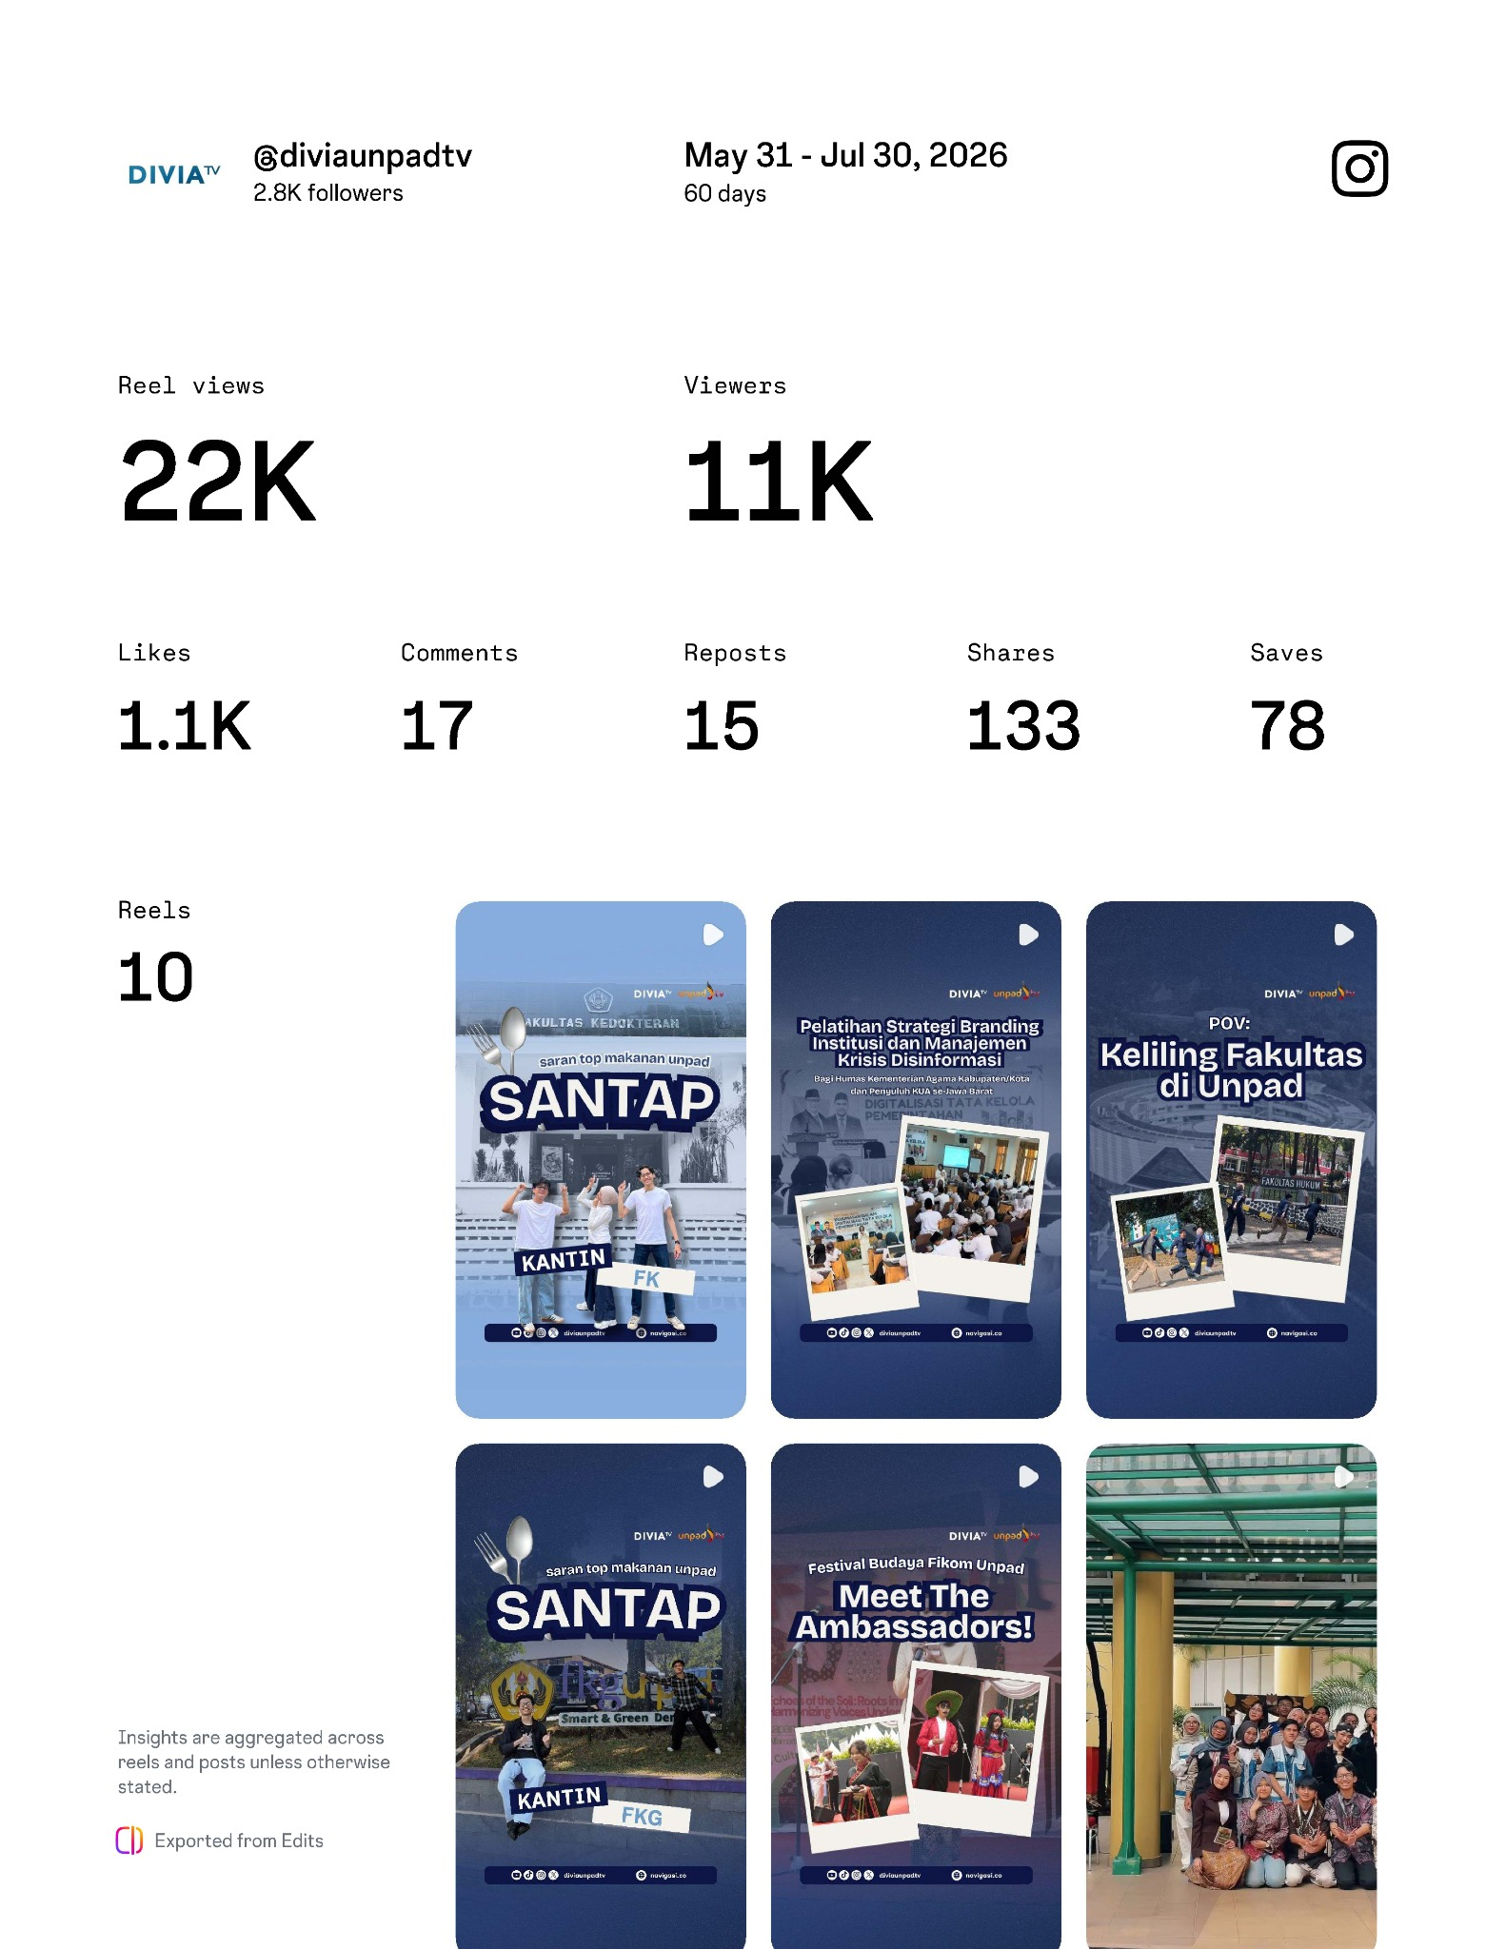
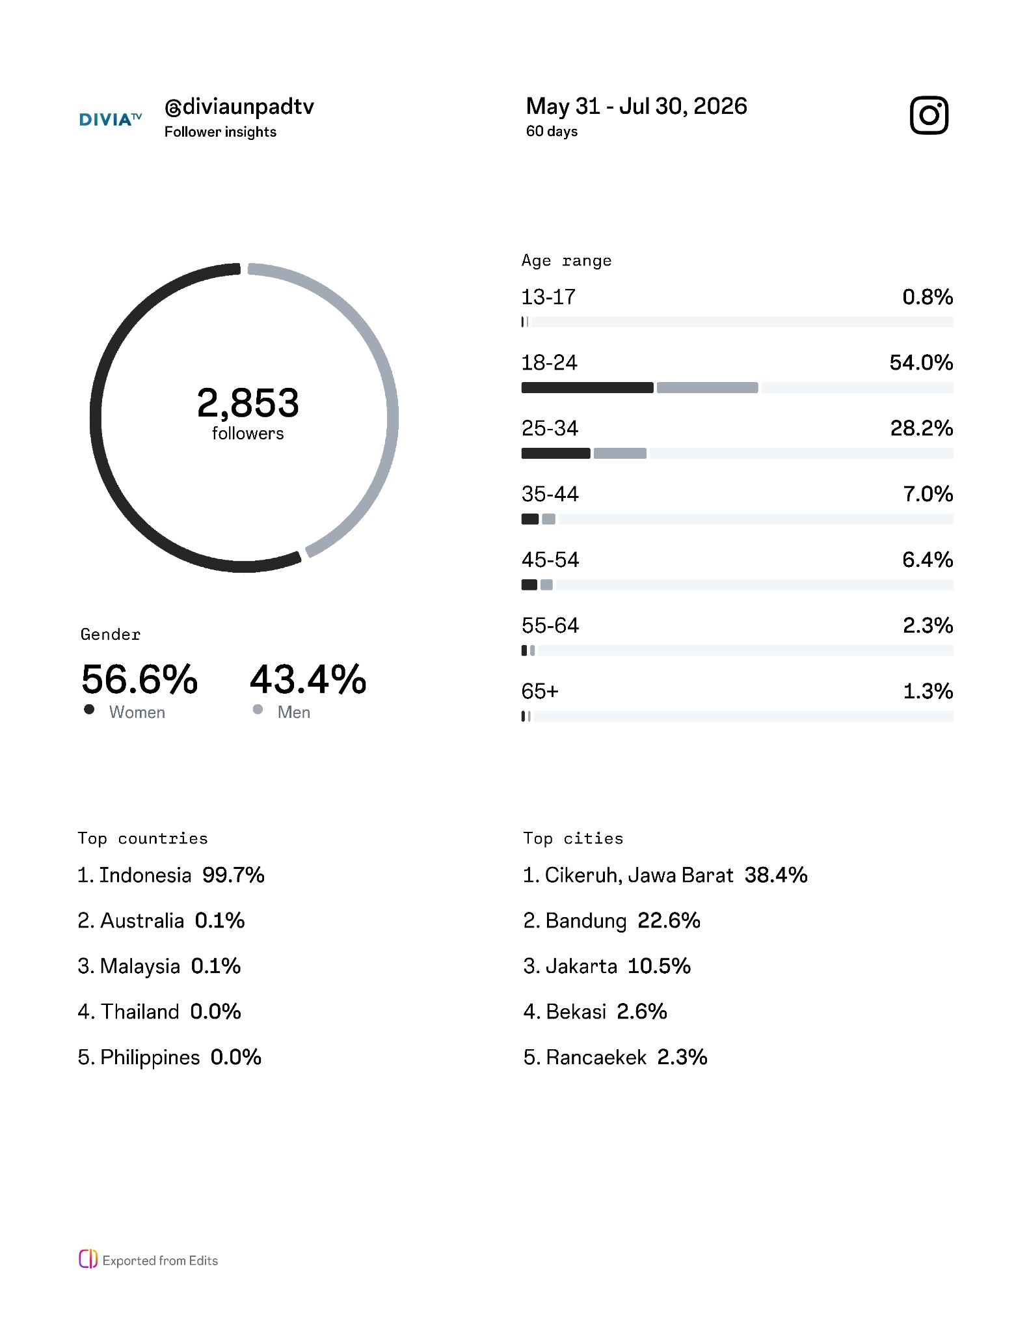
raihan.
Divia / Instagram, May 31 - July 30, 2026
Portfolio 2026
Instagram performance and audience
22K
Reel views in the Insights report
11K
Viewers in the Insights report
2,853
Total followers, not follower growth
Instagram Insights, 60 days
Instagram audience profile
54.0% of followers are aged 18–24. Account metrics reflect team results.
Selected work
Previous
Next
06 / 22

Slide 7
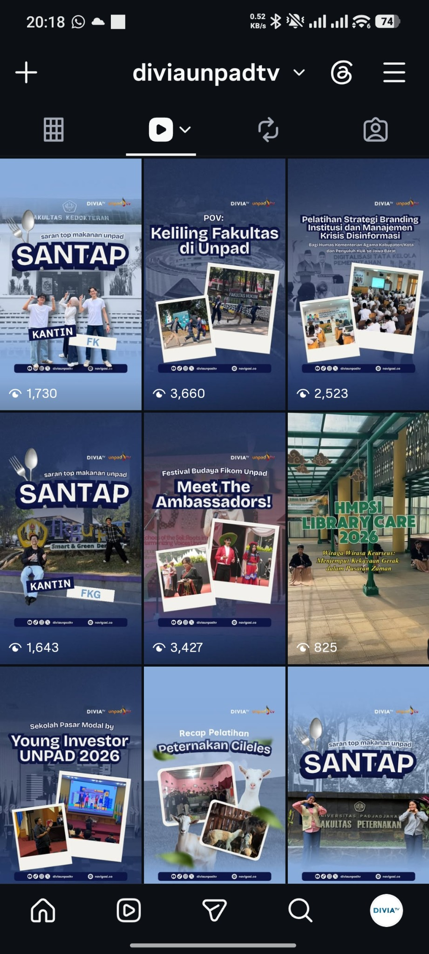
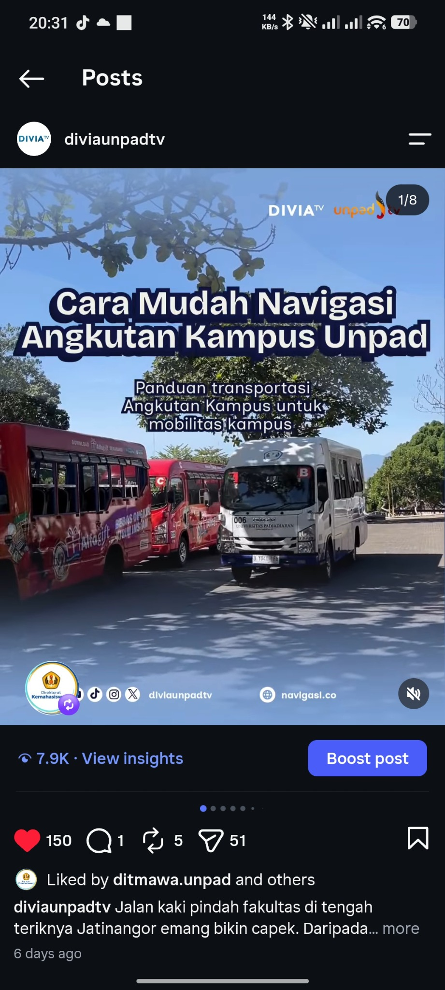
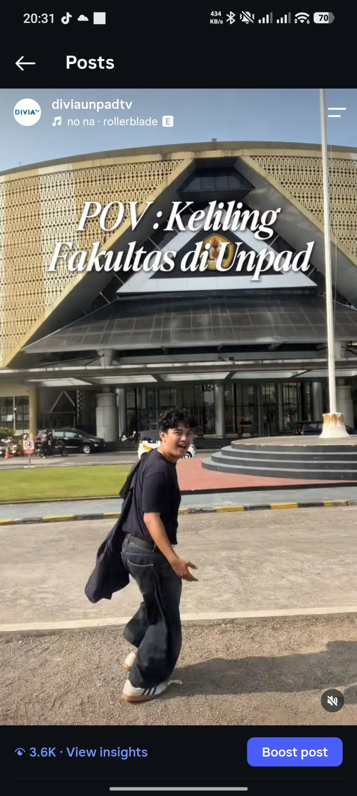
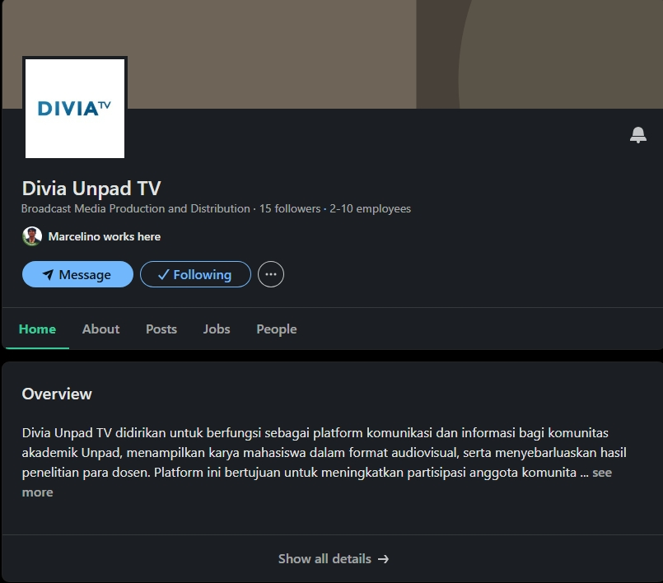
raihan.
Divia / Selected posts
Portfolio 2026
Content that resonates with students
Instagram feed
Campus transport guide
Faculty tour
Divia LinkedIn page
Screenshots: 7.9K views for the campus transport guide and 3.6K views for the faculty tour Reel.
Figures for each post reflect the screenshot date and may differ from aggregate reports.
Selected work
Previous
Next
07 / 22

Slide 8
raihan.
Divia Unpad TV / B2B communications
Portfolio 2026
Materials for business partnerships
As part of a three-person team, I optimized weekly social content. I also developed a
company profile, a competitor-informed rate card, and media partnership SOPs.
Company profile
Rate card
SOP media partnership
Introducing Divia’s services
and position to potential
partners.
Proposal materials informed
by competitor analysis.
Clarifying collaboration
workflows and partner
coordination.
Open content calendar & working documents
Selected work
Previous
Next
08 / 22

Slide 9

raihan.
TIRIZ / September - December 2025
Building a local ice cream brand’s
digital presence
Digital Marketing Strategist
TIRIZ is an emerging local food and beverage (F&B) brand
specializing in innovative ice cream and dairy products. It focuses
on high-quality, accessible products while building a strong digital
presence and community engagement in the local market.
850
I managed digital strategy and execution with a five-person team.
The two-month plan combined educational, promotional, trend-led,
and engagement content for Unpad students.
Instagram follower
growth during the
campaign
Content and partnerships worked together: four micro-influencers, an online-to-offline booth, and an Instagram giveaway.
Selected work
Previous
Next
09 / 22

Slide 10
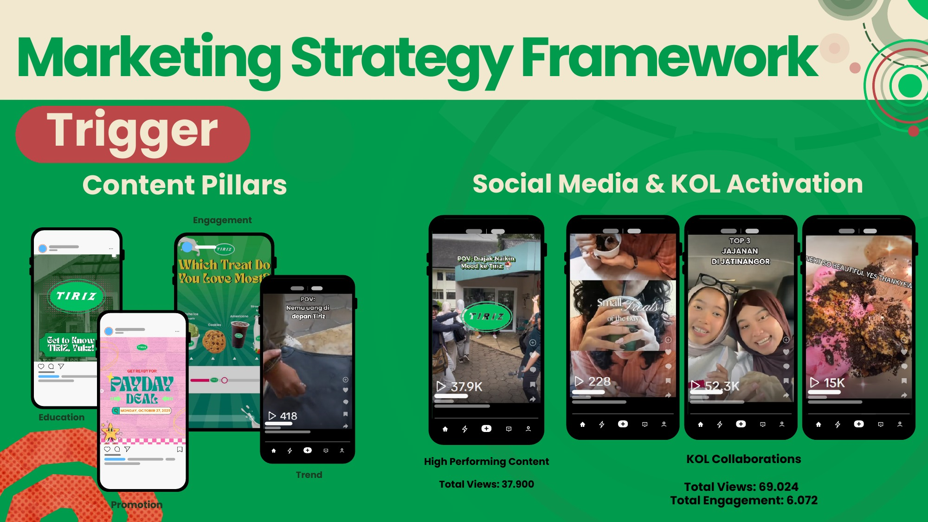
raihan.
TIRIZ / Content & partnerships
Portfolio 2026
Content, execution, and partnerships
37,900
Views on the top-performing
promotional post
69,024
Total views from four
micro-influencer
collaborations
6,072 total KOL engagements
Original TIRIZ report, page 9. Team campaign results.
Selected work
Previous
Next
10 / 22

Slide 11
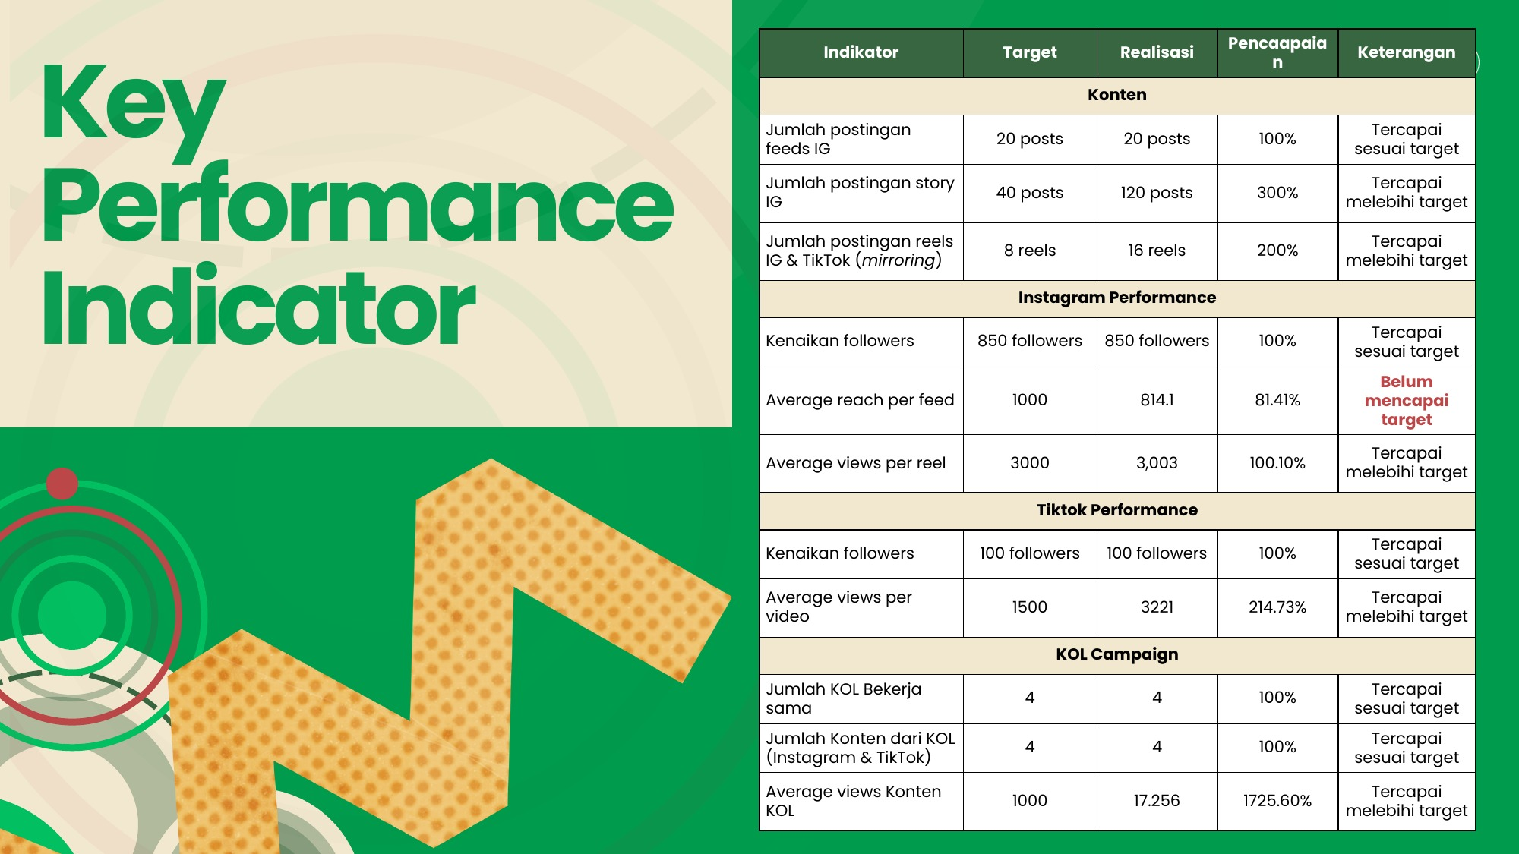
raihan.
TIRIZ / Campaign evaluation
Portfolio 2026
Campaign results at a glance
Metric | Target | Actual
Instagram feed posts | 20 | 20
Instagram Stories | 40 | 120
Reels / short-form videos | 8 | 16
Instagram follower growth | 850 | 850
Average reach per Instagram feed post | 1,000 | 814.1
Average views per Instagram Reel | 3,000 | 3,003
TikTok follower growth | 100 | 100
Average views per TikTok video | 1,500 | 3,221
Original KPI report, page 16
Stories reached 300%
of their target.
Instagram feed reach
remained below target.
View original TIRIZ campaign report (in Indonesian)
Selected work
Previous
Next
11 / 22

Slide 12
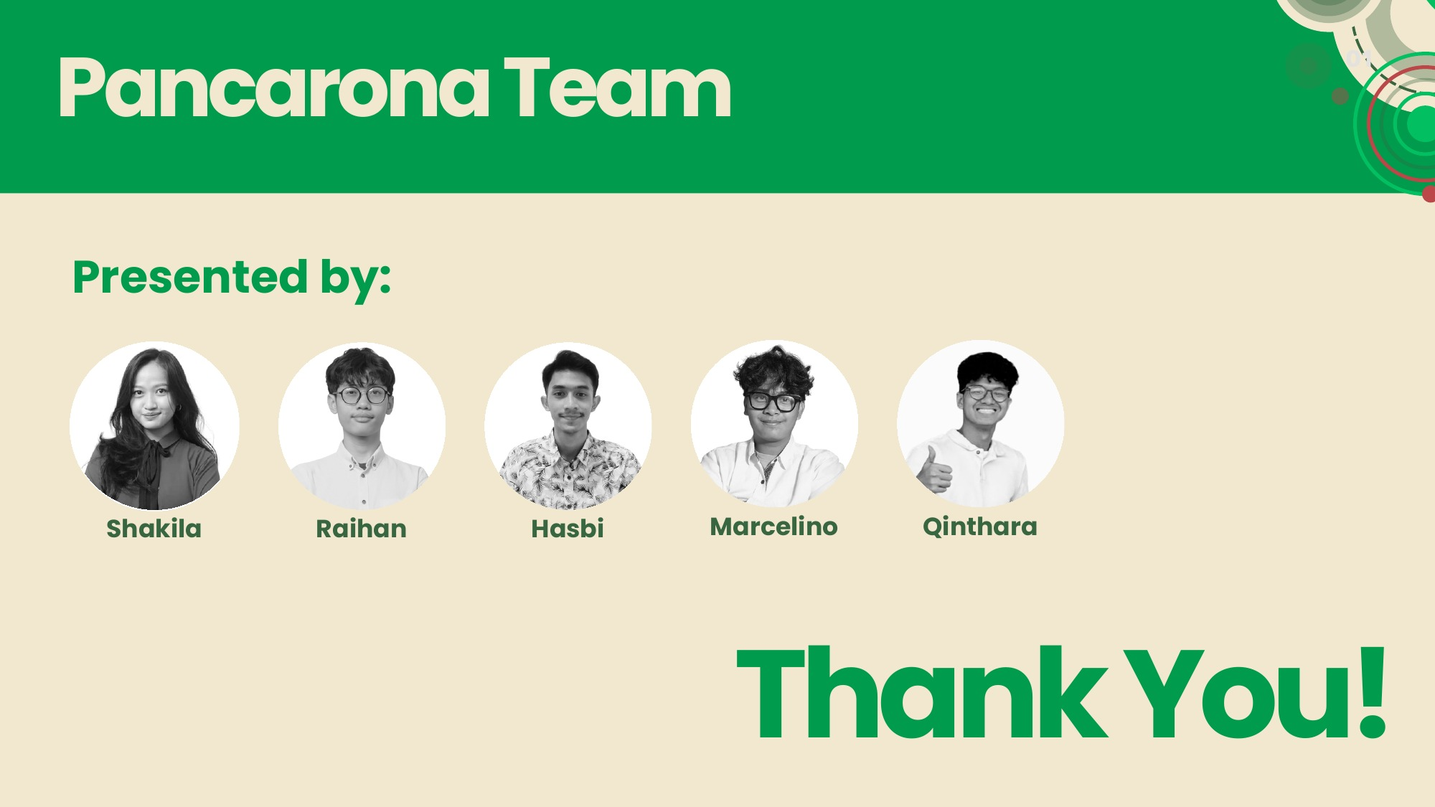
raihan.
TIRIZ / KOLs and campaign team
Portfolio 2026
KOL partnerships in the campaign
KOL targets and results in the Pancarona team’s campaign report.
KOL metric | Target | Actual
KOL partnerships | 4 | 4
Instagram & TikTok content | 4 | 4
Average views per KOL post | 1,000 | 17,256
KOL and campaign results reflect team effort. My
contributions included digital strategy and execution.
Pancarona Team, report page 19
Original TIRIZ report, pages 16 and 19
Selected work
Previous
Next
12 / 22

Slide 13
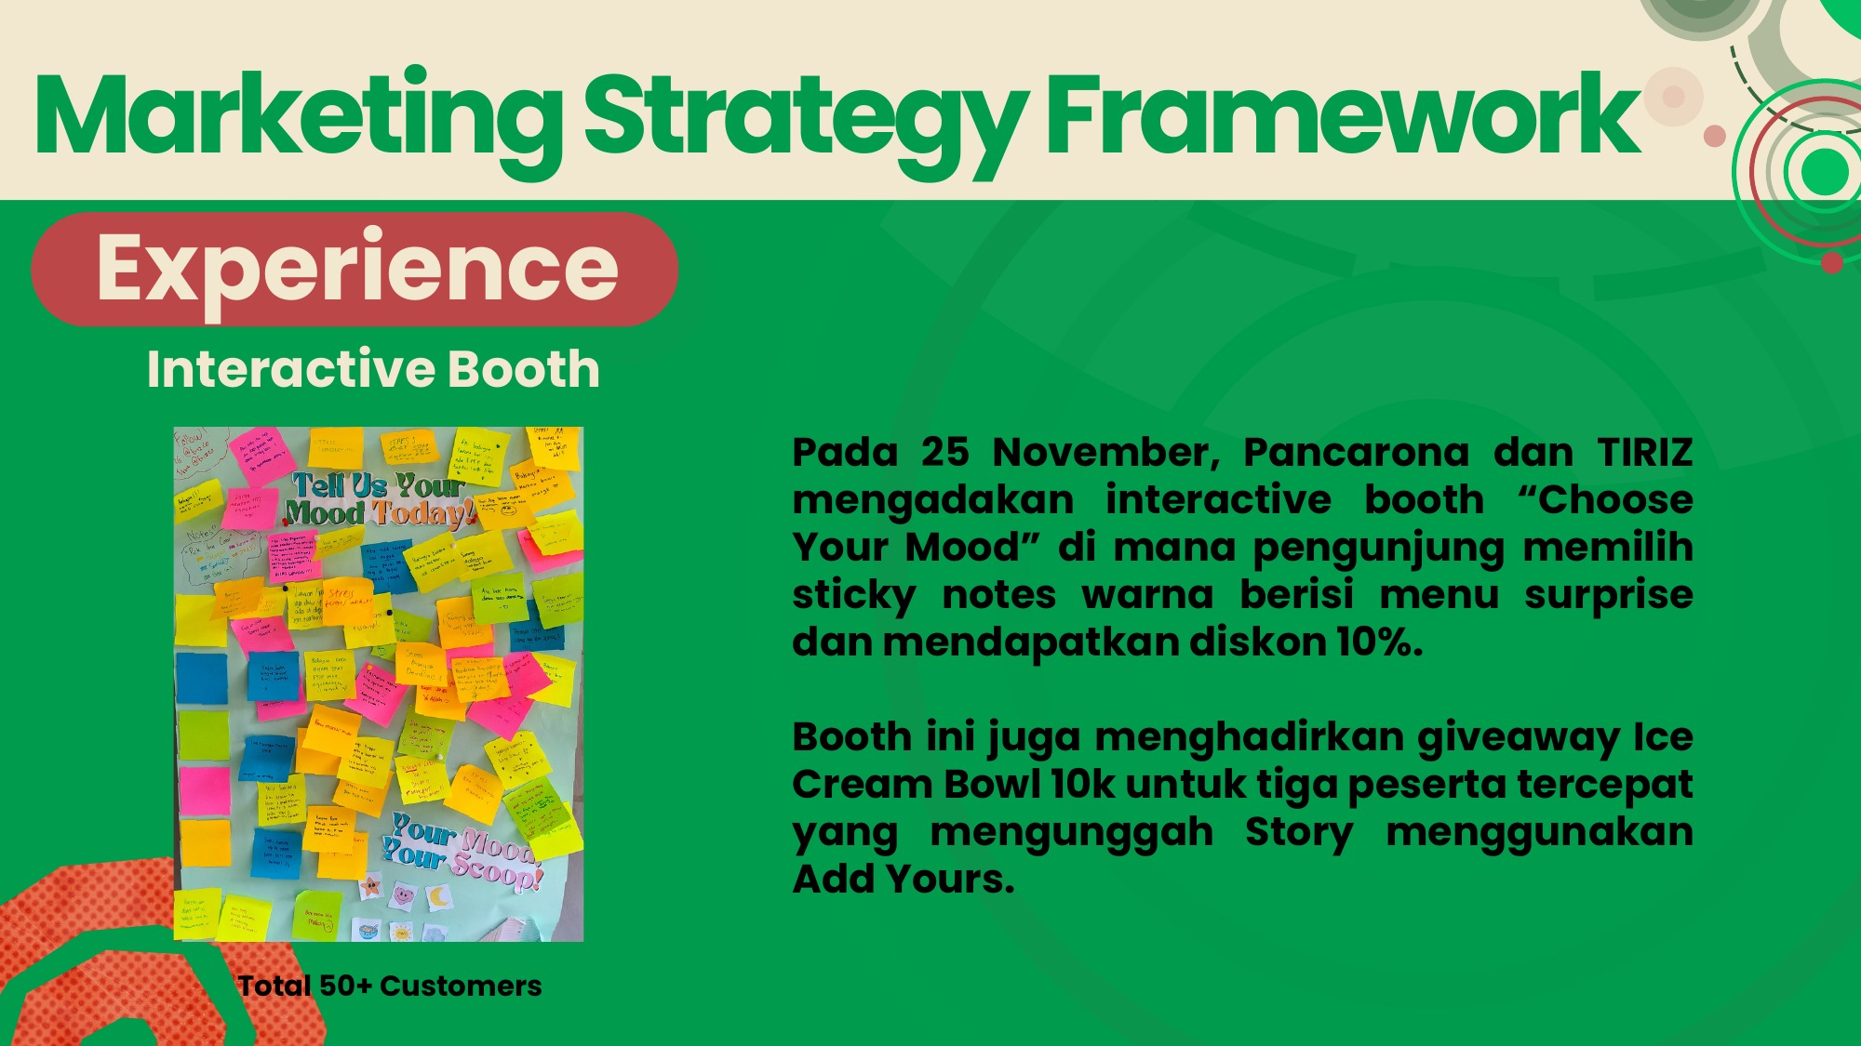
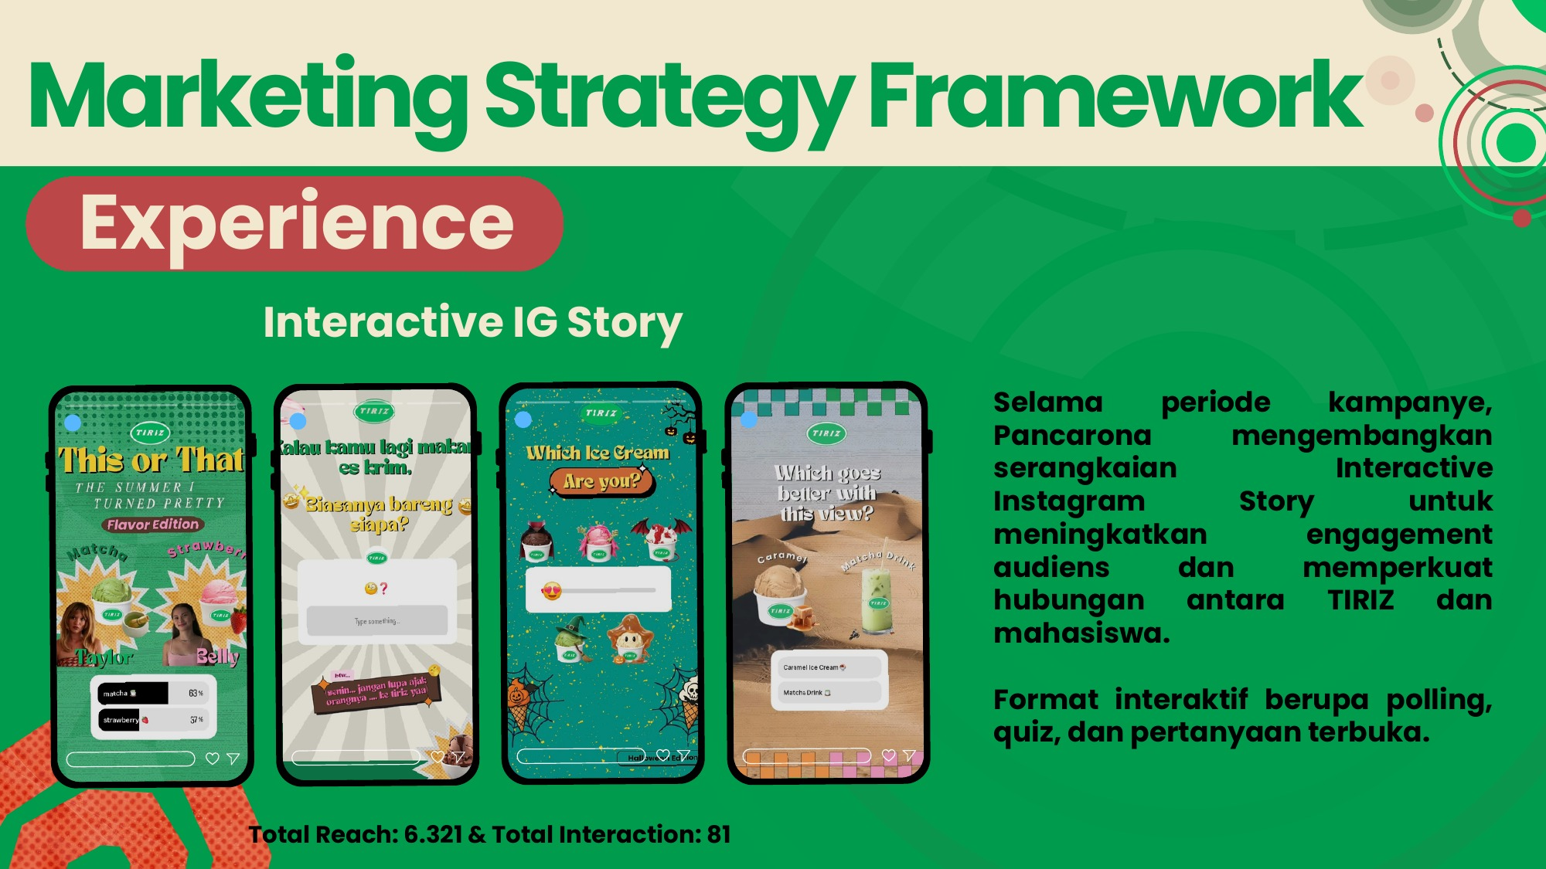
raihan.
TIRIZ / Booth and Instagram Stories
Portfolio 2026
Digital content and booth activation
The “Choose Your Mood” activation on November 25 connected digital content with the booth experience. Instagram
Stories used polls, quizzes, and open-ended questions.
50+
6,321
81
Customers at the booth activation
Total Instagram Story reach
Total Instagram Story interactions
Interactive booth, report page 10
Interactive Instagram Stories, report page 11
Selected work
Previous
Next
13 / 22

Slide 14

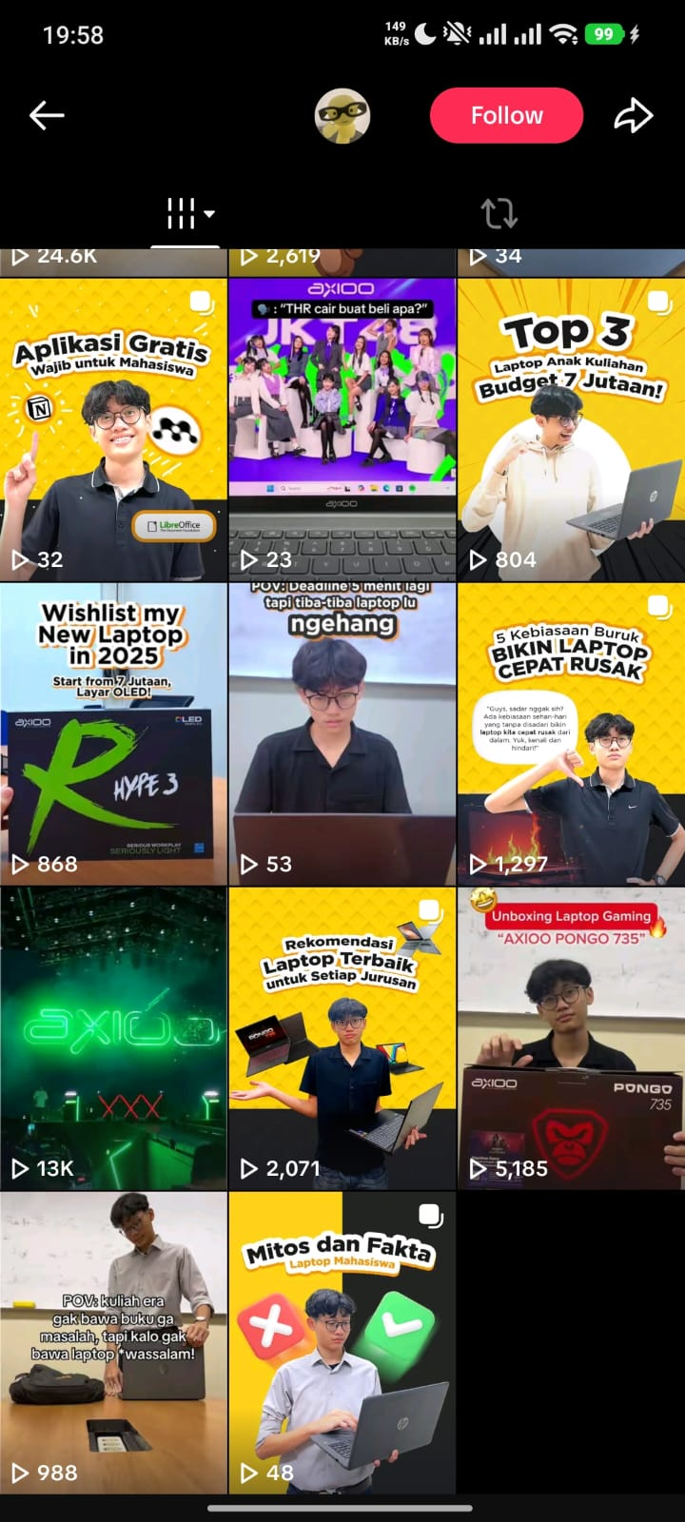
raihan.
Cakradata / January - February 2025
Technology content for students
Marketing Intern
Cakradata is a pioneering Indonesian technology firm using big data and
artificial intelligence (AI) for perception engineering. It specializes in digital
media monitoring, audience analysis, and reputation management, helping
brands and public figures build data-driven communication strategies and
strong digital images.
I reviewed digital performance through audience analysis and
media monitoring. I developed content plans and soft-sell copy for
Instagram and TikTok.
13,000
2,000
Example post from the Cakradata
feed
Top TikTok views
Top Instagram views
Selected work
Previous
Next
14 / 22

Slide 15

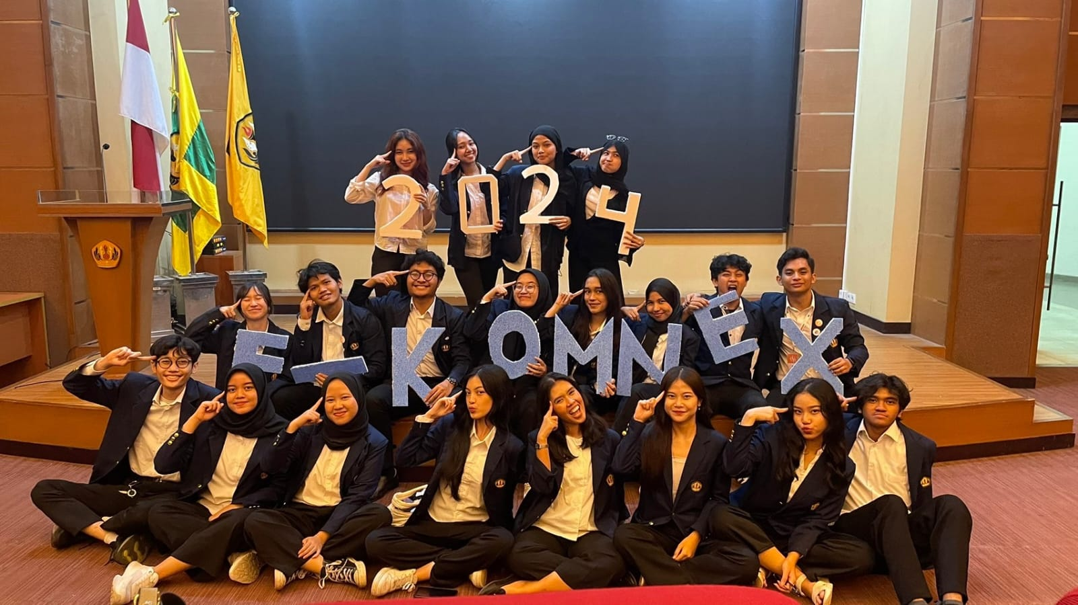
raihan.
Fikomnex 2024 / October - December 2024
Building campus partnerships
Head of Sponsorship Division
Fikom Communication Nexus (Fikomnex), formerly known
as Fikom Career Festival, is an annual event organized by
the Department of Profession and Scientific Affairs at BEM
Fikom Unpad. It gives Fikom students a space to explore
career insights and professional pathways after
graduation.
I led a two-person team in pitching and coordinating
partnerships for a career event for Fikom students.
5
Student organization partnerships
Fikomnex team, 2024
Fikomnex partnership tracker
Selected work
Previous
Next
15 / 22

Slide 16

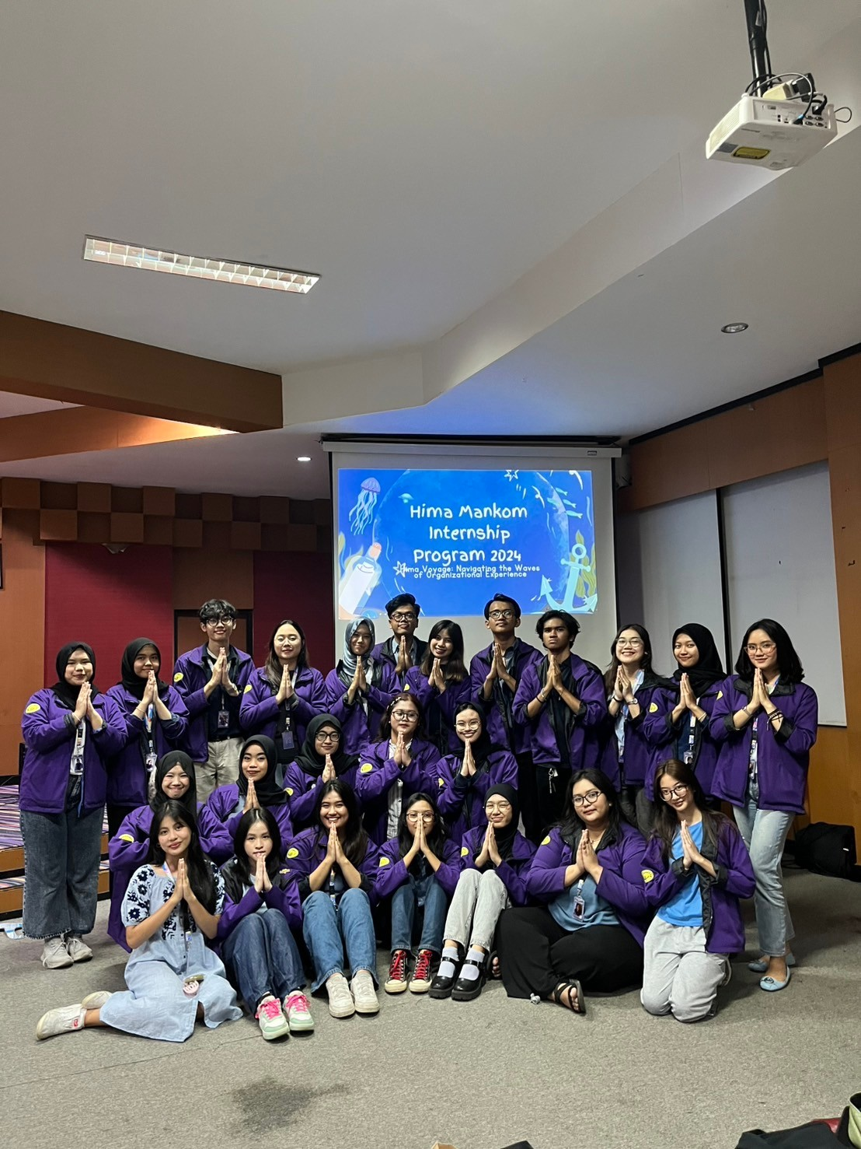
raihan.
Communication Management Student Association / February - December 2024
Leading HIMA’s Internship Program
Staff, Human Resources and
Organizational Development Department
The Communication Management Student Association is
the primary student association representing the
Communication Management study program at Padjadjaran
University. It focuses on organizational management,
student advocacy, and comprehensive skill-building
initiatives.
I led a nine-person team and coordinated the HIMA
Internship Program across eight divisions. 81 of 92 new
students took part in the program, a participation rate of
approximately 88%. All established KPIs were achieved.
HIMA Internship Program 2024
Selected work
Previous
Next
16 / 22

Slide 17
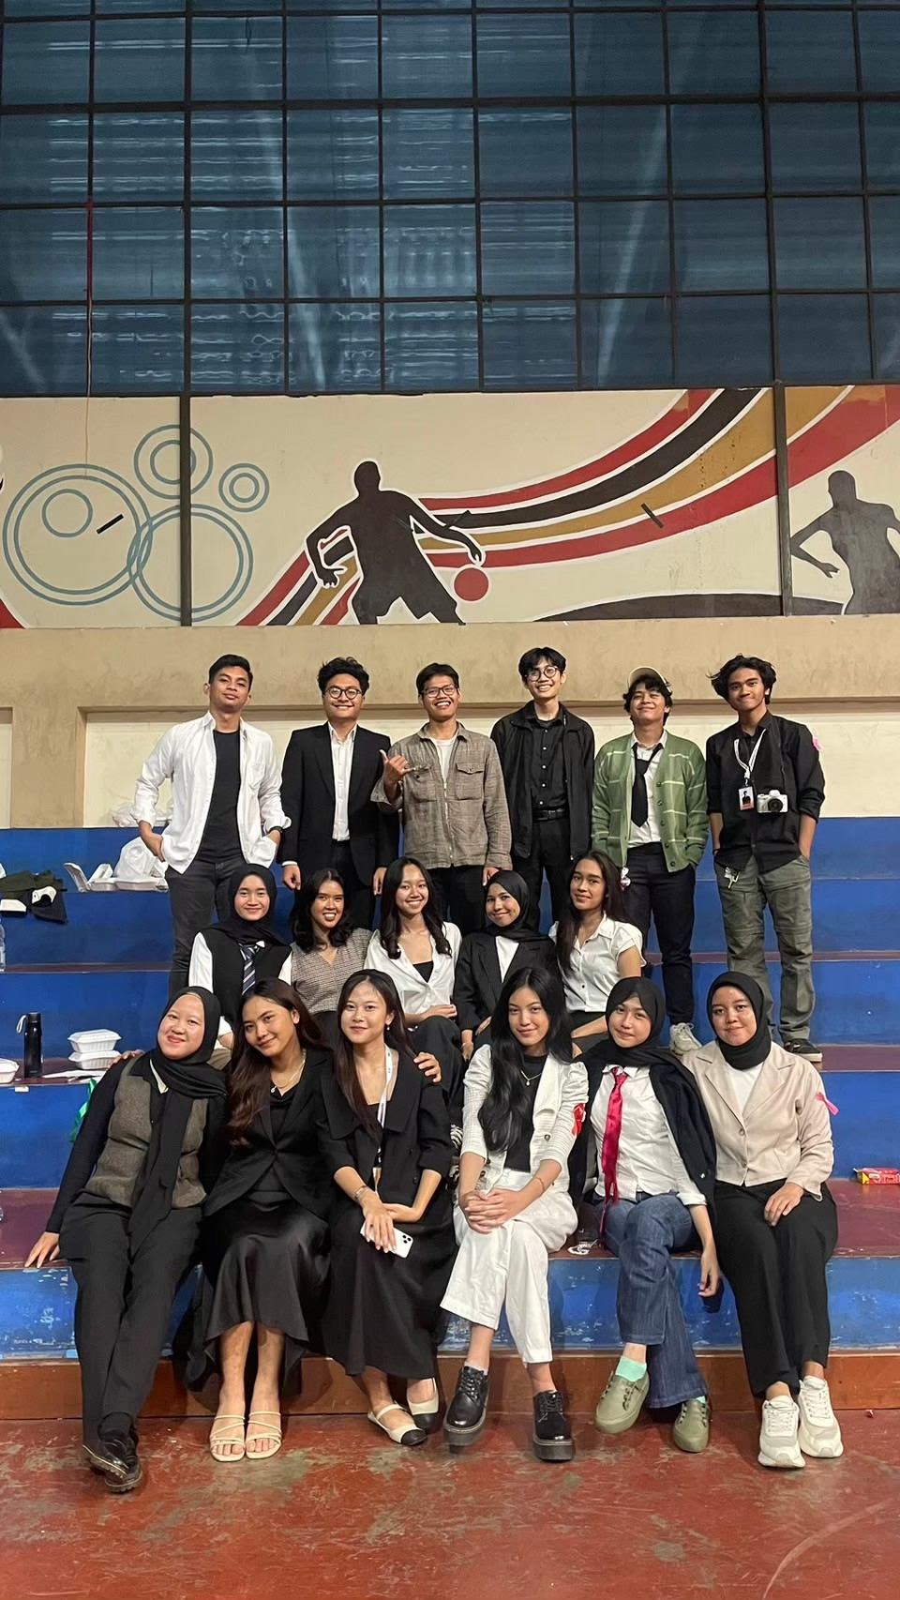
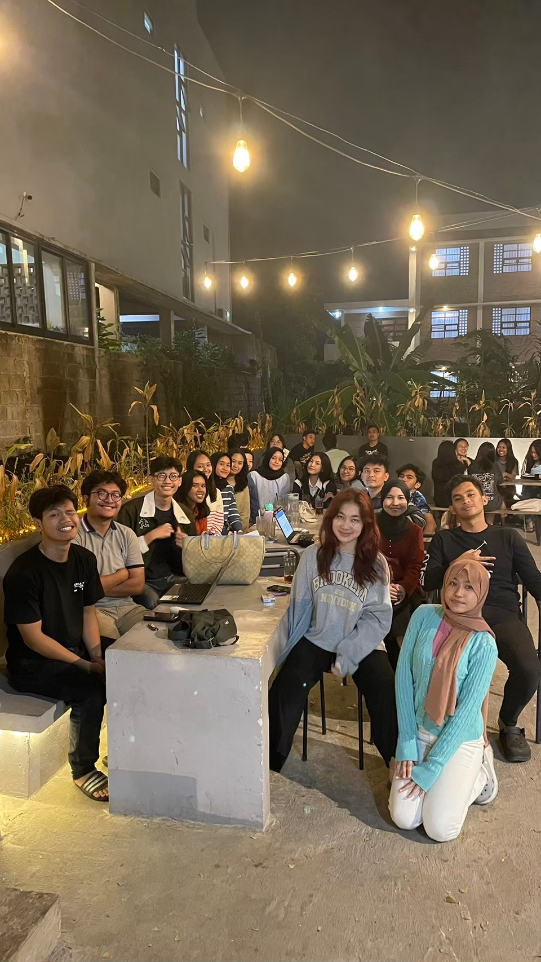
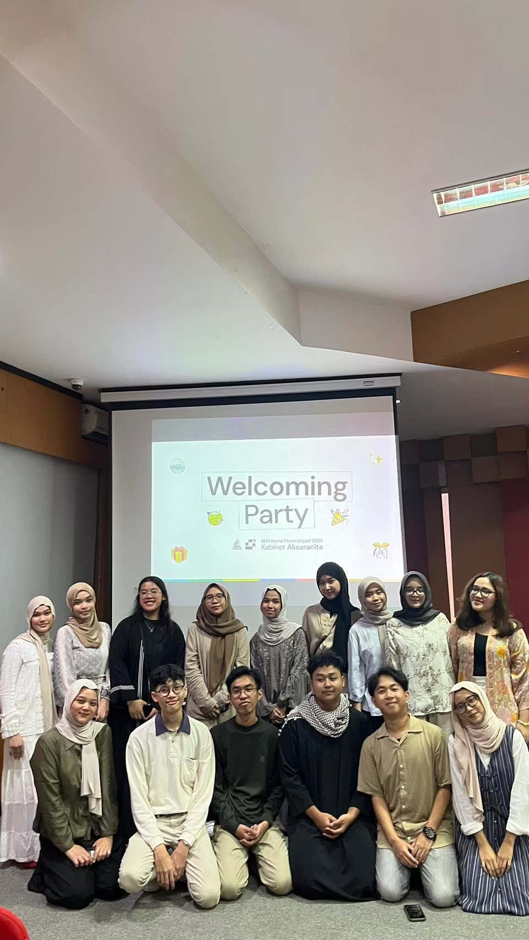
raihan.
BEM Fikom Unpad / March - December 2024
Coordinating with BEM Fikom
Staff, Bureau of Organizational Synergy and Development
BEM Fikom Unpad is the highest student executive body at
the Faculty of Communication Sciences, Padjadjaran
University. It leads strategic initiatives, student advocacy, and
faculty-wide programs with social impact.
As part of the Organizational Synergy and Development
(SPO) Bureau, I supervised the 14-member Department of
Profession and Scientific Affairs, monitored its performance,
and supported its programs.
I also served as event lead for Welcoming Party, an event
welcoming the newly formed cabinet staff. I developed the
event concept and led a team of fellow SPO staff. The event
met its set targets.
Photo with the
Department of Profession
and Scientific Affairs,
supervised by me as part
of the SPO Bureau.
Meeting of the
Department of Profession
and Scientific Affairs,
supervised by me as part
of the SPO Bureau.
BEM Fikom 2024
Welcoming Party photo,
where I served as event
lead.
Selected work
Previous
Next
17 / 22

Slide 18

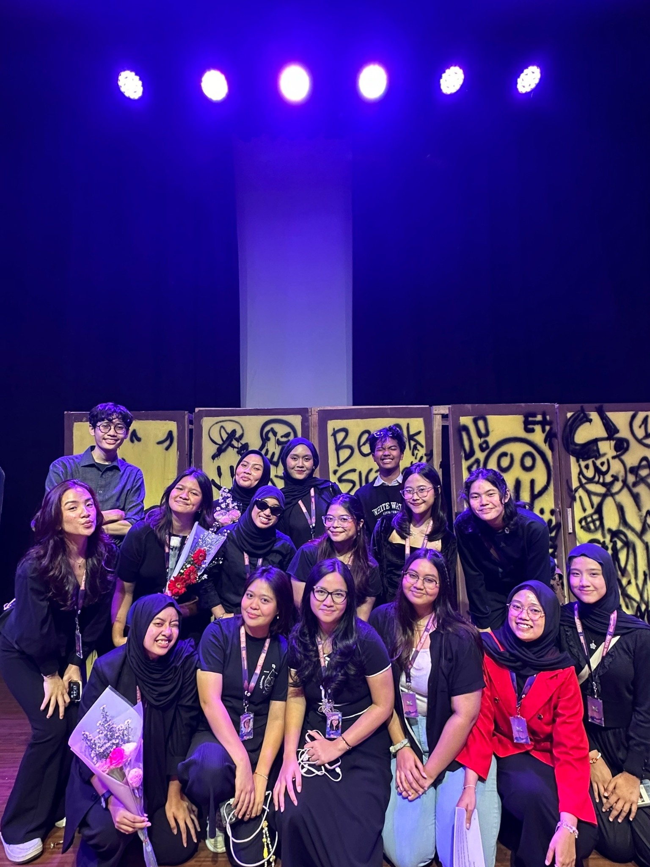
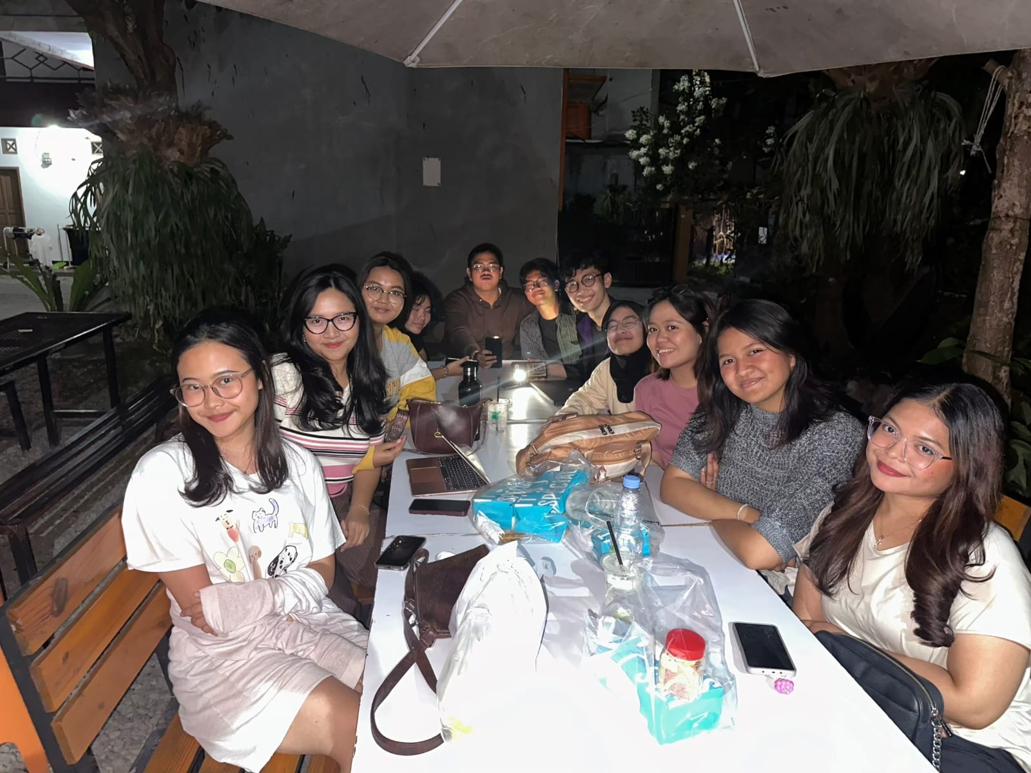
raihan.
Home Theatre / June - December 2024
Leading Home Theatre’s HR Team
Co-head of HR
Hint of Merge Entertainment Theatre (Home
Theatre) is a theatrical production organized by
Fikom Unpad. It gives students a platform to
express their interests, talents, aspirations, and
critiques of current issues through theatre.
I coordinated a 15-person HR team across
nine divisions, handled recruitment, and
helped resolve internal conflicts.
Home Theatre HR team meeting
photo.
Home Theatre HR division photo.
Selected work
Previous
Next
18 / 22

Slide 19
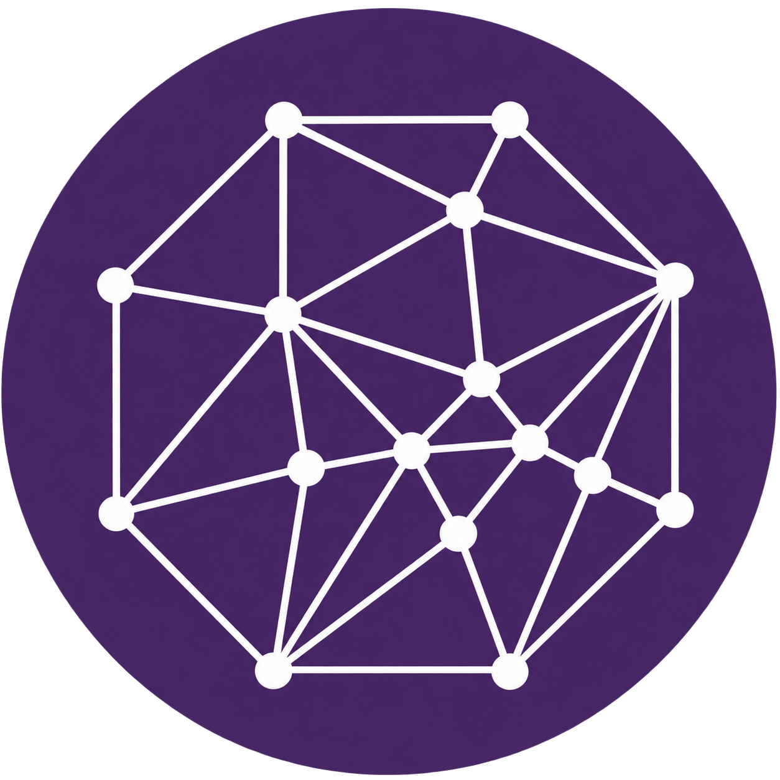
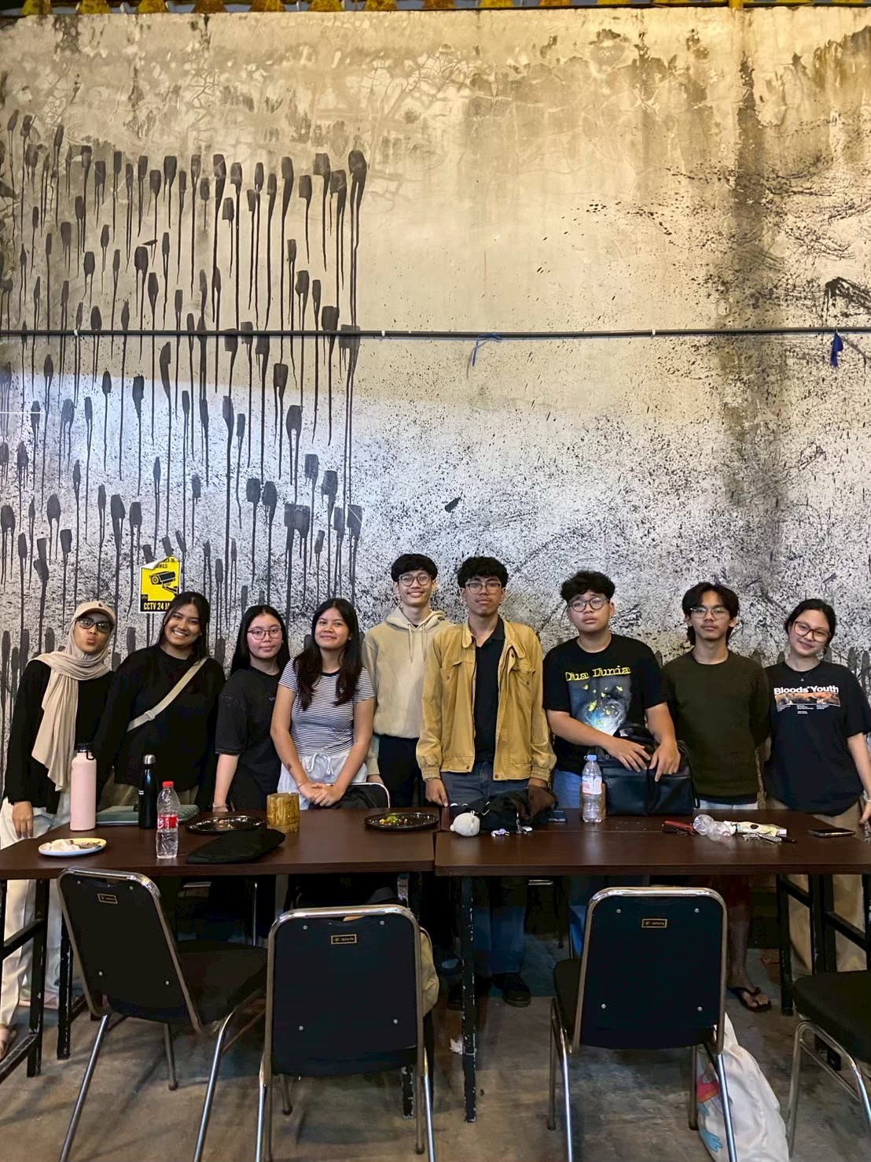
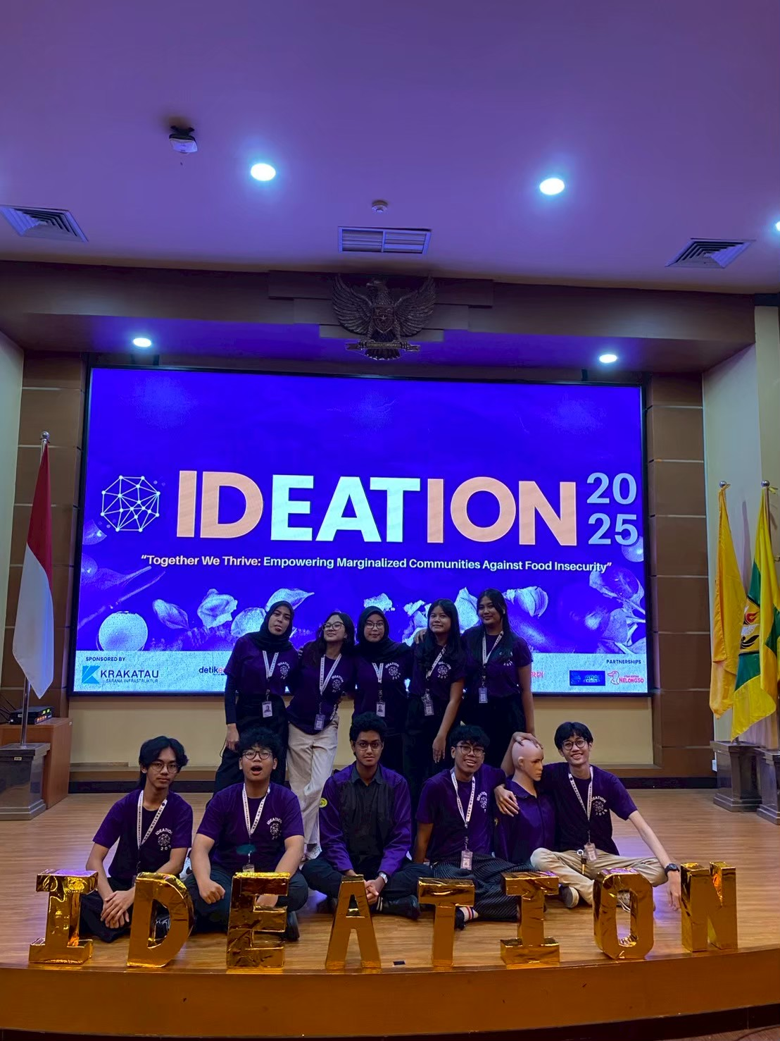
raihan.
Ideation Epicentrum / February - June 2025
Event concept and delivery
Event Management Staff
Ideation is an international communication
competition within Epicentrum, organized by the
Communication Management Study Program at the
Faculty of Communication Sciences, Padjadjaran
University. It challenges participants to address a
social issue through strategic communication design
in the form of a social campaign.
I developed concepts for four event
segments and delivered the event with a
seven-person team as part of an
international communication competition.
Ideation Epicentrum team photo.
Event Management team on Ideation
Final Day.
Ideation work tracker
Selected work
Previous
Next
19 / 22

Slide 20
raihan.
Skills
Portfolio 2026
Skills I bring
Content strategy & copywriting
Editorial calendars and LinkedIn
content
Social media analytics
Performance reviews against campaign
targets
Partnerships & B2B communication
Pitching, partner coordination, and
proposal materials
Team & event coordination
Student programs and cross-functional
communication
Certification: Fundamentals of Digital Marketing, Google (2025)
Selected work
Previous
Next
20 / 22

Slide 21
raihan.
Hard skills
Portfolio 2026
Tools I use
Google Workspace
Docs / Sheets / Slides / Drive
For shared documents, spreadsheets, presentations,
and file management.
Microsoft tools
Word / Excel / PowerPoint
For drafting documents, working with spreadsheets,
and preparing presentations.
Canva
Layout / Text / Visuals
Basic editing: adapting templates, layouts, text, and
visual elements.
Selected work
Previous
Next
21 / 22

Slide 22
raihan.
Contact
Portfolio 2026
Let’s work
together.
Open to opportunities in marketing communication, social media, and public relations.
mraihanr0511@gmail.com
LinkedIn
+62 821 2804 4014
Portfolio website
Selected work
Previous
22 / 22

