Slide 1
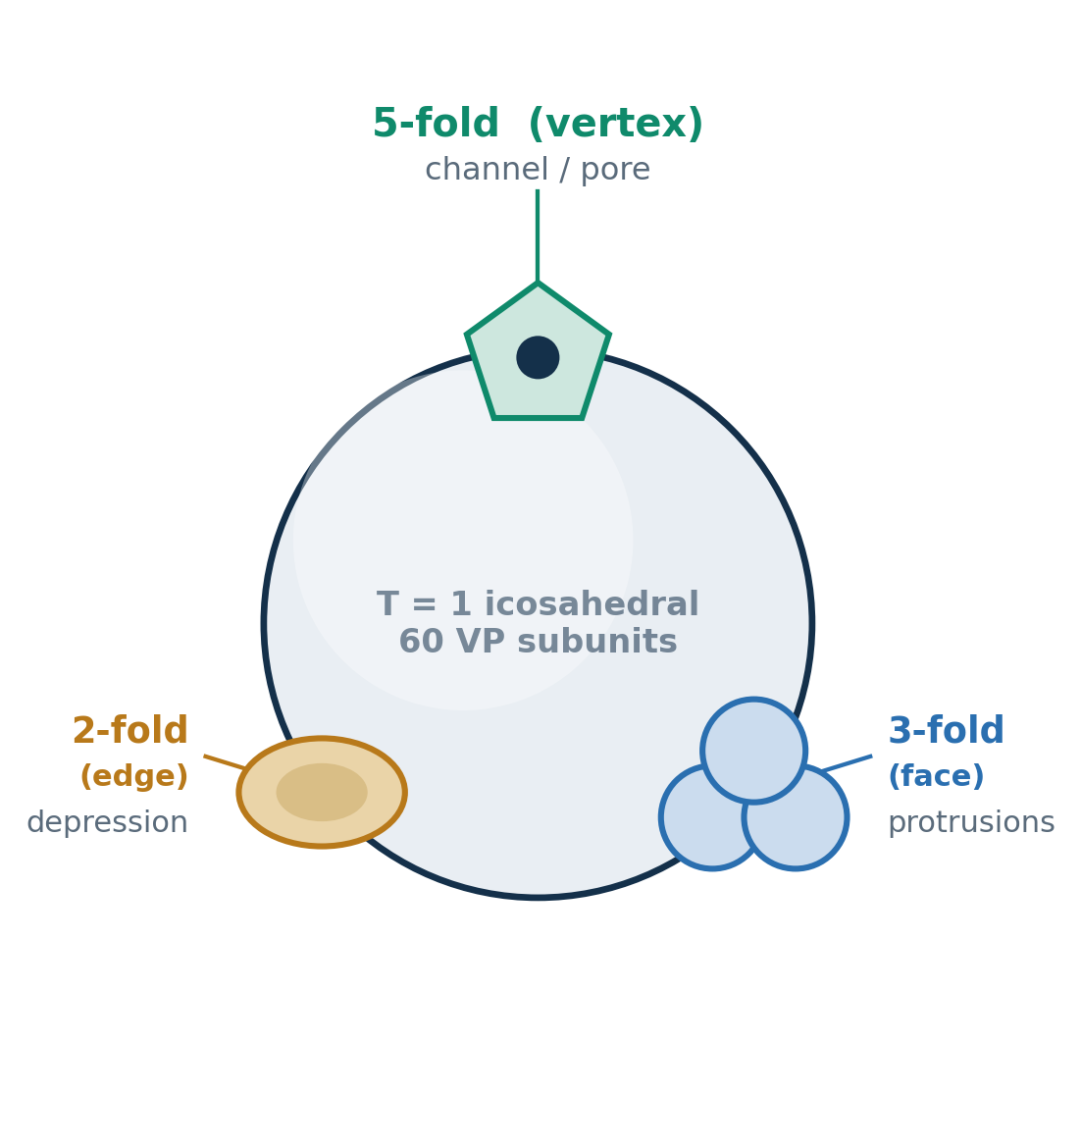
AAV Capsid Architecture: The Icosahedral Symmetry Axes
60 VP subunits (VP1:VP2:VP3 ≈ 1:1:10) in T=1 icosahedral symmetry (~26 nm). Each subunit is an 8-stranded β-barrel; its surface loops (variable regions VR-I–IX) build the topology at the 2-, 3-, and 5-fold axes.
5-fold
vertex
Topology — Pore / channel at the vertex, ringed by a canyon; walls from the DE loops of five subunits.
Residues — Polar, largely uncharged rim (Asn / Thr / Gln-rich); near-neutral surface charge.
Role — Genome packaging & ejection portal; VP1u / PLA₂ externalization for endosomal escape.
3-fold
face
Topology — Tallest surface features — protrusions / “spikes” from intertwined VR loops of three subunits.
Residues — Most variable across serotypes; charged / basic patches carry most of the surface charge.
Role — Receptor binding & tropism (AAVR) and the dominant antibody epitopes; capsid-engineering hotspot.
2-fold
edge
Topology — Depression / dimple at the two-subunit interface; a valley between the 3-fold protrusions.
Residues — Conserved inter-subunit contacts; hydrophobic character in the depression floor.
Role — Capsid assembly & mechanical stability of the VP–VP interface; secondary antibody epitopes.
Icosahedral asymmetric unit = one VP; 60 copies related by the 2-, 3-, and 5-fold axes. [add structural refs, e.g. Xie 2002; Govindasamy; DiMattia]

