Slide 1


OCP Charge: A Semi-Autonomous Robotic EV Charging System
Reia Menezes | M00791121 | PDE4439 - Dissertation Presentation | MSc Robotics | Middlesex University Dubai

Slide 2
Table of Contents
Introduction
Background Research
Methodology
Implementation
Demonstration
Testing
Evaluation
Future
References

Slide 3
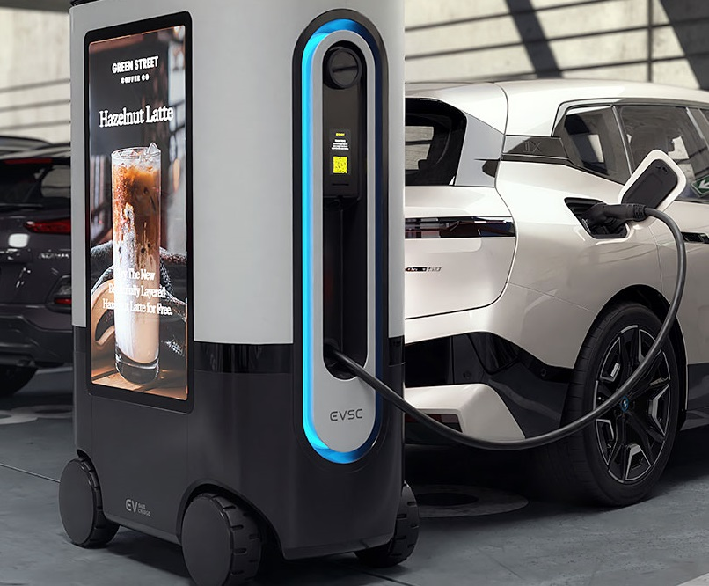

Introduction
To design and develop a mobile robotic system that reserves parking, verifies vehicle identity through ANPR, and simulates EV charging using a connected mobile application.
Notes:
Electric vehicle ownership is growing rapidly, but charging infrastructure hasn’t kept up. In cities, finding a charger in shared parking areas can be frustrating, with limited availability and long waiting times. Fixed charging stations are expensive and not scalable everywhere. That’s where OCP Charge comes in — a mobile robot that automates the charging experience.
The project focuses on building a robotic prototype capable of booking, verifying, and simulating EV charging autonomously. It includes both hardware and software components — a mobile robot, camera, tablet interface, ANPR verification, and a booking app — all connected through Firebase for real-time data sharing. The system is designed for parking lots, offices, or smart city environments. The motivation came from observing the gap between EV demand and flexible charging options. Inspired by ZiGGY, a commercial mobile charger in the US, I wanted to explore how such technology could be replicated affordably in an academic context. The aim was to design a robotic system that autonomously reserves, verifies, and simulates EV charging. Key objectives included developing the booking app, integrating ANPR, building the robot base, and ensuring smooth data flow between all modules.

Slide 4
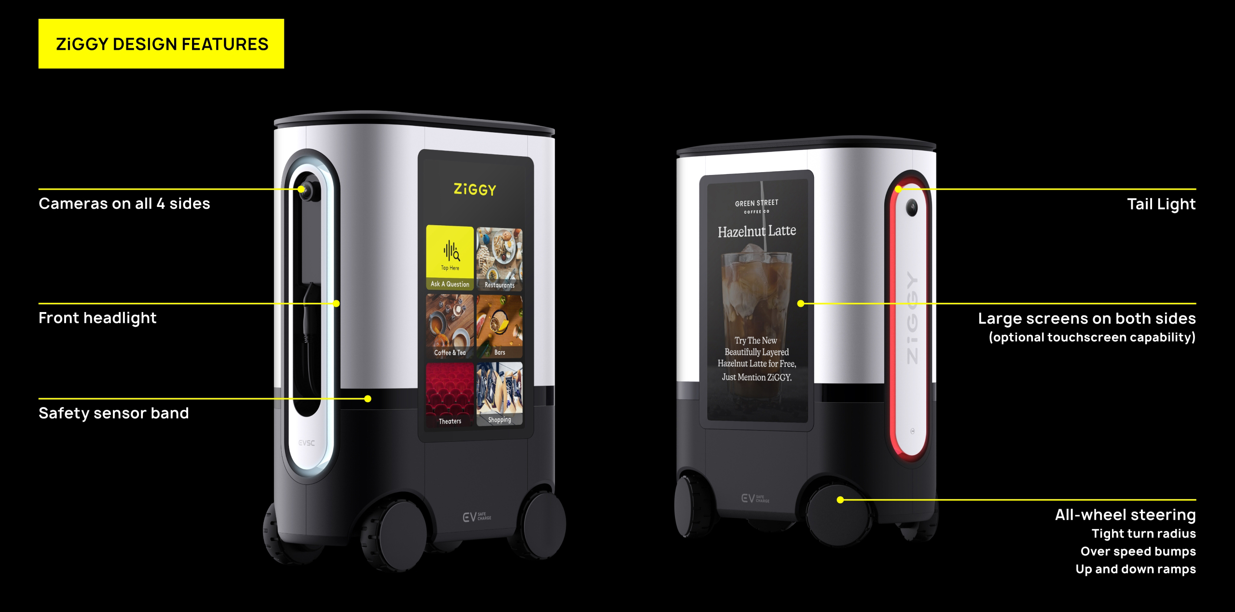
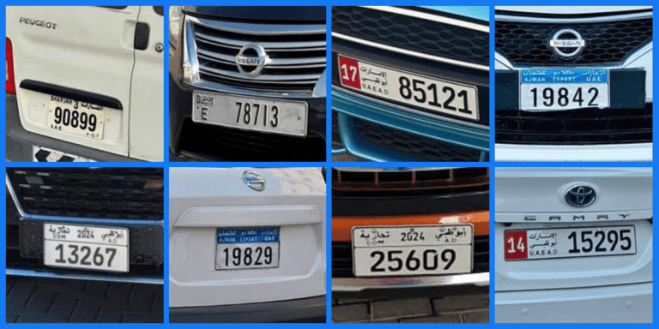
Background Research
Notes:
My background research covered three main areas: First, smart parking systems, where IoT-based slot booking improves parking efficiency. Second, mobile robotics in structured environments, focusing on path control and sensor integration. Third, ANPR systems, which are widely used in tolls and access control for automatic vehicle verification. I also studied ZiGGY as an industry benchmark and adopted Firebase as a lightweight IoT bridge for real-time data.

Slide 5
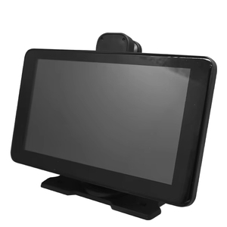
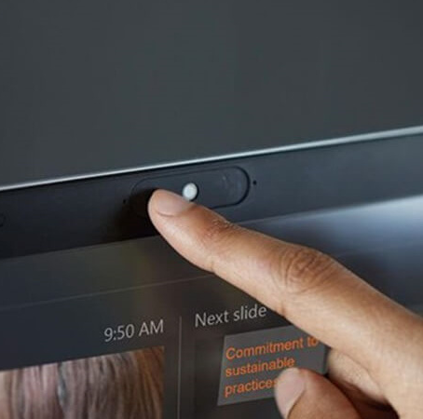
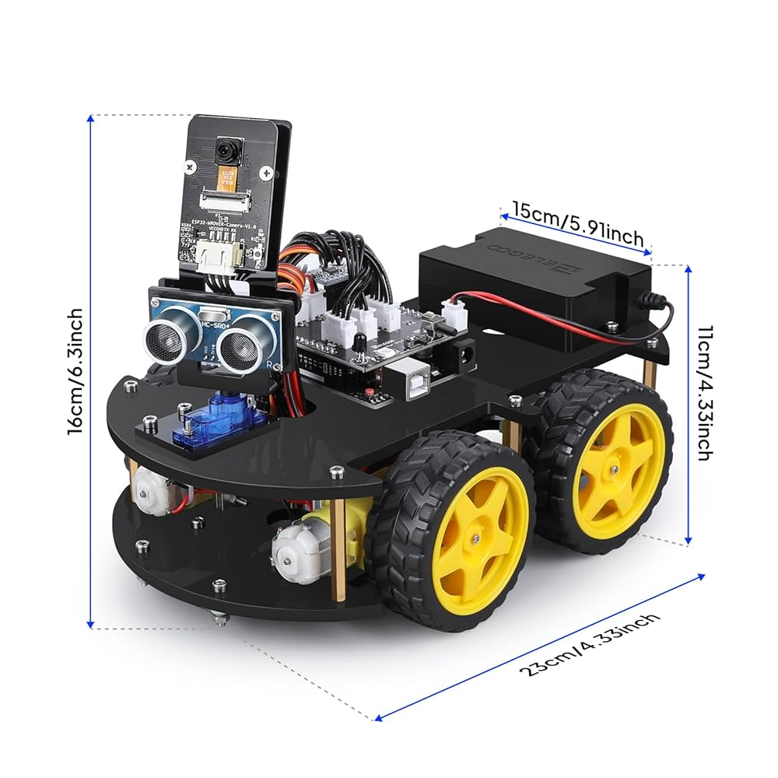
Methodology - Hardware Components
Notes:
The system was built using both hardware and software layers. On the hardware side, I used the Elegoo Smart Car V4.1, Arduino Uno, motor driver, tablet, and camera. On the software side, I developed two Flutter apps — one for the user and one for the robot tablet — both synced through Firebase. ANPR was implemented in Python using OpenCV and Tesseract OCR for license plate recognition.

Slide 6




METHODOLOGY – software components

Slide 7
Methodology - Functional and Non-Functional Requirements
Functional | Non-Functional
Allow EV users to book a charging robot via mobile app | System should respond to user input in under 2 seconds
Store and retrieve booking details in real-time using Firebase | ANPR accuracy should be above 85% under good lighting
Control robot movement based on booking status and timer | Robot movement should be stable and obstacle-aware (basic level)
Detect and capture the number plate using a camera | UI should be user-friendly, minimal, and touch-optimized
Recognize and extract plate text using ANPR (OCR) | Data communication should be secure and real-time
Match plate to booking and decide access (grant or deny) | System must be modular
Display visual status and countdown on robot-side tablet | Power supply should support at least 30 minutes of operation
Notes:
Functionally, the system had to handle bookings, control robot movement, perform plate recognition, and decide access. Non-functionally, it had to be fast, stable, and easy to use. I aimed for under 2-second response time, at least 85% ANPR accuracy, and modularity for future upgrades.

Slide 8
Implementation
Stage 1
Hardware Assembly
Stage 2
App Development
(User)
Stage 3
App Development
(Robot)
Stage 4
Robot Car logic with Arduino
Stage 5
ANPR
Stage 6
Integration, Testing & Sync
Notes:
Implementation took place in six stages:
Hardware assembly of the robot.
Flutter app development for bookings.
Tablet interface integration.
Arduino-based motor control.
ANPR setup using OpenCV and Tesseract.
Final system testing with Firebase integration. The system worked end-to-end — user books through the app, robot receives booking, verifies via camera, and simulates charging with a countdown timer on the tablet.

Slide 9
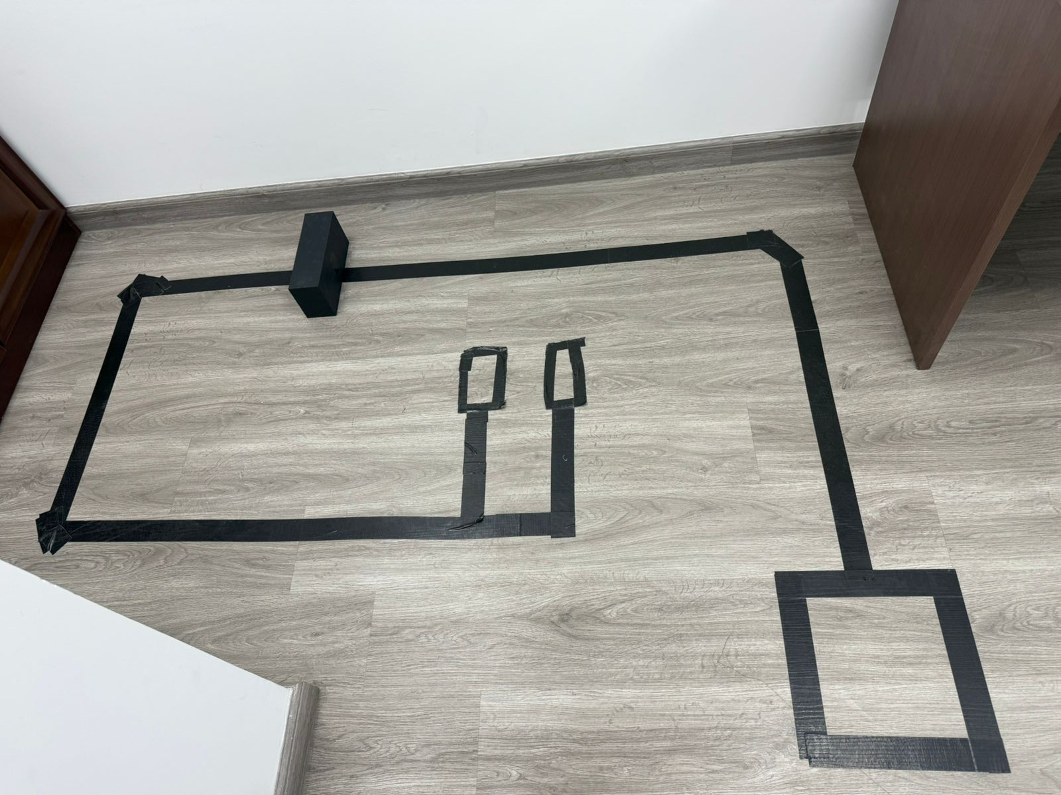

The Setup
Parking Spots
Obstacle (Car Reversing)
Robot Base
Car

Slide 10

Demonstration
https://youtu.be/wWhxiFTpe3s
Notes:
Here’s a short demonstration of the system in action: A user makes a booking on the app → data goes to Firebase → the robot displays it on the tablet → once the car arrives, ANPR verifies the plate → the robot displays “Access Granted” and starts the simulated charging sequence. This shows the full cycle of booking, verification, and service execution. Testing covered each module individually and as a full system. Firebase synchronization worked within 1–2 seconds. Robot control and timers were accurate to within 3 seconds. ANPR performed well in good lighting with around 88% accuracy but dropped in poor conditions. I also tested multiple booking inputs and ensured error handling for mismatched plates.
The project achieved its main goals: automation, real-time data flow, and vehicle verification. It worked reliably in a controlled setup with correct bookings. Challenges included lighting conditions, plate angle variation, and limited battery time. Still, the results proved the system’s feasibility and potential for smart parking applications.

Slide 11
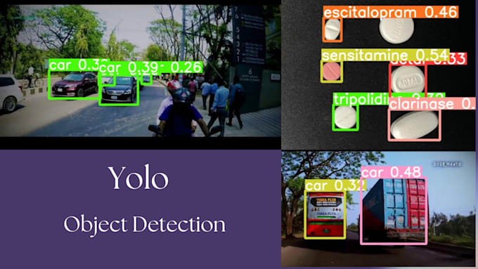
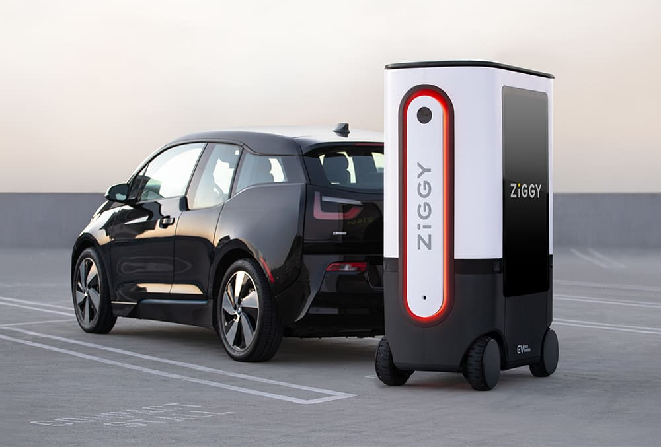
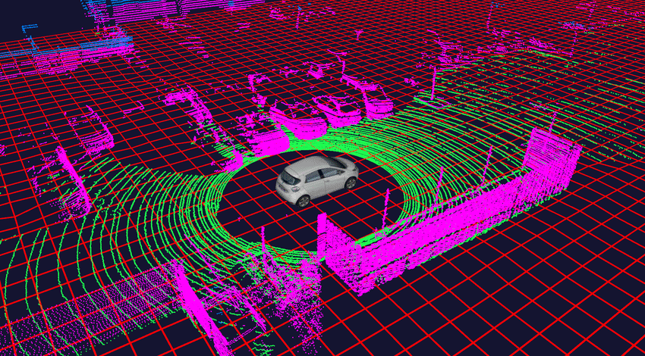
Future
Notes:
In the future, I plan to integrate full obstacle avoidance for autonomous navigation, use deep learning for better ANPR accuracy, and add payment gateways for real-world usage. Further possibilities include multi-robot coordination and solar charging. The ultimate goal is to evolve OCP Charge into a scalable, deployable smart city solution. To summarize, OCP Charge demonstrates how robotics, computer vision, and IoT can combine to automate EV charging in a realistic, efficient way. It meets the objectives of being modular, affordable, and testable, while setting a strong foundation for future innovation in smart parking infrastructure.

Slide 12
References
[1] R. of World. (2025, May) How uae is shifting gears to leadmiddle east’s ev revolution. Accessed: 22-Sep-2025. [Online]. Available:https://restofworld.org/2025/uae-middle-east-ev-leader
[2] International Energy Agency. (2024) Global ev outlook 2024: Trendsin electric cars. Accessed: 22-Sep-2025. [Online]. Available: https://www.iea.org/reports/global-ev-outlook-2024/trends-in-electric-cars8
[3] R. M. Bridi, F. Almannaei, and N. A. Abed, “The propensity to adoptelectric vehicles in the united arab emirates: An analysis of economicand geographic factors,” Sustainability, vol. 16, no. 2, p. 770, 2024.
[4] M. Asna, A. A. A. Eladl, and M. E. Salem, “Analysis of an optimalplanning model for electric vehicle fast-charging stations in al ain city,united arab emirates,” in 2021 International Conference on Smart EnergySystems and Applications (ICSESA). IEEE, 2021, pp. 158–163.
[5] A. Sarda, S. Mishra, and A. Khare, “A review of the electric vehiclecharging technology, impact and future trends,” Energy Reports, vol. 10,pp. 1963–1979, 2024.
[6] EV SafeCharge. (2022) Ziggy: The first mobile ev charging robot.Accessed: 22-Sep-2025. [Online]. Available: https://www.evsafecharge.com/ziggy
[7] Z. Kir´aly, B. Tak´acs, and T. Kov´acs, “The implementation of the mechan-ical system for automatic, robot-controlled ev charging system,” WorldElectric Vehicle Journal, vol. 16, no. 8, p. 453, 2025.
[8] G. R. Santos, J. M. R. Ferreira, and P. A. C. Rocha, “Exploring electricvehicle robot charging stations,” Energy Research & Social Science, vol.113, p. 103463, 2025.
[9] Y. Xue, T. H. Nguyen, and H. Lin, “A review of robotic charging forelectric vehicles,” Renewable and Sustainable Energy Reviews, vol. 184,p. 113591, 2025.
Notes:
Finally, I’d like to acknowledge all the research sources, libraries, and tools that supported this project — including IEEE papers on smart parking, EV Safe Charge’s ZiGGY, and open-source technologies like OpenCV, Tesseract, Flutter, and Firebase.

