Slide 1
Context
Chapter 9 introduced the model of aggregate demand and supply.
Chapter 10 developed the IS-LM model, the basis of the aggregate demand curve.
In Chapter 11, we will use the IS-LM model to
  see how policies and shocks affect income and the interest rate in the short run when prices are fixed
  derive the aggregate demand curve
  explore various explanations for the
  Great Depression

Slide 2
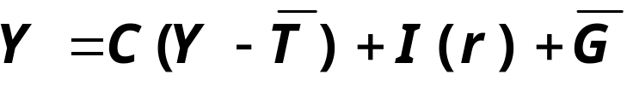
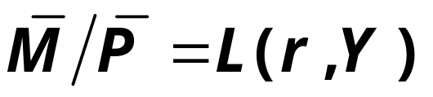
Equilibrium in the IS-LM Model
The IS curve represents equilibrium in the goods market.
r
LM
The LM curve represents money market equilibrium.
r₁
IS
Y
Y₁
The intersection determines
the unique combination of Y and r
that satisfies equilibrium in both markets.

Slide 3
Policy analysis with the IS-LM Model
r
LM
Policymakers can affect macroeconomic variables with
  fiscal policy: G and/or T
  monetary policy: M
We can use the IS-LM model to analyze the effects of these policies.
r₁
IS
Y
Y₁

Slide 4
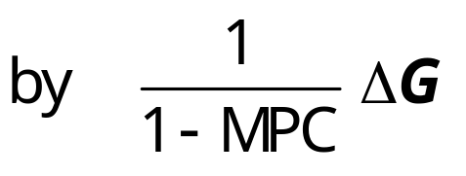
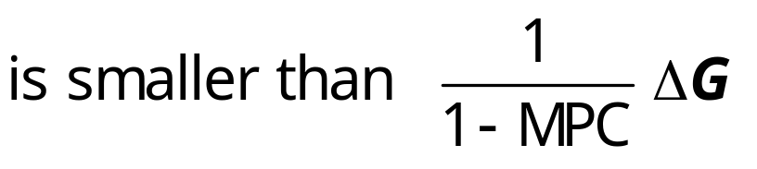
An increase in government purchases
1. IS curve shifts right
r
causing output & income to rise.
LM
r₂
2.
r₁
2. This raises money demand, causing the interest rate to rise…
1.
IS₂
IS₁
Y
3. …which reduces investment, so the final increase in Y
Y₁
Y₂
3.
Notes:
Chapter 10 showed that an increase in G causes the IS curve to shift to the right by (ΔG)/(1-MPC).

Slide 5
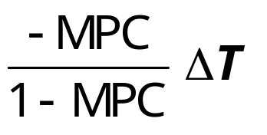
A tax cut
Because consumers save (1−MPC) of the tax cut, the initial boost in spending is smaller for ΔT than for an equal ΔG…
and the IS curve
shifts by
r
LM
r₂
2.
r₁
1.
IS₂
1.
IS₁
Y
Y₁
Y₂
2.
…so the effects on r and Y are smaller for a ΔT than for an equal ΔG.
2.
Notes:
Chapter 10 used the Keynesian Cross to show that a decrease in T causes the IS curve to shift to the right by (-MPC×ΔT)/(1-MPC).
If your students ask why the IS curve shifts to the right when there’s a negative sign in the expression for the shift, remind them that ΔT < 0 for a tax cut, so the expression actually is positive.
The term showing the distance of the shift in the IS curve is almost the same as in the case of a government spending increase, where the numerator of the fraction equals (1) for government spending rather than (-MPC) for the tax cut. Here’s the intuition: Every dollar of a government spending increase adds to aggregate spending. However, for tax cuts, the fraction (1-MPC) of the tax cut leaks into saving, so aggregate spending only rises by MPC times the tax cut.

Slide 6
Monetary Policy: an increase in M
r
1. ΔM > 0 shifts
the LM curve down
(or to the right)
LM₁
LM₂
r₁
2. …causing the interest rate to fall
r₂
3. …which increases investment, causing output & income to rise.
IS
Y
Y₁
Y₂
Notes:
Chapter 10 showed that an increase in M shifts the LM curve to the right.
Here is a richer explanation than what appears on this slide:
The increase in M causes the interest rate to fall. [People like to keep optimal proportions of money and bonds in their portfolios; if money is increased, then people try to re-attain their optimal proportions by “exchanging” some of the money for bonds: they use some of the extra money to buy bonds. This increase in the demand for bonds drives up the price of bonds -- and causes interest rates to fall (since interest rates are inversely related to bond prices).
The fall in the interest rate induces an increase in investment demand, which causes output and income to increase.
The increase in income causes money demand to increase, which increases the interest rate (though doesn’t increase it all the way back to its initial value; instead, this effect simply reduces the total decrease in the interest rate).

Slide 7
Interaction between monetary & fiscal policy
Model:
monetary & fiscal policy variables
(M, G and T ) are exogenous
Real world:
Monetary policymakers may adjust M
in response to changes in fiscal policy,
or vice versa.
Such interaction may alter the impact of the original policy change.

Slide 8
The Fed’s response to ΔG > 0
Suppose Congress increases G.
Possible Fed responses:
  1. hold M constant
  2. hold r constant
  3. hold Y constant
In each case, the effects of the ΔG
are different:

Slide 9

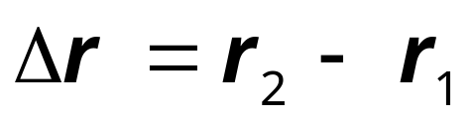
Response 1: hold M constant
If Congress raises G,
the IS curve shifts right
r
LM₁
If Fed holds M constant, then LM curve doesn’t shift.
Results:
r₂
r₁
IS₂
IS₁
Y
Y₁
Y₂

Slide 10
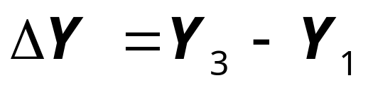
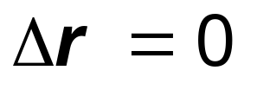
Response 2: hold r constant
If Congress raises G,
the IS curve shifts right
r
LM₁
LM₂
To keep r constant, Fed increases M to shift LM curve right.
r₂
r₁
IS₂
Results:
IS₁
Y
Y₁
Y₂
Y₃

Slide 11
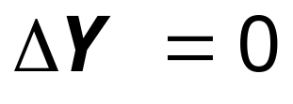
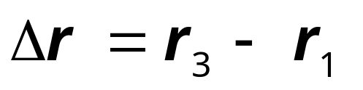
Response 3: hold Y constant
If Congress raises G,
the IS curve shifts right
r
LM₂
LM₁
r₃
To keep Y constant, Fed reduces M to shift LM curve left.
r₂
r₁
IS₂
Results:
IS₁
Y
Y₁
Y₂

Slide 12
Estimates of fiscal policy multipliers
from the DRI macroeconometric model
Estimated value of
ΔY / ΔG
Estimated value of
ΔY / ΔT
Assumption about monetary policy
Fed holds money supply constant
0.60
−0.26
Fed holds nominal interest rate constant
1.93
−1.19
Notes:
The preceding slides show that the impact of fiscal policy on GDP depends on the Fed’s response (or lack thereof). This slide shows estimates of the fiscal policy multipliers under different assumptions about monetary policy; these estimates are consistent with the theoretical results on the preceding slides.
First, the slide shows estimates of the government spending multiplier for the two different monetary policy scenarios. Then, the slide reveals the tax multiplier estimates. (If you wish, you can turn off the animation so that everything appearing on the slide appears at one time. Just click on the “Slide Show” pull-down menu, then on “Custom animation…”, then uncheck all of the boxes next to the elements of the screen that you do not wish to be animated.
Regarding the estimates: First, note that the estimates of the fiscal policy multipliers are smaller (in absolute value) when the money supply is held constant than when the interest rate is held constant. This is consistent with the results from the IS-LM model presented in the preceding few slides.
Second, notice that the tax multiplier is smaller than the government spending multiplier in each of the monetary policy scenarios. This should make sense from material presented earlier in this chapter: the government spending multiplier (for a constant money supply) is 1/(1-MPC), while the tax multiplier is only (-MPC)/(1-MPC).

Slide 13
Shocks in the IS-LM Model
IS shocks: exogenous changes in the demand for goods & services.
Examples:
  stock market boom or crash
  ⇒ change in households’ wealth
  ⇒ ΔC
  change in business or consumer
  confidence or expectations
  ⇒ ΔI and/or ΔC

Slide 14
Shocks in the IS-LM Model
LM shocks: exogenous changes in the demand for money.
Examples:
  a wave of credit card fraud increases demand for money
  more ATMs or the Internet reduce money demand

Slide 15
EXERCISE:
Analyze shocks with the IS-LM model
Use the IS-LM model to analyze the effects of
  A boom in the stock market makes consumers wealthier.
  After a wave of credit card fraud, consumers use cash more frequently in transactions.
For each shock,
  use the IS-LM diagram to show the effects of the shock on Y and r .
  determine what happens to C, I, and the unemployment rate.
Notes:
Earlier slides showed how to use the IS-LM model to analyze fiscal and monetary policy. Now is a good time for students to get some hands-on practice with the model. Also, note that part (b) helps students learn that shocks and policies can potentially affect all of the model’s endogenous variables, not just the ones that are measured on the axes.
After working this exercise, your students will better understand the following case study on the 2001 U.S. economic slowdown that immediately follows.
Suggestion: Instead of having students work on these exercises individually, get them into pairs. One student of each pair works on the first shock, the other student works on the second shock. Give them 5 minutes to work individually on the analysis of the shock. Then, allow 10 minutes (5 for each student) for students to present their results to their partners. This activity gives students immediate application and reinforcement of the concepts, so students learn them better and will then better understand and appreciate the remainder of your lecture on Chapter 11.
Answers:
1a. The IS curve shifts to the right, because consumers feel they can afford to spend more given this exogenous increase in their wealth. This causes Y and r to rise.
1b. C rises for two reasons: the stock market boom, and the increase in income. I falls, because r is higher. u falls, because firms hire more workers to produce the extra output that is demanded.
2a. (This is a continuation of the in-class exercise at the end of the PowerPoint presentation of Chapter 10.) The increase in money demand shifts the LM curve to the left: We are assuming that all other exogenous variables, including M and P, remain unchanged, so an increase in money demand causes an increase in the value of r associated with each value of Y (this can be seen easily using the Liquidity Preference diagram). This translates to an upward (i.e. leftward) shift in the LM curve. This shift causes Y to fall and r to rise.
2b. The fall in income causes a fall in C. The increase in r causes a fall in I. The fall in Y causes an increase in u.

Slide 16
CASE STUDY
The U.S. economic slowdown of 2001
~What happened~
1. Real GDP growth rate
  1994-2000: 3.9% (average annual)
  2001: 1.2%
2. Unemployment rate
  Dec 2000: 4.0%
  Dec 2001: 5.8%

Slide 17
CASE STUDY
The U.S. economic slowdown of 2001
~Shocks that contributed to the slowdown~
1. Falling stock prices
  From Aug 2000 to Aug 2001: -25%
  Week after 9/11: -12%
2. The terrorist attacks on 9/11
  increased uncertainty
  fall in consumer & business confidence
Both shocks reduced spending and
shifted the IS curve left.

Slide 18
CASE STUDY
The U.S. economic slowdown of 2001
~The policy response~
1. Fiscal policy
  large long-term tax cut,
  immediate $300 rebate checks
  spending increases:
  aid to New York City & the airline industry,
  war on terrorism
2. Monetary policy
  Fed lowered its Fed Funds rate target
  11 times during 2001, from 6.5% to 1.75%
  Money growth increased, interest rates fell

Slide 19
CASE STUDY
The U.S. economic slowdown of 2001
~What’s happening now~
In the first quarter of 2002, Real GDP grew at an annual rate of 6.1%, according to final figures released by the Bureau of Economic Analysis on June 27, 2002.
However, in its news release of June 7, 2002, the NBER Business Cycle Dating Committee had not yet determined the date of the trough in economic activity, though it acknowledges that the economy seems to be picking up.

Slide 20
What is the Fed’s policy instrument?
What the newspaper says:
“the Fed lowered interest rates by one-half point today”
What actually happened:
The Fed conducted expansionary monetary policy to shift the LM curve to the right until the interest rate fell 0.5 points.
The Fed targets the Federal Funds rate:
it announces a target value,
and uses monetary policy to shift the LM curve
as needed to attain its target rate.
Notes:
In case your students aren’t familiar with the Fed Funds rate, you might briefly explain that it’s the rate banks charge each other on overnight loans. Since most short-term interest rates move closely together, the changes in the Fed Funds rate caused by monetary policy end up causing similar changes in most other short-term rates. Long term rates may well also move in the same direction, but they are also affected by other factors beyond the scope of this chapter. Chapter 18 discusses monetary policy in detail.

Slide 21
What is the Fed’s policy instrument?
Why does the Fed target interest rates
instead of the money supply?
  1) They are easier to measure than the money supply
  2) The Fed might believe that LM shocks are more prevalent than IS shocks. If so, then targeting the interest rate stabilizes income better than targeting the money supply.
  (See Problem 7 on p.306)

Slide 22
IS-LM and Aggregate Demand
So far, we’ve been using the IS-LM model to analyze the short run, when the price level is assumed fixed.
However, a change in P would shift the LM curve and therefore affect Y.
The aggregate demand curve
(introduced in chap. 9 ) captures this
relationship between P and Y

Slide 23
Deriving the AD curve
r
LM(P₂)
Intuition for slope
of AD curve:
↑P ⇒ ↓(M/P )
⇒ LM shifts left
⇒ ↑r
⇒ ↓I
⇒ ↓Y
LM(P₁)
r₂
r₁
IS
Y₂
Y₁
Y
P
P₂
P₁
AD
Y₂
Y₁
Y
Notes:
It might be useful to explain to students the reason why we draw P₁ before drawing the LM curve:
The position of the LM curve depends on the value of M/P. M is an exogenous policy variable. So, if P is low (like P₁ in the lower panel of the diagram), then M/P is relatively high, so the LM curve is over toward the right in the upper diagram. If P is high, like P₂, then M/P is relatively low, so the LM curve is more toward the left.
Because the value of P affects the position of the LM curve, we label the LM curves in the upper panel as LM(P₁) and LM(P₂).

Slide 24
Monetary policy and the AD curve
r
LM(M₁/P₁)
The Fed can increase aggregate demand:
↑M ⇒ LM shifts right
r₁
LM(M₂/P₁)
r₂
⇒ ↓r
IS
Y₁
Y₂
Y
⇒ ↑I
⇒ ↑Y at each value of P
P
P₁
AD₂
AD₁
Y₁
Y₂
Y
Notes:
It’s worth taking a moment to explain why we are holding P fixed at P₁:
To find out whether the AD curve shifts to the left or right, we need to find out what happens to the value of Y associated with any given value of P. This is not to say that the equilibrium value of P will remain fixed after the policy change (though, in fact, we are assuming P is fixed in the short run). We just want to see what happens to the AD curve.
Once we know how the AD curve shifts, we can then add the AS curves (short- or long-run) to find out what, if anything, happens to P (in the short- or long-run).

Slide 25
Fiscal policy and the AD curve
r
LM
Expansionary fiscal policy (↑G and/or ↓T ) increases agg. demand:
↓T ⇒ ↑C
⇒ IS shifts right
⇒ ↑Y at each value of P
r₂
r₁
IS₂
IS₁
Y₁
Y₂
Y
P
P₁
AD₂
AD₁
Y₁
Y₂
Y

Slide 26
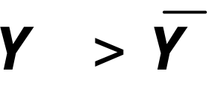
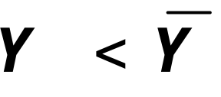
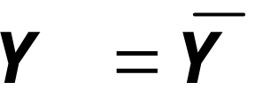
IS-LM and AD-AS in the short run & long run
Recall from Chapter 9: The force that moves the economy from the short run to the long run
is the gradual adjustment of prices.
In the short-run equilibrium, if
then over time, the price level will
rise
fall
remain constant
Notes:
The next few slides put our IS-LM-AD in the context of the bigger picture - the AD-AS model in the short-run and long-run, which was introduced in Chapter 9.

Slide 27

The SR and LR effects of an IS shock
r
LRAS
LM(P₁)
IS₁
A negative IS shock shifts IS and AD left, causing Y to fall.
IS₂
Y
P
LRAS
P₁
SRAS₁
AD₁
AD₂
Y
Notes:
Abbreviation:
SR = short run, LR = long run

Slide 28
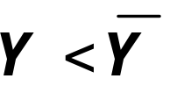
The SR and LR effects of an IS shock
r
LRAS
LM(P₁)
In the new short-run equilibrium,
IS₁
IS₂
Y
P
LRAS
P₁
SRAS₁
AD₁
AD₂
Y

Slide 29
The SR and LR effects of an IS shock
r
LRAS
LM(P₁)
In the new short-run equilibrium,
IS₁
IS₂
Over time,
P gradually falls, which causes
  SRAS to move down
  M/P to increase, which causes LM
  to move down
Y
P
LRAS
P₁
SRAS₁
AD₁
AD₂
Y

Slide 30
The SR and LR effects of an IS shock
r
LRAS
LM(P₁)
LM(P₂)
IS₁
IS₂
Over time,
P gradually falls, which causes
  SRAS to move down
  M/P to increase, which causes LM
  to move down
Y
P
LRAS
P₁
SRAS₁
P₂
SRAS₂
AD₁
AD₂
Y

Slide 31
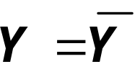
The SR and LR effects of an IS shock
r
LRAS
LM(P₁)
LM(P₂)
This process continues until economy reaches a long-run equilibrium with
IS₁
IS₂
Y
P
LRAS
P₁
SRAS₁
P₂
SRAS₂
AD₁
AD₂
Y
Notes:
A good thing to do: Go back through this experiment again, and see if your students can figure out what is happening to the other endogenous variables (C, I, u) in the short run and long run.

Slide 32
EXERCISE:
Analyze SR & LR effects of ΔM
Draw the IS-LM and AD-AS diagrams as shown here.
Suppose Fed increases M. Show the short-run effects on your graphs.
Show what happens in the transition from the short run to the long run.
How do the new long-run equilibrium values of the endogenous variables compare to their initial values?
r
LRAS
LM(M₁/P₁)
IS
Y
P
LRAS
P₁
SRAS₁
AD₁
Y
Notes:
This exercise has two objectives:
1. To give students immediate reinforcement of the preceding concepts.
2. To show them that money is neutral in the long run, just like in chapter 4.
You might have your students try other exercises using this framework:
* the short-run and long-run effects of expansionary fiscal policy. Have them compare the long-run results in this framework with the results they obtained when doing the same experiment in Chapter 3 (the loanable funds model).
* Immediately after a negative shock pushes output below its natural rate, show how monetary or fiscal policy can be used to restore full-employment immediately (i.e., without waiting for prices to adjust).

Slide 33
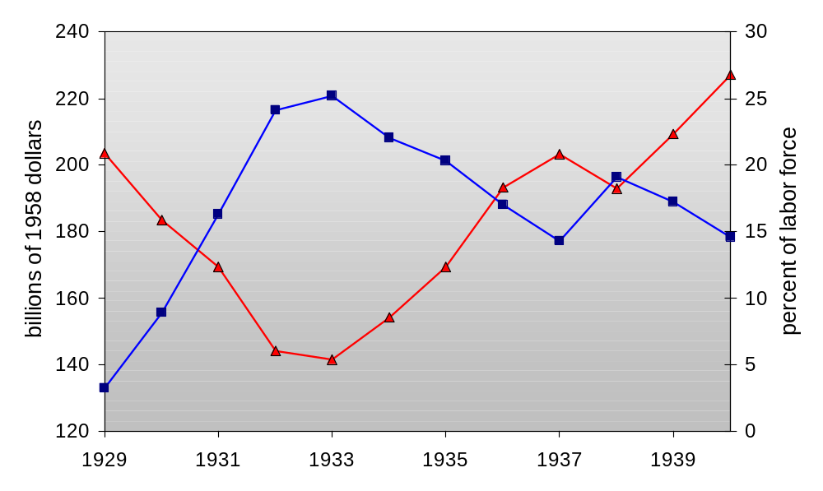
The Great Depression
Unemployment (right scale)
Real GNP
(left scale)
Notes:
This chart presents data from Table 11-2 on p.296 of the text. For data sources, see notes accompanying that table.
Note the very strong negative correlation between output and unemployment.

Slide 34
The Spending Hypothesis:
Shocks to the IS Curve
asserts that the Depression was largely due to an exogenous fall in the demand for goods & services -- a leftward shift of the IS curve
evidence:
output and interest rates both fell, which is what a leftward IS shift would cause

Slide 35
The Spending Hypothesis:
Reasons for the IS shift
Stock market crash ⇒ exogenous ↓C
  Oct-Dec 1929: S&P 500 fell 17%
  Oct 1929-Dec 1933: S&P 500 fell 71%
Drop in investment
  “correction” after overbuilding in the 1920s
  widespread bank failures made it harder to obtain financing for investment
Contractionary fiscal policy
  in the face of falling tax revenues and increasing deficits, politicians raised tax rates and cut spending
Notes:
In item 2, I’m using the term “correction” in the stock market sense.

Slide 36
The Money Hypothesis:
A Shock to the LM Curve
asserts that the Depression was largely due to huge fall in the money supply
evidence:
M1 fell 25% during 1929-33.
But, two problems with this hypothesis:
  P fell even more, so M/P actually rose slightly during 1929-31.
  nominal interest rates fell, which is the opposite of what would result from a leftward LM shift.

Slide 37
The Money Hypothesis Again:
The Effects of Falling Prices
asserts that the severity of the Depression was due to a huge deflation:
P fell 25% during 1929-33.
This deflation was probably caused by
the fall in M, so perhaps money played
an important role after all.
In what ways does a deflation affect the economy?

Slide 38
The Money Hypothesis Again:
The Effects of Falling Prices
The stabilizing effects of deflation:
↓P ⇒ ↑(M/P ) ⇒ LM shifts right ⇒ ↑Y
Pigou effect:
  ↓P ⇒ ↑(M/P )
  ⇒ consumers’ wealth ↑
  ⇒ ↑C
  ⇒ IS shifts right
  ⇒ ↑Y

Slide 39
The Money Hypothesis Again:
The Effects of Falling Prices
The destabilizing effects of unexpected deflation:
debt-deflation theory
↓P (if unexpected)
  ⇒ transfers purchasing power from borrowers to lenders
  ⇒ borrowers spend less,
  lenders spend more
  ⇒ if borrowers’ propensity to spend is larger than lenders, then aggregate spending falls, the IS curve shifts left, and Y falls

Slide 40
The Money Hypothesis Again:
The Effects of Falling Prices
The destabilizing effects of expected deflation:
↓π^{e}
  ⇒ r ↑ for each value of i
  ⇒ I ↓ because I = I (r )
  ⇒ planned expenditure & agg. demand ↓
  ⇒ income & output ↓
Notes:
The textbook (from the bottom of p.299 through p.300) uses an “extended”
IS-LM model, which includes both the nominal interest rate (measured on the vertical axis) and the real interest rate (which equals the nominal rate less expected inflation). Because money demand depends on the nominal rate, which is measured on the vertical axis, the change in expected inflation doesn’t shift the LM curve. However, investment depends on the real interest rate, so the fall in expected inflation shifts the IS curve: each value of i is now associated with a higher value of r, which reduces investment and shifts the IS curve to the left. Results: income falls, i falls, and r rises --- which is exactly what happened from 1929 to 1931 (see table 11-2 on pp.296-7).
This slide gives the basic intuition, which students often can grasp more quickly and easily than the graphical analysis. After you cover this material in your lecture, it will be easier for your students to grasp the analysis on pp.299-300.

Slide 41
Why another Depression is unlikely
Policymakers (or their advisors) now know
much more about macroeconomics:
  The Fed knows better than to let M fall
  so much, especially during a contraction.
  Fiscal policymakers know better than to raise taxes or cut spending during a contraction.
Federal deposit insurance makes widespread bank failures very unlikely.
Automatic stabilizers make fiscal policy expansionary during an economic downturn.
Notes:
Examples of automatic stabilizers:
the income tax: people pay less taxes automatically if their income falls
unemployment insurance: prevents income - and hence spending - from falling as much during a downturn
This is discussed in Chapter 14.

Slide 42
Chapter summary
1. IS-LM model
  a theory of aggregate demand
  exogenous: M, G, T,
  P exogenous in short run, Y in long run
  endogenous: r,
  Y endogenous in short run, P in long run
  IS curve: goods market equilibrium
  LM curve: money market equilibrium

Slide 43
Chapter summary
2. AD curve
  shows relation between P and the IS-LM model’s equilibrium Y.
  negative slope because
  ↑P ⇒ ↓(M/P ) ⇒ ↑r ⇒ ↓I ⇒ ↓Y
  expansionary fiscal policy shifts IS curve right, raises income, and shifts AD curve right
  expansionary monetary policy shifts LM curve right, raises income, and shifts AD curve right
  IS or LM shocks shift the AD curve

