Slide 1

A Comparative Analysis of Simulated Annealing Algorithm and Genetic Algorithm
By: 15006280
Notes:
Hello everyone, and welcome to this presentation and today, I’ll be walking you through the comparative analysis of two optimization techniques: Simulated Annealing (SA) and Genetic Algorithm (GA).
Our focus will be on understanding the strengths, weaknesses, and applicability of these algorithms through the lens of performance metrics such as solution quality, computational efficiency, robustness, and scalability.
Let's get started!

Slide 2

Introduction to the Problem
The Traveling Salesman Problem (TSP) is a classical optimization challenge :
1
2
3
Visit every city once and return to the start
Applications: logistics, routing, circuit design.
Complexity grows factorially with the number of cities
Notes:
The Traveling Salesman Problem (TSP) is a classic optimization challenge:
Finding the shortest route that visits every city exactly once and returns to the start.
It has applications in logistics, circuit design, and data clustering.
T.S.P's complexity grows factorially with the number of cities, making exhaustive calculations impractical for even 50 cities. This makes TSP a benchmark for heuristic and metaheuristic algorithms, which find good solutions without evaluating every possibility.
In this presentation, we’ll compare Simulated Annealing and Genetic Algorithm, two such approaches, to tackle the TSP effectively.

Slide 3
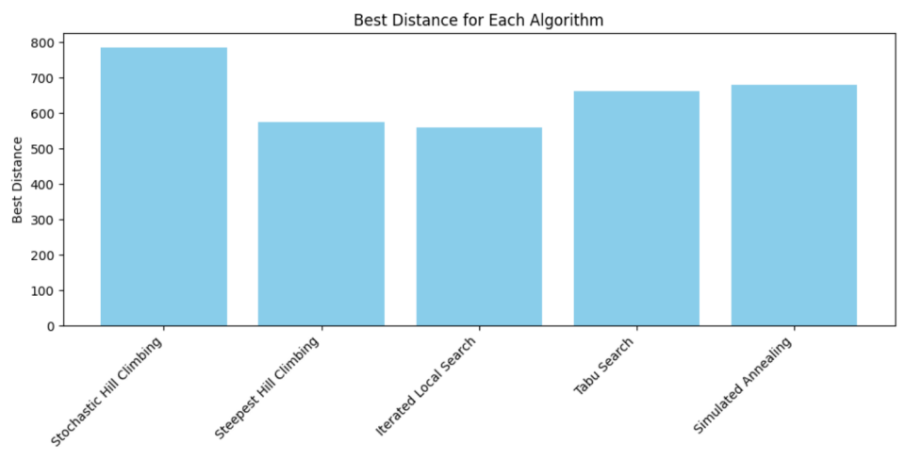
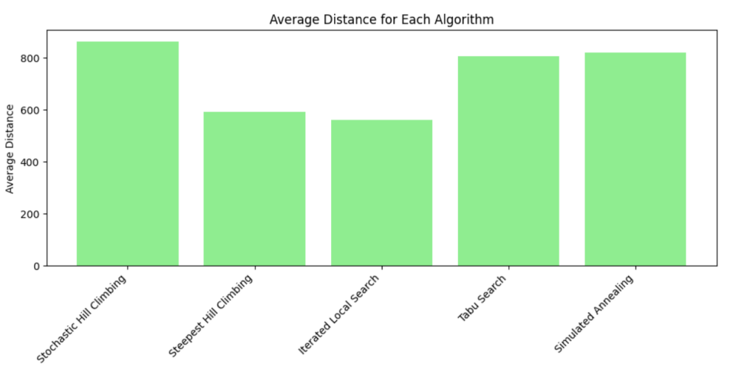
Why is Simulated Annealing the Preferred Single Search Algorithm?
Best Distance
Local Search: 560.40
Steepest Hill Climbing: 575.11
786.05
575.11
560.40
661.40
679.28
Average Distance
Local Search: 562.70
Steepest Hill Climbing: 592.10
863.42
592.10
806.66
891.94
562.70
Notes:
Exploration vs. Exploitation:
While Iterated Local Search and Steepest Hill Climbing performed better in terms of best and average distances, they are heavily biased towards exploitation. This makes them efficient for small to medium-sized problems but limits their ability to escape local optima in more complex landscapes. In contrast, Simulated Annealing balances exploration (probabilistic acceptance of worse solutions) and exploitation, unlike deterministic approaches like Steepest Hill Climbing.
2) Alignment with Genetic Algorithms: Both Simulated Annealing and Genetic Algorithms use probabilistic mechanisms to escape local optima (temperature in SA, mutation/crossover in GA). In contrast, Steepest Hill Climbing, Iterated Local Search, and Tabu Search lack these global exploration properties. Steepest Hill Climbing being purely deterministic, Iterated Local Search relying on structured restarts, and Tabu Search using memory-based mechanisms to avoid revisits. These approaches are less conceptually aligned with the evolutionary and probabilistic nature of Genetic Algorithms, making Simulated Annealing a more suitable choice for meaningful and fair comparison.

Slide 4
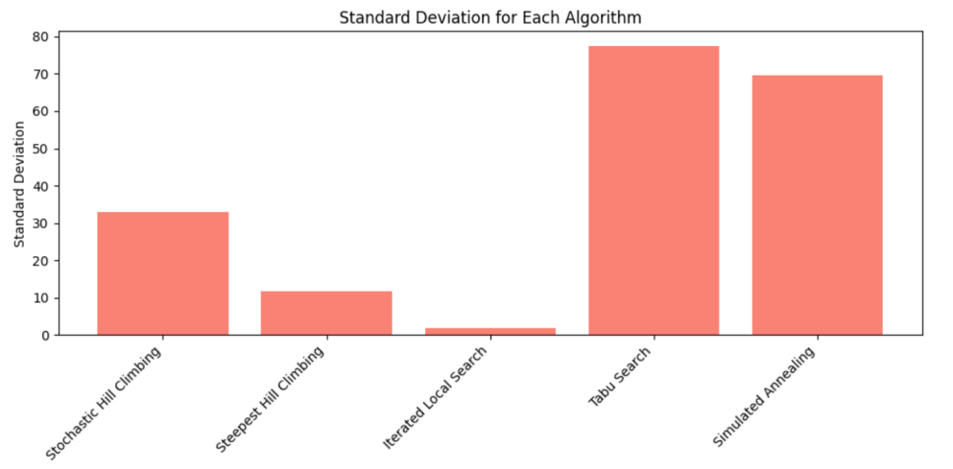
Why is Simulated Annealing the Preferred Single Search Algorithm?
33.03
69.70
11.80
77.51
1.79
Notes:
3) Robustness to Problem Variations:
In terms of robustness to problem variations, Iterated Local Search (ILS) demonstrates the best performance with the lowest best distance (559.86) and a very small standard deviation (1.78). However, its exploration is quite limited, as it primarily relies on repeated restarts to escape local optima, resulting in a narrow solution space.
On the other hand, Simulated Annealing (SA) shows higher variability, with a standard deviation of 69.71. This greater variability indicates that SA explores a wider solution space, making it more adaptable to larger and more complex instances of the Traveling Salesman Problem (TSP), even though this broader search comes at the cost of less consistency in the quality of the solutions.

Slide 5
Why is Simulated Annealing the Preferred Single Search Algorithm?
Simplicity and Practicality:
In contrast, Steepest Hill Climbing and Iterated Local Search lack these global exploration properties, making them less conceptually aligned with evolutionary algorithms. This alignment ensures that the comparison will be meaningful and fair.
Escaping Local Optima:
Compared to Steepest Hill Climbing, which is deterministic and often gets stuck in local optima, Simulated Annealing has a clear mechanism to escape these traps. Its probabilistic acceptance of worse solutions enables it to continue searching globally, even at the cost of higher variance in results.

Slide 6


Simulated Annealing (SA) vs Genetic Algorithm (GA)
Two heuristic methods were compared:
1
Simulated Annealing (SA):
2
Genetic Algorithm (GA)
A probabilistic single-solution
A population-based evolutionary algorithm.
Compare solution quality, efficiency, and robustness.
Notes:
This slide introduces the two heuristic methods used in this study: Simulated Annealing and Genetic Algorithm. Each represents a distinct approach to optimization, and we aim to compare their performance across key metrics by the.
Solution Quality: Measured by the best and average distances achieved by each algorithm.
Computational Efficiency: Analyzed through computation times.
Robustness: Evaluated based on consistency across multiple runs, represented by standard deviations.

Slide 7
Methodology: Data Preparation
Distance matrix
3
Generated a distance matrix as input for both algorithms.
Calculate distances
2
Euclidean distances calculated for all city pairs.
1
Dataset
City coordinates (50 cities).
Notes:
This slide outlines the data preparation process, which forms the foundation for the analysis of both Simulated Annealing and Genetic Algorithm
Dataset:
Used coordinates (x, y) of 50 cities as nodes for the T.S.P.
Calculate Distances: Computed pairwise Euclidean distances to represent shortest paths accurately.
Distance Matrix:
Organized distances into a matrix, serving as the primary input for both SA and GA and enables evaluation of solutions by summing route distances.
Consistent and precise data preparation ensured a fair benchmark, enabling a robust comparison of both algorithms' performance.

Slide 8
Algorithm Parameters
Simulated Annealing:
Genetic Algorithm
1
Initial temperature,
Cooling rate,
Stopping condition.
2
Population size,
Mutation rate,
Crossover rate, Generations.
Notes:
This slide highlights the key parameters used to configure the two algorithms: Simulated Annealing and Genetic Algorithm. Fine-tuning these parameters is critical for achieving optimal performance.
For SA, the key parameters include the initial temperature, cooling rate, and stopping condition.
For GA, the parameters are population size, mutation rate, crossover rate, and the number of generations.

Slide 9
Performance Metrics
Best Distance: Shortest route.
Average Distance: Reflects typical solution quality.
Computation Time: Efficiency of execution.
Robustness: Consistency of results across runs.
Notes:
As you can see from this slide which highlights the metrics used to evaluate Simulated Annealing and Genetic Algorithm
Best Distance: Measures the shortest route found, reflecting the ability to achieve optimal solutions.
Average Distance: Represents the typical solution quality across runs, indicating consistency.
Computation Time: Assesses execution time, critical for time-sensitive applications.
Robustness: Analyzes result consistency (via standard deviation), ensuring reliable outcomes.

Slide 10
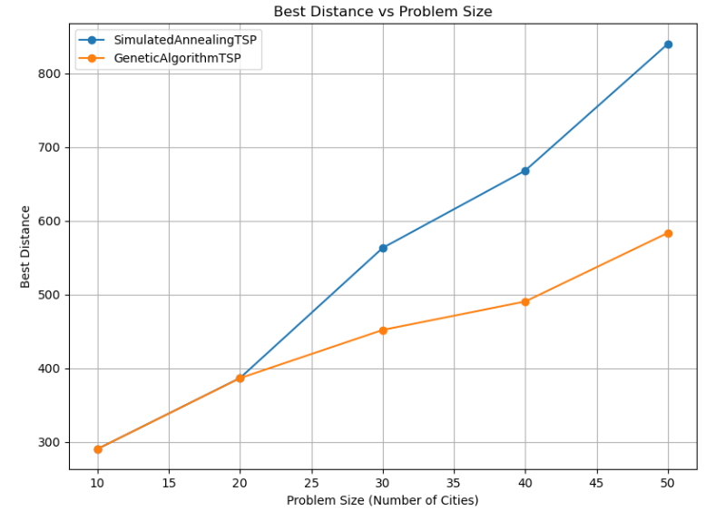
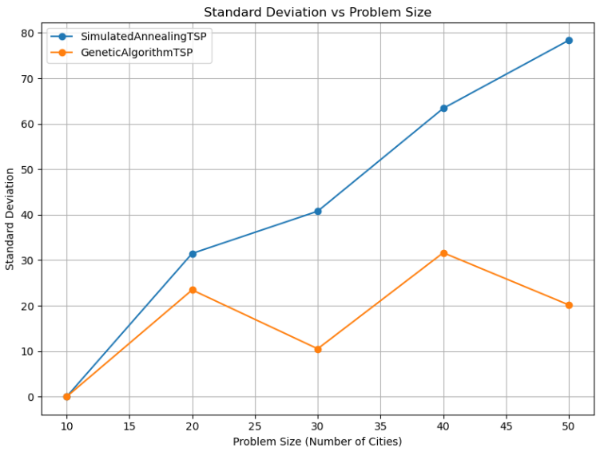
Results Summary
Notes:
Now, I am going to discuss the key results of the comparison between Simulated Annealing and Genetic Algorithm using the performance metrics we discussed earlier.
1) Best Distance:
As shown in the first graph, GA consistently found better routes compared to SA.
The gap in performance widened as the problem size increased, highlighting GA’s superior ability to explore and exploit the solution space effectively.
2) Robustness:
The second graph shows the standard deviation of results across multiple runs.
GA demonstrated much lower variability, indicating greater robustness and reliability in its performance.
SA, on the other hand, exhibited significant fluctuations, particularly for larger problem sizes.

Slide 11
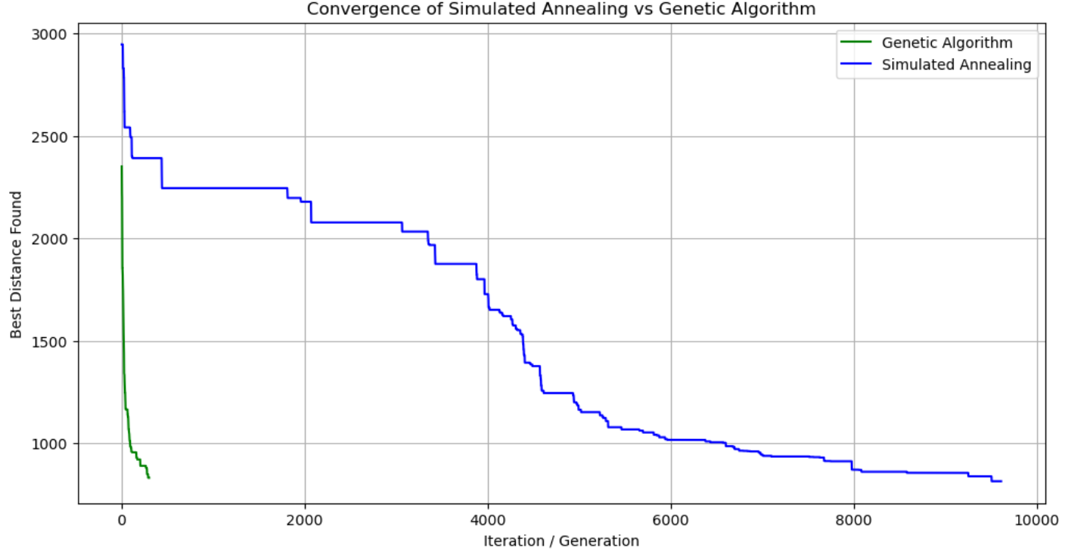
Results Summary
Genetic Algorithm scaled better with problem size.
Notes:
3) Scalability and Convergence:
The third graph compares the convergence behavior of both algorithms.
GA scaled better with increasing problem size and maintained a steady improvement in solution quality across generations.
SA converged more quickly, but this came at the cost of solution quality and robustness, particularly as the complexity increased.

Slide 12


Key Takeaways
The Genetic Algorithm (GA) is the preferred choice for large and complex problems due to its superior solution quality, robustness, and scalability.
Simulated Annealing (SA) is faster and may be better suited for smaller problems or scenarios where computational efficiency is critical.
Notes:
Genetic Algorithm consistently outperforms Simulated Annealing (SA) in finding shorter routes and demonstrates greater reliability across multiple runs. Its ability to handle complex problem sizes makes it the preferred option for tasks that demand high accuracy and consistent results.
While Simulated Annealing’s strength lies in its speed, particularly for smaller problem instances or when computational resources are limited. This makes SA an ideal choice for real-time applications or environments where quick decision-making is a priority.
These insights provide a clear understanding of the trade-offs between the two algorithms, which can guide the application in real-world scenarios.

