Slide 1

Applying Container Technology to the NOAA-GFDL MSD FRE Workflow
Ciheim Brown, Dana Singh, Thomas Robinson

Slide 2
Outline
NOAA-GFDL MSD
Post-processing
The problem
The solution
Container build and registry
Dockerfile
How it runs
Runscript
Challenges
Timeline + The Future

Slide 3
NOAA-GFDL MSD
NOAA-GFDL is NOAA’s Geophysical Fluid Dynamics Laboratory located in Princeton, New Jersey
Established in 1955
One of ten NOAA research laboratories
Modeling Systems Division (MSD) is responsible for the development and maintenance of the Flexible Modeling System (FMS) Runtime Environment (FRE)

Slide 4
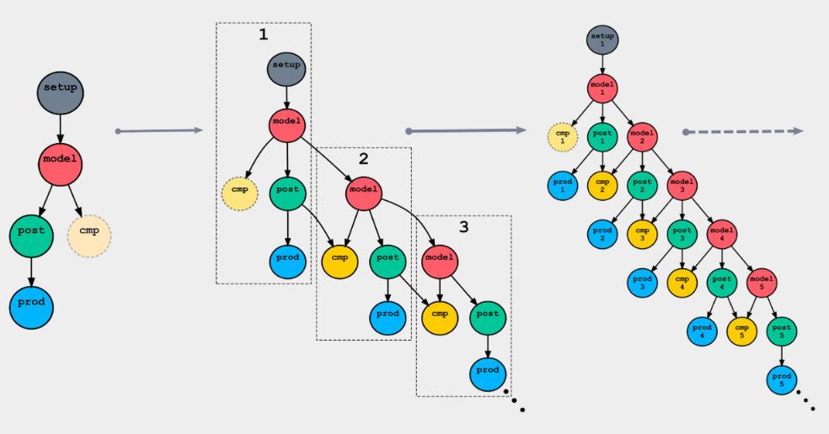
Post-processing Overview
Post-processing is necessary to convert raw model output to useful scientific data
Workflow is managed via the cylc workflow engine
Made up of (mostly) interdependent tasks but some are allowed to fail

Slide 5

The problem
The current method of post-processing is set up best for GFDL systems and requires a certain level of understanding to get started. This creates a few problems:
Lack of portability
Limited usefulness for the greater scientific community
Reduced collaborative efforts
Difficulty for new users

Slide 6
The solution
Increase usability of GFDL post-processing workflow
Less steps to configure experiment
Software already installed in container
Simple instruction set
Increase availability of GFDL post-processing workflow
Portability through cloud testing
Public release

Slide 7

Building the container
Container image is built from a condaforge/mambaforge parent image (Ubuntu)
Installs needed packages
Python, csh, netcdf, etc.
Installs GFDL post-processing workflow
Creates conda environment
GFDL GitLab container registry
Builds using on-prem gitlab self-hosted runner
Several applications are built including models and base containers
The post processing container image is built and maintained each release

Slide 8
Running the container
When a user launches the post-processing container:
Use a SIF file
singularity exec
apptainer exec
Run script executes a series of configuration and workflow commands:
Environment setup
Post processing configuration
Starts workflow via cylc
The container allows for simplistic post-processing by automating environment variable setup, directory creation, and directory clean up
Run in different environments (GAEA, PPAN, Cloud)

Slide 9
Dockerfile/Runscript Highlights
Dockerfile installs the packages we need
Runscript sets up environment and starts workflow
# apt installs to /usr/bin/
RUN apt update \
&& apt -y install uuid-runtime time csh python bc
RUN conda env create --file /opt/conda/cylc-flow-tools/cylc-flow-tools.yaml -p /opt/conda/cylc-flow-tools \
&& git config --global --add safe.directory /mnt2 \
&& conda config --add pkgs_dirs /opt/conda/cylc-flow-tools/lib/python3.11/site-packages
RUN conda install urwid==2.*
conda config --add envs_dirs /opt/conda
conda init --all
source /opt/conda/etc/profile.d/conda.sh
source ~/.bashrc
conda deactivate
conda activate /opt/conda/cylc-flow-tools
cylc stop --now $expname/run*
cylc clean $expname
rose macro --validate
bin/install-exp $expname
cylc play -v --no-detach $expname

Slide 10
Challenges
Hard coded behavior within workflow scripts
Updates to scripts
Large file transfer to and storage on cloud resources
Different behavior between on-prem and cloud running
Troubleshooting task failure is more difficult in container

Slide 11
Timeline
June
2023
July
2023
Oct
2023
Dec
2023
May 2024
Sept
2024
Start of Project
Early User Testing
Local v1 Release
Dockerfile and Runscript development begins
Successful Post-processing
attempt in Container
Cloud Testing Begins
Workflow ran to completion
+ PP files were generated
AWS cloud resource
Single user test begin on
GFDL hardware
Available for GFDL users

Slide 12
The Future
Continue user testing
Test and compare performance to bare metal
Be as efficient as possible
Explore more ways to use container technology in our workflow
New release available for all users

Slide 13
Summary
Demonstrated ability to post-process in container environment
Increased portability in post-processing
Early release available locally at GFDL
User testing underway
Public release soon

Slide 14
Acknowledgments
MSD team
Thomas Robinson
Bennett Chang (Intern; FRE-CLI)
MSD

