Slide 1
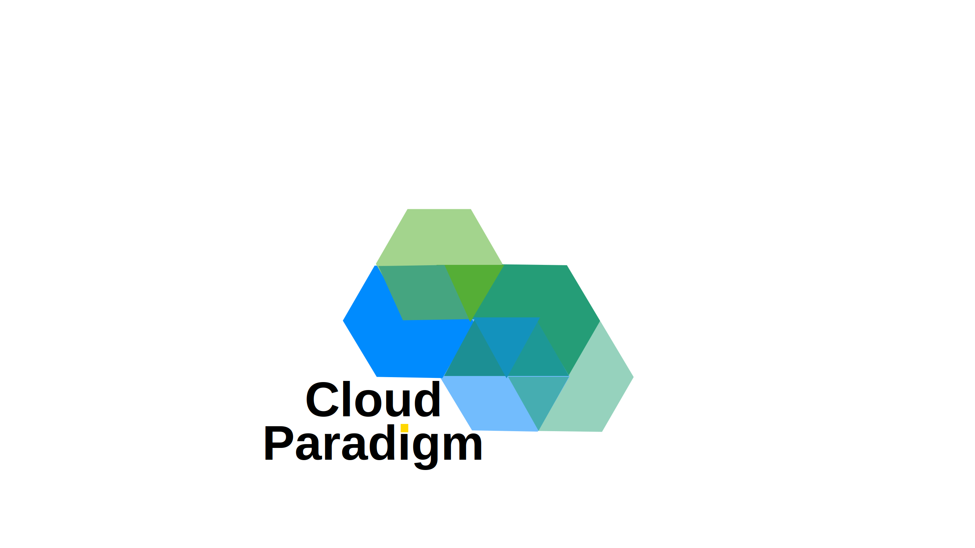
PRESENTED BY CLOUD PARADIGM PTY LTD
Infrastructure is Dead,
Long Live Infrastructure
in the Age of Agentic AI
Reid Purvs
Owner & Principal | Cloud Paradigm Pty Ltd
March 2026

Slide 2
PRESENTATION OVERVIEW
Infrastructure is Dead,
Long Live Infrastructure in the Age of Agentic AI
The rise of Agentic AI is fundamentally transforming how enterprise Azure environments are architected, designed, deployed, and managed. Traditional infrastructure practices — once reliant on manual processes and static configurations — are giving way to intelligent, autonomous systems capable of making real-time decisions at scale. By integrating Agentic AI with DevOps pipelines, organisations can achieve self-optimising architectures, accelerated deployments, and continuous operational intelligence. This presentation explores how this convergence redefines the infrastructure lifecycle — shifting engineers from reactive administrators to strategic orchestrators in an increasingly autonomous, AI-driven cloud landscape.
Agentic AI
Azure
DevOps
Enterprise Cloud
Infrastructure
Cloud Paradigm Pty Ltd | cloudparadigm.com.au

Slide 3
AGENDA
Session Overview
Infrastructure is Dead — Long Live Infrastructure in the Age of Agentic AI
Open (0–8 min) Setting the scene + opening poll
What Agentic AI actually means, and where your org sits today
Part 1 (8–22 min) The infrastructure paradigm shift
From manual pipelines to autonomous, intent-driven architectures
Part 2 (22–38 min) Agents in the DevOps lifecycle
Pipeline integration, live demo, guardrails and governance + Q&A
Part 3 (38–52 min) Real-world application
Two case studies, audience poll, and addressing your concerns
Part 4 (52–60 min) Getting started + open Q&A
The engineer's new role, adoption roadmap, key takeaways
Agentic AI
Azure
DevOps
Enterprise Cloud
Infrastructure
Cloud Paradigm Pty Ltd | cloudparadigm.com.au

Slide 4
OPENING POLL
Where does your organisation sit
on the cloud automation maturity curve?
Raise your hand for the option that best describes you today:
Level 1 — Manual
Infrastructure provisioned by hand; runbooks and tickets rule the day
Level 2 — Scripted
Terraform or Bicep in place, but humans drive every pipeline trigger
Level 3 — Automated
CI/CD pipelines running reliably; some self-healing in production
Level 4 — Intelligent
AI-assisted code review, anomaly detection, or auto-remediation in play
Poll
Audience Participation
Cloud Maturity
Cloud Paradigm Pty Ltd | cloudparadigm.com.au

Slide 5
FOUNDATIONS
What is Agentic AI?
And what it definitely is not
A working definition
An Agentic AI system perceives its environment, reasons over a goal, plans a sequence of actions, executes those actions using tools, and adapts based on results — with minimal human intervention at each step.
Not a chatbot
Copilots suggest. Agents act. The difference is autonomy, memory, and tool use.
Not pure automation
Scripts follow fixed rules. Agents reason about context and handle novel situations.
Key capabilities that make it work
Goal decomposition, tool calling, memory, multi-step planning, and feedback loops
Agentic AI
Foundations
LLM
Azure AI Foundry
Cloud Paradigm Pty Ltd | cloudparadigm.com.au

Slide 6
PART 1
The Old World
Manual pipelines, static configs, reactive operations
How infrastructure worked (and in many places still does)
Ticket-driven provisioning
Engineers open requests; wait times measured in hours or days; human bottlenecks at every stage
Static configuration drift
IaC templates describe desired state but nothing enforces it continuously; drift accumulates silently
Reactive incident response
Alerts fire, engineers wake up, they dig through logs, identify root cause, apply fix — repeat
Knowledge locked in individuals
Runbooks age out; tribal knowledge walks out the door; onboarding takes months
Legacy Ops
Manual Provisioning
Incident Response
IaC
Cloud Paradigm Pty Ltd | cloudparadigm.com.au

Slide 7
PART 1
The New World
Autonomous agents, intent-driven infrastructure, proactive operations
What the AI-native infrastructure paradigm looks like
Intent-driven provisioning
An engineer describes the outcome in natural language; an agent reasons, generates IaC, validates, and deploys
Continuous compliance enforcement
Agents monitor configuration state in real time and remediate drift before it causes incidents
Proactive self-healing
Agents detect anomalies, correlate signals across services, and remediate — often before an alert fires
Institutional knowledge encoded
Runbooks become agent prompts; best practices are embedded in guardrails; expertise scales across teams
Agentic AI
Self-Healing
Intent-Driven
Azure
Cloud Paradigm Pty Ltd | cloudparadigm.com.au

Slide 8
PART 1
Agentic AI Architecture on Azure
The building blocks available to you today
Azure AI Foundry
Model deployment, orchestration, and evaluation — the core runtime for your agents
Semantic Kernel
Microsoft's open-source SDK for building agent workflows that call Azure services as tools
GitHub Copilot for Azure
AI-assisted IaC generation, PR reviews, and pipeline troubleshooting inside your existing workflow
Azure DevOps + Pipelines
The CI/CD backbone that agents plug into to trigger, monitor, and validate deployments
Azure Policy + Defender for Cloud
The guardrail layer — agents can query, enforce, and remediate against policy definitions
Azure AI Foundry
Semantic Kernel
GitHub Copilot
Azure DevOps
Cloud Paradigm Pty Ltd | cloudparadigm.com.au

Slide 9
PART 1
How Agents Interact with Azure
ARM, Bicep, Terraform, REST APIs — the agent toolbox
Tool calling as the integration mechanism
Agents don't have direct access to Azure — they call functions you expose. Each function wraps an Azure operation.
Infrastructure as code generation
Agent reasons about requirements, generates Bicep or Terraform, validates with what-if/plan, then executes via pipeline
ARM and REST API calls
For dynamic operations (scaling, restarting, tagging), agents call ARM REST endpoints directly with managed identity
Authentication and least-privilege
Agents authenticate as managed identities with scoped RBAC — no hardcoded credentials, full audit trail in Entra ID
ARM
Bicep
Terraform
REST API
Managed Identity
Cloud Paradigm Pty Ltd | cloudparadigm.com.au

Slide 10
PART 2
Agents in the DevOps Lifecycle
Plan — Provision — Monitor — Remediate
Plan
Agent analyses requirements, estimates cost with Azure Pricing API, flags risks, proposes architecture
Provision
Agent generates IaC, runs validation (what-if/plan), awaits approval gate if configured, then triggers pipeline
Monitor
Agent continuously queries Azure Monitor, Log Analytics, and Cost Management; surfaces anomalies with context
Remediate
On detecting drift or incident, agent executes a known remediation or escalates to human with full context attached
DevOps
Azure Pipelines
Azure Monitor
Remediation
Cloud Paradigm Pty Ltd | cloudparadigm.com.au

Slide 11
LIVE DEMO
Agentic Provisioning
Spinning up an Azure environment from a single natural language prompt

Slide 12
LIVE DEMO
Demo Architecture
Claude + GitHub Codespaces + Azure Environment
CLAUDE
GITHUB
AZURE ENVIRONMENT
C
Repo
Codespaces
Resource Group
(RG)
Preferred Scripting Language
(Bicep / Terraform / PowerShell)
AI Agent / claude.ai
① Setup base Repo
② Setup base Azure
③ Setup base Claude
④ Vibe Code ↺ Repeat
Cloud Paradigm Pty Ltd | cloudparadigm.com.au

Slide 13
PART 2
Guardrails and Governance
Policy enforcement, approval gates, and audit trails
The trust problem — and how to solve it
Autonomous agents are only as trustworthy as the boundaries you put around them. Governance is not optional.
Azure Policy as the rulebook
Define allowed regions, SKUs, required tags, and network configurations. Agents check policy before acting.
Human-in-the-loop approval gates
For high-blast-radius actions (prod deployments, security group changes), agents pause and request explicit approval
Full audit trail in Entra ID and Monitor
Every agent action is logged with the managed identity, timestamp, and operation — indistinguishable from human audit trails
Azure Policy
Governance
Compliance
RBAC
Audit
Cloud Paradigm Pty Ltd | cloudparadigm.com.au

Slide 14
Q&A — BREAK #1
Questions So Far?
5 minutes — anything from Parts 1 and 2

Slide 15
PART 3 — CASE STUDY
Autonomous Remediation
Multi-region Azure environment — persistent configuration drift
The scenario
A financial services client running workloads across Australia East, Southeast Asia, and West Europe was experiencing weekly configuration drift incidents. Manual detection averaged 4 hours; remediation added another 2.
The agentic approach
An agent was deployed to poll Azure Resource Graph every 15 minutes, compare live state against the approved Bicep baseline, and automatically remediate low-risk drift (tags, diagnostic settings, NSG rules) — escalating high-risk changes for human approval.
The outcome
Mean time to detect dropped from 4 hours to under 3 minutes. 78% of drift events were remediated autonomously. Engineers shifted from firefighting to reviewing weekly summary reports.
Case Study
Remediation
Azure Resource Graph
Multi-Region
Cloud Paradigm Pty Ltd | cloudparadigm.com.au

Slide 16
PART 3 — CASE STUDY
Agent-Driven Cost Optimisation
Continuous right-sizing across a 400-VM estate
The scenario
A retail organisation running 400+ VMs across dev, test, and production environments was overspending by an estimated 35% due to over-provisioned SKUs and orphaned resources left running outside business hours.
The agentic approach
An agent was connected to Azure Cost Management and Monitor. It generated weekly right-sizing recommendations, automatically shut down dev/test resources outside business hours, and flagged orphaned disks and NICs for review.
The outcome
Monthly Azure spend reduced by 28% within 60 days. Zero production incidents attributable to agent actions. The team redirected saved budget toward new product development infrastructure.
Case Study
Cost Optimisation
Right-Sizing
Azure Cost Management
Cloud Paradigm Pty Ltd | cloudparadigm.com.au

Slide 17
POLL #2
What is your biggest concern
about adopting agentic infrastructure?
Raise your hand for your top concern:
A — Security and blast radius
An agent with write access to production is a large attack surface if compromised
B — Auditability and compliance
How do I prove to auditors that agent actions meet our regulatory requirements?
C — Trust and explainability
I don't know why the agent made a particular decision — that makes me uncomfortable
D — Team readiness
We don't have the skills to build, run, or debug agentic systems yet
Poll
Audience Participation
Governance
Security
Cloud Paradigm Pty Ltd | cloudparadigm.com.au

Slide 18
PART 3
Addressing the Concerns
Security, trust, blast radius, and compliance — head on
Security and blast radius
Scope agent identity to minimum required permissions. Separate identities per environment. Network-restrict agent egress.
Auditability and compliance
Every agent action via managed identity appears in Entra ID audit logs. Pair with Azure Monitor alerts for immediate visibility.
Trust and explainability
Require agents to produce a plan and rationale before execution. Log the reasoning chain. Implement mandatory human review for Tier 1 actions.
Team readiness
Start with a single low-risk use case (e.g., dev environment provisioning). Build internal capability before expanding scope.
Security
Compliance
Trust
RBAC
Governance
Cloud Paradigm Pty Ltd | cloudparadigm.com.au

Slide 19
PART 4
The Engineer as Orchestrator
From reactive administrator to strategic architect
The role is not disappearing — it is evolving
Engineers who thrive will be those who learn to design, direct, and govern agents — not those who resist the shift.
Skills that matter more
Prompt engineering for infrastructure, tool design, agent orchestration, policy definition, and outcome-based thinking
Skills that matter less
Remembering CLI flags, writing repetitive YAML, manually chasing alerts at 2am
The new value-add
Designing the guardrails, defining the goals, reviewing agent outputs, and escalating edge cases — humans set the intent, agents execute
Engineers
Orchestration
Skills
Future of Work
Cloud Paradigm Pty Ltd | cloudparadigm.com.au

Slide 20
PART 4
A Practical Adoption Roadmap
Crawl — Walk — Run
Crawl — Low-risk, high-visibility wins (Months 1–3)
Deploy an agent for dev/test environment provisioning. Instrument with full logging. Let the team get comfortable with agent outputs.
Walk — Expand scope with human-in-the-loop (Months 3–6)
Add cost optimisation and drift detection agents. Introduce approval gates for production actions. Build a library of tested agent tools.
Run — Autonomous operations with governance layer (Month 6+)
Extend to production monitoring and remediation. Define clear escalation paths. Implement an agent health dashboard and anomaly detection on agent behaviour itself.
Guiding principle throughout
Start narrow, instrument everything, expand only what you trust, and always maintain a clear human override path
Adoption
Roadmap
DevOps
Governance
Azure
Cloud Paradigm Pty Ltd | cloudparadigm.com.au

Slide 21
KEY TAKEAWAYS
Infrastructure is Evolving,
Not Dying — Five things to take away today
1. Agentic AI is an amplifier, not a replacement
The best outcomes come from human intent + agent execution. Neither alone is sufficient.
2. Azure has the building blocks today
AI Foundry, Semantic Kernel, GitHub Copilot, and Azure Policy form a complete agentic stack right now.
3. Guardrails are not optional
Governance, least-privilege identity, and approval gates are what make autonomous systems trustworthy.
4. Start small and instrument everything
A single well-governed use case that builds team confidence is worth more than a grand vision that stalls.
5. The engineer's role is expanding, not shrinking
Orchestrating agents, designing guardrails, and encoding institutional knowledge is high-value, high-impact work.
Agentic AI
Azure
DevOps
Governance
Infrastructure
Cloud Paradigm Pty Ltd | cloudparadigm.com.au

Slide 22
Q&A — OPEN DISCUSSION
Questions, Challenges, Ideas?
Let's talk — no such thing as a bad question

Slide 23
CONTACT
Get in Touch
Reid Purvs | Owner & Principal, Cloud Paradigm Pty Ltd
MOBILE
EMAIL
WEBSITE
+61 427 038 685
reidpurvis@cloudparadigm.com.au
www.cloudparadigm.com.au
Cloud Paradigm Pty Ltd | cloudparadigm.com.au

