Slide 1
Machine Learning Lecture 1: The Big Picture
Reid Wyde

Slide 2
Course Outline
Lecture 1 – The Big Picture
Lecture 2 – Linear Algebra
Lecture 3 – Probability and Statistics
Lecture 4 – Supervised Models I
Lecture 5 – Supervised Models II
Lecture 6 – Unsupervised Models
Lecture 7 – Deep Learning Intro I: Training and Optimizers
Lecture 8 – Deep Learning Intro II: Computer Vision
Lecture 9 – Deep Learning Intro III: Sequence Learning
Lecture 10 – Reinforcement Learning
Lecture 11 – Neural Architecture Search (AutoML)
Lecture 12 – Graph Neural Networks

Slide 3
Lecture 1 Outline
Machine Learning as Task-Performance-Experience
Supervised vs Unsupervised Learning
Generalization
Partitioning Data, Train-Test Split
Data Leakage
Learning Curves, Underfitting, Overfitting, Bias-Variance Tradeoff
Data Augmentation
Parameters and Hyperparameters
Partitioning Data II: Train-Validate-Test Split
K-Folds Cross Validation
Summary
Closing Thoughts
Extra Resources
Notes:
We’re going to be mentioning a lot of models, and a lot of different kinds of models in this first lecture. You will probably recognize some of them. If not, that’s alright. Explaining specific models is not the goal of the lecture.
This lecture is mostly about data and how we treat our data in very general terms, because that’s what’s most important in this field. I will sometimes refer to ML as “data driven modeling” to emphasize this.
In the real world, solving a problem no one has solved yet, 90% of your effort is related to data engineering, not model building

Slide 4
Task-Performance-Experience
An algorithm is said to learn from experience 𝐸 with respect to some class of tasks 𝑇 and performance measure 𝑃 if its performance at tasks in 𝑇 (as measured by 𝑃) improves with experience 𝐸 (Michell 1997).
For our purposes, algorithms are models
Models are function approximators
They can themselves be elementary functions or compositions of elementary functions
Examples:
Linear maps / linear transforms / affine transforms
Polynomials
Exponentials
Decision Trees
Neural Networks
And many more!
Real world
In silico
input
input
channel
model
output
output
Notes:
The point is that there is a real world relationship, we can call it the channel, that we are trying to model. If we had an exact description of the channel we would be done (within limits of computational ability).
Since we don’t have the actual channel, we assume it to be a (possibly stochastic) function (i.e. a function with a random element), and our model stands in as the approximation of the channel.
In signal processing there are multiple names for this idea of the real world channel. You might also call it “the system” or the “transfer function.”
We will go into more detail on linear maps in Lecture 3 and 7
We will go into more detail on decision trees in Lecture 6
We will go into more detail on neural nets in Lectures 9 and 10
We will go more into detail on function approximators in lecture 8 on ML theory

Slide 5
Algorithms: Supervised vs Unsupervised
Supervised: Input-output pairs exist
There’s a right answer (“label”) and we want our model to predict as close to the right answer as possible.
E.g. classification, regression, etc.
Unsupervised: Only data exists
Operate on the data without there being a right answer to compare to.
E.g. PCA, ICA, clustering, etc.
Self-Supervised: Data exists, input-output pairs can be created automatically
E.g. taking clean audio and adding noise to it, so that the clean audio is the output and the noisy audio is the input
The vast majority of all real world data is unlabeled
Notes:
We say that a supervised approach requires “labeled” data. Even if we’re doing regression, not classification, we might still call the outputs “labels.”
We’re going to cover supervised models in more detail in Lecture 5 and 6.
We’re going to cover unsupervised models in more detail in Lecture 7.
Other examples of self-supervised
-Predicting a missing word given the words before and after
-Infilling images

Slide 6

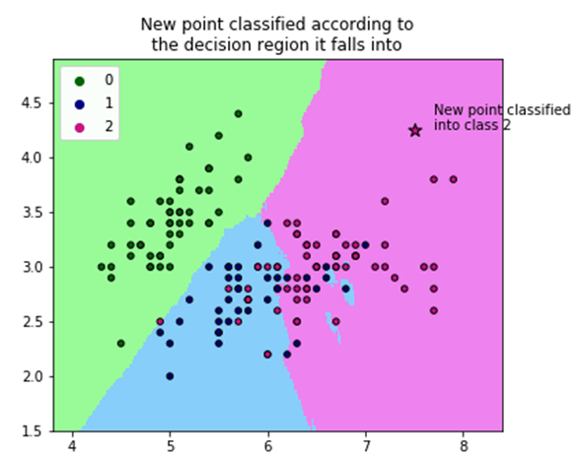
Task: What we want the model to do
Examples:
We want the model to classify this contact as target or non-target
We want the model to predict the contact’s location
We want the model to group similar contacts together
We want the model to love us unconditionally
Notes:
On the left we see a classifier, with decision boundaries. This type of model is called k-nearest neighbors or K-NN.
In the middle we see a grouping algorithm called K-means. It runs iteratively until the centroids converge. It could then be used for classification in the same way as K-NN.
We’ll talk about unsupervised models like K-means in lecture 7

Slide 7
Tasks, cont’d
The type of task determines what kind of model output you want
Classification -> single discrete value (label), or probability distribution over labels
Regression -> single real value (or tensor), or probability distribution over real values (or tensors)
Transcription / translation -> text, or symbols, or language tokens
Anomaly detection (special case of classification) -> Binary (yes/no)
Synthesis / sampling / denoising -> output same data type as input
The structure of the task (in part) determines the structure of the model
Notes:
If you could define precisely what data type corresponds to love, your model could output it. Maybe a heartfelt letter, or a picture, or the sound of a heartbeat.
Tensors are just the math word for multidimensional arrays
There’s formalism associated with them like there is for matrices

Slide 8
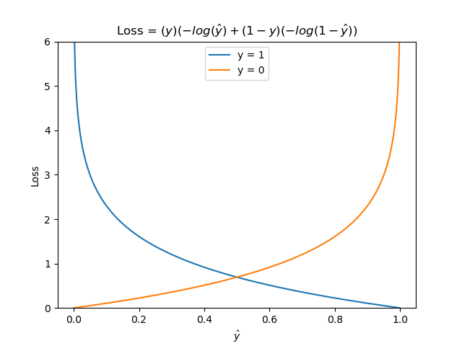
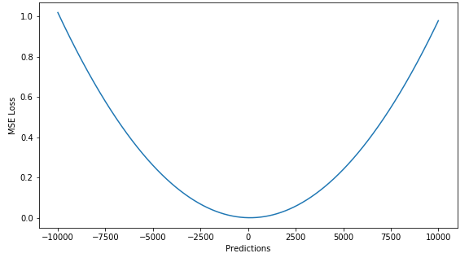
Performance Measure: How to judge the model
Quantitative measure of model performance
A.k.a. Objective function, loss function
Different performance measures for different tasks
Cross-entropy (a.k.a. log-loss) for classification
Mean squared error (MSE) for regression
Many more: Accuracy, precision, recall, specificity, F1, AUC, logMSE, etc…
Cross-entropy
Mean Squared Error
Notes:
In lecture 9 we will revisit MSE and log-loss in the context of deep neural nets.
It turns out that not all of these performance measures can actually be used directly during training. We’ll go more into depth on that in lecture 9.

Slide 9
Experience: How you train the model
The experience requires a model and data (and a performance measure P)
The data can be the entire dataset or any subset of it
The model parameters are adjusted to (better) fit the data of this experience (i.e. to perform better with respect to P)
Examples (where P is MSE):
Fitting a gaussian distribution to a dataset’s mean and variance
Fitting a line to points in the Cartesian plane
Adjusting the coefficients of an FIR adaptive filter after receiving another audio sample
Notes:
The reason why we use the task-performance-experience formalism is because it is extensible to incredibly complex models and deep networks.
Break for questions

Slide 10
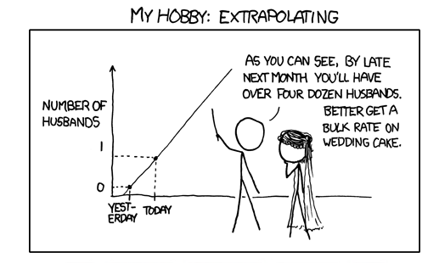
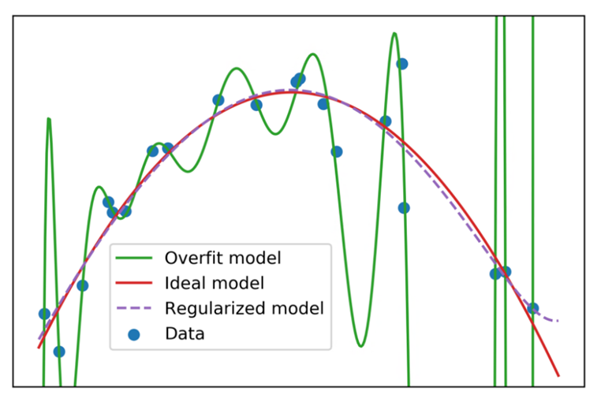
Generalization (Not Memorization!)
A useful model doesn’t memorize training data, it “learns” from the experience, so it can perform well on data it hasn’t yet experienced
We want the model to generalize to out of distribution data (i.e. non-training data)
Often we need a lot of data to create a model that generalizes well
source: Randall Munroe, xkcd.com
Notes:
In lecture 8 we’ll go over the probability theory of models more closely.
In this cartoon, you see that a line has been fit to only 2 data points. Haha extrapolating from two data points.
On the right, we see a more real world example, where noise has contributed high order terms to a polynomial model. The pink curve will generalize better than the green curve to new data, at the cost of not perfectly fitting the blue dots.
We’ll talk more about that tradeoff later in the lecture.

Slide 11
Partitioning Data, Train-Test Split
In order to evaluate model performance on data it hasn’t experienced, we don’t train on all of our dataset
The data we don’t train on is called the “test set”
The default is an 80/20 train-test split, but it varies by problem
Our model’s performance on the test set is the best predictor of how well it will generalize to unseen data
Often we must be careful about how we partition our data, or else we can bias our prediction of our model’s performance; this is called data leakage
Notes:
Data leakage is a very specific problem, but there are other ways that improperly partitioning data will negatively impact your model.
The distribution of examples in your training data will set the priors for your model.
E.g. if you have a 100:1 negative to positive examples ratio, then your model, given no additional information, will default to a 100:1 likelihood
If you had a very good idea about what the real world statistics will be like, it might be a good idea to divide your data so that those real world statistics are represented in the training data.
That is called data stratification.
If you don’t know what the real world statistics will be like, you might have to decide what the preferable scenario will be: a missed detection or a false positive.
We’ll go over this idea more in Lecture 5 on Supervised Models.

Slide 12
Data Leakage
Data leakage occurs when the model is allowed to train on the testing data
This biases our estimate of how well the model generalizes, because it will overperform on the testing data compared to new data from the real world
Example:
You have a dataset of audio samples and surveys from users who used a customer support line
There are multiple audio samples per user
We are training a model to classify the mood of the user
We want this model to generalize well to new users
If we partition our dataset such that datapoints from a given user end up in both training and testing data, we have allowed our testing data to leak into our training data (it’s being tested on a user it’s already experienced)
Solution: we should partition our data with respect to users, not samples

Slide 13
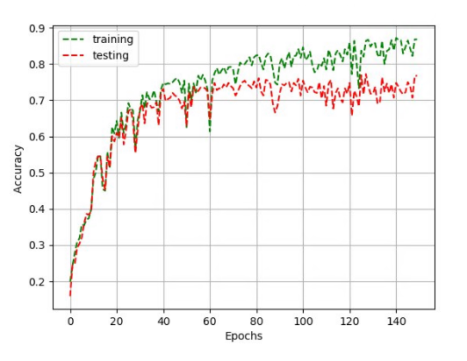
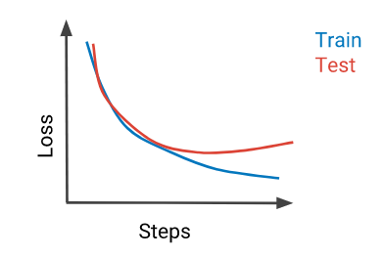
Learning Curves
A learning curve is a plot of the model’s performance vs experience
Learning curves allow us to analyze many things:
The model’s capacity (best performance on training data)
How quickly the model learns
How much data the model needs to perform well
How well the model generalizes
Notes:
1 epoch means 1 full run of training over our entire train set
Performance improvement here is an increase in accuracy, but it could also be a decrease in MSE or log-loss, in which case this curve points down instead of up

Slide 14
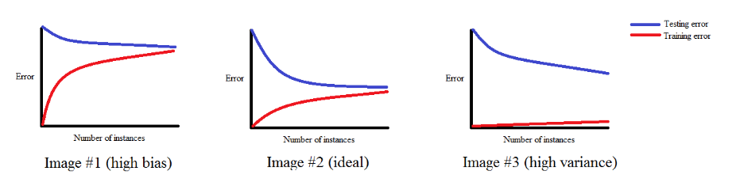
Underfitting, Overfitting, Bias, Variance
A model that doesn’t perform well on the training or testing data is “high bias”
The model has “underfit” the training data
A model that performs well on the training data, but not testing data is “high variance”
The model has “overfit” the training data
A model that performs well on testing data, but not training data is “spooky”
It’s likely the model must be trained more to analyze its performance; check code for bugs
Notes:
In these images, the training error is shown to come from the bottom. What that is saying is that for a small number of examples, we could perfectly fit the training data. As the number of examples grows, it might not be possible to perfectly fit the training data.
For randomly initiated models that are learning iteratively over a large amount of data, the training error curve comes down from the top, just like the testing error curve. More on that behavior in lecture 9.
In the middle, we see the ideal model. It’s ideal because the asymptotic training and testing error is about the same, and it’s not very high.

Slide 15
Bias-Variance Tradeoff
In general it is difficult to construct a model that can achieve perfect performance on the training data, while still performing well on the testing data
The training data may have noise, which we don’t want to model
In fact, there is a general tension between model capacity and model generalization
This is known as the “bias-variance tradeoff”
This is why simpler models are almost always considered more robust
Notes:
(explain the slides)
However, especially in natural language processing, this bias variance tradeoff intuition tends to break down. This is due to a couple factors including the fact that language is highly structured and the datasets can be massive.
We’ll talk more about that in lecture 10.

Slide 16
Bias-Variance Tradeoff
Likely to underfit
Likely to overfit
Optimal capacity
Generalization error
Variance
Bias
Model capacity
Notes:
Here model capacity might be number of polynomial degrees, number of neurons in a neural net, number of biquads in a filter cascade, depth of a decision tree, etc.
Don’t confuse model capacity with number of training iterations.
You train the model to convergence, and then you can evaluate the relationship between complexity and generalization.

Slide 17

Addressing High Bias and Variance in Models
A high bias model has low capacity
Increase model complexity until it can perform well on the training data
A high variance model has poor generalization
Increase the size of your dataset (never a bad option, but can be expensive)
Regularize your model. Regularization is when you change the experience to avoid overfitting.
E.g. adding the square of the coefficients of your model to the loss function (L2 normalization, a.k.a. “leaky” LMS)
E.g. Limiting the degree of a polynomial model
Notes:
Regularization can be interpreted in many different ways
Occam’s razor
Setting a prior on the noise
Setting a prior on the information of each point

Slide 18
Common Early Debugging Steps
Count and verify your train/test ratio
Visualize input and output pairs before, during, and after training
Review process for data leakage
Testing data should receive the same pre-model processing as training data!
We want the training data statistics and the testing data statistics to be as close as possible, so the model has the best chance at generalization
Notes:
Break for questions

Slide 19
Data Augmentation
Collecting data can be expensive
Real world data is often noisier than perfect simulations, which hurts generalization
It is possible to artificially inflate the size of a dataset and make the model more robust at the same time through data augmentation
It can also prevent overfitting
Data augmentation is when you train on transformed versions of the original dataset
If your augmentation includes a noise element, your model becomes robust to that kind of noise
Examples:
Adding white noise to image or audio data
Randomly cropping image data
Adding reverb to audio data
Flipping images on an axis
augmentation
data
transforms
noise
input
model
output
training
Notes:
This is also termed noise aware training
Stochastic noise injection
It’s related to a similar class of techniques called adversarial training, which we’ll talk more about in lectures 9 and 10.
The dashed lines represent potentially stochastic relationships. We might inject noise only some of the time, or at varying amounts.
For classification, you usually don’t change the output labels. There is a concept called noisy labels, but that’s beyond the scope of this lecture.
You might apply transforms to the output, for example, if you were doing image reconstruction. If you flip the input, you flip the output.

Slide 20
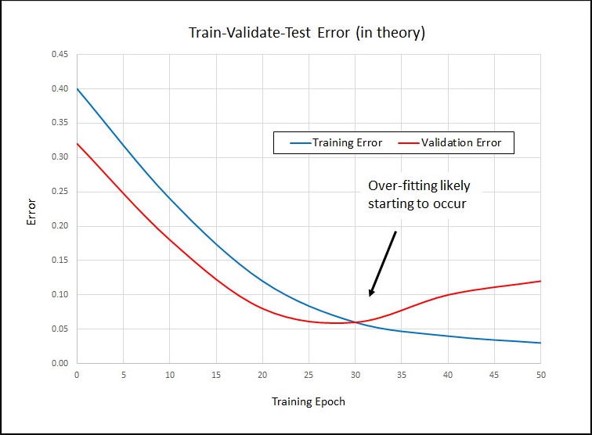
Parameters and Hyperparameters
Parameters of a model are automatically learnable
Values of parameters are learned from experience
Examples:
Coefficients of a polynomial
Weights of a neural network
The set of (μ, σ) pairs of a GMM
Hyperparameters are not automatically learnable
Values of hyperparameters must be chosen apriori
Examples:
Maximum degree of a polynomial
Structure of a neural network
Number of Gaussians in a GMM
Type / amount of noise in data augmentation
Optimal number of training epochs (to not overfit)
Notes:
Sometimes it’s possible to adjust hyperparameters during training. Learning rate adjustment during training is a well studied part of machine learning optimization. We’ll go over learning rate more in lecture 9.
In lecture 12 we will go over techniques used to automatically develop the structure of neural networks and choose hyperparameters for all kinds of models. This is called AutoML, model search, architecture search, and various other names.
In the image on the right, the hyperparameter that we are investigating is the optimal number of training epochs. They used a validation set to determine it, and we’re going to talk about validation on the next slide.

Slide 21
Partitioning Data II: Train-Validate-Test Split for Hyperparameter Search
We can experiment with hyperparameters, but we want to avoid data leakage
To experiment with hyperparameters, we divide data into training, validation, and testing
60/20/20 and 70/10/20 divisions are common
Loop over hyperparameter values
Initialize model with hyperparameter value
Train model on training data
Evaluate model performance on validation data
Choose best hyperparameter value based on validation data performance
(Optional) Retrain model on all training and validation data
Evaluate model performance on testing data

Slide 22
K-Folds Cross Validation
Dividing data into train/test can result in labels that are unequally distributed between partitions
i.e. all of the examples for a given class can end up in training or testing, which would bias our model
Evaluation of model performance on a single train-test split is just a point estimate of performance
We want a tight estimate of model generalization performance
To address this, we repeat the process of training and testing many times on different splits of the data
Divide the data into K nearly equal subsets (a.k.a. folds)
Loop i from 0 to K-1:
Train model on all subsets except the i^{th} subset
Evaluate model on the i^{th} subset
We get a tighter estimate of model generalization performance
(For free) we get an estimate of the sensitivity of the model to different datasets
Notes:
This is especially important for small datasets, because small samples of small datasets may not satisfy the law of large numbers

Slide 23
Summary
Machine learning as task-performance-experience (plus our model!)
Goal: Generalize model to unseen data
Train-test split to evaluate model generalization performance
Avoid data leakage with careful data handling
Use learning curves to evaluate models for underfitting and overfitting
Use data augmentation to increase the size of a dataset, improve model robustness to noise, and prevent overfitting
Experiment with hyperparameters using a train-validation-test split
Use K-folds cross validation to better evaluate model performance and sensitivity

Slide 24
Closing Thoughts
There is no replacement for domain specific knowledge.
Data scientists must understand where their data comes from
ML is not magic. Ultimately, it's all about the quality of your data.
That's why I prefer “data driven modeling” to “machine learning”
90% of your effort is related to data engineering, not model building
Many of these techniques have been derived independently multiple times.
There are strong overlaps between ML and other fields such as signal processing, physics, information theory, optimization, and optimal control
I encourage you to draw connections to the math you already know
Occam's razor. Simpler is almost always better.
Pareto principle: 80% of the gain comes from 20% of the effort, and 20% of the gain comes from 80% of the effort.

Slide 25
Extra Resources
Coursera Machine Learning Course by Andrew Ng
Introduction to supervised and unsupervised machine learning, covering many models, ends with basic neural networks
Original course was taught in octave (essentially MATLAB language)
Focus on practice and implementation, not just theory
Applied Linear Algebra: The Decoupling Principle by Lorenzo Sadun
Application focused, very good for building intuition around linear transforms and vector spaces
Dr. Sadun also has many online video lectures which are of very high quality
Deep Learning by Goodfellow, Bengio, and Courville
Concise and clear descriptions of many kinds of neural networks, with many citations for further research by the student
Reinforcement Learning by Sutton and Barto
Detailed treatment of reinforcement learning from tabular methods and dynamic programming to modern deep neural network approaches

