Slide 1
Effect of crisis on people’s behaviour as seen through data
Shift to a more digital world

Slide 2
Table of contents
1. Key events
2. Remote work
3. Changes in mobility in different countries
4. Increased online presence
5. Changes in household expenditure

Slide 3
Key events in Europe
Russian invasion of Ukraine and increase of inflation
First COVID-19 case in Europe
Various European countries introduce COVID-19 restrictions,
stock market crash
Largest COVID-19 wave,
over 3M cases daily globaly
Bitcoin boom
Start of vaccination against COVID-19
Brexit transition period end
2020
2021
2022
2023
Jan 2020
March 2020
Nov 2020
Dec 2020
Jan 2021
January 2022
Feb 2022
Notes:
either events during covid/related to covid or global events from 2019 to 2022

Slide 4
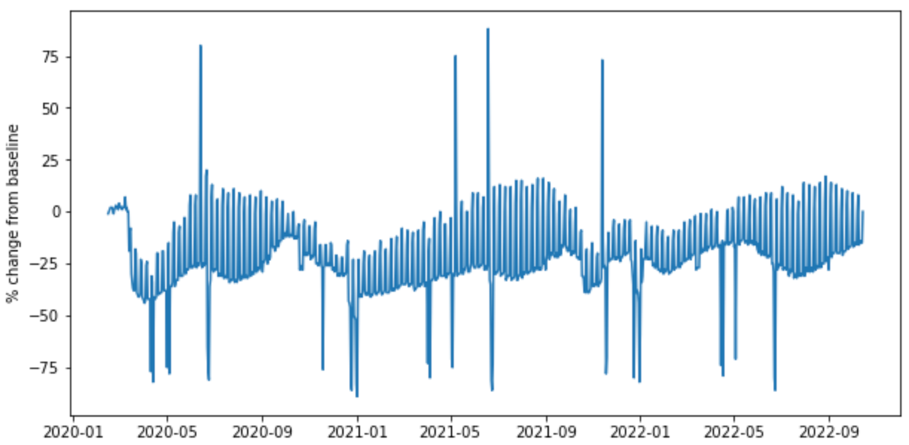
Remote work is here to stay
% change from baseline* of activity in workplaces in Latvia
* The baseline is the median value, for the corresponding day of the week, during the 5-week period Jan 3–Feb 6, 2020.

Slide 5
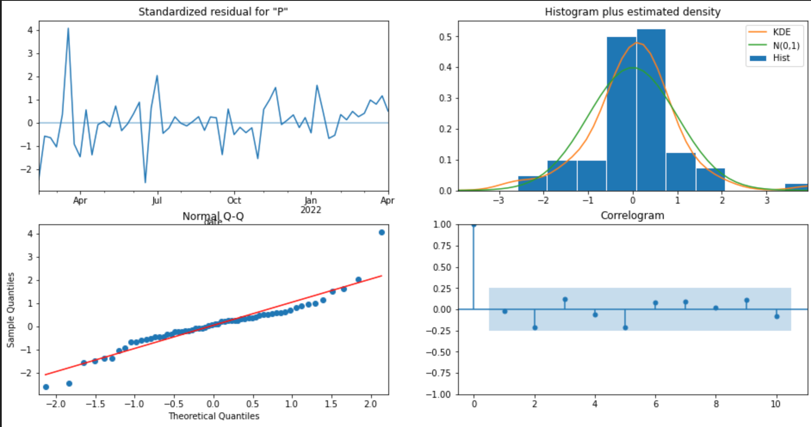
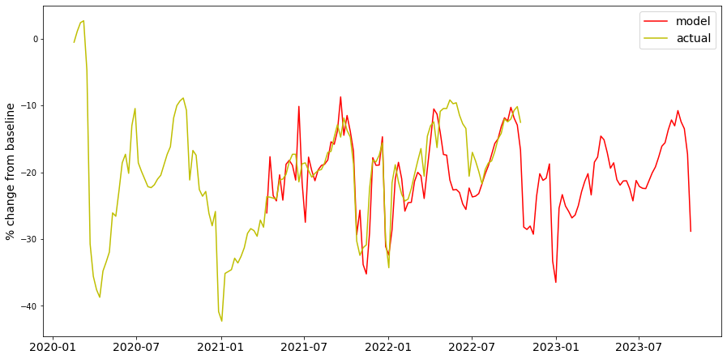
Remote work is here to stay
diagnostic plots for SARIMA model
predicted % change from baseline of activity in workplaces in Latvia
* The baseline is the median value, for the corresponding day of the week, during the 5-week period Jan 3–Feb 6, 2020.

Slide 6
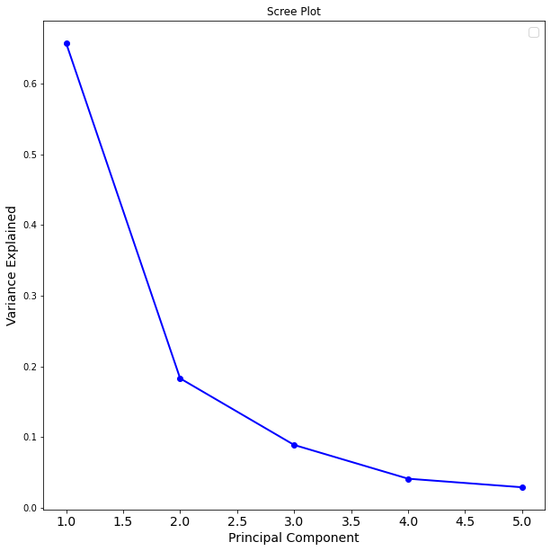
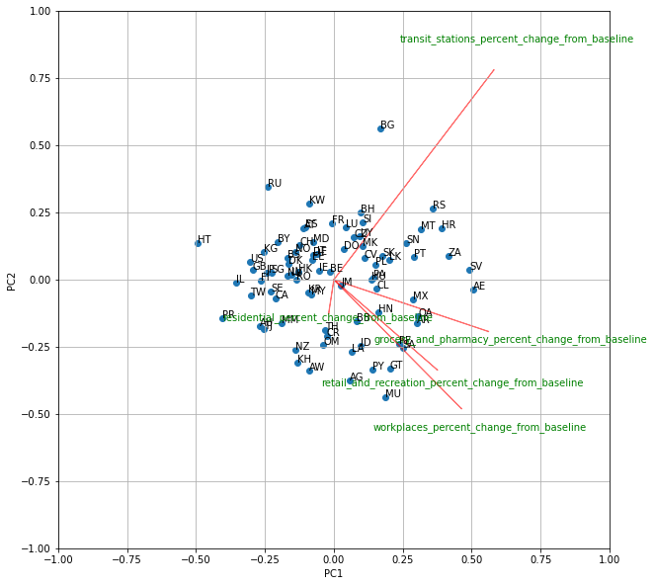
The changes in mobility in different parts of the world
Biplot of changes during Sep-Oct compared to the baseline
* The baseline is the median value, for the corresponding day of the week, during the 5-week period Jan 3–Feb 6, 2020.
Notes:
izmainas neietekme kontitentus un ir visaptverosas

Slide 7
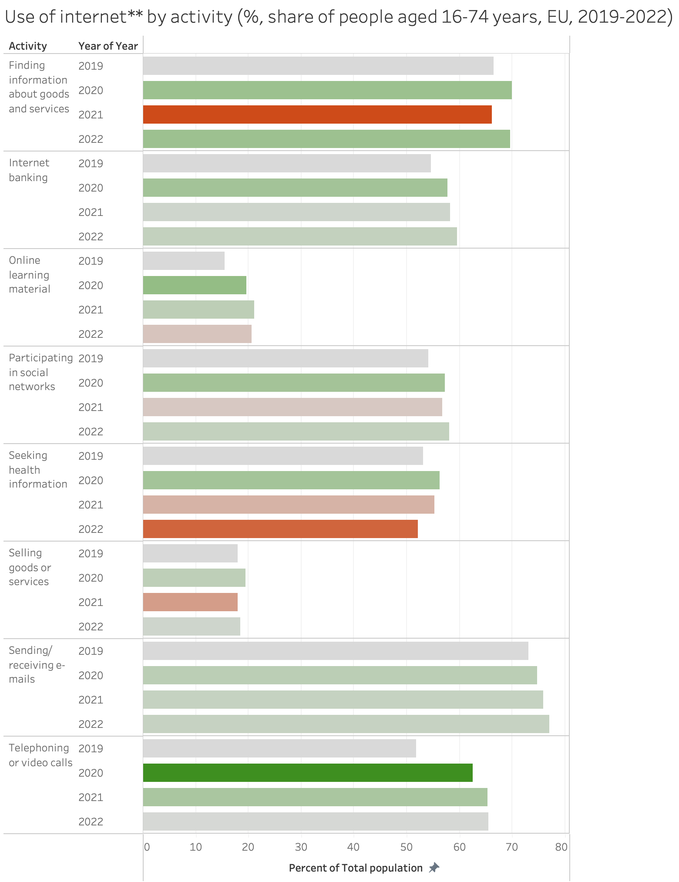
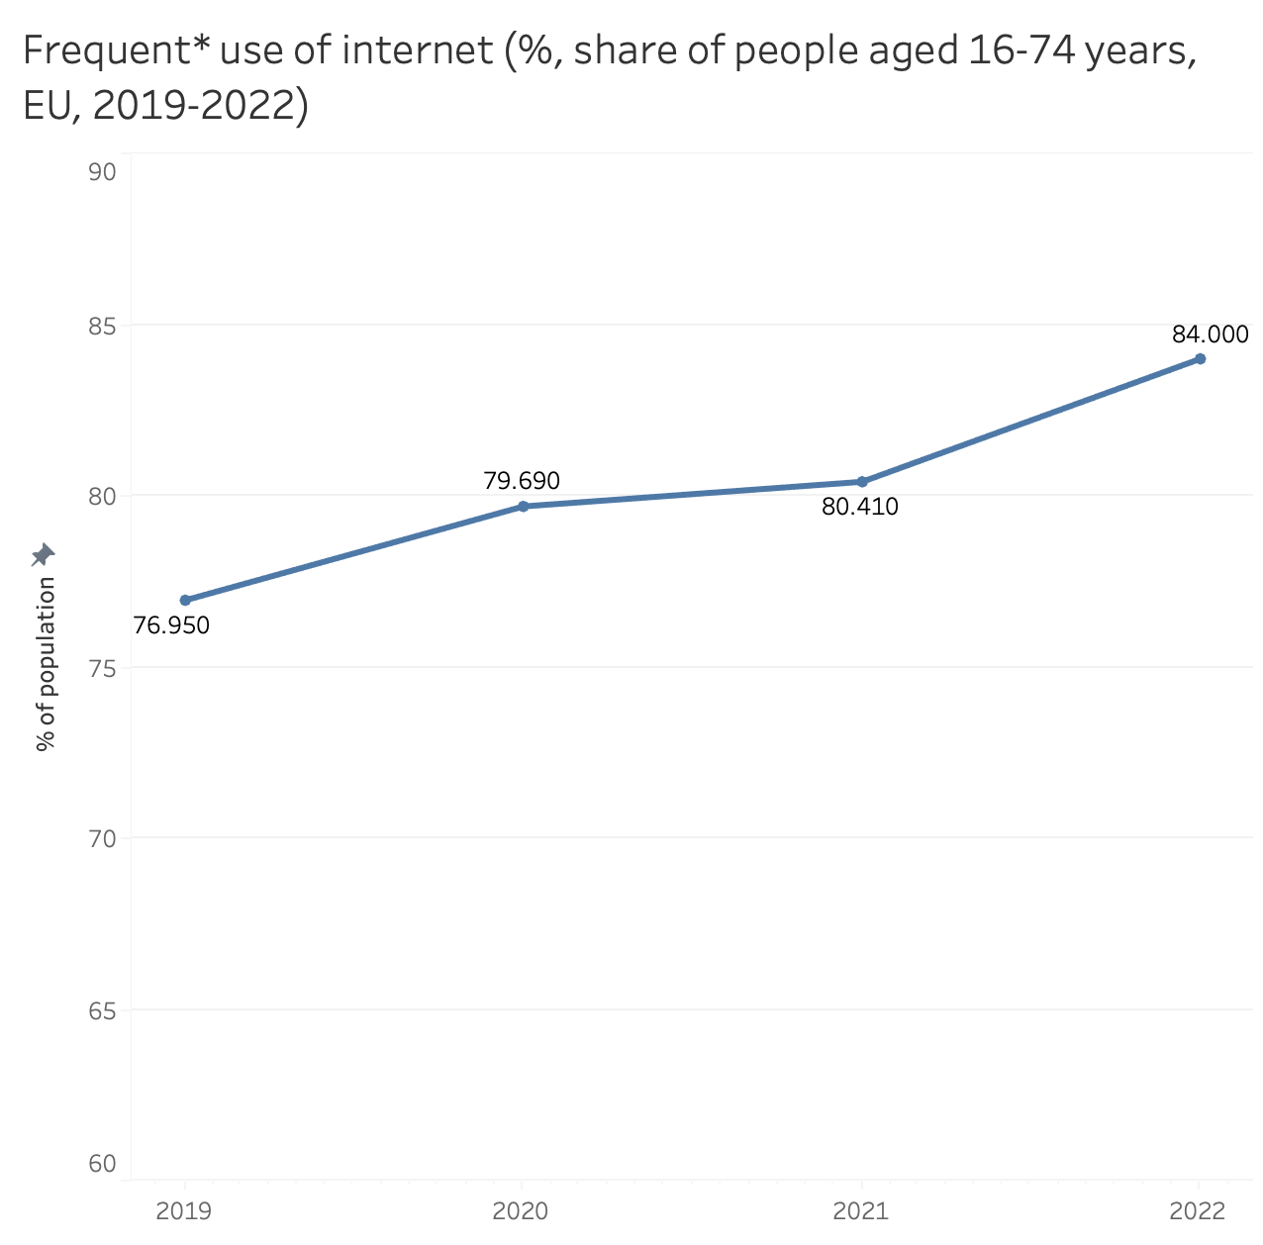
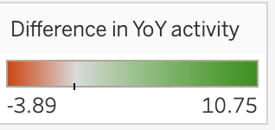
Online presence has increased
*Frequent use: every day or almost every day on average within the last 3 months before the survey.
**Within the last 3 months before the survey.
Notes:
online shopping, online banking became more used.
due graph in tableau, comparing 2019, 2022,2021
each country seperate including eu.

Slide 8
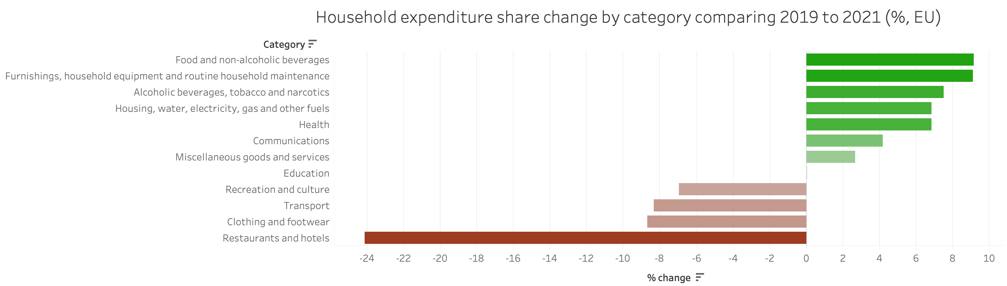
Changes in household expenditure
Notes:
people focused more on necessities
and adjusting to a digital world
changes due to inflation, loss of income or savings during covid and the restrictions
then do comparison of categories in stacked bar and look at primary needs vs others
change these graphs to be difference between 2019 and 2021

Slide 9
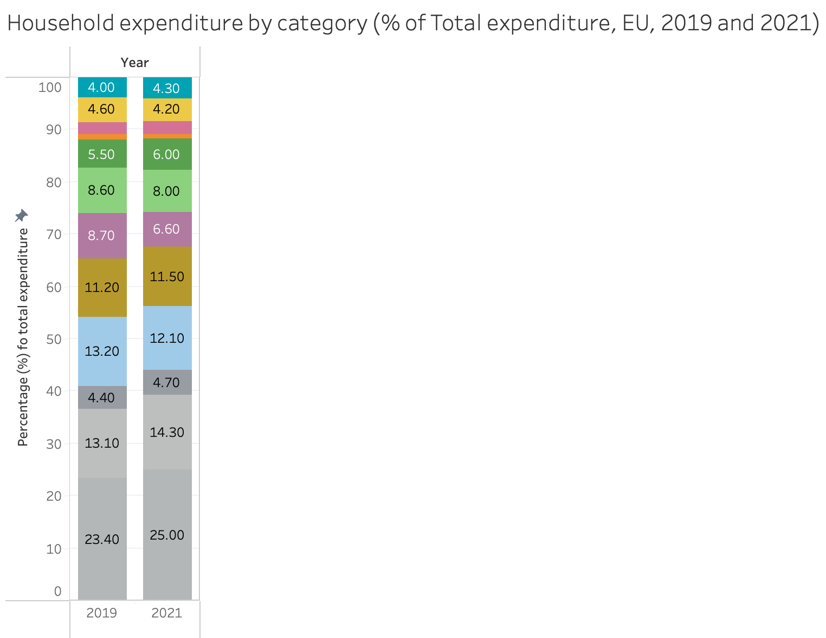
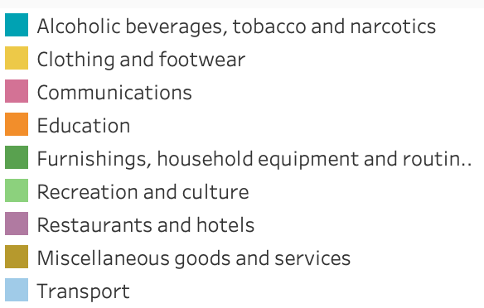
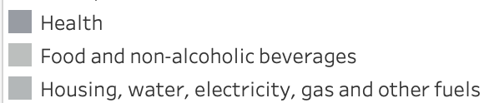
Changes in household expenditure
Non-primary:
Primary:
Notes:
people focused more on necessities
and adjusting to a digital world
changes due to inflation, loss of income or savings during covid and the restrictions
then do comparison of categories in stacked bar and look at primary needs vs others
change these graphs to be difference between 2019 and 2021

Slide 10
Datasets used:
Google mobility data
Household expenditure (eurostat)
Internet users (eurostat)

Slide 11
Thank you! Any questions?

