Slide 1
The Mortality and Medical Costs of Air Pollution: Evidence from Changes in Wind Direction
Tatyana Deryugina¹, Garth Heutel², Nolan Miller¹, David Molitor¹, and Julian Reif¹
¹Illinois Gies College of Business and NBER
²Georgia State University and NBER
Notre Dame
March 26, 2019

Slide 2
How bad is air pollution for adult health?
Air pollution harms health and increases medical costs
Recent epidemiological focus on “fine particulate matter” (PM 2.5)
Optimal environmental policy depends on magnitude of health effects
Large literature on the health effects of air pollution (e.g., Chay and Greenstone 2003; Currie and Neidell 2005; Anderson 2016; Knittel et al. 2016; Schlenker and Walker 2016; Deryugina and Reif 2019)
Most evidence is limited to infants and pollutants other than PM 2.5

Slide 3
Research questions
Setting: elderly population in the United States, 1999-2013
What is the causal effect of acute (one-day) exposure to PM 2.5 pollution?
Short-run outcomes: three-day mortality, health care use, and medical spending
Long-run outcomes: life-years lost
How much does the mortality effect vary across the elderly population?
Who is most vulnerable?

Slide 4
Identification is challenging
Is the pollution variation exogenous?
Quasi-experimental studies generally confined to small areas and time periods
How does mortality map to life-years lost?
What is the best way to estimate heterogeneous treatment effects?
Not straightforward in high-dimensional settings

Slide 5
How do we address these challenges?
Innovation #1: use variation in wind direction as instrument for daily pollution
Estimate causal effect of PM 2.5 on mortality, hospitalizations, and spending
Instrument also controls for other pollutants (e.g., carbon monoxide)
Innovation #2: develop new methodology to estimate life-years lost (LYL)
Predict life expectancy using high-dimensional Medicare data and machine learning
Innovation #3: develop two new approaches to characterize heterogeneity
Use predicted life expectancy
Use generic machine learning approach of Chernozhukov et al. (2018)

Slide 6
Contributions to the literature
Air pollution and health
Novel dataset: 13 years of Medicare administrative data combined with daily climate data
New instrument: changes in daily wind direction
LYL approach: we show that traditional methods are biased upwards
New analysis: distribution of mortality burden
Generic machine learning inference on heterogeneous treatment effects
We adapt the Chernozhukov et al. RCT methodology to a quasi-experimental setting
Our LYL and heterogeneity methodologies can be applied to other settings
Example: effect of health insurance on mortality

Slide 7
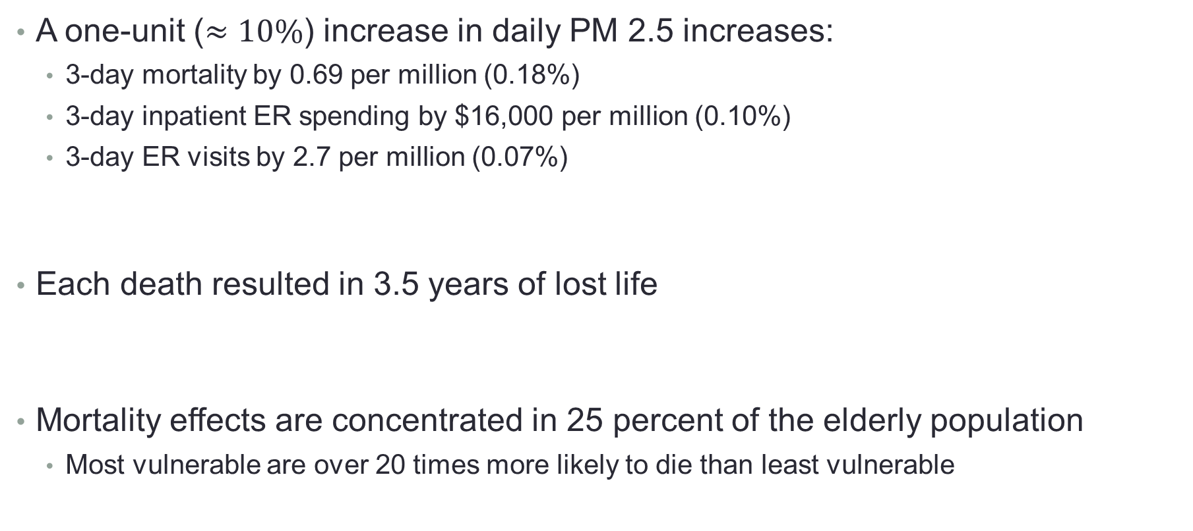
Preview of results
A one-unit ($≈10\%$) increase in daily PM 2.5 increases:
3-day mortality by 0.69 per million (0.18%)
3-day inpatient ER spending by $16,000 per million (0.10%)
3-day ER visits by 2.7 per million (0.07%)
Each death resulted in 3.5 years of lost life
Mortality effects are concentrated in 25 percent of the elderly population
Most vulnerable are over 20 times more likely to die than least vulnerable

Slide 8
Background and Data

Slide 9
EPA regulates six air pollutants
Carbon monoxide
Ozone
Nitrogen dioxide
Sulfur dioxide
Lead
Particulate matter
Total suspended particulates
PM 10
PM 2.5 (our focus today)
PM 2.5 is regulated at the daily and annual levels

Slide 10
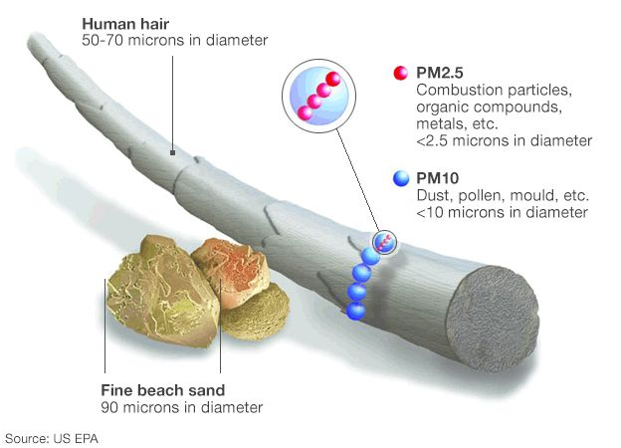
PM 2.5 particles are less than 2.5 microns in diameter

Slide 11
Daily environmental data
Air pollution obtained from EPA site monitors
PM 2.5 data available beginning in 1999
Not available for all counties→ limiting factor in the final size of our sample
Temperature and precipitation obtained from Schlenker and Roberts (2009)
Wind direction and wind speed obtained from National Centers for Environmental Information
All data are aggregated to the county-day level

Slide 12
Daily mortality and health care utilization data
Medicare enrollment files (1999-2013)
Main sample: Medicare beneficiaries ages 65-100
Data on exact date of death, zip code of residence, age, sex, and race
Fee-for-service sample (2001-2013)
“Traditional Medicare”, includes 70% of all enrollees in our sample
Detailed data on hospital spending, hospital admissions, and chronic conditions
Aggregate to county-day level and merge with environmental data
Main specification: N = 1,980,549

Slide 13
PM 2.5 levels are decreasing over time
Current annual PM 2.5 standard

Slide 14
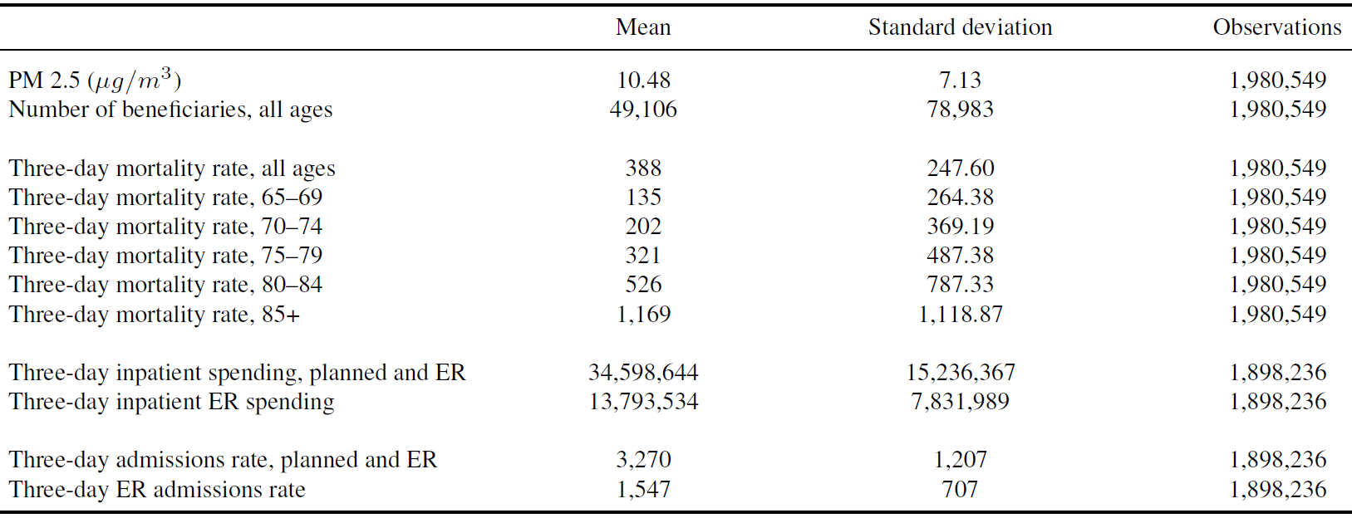
Summary statistics, 1999-2013
Notes: Unit of observation is county-day. All rate/spending variables are per million beneficiaries.

Slide 15
Summary statistics, 1999-2013
Notes: Unit of observation is county-day. All rate/spending variables are per million beneficiaries.

Slide 16
Summary statistics, 1999-2013
Notes: Unit of observation is county-day. All rate/spending variables are per million beneficiaries.

Slide 17
Summary statistics, 1999-2013
Notes: Unit of observation is county-day. All rate/spending variables are per million beneficiaries.

Slide 18
Empirical STrategy

Slide 19
Empirical strategy
Wind carries pollutants over long distances
Wind direction is strongly related to air pollution
Our innovation: it is not necessary to isolate a particular pollution source!
Maximizes the size of our estimation sample
Identifying assumption:
Wind direction is unrelated to health except through pollution (conditional on controls)

Slide 20
How do we construct our instruments?
Use clustering algorithm to assign pollution monitors to 100 regional groups
First stage is group-specific relationship between wind direction and pollution
Allow pollution transport patterns to vary across groups
Wind blowing from the west can have a different effect in California than in Massachusetts

Slide 21
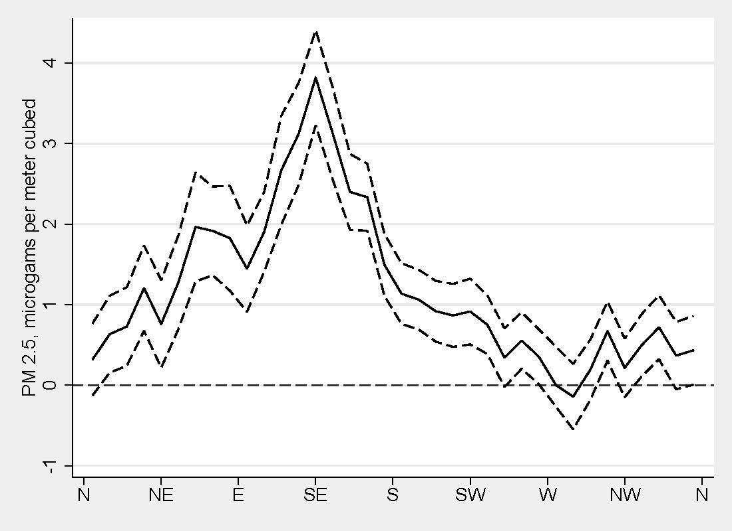
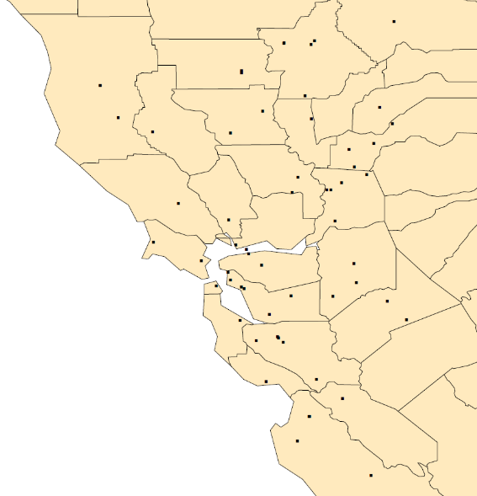
Wind direction and PM 2.5 in Bay Area, CA
San Francisco
Regression of PM 2.5 on 10-degree bins and controls

Slide 22
Wind direction and PM 2.5 in Bay Area, CA
San Francisco
Dirty
Regression of PM 2.5 on 10-degree bins and controls

Slide 23
Wind direction and PM 2.5 in Bay Area, CA
Clean
San Francisco
Dirty
Regression of PM 2.5 on 10-degree bins and controls

Slide 24
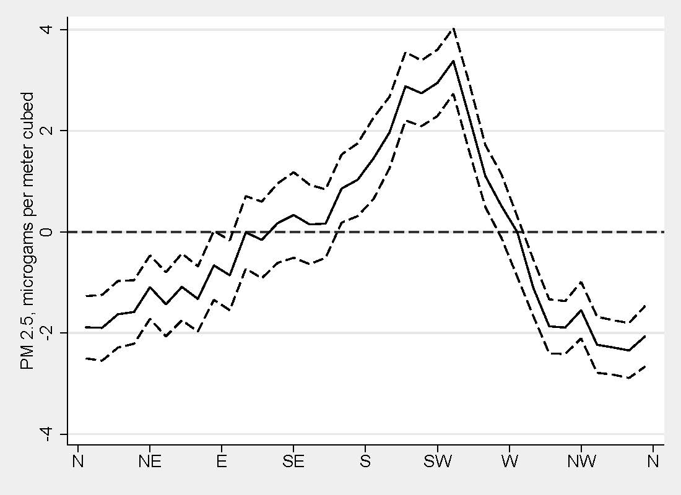
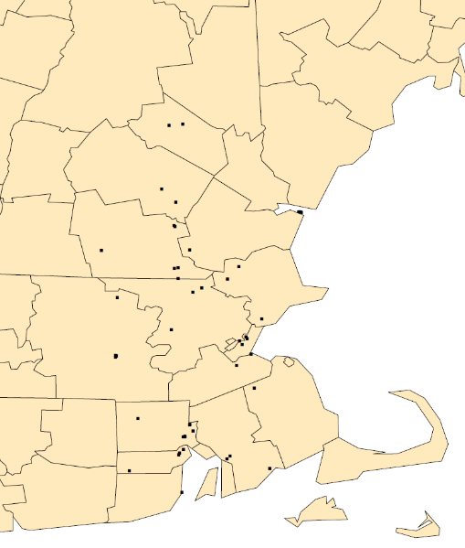
Wind direction and PM 2.5 in the Boston Area
Boston
Regression of PM 2.5 on 10-degree bins and controls

Slide 25
Wind direction and PM 2.5 in the Boston Area
Boston
Dirty
Regression of PM 2.5 on 10-degree bins and controls

Slide 26
Wind direction and PM 2.5 in the Boston Area
Clean
Boston
Dirty
Regression of PM 2.5 on 10-degree bins and controls

Slide 27
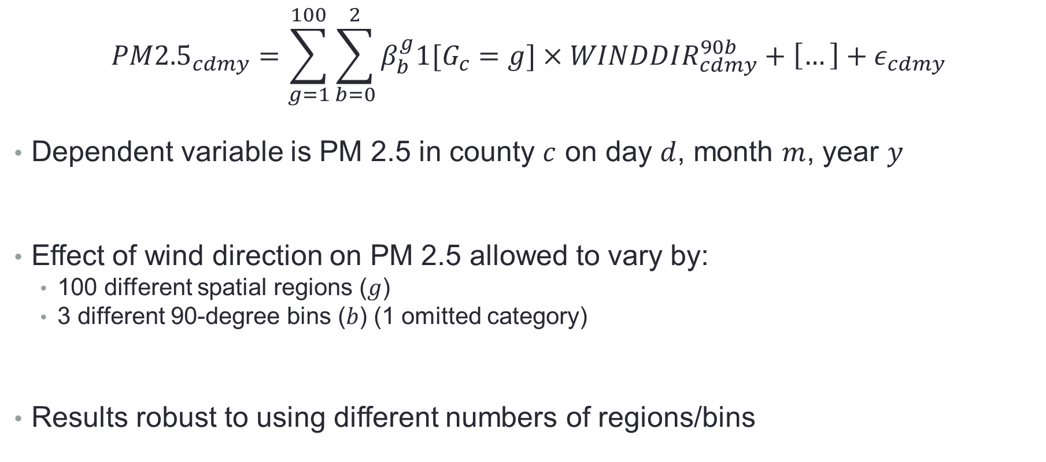
First stage has 300 instruments
$${PM2.5}_{cdmy}=\sum_{g=1}^{100}{\sum_{b=0}^{2}{β_{b}^{g}1[G_{c}=g]×WINDDIR_{cdmy}^{90b}}}+\left[…\right]+ε_{cdmy}$$
Dependent variable is PM 2.5 in county $c$ on day $d$, month $m$, year $y$
Effect of wind direction on PM 2.5 allowed to vary by:
100 different spatial regions ($g$)
3 different 90-degree bins ($b$) (1 omitted category)
Results robust to using different numbers of regions/bins

Slide 28
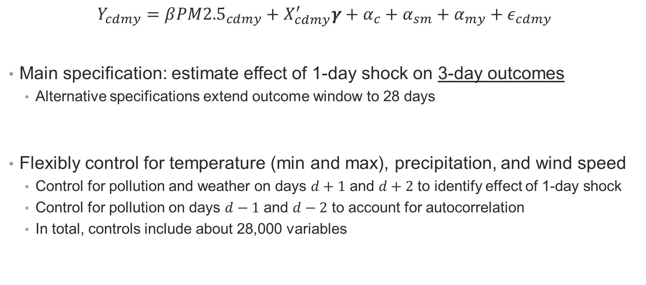
Second stage
$$Y_{cdmy}=β{PM2.5}_{cdmy}+X_{cdmy}^{′}γ+α_{c}+α_{sm}+α_{my}+ε_{cdmy}$$
Main specification: estimate effect of 1-day shock on 3-day outcomes
Alternative specifications extend outcome window to 28 days
Flexibly control for temperature (min and max), precipitation, and wind speed
Control for pollution and weather on days $d+1$ and $d+2$ to identify effect of 1-day shock
Control for pollution on days $d−1$ and $d−2$ to account for autocorrelation
In total, controls include about 28,000 variables

Slide 29


Locally-produced pollution is bad variation
Wind blows from west
Power plant
Pollution monitor

Slide 30
Locally-produced pollution is bad variation
Wind blows from west
Power plant
Pollution monitor
→ high pollution readings

Slide 31
Locally-produced pollution is bad variation
Wind blows from west
Power plant
Pollution monitor
→ high pollution readings
Pollution exposure goes up in half the county

Slide 32
Locally-produced pollution is bad variation
Wind blows from east
Power plant
Pollution monitor

Slide 33
Locally-produced pollution is bad variation
Wind blows from east
Power plant
Pollution monitor
→ low pollution readings

Slide 34
Locally-produced pollution is bad variation
Wind blows from east
Power plant
Pollution monitor
→ low pollution readings
But again, pollution exposure increases for half the county → measurement error

Slide 35
What variation are we capturing?
Our first stage imposes restriction that the effect of wind direction on pollution is identical across counties within a regional group
This removes variation from locally generated air pollution
Thus, variation comes primarily from long-range transport
This variation affects all parts of the county (unit of observation)
Minimizes measurement error
Our estimate has a LATE interpretation
Requires monotonicity assumption

Slide 36
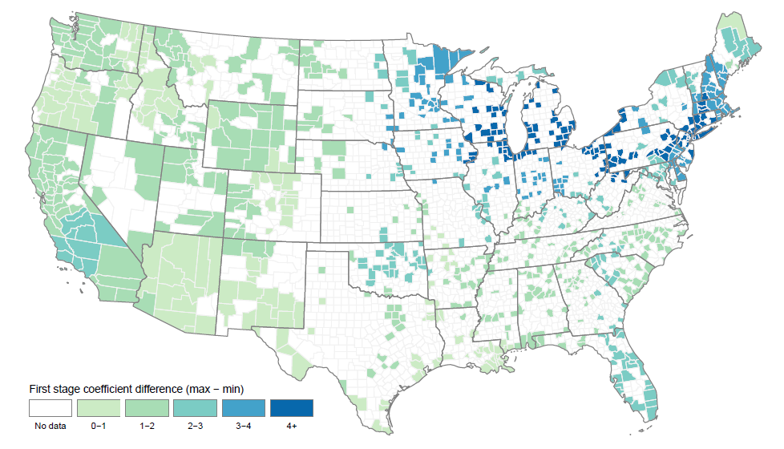
Our identifying variation is concentrated in Midwest/Northeast
Notes: Larger differences (4+) indicate greater effect of changes in wind direction on pollution levels

Slide 37
Results

Slide 38
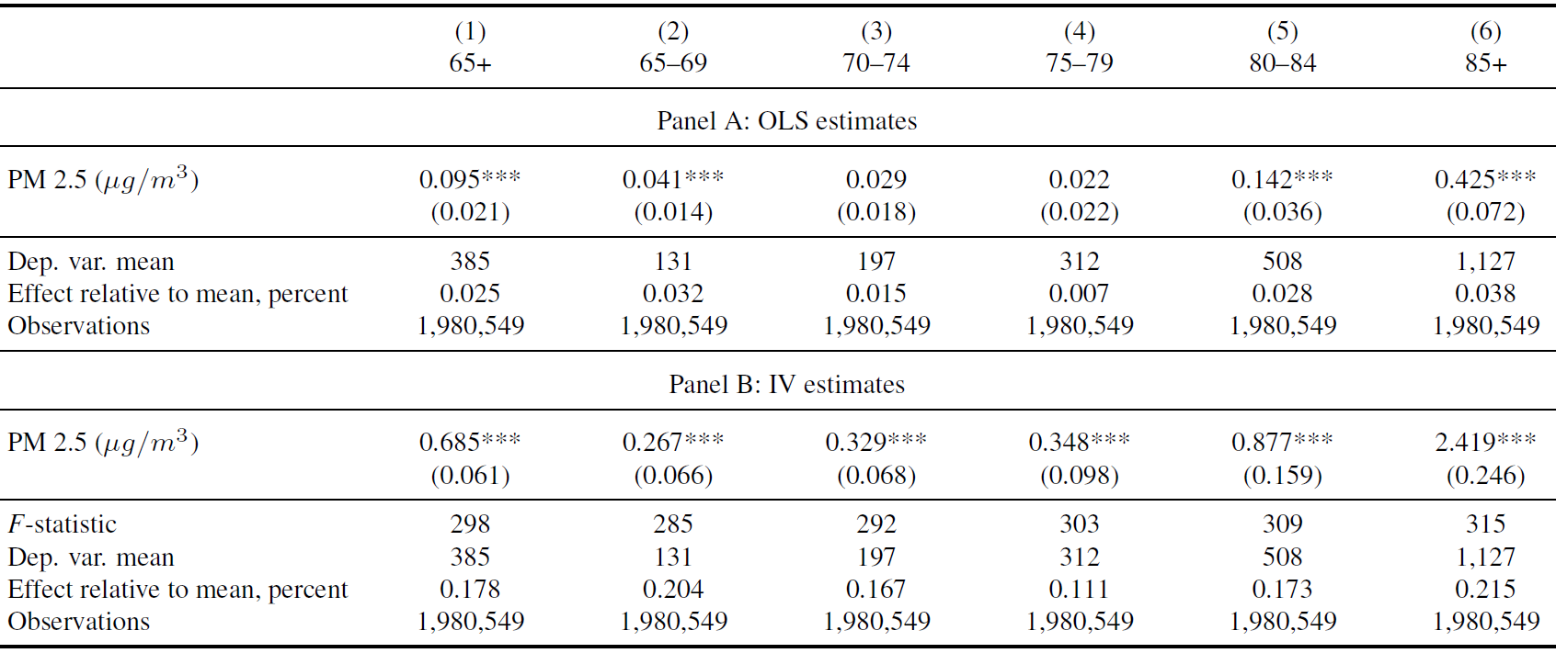
Effect of PM 2.5 on 3-day mortality, by age
Dependent variable is 3-day mortality rates per million beneficiaries. Standard errors clustered by county. *** $p< 0.01$, ** $p<0.05$, * $p<0.10$.

Slide 39
Effect of PM 2.5 on 3-day mortality, by age
Dependent variable is 3-day mortality rates per million beneficiaries. Standard errors clustered by county. *** $p< 0.01$, ** $p<0.05$, * $p<0.10$.

Slide 40
IV estimate is much larger than OLS
Dependent variable is 3-day mortality rates per million beneficiaries. Standard errors clustered by county. *** $p< 0.01$, ** $p<0.05$, * $p<0.10$.

Slide 41
Mortality effect increases with age
Dependent variable is 3-day mortality rates per million beneficiaries. Standard errors clustered by county. *** $p< 0.01$, ** $p<0.05$, * $p<0.10$.

Slide 42
Mortality effect increases with age
Dependent variable is 3-day mortality rates per million beneficiaries. Standard errors clustered by county. *** $p< 0.01$, ** $p<0.05$, * $p<0.10$.

Slide 43
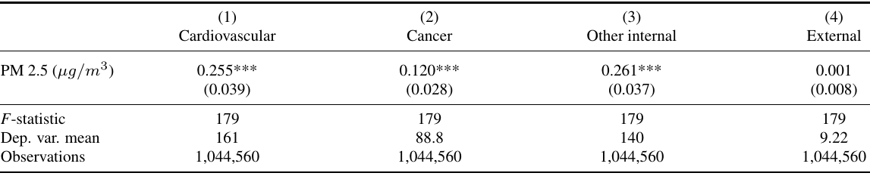
No effect on external causes of death
Dependent variable is 3-day mortality rates per million beneficiaries. Standard errors clustered by county. *** $p< 0.01$, ** $p<0.05$, * $p<0.10$.
External causes of death include motor vehicle fatalities, homicides, falls, poisonings, and other accidents

Slide 44
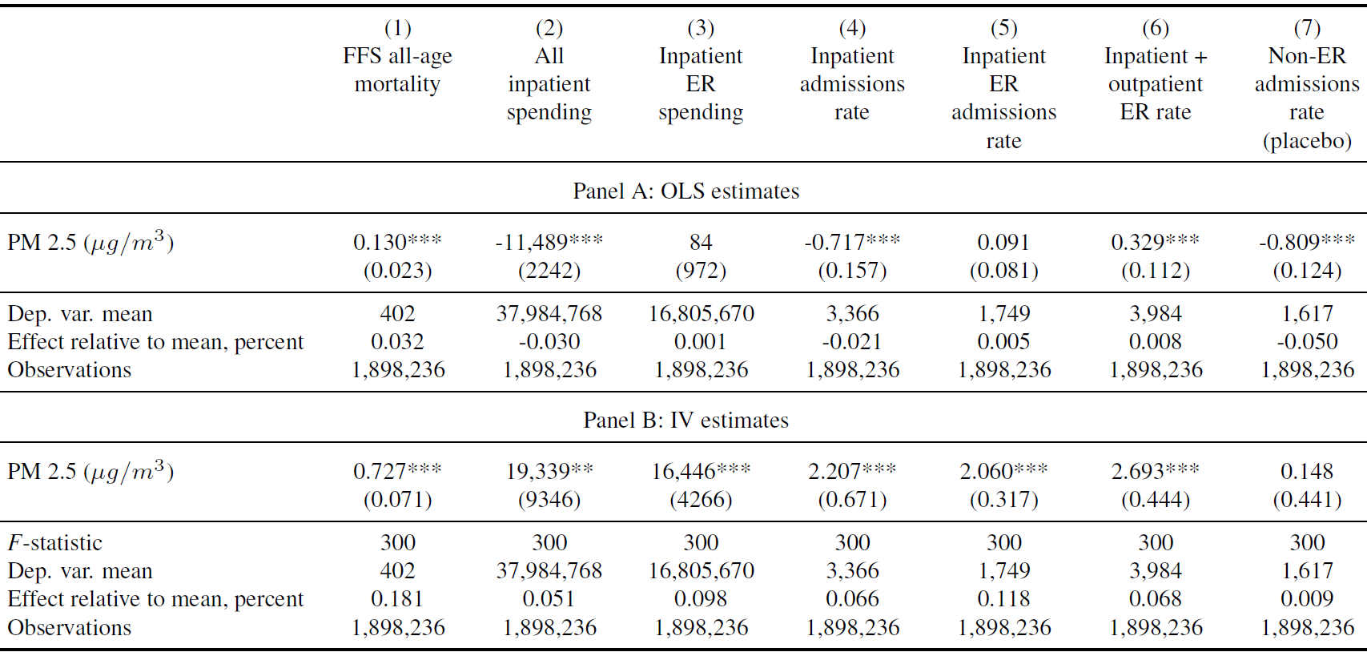
Effect of PM 2.5 on 3-day hospital spending
All outcomes are 3-day rates per million. Std. errors clustered by county. *** $p< 0.01$, ** $p<0.05$, * $p<0.10$.

Slide 45
Effect of PM 2.5 on 3-day hospital admissions
All outcomes are 3-day rates per million. Std. errors clustered by county. *** $p< 0.01$, ** $p<0.05$, * $p<0.10$.

Slide 46
No effect on planned admissions (placebo)
All outcomes are 3-day rates per million. Std. errors clustered by county. *** $p< 0.01$, ** $p<0.05$, * $p<0.10$.

Slide 47
IV and OLS results are very different
All outcomes are 3-day rates per million. Std. errors clustered by county. *** $p< 0.01$, ** $p<0.05$, * $p<0.10$.

Slide 48
IV and OLS results are very different
All outcomes are 3-day rates per million. Std. errors clustered by county. *** $p< 0.01$, ** $p<0.05$, * $p<0.10$.

Slide 49
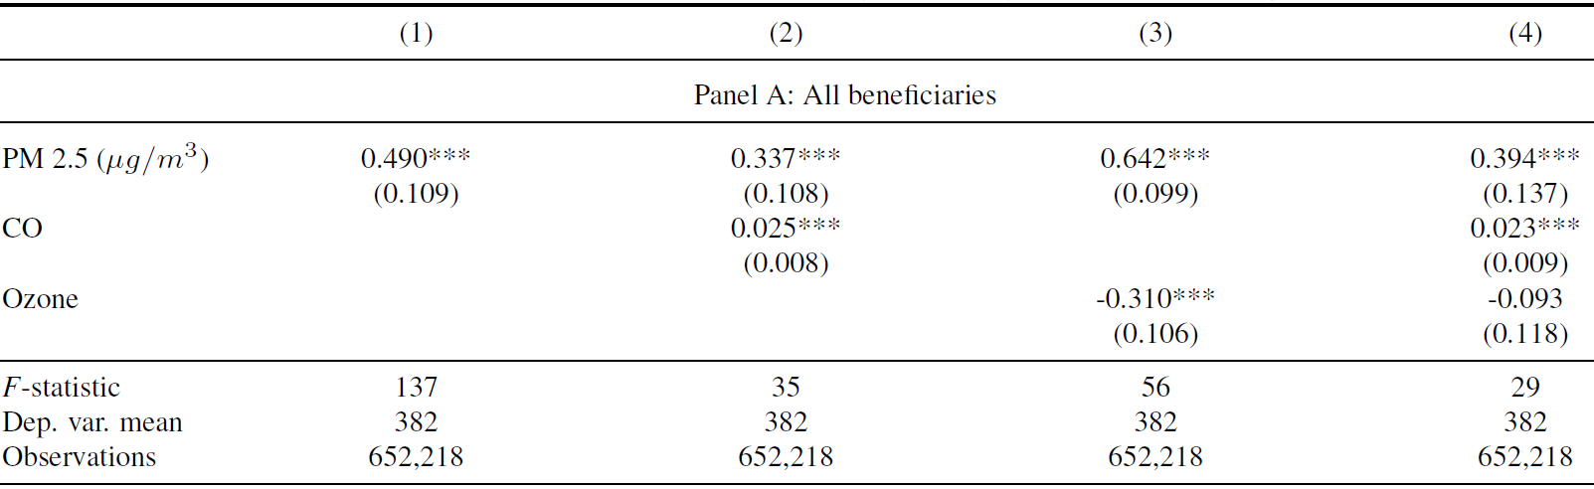
Effect of PM 2.5 on mortality, controlling for other pollutants
Dependent variable is 3-day mortality rates per million beneficiaries. Standard errors clustered by county. *** $p< 0.01$, ** $p<0.05$, * $p<0.10$.

Slide 50
Our results are not driven by mortality displacement
Main (3-day) specification

Slide 51

Estimating life-years lost (${\hat{L}}_{cdmy}$)
Naïve example: multiply deaths by average life expectancy
Is biased if decedents are unrepresentative of typical Medicare beneficiary
More sophisticated: Deschênes and Greenstone (2011) control for age
Intuitively, adding more controls should reduce bias

Slide 52
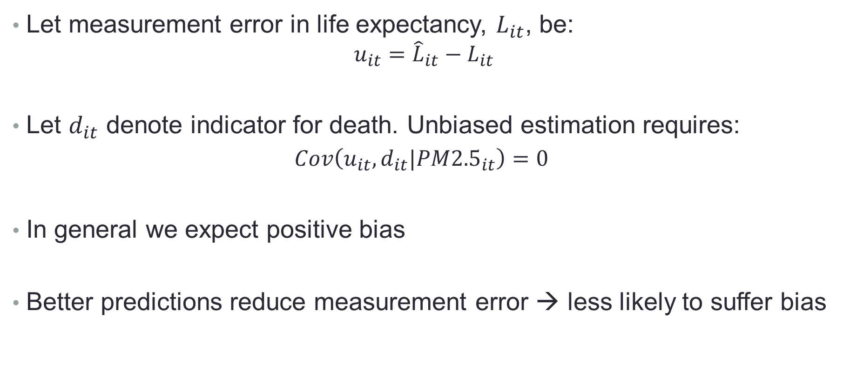
We first develop an econometric framework
Let measurement error in life expectancy, $L_{it}$, be:
$$u_{it}={\hat{L}}_{it}−L_{it}$$
Let $d_{it}$ denote indicator for death. Unbiased estimation requires:
$$Cov\left(u_{it}, d_{it}|PM{2.5}_{it}\right)=0$$
In general we expect positive bias
Better predictions reduce measurement error → less likely to suffer bias

Slide 53
We predict life expectancy using Medicare data
We create a survival dataset for the 2002 Medicare cohort
Individuals are observed from 2002-2013
High-dimensional data on demographics, prior health care use, and prior health
Predict survival using two different machine learning methods:
Cox-Lasso (Tibshirani 1997)
Survival random forest (Ishwaran et al. 2008)
Calculate life expectancy using these survival estimates
Aggregate to county-day level to create new outcome: life-years lost

Slide 54
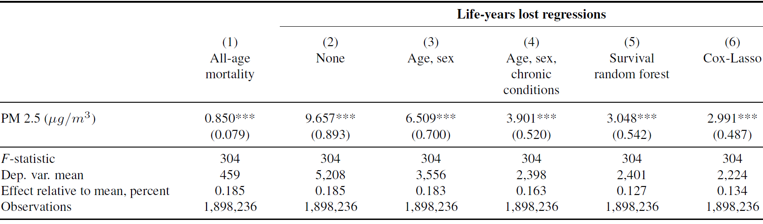
Daily PM 2.5 and life-years lost, IV
Dependent variable is life-years lost per million beneficiaries over the three days following the pollution shock. Standard errors clustered by county. *** $p< 0.01$, ** $p<0.05$, * $p<0.10$.

Slide 55
Daily PM 2.5 and life-years lost, IV
Dependent variable is life-years lost per million beneficiaries over the three days following the pollution shock. Standard errors clustered by county. *** $p< 0.01$, ** $p<0.05$, * $p<0.10$.

Slide 56
Daily PM 2.5 and life-years lost, IV
Dependent variable is life-years lost per million beneficiaries over the three days following the pollution shock. Standard errors clustered by county. *** $p< 0.01$, ** $p<0.05$, * $p<0.10$.

Slide 57
Daily PM 2.5 and life-years lost, IV
Dependent variable is life-years lost per million beneficiaries over the three days following the pollution shock. Standard errors clustered by county. *** $p< 0.01$, ** $p<0.05$, * $p<0.10$.

Slide 58
Social value of mortality reduction
PM 2.5 levels decreased by 4.9 units from 1999-2013
Our estimates imply that this 4.9 unit reduction:
Saves 54,000 lives (235,000 life-years) annually
$100,000 per life-year implies $23.5 billion in annual benefits
Approximately equal to estimated compliance costs
Much larger than the corresponding medical cost savings ($1.5 billion)

Slide 59
Heterogeneity

Slide 60
Heterogeneous treatment effects
Mortality effects of pollution are likely to vary across the elderly population
Who is most vulnerable?
We search for heterogeneity using two different approaches:
Use predicted life expectancy as a measure of vulnerability
Method of Chernozhukov, Demirer, Duflo, and Fernandez-Val (2018) (“CDDF”)

Slide 61
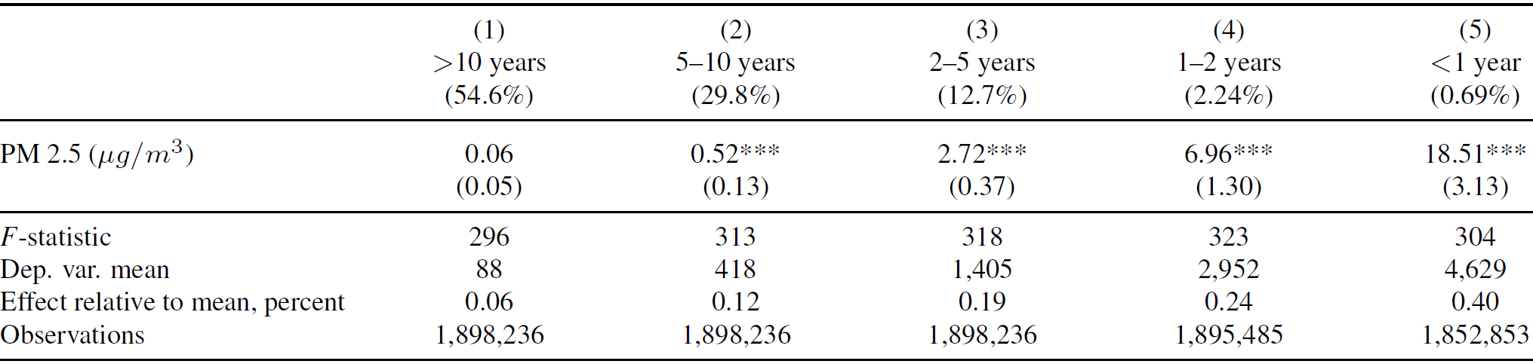
Elderly with low LE are the most vulnerable
Notes: Column header displays predicted life expectancy. Standard errors clustered by county. *** $p< 0.01$, ** $p<0.05$, * $p<0.10$.

Slide 62
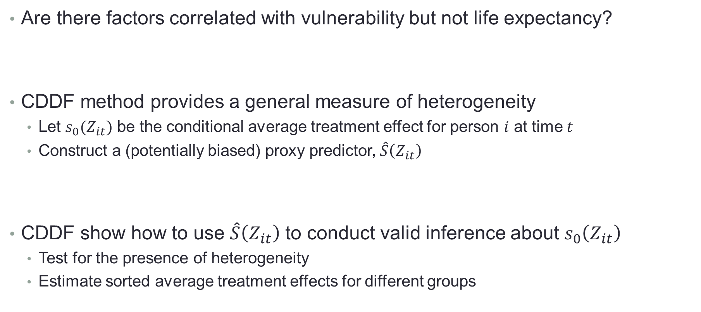
Is life expectancy the best measure of vulnerability?
Are there factors correlated with vulnerability but not life expectancy?
CDDF method provides a general measure of heterogeneity
Let $s_{0}(Z_{it})$ be the conditional average treatment effect for person $i$ at time $t$
Construct a (potentially biased) proxy predictor, $\hat{S}\left(Z_{it}\right)$
CDDF show how to use $\hat{S}\left(Z_{it}\right)$ to conduct valid inference about $s_{0}\left(Z_{it}\right)$
Test for the presence of heterogeneity
Estimate sorted average treatment effects for different groups

Slide 63
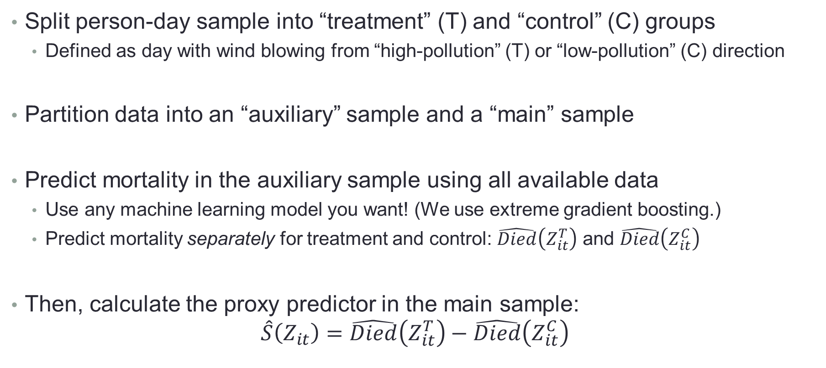

Estimating the proxy predictor, $\hat{S}\left(Z_{it}\right)$
Split person-day sample into “treatment” (T) and “control” (C) groups
Defined as day with wind blowing from “high-pollution” (T) or “low-pollution” (C) direction
Partition data into an “auxiliary” sample and a “main” sample
Predict mortality in the auxiliary sample using all available data
Use any machine learning model you want! (We use extreme gradient boosting.)
Predict mortality separately for treatment and control: $\hat{Died}\left(Z_{it}^{T}\right)$ and $\hat{Died}\left(Z_{it}^{C}\right)$
Then, calculate the proxy predictor in the main sample:
$$\hat{S}\left(Z_{it}\right)=\hat{Died}\left(Z_{it}^{T}\right)−\hat{Died}\left(Z_{it}^{C}\right)$$

Slide 64
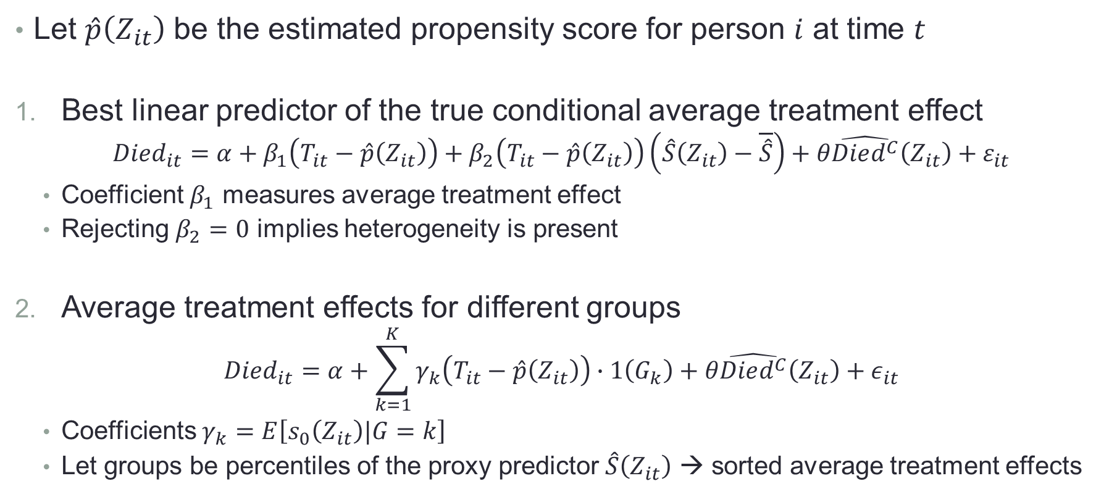
Measuring heterogeneous treatment effects
Let $\hat{p}\left(Z_{it}\right)$ be the estimated propensity score for person $i$ at time $t$
Best linear predictor of the true conditional average treatment effect
$$Died_{it}=α+β_{1}\left(T_{it}−\hat{p}\left(Z_{it}\right)\right)+β_{2}\left(T_{it}−\hat{p}\left(Z_{it}\right)\right)\left(\hat{S}\left(Z_{it}\right)−\overline{\hat{S}}\right)+θ\hat{Died^{C}}\left(Z_{it}\right)+ε_{it}$$
Coefficient $β_{1}$ measures average treatment effect
Rejecting $β_{2}=0$ implies heterogeneity is present
Average treatment effects for different groups
$$Died_{it}=α+\sum_{k=1}^{K}{γ_{k}\left(T_{it}−\hat{p}\left(Z_{it}\right)\right)}∙1\left(G_{k}\right)+θ\hat{Died^{C}}\left(Z_{it}\right)+ε_{it}$$
Coefficients $γ_{k}=E\left[s_{0}\left(Z_{it}\right)|G=k\right]$
Let groups be percentiles of the proxy predictor $\hat{S}\left(Z_{it}\right)$ → sorted average treatment effects

Slide 65
Challenges in implementing the CDDF methodology
CDDF was designed for RCT’s (binary treatment variables)
Solution: we discretize our instrument (“high” pollution-wind direction vs “low”)
Machine learning does a poor job predicting daily mortality
Probability of somebody dying on any given day is very low
We follow Einav et al. (2018) and “downsample” the data for the prediction step
Our person-day sample includes about 50 billion observations
Focus on 1-day mortality instead of 3-day mortality
Employ a smaller set of fixed effects (Census division instead of county)
Estimate regressions using 250 subsamples, then aggregate

Slide 66
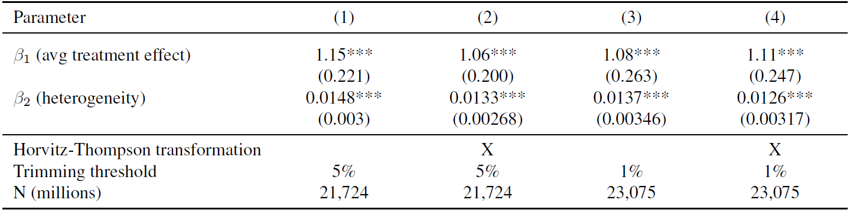
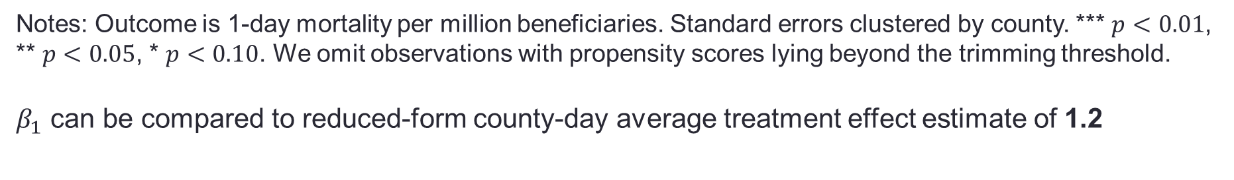
Best linear prediction of conditional ATE
Notes: Outcome is 1-day mortality per million beneficiaries. Standard errors clustered by county. *** $p<0.01$, ** $p<0.05$, * $p<0.10$. We omit observations with propensity scores lying beyond the trimming threshold.
$β_{1}$ can be compared to reduced-form county-day average treatment effect estimate of 1.2

Slide 67
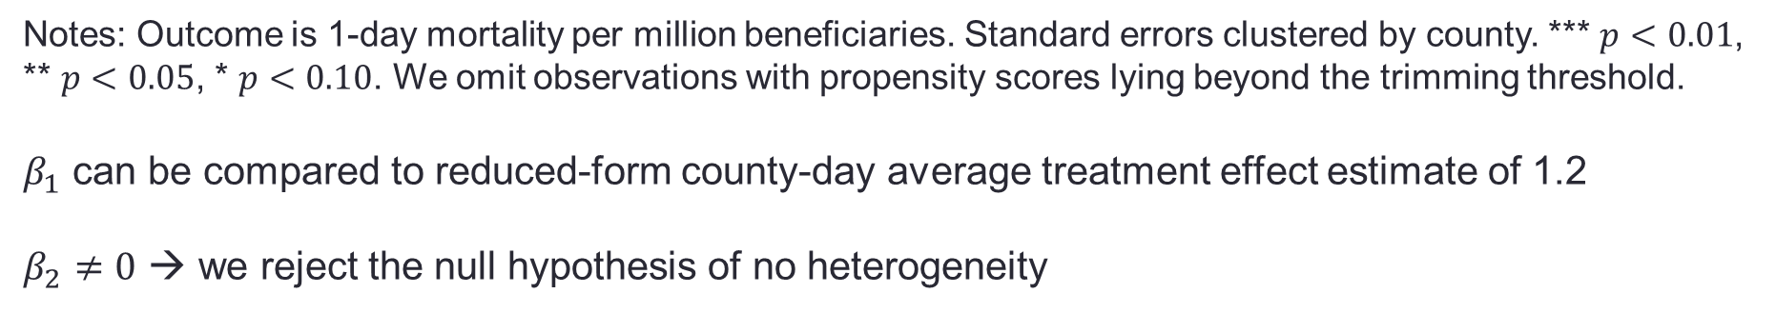
Best linear prediction of conditional ATE
Notes: Outcome is 1-day mortality per million beneficiaries. Standard errors clustered by county. *** $p<0.01$, ** $p<0.05$, * $p<0.10$. We omit observations with propensity scores lying beyond the trimming threshold.
$β_{1}$ can be compared to reduced-form county-day average treatment effect estimate of 1.2
$β_{2}≠0$ → we reject the null hypothesis of no heterogeneity

Slide 68
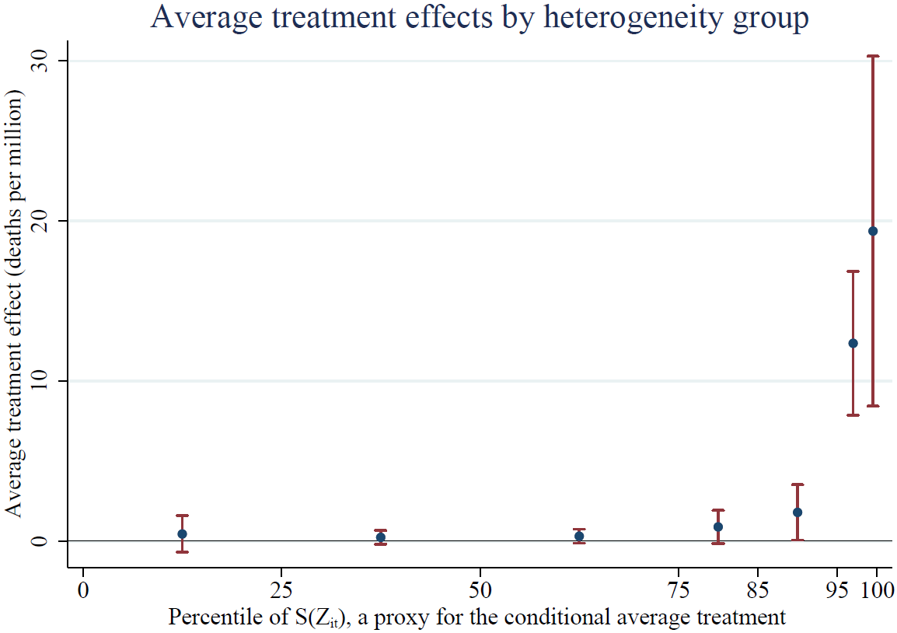
Sorted group average treatment effects
Similar to the life expectancy analysis, mortality effects are concentrated in the tail.

Slide 69
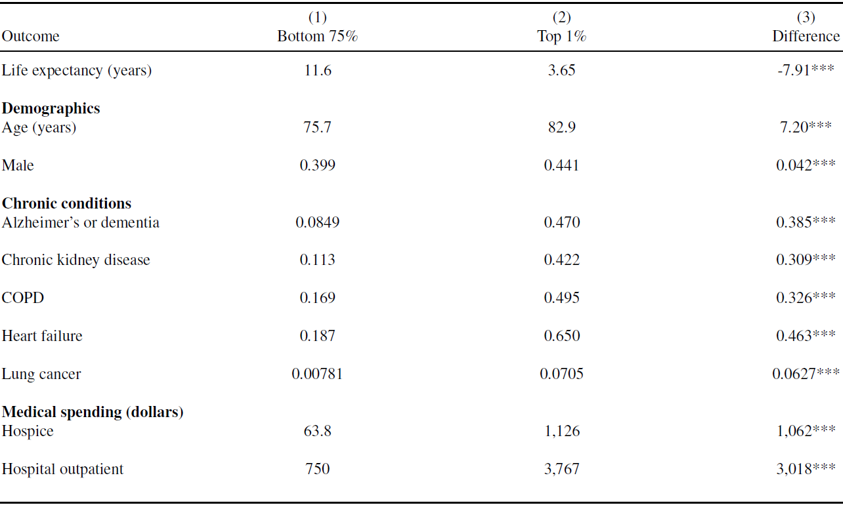
Comparing the least and most vulnerable groups

Slide 70
Comparing the least and most vulnerable groups

Slide 71
Comparing the least and most vulnerable groups

Slide 72
Comparing the least and most vulnerable groups

Slide 73
Discussion of results
Current levels of PM 2.5 harm the elderly
Mortality costs are order of magnitude larger than medical costs
Effects of chronic (>1-day) exposure may be larger
Accounting for health when calculating LYL matters greatly
Controlling for just age and sex helps, but is insufficient
Estimates shrink by over 50 percent after factoring in health care variables
Mortality effects are concentrated in 25 percent of the population
Elderly with low predicted life expectancy are the most vulnerable
Is life expectancy a good measure of vulnerability outside of this setting?

Slide 74
Questions?

Slide 75
Additional tables and figures

Slide 76
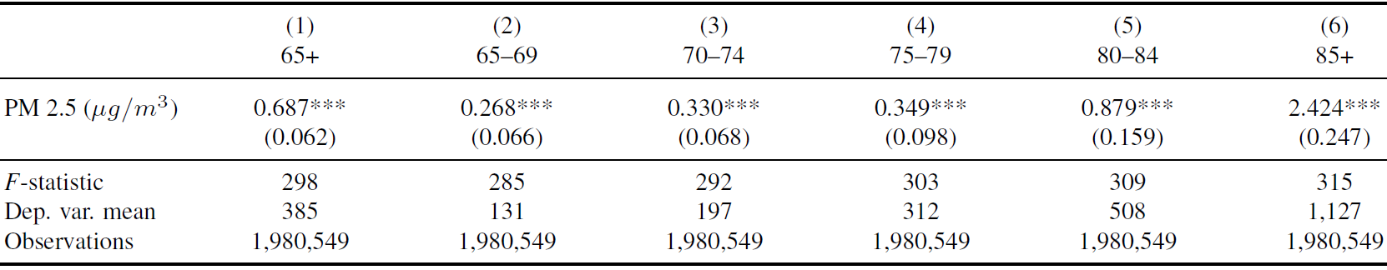
Daily PM 2.5 and mortality, LIML IV
Notes: Dependent variable is 3-day mortality rate per million beneficiaries. Standard errors clustered by county. *** $p<0.01$, ** $p<0.05$, * $p<0.10$.

Slide 77
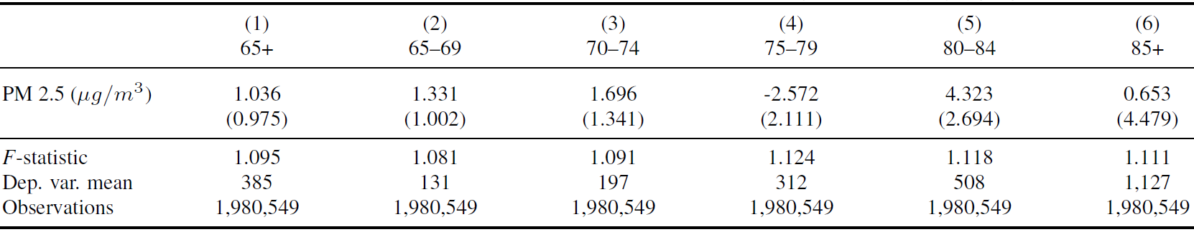
Daily PM 2.5 and mortality, placebo IV
Notes: Dependent variable is 3-day mortality rate per million beneficiaries. Standard errors clustered by county. *** $p<0.01$, ** $p<0.05$, * $p<0.10$.

Slide 78
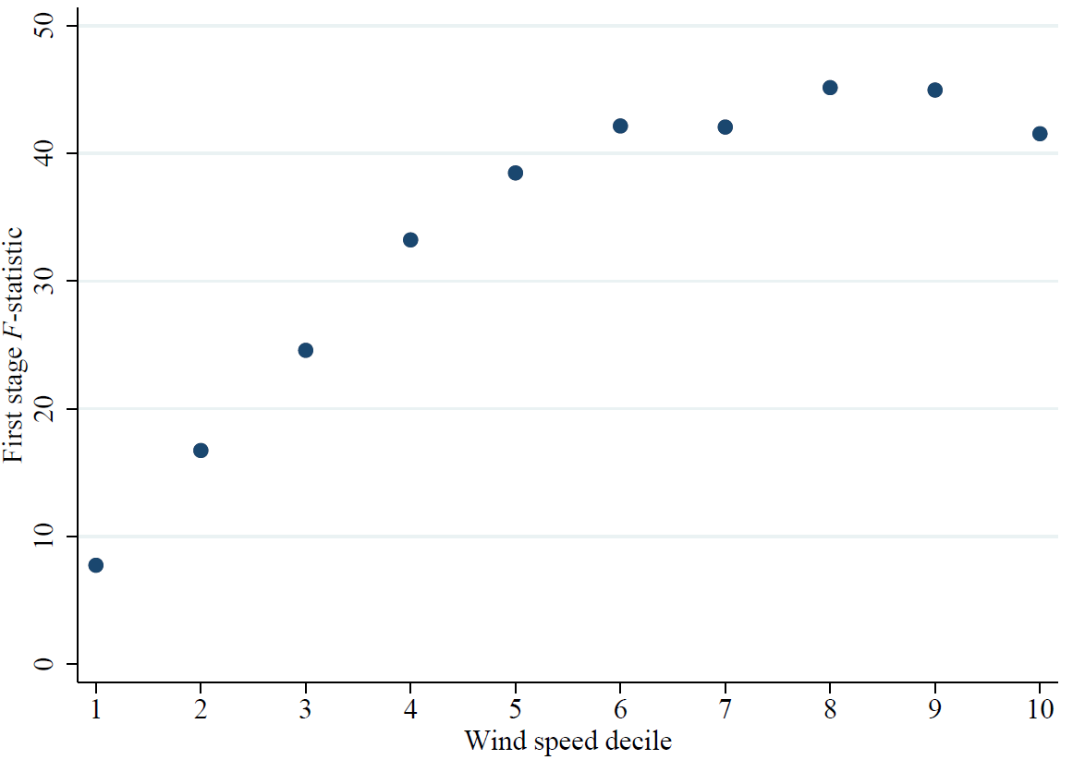
First stage is strongest on high wind speed days
This figure reports the F-statistic for our first stage for ten different subsamples that each include only days that fall within a particular wind speed decile.

Slide 79
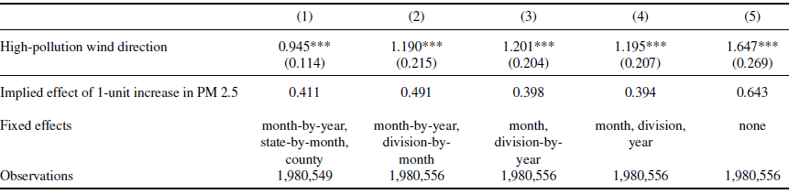
Reduced form estimates (county-day sample)
Notes: Outcome is 1-day mortality per million beneficiaries. Regression specification is:
$$Y_{cdmy}=βT_{cdmy}+X_{cdmy}^{′}γ+α_{c}+α_{sm}+α_{my}+ε_{cdmy}$$
where $T_{cdmy}$ is indicator for wind direction associated with high pollution.

Slide 80
Reduced form estimates (county-day sample)
Notes: Outcome is 1-day mortality per million beneficiaries. Regression specification is:
$$Y_{cdmy}=βT_{cdmy}+X_{cdmy}^{′}γ+α_{c}+α_{sm}+α_{my}+ε_{cdmy}$$
where $T_{cdmy}$ is indicator for wind direction associated with high pollution.
Baseline specification, which uses continuous instrument, estimates an effect of 0.40 for daily mortality

Slide 81
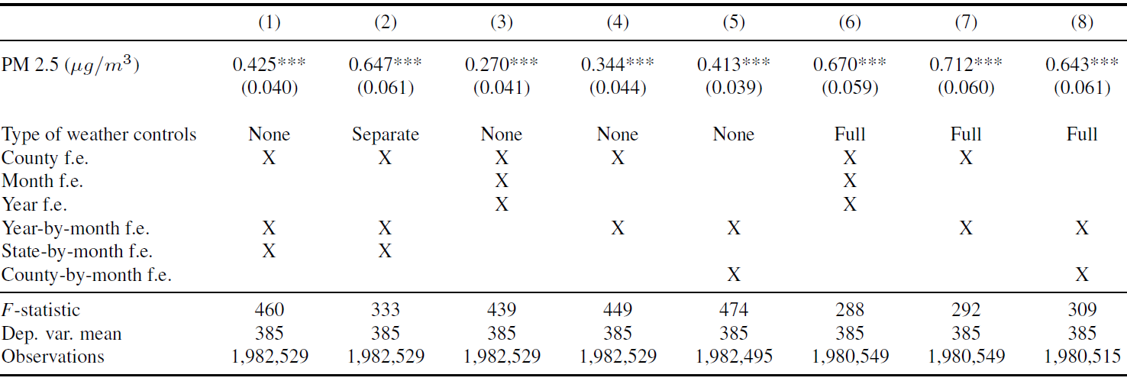
Different fixed effects and weather controls, IV
Notes: Dependent variable is 3-day mortality rate per million beneficiaries. Standard errors clustered by county. *** $p<0.01$, ** $p<0.05$, * $p<0.10$.

Slide 82
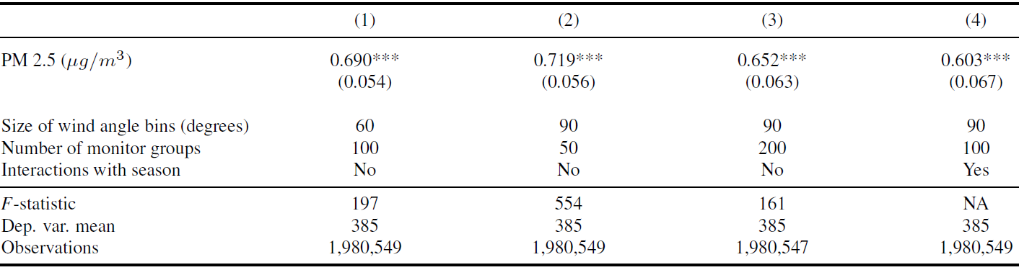
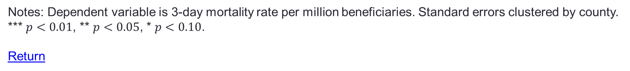
Different numbers of monitor groups and wind angle bins
Notes: Dependent variable is 3-day mortality rate per million beneficiaries. Standard errors clustered by county. *** $p<0.01$, ** $p<0.05$, * $p<0.10$.
Return

Slide 83
Adding variables increases precision
Estimated using all available data
Life expectancy is estimated as of January 1 of the calendar year of death.

