Slide 1
SEP 420 – Web Programming and Scripting
Week 10

Slide 2
Learning Outcomes
Searching through Arrays
Using functions

Slide 3
Searching An Array
How to search for an item in an array
Here is the process for searching for an item in an array:
Create a for-loop that iterates through each item in the array
For each item in the array, check if the item matches the search criteria
If yes, then you found the item! And then do something with the item
If no, then keep searching until you reach the end of the array

Slide 4
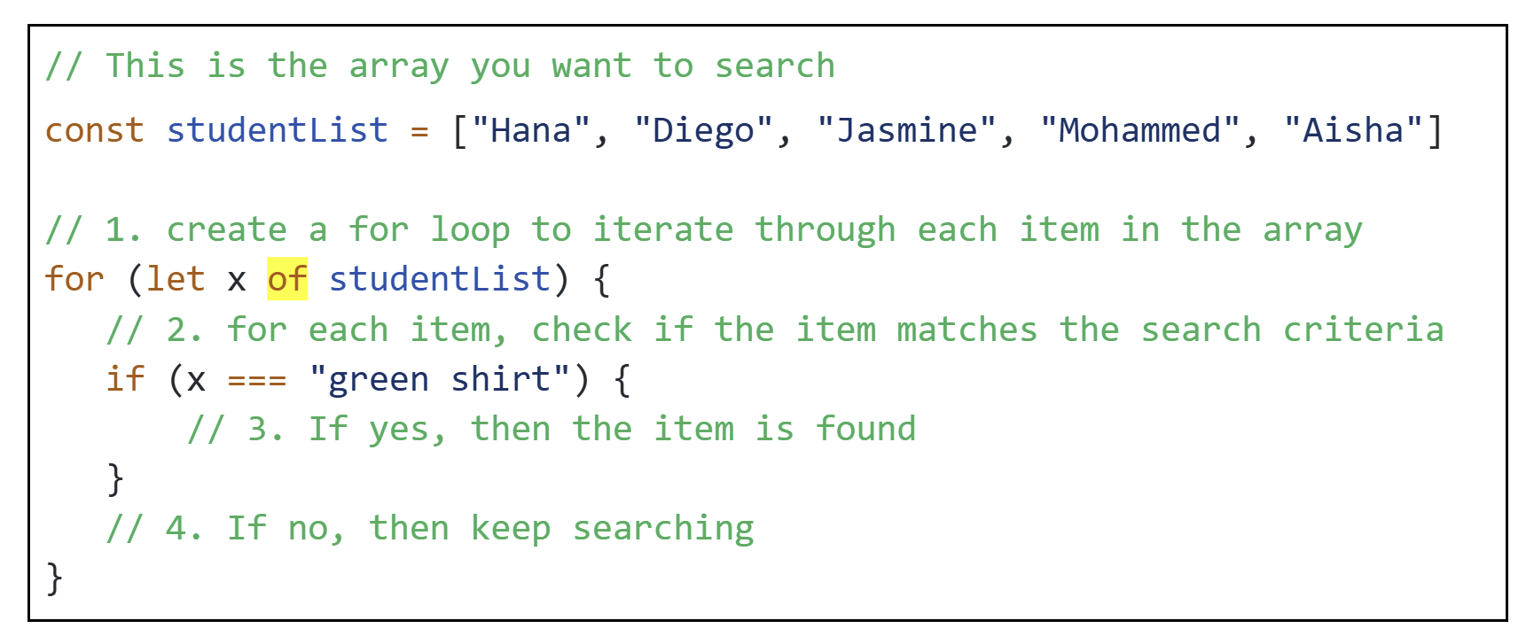
Example: Searching for a student named “Jasmine”
In this example, the search criteria is looking for a student whose name is “Jasmine”

Slide 5
How do you deal with the results of your search?
Typically, developers create a variable to keep track of whether an item is found (or not).
Before the loop begins, the variable is set to some initial value.
If the item is found, the variable’s value is updated to some value that helps the developer identify that a match was found.
At the end of the loop, examine the value of the variable.
If the variable retains its default value, then this means that a matching item was NOT found
If the variable’s value is different from its default value, then this means a matching item was found

Slide 6
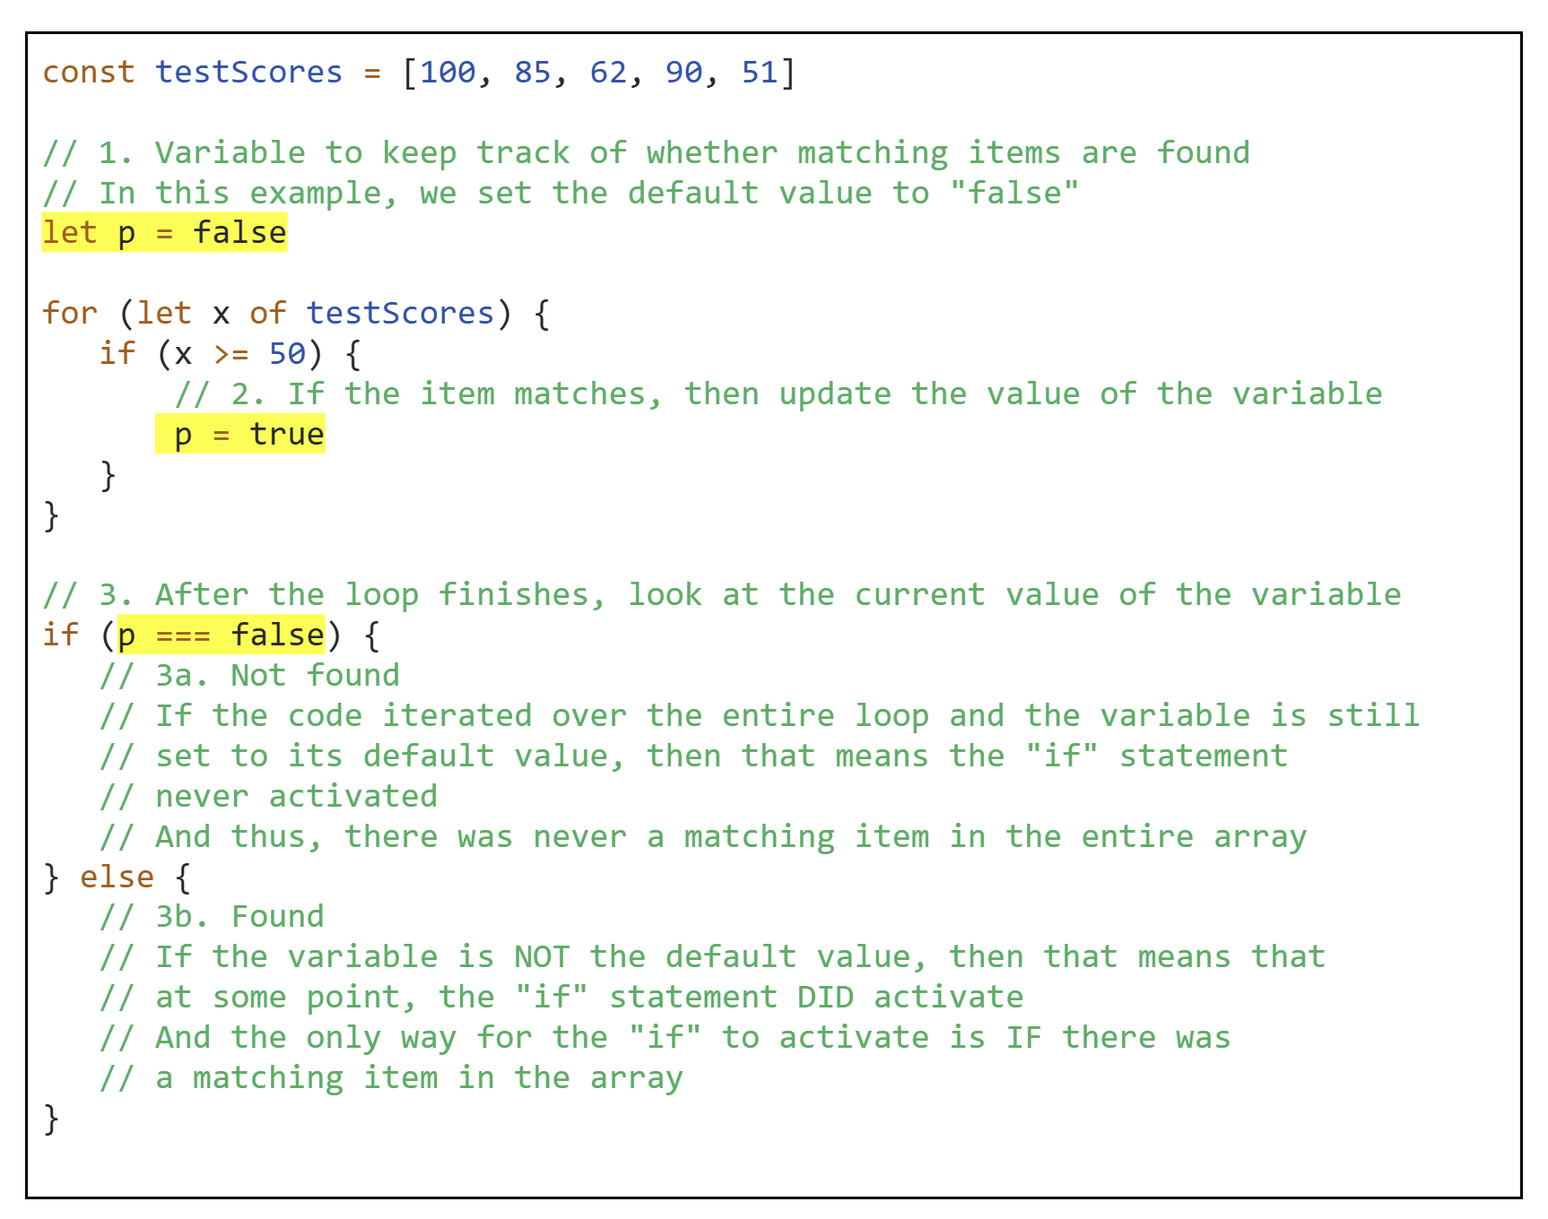
Example code
NOTE: When you write your code you should use meaningful variable names! Not variable names like “a”, “b”, “c”, “x”!

Slide 7
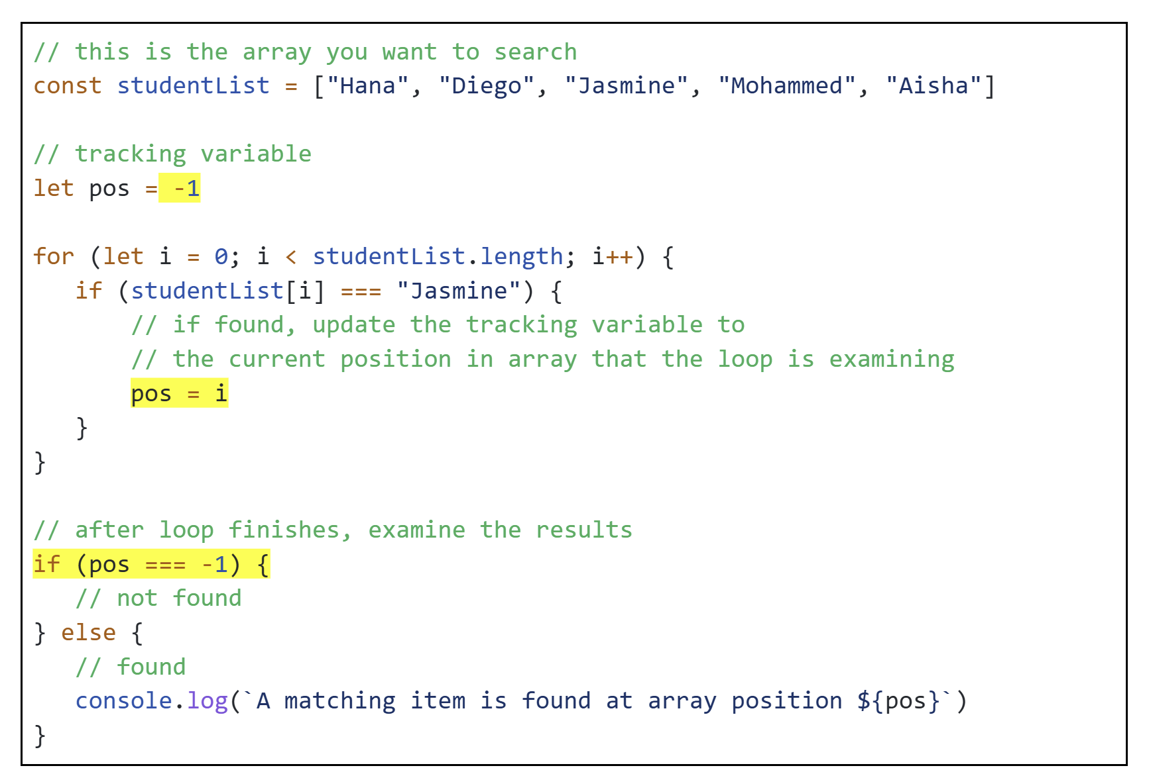
What do I set the default value of the tracking variable to?
This depends on what you want to do when you find a matching item.
Example 1: Does a matching item exist?
If you simply want to know whether a matching item exists, then use boolean values.
Default value: false
If the item is found, update the tracking variable to true.
Example 2: Where in the array is the matching item located?
If you need the position number of the first matching item, then use a number value.
Default value: -1
If the item is found, update the tracking variable to the position number of the matching item

Slide 8
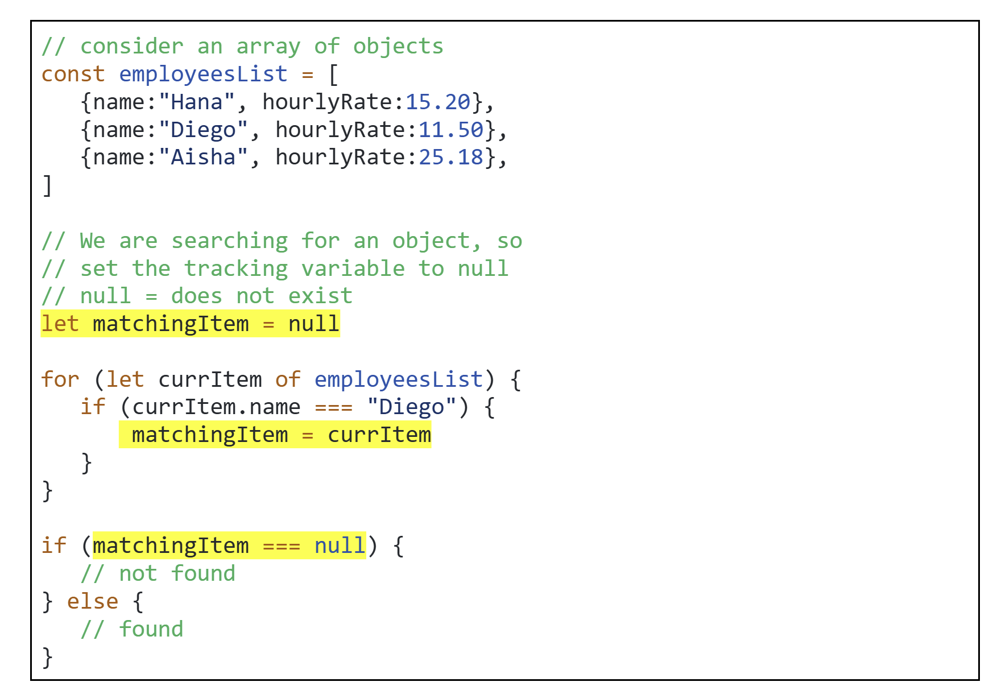
Example 3: Tracking Variables and Arrays of Objects
Suppose you want to retrieve a specific matching item from an array of objects and then do something with that object
Default value: null (null means “does not exist”)
If the search criteria is found, set the tracking variable to the matching object

Slide 9
When an item is found, do I need to keep searching the array?
You MUST keep searching if:
Your list contains many items that meet the search criteria AND
You want to find all matching items
Examples:
Given a list of test scores, search for all scores > 80%
In a class, it is very likely that there is more than one student who achieved an 80%+ on the tier test.
Thus, the professor cannot simply stop searching when they find the first student with 80%.
They have to search through the entire class list of test scores.
Given a student’s email inbox, find all emails sent by their professor.
All college students will have an inbox filled with emails from a variety of people (college, professors, friends, possible employers, etc).
If you want to get all the emails sent by a specific person, then you must examine all items in the inbox.

Slide 10
When an item is found, do I need to keep searching the array?
You do NOT need to keep searching if:
Every item in your array is unique OR
Many items in your list meet the search criteria, BUT you only care about finding the first occurrence of an item
Example: Every item in the array is unique
Given a list of student ids, check if there is a student with the id: 1005235
By definition, each student has a unique student id
Therefore, every value in the list should be unique.
If you find a matching student id, there is no need to continue searching because you know that the remaining items will not match.
Example: Many items meet search criteria, but you only care about finding the first occurrence
Does Netflix have any movies that are 120 minutes in length or longer?
Among all the movies on Netflix, there are likely many movies that meet the search criteria. However, the question is asking you if there exists a movie that is >= 120 minutes.
It doesn't matter if there are 5 matching movies, 50 matching movies, or 500 matching movies. The question only cares about whether there is at least 1 movie that matches.
Thus, you just need to check if you can find one movie that matches.
If yes, then you’ve answered the question…and there is no need to continue searching.

Slide 11
Example: Searching a List of Employees
Given an array of employees, create a function that:
Searches for an employee by name
If the employee with the matching name is found:
Increase their hourly rate by 20%
Output a message to the screen showing their updated hourly rate
If the employee is not found:
Output a message to the screen showing an appropriate error message
Every employee has a name and an hourly rate
const employeesList = [
{name:"Hana", hourlyRate:15.20},
{name:"Diego", hourlyRate:11.50},
{name:"Aisha", hourlyRate:25.18},
]
The function should accept the
array of employees and
name
as function parameters
const increaseSalary = (employeesList, employeeName) => {
}

Slide 12
Summary

