Slide 1
SEP420- Web Programming and Scripting
Week 6

Slide 2
Learning Outcomes
CSS relationship selectors
Child selectors
Descendant selectors
Conflicting Rules
Additive Rules

Slide 3
CSS Relationship Selectors
Currently, we know of 3 different methods for selecting elements:
Tag
→ style to apply to all of the tags of that type
Class
→ reusing the style across different tags
Id
→ only use the style once

Slide 4
CSS Relationship Selectors
CSS relationship selectors enable you to select elements based on their relationship with another element on the screen.
  Parent
  Child
  Sibling
  Ancestor (grand parent, great-grandparent, great-great-grandparent, etc)
  Descendant (grandchild, great-grandchild, great-great-grandchild, etc)
There are 4 relationship selectors:
Child selector
Descendant selector
Adjacent Sibling selector (+)
General sibling selector (~)
In this course, we focus on #1 and #2

Slide 5
Syntax Examples
// selects any p that is a child of body
body > p { }
// selects all p that are descendants of body
body p { }
// selects any h1 that is a child of an element with class = abc
.abc > h1 { }
// <a> is a child of <li> which is a child of <ul>
ul > li > a { }
// What does this mean?
ul > .abc a > div #xyz h1 {
}

Slide 6
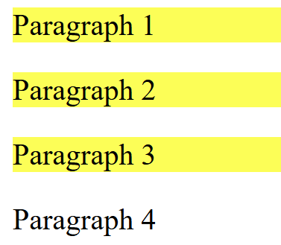
Example 1: Child Selector
body > p {
background-color:yellow;
}
<body>
<p>Paragraph 1</p>
<p>Paragraph 2</p>
<p>Paragraph 3</p>
<footer>
<p>Paragraph 4 </p>
</footer>
</body>

Slide 7
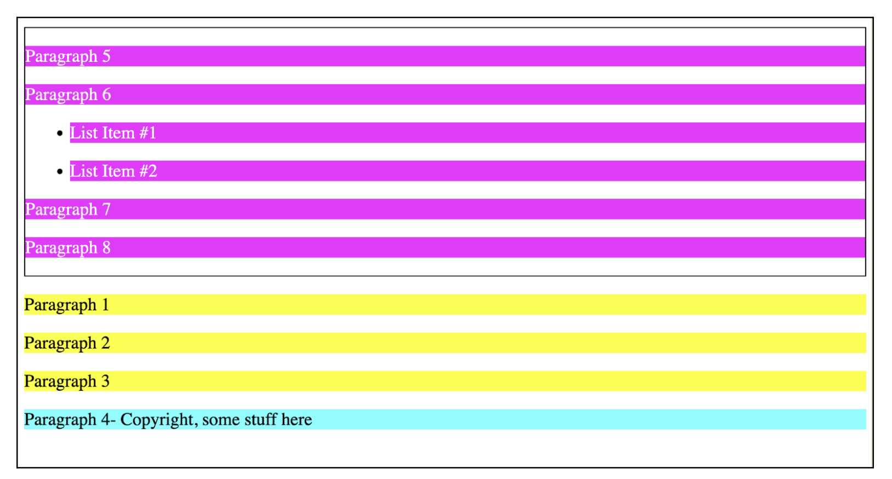
Example #2 - Descendants selector (space)

Slide 8
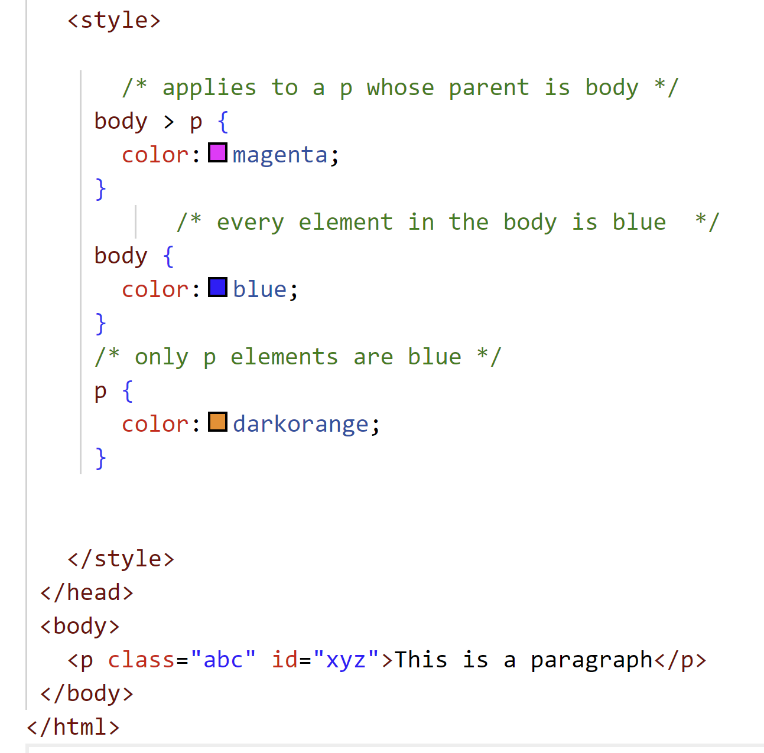
Combining CSS and Conflicts
Two CSS selectors can have conflicting rules
Two CSS selectors can have additive rules (combining)
You have 5 rules that conflict
When you have a conflict, the browser resolves the conflicts by going from
– Least precise to most precise
And the most precise rule wins
“Specific”
The most specific rule is going to win
More generic rules lose
Output?

Slide 9
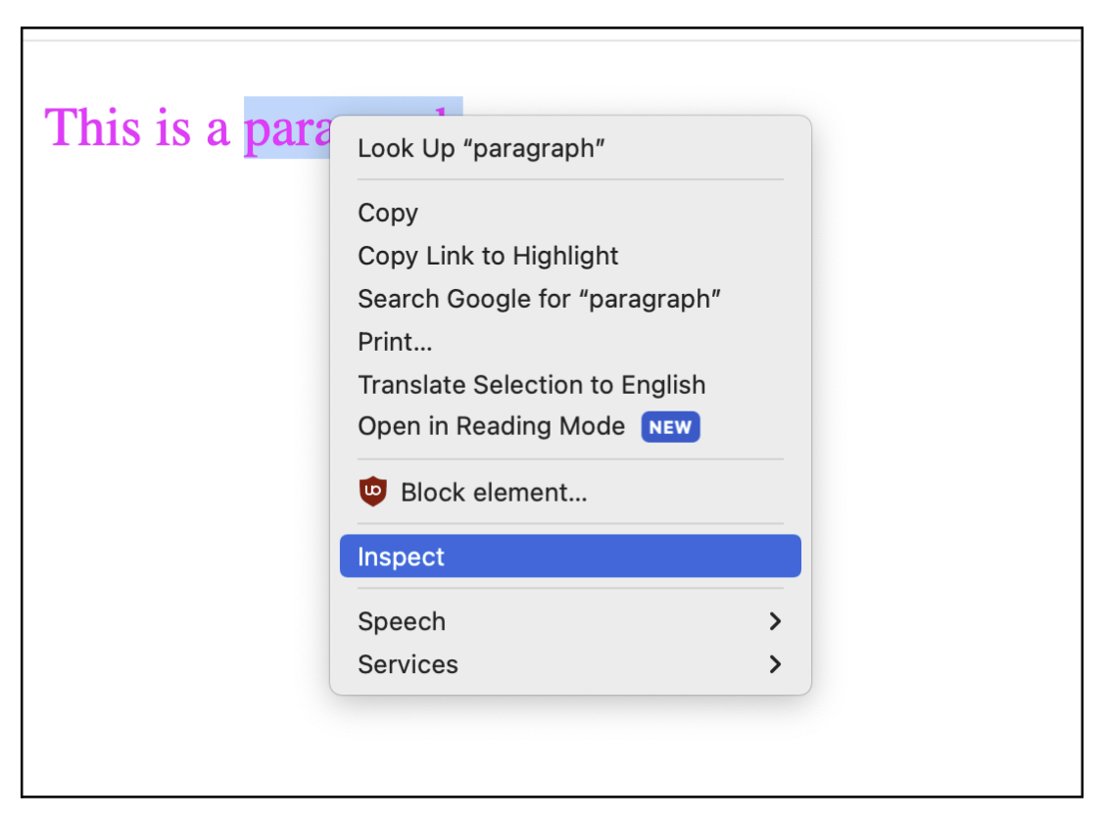
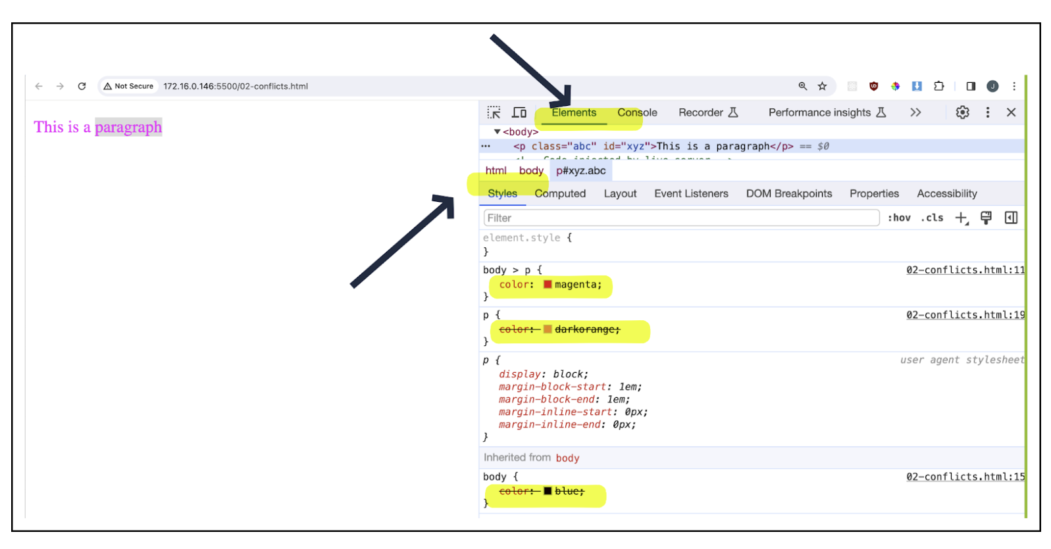
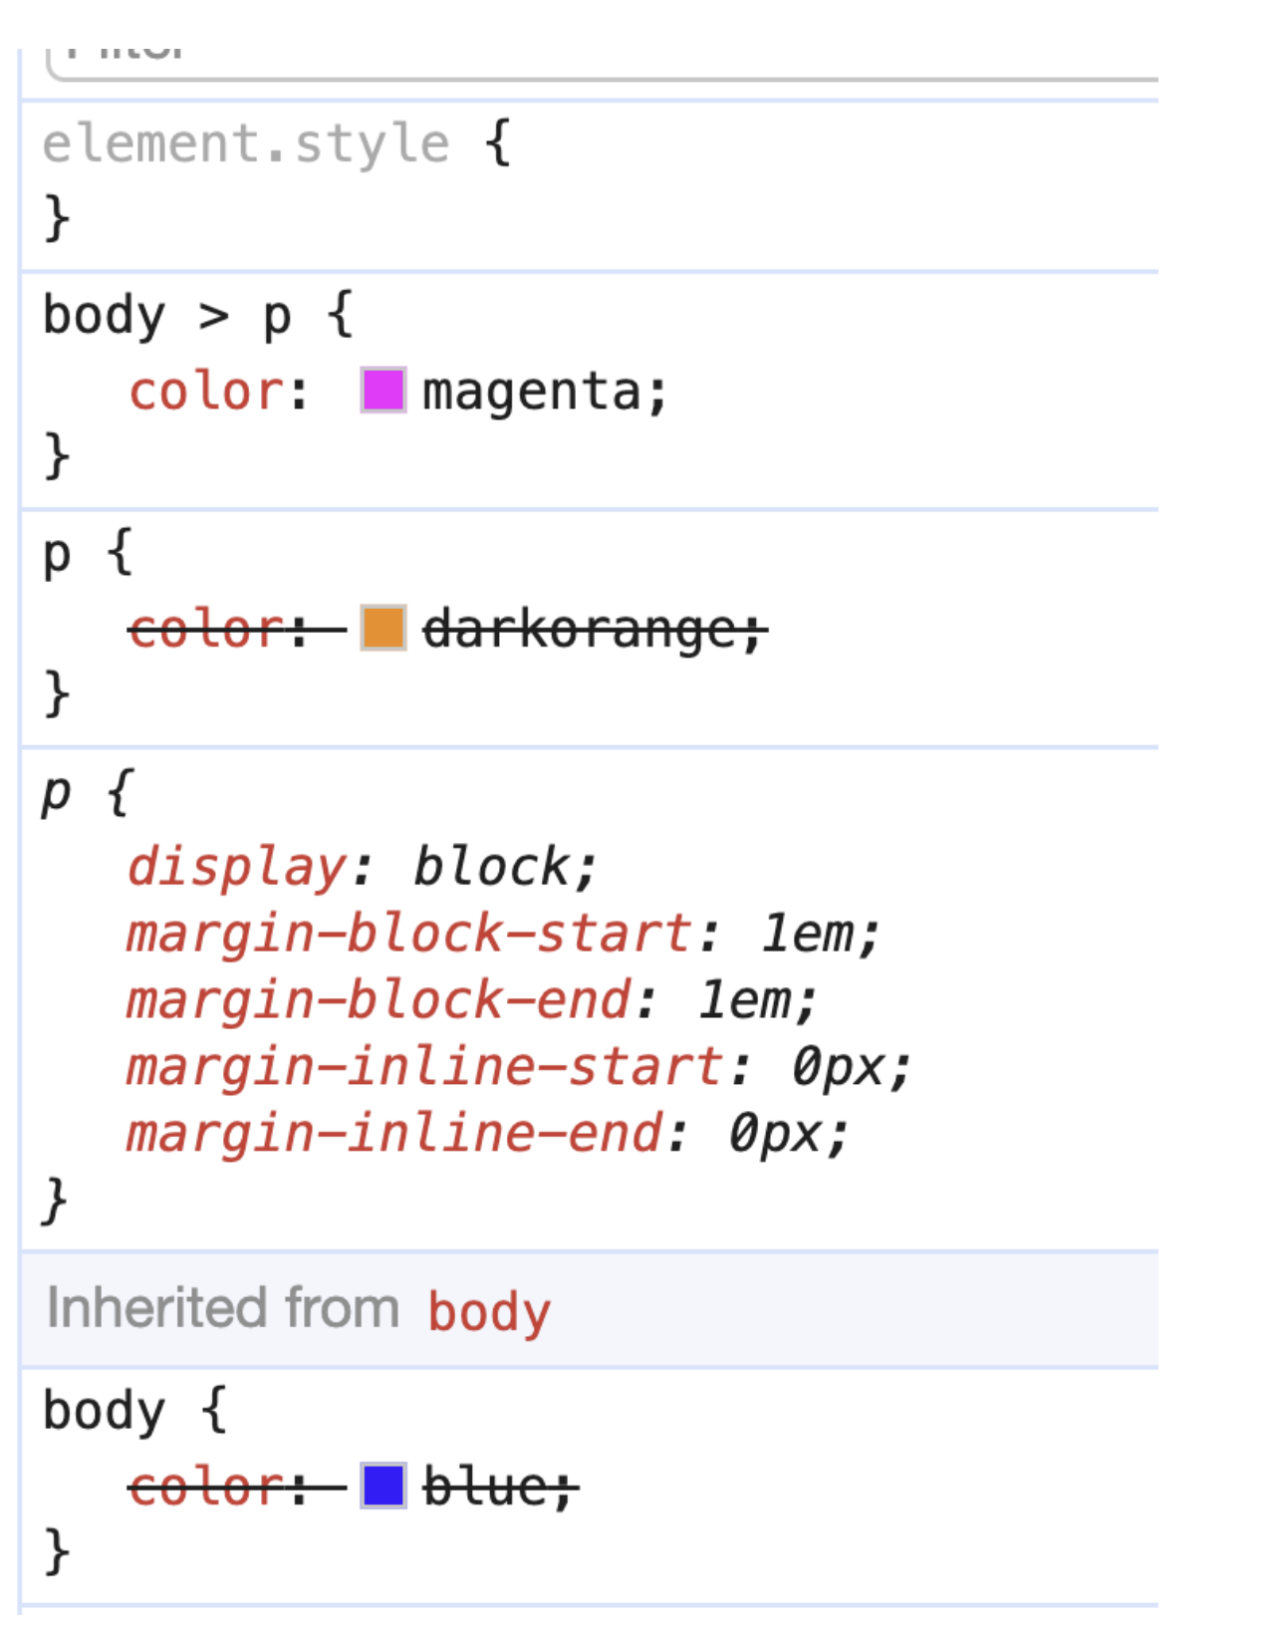

Example: Tag Conflicts
To see the final browser computation:
1/ Right click on the <p> and choose inspect
2/ Ensure Elements is selected
Then look at the Styles tab

Slide 10
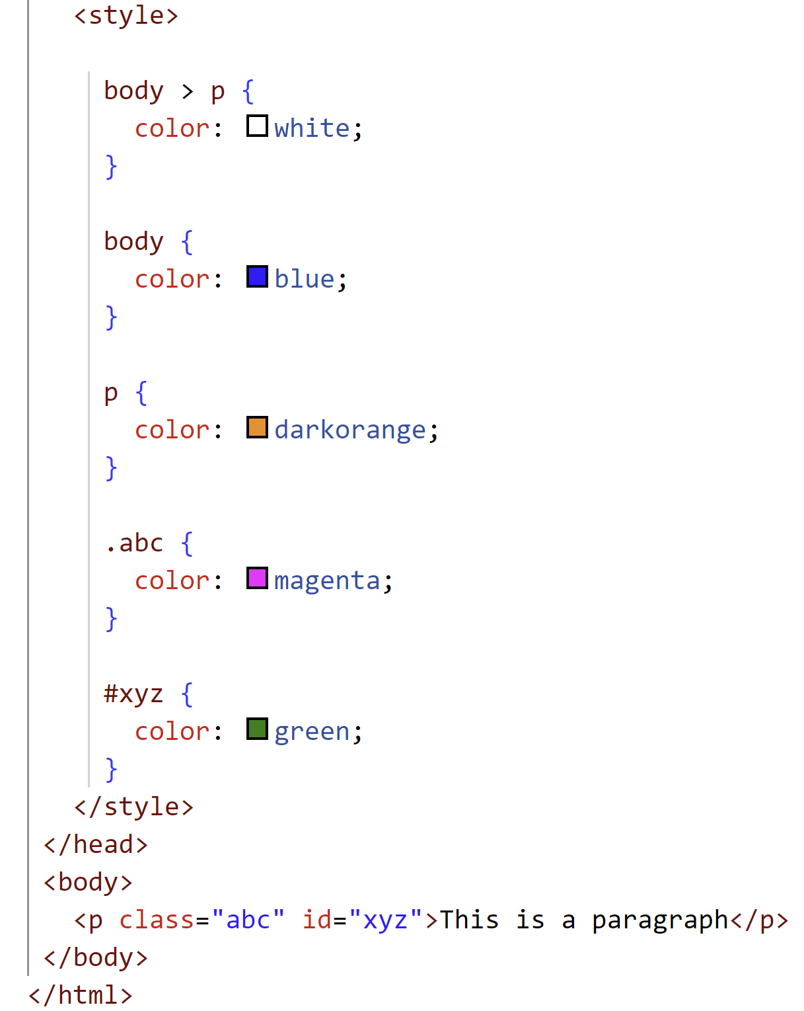
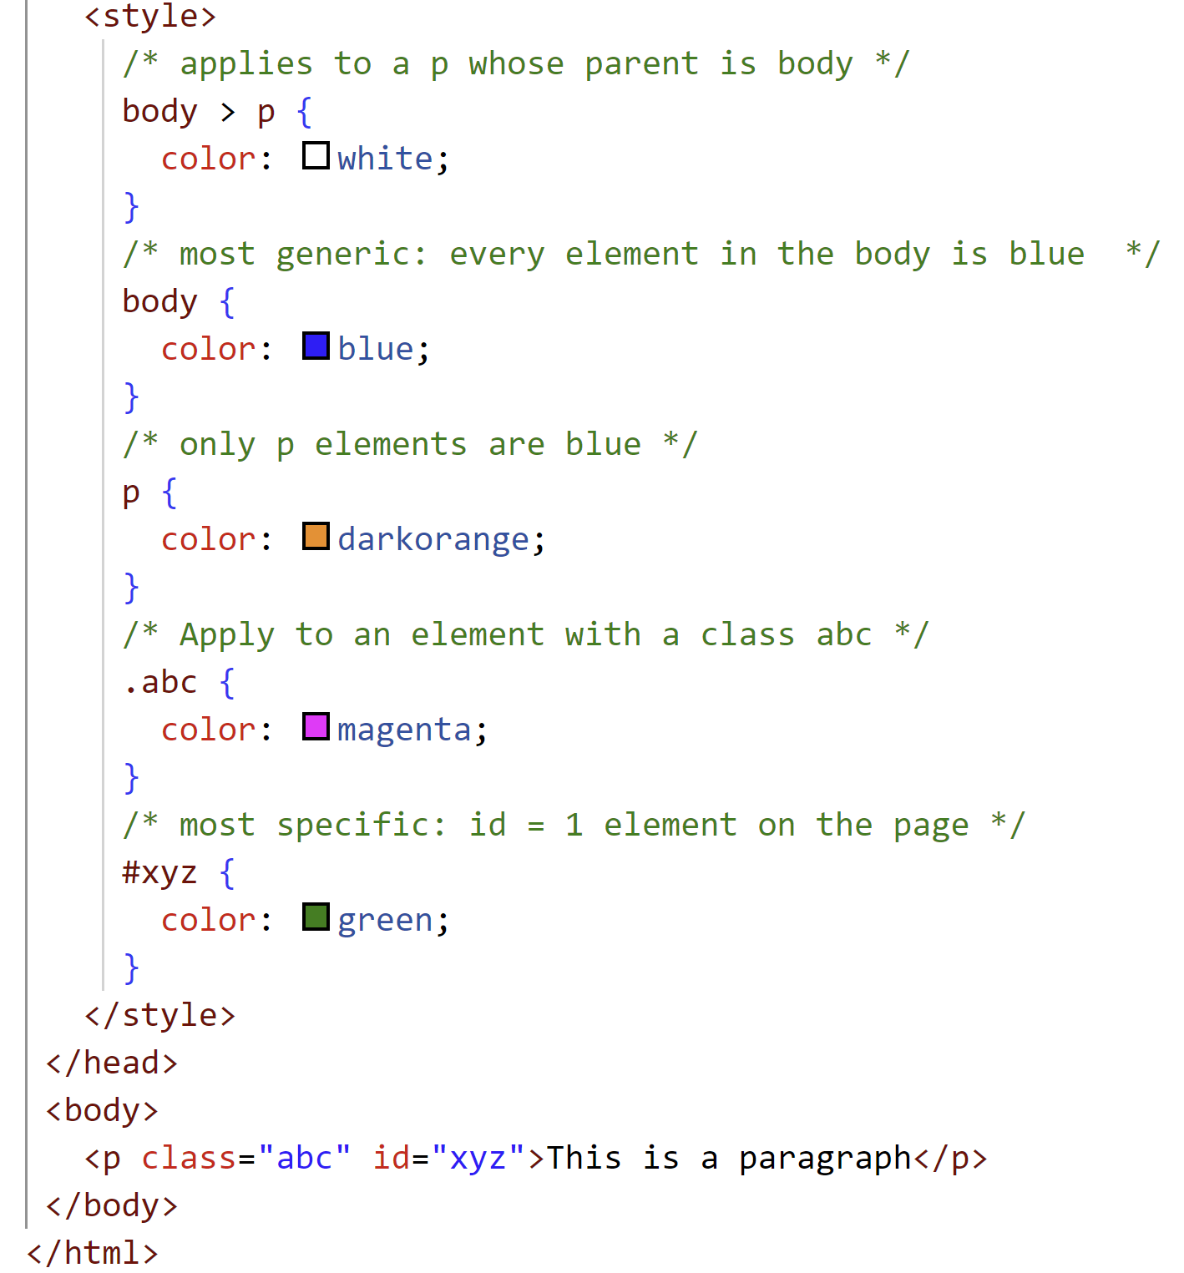
Example: Class vs. Id Conflicts
Id always wins over class
Output?

Slide 11
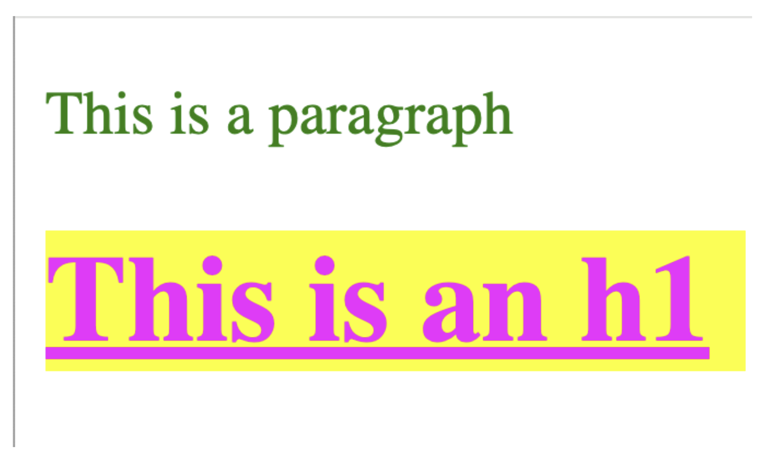
CSS Rules Can be Additive
h1 {
background-color: yellow;
text-decoration:underline;
}
body > h1 {
color:magenta;
font-weight:bold;
}

Slide 12
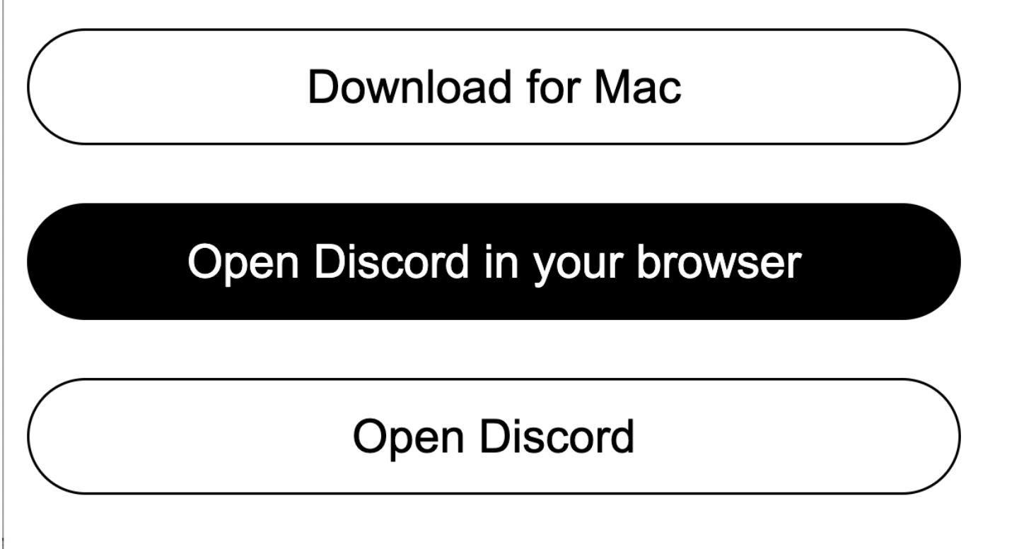
Example

Slide 13
Wrap Up of Weeks 1-6
HTML
Headings, paragraphs, links, img, lists (ordered/unordered), tables
Semantic tags: for organization
  Header,footer, nav, article, main, section
Container tags for styling
  Div → containing elements for layout purposes
  Span → containing text for styling purposes

Slide 14
Wrap Up of Weeks 1-6
CSS:
Changing color and fonts
Layout with flexbox
In-line and block level elements
Whitespacing (margin, padding)
Borders
Widths
Unit of measurements (px, %, vw/vh)
Internal stylesheets <style>
Select elements with selectors
  Tag
  Class
  Id
  Relationship selector (4)
    Child
    Descendant
Tag conflics
Additive CSS rules that combine

