Slide 1
SEP420- Web Programming and Scripting
Week 6

Slide 2
Deploy
Website → upload the website code to a server computer and get a public facing URL for it so you can give the address to other people
Mobile app → put the app in the app store
C/C++ → compile the app, and give someone the final .exe/.dmg file to run
You need a server computer
Computer that is on the internet somewhere
And you can access it!
You can also upload your code to that computer
The computer contains software that displays your website when the person visits your domain name

Slide 3
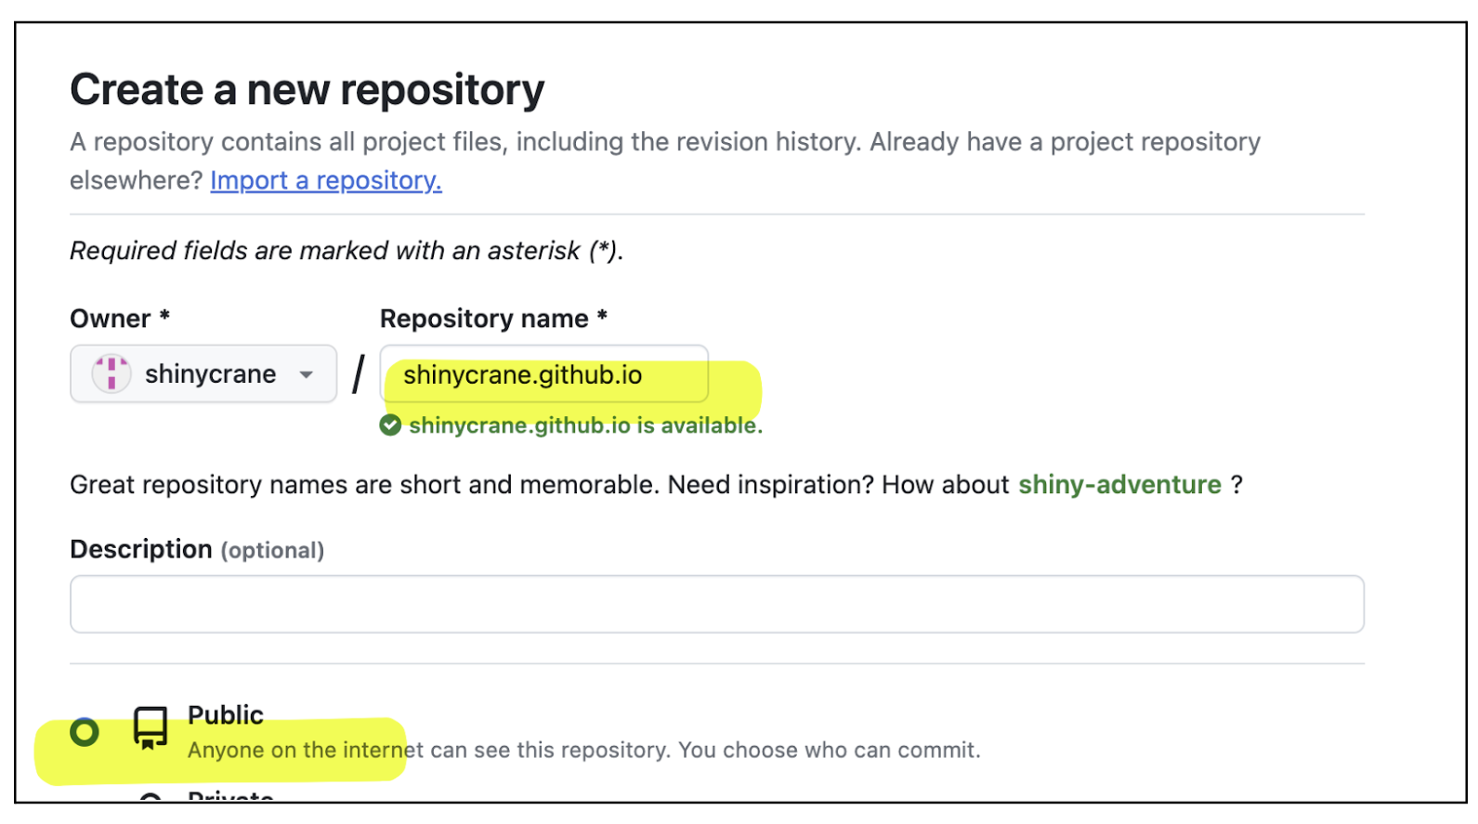
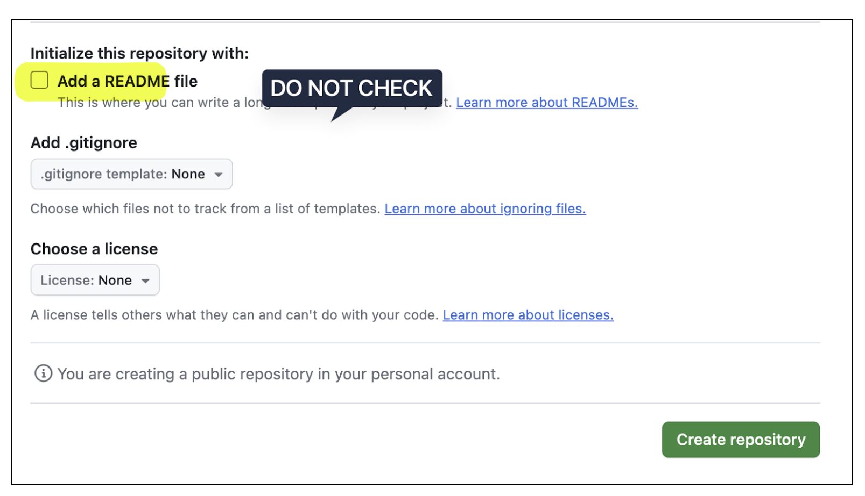
Deploying a Website
Documentation:
https://pages.github.com/
1/ Create a new repository called:
username.github.io
Replace username with your Github
username

Slide 4
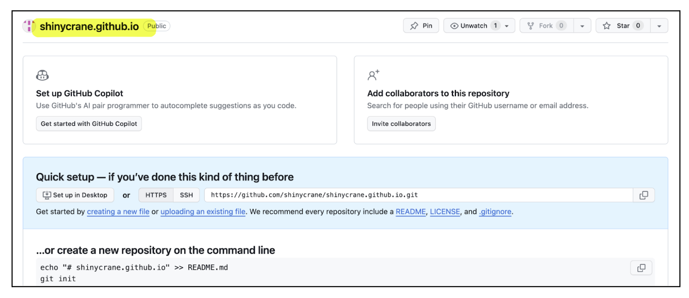
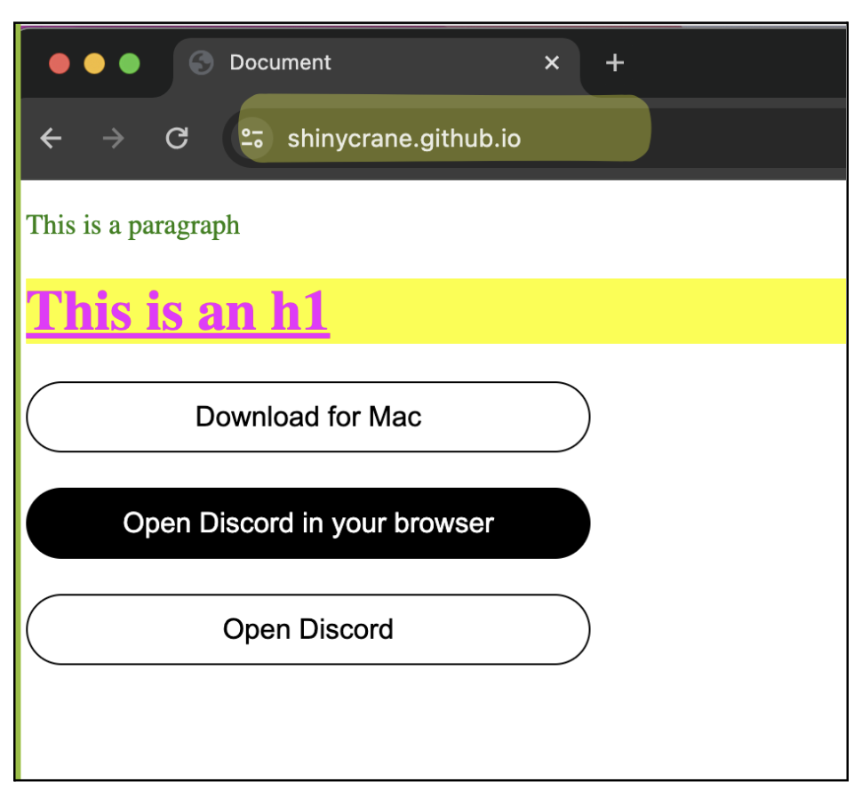
Result
Choose the HTML file you want to upload. Rename the file index.html before uploading it.
In Github, use the “uploading an existing file” option to upload your html file
After uploading, press COMMIT CHANGES to save your file to the repository
In the browser, type:
http://username.github.io
(replace username with your github username)

