Slide 1


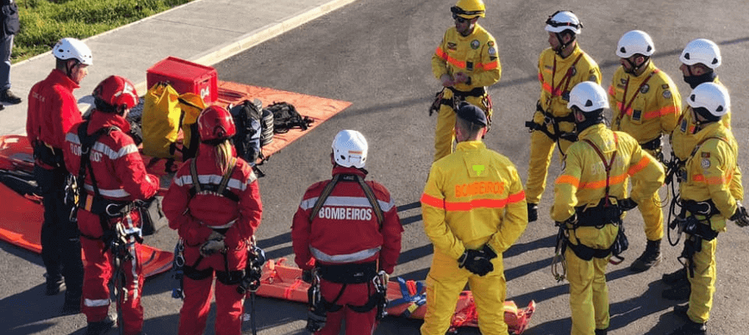
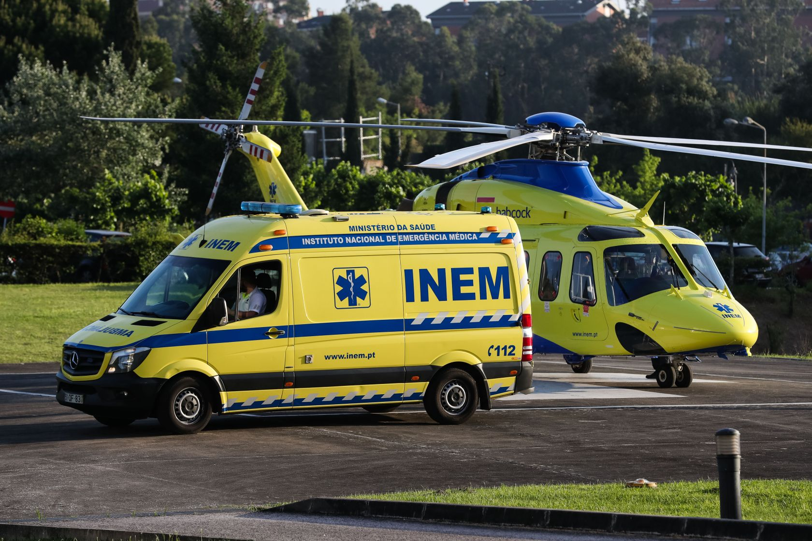
Predicting the quantity of resources needed for every Civil Protection emergency
Filipa Costa ..| filipabcosta@tecnico.ulisboa.pt
Miguel Neves ..| neves.miguel8@gmail.com
DatAttack 2023

Slide 2
1. Introduction
Fires, car accidents, and natural catastrophes are responsible for extensive damage and endangering lives;
If the necessary resources are known in advance, they can be made available where and when they are needed;
Predicting the quantity of resources needed to properly address the emergency situation is important to save lives and reduce damage in such circumstances.

Slide 3
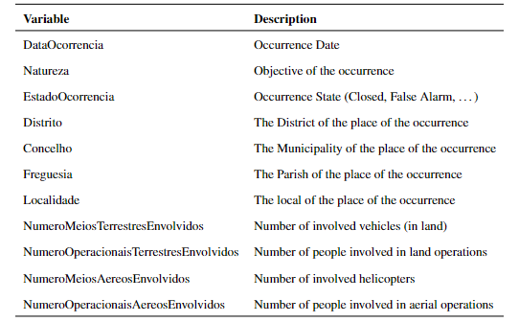
2. Data Exploration & Preparation
Table 1: Variables belonging to the used dataset, and their description.
Missing values only made up 0.003% of all observations, thus were eliminated;

Slide 4
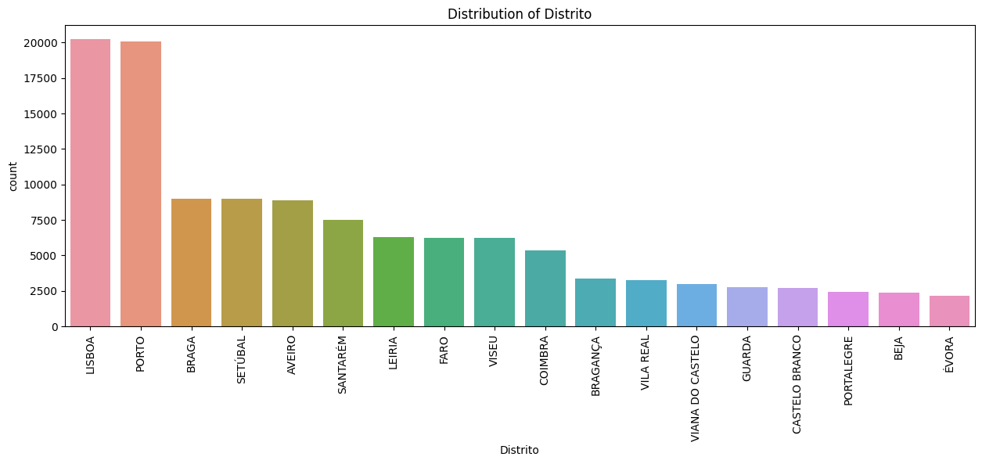
2. Materials and Methods
2. Data Exploration & Preparation
Figure 1.1: Number of incidents per District

Slide 5
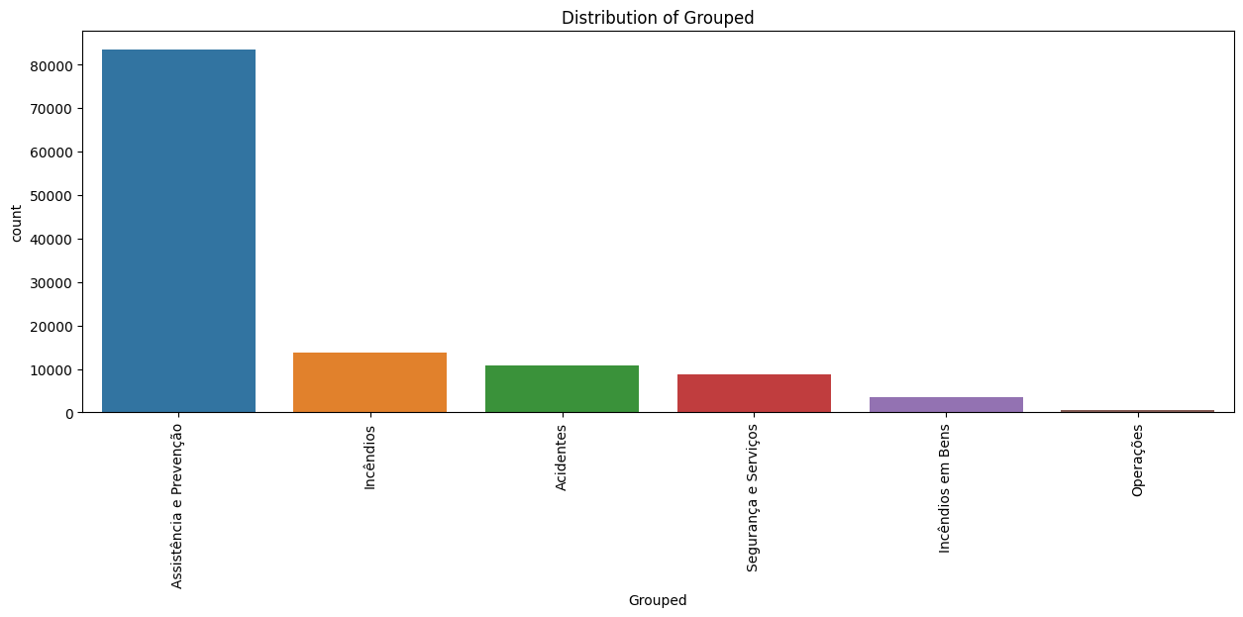
2. Materials and Methods
2. Data Exploration & Preparation
Figure 1.2: Number of incidents per District

Slide 6
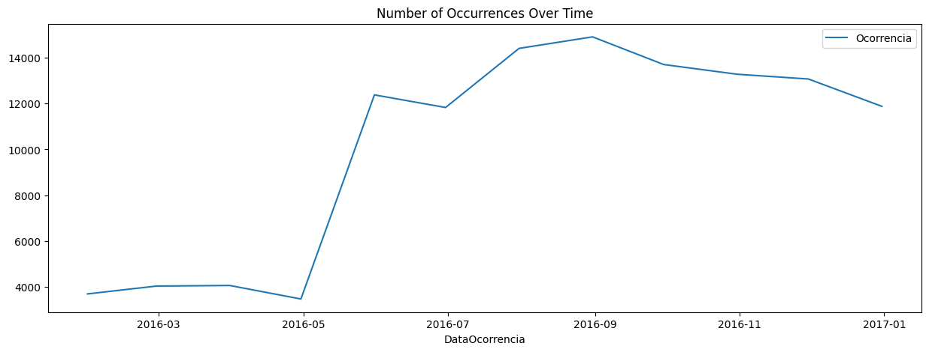
2. Materials and Methods
2. Data Exploration & Preparation
Figure 1.3: Number of incidents per Month

Slide 7
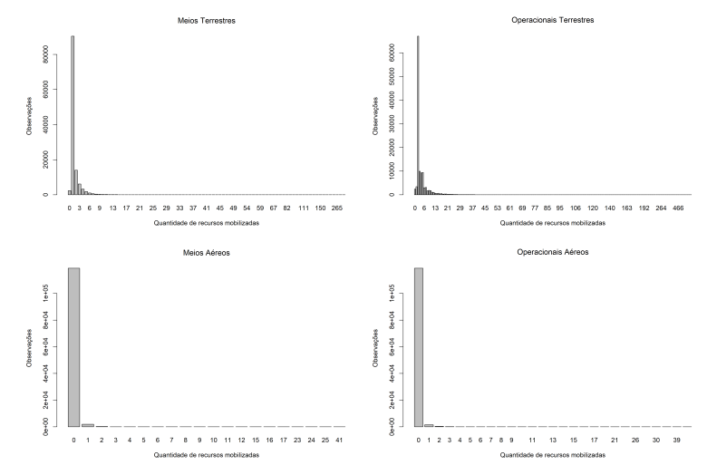
2. Materials and Methods
2. Data Exploration & Preparation
Figure 1: Number of observations by quantity of resources needed to be allocated, in each type of resource

Slide 8
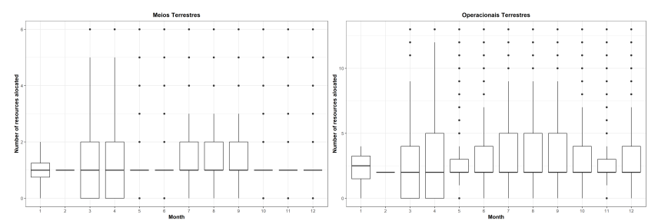
2. Materials and Methods
2. Data Exploration & Preparation
Figure 2: Number of Number of resources alocated by Month in each type of resource - number of vehicles in the left and number of people in the right.

Slide 9
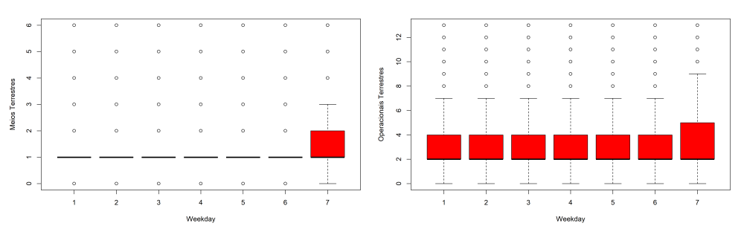
2. Materials and Methods
2. Data Exploration & Preparation
Figure 3: Number of resources allocated by Day of the Week in each type of resource - number of vehicles in the left and number of people in the right.

Slide 10
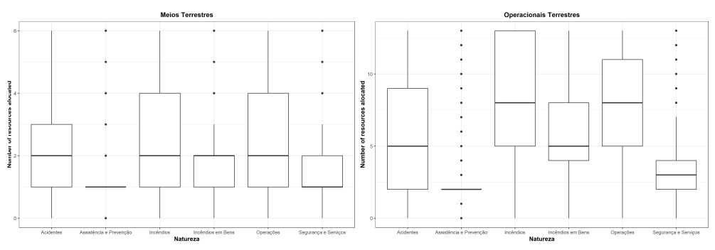
2. Materials and Methods
2. Data Exploration & Preparation
Figure 4: Number of resources allocated by Emergency Nature in each type of resource - number of vehicles in the left and number of people in the right.

Slide 11
2. Materials and Methods
2. Data Exploration & Preparation
We only consider the events which EstadoOcorrencia=Encerrado, since this represents 98% of the record;
The granularity of Concelho, Freguesia and Localidade was too big; District is the one that will be included in the models because it has less granularity.

Slide 12

2. Materials and Methods
2. Data Exploration & Preparation
Geographical distribution of allocated
resources given Month and Civil
Emergency

Slide 13
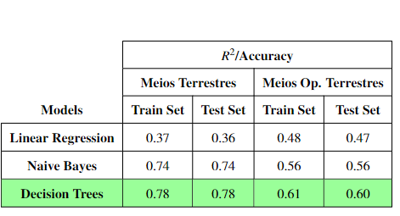
3. Results and Discussion
Independent Variables:
Month, Distrito, Weekday, Natureza
Dependent Variables: NumeroMeiosTerrestresEnvolvidos, NumeroOperacionaisTerrestresEnvolvidos
Table 2: Results of performance measures R2 and Accuracy on both train and test set..

Slide 14
4. Conclusions
It was possible to predict the number of people and vehicles needed to be allocated with accuracies of 60% and 78%, respectively;
Incêndios and Operações are the civil emergencies that need a higher quantity of resources;
The number of resources needed to be allocated depends both on the day of the week (Sunday, Monday...) and the Month;
The quantity of resources needed tends to be higher during the Summer and on Saturdays.

Slide 15
5. Future Work
Including more variables, such as population density and geographical area, could be possible to find more patterns in the data, and consequently improve the prediction models performance;
Since Civil Protection emergencies occur every year, a yearly approach would also be valuable;
Perform more methods (e.g. XGBoost) and performance measures;
Do a more narrower study on the different Concelhos, Freguesias and Localidades.

Slide 16
Predicting the quantity of resources needed for every Civil Protection emergency
Filipa Costa ..| filipabcosta@tecnico.ulisboa.pt
Miguel Neves ..| email
DATATTACK 2023

