Slide 1
Intermediate Next JS
by Muhammad Rhefa Farizi

Slide 2
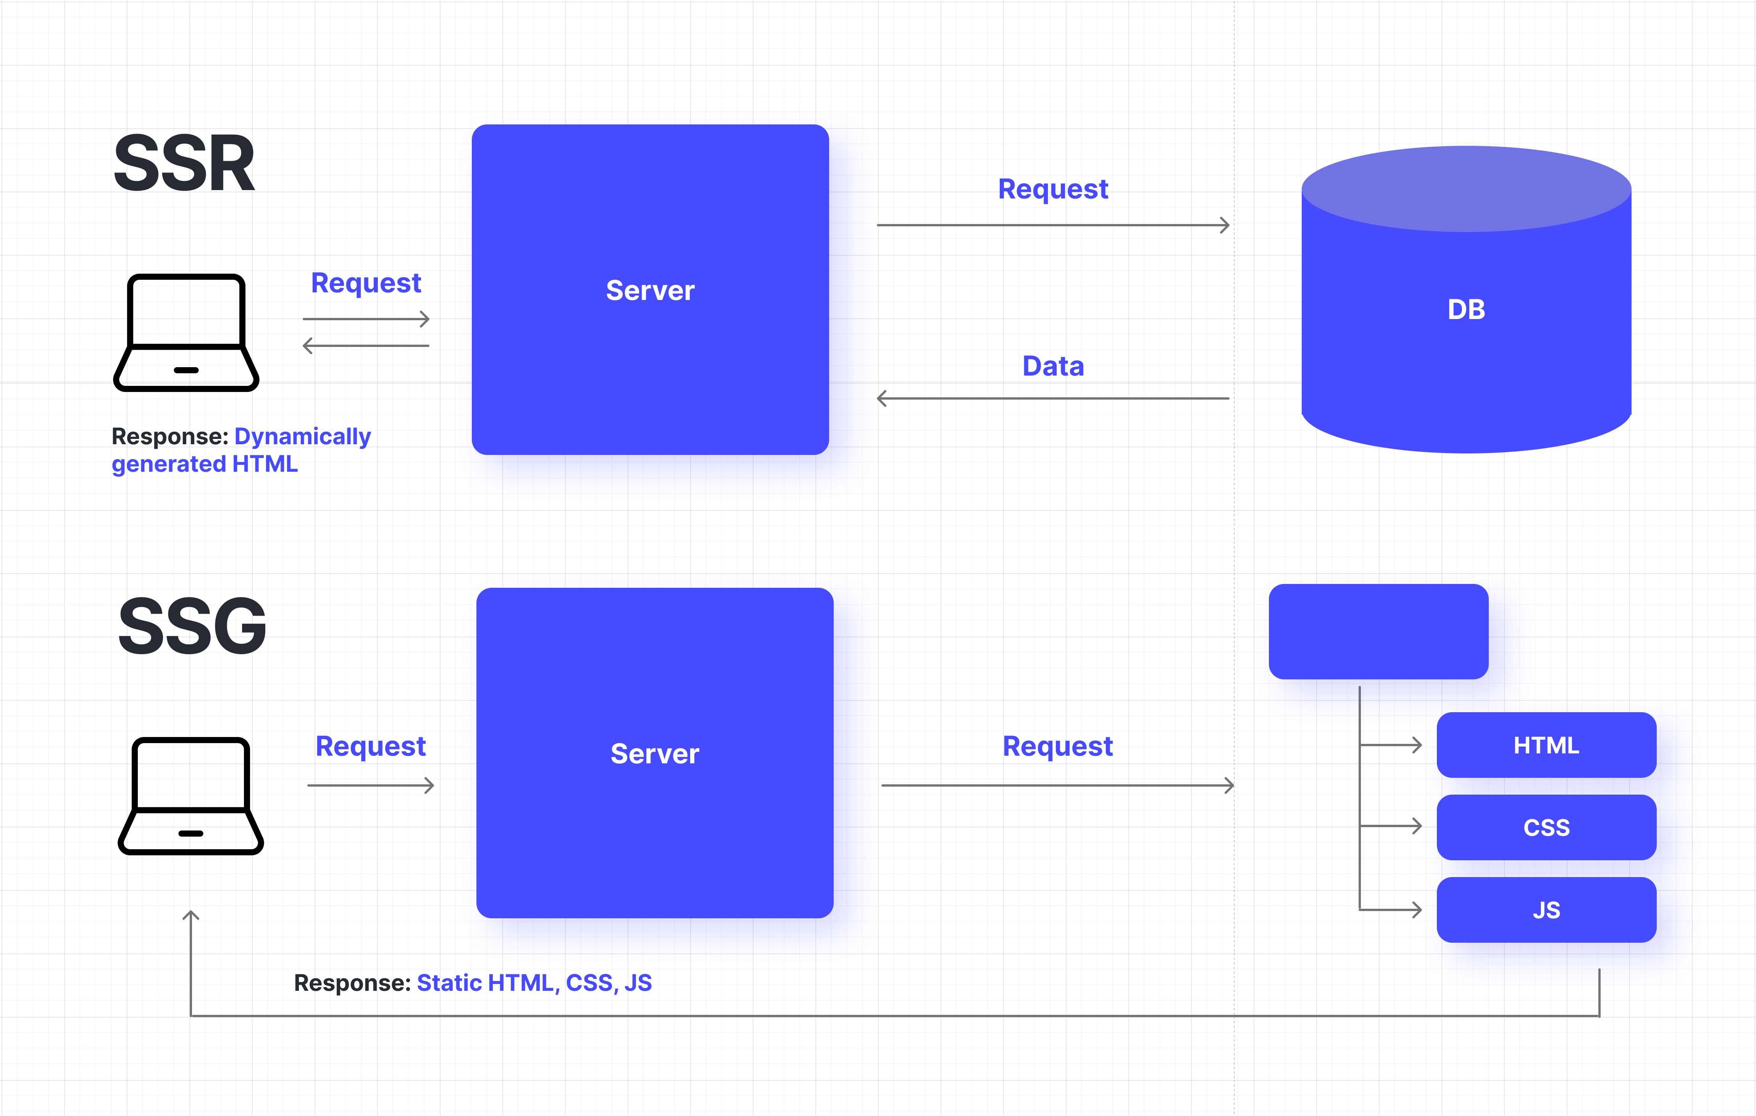
SSG (Static Site Generation)
SSR renders JavaScript code on the server and send indexable HTML to the user. The HTML is generated during runtime.
SSG generates HTML during build time. Such websites are extremely fast since the HTML content is served even before the user make a request.
On the other hand, the website needs to be rebuilt and reloaded every time a change is made.

Slide 3
Terima Kasih

