Slide 1
ENGINEER PORTFOLIO & EXECUTIVE PRESENTATION · 2026
Reiky Aryanando Pratama
3.81 / 4.00
Bachelor of Informatics GPA
Junior Backend & Full-Stack Developer · REST APIs · Web & Mobile
Universitas Islam Indonesia
Informatics graduate (GPA 3.81 / 4.00) & Backend Developer Intern at Badan Sistem Informasi Universitas Islam Indonesia. Building clean REST APIs, understanding relational database design, and developing practical web & mobile applications across Laravel, Go, Flutter, and React.
05+ Systems
Production & Thesis Deliveries
Backend, Mobile & IoT Architectures
AWS & Cisco
EMAIL
LOCATION
PORTFOLIO
reikyranp@gmail.com
Yogyakarta, Indonesia (WIB)
https://reiky03.github.io
Industry Certifications
Cloud re/Start & Cyber Threat Mgmt
Handcrafted with discipline · reiky03.github.io · Confidential & Curated
Notes:
Cover slide introducing Reiky Aryanando Pratama as Backend & Full-Stack Developer with current internship at BSI UII.

Slide 2
01 · PROFESSIONAL PROFILE
02 / 11
Beyond the Code: Systems, Craft & Precision
A blend of strong academic grounding, rigorous software engineering, and active production delivery.
ENGINEERING CORE
CURRENT PRODUCTION ROLE · SINCE DEC 2025
Backend Developer Intern
Building Practical & Reliable Software
Badan Sistem Informasi · Universitas Islam Indonesia
I believe that good software starts with clear fundamentals, solid data integrity, and thoughtful design. My journey spans foundational engineering: from organizing normalized database schemas and clean REST APIs to building responsive client interfaces.
Through my internship at Badan Sistem Informasi UII and academic research, I stay curious, open to feedback, and dedicated to writing maintainable code that helps real users.
• Assisting in developing and maintaining REST APIs using Laravel and Lumen.
• Profiling and tuning MySQL queries for enterprise catalog services.
• Exploring Model Context Protocol (MCP) AI integrations for campus automation.
ACADEMIC EXCELLENCE & PUBLISHED RESEARCH
Bachelor of Informatics (GPA 3.81 / 4.00)
• Reliability-First — Normalized schemas, idempotent transactions, and defensive error boundaries.
Universitas Islam Indonesia · Class of 2026
• Full-Stack Agility — Seamless bridge between server-side Go/PHP and client-side TypeScript/Flutter.
• Published Researcher: Park Masjid thesis published in Technologia: Jurnal Ilmiah (2026).
• Award Winner: Best Team Award at Informatics Expo Design Thinking (2022).
• Certified: AWS re/Start Cloud Architecture & Cisco Cyber Threat Management.
• Academic Rigor — GPA 3.81/4.00, published thesis research, and certified cloud practices.
Notes:
Professional background highlighting education, GPA 3.81, role at Badan Sistem Informasi UII, and published research.

Slide 3
02 · TECHNICAL TOOLKIT
03 / 11
What I Build With: A Focused Engineering Stack
Refined through production backend internships, academic research, and full-stack software delivery.
01
02
03
04
Backend & Systems
Web & Interfaces
Mobile Engineering
Data & Infrastructure
Backend services, RESTful API endpoints, and clean server-side application logic.
Interactive, accessible, and fast web applications with crisp design systems and zero layout thrash.
Native and cross-platform mobile apps with fluid animations, offline caches, and hardware integrations.
Normalized data models, real-time database synchronizations, and containerized deployment pipelines.
CORE COMPETENCIES
CORE COMPETENCIES
CORE COMPETENCIES
CORE COMPETENCIES
PHP & Laravel
TypeScript
Flutter & Dart
PostgreSQL
Lumen Microservices
React & Next.js
Riverpod State Mgmt
MySQL Tuning
Go (Golang)
Vue.js 3 & Vite
Kotlin (Android Native)
Redis In-Memory Cache
RESTful APIs
Tailwind CSS
Jetpack Compose
Firebase Firestore
gRPC & Protobuf
HTML5 / Modern CSS
React Native & Expo
Docker Containers
MCP AI Protocol
GSAP Animation
SQLite / AsyncStorage
AWS Cloud Services
RBAC Security
Component Systems
Hardware Sensors
Git CI/CD Workflows
Notes:
Overview of technical competencies organized into Backend, Web Interfaces, Mobile Engineering, and Data/Cloud Infrastructure.

Slide 4
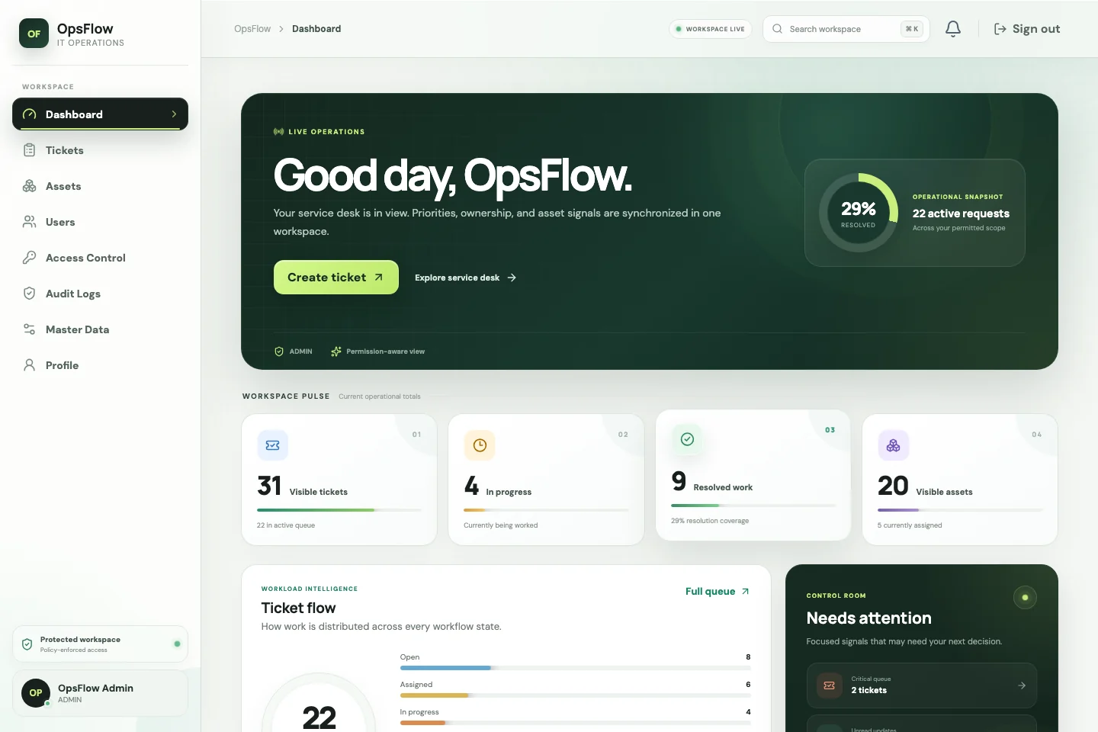
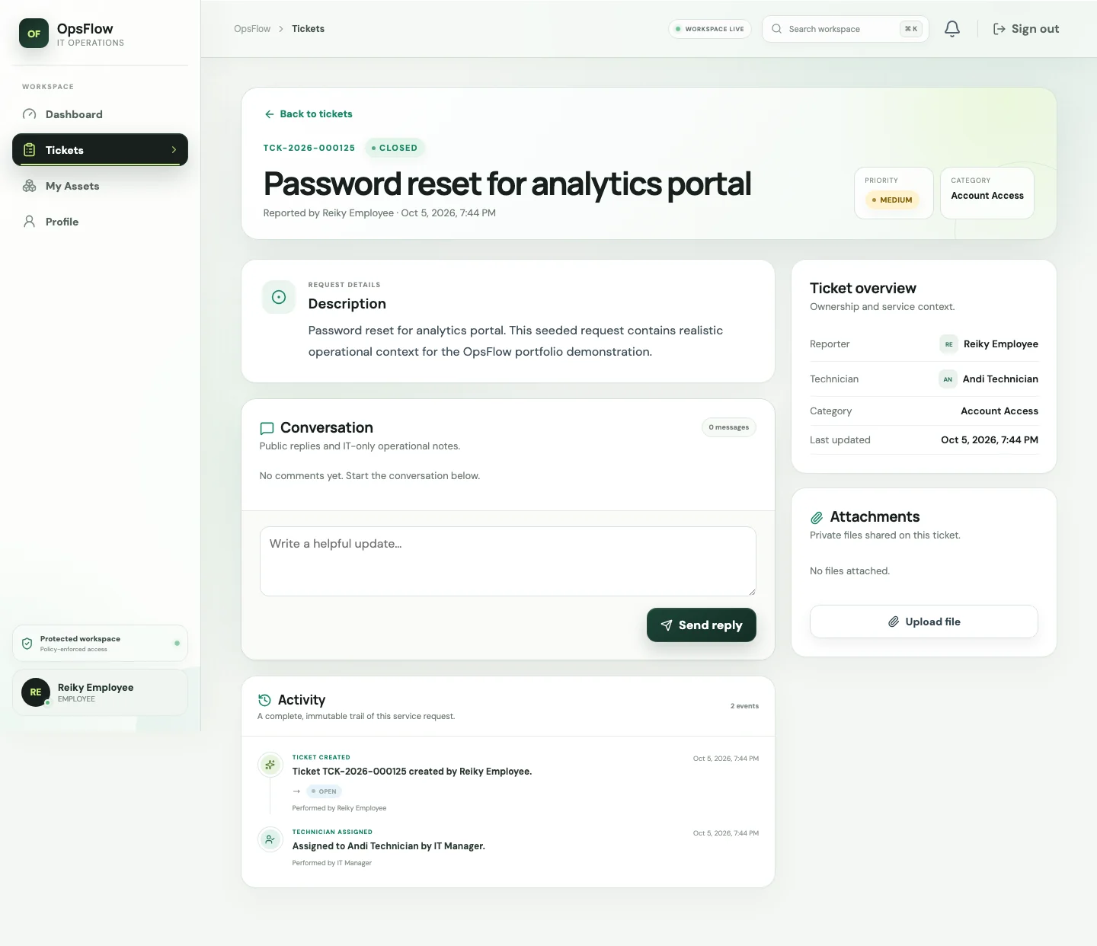
03 · CASE STUDY 01 / PLATFORM
04 / 11
OpsFlow: Enterprise Service Desk & Asset Control
Make internal IT work visible, assignable, and auditable from initial request to resolution.
SERVICE DESK / WEB PLATFORM
OpsFlow Platform
A full-featured internal operations and service desk platform built to eliminate lost tickets and opaque IT requests. Engineered with multi-role access controls, automated technician handoffs, audit histories, and asset allocation tracking.
KEY ARCHITECTURAL HIGHLIGHTS
• Role-Based Access Control: Strict separation for Admins, Technicians, and Department Requesters.
• Ticket Lifecycle & SLAs: Real-time status transitions with automated escalation and notifications.
OpsFlow Operations Dashboard: Real-time ticket queues, SLA metrics & status breakdown
• Asset Tracking & Audit Log: Immutable operational history for hardware, licenses, and assignments.
TECH STACK: Laravel · React · TypeScript · PostgreSQL · Docker
Notes:
Case study on OpsFlow: internal IT service desk platform with Laravel, React, TypeScript, and PostgreSQL.

Slide 5
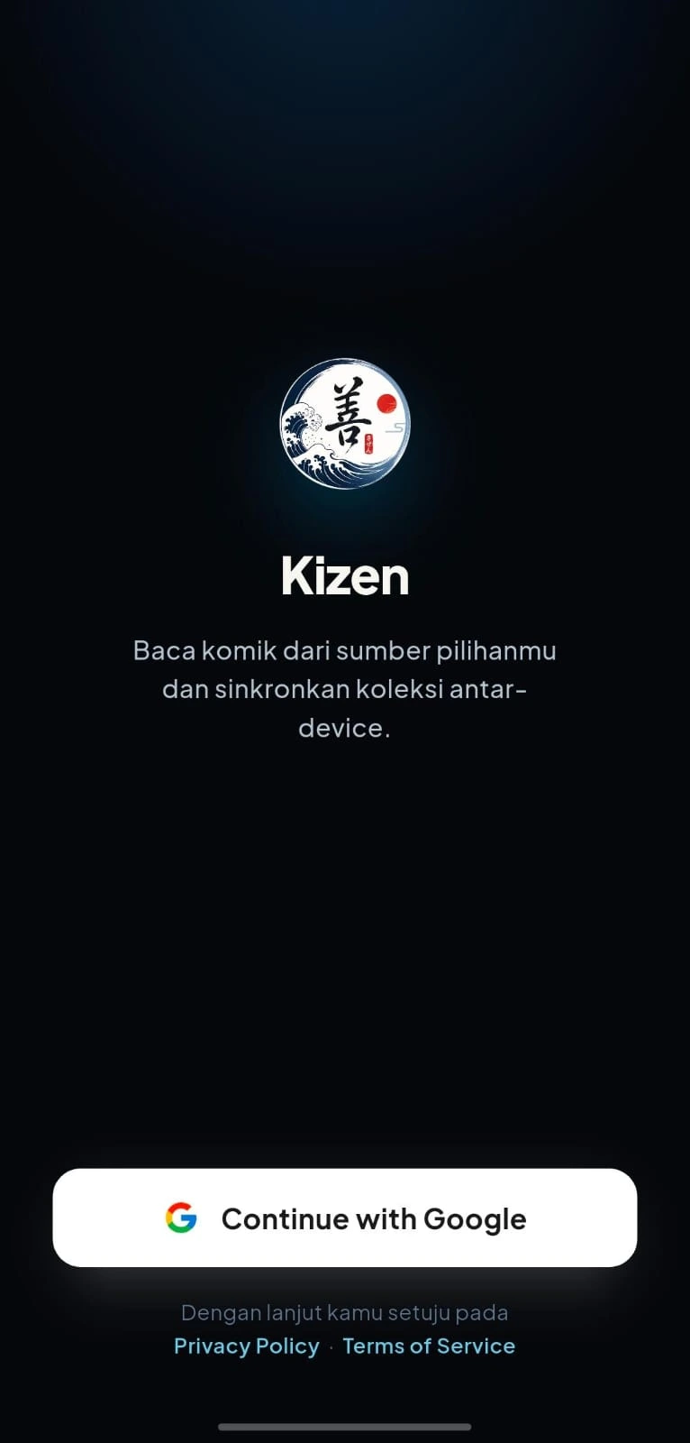
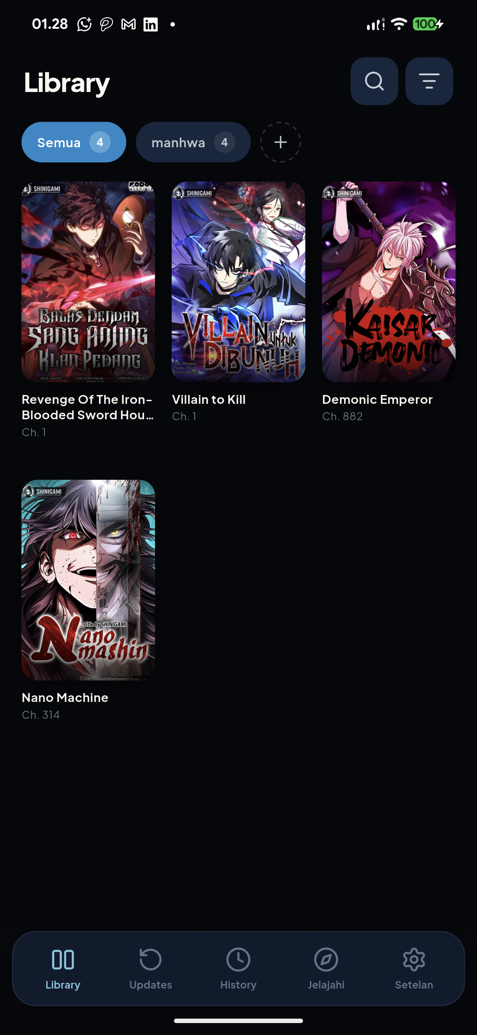
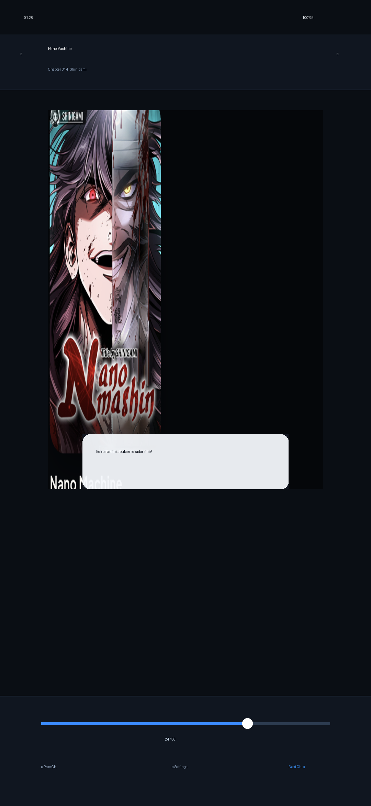
04 · CASE STUDY 02 / MOBILE & CLOUD
05 / 11
Kizen: Manga & Comic Reader with Cloud Sync
A personal comic reader app built with Flutter, Riverpod, and multi-source cloud sync.
MOBILE & CLOUD / FLUTTER
Kizen Application
A cross-platform manga and comic reader application delivering a clean and lightweight reading experience. Engineered with Riverpod reactive state management, Tachiyomi-inspired library organization, and multi-source scraping architecture.
CORE CAPABILITIES & ENGINEERING
• Multi-Source Scrapers: Modular extension architecture for fetching chapters dynamically.
• Cloud Sync & Progress: Firebase Firestore syncing reading history across multiple devices.
• Infinite Scroll Engine: Preloaded image pipeline with zero stutter and memory-conscious caching.
TECH STACK: Flutter · Dart · Riverpod · Firebase · Firestore
Cloud Sync Onboarding
Library & Collections
High-Res Infinite Reader
Notes:
Case study on Kizen: Flutter manga reader app with Riverpod state management and Firebase synchronization.

Slide 6
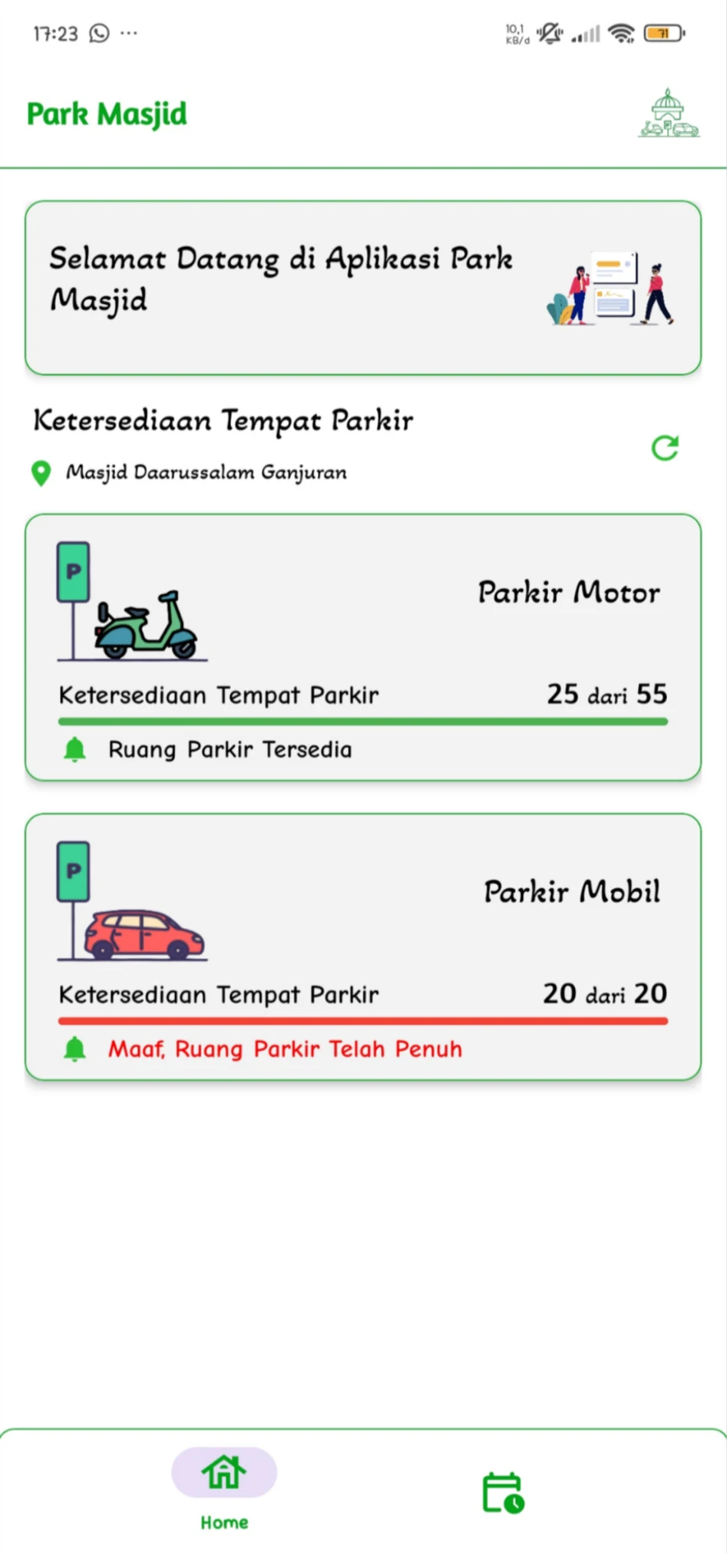
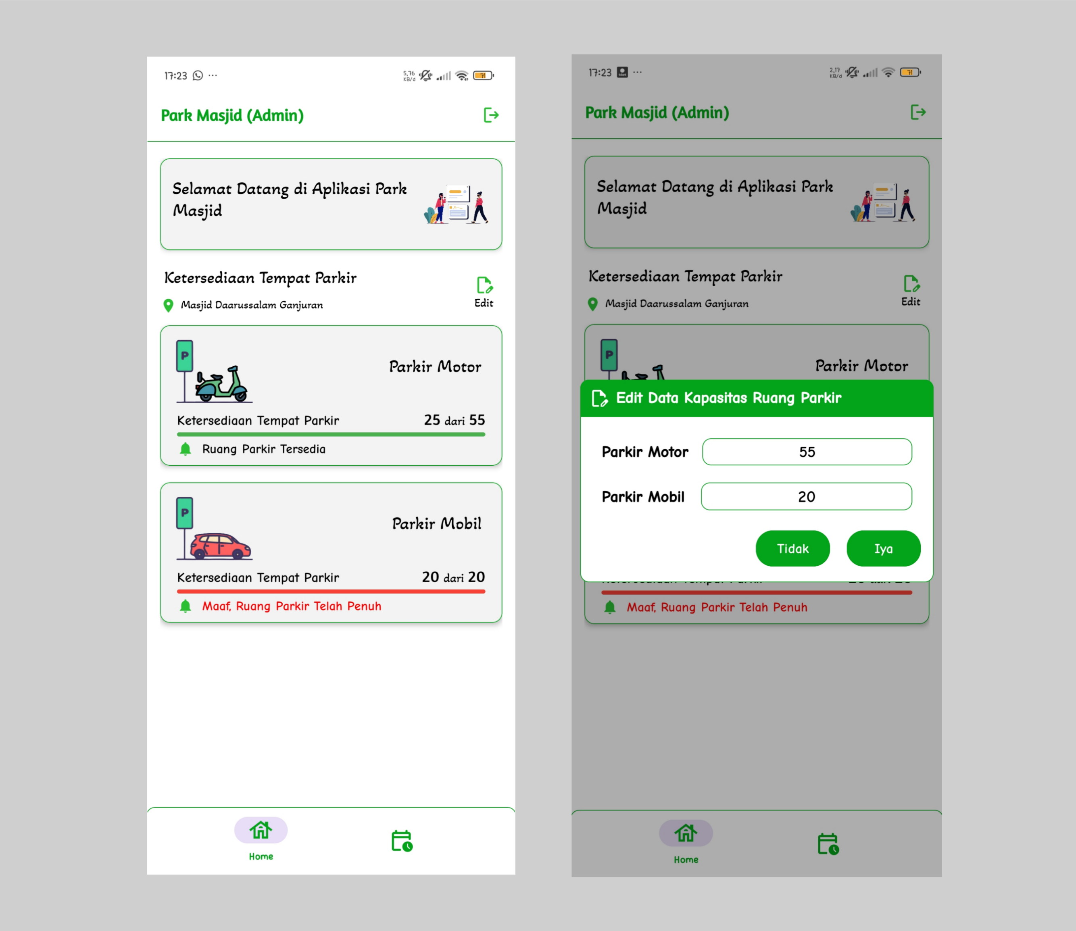
05 · CASE STUDY 03 / THESIS & IOT
06 / 11
Park Masjid: IoT-Integrated Smart Mosque Parking
Hardware-integrated vehicle counter with realtime Firebase sync and prayer schedule automation.
UNDERGRADUATE THESIS RESEARCH
Park Masjid Platform
An Android and IoT thesis system engineered to eliminate parking congestion at major congregational mosques. Directly connects gate sensors to Firebase Realtime Database to broadcast live parking availability to thousands of worshippers.
Published as academic research in Technologia: Jurnal Ilmiah (2026).
KEY INNOVATIONS & ACHIEVEMENTS
• Live Vehicle Counters: Realtime updates for motorcycle and car parking slots via IoT sensors.
• Administrator Control: Live capacity overrides, security controls, and prayer schedule editor.
• Published Research: Peer-reviewed academic paper verifying hardware-to-app latency.
TECH STACK: Kotlin · Android SDK · Firebase Realtime DB · IoT · Material 3
Visitor Live Slot Counter
Administrator Capacity & Schedule Editor
Notes:
Case study on Park Masjid: IoT vehicle counter and Android app thesis published in Technologia Jurnal Ilmiah.

Slide 7

06 · CASE STUDY 04 / RELIABILITY & ARCHITECTURE
07 / 11
OrderForge & Native Android Architecture
Explorations in e-commerce checkout consistency and clean native mobile architecture.
COMMERCE & RELIABILITY
NATIVE ANDROID / OFFLINE-FIRST
OrderForge Checkout Engine
Katalog Komik Android App
An e-commerce order engine designed to explore data consistency during checkout surges with atomic Redis locks and idempotent payment processing.
A modern native Android application showcasing Google Clean Architecture, declarative Jetpack Compose UI, and offline-first Room Database caching.
• Atomic Redis reservation locks preventing overselling.
• 100% declarative Jetpack Compose UI with adaptive orientations.
• Cryptographic webhook deduplication preventing double-charges.
• Reactive Single Source of Truth repository with Room DB & Coroutines.
TECH STACK: Laravel · Next.js · PostgreSQL · Docker · Redis
TECH STACK: Kotlin · Jetpack Compose · Room DB · Retrofit · Coroutines
Notes:
Dual case study presenting OrderForge commerce reliability engine and Katalog Komik native Android app.

Slide 8
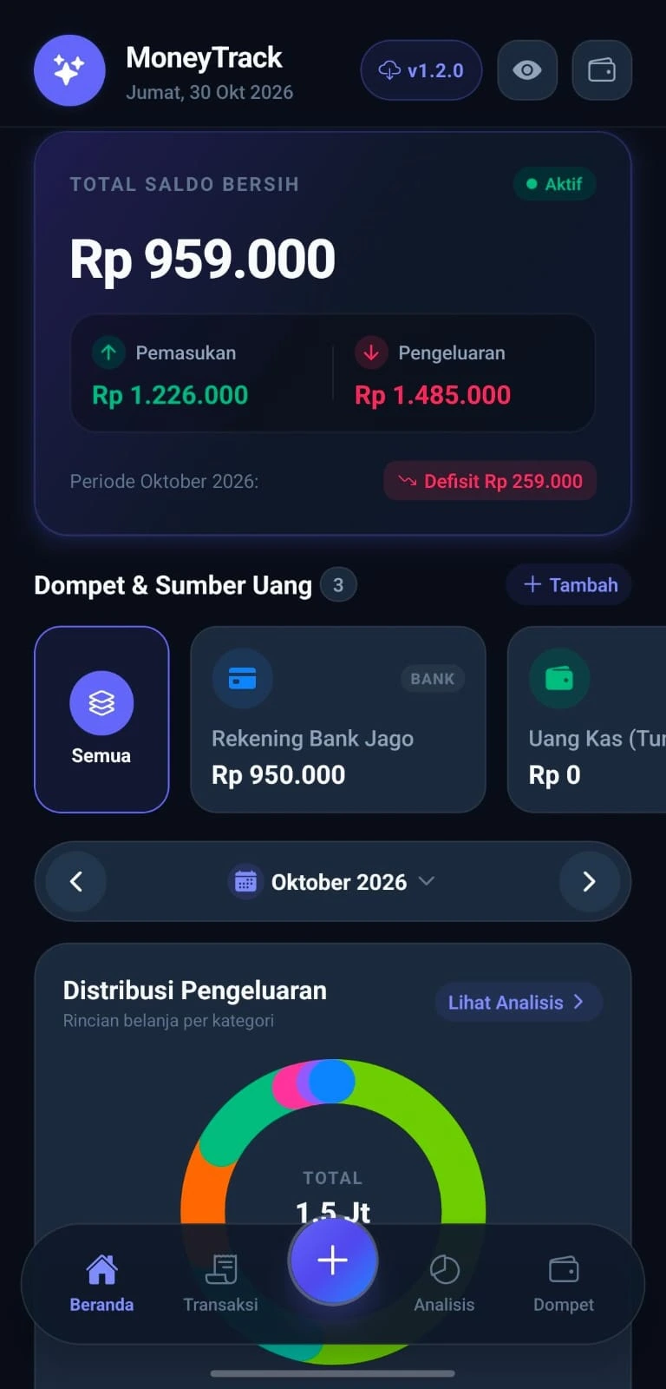
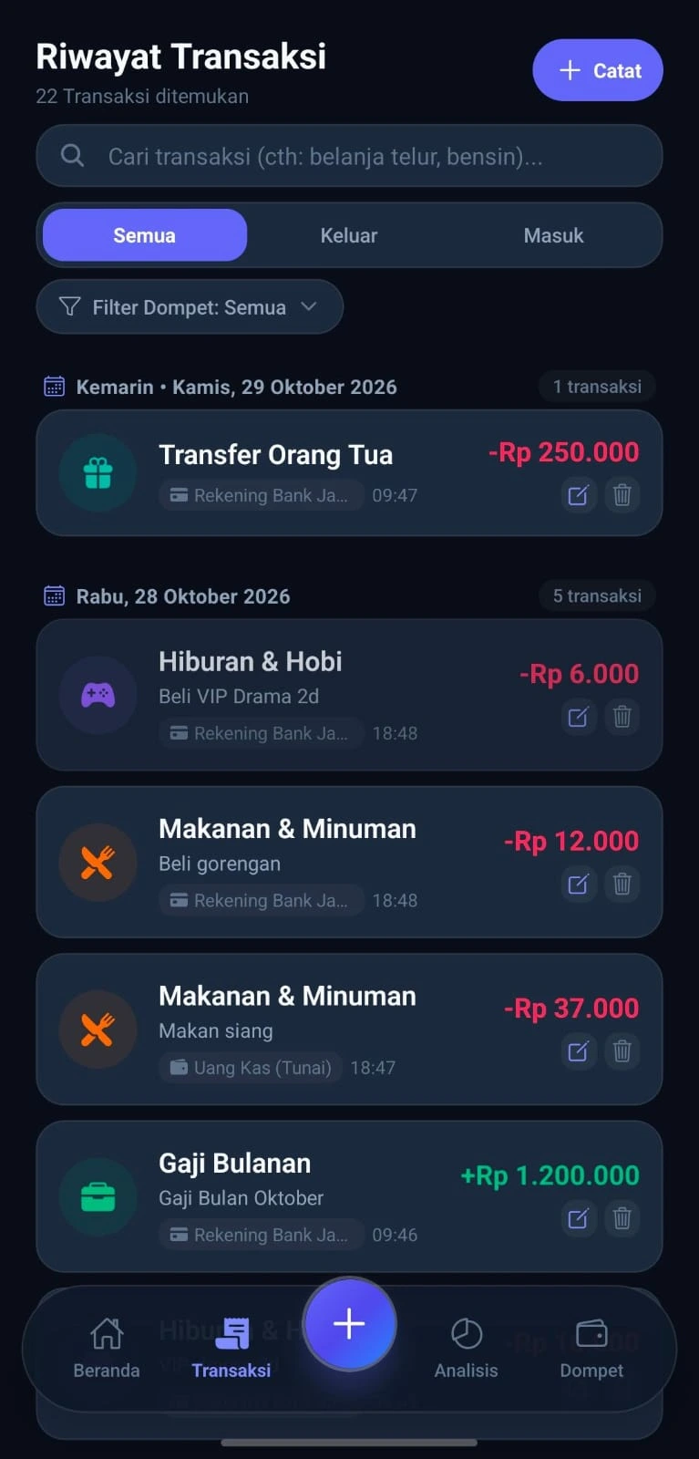
07 · CASE STUDY 05 / PERSONAL FINANCE
08 / 11
MoneyTrack: Offline-First Expense & Cash Flow Analytics
Know where every rupiah moves — zero cloud latency, multi-wallet accounts, and complete privacy.
MOBILE FINANCE & ANALYTICS
MoneyTrack Mobile App
A personal finance management application engineered for speed, privacy, and full offline functionality. Enables users to manage multiple bank accounts, e-wallets, and cash reserves with automated expense categorization and visual analytics.
CORE PRODUCT HIGHLIGHTS
• 100% Offline Storage: Encrypted local device storage with zero server dependency or network delay.
• Multi-Wallet Accounting: Seamless inter-wallet transfers with atomic debit/credit transaction logging.
• Dynamic Cash-Flow Charts: Realtime visual breakdowns of monthly income, expenditures, and categories.
TECH STACK: React Native · Expo · TypeScript · AsyncStorage · Charts
Balance & Wallet Breakdown
Filterable Transaction Ledger
Notes:
Case study on MoneyTrack: offline-first personal finance application with React Native, Expo, and TypeScript.

Slide 9
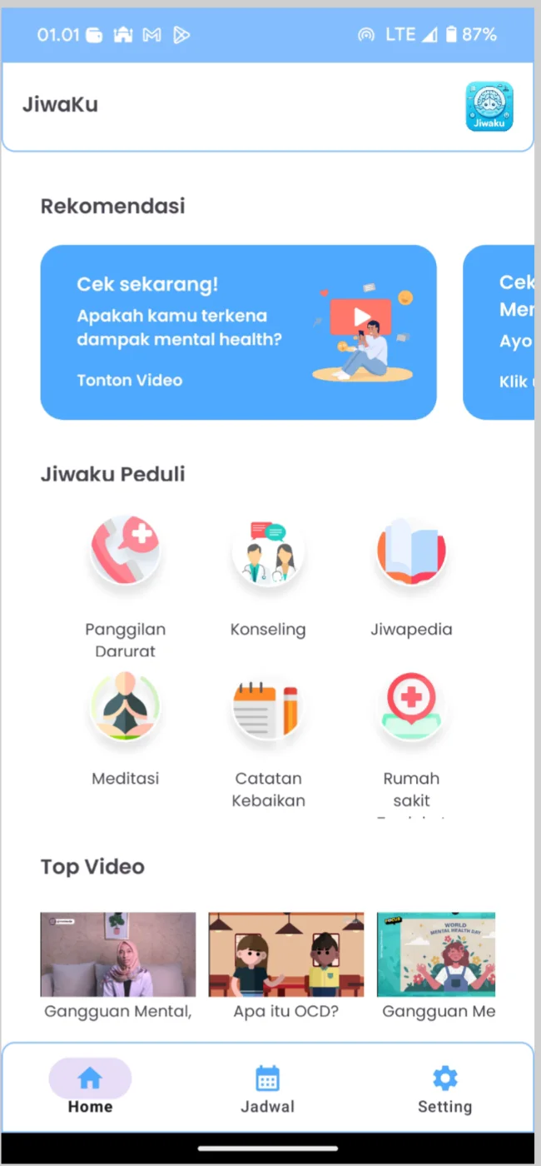
08 · SUPPLEMENTARY ARCHIVE
09 / 11
Also in the Making: Health Tech & Enterprise Deliveries
Additional explorations and production client deliverables from research and freelance projects.
HEALTH & WELLNESS · ANDROID
COMMERCE & WORKFLOW · FULLSTACK
JiwaKu Mental Health App
Enterprise Client Web Portal
A comprehensive mental wellness support app built with Kotlin, featuring real-time counseling chat, emergency psychiatric helpline routing, guided audio meditation, and Firebase Firestore authentication.
A custom full-stack web application developed to manage client invoicing, appointment scheduling, and automated PDF receipt generation with role-based access control and MySQL data integrity.
Delivered as a production freelance solution for a commercial service provider.
• Real-time counseling chat with Firestore listeners.
• Automated PDF invoice and receipt generation engine.
• Direct routing to certified psychiatric helplines.
• Role-based authentication (Client, Staff, Administrator).
• Built-in mood tracking journal and guided audio exercises.
• Automated appointment calendar with SMS/Email notifications.
• Zero data discrepancy audit logs for financial reconciliation.
TECH STACK: Kotlin · Android SDK · Firebase · Material 3
TECH STACK: Laravel · Vue.js 3 · Vite · MySQL · Tailwind CSS
Notes:
Supplementary archive showcasing JiwaKu mental wellness app and an Enterprise Client Web Portal.

Slide 10
09 · CAREER JOURNEY
10 / 11
Track Record of Impact & Milestones
Consistent trajectory across enterprise software engineering, academic excellence, and continuous growth.
PRODUCTION
DEC 2025 – PRESENT
Backend Developer Intern · Badan Sistem Informasi · Universitas Islam Indonesia
Assisting in developing REST APIs with Laravel and Lumen, organizing normalized MySQL databases, and exploring Model Context Protocol (MCP) AI integrations.
GOVERNANCE
AUG 2024 – DEC 2024
Enterprise Architecture & Systems Intern · Badan Sistem Informasi · Universitas Islam Indonesia
Mapped enterprise business processes, maintained application catalog repositories, and evaluated service interdependencies across campus platforms.
CLOUD
MAY 2024 – AUG 2024
AWS re/Start Cloud Graduate · Amazon Web Services & Dicoding Indonesia
Completed intensive 400+ hours training covering AWS cloud architecture, VPC networking, IAM security, Linux systems, and automated deployment pipelines.
HONORS
2021 – 2026
Bachelor of Informatics (GPA 3.81 / 4.00) · Universitas Islam Indonesia
Graduated with high honors. Authored published research on IoT smart parking in Technologia: Jurnal Ilmiah. Best Team Award at Informatics Expo.
Notes:
Chronological career progression from university distinction to AWS certification and active backend engineering internship at BSI UII.

Slide 11
10 · GET IN TOUCH
11 / 11
AVAILABLE FOR ROLES & CONTRACTS · 2026
Let’s build software that lasts.
Looking for a junior backend or full-stack developer? I’m eager to learn, contribute, and join a collaborative engineering team.
DIRECT INQUIRY
PROFESSIONAL NETWORK
reikyranp@gmail.com
linkedin.com/in/reikypratama
Fast response · Primary communication channel
Connect on LinkedIn for career discussions
OPEN SOURCE CODE
ONLINE PORTFOLIO & CV
github.com/reiky03
https://reiky03.github.io
Explore full repositories, commits & architectures
Interactive web portfolio & official downloadable CV
© 2026 Reiky Aryanando Pratama · Handcrafted with precision & discipline · Yogyakarta, Indonesia
Notes:
Closing slide with direct email, LinkedIn, GitHub, and live website links.

