Slide 1

RICHFIELD
CONNECT
Team Echo 5 · Richfield Connect · Hackathon 2026
Notes:
REILYN: "RC." (pause -- two full seconds) "That's all you're looking at right now... it's Richfield Connect. My name is Reilyn, tech lead -- database, security architecture, and the AI layer. Next to me is Keshav, who built the entire mobile application. And Saiyusha, who built the web dashboard. Three of us. One production system, built and shipped end to end."

Slide 2



PROBLEM STATEMENT
Graduate Employability Is A Visibility Problem
Students struggle to build a professional presence before graduating
Alumni and current students are disconnected from each other
Businesses struggle to discover and engage with Richfield-specific talent
Student struggle to build the digital portfolios, networks, and proven skills employers now expect.
Alumni lack a structured way to mentor and share experiences – resulting in lost learning and networking opportunities
Employers lack an efficient way to find verified talent, post relevant opportunities, and track applicants
In a nutshell- Students, alumni, and employers lack a connected platform to build skills, maintain networks, display all of their accomplishments, and efficiently connect job seekers with career opportunities.
Richfield Connect · Hackathon 2026
Notes:
REILYN states the three problems, then: "Richfield Connect is our answer: a student builds a verifiable portfolio from day one, an alumnus stays connected for life, a business discovers verified talent, and an administrator governs it with security enforced in the database, not a UI checkbox. Keshav's going to start with the part you'll hold in your hand."

Slide 3
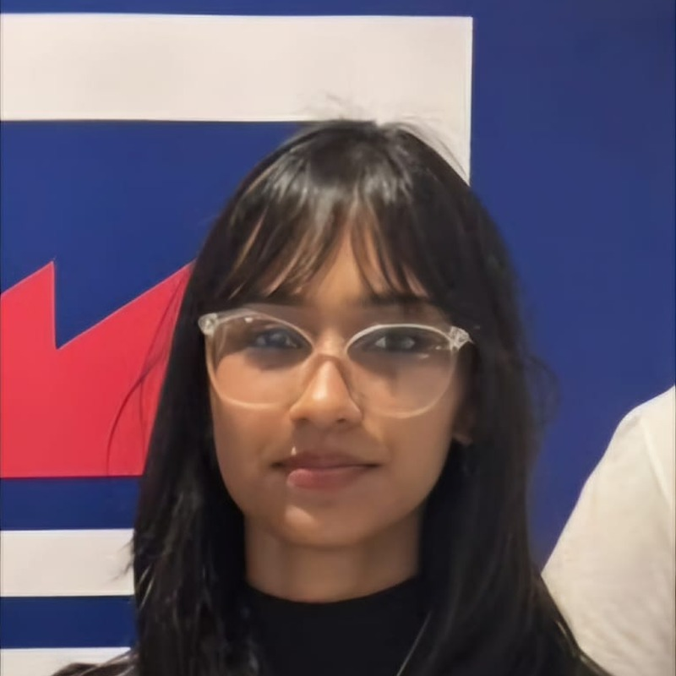


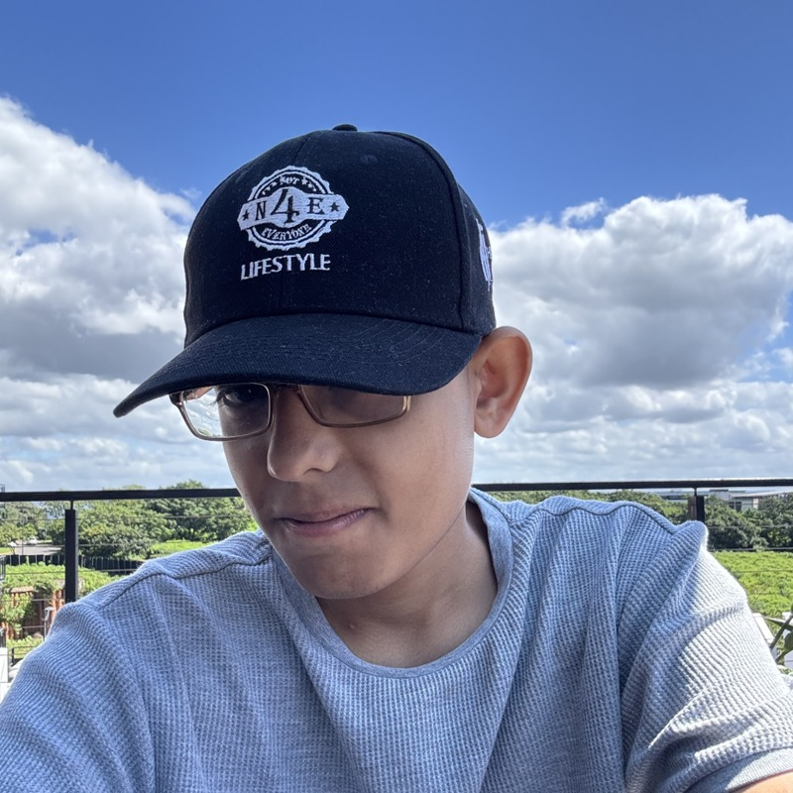

OUR TEAM
Meet Team Echo Five
Diya
Sashen
Reilyn
Keshav
Saiyusha
Architecture design, documentation & analytics dashboards
Frontend (iOS), app
UI/UX & testing
Backend, database, integration & Firebase Cloud Messaging
Frontend (Android), app UI/UX & testing
Admin web, Vercel deployment & React UI/UX
Richfield Connect · Hackathon 2026

Slide 4




SOLUTION OVERVIEW
Our Solution: One Ecosystem, Four Working Parts
Richfield Connect — a mobile-first platform where students build a portfolio from day one, alumni stay engaged for life, businesses discover verified Richfield talent, and administrators govern the whole ecosystem with real backend security.
Flutter Mobile App
Web Admin Console
Supabase Backend
AI Microservice
The primary product & demo surface — feed, portfolio, jobs, messaging, AI assistant, dashboards.
An administrator-only console for moderation, approvals, events and analytics.
Postgres + RLS is the system of record and the API — auth, storage, realtime, edge functions.
A Python/Flask service fronting Google Gemini for CV parsing and the Career AI assistant.
Richfield Connect · Hackathon 2026

Slide 5




USER TYPE BREAKDOWN
Four Roles – Four Access Levels
Student –
Currently enrolled
Alumni –
Richfield graduate
Business –
Verified recruiter
Administrator –
Richfield staff
Authorized by-
A Richfield institutional email
Authorized by-
TrackID on actual degree/certificate and being approved
Authorized by-
Submitting a business registration number and being approved
Authorized by-
A service-role script, never self-registered
Access-
Feed, portfolio, jobs, messaging, connections
Access-
Same as students with + career-pathway/mentorship relevant sections
Access-
User/content moderation, events publishing, platform analytics.
Access-
Can post & manage job listings, view job applications, analytics for their own listings
Richfield Connect · Hackathon 2026
Notes:
REILYN: "Everything Keshav and Saiyusha just showed you sits on top of one Postgres database, on Supabase... authorization is enforced in the database, not the interface. Anyone can skip the app entirely and call our API directly with a valid session token."

Slide 6
AUTH DESIGN, PART 1
Authentication — Student & Alumni
Student
Alumni
Domain-restricted self-registration
The deliberate design challenge — solved
Registration is restricted to @my.richfield.ac.za, @richfield.ac.za, @my.aaa.ac.za or @aaa.ac.za — enforced by handle_new_user() in the database, so it cannot be bypassed by editing the app.
Submits student number, TrackID on degree/certificate, & optionally supporting documents during sign-up.
Admin reviews this on web dashboard and reviews attachments and TrackID.
Admin then approves or denies verification.
If approved, user will be able to access app as an alumni
Richfield Connect · Hackathon 2026

Slide 7
AUTH DESIGN, PART 2
Authentication — Business & Administrator
Business / Employer
Administrator
Verified before it can reach students
No self-registration path — ever
Submits a registration number and uploads a supporting document upon sign-up
Admin then reviews this in the web-based admin dashboard
Admin approves or rejects
Approval automatically verifies the business account and logs the admin who verified them
Provisioned only by supabase/scripts/provision-admin.ts, run with the service-role key — there is no admin sign-up screen anywhere in the app.
A prevent_unauthorised_role_change trigger blocks any attempt to promote an account to admin through the ordinary API.
Richfield Connect · Hackathon 2026

Slide 8
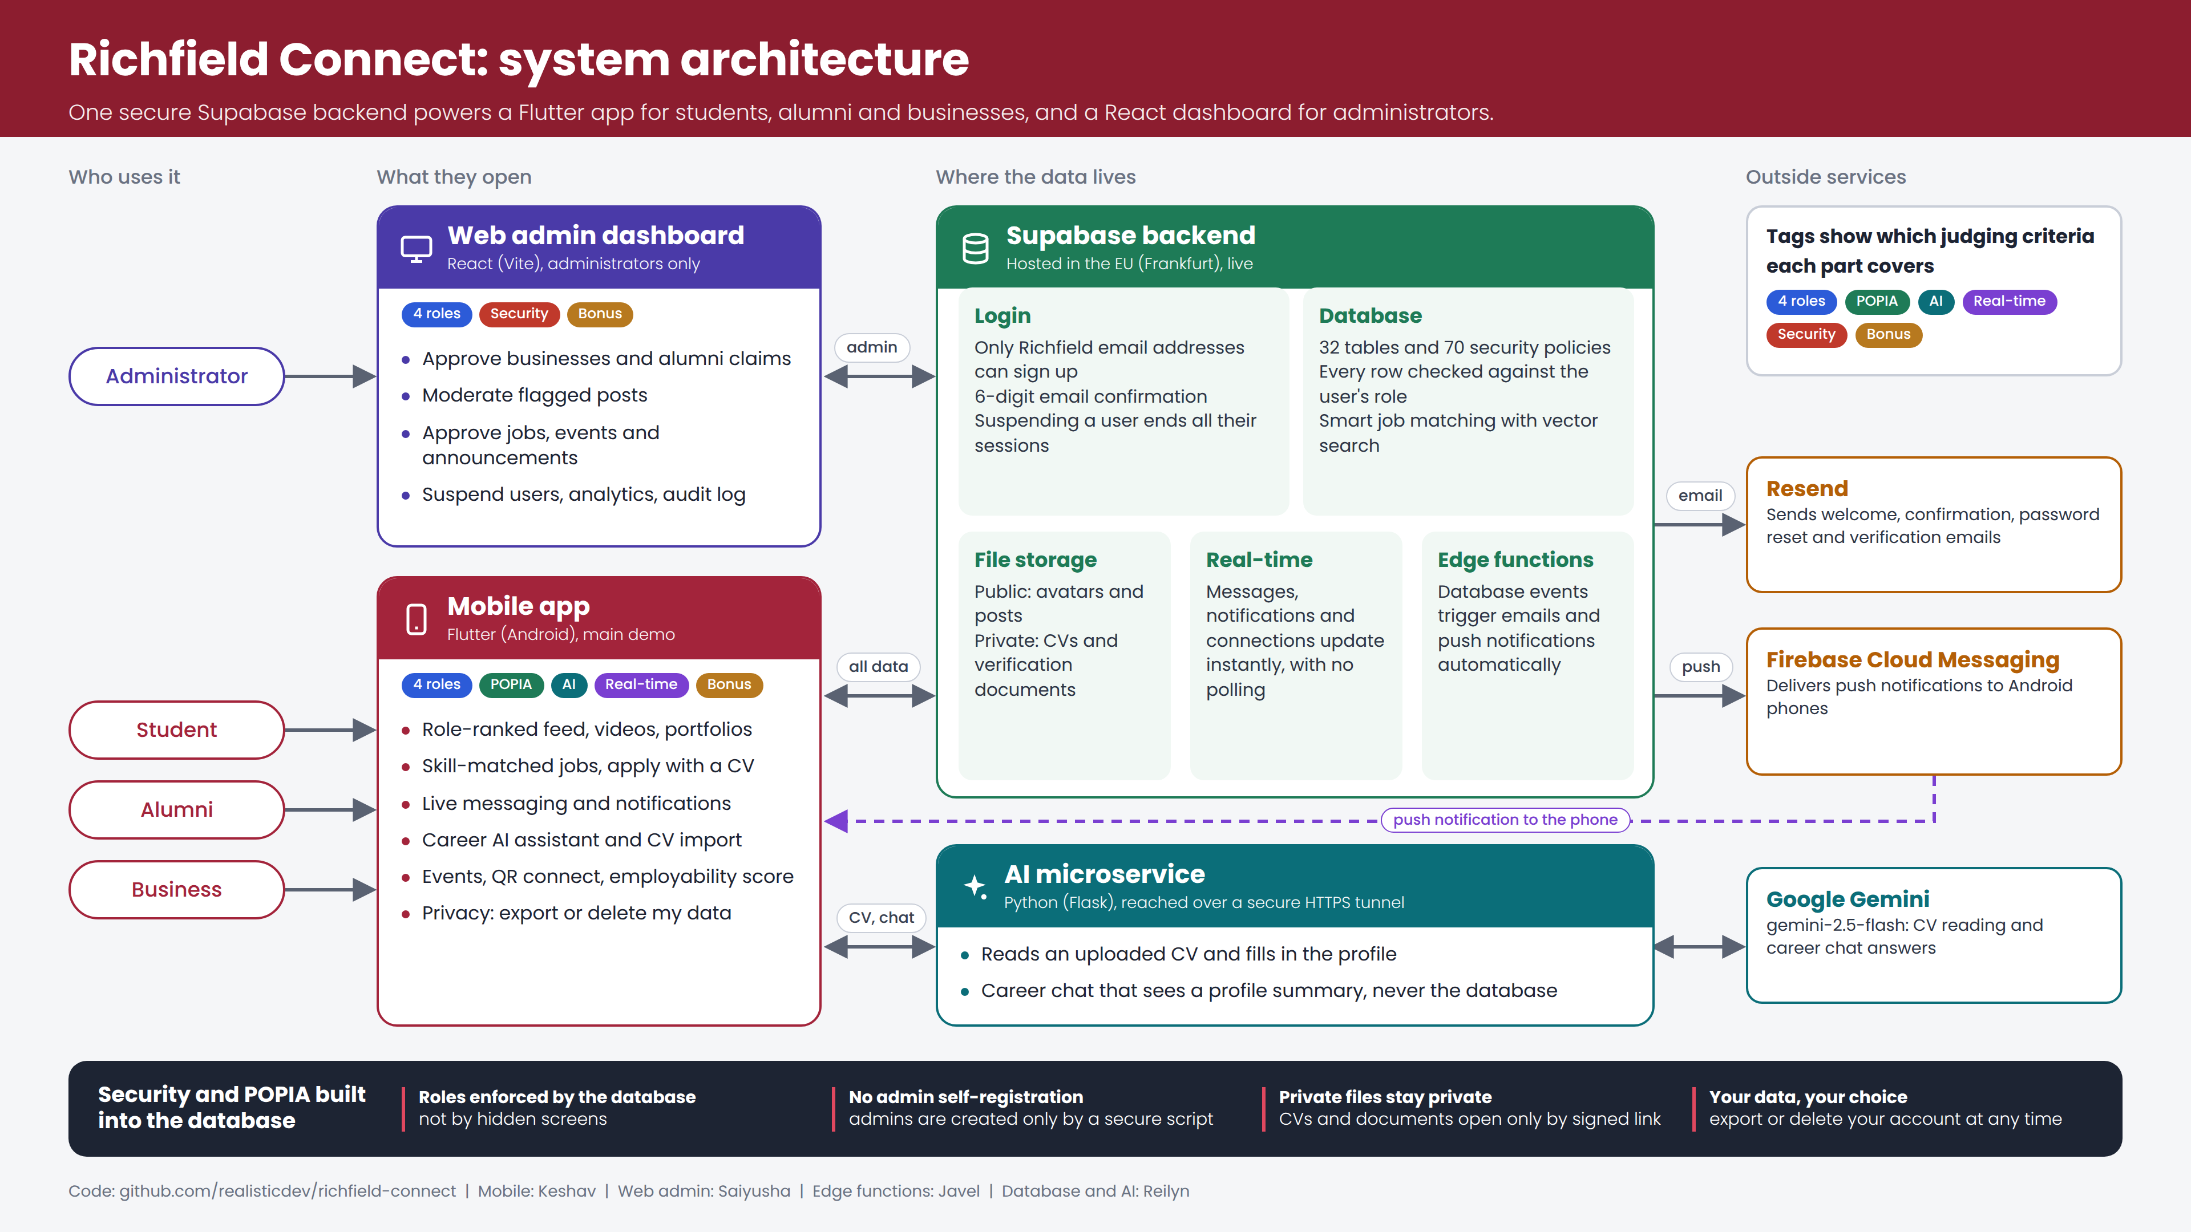
System Architecture
Four parts, one API surface — Flutter mobile + React web admin + Supabase + Python/Flask AI microservice
Figure 1 — Richfield Connect system architecture
Notes:
Rather than building a simple app, we built an ecosystem. Our Flutter mobile app and React web dashboard both talk directly to our Supabase backend. [CLICK] We leverage Row-Level Security so the database itself enforces our rules. [CLICK] Finally, we integrated a Python microservice to bring Google Gemini AI directly into the student's career journey. [NEXT SLIDE]

Slide 9
TECHNOLOGY CHOICE & JUSTIFICATION
Database — Why Postgres via Supabase
Chosen because data is relational by nature — profiles, skills, endorsements, connections, messages, opportunities and applications are many-to-many, with real referential integrity requirements. We researched NoSQL and chose SQL deliberately.
Security lives in the database
Server-side logic without a server
RLS lets us write policies on the table itself — enforced for every client, every query, forever.
Approvals, analytics, notifications, matching and POPIA export/delete run within the database, no need for a separate app server.
Extensions we actually needed
Supabase specifically
pgvector for skill/opportunity similarity, pg_net for outbound webhooks, Vault for secrets, and Realtime streaming of row changes over WebSockets — all on one engine.
Managed EU Postgres with Auth, Storage, Realtime, and Edge Functions under one JWT, plus SDKs for Flutter and React
Richfield Connect · Hackathon 2026
Notes:
REILYN, continuing the backend section: RLS lets us write "a business may read a certification only if the student allowed businesses" as a policy on the table itself -- enforced for every client, every query, forever.

Slide 10
TECHNOLOGY CHOICE & JUSTIFICATION
Mobile Framework — Why Flutter
Flutter + Dart compiles to native ARM code for both Android and iOS from one codebase — the mandatory mobile-app requirement met with room to spare.
Native feel even on mid-range devices
First-class Supabase & Firebase SDKs
Flutter draws its own widgets and compiles to native code, so the feed, video player and chat feel native even on mid-range devices.
supabase_flutter gives auth, PostgREST, Storage and Realtime in one package; firebase_messaging gives push — there is no complex networking layer to build or debug.
Fast iteration
Additional features from mature plugins
Hot reload makes a polished mobile prototype achievable in days rather than months
Deep-linked email confirmation, video posts, CV upload and QR Connect were all able to be built without native code
Richfield Connect · Hackathon 2026

Slide 11


GUIDED FROM FIRST LOGIN
Onboarding, Tutorial & the Career AI Assistant
First-time experience
Career AI assistant
A real model, not a scripted chatbot
Interactive first-launch tour
Feed, portfolio, jobs and messaging
Re-open it any time
From the account menu, not a one-off splash
Guided profile completion
The assistant explains what employers look for
Mobile app
Flask service
/api/chat
Gemini
2.5 Flash
The app sends a profile summary plus the question; advice comes back
Context-aware advice
Knows which profile sections are complete or missing
No database access
Gets a summary, never the raw row; holds no Supabase client
Ask it:
What posts attract employers?
How do I approach a connection?
Richfield Connect · Hackathon 2026
Notes:
REILYN: "Every single write that results from using the AI features -- saving a parsed CV, for instance -- goes back through the exact same authenticated Supabase path, under the exact same policies, as everything else in this system. That's the full stack. Now we're going to stop talking about it and show it to you."

Slide 12
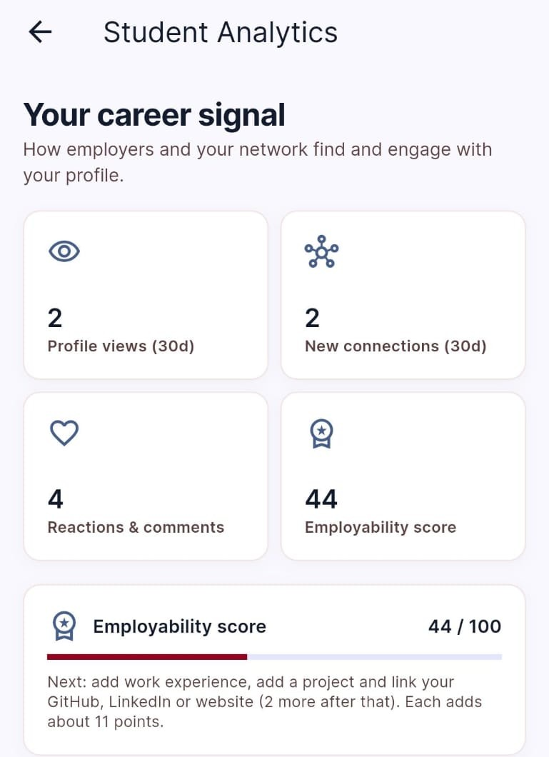
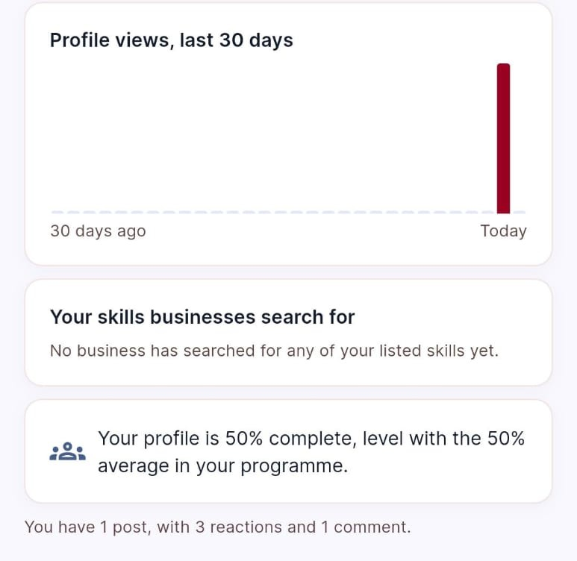
DATA ANALYTICS DASHBOARDS
Student Analytics Dashboard
Here the student can see:
Profile completeness
Which of their skills are highly sought after by businesses
Profile view count
Connection growth
Post engagement
Richfield Connect · Hackathon 2026

Slide 13
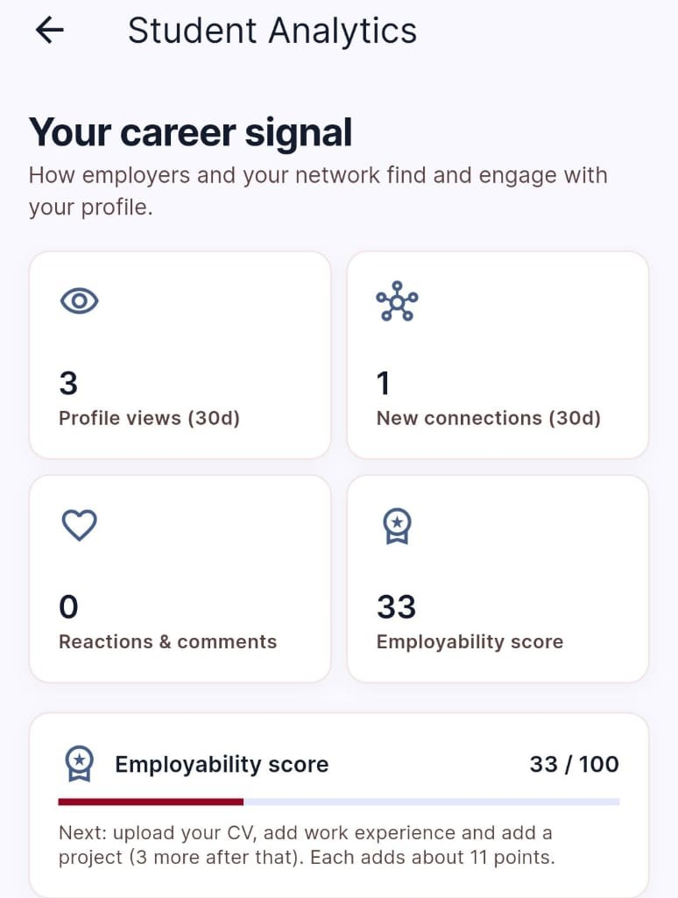
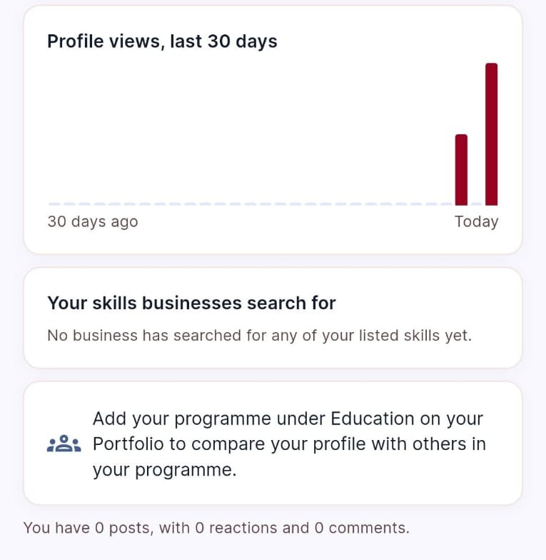
DATA ANALYTICS DASHBOARDS
Alumni Analytics Dashboard
Here the alumni can see:
Profile completeness
Which of their skills are highly sought after by businesses
Profile view count
Connection growth
Post engagement
Richfield Connect · Hackathon 2026

Slide 14
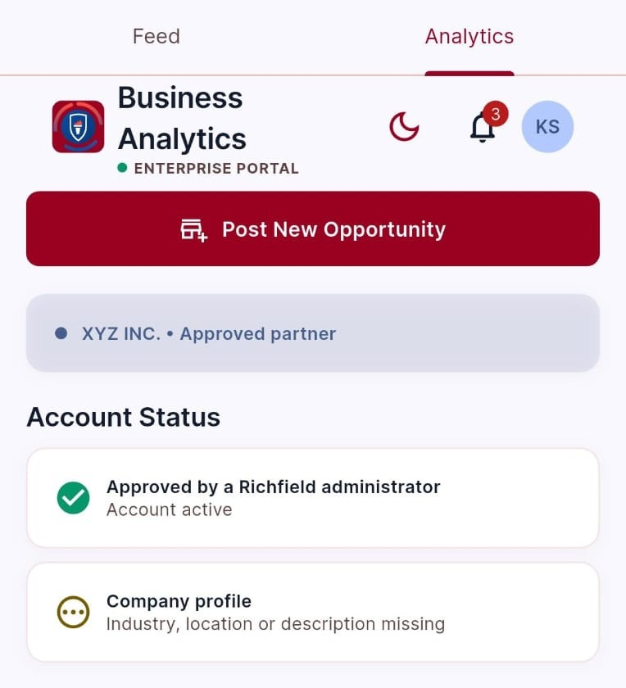
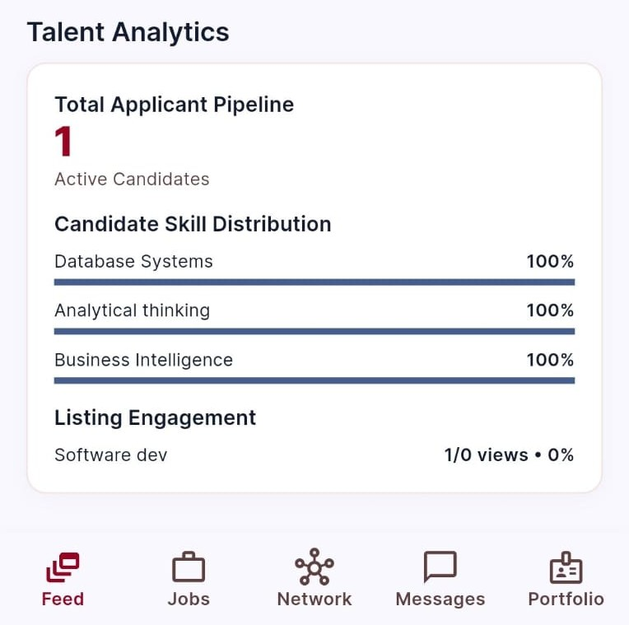
DATA ANALYTICS DASHBOARDS
Business Analytics Dashboard
Here the business can see:
Total applications per posted job opportunity
Engagement rate on job posting
Candidate skill distribution across different Richfield programs and years of study
Overall reach/ visibility
Richfield Connect · Hackathon 2026

Slide 15
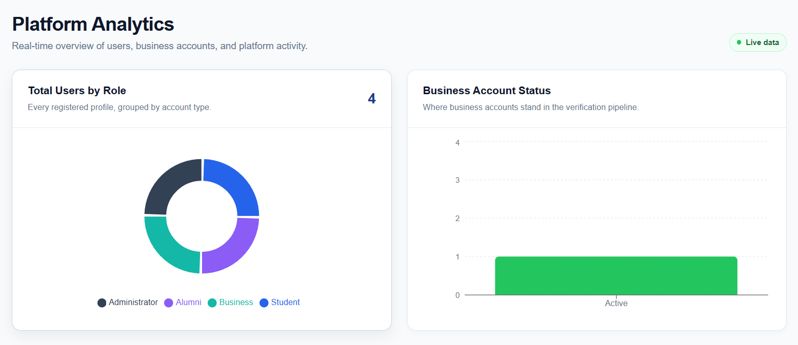
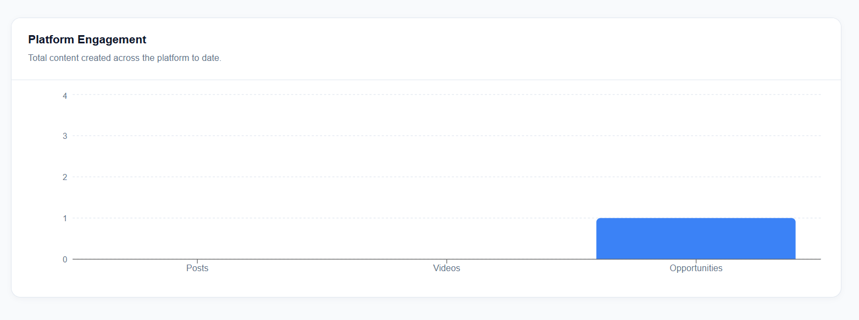
DATA ANALYTICS DASHBOARDS
● LIVE DATA
Administrator Analytics Dashboard
What the admin dashboard shows:
Total Users by their role (Student, Alumni, Business, Admin
Alumni verification status
Business account verification status
Platform engagement
With this data we can:
See what content keeps users engaged
Show that every alumni and business is verified
Spot gaps between job seekers and business and target outreach
Richfield Connect · Hackathon 2026
Notes:
SAIYUSHA: "Every chart you see here is rendered with recharts, but the numbers come from dedicated Postgres aggregate functions running server-side. The database does the computation once; the browser just draws it."

Slide 16



SECURITY & GOVERNANCE
Data Privacy & POPIA Compliance
71 RLS policies across 32 tables, checked by the database on every request
Who gets in
Who sees what
POPIA rights
Admins created by script only
provision-admin.ts + role trigger
Alumni & businesses approved
account_status pending → active
Suspended accounts can’t write
banned_until + sessions revoked
Per-section profile visibility
can_view_profile_section()
Emails and push tokens hidden
email, fcm_token not granted
AI sees a profile summary only
No database client in the AI service
Export my data (s23)
export_my_data()
Delete my account (s24)
delete_my_account()
Explicit consent
Consent text shown to users
Richfield Connect · Hackathon 2026
Notes:
REILYN: "We found a real credential exposed in our own git history earlier in this project, caught it, removed it, and turned our response into a standing rule about how we stage commits going forward. I'm telling you that not because we're proud it happened, but because catching your own mistake and closing it properly is exactly what real security practice looks like."

Slide 17



REALTIME, MATCHING, NLP & VIDEO
Additional Technical Features
Realtime Notifications
Smart Job Matching
NLP-Assisted Profile Building
Video Processing
Connection requests, messages, opportunity matches and admin announcements arrive over WebSockets (Realtime) plus FCM push — not polling.
recommend_opportunities() surfaces a newly-approved listing to students whose skills and programme genuinely align, driven by matching logic, not a broadcast.
A CV upload is parsed by Gemini through POST /api/parse-cv into strict JSON (skills, education, experience) via a response_schema — no prose to hand-parse.
Uploaded video is compressed/transcoded to 720p on-device with an auto-generated poster thumbnail before it ever reaches storage.
Richfield Connect · Hackathon 2026

Slide 18
THANK YOU
Team Echo Five · Richfield Connect
Team Echo 5 · Richfield Connect · Hackathon 2026

