Slide 1

Intro to
Kansas State University, Department of Entomology
Instructors: Reilly Brennan (reilly.brennan@usda.gov), Tania Kim (tkim@ksu.edu), Brian Spiesman (bspiesman@ksu.edu)

Slide 2
What is R?
R is a programming language and software environment for statistics, data analysis, and graphics
You type instructions instead of clicking
It is free and open source
It is built by and for data analysts
It is reproducible
Notes:
It grew out of the S language from Bell Labs and was first written by Ross Ihaka and Robert Gentleman at the University of Auckland in the early 1990s. Today it is maintained by the R Core Team and a large community of contributors.
A few things make R different from point-and-click software such as Excel, SPSS, or JMP:
You type instructions instead of clicking. That feels slower on day one and is much faster by week three, because instructions can be saved, repeated, and shared.
It is free and open source. Anyone can install it, read its code, and extend it.
It is built by and for data analysts. Statistical methods often appear in R first, written by the people who developed them.
It is reproducible. A script is a complete record of every step from raw data to final figure. Six months from now, you (or a reviewer) can rerun it and get the same answer.

Slide 3
R versus RStudio
 | R | RStudio
What it is | The language and the engine that runs calculations | An editor (an “IDE”) that makes working with R easier
Analogy | The engine of a truck | The dashboard, steering wheel, mirrors
Can you use it alone? | Yes, but it is bare-bones | No, it needs R installed underneath

Slide 4
What is R good for?
Task | Entomology example | packages
Cleaning and managing data | Combining weekly trap sheets from 20 sites into one dataset | dplyr, tidyr, readr, janitor, lubridate
Graphics | Seasonal phenology curves of tick life stages | ggplot2
Count-data statistics | Do light-trap catches differ by habitat? | base glm(), MASS, glmmTMB, lme4,
Dose–response bioassays | Estimating LC₅₀ for a pyrethroid against Aedes aegypti | drc
Survival analysis | Adult longevity under different temperatures | survival
Community ecology | Diversity and ordination of pitfall-trap beetle communities | vegan, iNEXT
Phenology | Predicting emergence from temperature records | base R, chillR
Spatial data and maps | Mapping collection sites; species distribution models | sf, terra
Biodiversity databases | Downloading occurrence records for a vector species | rgbif
Molecular data phylogenetics | Reading barcode sequences; plotting a tree | Biostrings (Bioconductor), ape
Reproducible reports | This document | rmarkdown, knitr, Quarto
Notes:
R is NOT good for:
Entering data in the field or lab. Use a spreadsheet, a paper datasheet, or a form app, then bring the data into R.
Processing raw sequencing reads or thousands of images. Dedicated command-line tools usually do the heavy lifting; R is great for analyzing their output.
One-off arithmetic. A calculator is fine. R pays off when a task will be repeated, checked, or shared.

Slide 5
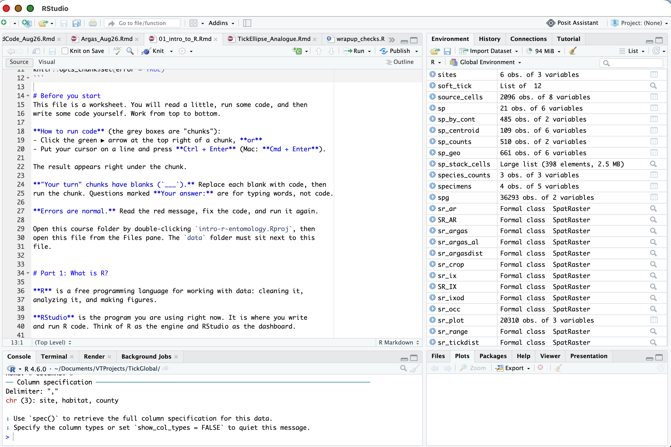
Source
Environment
Rstudio
layout
Console
Files/plots/packages/help
Notes:
RStudio (made by the company Posit) has four main panes:
Source (top left): scripts and R Markdown files. Write code here.
Console (bottom left): where code actually runs. You can type directly here for quick checks, but nothing typed here is saved.
Environment / History (top right): the objects (data, values) currently in memory.
Files / Plots / Packages / Help (bottom right): browse folders, view plots, and read documentation.

Slide 6
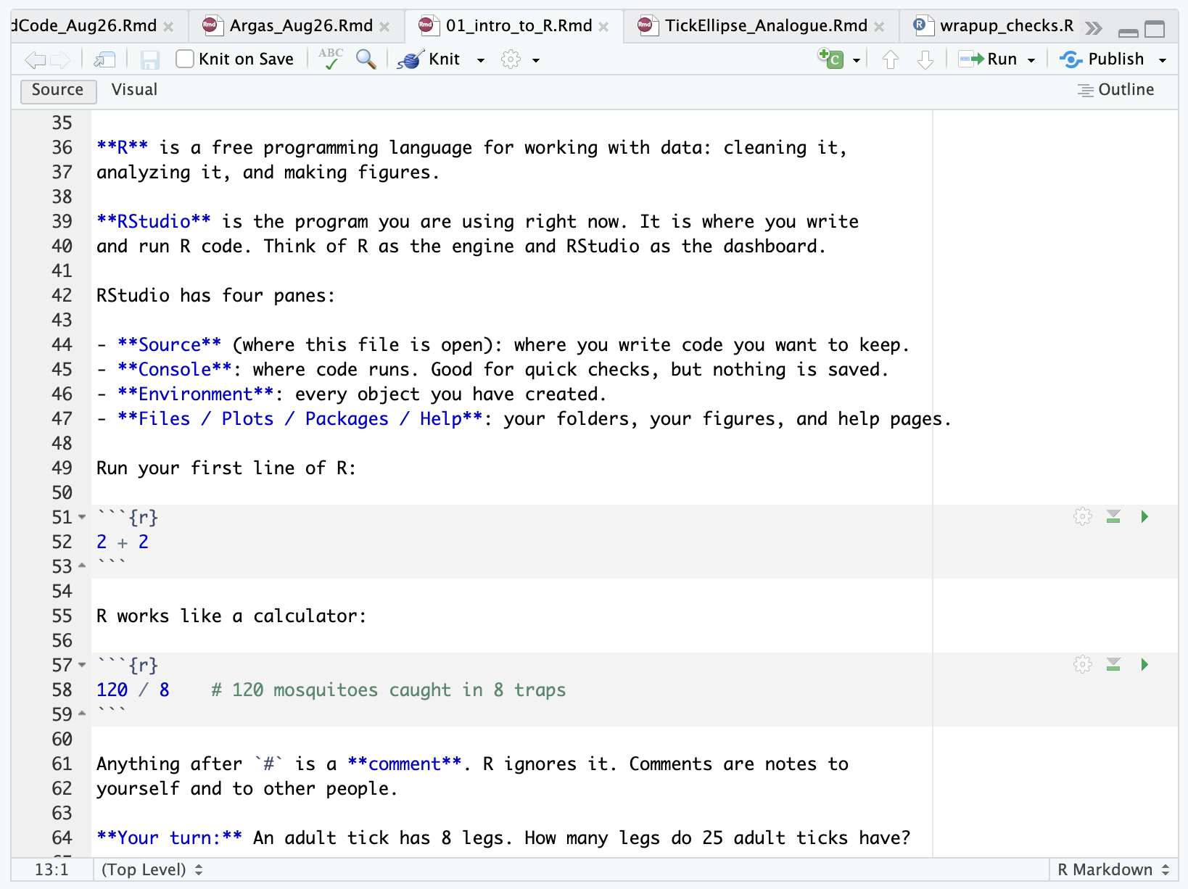
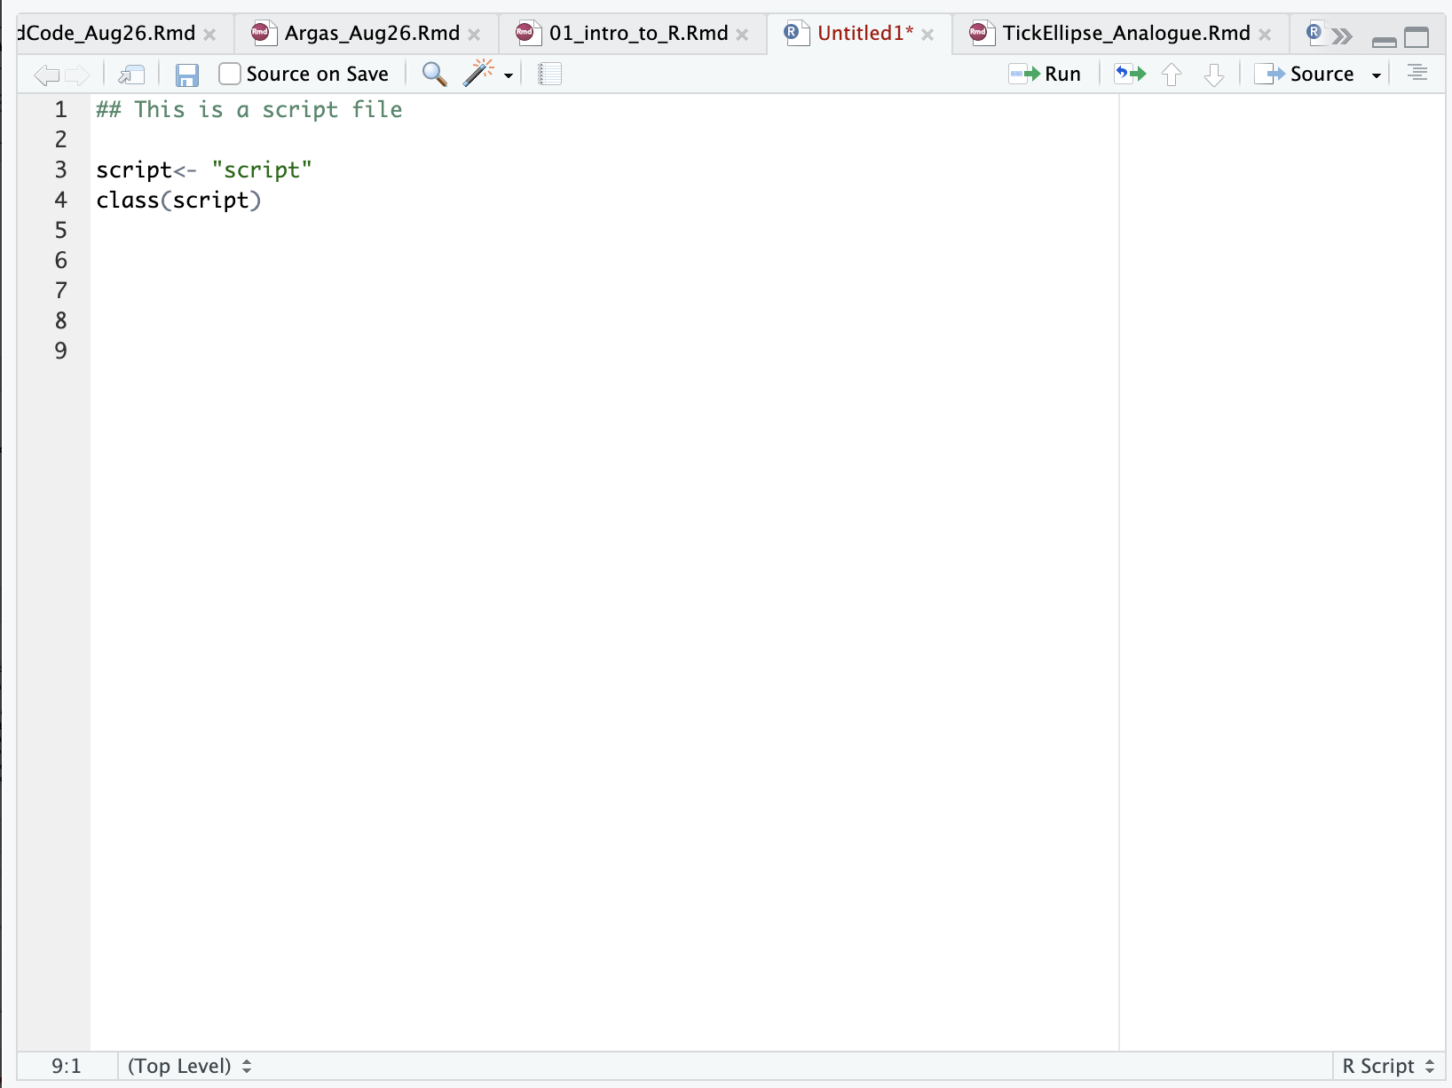
What is R Markdown?
R Markdown (.Rmd) lets you mix formatted text with code chunks.
Rmarkdown
R script
Notes:
R Markdown (.Rmd) lets you mix formatted text with code chunks. When you knit, R runs every chunk in order and weaves the results (numbers, tables, figures) into a report. A chunk looks like this:
You can also put R inside a sentence. For example, typing `r sum(c(14, 3, 0, 22))` in the text produces the number 39 when knitted. Because numbers in the text are calculated from the data, they update automatically if the data change. Quarto (.qmd) is a newer system that works almost the same way; everything in this module applies to it.

Slide 7
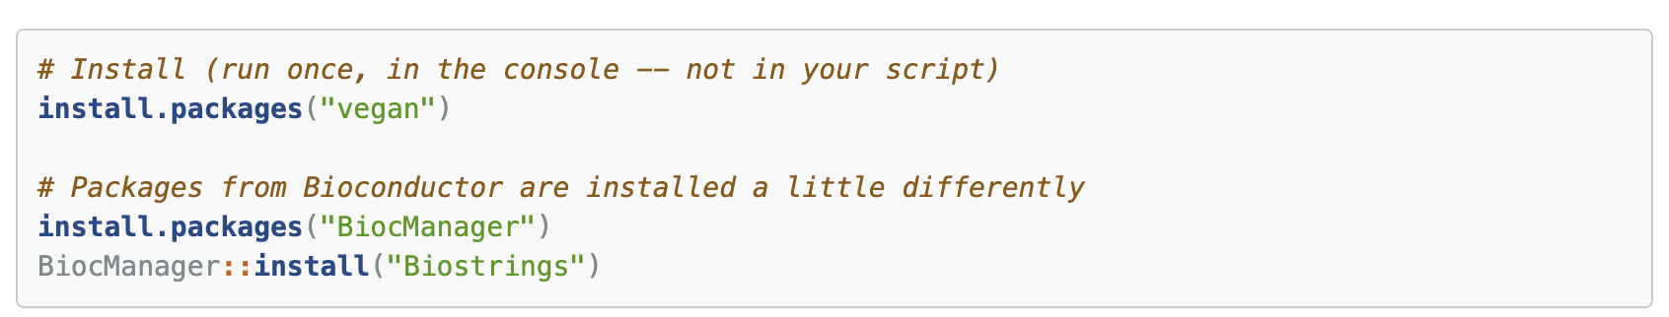
What is a package?
Step | Function | How often | Analogy
Install | install.packages("vegan") | Once per computer (and after updating R) | Buying a book and putting it on your shelf
Load | library(vegan) | Every time you start R | Taking the book off the shelf to read it
Notes:
When you install R you get base R: the language plus a core set of functions (mean(), lm(), plot() and many more). A package is a bundle of extra functions, data, and documentation that someone wrote to solve a particular problem.
Think of base R as a basic field kit. Packages are specialized add-on
There are more than 20,000 packages on CRAN (the main R repository) and more than 2,000 on Bioconductor (focused on genomics and molecular biology).

Slide 8
R Practice Time
Notes:
Work in RStudio Projects and use relative file paths.
Never edit raw data by hand. Every change lives in code.
Restart R often (Session → Restart R) and rerun your script from the top. If it only works in your current session, it doesn’t work.
Don’t save the workspace. In Tools → Global Options → General, uncheck “Restore .RData into workspace at startup” and set “Save workspace to .RData on exit” to Never. Your scripts, not a saved workspace, should recreate your results.
Comment the why. # exclude S04 on 2025-06-03: drag cloth torn is useful; # filter data is not.
Use set.seed() before anything random (simulations, resampling) so results repeat exactly.
Record your software versions with sessionInfo() (see the end of this document).
Learn version control (Git + GitHub) once you’re comfortable. It’s “track changes” for code.

Slide 9
Good habits and getting help
Work in RStudio Projects and use relative file paths.
Never edit raw data by hand
Restart R often (Session > Restart R) and rerun your script
Don’t save the workspace
Comment why in code chunks
Use set.seed() before anything random (simulations, resampling) so results repeat exactly
Record your software versions with sessionInfo()

Slide 10
Where to get help
Built-in help
Read the error message, then search for it, in quotes, online.
Ask well: a minimal reproducible example (a few lines of code and a tiny dataset that show the problem) gets answers fast.
Cheat sheets: Posit publishes one-page guides for dplyr, ggplot2, tidyr, R Markdown, and more (https://posit.co/resources/cheatsheets/).
Free books and lessons:
  R for Data Science, 2nd ed. (https://r4ds.hadley.nz)
  Data Carpentry, Data Analysis and Visualization in R for Ecologists (https://datacarpentry.org/R-ecology-lesson/)
AI assistants
Notes:
Built-in help: ?function_name, ??"search term", and package vignettes (browseVignettes("dplyr")).
Read the error message, then search for it, in quotes, online.
Ask well: a minimal reproducible example (a few lines of code and a tiny dataset that show the problem) gets answers fast. The reprex package helps.
Cheat sheets: Posit publishes one-page guides for dplyr, ggplot2, tidyr, R Markdown, and more (https://posit.co/resources/cheatsheets/).
Free books and lessons:
R for Data Science, 2nd ed. (https://r4ds.hadley.nz)
Data Carpentry, Data Analysis and Visualization in R for Ecologists (https://datacarpentry.org/R-ecology-lesson/)
AI assistants can explain error messages and draft code. Treat what they give you like code from a labmate: run it, read it, and check the results.

Slide 11
References
Abbott, W. S. (1925). A method of computing the effectiveness of an insecticide. Journal of Economic Entomology, 18, 265–267.
Broman, K. W., & Woo, K. H. (2018). Data organization in spreadsheets. The American Statistician, 72(1), 2–10.
Wickham, H. (2014). Tidy data. Journal of Statistical Software, 59(10), 1–23.
Wickham, H., Çetinkaya-Rundel, M., & Grolemund, G. (2023). R for Data Science (2nd ed.). O’Reilly. https://r4ds.hadley.nz

