Slide 1
Project requirements vs. Product
1. MP browsing with RecyclerView √
2. Inspection of details and pictures √
3. Commenting with an opinion √
4. Retrofit & Moshi + Room + Repositories √
5. Automatic updating of data (every 4h) with WorkManager √
6. Caching of images with Glide –library √
7. Fragments + navigation + ViewModels √
8. Correct indentation + camelCase + commented code √
9. No warnings by IDE (Android Studio) √

Slide 2
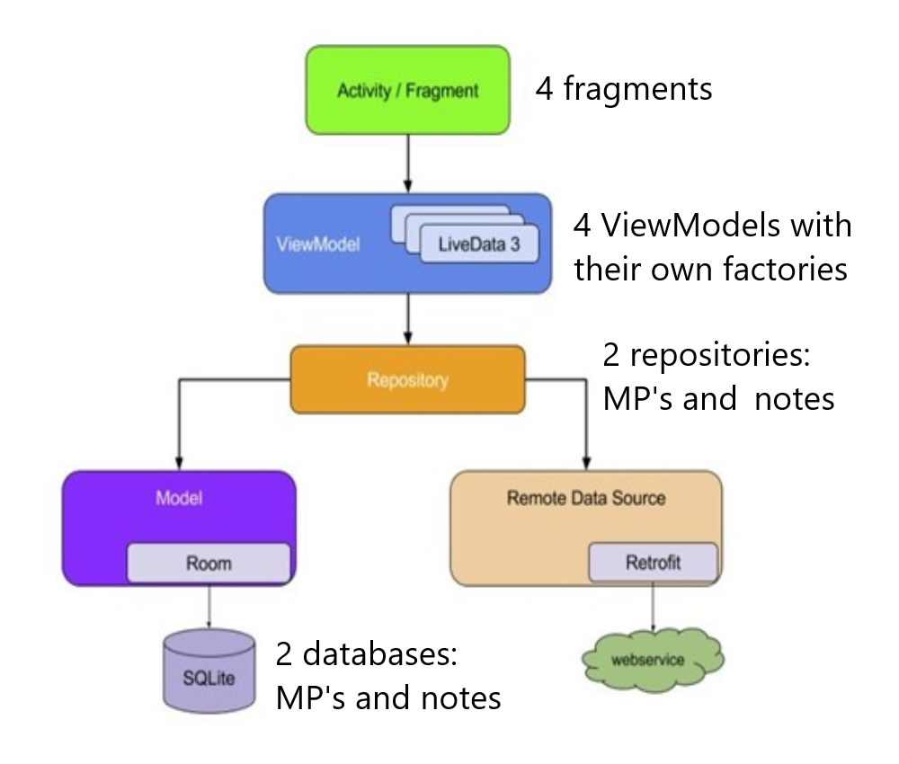
Architecture

Slide 3
Extra features
Searching for MP’s with partial first/last name or party.
Re-arrangement of the MP-list by first/last name, party or status.
Positive/negative notes.
Status for each MP which changes according to balance of positive/negative notes.
Notes are shown in a RecyclerView. They can be arranged by date or type and edited.
Made different layouts for landscape/portrait orientation.

